Slide 1
Research
Ministry
CERN
CNRS
CEA
IN2P3
DSM
GANIL
APC
Irfu
LSM
CC
LYON
SPhN
SPP
…
…
LAL
CPPM
IPNO
IPHC
22 laboratories with universities
3 100 FTE 230 M€ total CNRS budget
GANIL + 6 divisions @ Irfu
900 FTE 100M€ total budget

Slide 2
Jacques Martino IN2P3 Director
rECFA meeting
Paris March 2013
www.in2p3.fr

Slide 3
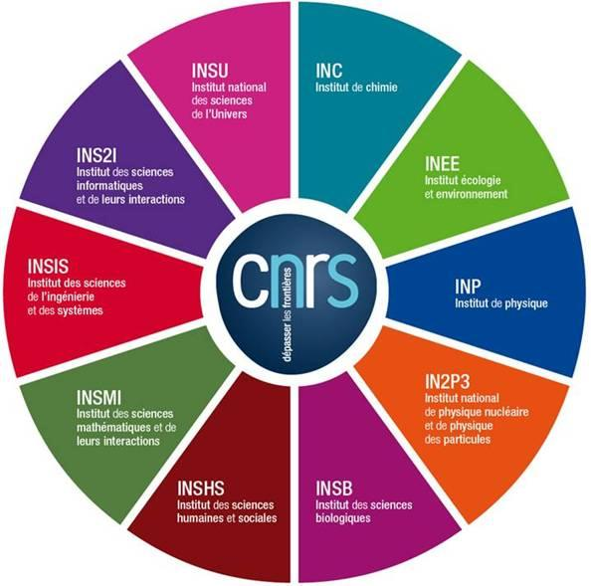
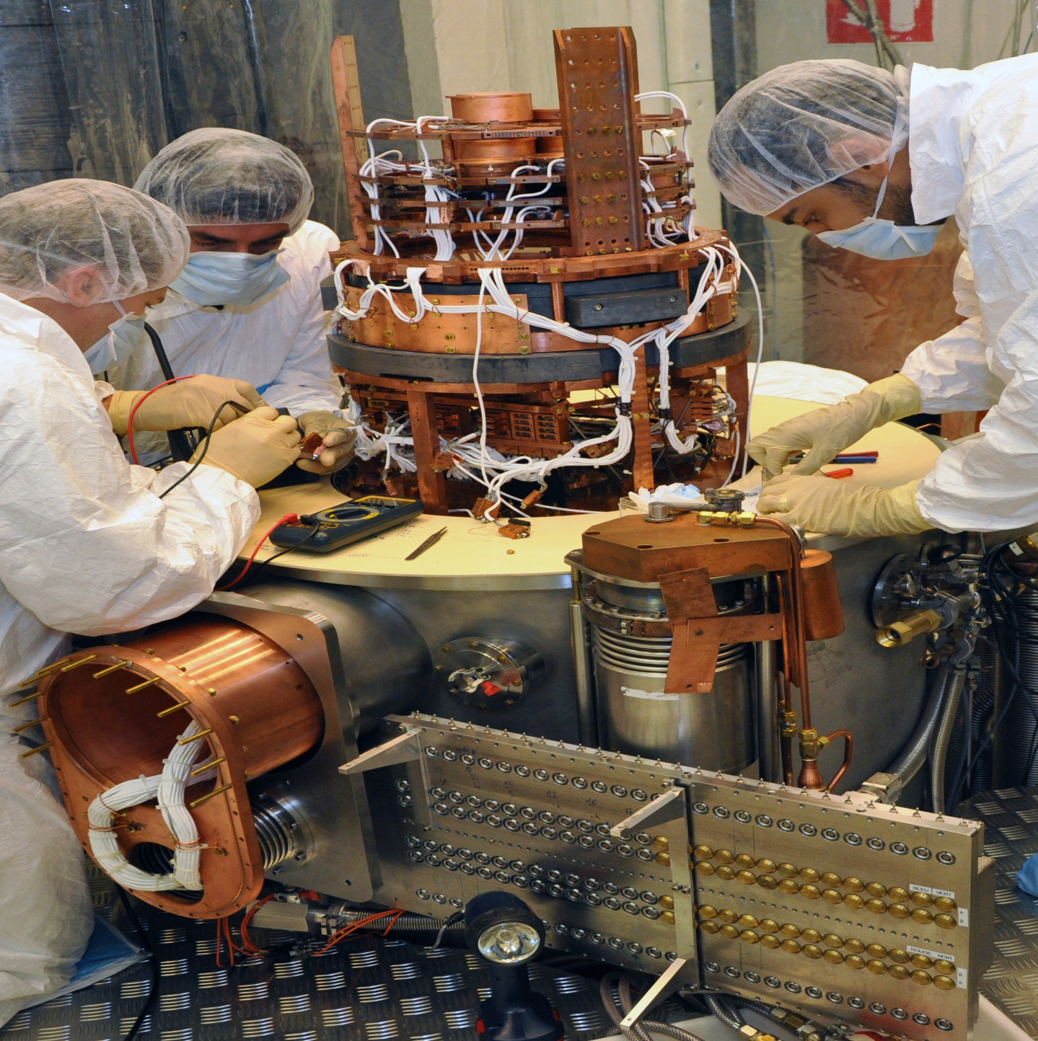
IN2P3, ONE OF CNRS INSTITUTES
3
The CNRS
10 institutes (3 national institutes: INSMI, INSU, IN2P3)
1,100 research units (95% in partnership)
34,000 researchers,
engineers, technicians
€3.3 billion budget
© CENBG, LSM Conception graphique : Anna Thibeau (IPNL)

Slide 4
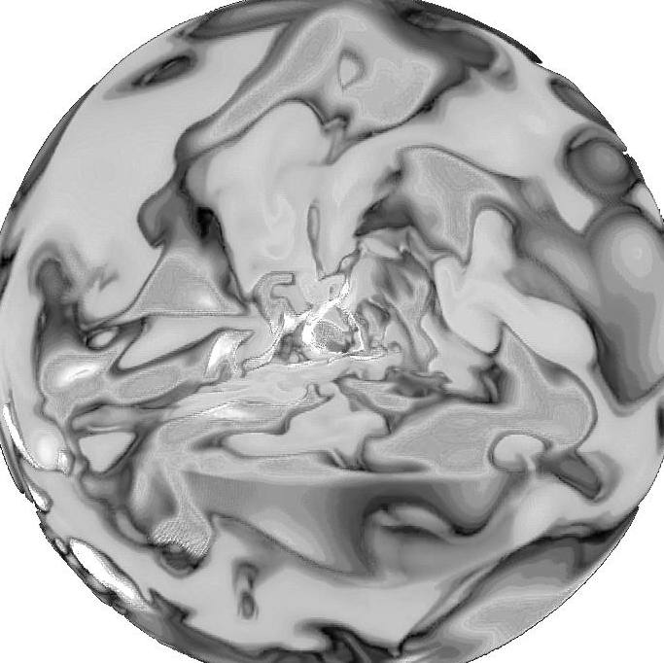
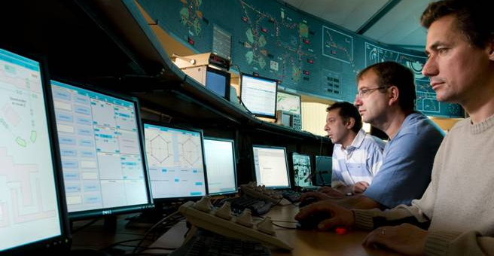
MISSIONS
TO PROMOTE AND UNIFY RESEARCH
ACTIVITIES IN THE FIELD OF
SUBATOMIC PHYSICS
PROVIDING
LINCKS WITH SOCIETY
Skills,
expertise
COORDINATION
NUCLEAR PHYSICS, PARTICLE AND ASTROPARTICLE PHYSICS
Interdisciplinary research,
training, innovation
teaching
Programmes on behalf of the CNRS and universities
EXPLORATION
© Fred Hulin/Scavo/Université Paris-Sud, Ganil/Philippe Stroppa, LSM, A. Palacios LUPM/CEA - Conception graphique : Anna Thibeau (IPNL)
The two infinities,
from particles
to the cosmos
CEA partnership

Slide 5
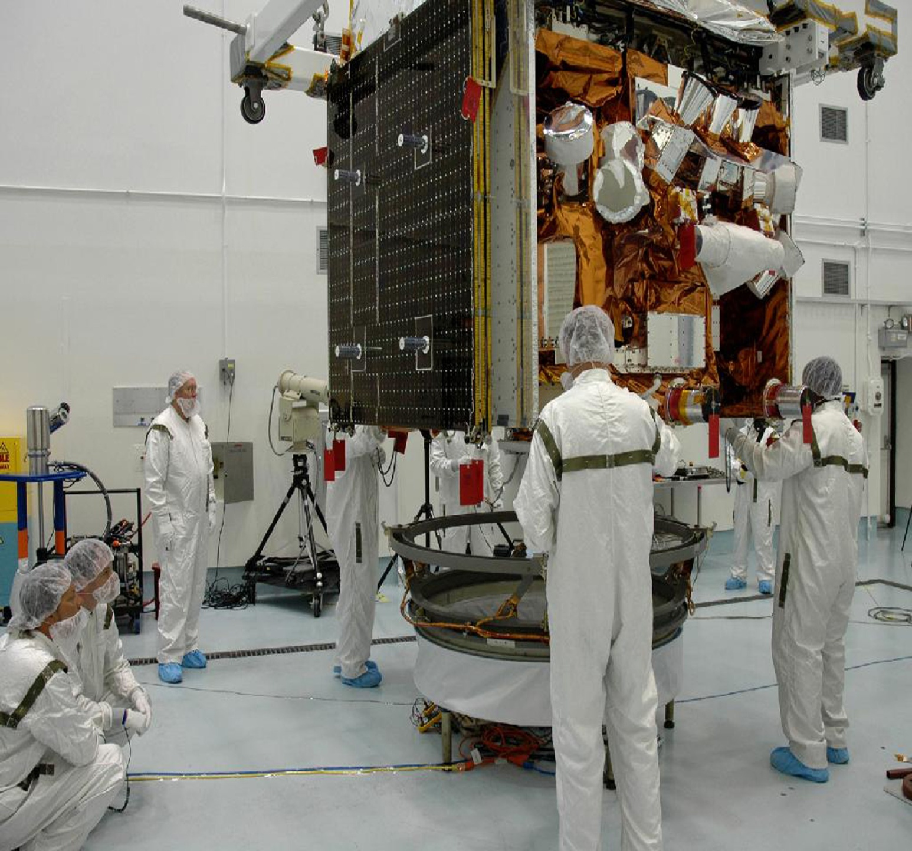
KEY FIGURES
3
3 100
researchers,
engineers and technicians
40 major international
projects
17 international research networks
© CENBG, LSM – Conception graphique : Anna Thibeau (IPNL)
77 M€
annual budget
(excluding salaries)
25 laboratories
and platforms

Slide 6
Notes:
La masse salariale et le FEI sur SE dépendent de l’axe M€
Les effectifs totaux et les effectifs permanents dépendent de l’axe Effectifs

Slide 7
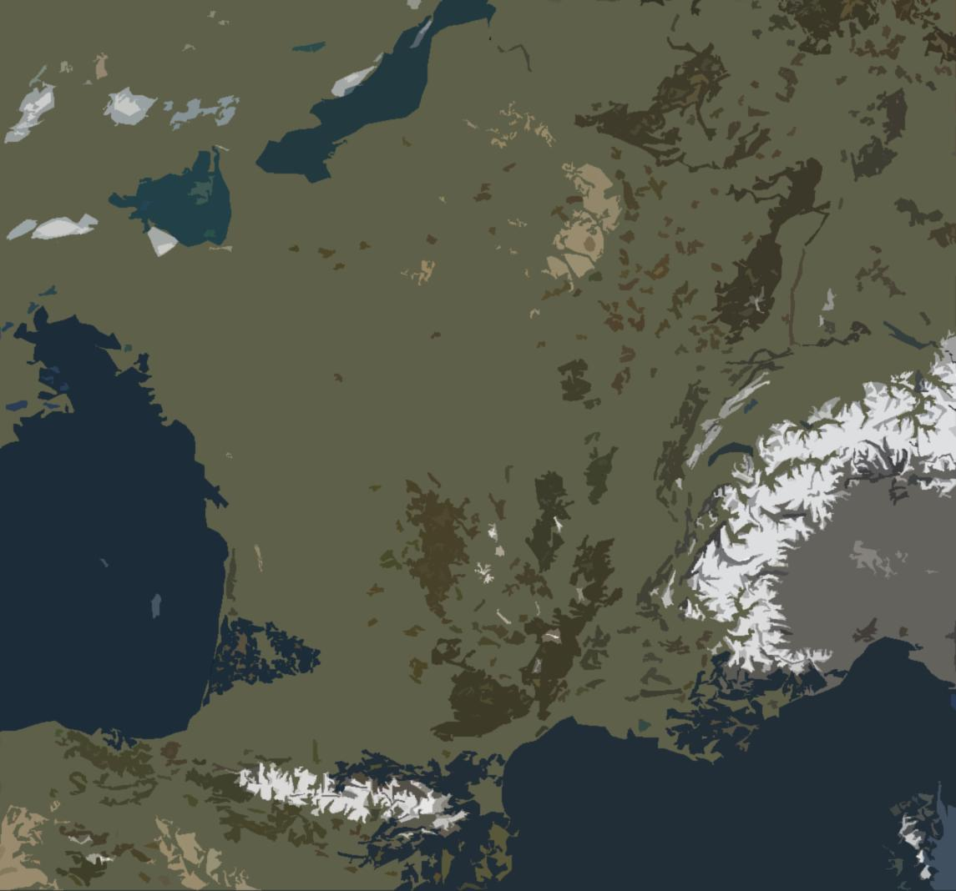
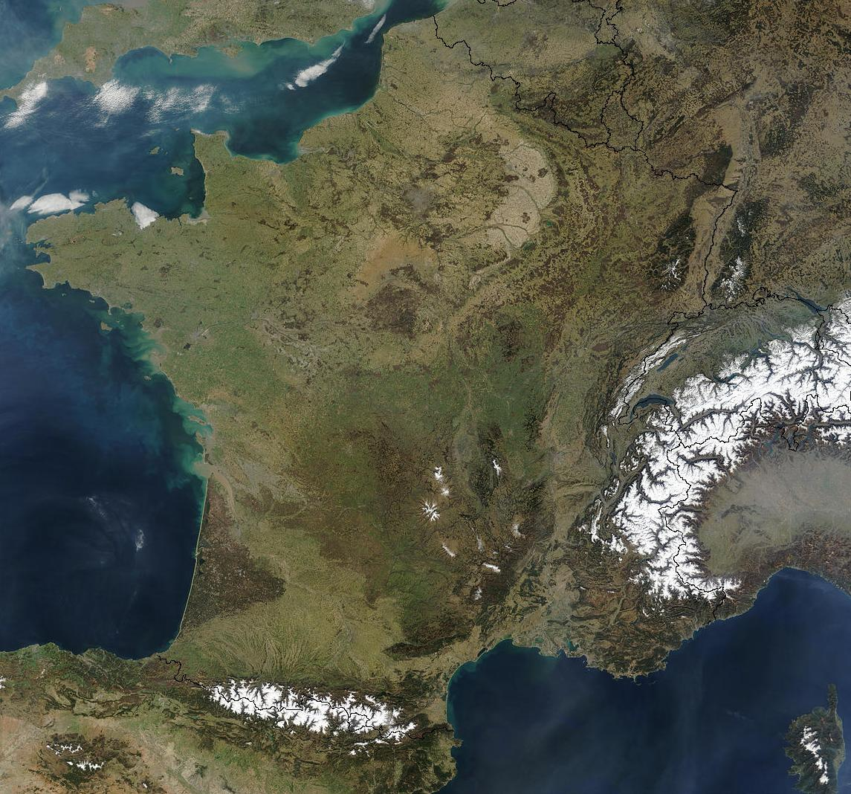
NETWORKED LABORATORIES
3
Ganil, LPC Caen
LNCA
APC, LPNHE,
Musée Curie
CSNSM
IMNC, IPNO, LAL, LLR, IDGC
IPHC
CC, IPNL, LMA
LSM, Lapp, Ulisse
Subatech
LPC Clermont
© CIA, LSM
CENBG
LPSC
LUPM
CPPM

Slide 8
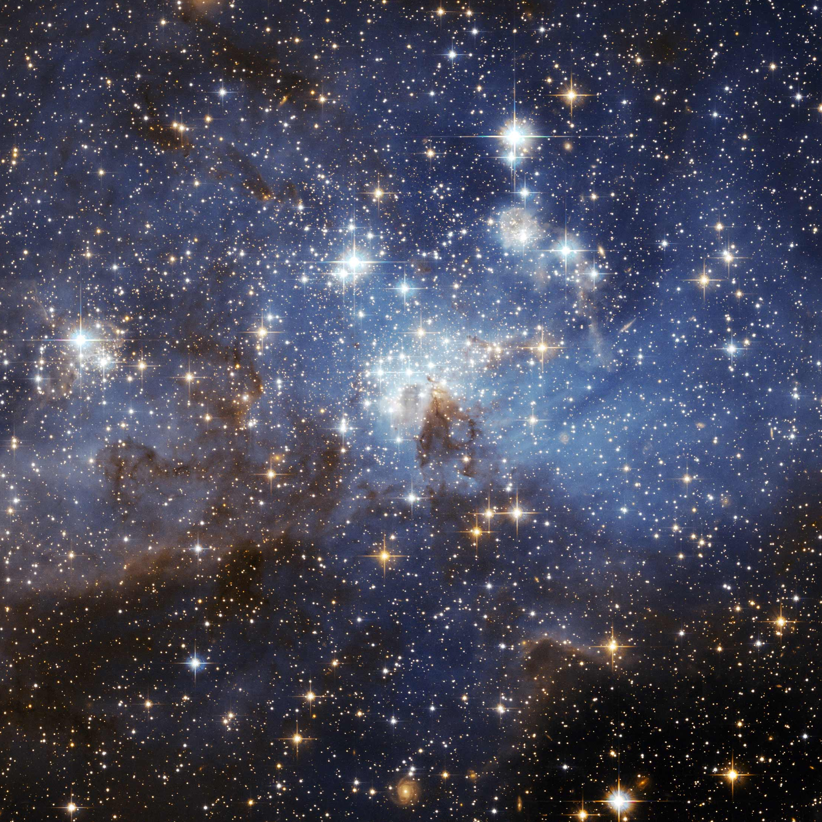
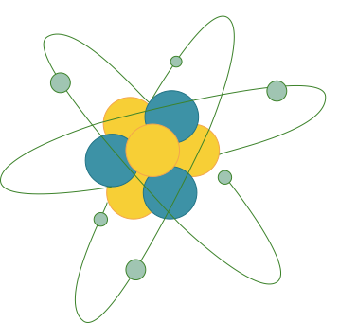
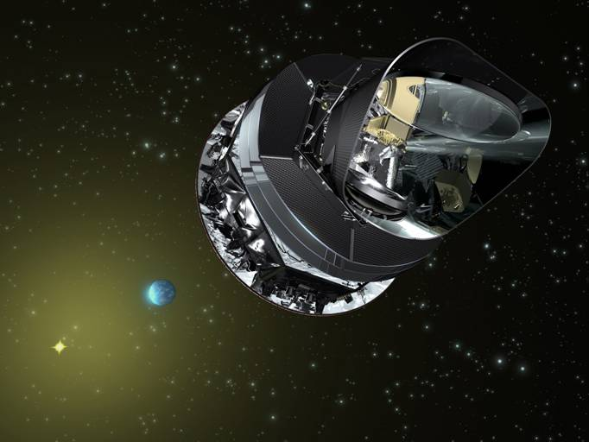
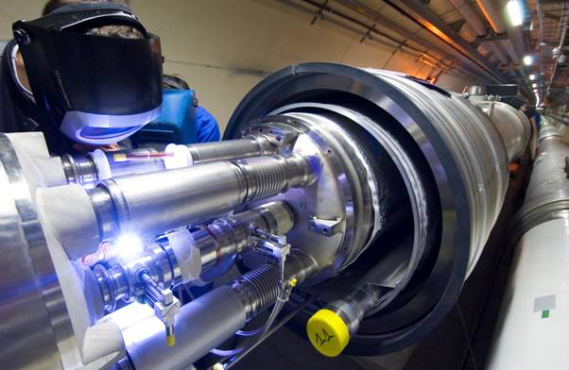
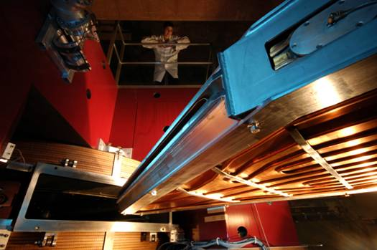
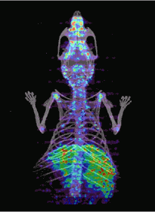
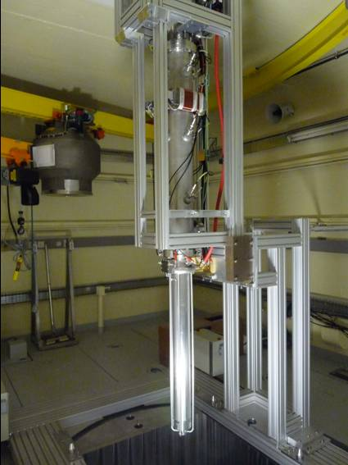
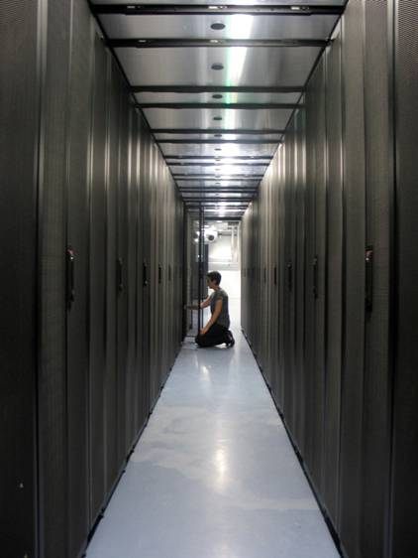
SCIENTIFIC THEMES
4
Astroparticle physics and neutrinos
Universe’s composition and behaviour
Particle physics
Nuclear and hadronic physics
Matter’s most elementary constituents and fundamental interactions
Structure of nuclear matter
Theory
Instrumentation
Computing grids
Accelerator R&D
Nuclear energy
Medical applications
© Ganil, Cern, CC-IN2P3, Guinevere, Amissa, Planck, LSM – Conception graphique : Anna Thibeau (IPNL)

Slide 9
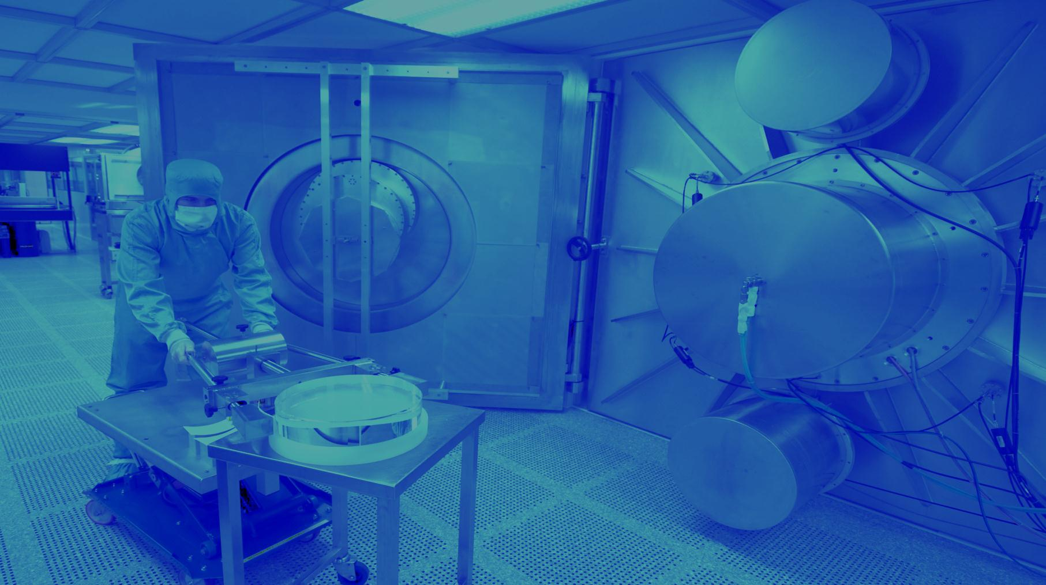
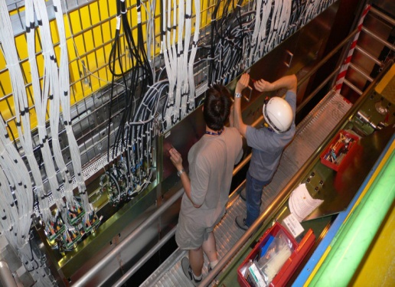
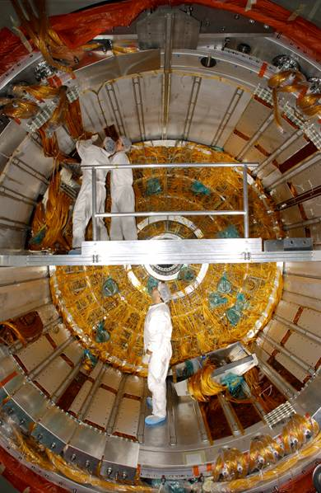
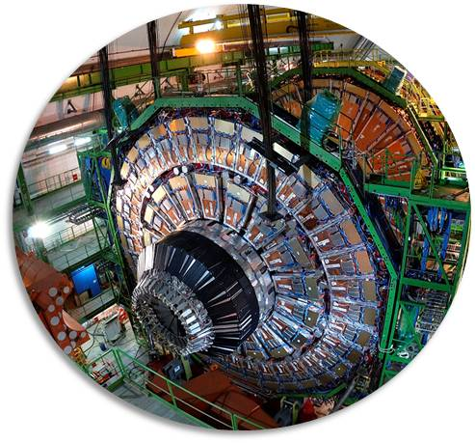
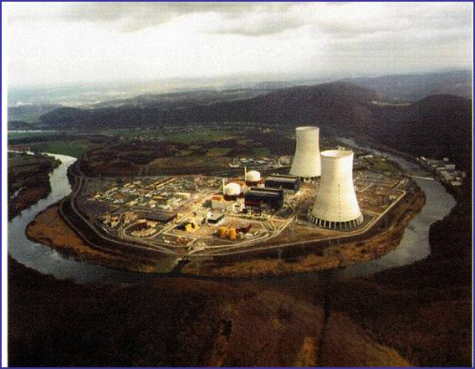
PARTICLE PHYSICS
5
ELEMENTARY CONSTITUENTS
ELEMENTARY CONSTITUENTS, FUNDAMENTAL INTERACTIONS
Particles’ mass
New physics
Supersymmetry
Antimatter
Neutrino’s nature and mass
Priorities:
LHC @14 TeV + upgrades
Neutrino Long Baseline
© Atlas, CMS, LHCb, Double Chooz, CNRS Photothèque / Hubert Raguet Conception graphique : Anna Thibeau (IPNL)
COLLISIONS
SUPERSYMMETRY
ANTIMATTER
HIGGS BOSON
DETECTORS
STANDARD MODEL

Slide 10
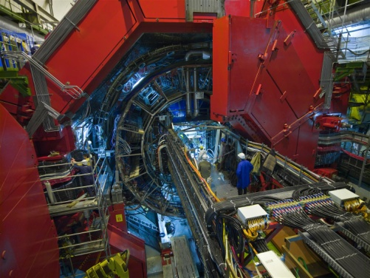
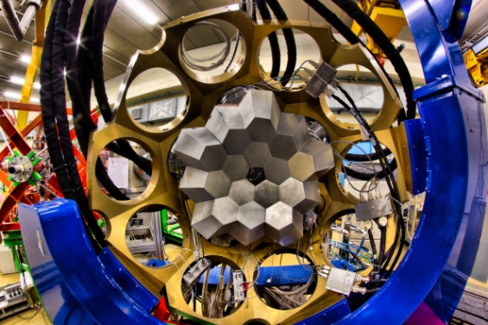
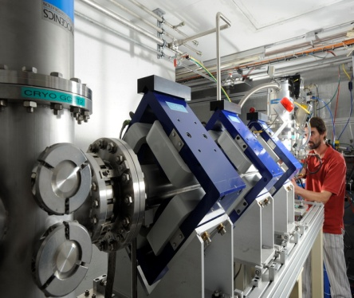
NUCLEAR PHYSICS
5
PROTON AND NUCLEUS
NUCLEON AND NUCLEI: THE EMERGENCE OF COMPLEXITY
Quark-gluon plasma
Proton’s structure
Nuclear structure
Exotic nuclei
Nuclear astrophysics
Priorities:
Ganil-Spiral2, Alice, JLab
© Agata, Alice, Fred Hulin/Scavo/Université Paris-Sud, Ganil/Philippe Stroppa, LSM, CNRS Photothèque / Hubert Raguet
Conception graphique : Anna Thibeau (IPNL)
EXTREME STATES
STABILITY
GLUONS
EXOTIC NUCLEI
SUPERHEAVY
QG PLASMA

Slide 11
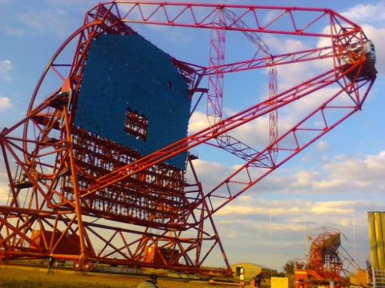
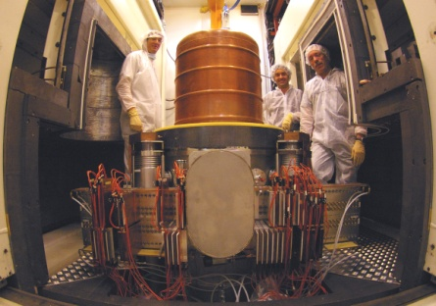
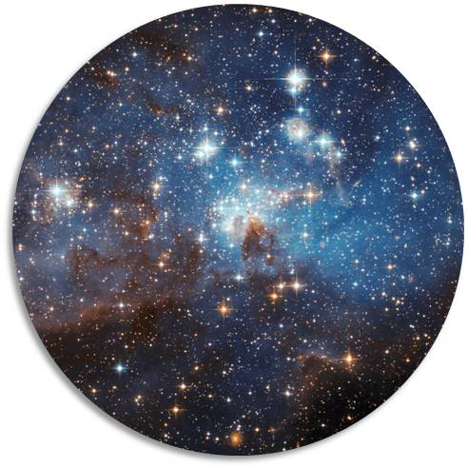
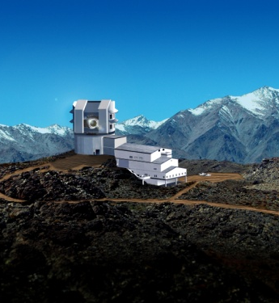
ASTROPARTICLE PHYSICS AND NEUTRINOS
5
UNIVERSE’S COMPOSITION
UNIVERSE’ S COMPOSITION AND BEHAVIOUR
Universe’s history
Dark matter and dark energy
Cosmic rays
Gravitational waves
Neutrinos
Priorities:
Virgo, LSST, Hess-CTA, Edelweiss
SuperNemo
© LSST, Hess, Nasa, LSM, CNRS Photothèque / Hubert Raguet Conception graphique : Anna Thibeau (IPNL)
COSMIC RAYS
UNIVERSE
BIG BANG
DARK ENERGY
SUPERNOVAE
GRAVITATIONAL

Slide 12
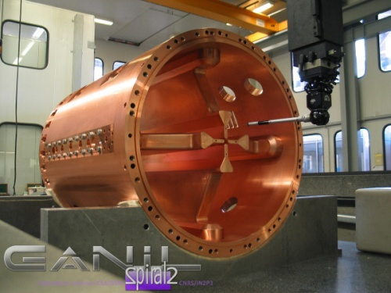
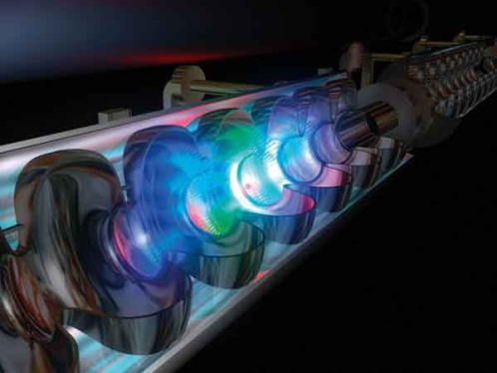
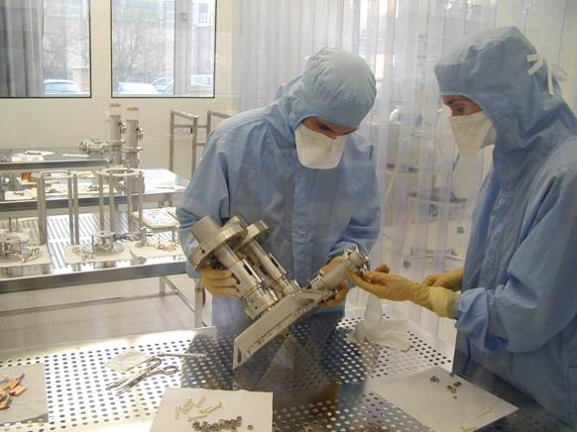
ACCELERATOR RESEARCH AND DEVELOPMENT
5
ACCELERATOR R&D
ACCELERATOR R&D, TECHNOLOGICAL PLATFORMS
Superconducting accelerator cavities and cryotechnology
Ion and electron sources
Target/source for radioactive beams
Beam dynamics
Laser acceleration
© CSNSM/Jean François Dars, Desy Hamburg, Ganil, CNRS/IN2P3 Conception graphique : Anna Thibeau (IPNL)
INTENSE BEAMS
LASERS
SUPERCONDUCTING
ION SOURCES
PLATFORMS
CRYOTECHNOLOGY

Slide 13
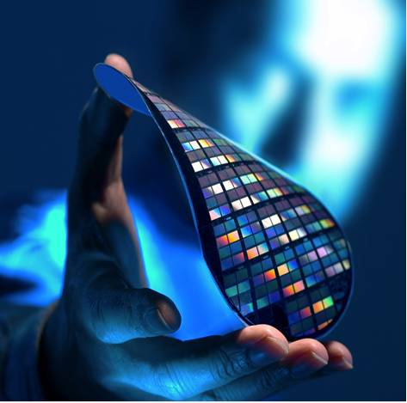
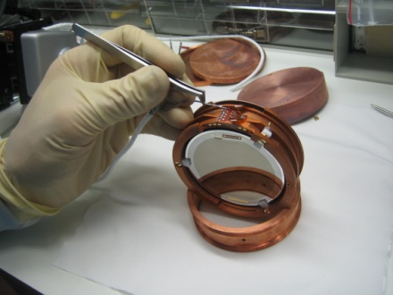
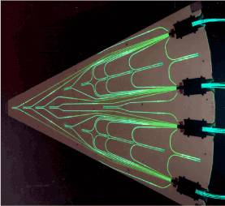
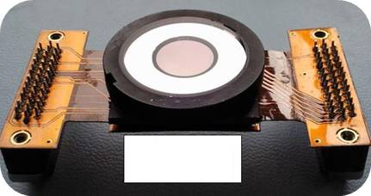
INSTRUMENTATION AND DETECTORS
5
INSTRUMENTATION
INSTRUMENTATION, DETECTORS, TECHNOLOGY TRANSFER
Silicon detectors
Photo-detectors, new generation scintillators
Gaseous detectors
Bolometers
Microelectronics
© LSM, D.R., IPNL – Conception graphique : Anna Thibeau (IPNL)
MICROELECTRONIcs
BOLOMETERS
CMOS
HODOSCOPES
IMAGERS
Ultra-granulary

Slide 14
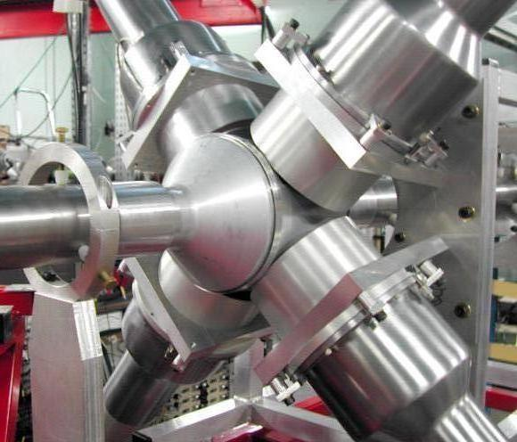
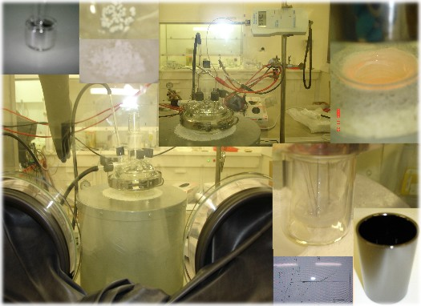
NUCLEAR PHYSICS AND ENERGY
5
BACK-END OF THE NUCL
BACK-END OF THE NUCLEAR FUEL CYCLE, NUCLEAR ENERGY
Transmutation of nuclear waste by ADS
Innovating nuclear systems with low wastes (thorium)
Waste storage radiochemistry
© Pacen, Gedepeon, Guinevere – Conception graphique : Anna Thibeau (IPNL)
TRANSMUTATION
MOLTEN SALTS
REACTORS
RADIOCHEmIstry
NUCLEAR WASTES
ADS

Slide 15
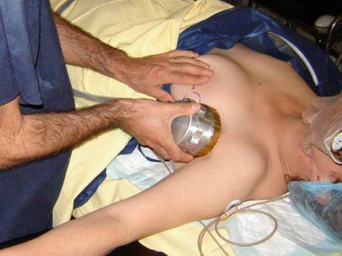
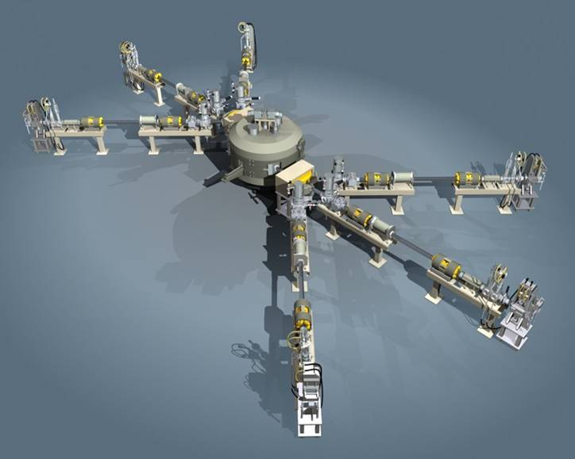
NUCLEAR PHYSICS AND HEALTH
5
NEW DIAGNOSTIC AND TH
NEW DIAGNOSTIC AND THERAPY TOOLS
Strong involvement of IN2P3 in the fight against cancer
Radioisotopes, radiobiology, radiotherapy
Dosimetry / beam monitors R&D
Accelerator technology
Imaging, simulations (Geant, Gate)
© Amissa, IMNC/CNRS, Arronax – Conception graphique : Anna Thibeau (IPNL)
BEAM MONITORS
SIMULATIONS
IMAGING
radiobiologY
HADRONTHERAPY
RADIOISOTOPES

Slide 16
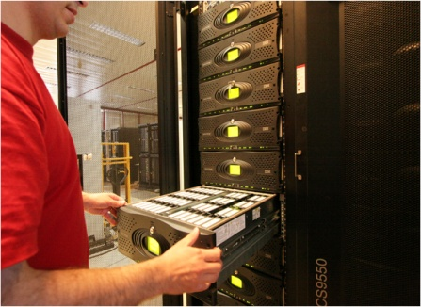
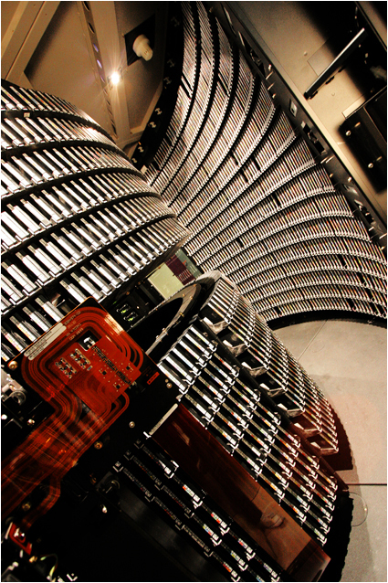
COMPUTING GRIDS
5
LARGE DATA-SET PROCE
LARGE DATA-SET PROCESSING
European and International level
Major contribution of CC-IN2P3 (Lyon)
High energy physics
Biomedical applications
© CC-IN2P3/CNRS/F. de Stefanis – Conception garphique : Anna Thibeau (IPNL)
infrastructures
DATA STORAGE
NETWORKS
COMPUTING CENTERS
INTERFACES
LCG

Slide 17
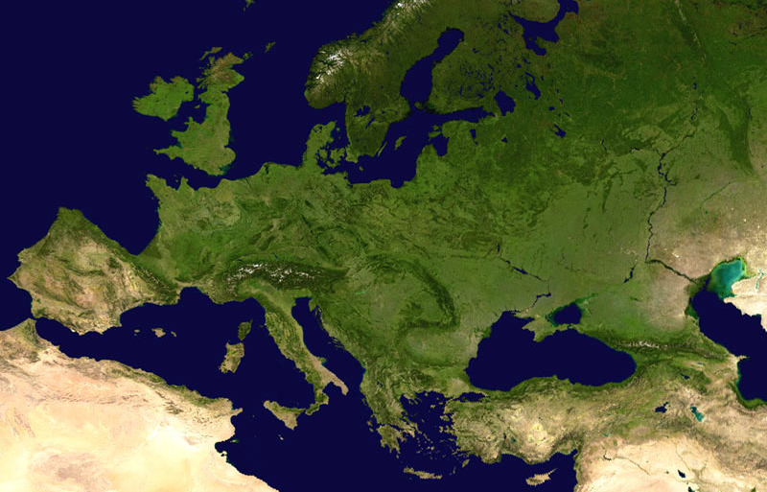
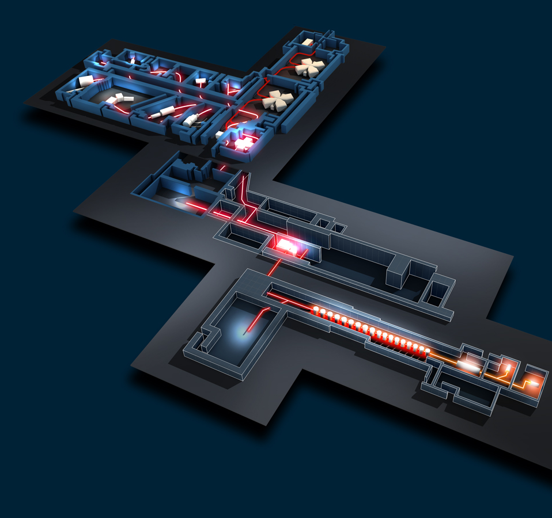
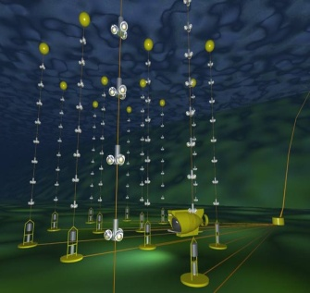
FRANCE : LARGE INFRASTRUCTURES
3
Spiral2 / Ganil
DChooz
CC-IN2P3
Edelweiss, Nemo / LSM
Antares
© Ganil/Spiral2, CNRS/IN2P3, coll. Edelweiss, Antares, DChooz, Nasa – Conception graphique : Anna Thibeau (IPNL)

Slide 18
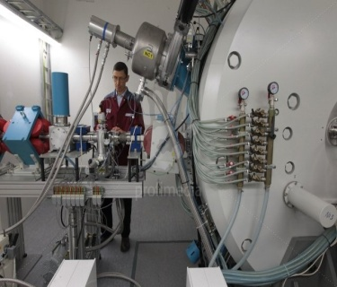
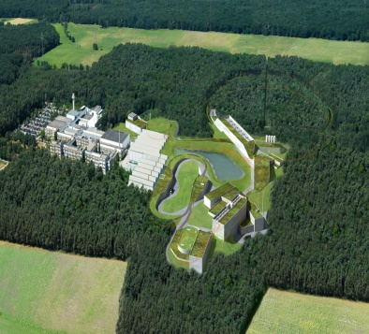
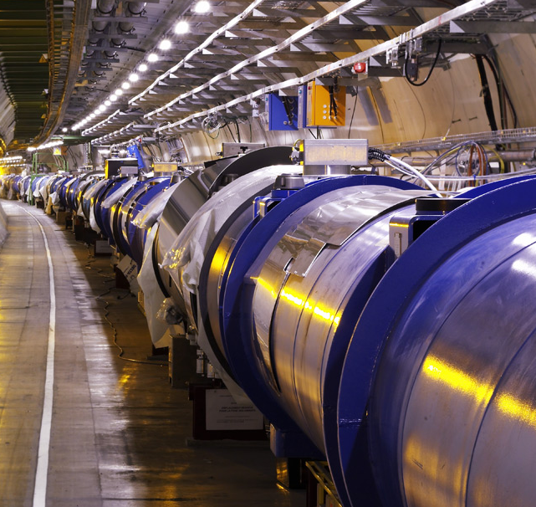
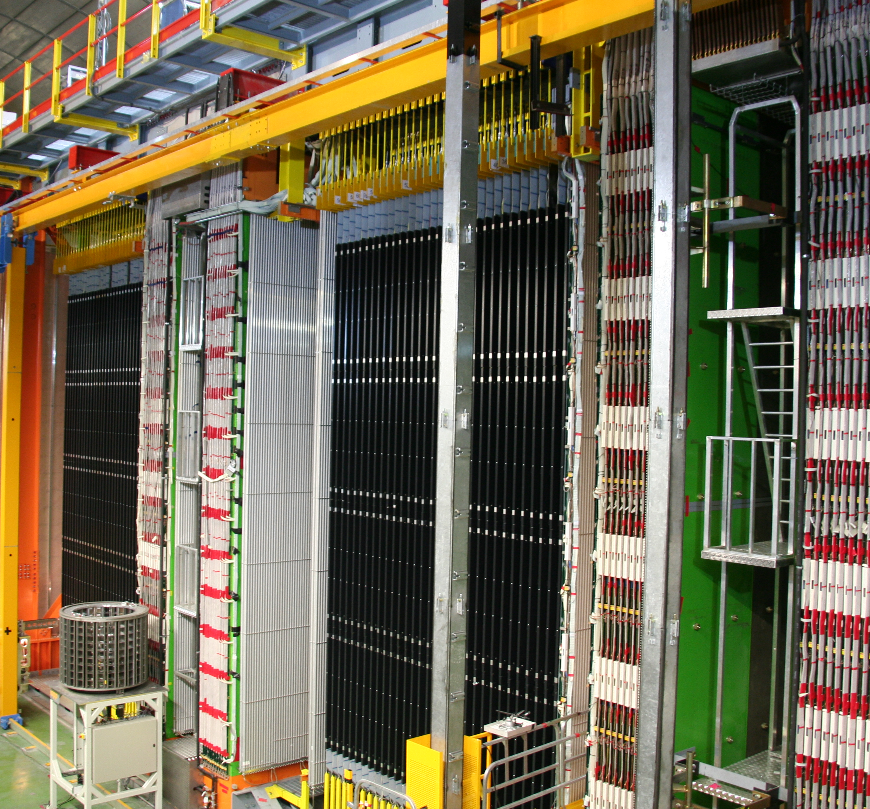
INTERNATIONAL COLLABORATIONS
3
Jyväskylä (Finland)
Fair / GSI (Germany)
JINR Dubna (Russia)
LHC, Isolde / Cern (Switzerland)
© Cern, Nasa, Opera, GSI, JINR Dubna, Profilmedia – Conception graphique : Anna Thibeau (IPNL)
Opera, Xenon / Gran Sasso Virgo (Italia)

Slide 19
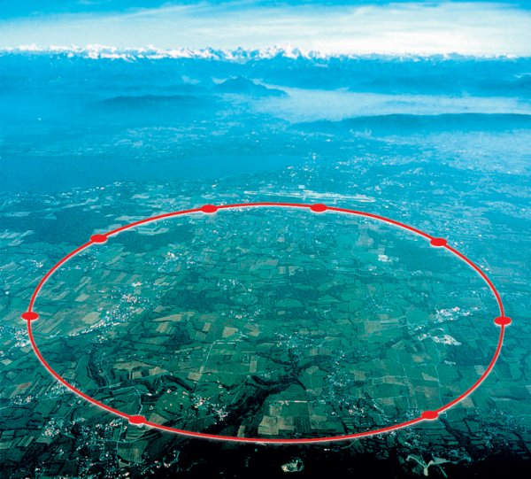
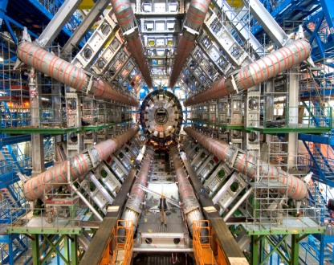
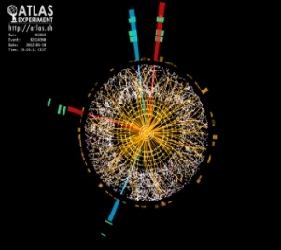
INTERNATIONAL COLLABORATIONS
3
LHC:
IN2P3 PARTICIPATION
75 M€*(experiments construction)
>500 engineers,technicians/year (over 6-8 years of construction)
106 FTP.year (accelerator)
~250 researchers
80 PhD students
106
40
43
11
Atlas
LHCb
Alice
© Cern
48
10
51
20
CMS
* excluding salaries

Slide 20
INTERNATIONAL COLLABORATIONS
3
DØ, CDF Tevatron
© Star/Phenix, Kamioka Observatory/ICRR/Université de Tokyo, Auger, Hess, ESA/Nasa, J.-P. Kneib (Observatoire Midi-Pyrénées) and R. Ellis (Caltech) – Conception graphique : Anna Thibeau (IPNL)
Star, Phenix Rhic, BNL
SNFactory (Hawaï)
Jlab
T2K / Jparc, Riken (Japan)
Hess (Namibia)
Fermi, AMS, Lisa Planck, Euclid
(Space)
LSST (Chili)
Auger (Argentina)
CTA

Slide 21
LINKS WITH INDUSTRY
5
INDUSTRIAL PARTNERSHI
INDUSTRIAL PARTNERSHIP AND APPLICATIONS
Expertise / high technology resources transferred to industry
Health (medical imaging)
Space industry
Environment (radioactivity measurements, Becquerel network)
Electronics
© Amissa, D.R., Arcane/CENBG – Conception graphique : Anna Thibeau (IPNL)
MICROELECTRONIcs
PRECISION OPTICS
TECHNOL
MEDICAL IMAGING
SIMULATIONS
EXPERTISE

Slide 22
HIGHER EDUCATION
5
PARTNERSHIP, CONTRAC
PARTNERSHIP, CONTRACTUALISATION, TRAINING, TEACHING
IN2P3 projects → visibility of universities/grandes écoles (Europe and International)
Laboratory “UMR” contracts
Regular meetings IN2P3 / Universities’ presidents
Teaching
Students’ training
© Université Claude Bernard Lyon 1, D.R. – Conception graphique : Anna Thibeau (IPNL)
LABORATORIES
COLLABORATIONS
TRAINING
YOUNG RESEARCHERS
CONTRACTS
VISIBILITY

Slide 23
COMMUNICATIONS
5
INCREASING VISIBILITY
INCREASING VISIBILITY, PROMOTING RESEARCH ACTIVITIES
Press and media
Conferences
Education/teacher programs and resources (Masterclasses, “Cosmos à l’école”…)
Partnership and networks (IN2P3 labs, Cern, CEA, “Science à l’école”, Interactions, Ippog)
Publications, website, exhibitions…
© LSM, LAL, École Polytechnique – Conception graphique : Anna Thibeau (IPNL)
exhibitions
PRESS AND MEDIA
PROMOTION
Education programs
NETWORKS
VISIBILITY

