Slide 1


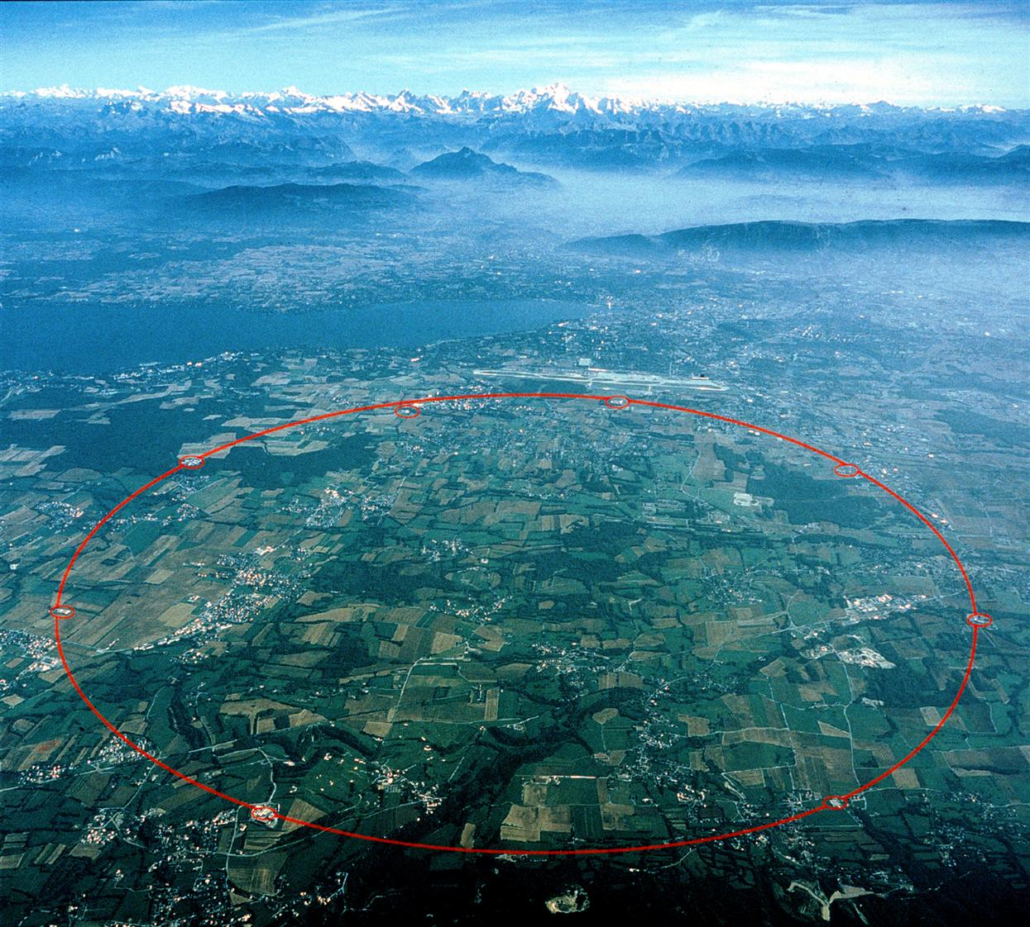
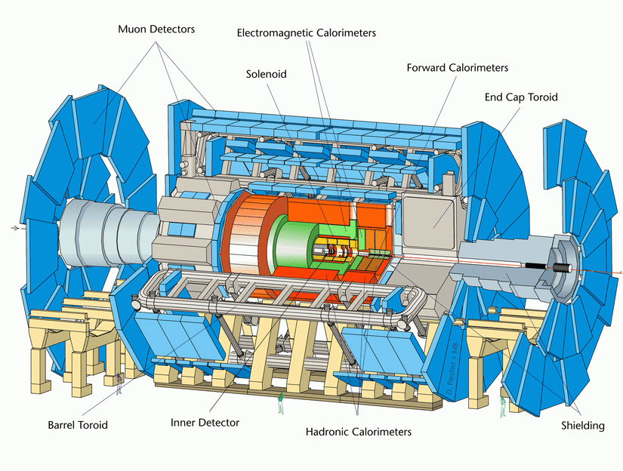
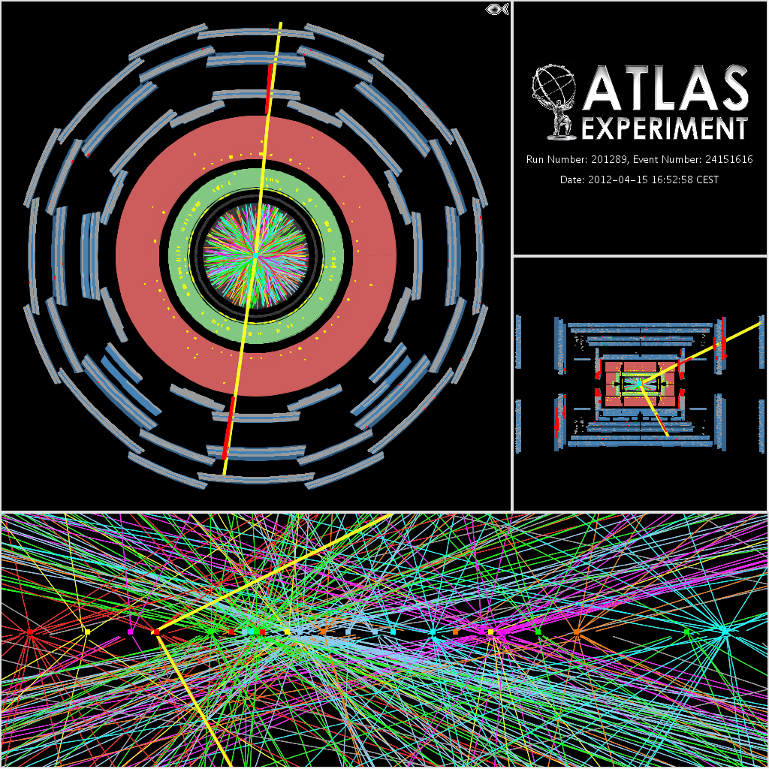
Single top-quark production at ATLAS
Seminar at CPPM
Huaqiao ZHANG (Michigan State University)
18th, Feb. 2013; Marseille, France

Slide 2
Outline
Single top-quark physics introduction
Single top-quark analysis at ATLAS, LHC
SM Single top-quark searches and measurement
New physics searches with single top signature
  Searches performed at ATLAS
  Possible searches in near future
Summary and outlook
References

Slide 3
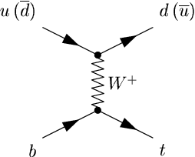
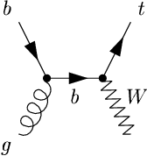
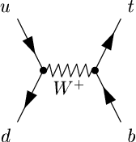
Single top-quark production
Predicted by SM, production via electroweak interaction
t-channel
Wt
s-channel
64.6^{+2.7}_{-2.0} pb @ 7TeV
15.7±1.1 pb @ 7TeV
4.6±0.2 pb @ 7TeV
87.8^{+3.4}_{-1.9} pb @ 8TeV
22.4±1.5 pb @ 8TeV
5.6±0.2 pb @ 8TeV
Calculated at NNLO approx.
N. Kidonakis, Phys. Rev. D 83 (2011) 091503
Calculated at NNLO approx.
N. Kidonakis, Phys. Rev. D 82 (2010) 054018
Calculated at NNLO approx.
N. Kidonakis, Phys. Rev. D 81 (2010) 054028
t-channel already observed at both Tevatron (2009) and LHC (2011)

Slide 4
Single top-quark physics (1)
Predicted by SM, production via electroweak interaction
t-channel
Wt
s-channel
Involve |V_{tb}| in the production vertices: Direct measurement of |V_{tb}|.
Production cross section proportional to |V_{tb}|²: Very sensitive to modifications of |V_{tb}|.

Slide 5
Single top-quark physics (2)
Predicted by SM, production via electroweak interaction
t-channel
Wt
s-channel
FCNC Zg…
b*…
W’,π⁺, π⁰…
Could involve beyond SM particles in the production: Direct search of new physics through EM interactions.
  Complementary/Leading sensitivity to new physics searches
Entangle the new physics once see different modification of single top-quark production cross section of these 3 channels

Slide 6
Single top-quark physics (3)
Predicted by SM, production via electroweak interaction
t-channel
Wt
s-channel
Check top decay products properties
  Top polarization/W helicity
  Charge Higgs searches

Slide 7
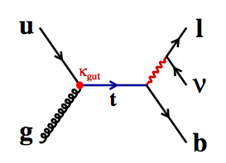
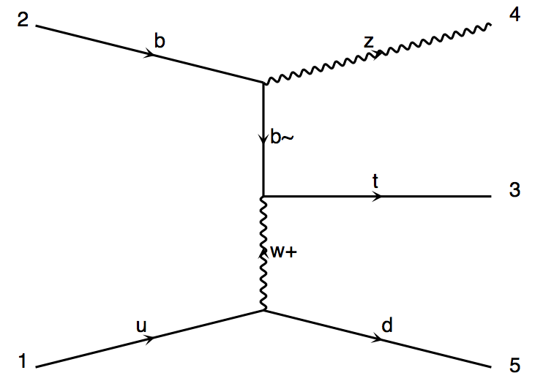
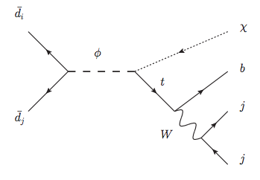
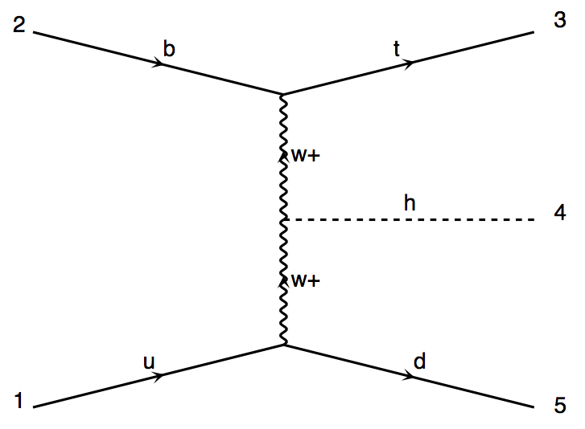
Single top-quark physics (4)
Additional single top-quark production model
  FCNC
tZj
b
Z
b
t
W
u
d
tX (RPV)
tHj
b
t
W
H
W
u
d
Phys. Rev. D 63 014018 (2000)
Phys. Rev. D 86 034008 (2012)

Slide 8
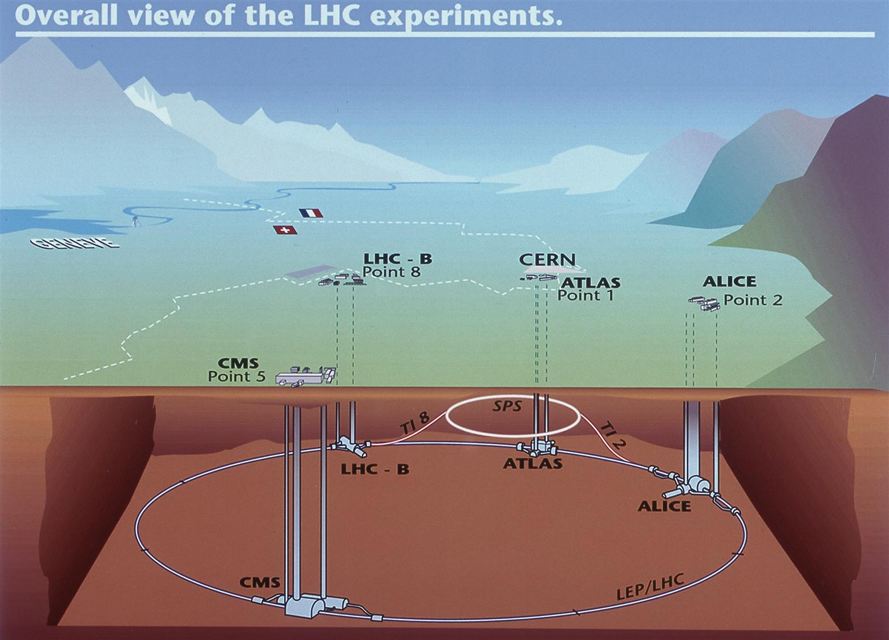
Large Hadron Collider (LHC)
LHC: Large Hadron Collider at CERN
27Km tunnel, 100 m underground
Collision: p-p or Pb-Pb or p-Pb
Ecm: 7/8TeV for P-P(Designed 14TeV)
2.76 GeV/parton for Pb-Pb/p-Pb
Instantaneous luminosity:
~8*10³³ for p-p now(Designed10³⁴)
Bunch crossing:
50ns Now, (Designed 25 ns)
Data taken:
Since 2011, delivered about 30 fb⁻¹
Four Major experiments:
ATLAS : General purpose detector
CMS : General purpose detector
Alice : Heavy ion physics
LHCb : b-Physics
Excellent running and where a 125 GeV Higgs boson like particle was observed in 2012

Slide 9
ATLAS Detector

Slide 10
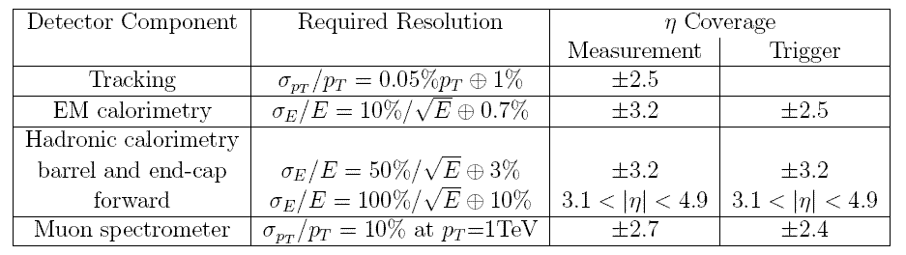
ATLAS Detector
Physical Goal: precision electroweak theory tests, Higgs Hunting and Physics beyond standard model
Physics related to Calo: W,Z,top, Higgs, SUSY…
Requirements to Calorimeter: Good ability of e/g ID and energy measurement for e/g, jets/Etmiss

Slide 11
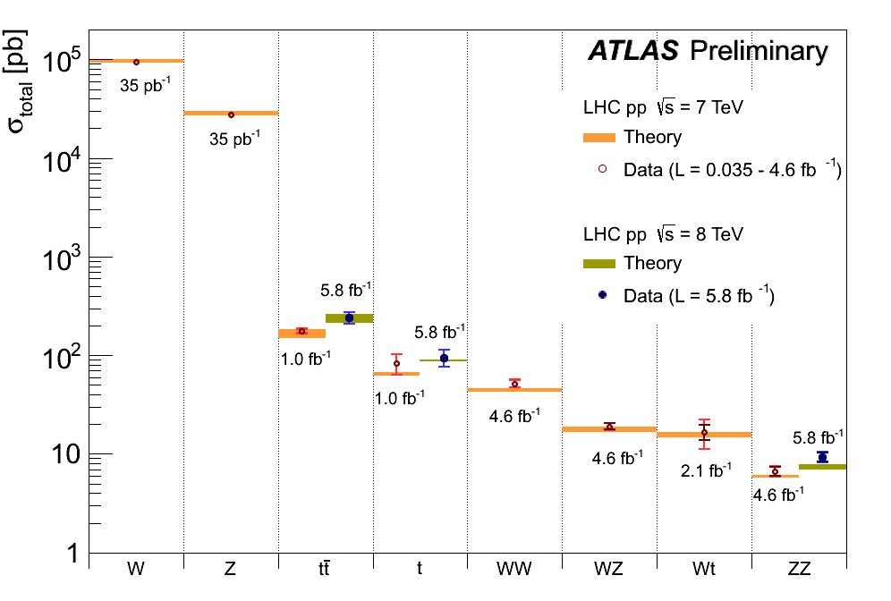
Single top-quark @ ATLAS (1)
Measurements in single top events
  Establish production experimentally to test SM
  Measure cross sections to probe |Vtb|
  Measure charge asymmetry to probe PDF(u)/PDF(d)
  Top polarization/W helicity
Searches with single top
  FCNC (ug→t,cg→t)
  W’(tb resonance)
  Fourth generation quarks
  Excited quarks
  Anomalous Couplings
Background to most of new physics searches
t-channel
Wt

Slide 12
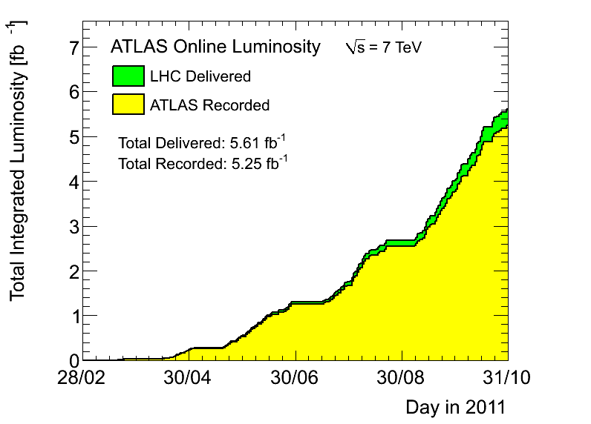
Single top-quark @ ATLAS (2)
LHC is a top factory
  240k top events/fb @ 7TeV, of which more than 1/3 are single top-quark events
ATLAS collected 5.25 fb⁻¹ 7 TeV p-p collision data in 2011
  21.7 fb⁻¹ 8 TeV p-p data already on tape, ready to be analyzed
Results Presented in this talk
t-channel cross section
t-channel charge asymmetry
Wt Evidence
s-channel searches
FCNC searches
W’/tb resonance searches
b*/Wt resonance searches

Slide 13
SM single process analysis
t-channel single top-quark measurement
  Precision measurement at 7 TeV (This talk)
  Update to 8 TeV with preliminary results
Wt channel single top-quark Evidence
  Only accessible at LHC
  Evidence with 7 TeV data (This talk)
  Expect observation/measurement with 8 TeV data
s-channel single top-quark searches
  First limit setting (This talk)
  Still a long way to an observation

Slide 14
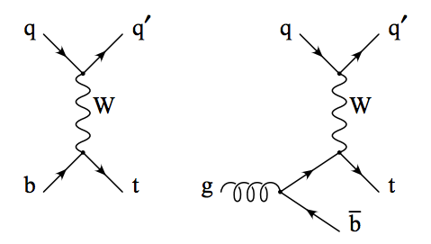
t-channel single top
Interaction of light quark and b-quark by exchange a W boson
  Single top-quark + forward light quark
More than 1/3 of top-pair cross section
Searches with top quark leptonic decay
  Single top-quark system could be reconstructed
Observed both at Tevatron and LHC

Slide 15
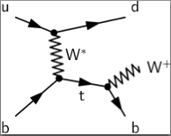
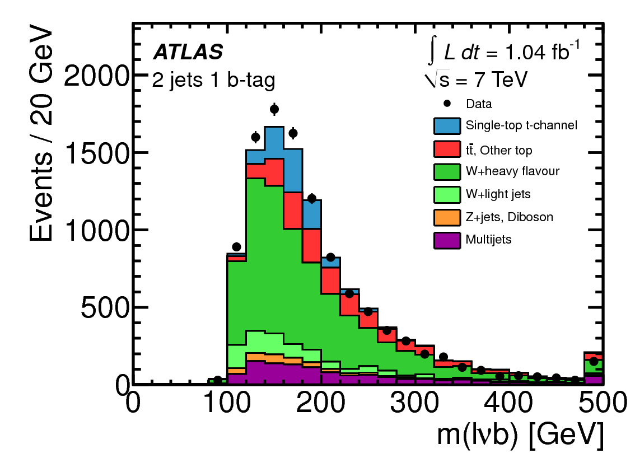
t-channel: Event Selection
Exactly one electron or muon
  Pt>25 GeV, |η|<2.5
  electron or muon trigger
2 or 3 jets
  Pt>25 GeV, |η|<4.5
  One b-tagged
Missing transverse momentum
  MET > 25 GeV
Veto against multijets
PLB 717 (2012) 330-350
arXiv:1205.3130; 1.04 fb⁻¹
Process after sel. | fraction | modeling
t-channel | 11% | Simulation
top pair, other top | 24% | Simulation
W+light jet | 6% | Data driven
W+heavy flavor | 46% | Data driven
Z+jets, diboson | 2% | Simulation
Multijets | 11% | Data driven

Slide 16
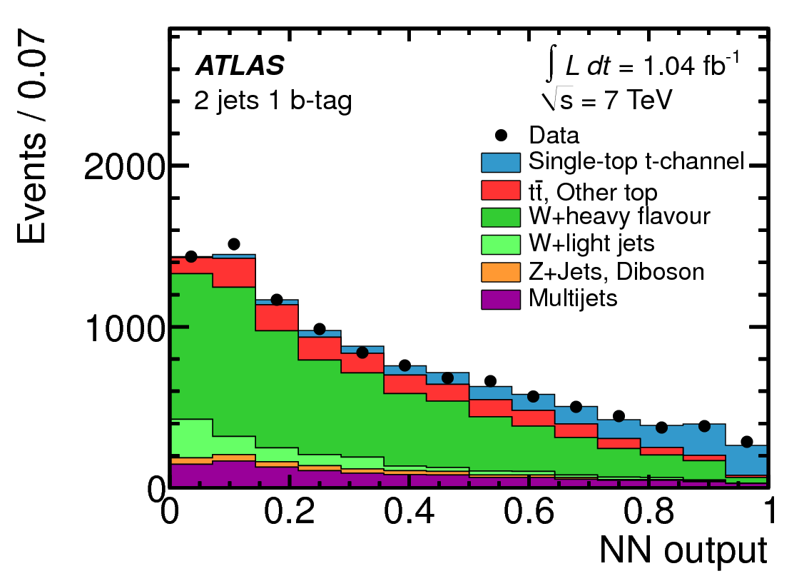
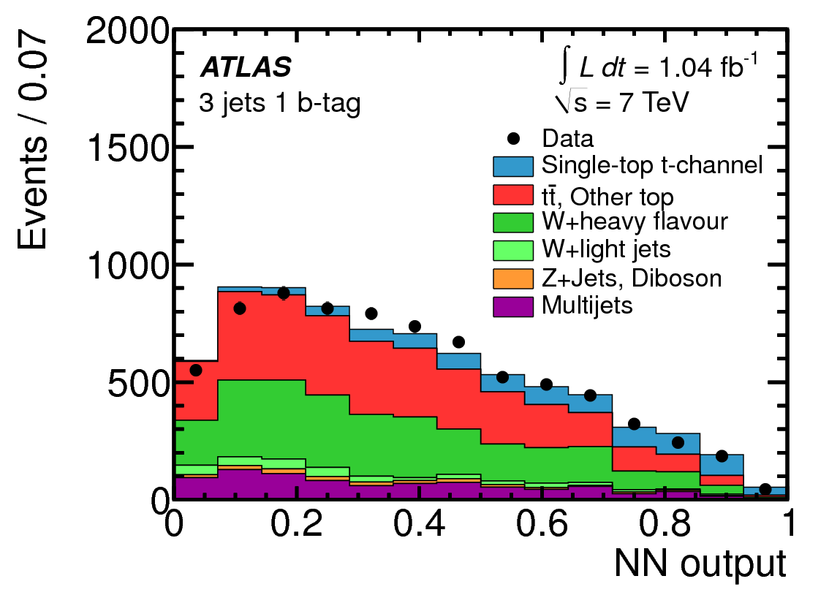
t-channel: Neural Network
Use Neural Network to combine several variables into to a powerful one
Separate training for 2 jets and 3 jets events
12 variables 18 variables

Slide 17
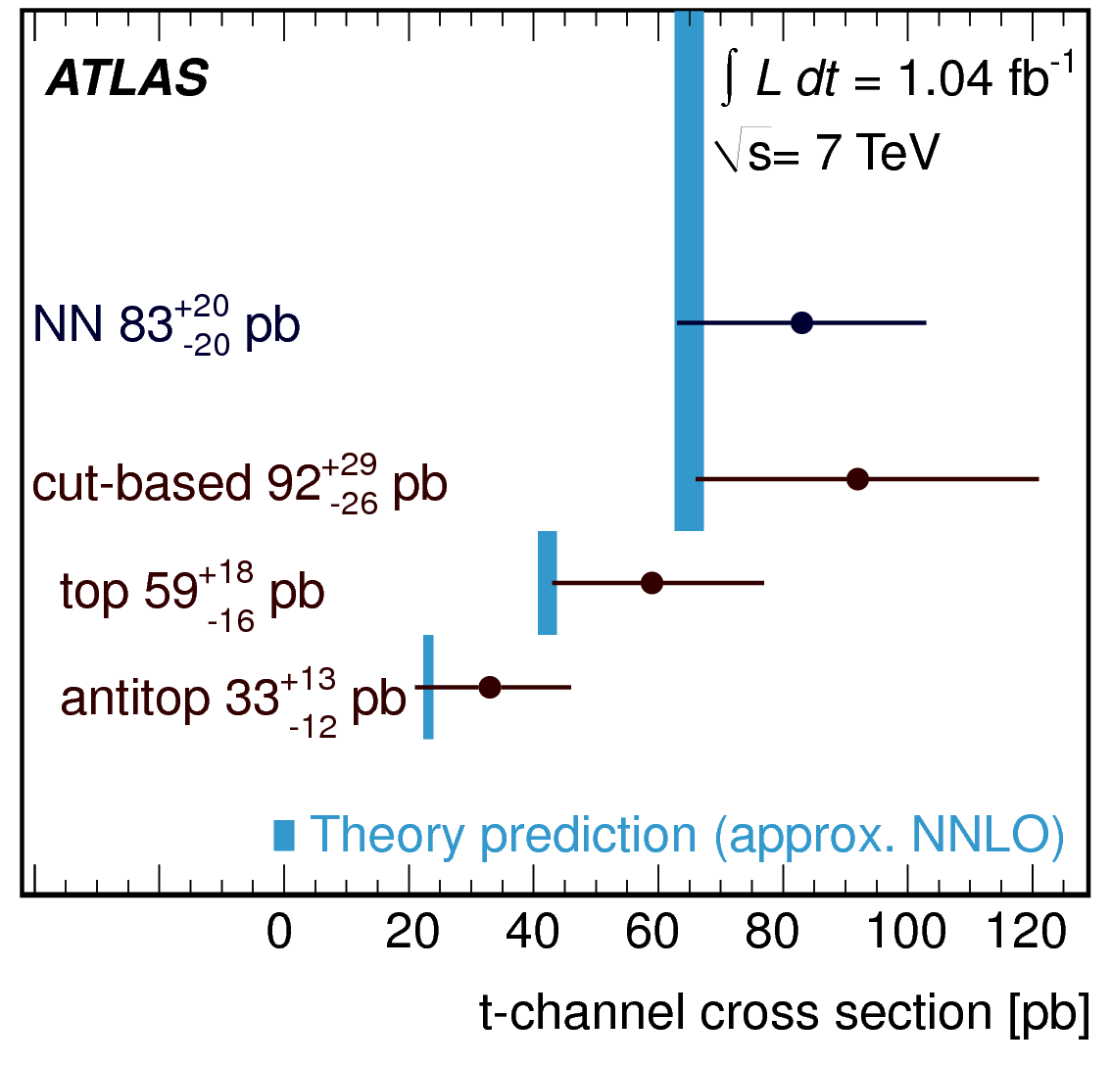
t-channel: Results
t-channel cross section extraction
  Maximum likelihood fit using the full NN output distribution
  Simultaneous determination of signal and background rates
  Cross checked with Cut based results
|Vtb| measurement:
  |Vtb|>>|Vtd|,|Vts|, Measured cross section proportional to |Vtb|².
Total unc. 24%
Main systematics
  ISR/FSR: 14%
  Btag eff. 13%
Obs. 7.2 σ; exp 6.0 σ

Slide 18
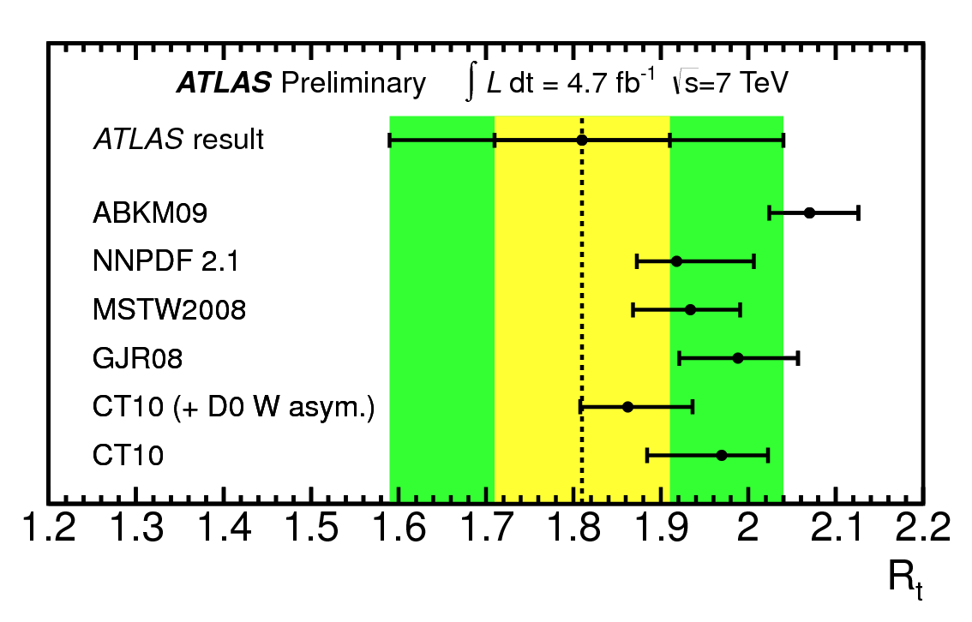

t-channel: Charge asymmetry
Updated analysis with 4.7 fb⁻¹ data
Initial u/d quark determines the final state lepton charge
Ratio of t-channel lepton charge constrains the light quark PDF
  Same strategy as cross section measurement
  NN trained for positive and negative charged lepton separately
Main systematics:
  : JES 20%
  : stat. 6%; JES 4%; BG norm. 4%
ATLAS-CONF-2012-056, 4.7 fb⁻¹

Slide 19
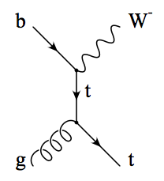
Wt-channel single top
Single top quark associate production with a W Boson
1/10 of ttbar cross section
  Abundant signal
Difficulty: Separation against top-pair events
Searches both at the tow W all leptonic decay channel (Dilepton) and only one W leptonic decay channel at ATLAS
First evidence seen by both ATLAS & CMS
Observation expected with 8 TeV data

Slide 20
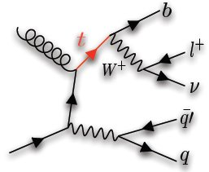
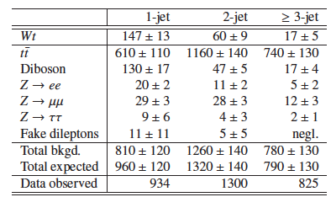
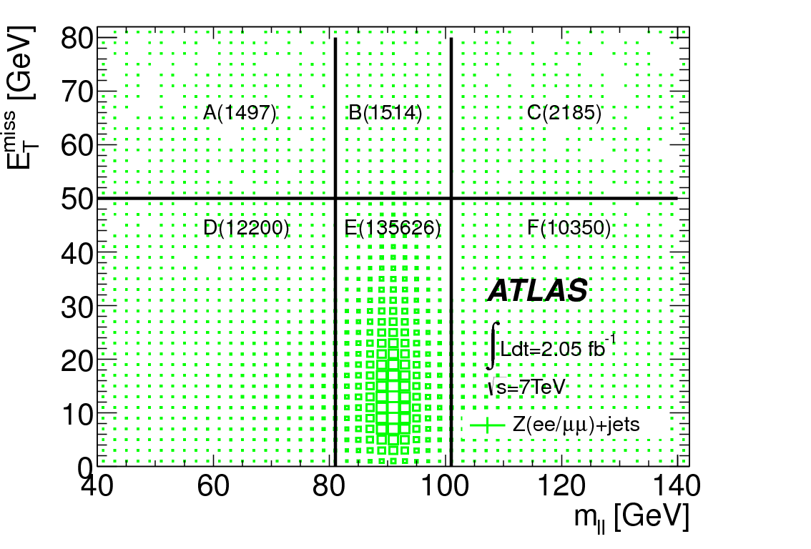
Wt channel: Event Selection
Exactly 2 leptons (ee, μμ, eμ)
  Pt>25 GeV, |η|<2.5
  Fire electron or muon trigger
1 (signal region), 2 or >=3 (C.R.) jets
  Pt>30 GeV, |η|<2.5 (no b-tagging)
Missing transverse momentum
  MET > 50 GeV
Veto against Z->ττ
Anti Z window in ee/μμchannel
v
W⁻
l⁻
PLB 716 (2012) 142-159
arXiv:1205.5764; 2.05 fb⁻¹
Simulation
ABCDEF
Matrix method
Z->ee,Z->μμ,Fake dilepton normalized from data

Slide 21
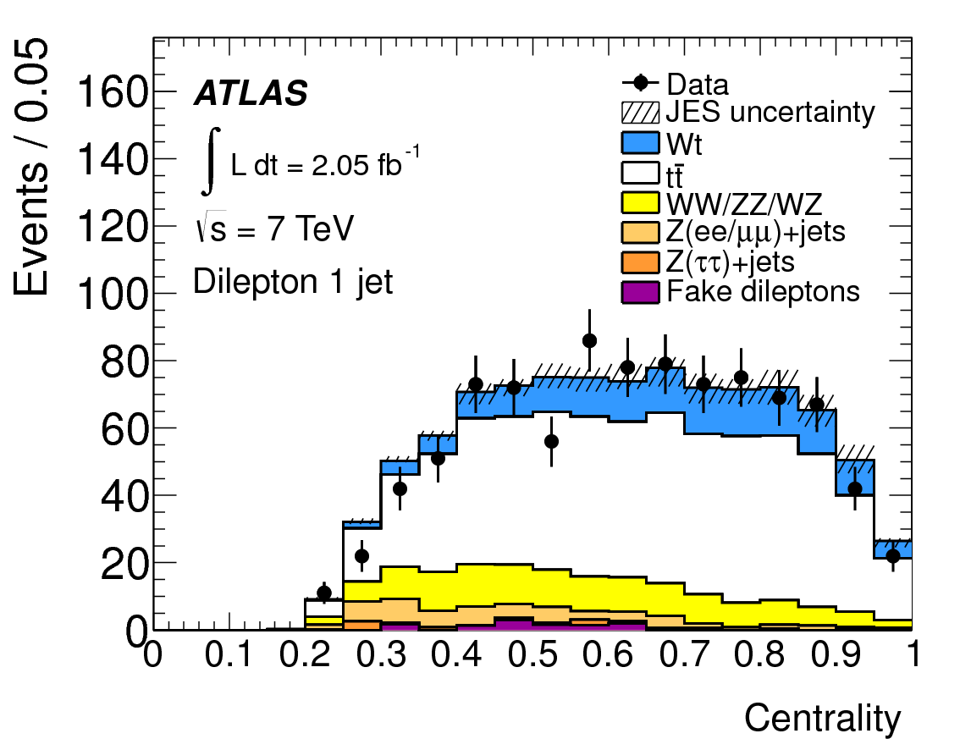
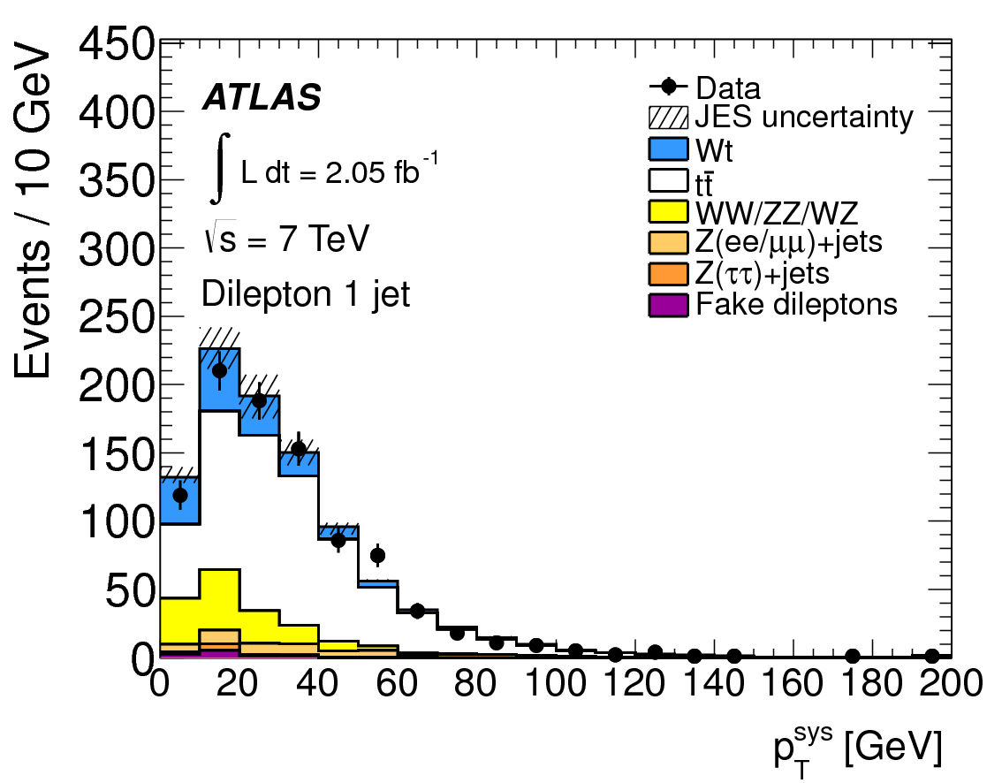
Wt channel: BDT
In 1-jet signal region: 64% are top pair
  Even more in control regions
  There is no powerful variable to separate top pair and Wt
Use BDT to combine 22 well modeled variables into a powerful one
Trained in 1-jet bin, and applied to 1-jet and control region of 2-jet, >=3 jet
…

Slide 22
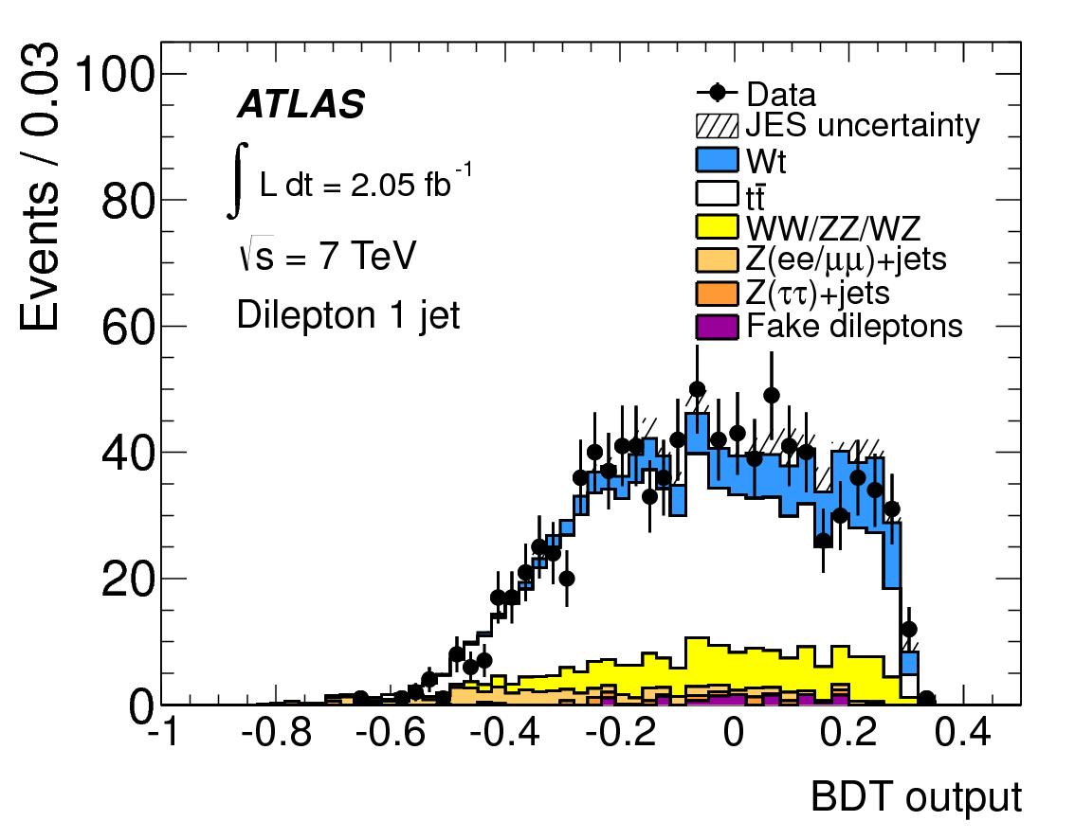

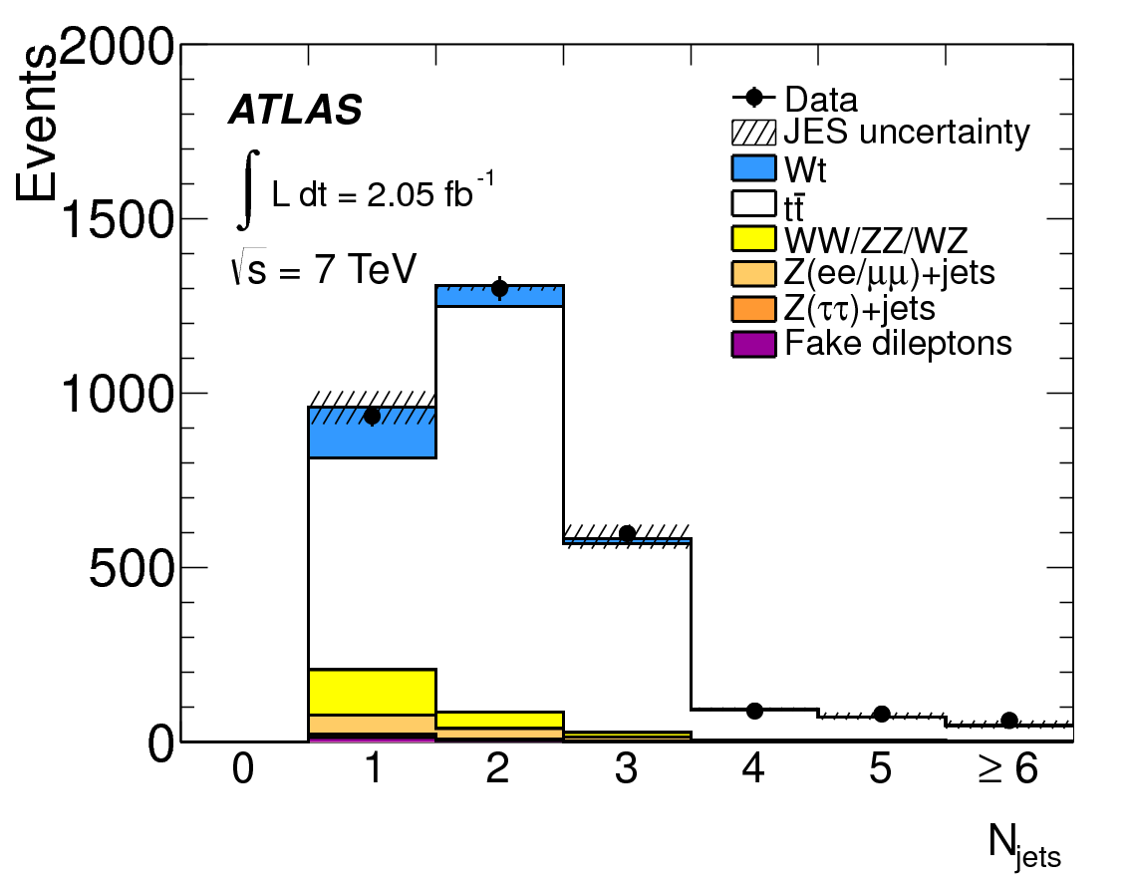
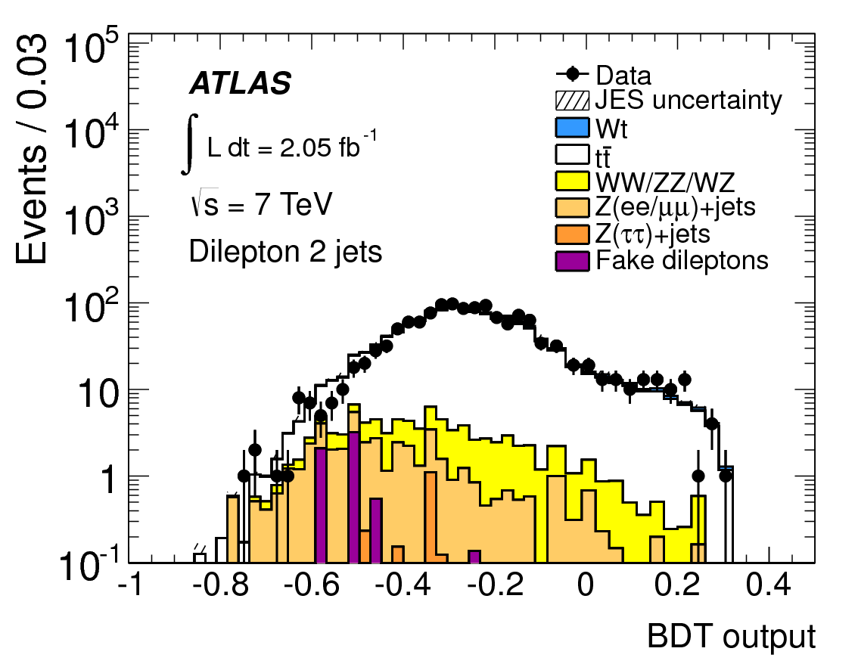
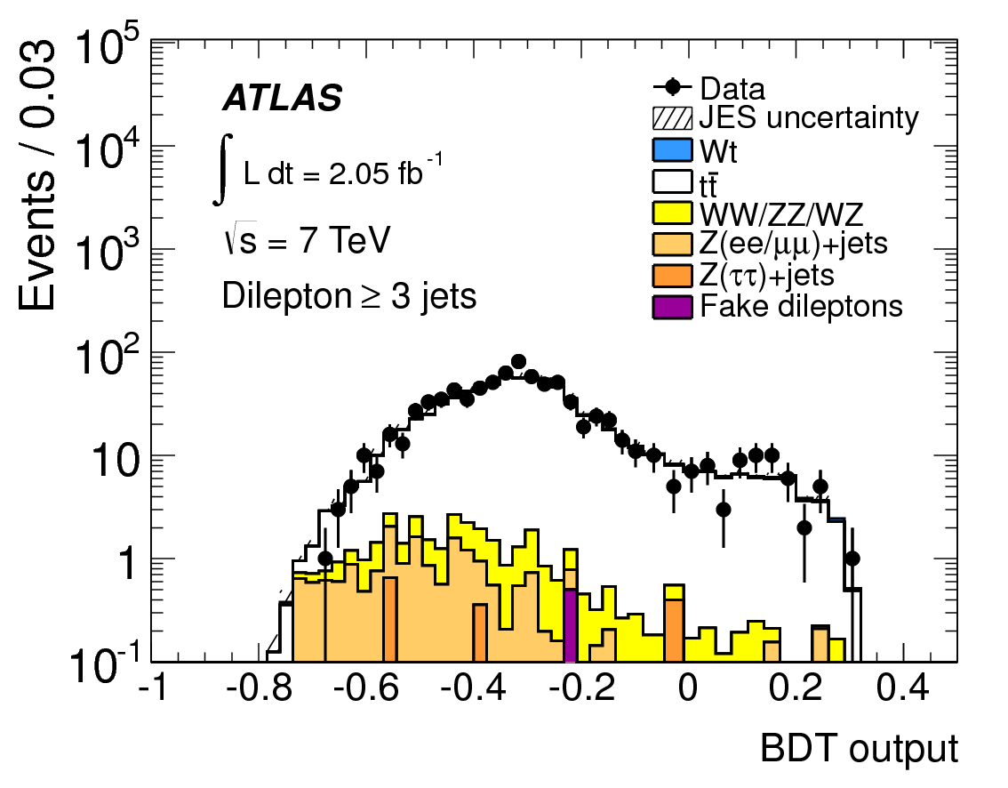
Wt channel: signal extraction
Maximum likelihood fit
Including 2-jet and >=3 jet bin in the likelihood function to control top pair
  Simultaneous determination of signal and background rates
tt: >90%

Slide 23

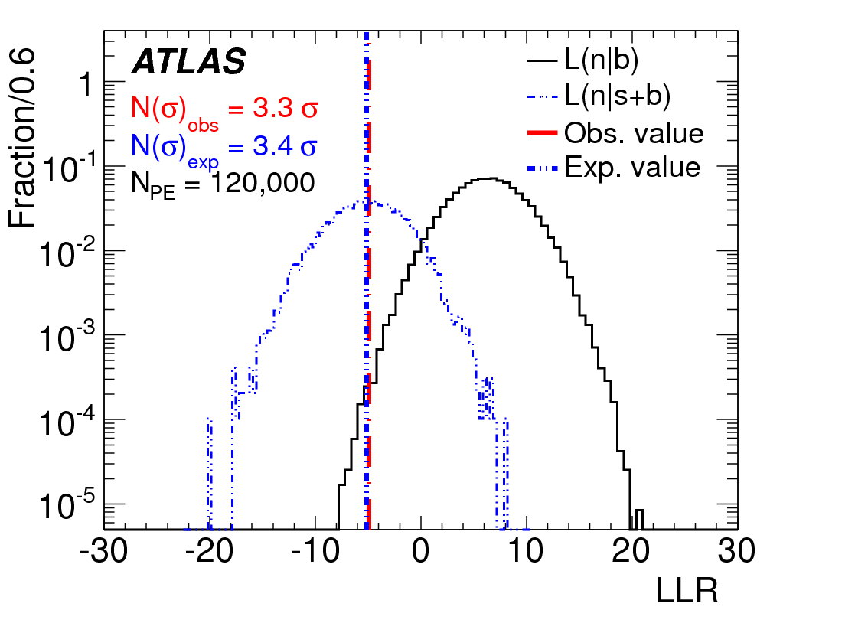

Wt channel: Results
Measured SM Wt cross section
Significance estimated by pseudo experiments:
Interpreted to |Vtb| by assume Wt mainly produced from |Vtb|, without any assumption on top decay
First Evidence :
3.3σ obs. 3.4σ exp.
Total uncertainties: 33%
Main uncertainties:
  Data statistics: 17%
  JES 14%
  Theory modeling: 12%, 14%

Slide 24
s-channel single top
Production through an off-shell W boson
  Single top-quark + central b-quark
Less than 1/30 cross section of top pair events
Difficulty: Suffers from large background and small signal cross section
Searches with leptonic top decays
  Single top-quark system could be reconstructed
Evidence at Tevatron
First preliminary limit at ATLAS (this talk)

Slide 25
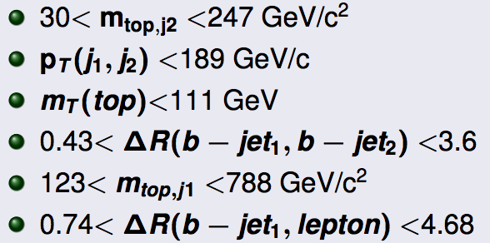
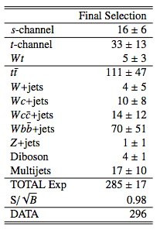
s-channel: event selection
Same preselection as t-channel
  Except 2 central b-jet required |η|<2.5
Further cut to improve the sensitivity
Simulation: s-channel, t-channel, Wt, top pair, Z+jets, diboson
Data Driven: W+jets, Multijets
Dominated background after selection:
  Top pair 39%; W+jets 34%
ATLAS-CONF-2011-118, 0.7 fb⁻¹

Slide 26
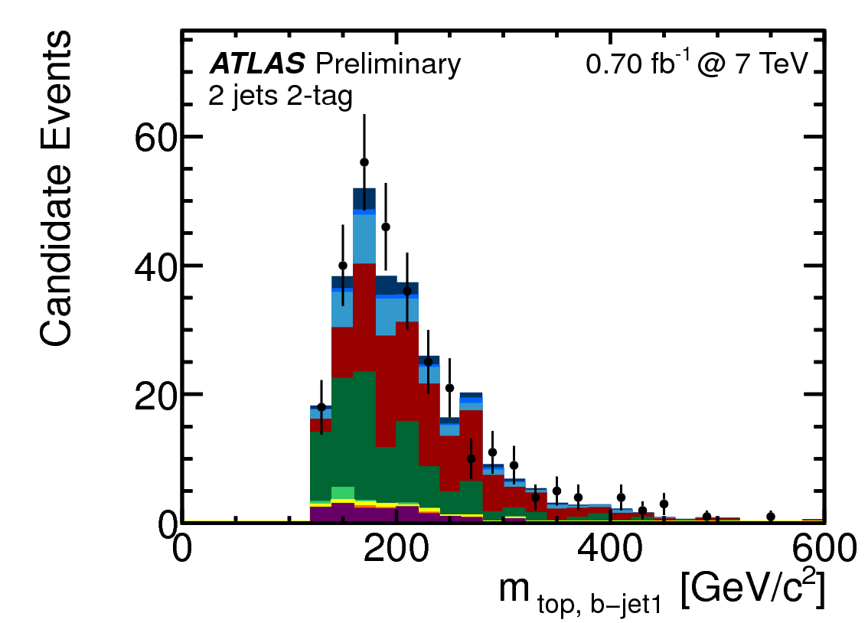
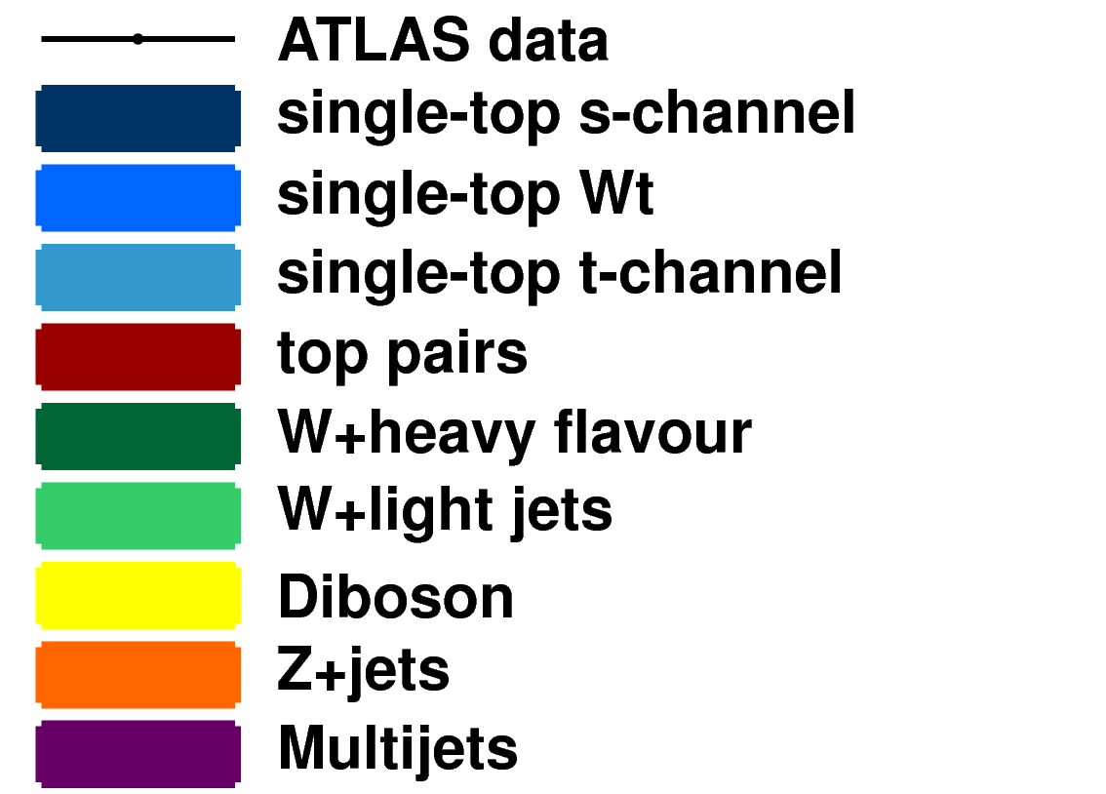
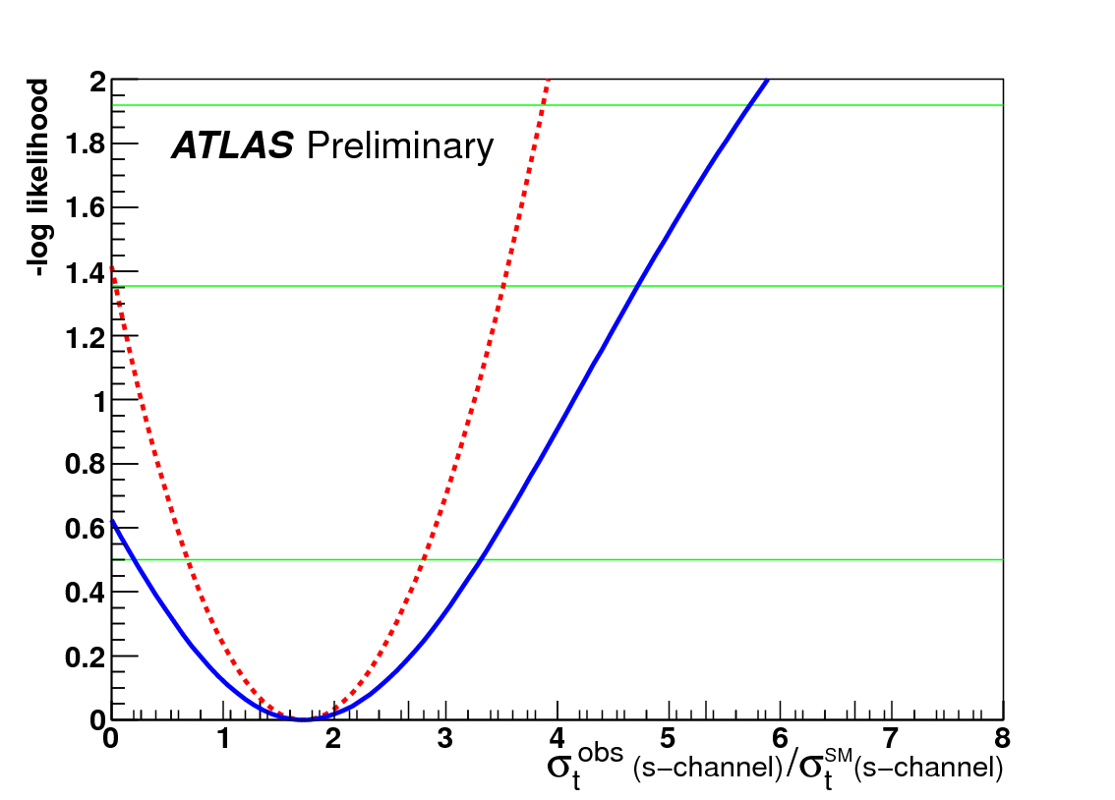

s-channel: results
Cut and counting experiment
Extract single and background rates by maximum the likelihood function with unc.
Main uncertainties from:
  Data statistics 100%
  Others from 20-60%
95% C.L. Limits on s-channel production

Slide 27
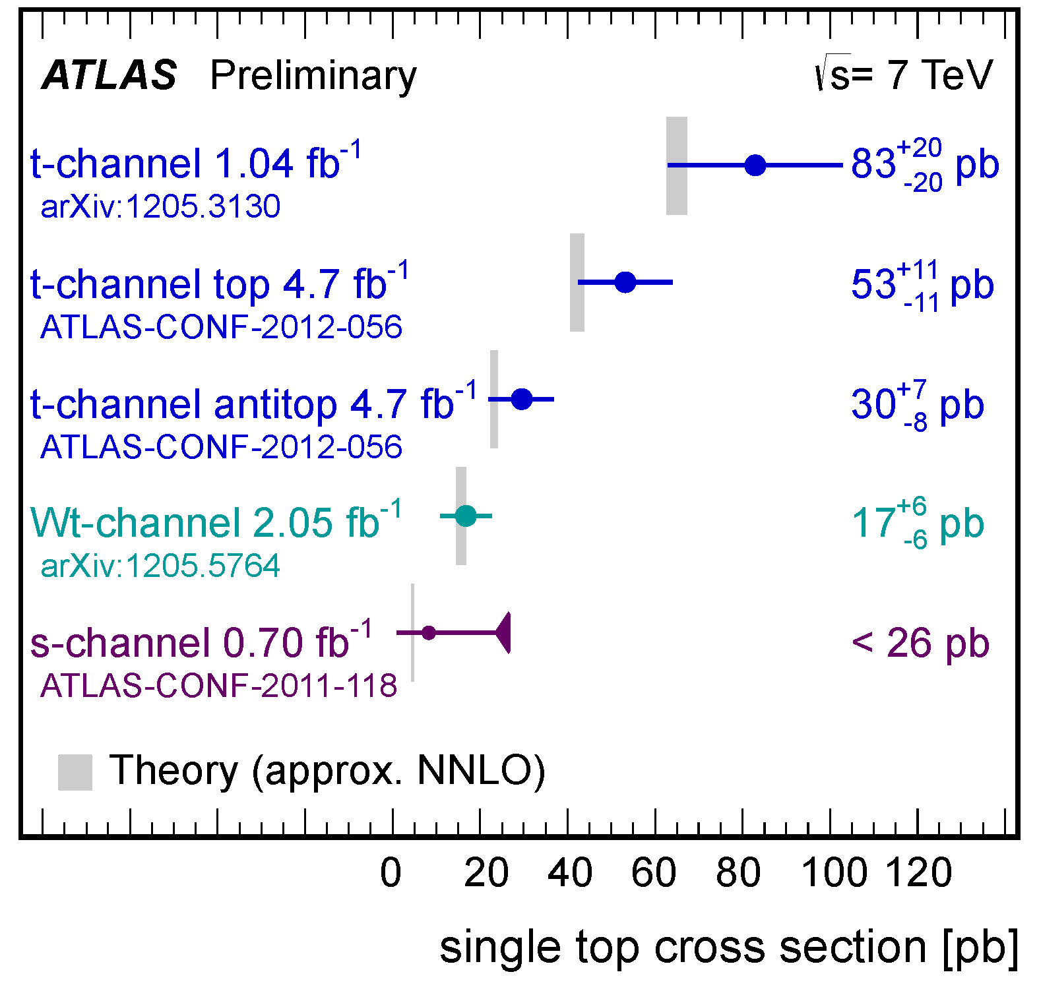
single top measurements
t-channel cross section accuracy 25%, significance 7.2σ
Wt cross section accuracy 33%, 3.3 σ obs., 3.4 σ exp. (First Evidence)
  CMS confirm the evidence (arXiv:1209.3489)
s-channel limit at 5xSM predictions

Slide 28
New physics with single top signature searches
FCNC single top production
  Signature: top-quark
tb/W’ resonance searches
  Signature: top-quark + central b-quark
Wt/b* resonance searches
  Signature: top-quark + W boson

Slide 29
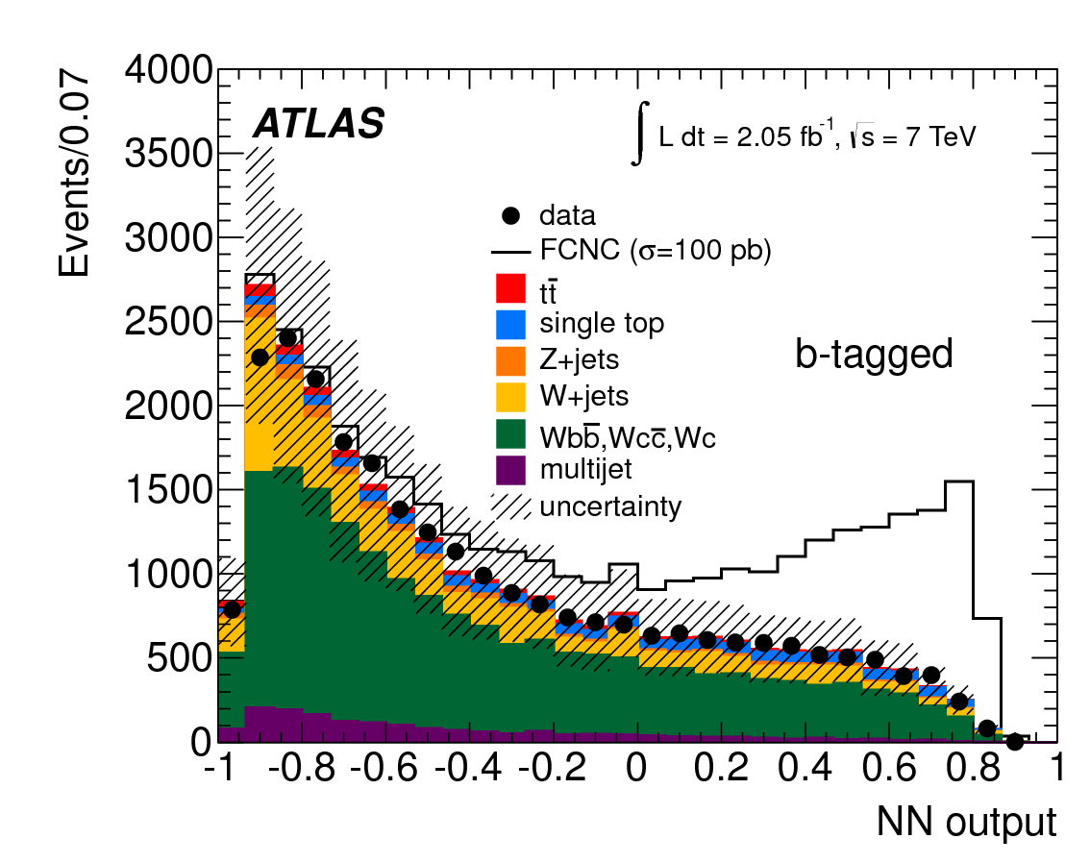

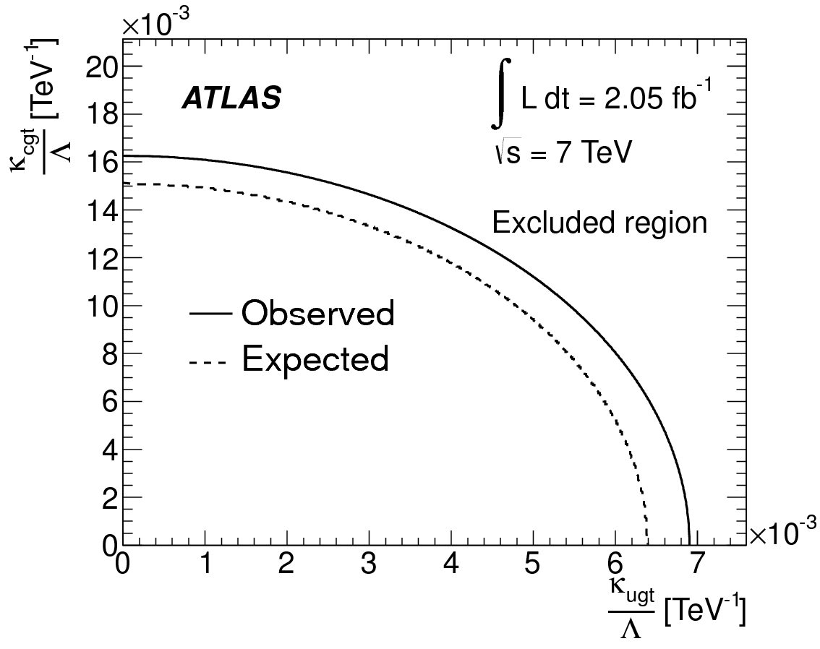
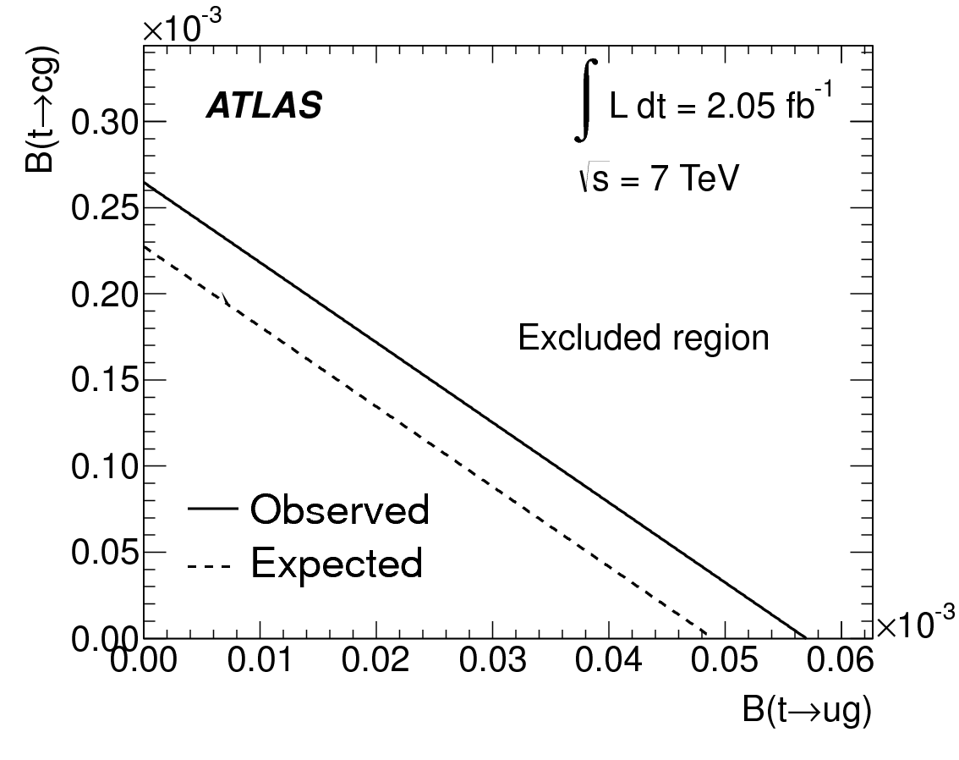
FCNC single top search
Highly suppressed in SM: new physics if exceed
Same selection and background modeling strategy as t-channel analysis in 1-jet bin
Use Neural Network output as discriminant
  11 input variables
Set limits on cross section and FCNC coupling to up quark and charm quark
Translate to top decay branching ratio to ug and cg
\C
PLB 712 (2012) 351-369
ArXiv:1203.0529, 2.05 fb⁻¹
World’s best Limit on FCNC coupling ugt and cgt

Slide 30
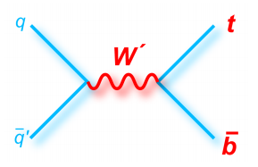
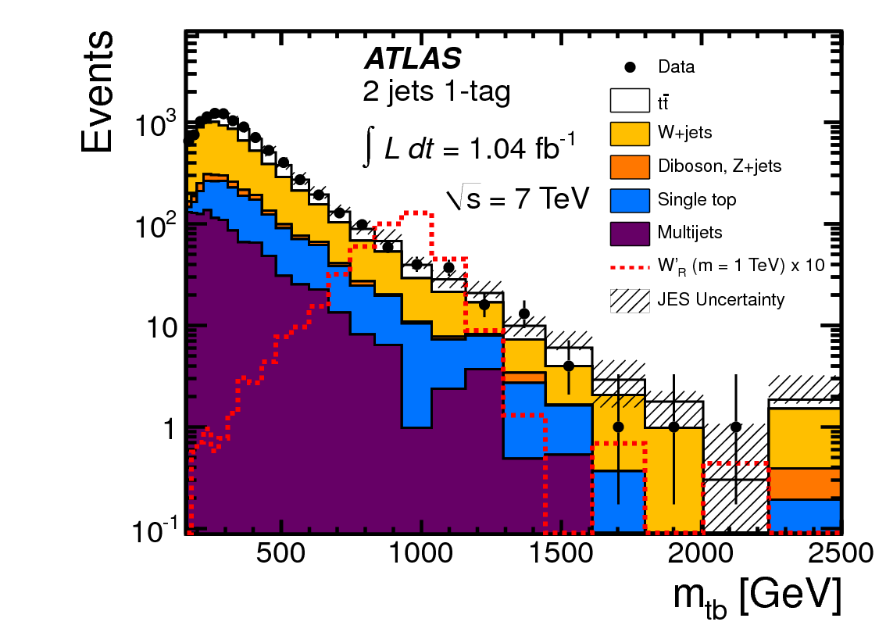
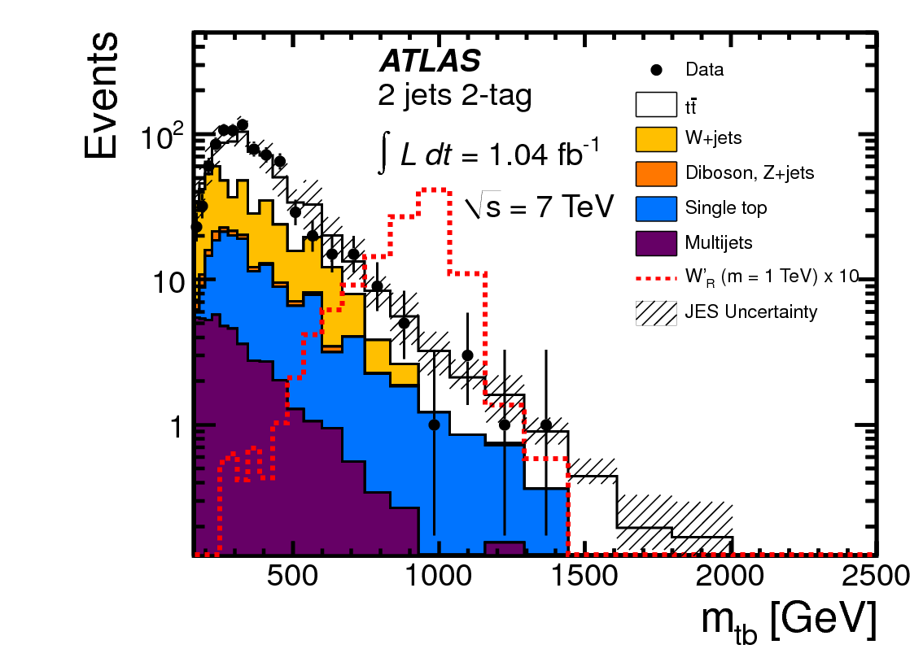
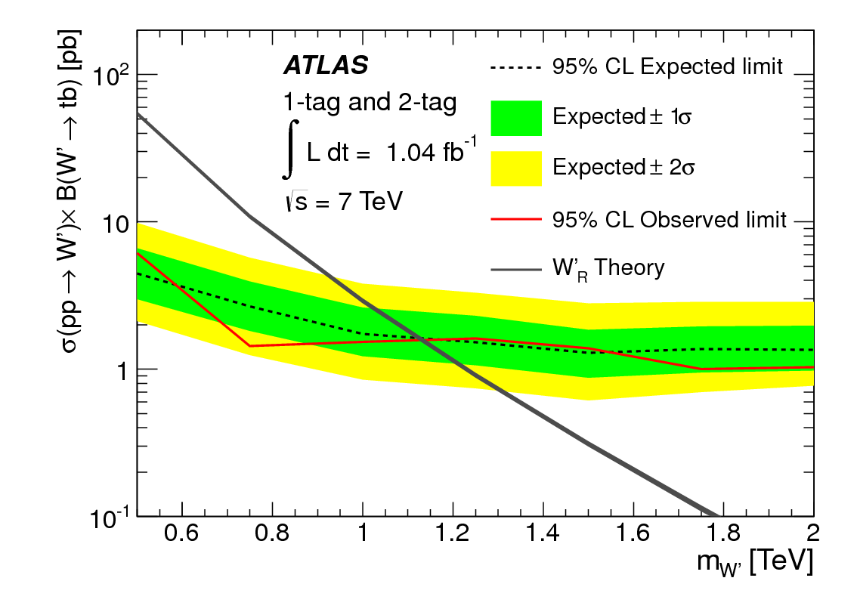
tb resonance searches: W’
Right handed W’_{R} model with SM like couplings (PRD 66, 075011 2002)
Same selection and background modeling strategy as s-channel analysis
Use the invariant mass of final state t+b as discriminant
Combined both 1 and 2 b-tagged events
No excess found, Set limits on W’_{R} masses
Extra gauge boson?
PRL 109 (2012) 081801
arXiv:1205.1016; 1.04 fb⁻¹
M_{W’}>1.13TeV @ 95% C.L.

Slide 31
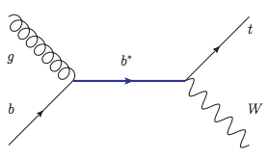
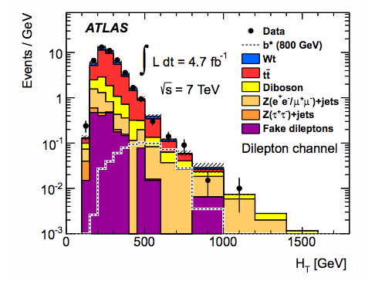
Wt resonance searches: b* (1)
Excite quark/lepton could reveal the substructure of SM fundamental particles
Composite 3rd generation quark model allows FCNC/SM coupling
Search excited bottom quark in the signature of W boson plus single top-quark
  Both dileptonic and semileptonic final states are analyzed
Same selection and background modeling as SM Wt analysis
  Look at W+t without extra jets
ArXiv:1301.1583, 4.7 fb⁻¹
Dileptonic discriminate: HT

Slide 32
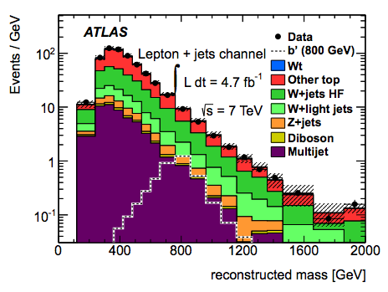
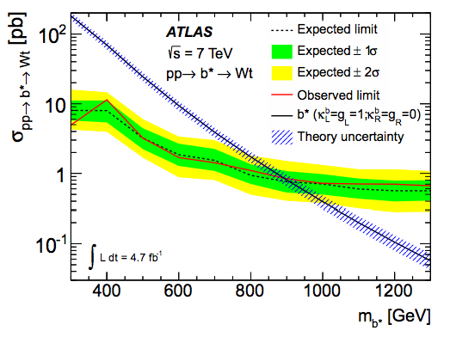
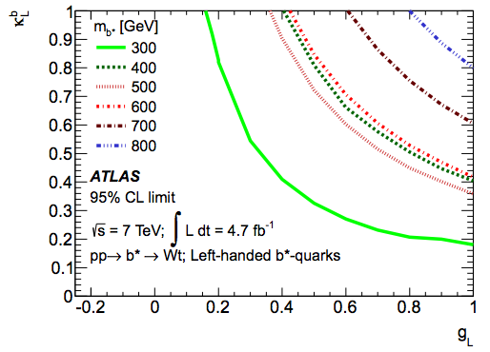

Wt resonance searches: b* (2)
Lepton + jets discriminate: b* mass
No excess found, set limit to b* mass
  Bayesian limit set at 95% C. L.
Translate b* mass limit into 2D coupling plate
Set Limits for left-, right- handed and vector like quarks separately
Left handed b* quark: > 870 GeV @ 95% C.L.
Vector Like b* quark: > 1030 GeV @ 95% C.L.
ArXiv:1301.1583, 4.7 fb⁻¹
Left handed b*
Vector like b*

Slide 33
Future single top physics
SM single top-quark process
  Cross section measurement => |Vtb|
  Anomalous coupling
  Top polarization
Understanding of mass origin
  Top quark: heaviest: 175 GeV > mH(125GeV)
  What is the Yukawa coupling of top quark to Higgs
    ttH, tHj(information of h-t-t and h-W-W coupling interferences)
  If Top quark(3rd generation quark) is not elementary
    Excited quarks: b*/t* searches
Search for Dark Mater candidates/SUSY
  Singly produced top + X: top + MET signature
  Could probe higher mass of X compared to the pair Prod.
  Benefit from the top-quark as tagger

Slide 34

Summary and outlook
Measurement of 3 SM single top-quark model
  ~25% accuracy on cross section, 6% on top and anti-top cross section ratio for t-channel;
    7.2 σ obs. (6.0 exp.) significance
  First Evidence for Wt : 3.3 σobs. (3.4 σ exp.)
Search for new physics with ST
  FCNC: world best limit on ugt/cgt
  W’/tb resonance: extend Tevatron limit
  b*/Wt resonance: first limit
Outlook at higher E_{cm} and Lumi
  Benefit from increase of σ
  Sensitivity to new physics extended
More 8 TeV data results coming soon

Slide 35
ATLAS single top-quark paper
Finished/preparing as Feb. 2013
FCNC searches: PLB 712 (2012) 351-369
t-Channel cross section: PLB 717 (2012) 330-350
* Wt Evidence: PLB 716 (2012) 142-159
W’/tb resonance searches: PRL 109 (2012) 081801
* b*/Wt resonance searches: arXiv:1301.1583, 4.7 fb⁻¹
W’/tb resonance searches @ 8 TeV: TOPQ-2012-19
* Wt measurement @ 8 TeV: TOPQ-2012-20
t-channel top/anti-top ratio @ 7 TeV: TOPQ-2012-21
*: I am the paper co-editor

Slide 36
ATLAS single top CONF note
Preparing/finished as Feb. 2013
ATLAS-CONF-2011-027
ATLAS-CONF-2011-088
ATLAS-CONF-2011-118
ATLAS-CONF-2011-104
ATLAS-CONF-2011-101
ATLAS-CONF-2012-056
ATLAS-CONF-2012-095

Slide 37
THANK YOU

Slide 38



tHj process
PLB 347 (1997)
PRD 63 014018

