Slide 1
Using Profile Likelihood ratios at the LHC
Clement Helsens, CERN-PH
Top LHC-France, CC IN2P3-Lyon, 22 March 2013

Slide 2
Outline
Introduction
Reminder of statistic
  Hypothesis testing
Profile Likelihood ratio
Some example helping to build an analysis
  From real analyses
  From Toy MC
Conclusion

Slide 3
Introduction
Disclaimers
  This talk is not a lecture in statistic!
  I will not encourage you to use any particular tool or method
Only talk about (hybrid) Frequentist methods and not about Bayesian marginalization
This talk should be seen like a methodology to follow when one wants to use profiling in an analysis
For the example I will only talk about searches (LHC is a discovery machine ☺ )
I will rather try to give tips to perform an analysis using profiling rather than reviewing analysis using it
  This might help you to have better results

Slide 4
Hypothesis Testing 1/5
Deciding between two hypothesis
  Null hypothesis H₀ (background only, process already known)
  Test hypothesis H₁ (background + alternative model)
Why can’t we just decide by testing H₀ hypothesis only? Why do we need an alternate hypothesis?
  Data points are randomly distributed:
    If a discrepancy between the data and the H₀ hypothesis is observed, we will be obliged to call it a random fluctuation
    H₀ might look globally right but predictions slightly wrong
    If we look at enough different distributions, we will find some that are mis-modeled
    Having a second hypothesis provides guidance where to look
Duhem–Quine thesis:
  It is impossible to test a scientific hypothesis in isolation, because an empirical test of the hypothesis requires one or more background assumptions (also called auxiliary/alternate hypotheses).
  http://en.wikipedia.org/wiki/Quine-Duhem_thesis

Slide 5
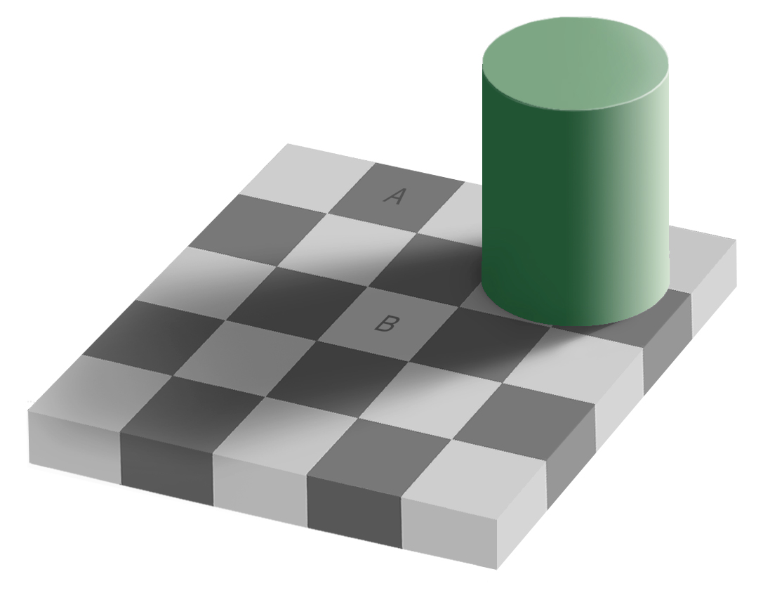
Hypothesis Testing 2/5
Is square A darker than square B? (there is only one correct answer)

Slide 6
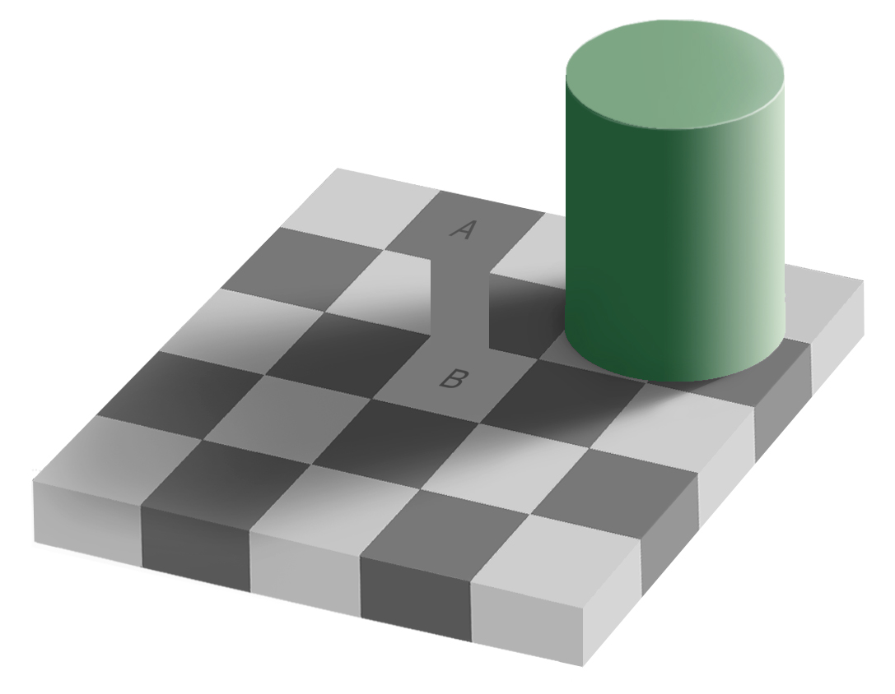
Hypothesis Testing 3/5
Is square A darker than square B? (there is only one correct answer)

Slide 7
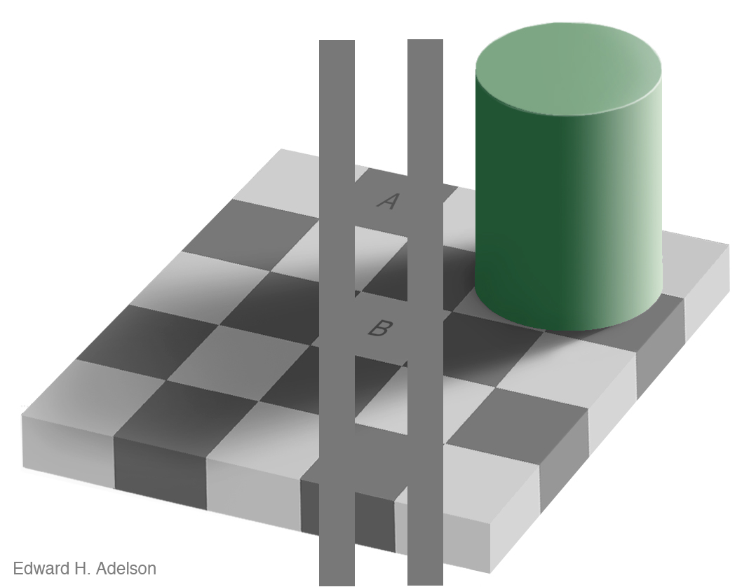
Hypothesis Testing 4/5
Since the perception of the human visual system is affected by context, square A appears to be darker than square B but they are exactly the same shade of gray
http://web.mit.edu/persci/people/adelson/checkershadow_illusion.html

Slide 8
Hypothesis Testing 5/5
So proving one hypothesis is wrong does not mean the proposed alternative must right
For example, search for highly energetic processes (like heavy-quarks)
  Use inclusive distributions like H_{T} (Σp_{T})
  If discrepancies observed in the tails of HT, does this necessarily means we have new physics?

Slide 9
Frequentist Hypothesis Testing 1/2
1) Construct a quantity that ranks outcomes as being more signal-like or more background-like. Called a test statistic:
  Search for a new particle by counting events passing selection cuts
  Expect B events in H₀ and S+B events in H₁
  The number of observed events n_{Obs} is a good test statistic
2) Build a prediction of the test statistic separately assuming
  H₀ is true
  H₁ is true
3) Run the experiment and get n_{Obs} (in our case run LHC + ATLAS/CMS)
4) Compute the p-value

Slide 10
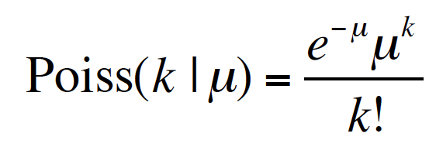
Frequentist Hypothesis Testing 2/2
Poisson distribution
A p-value is not the probability that H₀ is true
Could ask the question: what is the chance of getting n==n_{Obs} (Chance of getting exactly 1000 events when 1000 are predicted? It is small)
If p<p_{thr}, then we can make a statement
We commonly use p_{thr} = 0.05 and say we can exclude the hypothesis under test at the 95% C.L. (Confidence Level)

Slide 11
Log Likelihood ratio
What should be done if we do not want a counting experiment?
Neyman-Pearson Lemma (1933): The likelihood ratio is the “uniformly most powerful” test statistic
Acts like the difference of χ² in the Gaussian limit
Used at the Tevatron (mclimit, collie). Needs Pseudo-data

Slide 12
P-values and -2lnQ (From LEP)
P-value for testing H₀ = P(-2lnQ ≤ -2lnQ_{obs} | H₀) = CL_{b}
  Blue ➔ p-value to rule out H₀ called in HEP 1-CL_{b}
  Use for discovery
P-value for testing H₁ = P(-2lnQ ≥ -2lnQ_{obs} | H₁) = CL_{sb}
  Red ➔ p-value to rule out H₁
  Use for exclusion
For exclusion use instead CL_{s} = CL_{sb}/CL_{b} better for small number of expected events
  If CL_{s} ≤ 0.05 ➔ 95% C.L. exclusion
  Does not exclude where there is no sensitivity

Slide 13
Sensitivity
H₀ and H₁ well separated
very small CL_{sb}
very sensitive
No signal, able to exclude H₁
May want to reconsider modeling if -2ln(Q_{obs}) >10 or <-15
H₀ and H₁ are not separated at all
Large CL_{sb}
No sensitivity
Not able to exclude H₁

Slide 14
Incorporating systematics
Our Monte-Carlo model can never be perfect, as well as our theoretical predictions
This is why systematics uncertainties are here for, no?
We parameterize our ignorance of the model predictions with nuisance parameters.
Systematics are usually called nuisance parameters
What we usually do (in hybrid/frequentist methods)
  Define those nuisance parameters for 2 variations, typically give the +/- 1σ and allow them to vary in a range
  Assume a probability density for the nuisance parameters
    Gaussian (most used)
    But could be also LogNormal, unconstrained
  Assume some interpolation methods
    Linear ➔ MINUIT can run into troubles at 0
    Parabolic

Slide 15
Fitting/Profiling
Fitting == Profiling nuisance parameters
Fitting or Profiling nuisance parameters should/could be seen as an optimization step
Usually use MINUIT to fit the nuisance parameters
A nuisance parameter could be for example the b-tagging efficiency
  Imagine the performance group is not able to measure the b-tagging efficiency very accurately:
    Large values of the b-tagging systematic will be observed
    Could even be the dominant one
    What if we see that data/MC agrees very well in control regions?
    Shall we estimate sensitivity without profiling?
    Might be better to use the information in data!

Slide 16
Deeper in the Log Likelihood ratio
Models with large uncertainties will be hard to exclude:
  Either many different nuisance parameters
  Or one parameter that has a big impact
: Maximize LLR assuming H₁
: Maximize LLR assuming H₀
are function of the nuisance parameters that are fitted

Slide 17
What is done in practice
Fit twice:
  Once assuming H₀, once assuming H₁
  Two sets of fitted parameters are extracted
When running Toy-MC should:
  Assume H₀
  Assume H₁
So at the end of the day, 4 fits are needed to have one 2 expected values to be used to compute the confidence level

Slide 18
Building an analysis using profiling
If you are running a cut and count analysis, you can not use profiling of nuisance parameters, all the systematics have the same impact for all the samples:
  All normalization, no shape
If you are using a shape analysis that is tight enough there is also maybe no need to use profiling
But if you have sidebands (enough bins or channels to constrain the nuisance parameters), you might want to consider using profiling
Number of things needs to be checked (not a complete list!!) :
  If the fitted nuisance parameters are constrained in data
  Pull distributions: (fit-injected)/(fitted error)
  Fitted error

Slide 19
Fitting or not fitting?
See Favara and Pieri, hep-ex/9706016
Some channels or bins within channels might be better off being neglected when estimating the sensitivity in order to gain discrimination power
If the systematic uncertainty on the background B exceeds the expected signal S, then reduce sensitivity
Fitting background helps to constraint them
Sidebands with little signal provide useful information, but they need to be fitted

Slide 20
Toy MC example: Binning
All cases :
  500 GeV t’, 100% mixing to Wb
  Only consider ttbar as a background
  Systematic added (norm only)
    50% in total for BG (same in all bins)
Comparison made for
  Statistical only nuisance parameters
  Statistical + Systematics no profiling
  Statistical + Systematics profiling

Slide 21
Toy MC example: Case 1
Nominal distributions for background and signal
  CL_{s} (STAT only)
  = 1.5e⁻⁵
  CL_{s} (STAT+SYST)
  = 2.9e⁻⁵
  CL_{s} (STAT+SYST PROF)
  = 2.2e⁻⁵

Slide 22
Toy MC example: Case 2
Set the first bin to:
  Signal: 0
  Background: 100
  S/B = 0
  CL_{s} (STAT only)
  = 1.5e⁻⁵
  CL_{s} (STAT+SYST)
  = 2.8e⁻⁵
  CL_{s} (STAT+SYST PROF)
  = 1.4e⁻⁵

Slide 23
Toy MC example: Case 3
Set the first bin to:
  Signal: 10
  Background: 100
  S/B = 0.1
  CL_{s} (STAT only)
  = 1.2e⁻⁵
  CL_{s} (STAT+SYST)
  = 2.0e⁻⁴
  CL_{s} (STAT+SYST PROF)
  = 1.7e⁻⁵

Slide 24
Toy MC example: Summary
 | S,B, S/B (first bin) | Log(1+S/B) (first bin) | CLs (STAT) | CLs (STAT+SYST) | CLs (STAT+SYST Prof)
Case 1 | 0.25, 0.35, 0.71 | 0.54 | 1.5 | 2.9 | 2.2
Case 2 | 0, 100, 0 | 0 | 1.3 | 2.8 | 1.4
Case 3 | 10, 100, 0.1 | 0.095 | 1.2 | 20.4 | 1.7
Case 4 | 1, 100, 0.01 | 0.001 | 1.5 | 3.2 | 1.6
Case 5 | 100, 100, 1 | 0.69 | 0.8 | 3.2 | 1.7
Case 6 | 1, 1, 1 | 0.69 | 1.3 | 2.4 | 2.3
If not fitting ➔ bins with large B and medium S degrades sensitivity by a lot!
Fitting helps to recover sensitivity!

Slide 25
Toy MC example: Profiling
In the next slides I will take an other toy-MC example
  Signal: Gaussian signal
  BG1: linearly falling background
  BG2: flat background
  Data are fluctuations around the expected Monte-Carlo predictions
Systematics
  Normalization only:
    Luminosity ± 5% for all the samples
    BG1: ± 20%
    BG2: ± 20%
  One shape systematic affecting BG1 and BG2

Slide 26
Optimize the binning 1/4
Two competing effects:
  1) Split events into classes with very different S/B improves the sensitivity of a search or a measurement
  Adding events in categories with low S/B to events in categories with higher S/B dilutes information and reduces sensitivity
  ➔Pushes towards more bins
  2) Insufficient Monte-Carlo can cause some bins to be empty, or nearly so.
  Need reliable predictions of signals and backgrounds in each bin
  ➔Pushes towards fewer bins

Slide 27
Optimize the binning 2/4
It doesn’t matter that there are bins with zero data events
  in any case, most of the time a search analysis is build blinded
  so you do not know a-priori if all your bins will be populated with data events
  there’s always a Poisson probability for observing zero events
The problem is wrong prediction:
  Zero background expectation and nonzero signal expectation is a discovery!
  Never have bins with empty background predictions
Pay attention to Monte-Carlo error
  keep in mind that the statistical error in each bin is an un-correlated nuisance parameter
Do not hesitate to merge bins in order to reduce the statistical error in each bin below a certain threshold
  For example ΔB/B < 10%

Slide 28
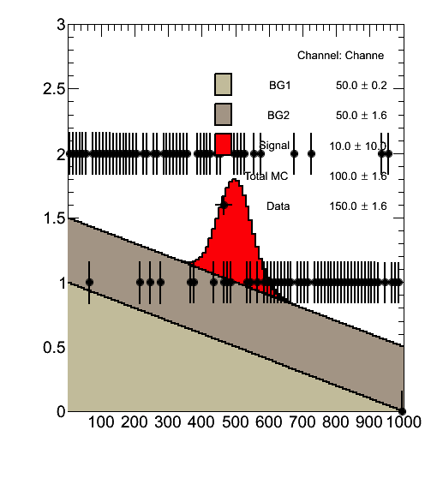
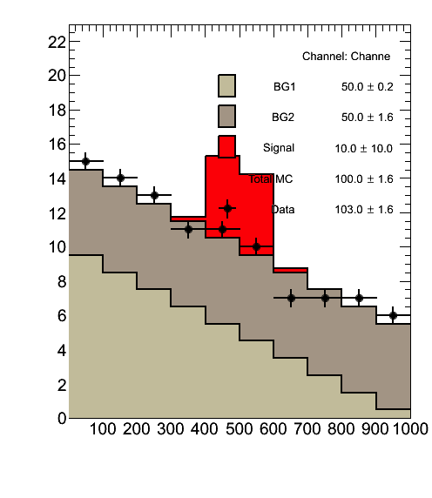
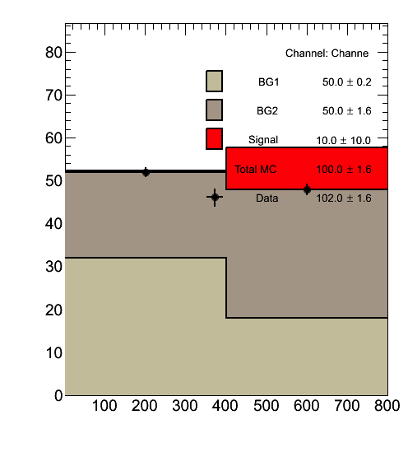
Optimize the binning 3/4
Binning (1) is obviously too fine
Binning (2) seems more or less okay
Binning (3) is obviously too coarse ➔ reduced sensitivity
(1)
(2)
(3)

Slide 29
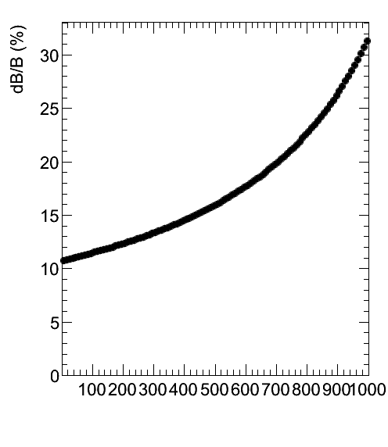
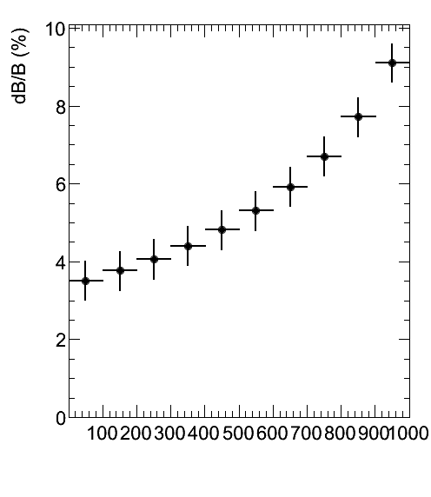
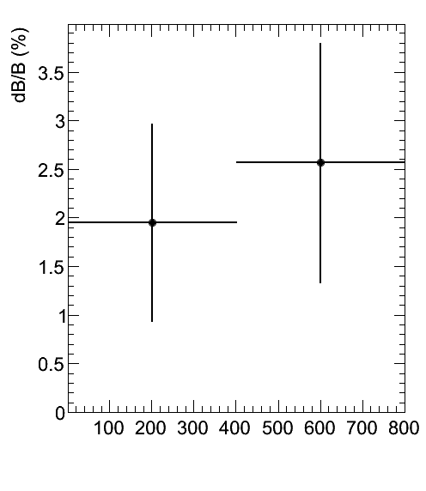
Optimize the binning 4/4
Binning (1) has ΔB/B always > 10%
Binning (2) has ΔB/B always < 10%
Binning (3) has a very small ΔB/B but only 2 bins!!!
Take binning 2 in the following (could even have considered a non-uniform binning)
(1)
(2)
(3)

Slide 30
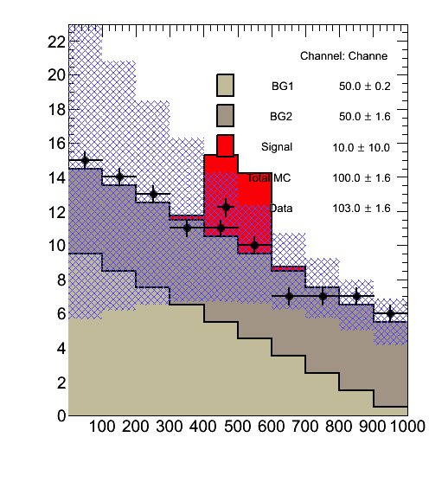
Pre-fit plot
Very large systematics at low values
(Pseudo) Data compatible with MC predictions

Slide 31
Shape systematic
Real shape systematics
Asymmetric

Slide 32
Context of the study
Will consider 3 cases in the following:
  No fitting
  Fitting the shape systematic only
  Fitting all the systematics

Slide 33
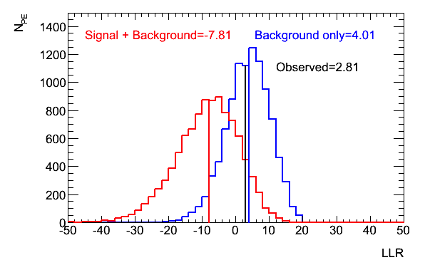
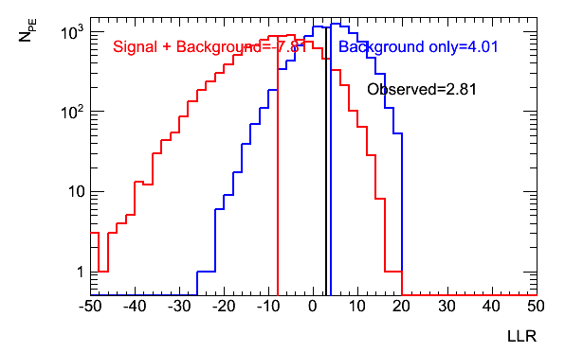
No fitting
CL_{s} expected = 0.148 ➔ not able to exclude

Slide 34
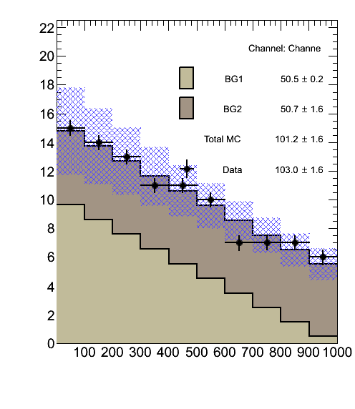
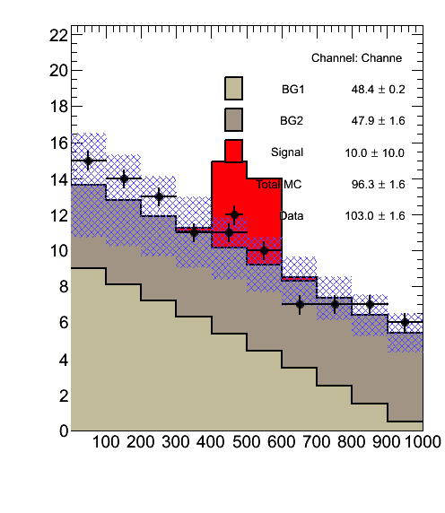
Fitting the shape systematic 1/2
CL_{s} expected = 0.071 ➔ not able to exclude, but much better result
Reduce the uncertainty
Post-Fit considering H₀
  Shape: 0.035 ± 0.252σ
Post-Fit considering H₁
  Shape: -0.105 ± 0.256σ

Slide 35
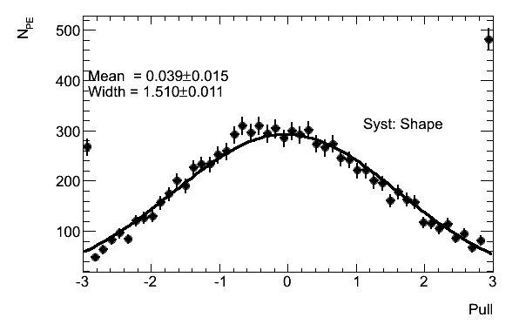
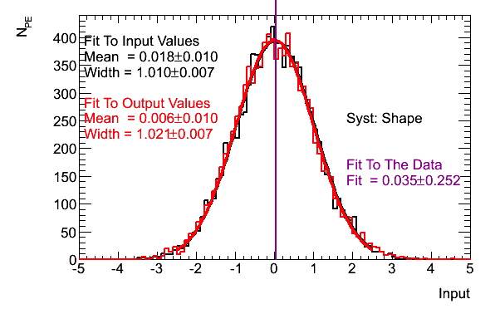
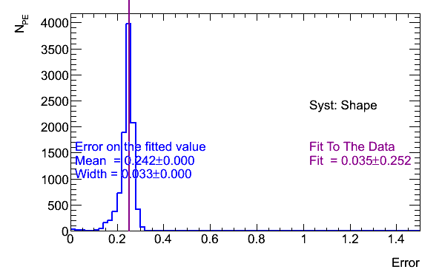
Fitting the shape systematic 2/2
Pull
We have a constraint here
  H₀: Shape: -0.035 ± 0.252σ
Pulls are wide, meaning that the shape systematic is also absorbing the others systematics
Injected/fitted
Fitted error

Slide 36
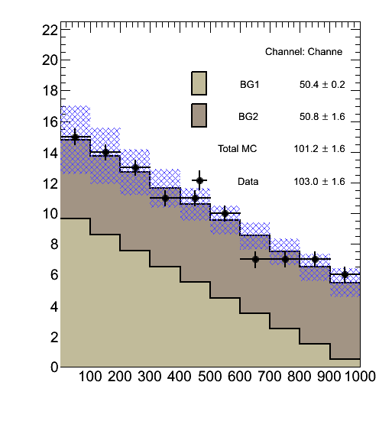
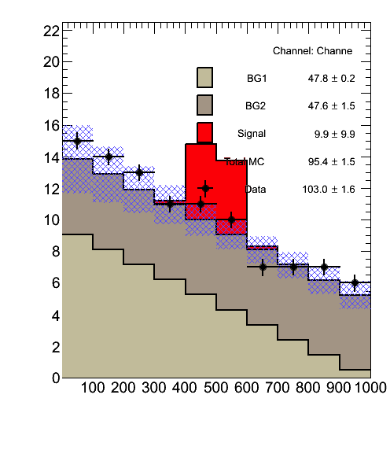
Fitting all systematics 1/5
CL_{s} expected = 0.065 ➔ still not able to exclude, but better results
Reduce the uncertainty
Post Fit considering H₀:
BG1_XS: -0.027 ± 0.81σ
BG2_XS: -0.005 ± 0.81σ
Shape: 0.044 ± 0.38σ
Luminosity: -0.007 ± 0.98σ
Post Fit considering H₁:
BG1_XS: -0.165 ± 0.94σ
BG2_XS: -0.187 ± 0.82σ
Shape: -0.004 ± 0.39σ
Luminosity: -0.213 ± 0.97σ

Slide 37
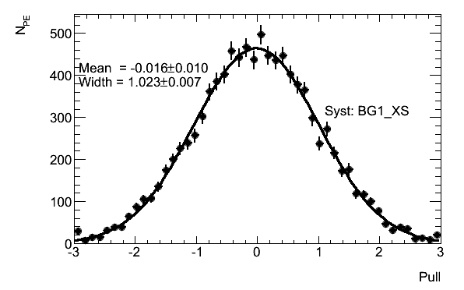
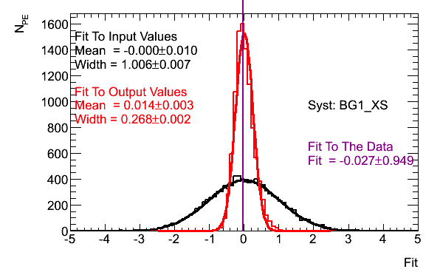
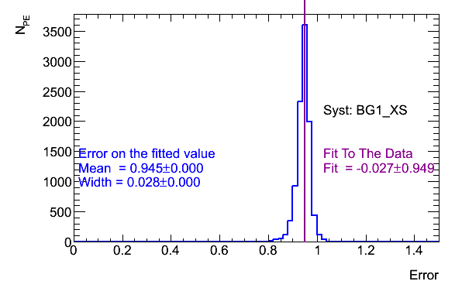
Fitting all systematics BG1_XS 2/5
Pull
No constraining power
H₀: BG1_XS: -0.027 ± 0.81σ
Pulls, error and fitted values look good
Injected/fitted
Fitted error

Slide 38
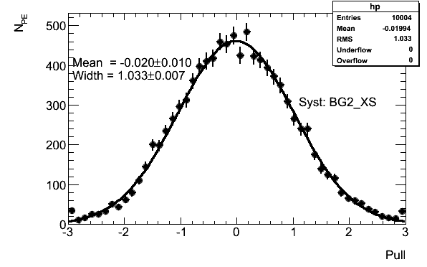
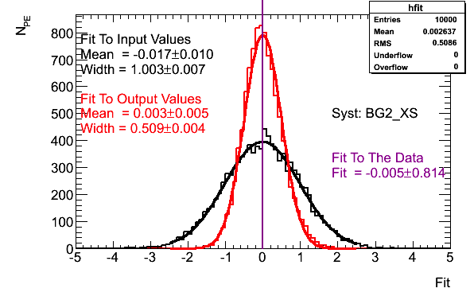
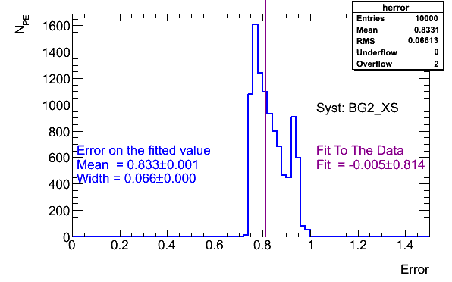
Fitting all systematics BG2_XS 3/5
Pull
No constraining power
H₀: BG2_XS: -0.005 ± 0.81σ
Pulls, errors and fitted values looks good
Injected/fitted
Fitted error

Slide 39
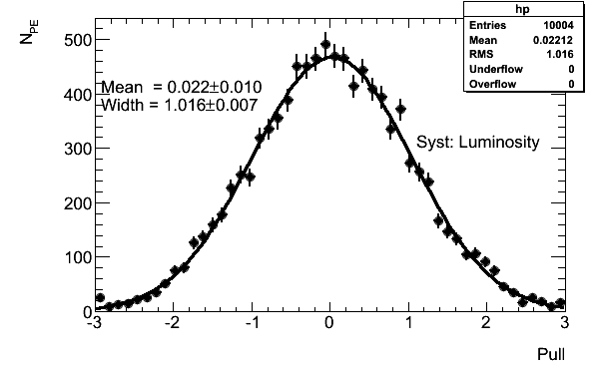
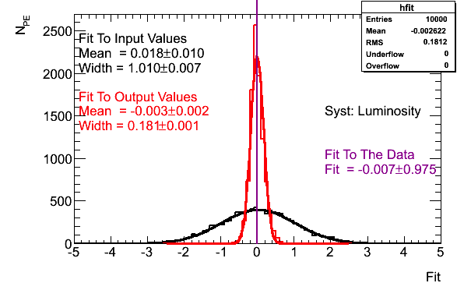
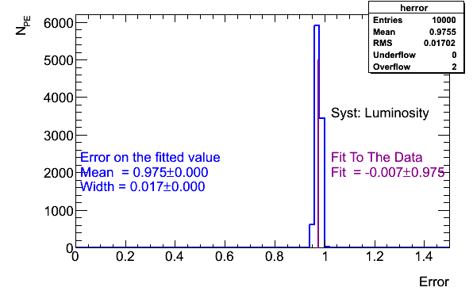
Fitting all systematics Luminosity 4/5
Pull
No constraining power
H₀: Luminosity: -0.007 ± 0.98σ
Pulls, errors and fitted values looks good
Injected/fitted
Fitted error

Slide 40
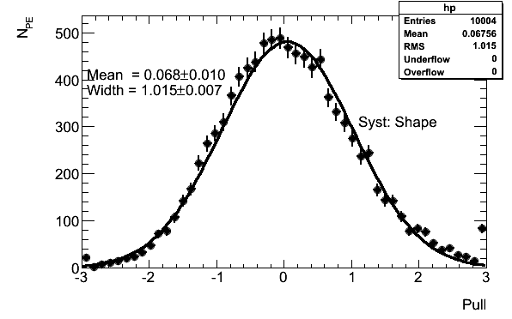
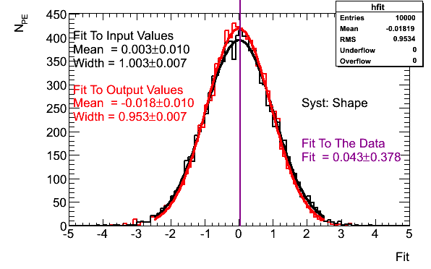
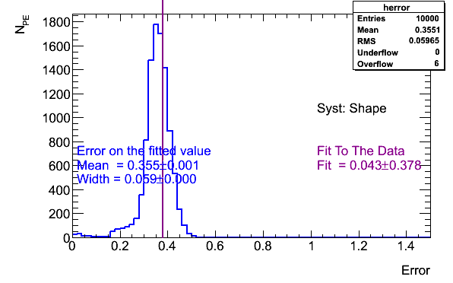
Fitting all systematics Shape 5/5
Pull
There is a constraining power here
H₀: Shape: -0.044 ± 0.38σ
Pulls, errors and fitted values looks good
Shape Systematic is obviously too large!
  Maybe comparing two models in a region of phase space where one one them is obviously wrong…
Fitted error

Slide 41
Constraining the nuisance parameters
One can argue (during internal review for example) that fitting nuisance parameters in data is similar to a measurement
So if for example one fits in data the b-tagging efficiency to be (in units of σ) 0.5 ± 0.2σ
  Does this means we can derive a measurement of the b-tagging efficiency with 0.2σ precision?
  Or maybe like in the Toy Monte-Carlo, the error is over-estimated and that in your signal region (that most of the case does not contain signal) you observe that your data/MC comparisons are within the systematics

Slide 42
Fitting overall parameters
An other solution than profiling could be to fit overall parameters or normalizations factors
Those normalization factors should be seen as correction factors
This can be used for example:
  When you have a dominant background
  When you have enough side-bands to constraint the parameter
  When you have evidence that data/MC in control region is not great and your systematics uncertainties are very large

Slide 43
Fitting overall parameters, example 1/4
Example of Ht+X: ATL-CONF-2013-018
Using HT distribution as discriminant: scalar sum of all the objects p_{T} in the event
“Poor mans way” to discover new physics, and if something unexpected appears in HT tails, either mis-modeling or signal
Can not use HT to identify the type of new particle…
This analysis is suffering from large systematics and obviously what seems to be a mis-modeling of HT

Slide 44
Fitting overall parameters, example 2/4
Obvious incorrectness of the the ttbar heavy/light flavor background, especially in the 6jets 4 tags in the low HT region= control region
This analysis will fit two free parameters ttbar light and HF
  Ttbar HF: 1.35 ± 0.11 (stat) ttbar + light: 0.87 ± 0.02 (stat)

Slide 45
Fitting overall parameters, example 3/4
No evidence of signal, no strong mis-modeling outside of the systematic bands
When un-blinding the analysis have not found any signal
This analysis will fit two free parameters ttbar light and HF
  Ttbar HF: 1.21 ± 0.08 (stat) ttbar + light: 0.88 ± 0.02 (stat)

Slide 46
Fitting overall parameters, example 4/4
No evidence of signal, no strong mis-modeling outside of the systematic bands
When un-blinding the analysis have not found any signal
This analysis will fit two free parameters ttbar light and HF
  Ttbar HF: 1.21 ± 0.08 (stat) ttbar + light: 0.88 ± 0.02 (stat)

Slide 47
Other tips that could help performing a profiled analysis
Merging channels:
  If you are performing an analysis using leptons (for example single lepton analysis) you can merge electron and muon for example, if there is no reason the physics is different between the 2 lepton flavors ➔ this will help to gain statistics in the tails
Merging Backgrounds:
  If you are suffering from low Monte-Carlo statistic for small background and if the shape of those small backgrounds looks similar, why not merging them in a single sample!
Merging systematics:
  It is also possible to merge small systematics that have the basically the same effect. For example, if you have several lepton systematics (like trigger SF, Reco SF, ID SF) then might be better to merge them into a single systematic
Note that when merging channels or background, the systematic treatment should remain consistent

Slide 48
Other tips that could help performing a profiled analysis
You might also want to consider smoothing of histograms
  Be also very cautious here, because if there is no shape to start with, smoothing algorithm might invent a shape…
Keep in mind that profiling nuisance parameter is at the end of the day a fit (using MIMUIT)
  So if you give to MINUIT crapy/shaky templates, it can not do miracles…
  Number of parameters, their variations are the most important thing when doing profiling

Slide 49
Summary
Hope you know everything about profiling now ☺
Profiling should be really seen as an optimization step that helps to recover the degradation due to systematics
Now time for discussion
References:
  Mclimit: http://www-cdf.fnal.gov/~trj/mclimit/production/mclimit.html
  Roostat: https://twiki.cern.ch/twiki/bin/view/RooStats/WebHome
  Wikipedia has a lot of interesting and detailed information about statistics!!

Slide 50
Bonus slides

Slide 51
Toy MC example: Case 4
Set the first bin to:
  Signal: 1
  Background: 100
  S/B = 0.01
  CL_{s} (STAT only)
  = 1.5e⁻⁵
  CL_{s} (STAT+SYST)
  = 3.2e⁻⁵
  CL_{s} (STAT+SYST PROF)
  = 1.6e⁻⁵

Slide 52
Toy MC example: Case 5
Set the first bin to:
  Signal: 100
  Background: 100
  S/B = 1
  CL_{s} (STAT only)
  = 8.0e⁻⁶
  CL_{s} (STAT+SYST)
  = 3.2e⁻⁵
  CL_{s} (STAT+SYST PROF)
  = 1.7e⁻⁵

Slide 53
Toy MC example: Case 6
Set the first bin to:
  Signal: 1
  Background: 1
  S/B = 1
  CL_{s} (STAT only)
  = 1.3e⁻⁵
  CL_{s} (STAT+SYST)
  = 2.4e⁻⁵
  CL_{s} (STAT+SYST PROF)
  = 2.3e⁻⁵

Slide 54
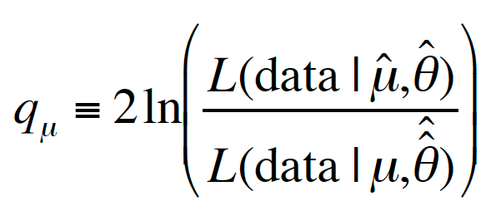
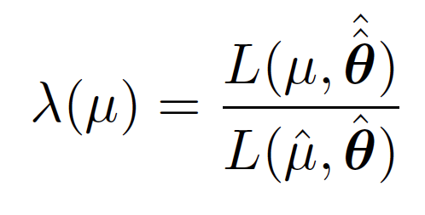
An other Likelihood ratio 1/4
One being used in RooStat (hep-ex/1007.1727) and at the LHC
Here the fitting is not an optimization, it is useful for the correctness of the model
µ is the best fit value of the signal rate
Should distinguish between µ=0 (zero signal, SM, Null hypothesis, H₀) and µ >0 (test hypothesis, H₁)
^
Maximize L for specified µ
Maximize L, fit is done on Data

Slide 55
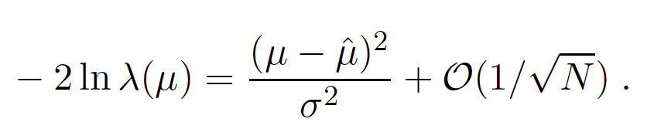
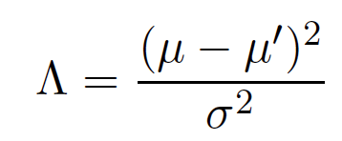
An other Likelihood ratio 2/4
Wald approximation for profile LLR (1943)
Non central chi-square for -2lnλ(µ) (Wilks’s theorem):
Sample size

Slide 56
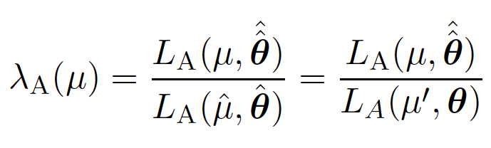
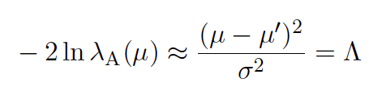
An other Likelihood ratio 3/4
Asimov dataset: to estimate the median value of -2lnλ(µ), consider a special dataset where all the statistical fluctuations are suppressed
Assimov value of -2lnλ(µ) gives the non-centrality paramter

Slide 57
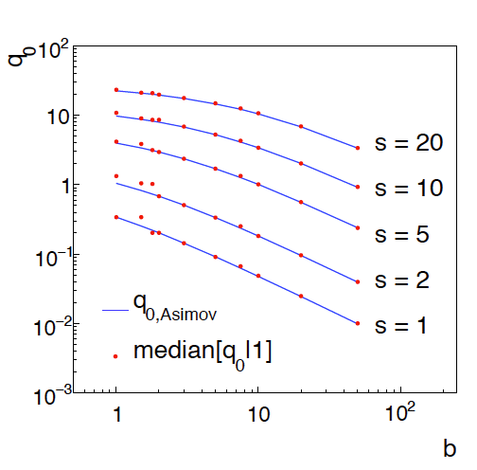
An other Likelihood ratio 4/4
At the end of the day we have an asymptotic formulae
  Much faster than running toy-MC
  Very good approximation in most of the cases
Poisson discreteness can make it break down

