Slide 1
Roberto Chierici CNRS/IPNL
ATLAS and CMS
in top physics
Combination of measurements,
systematic errors and all that
21st March 2013

Slide 2
Summary
ATLAS vs CMS in top physics
The importance of talking to each other
The TOPLHCWG
Comparison of main measurements for combination
Status of current combinations
Treatment of systematic errors
Main differences and dominating systematic errors
The saga of theory errors
Discussion…
This is not a review, rather a collection of facts+ideas+(personal) comments on the comparison of ATLAS and CMS in the way errors on top physics results are estimated. These slides are there mostly for driving the discussion…

Slide 3
TOPLHCWG: a reminder
Born for combining precision measurements in top physics at the LHC
To have this a success, it is important that ATLAS and CMS keep the level of communication very high, and stay in close contact with the TH community (we learn a lot from each other)
The natural forum for top measurements is the TOPLHCWG: cross experiment group to prepare/discuss/perform LHC combination s on top physics
Define guidelines, observables
Agree on method for performing the combination, and the way results are presented
Document the work in correspondence of major updates and conferences
Natural forum at the LHC for discussing ideas/issues on top physics
Natural bridge to the theory community and the TeVEWWG for world averages
First combinations we agreed to perform…
Top pair and single top t-channel cross sections, top mass, W helicities in top-pair
…and topics for discussion and common agreements
Cross-experiment efforts on JetMET, radiation and b-tag systematics
Common definition of particle level quantities (leptons/jets/acceptances/top quarks!)
The group is very active by now
A few preparatory closed meetings, at least two open sessions per year (Next one 18-19 April !)
Open mailing list: lhc-toplhcwg@cern.ch, well integrated in the LPCC CERN structure

Slide 4
Representatives
Coordinators
ATLAS(M. Cristinziani)+CMS(R.C.)+TH(M. Mangano)+LHCb(later)
Physics group conveners
ATLAS(M. Costa, T. Carli)+CMS(R. Tenchini, M. Mulders)
Domain experts for each combination
Top mass (G. Cortiana(ATLAS), S. Wimpenny (CMS))
Top-pair cross-section (E.Shabalina(ATLAS), M. Aldaya (CMS))
Single top (J. Donini(ATLAS), L. Lista(CMS))
W helicities (K. Kroeninger(ATLAS), M. Soares(CMS))
Interlocutors from the various Monte Carlo tools
Omni purpose generators (P. Skands, B. Webber)
NLO tools (P. Nason, S. Frixione)
Matched tools (M. Mangano, F. Maltoni, J. Winter)
Key persons are invited in relevant (closed) meetings
Examples: generator conveners, TeVEWWG members, JetMET or b-tag experts,…
Experiments
Theory
Guests

Slide 5
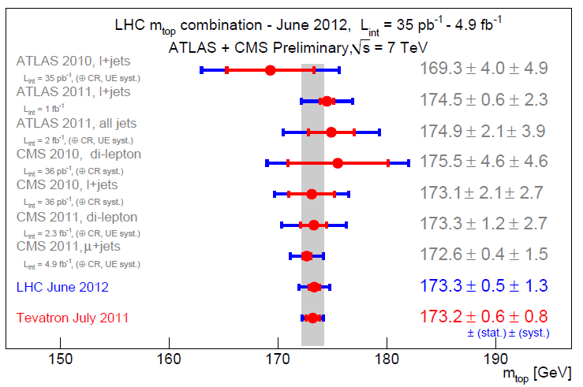
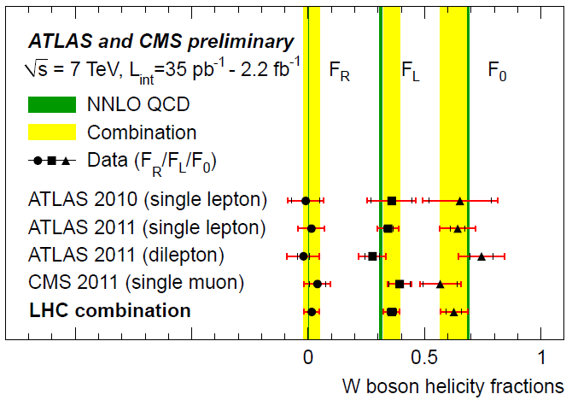
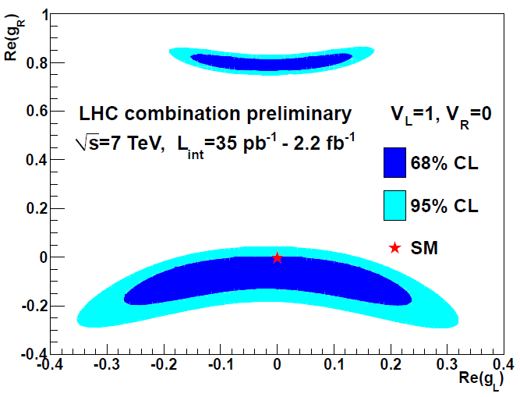
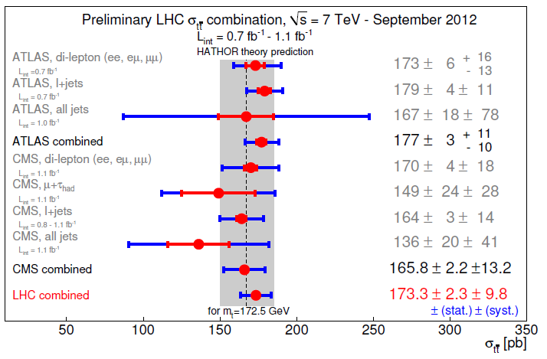
Some highlights
Top mass
NEW !
tt cross section
W helicities, |V|_{tb}
Single top t-channel in the works….
Other quantities under discussion and study
(differential distributions, spin correlation, tt+V, Wt channel, helicities in single top,….)

Slide 6
Treatment of systematic errors
Largely dominating our precision measurements in top physics
Understanding how they are determined is a key point for the comparison of our measurements/techniques/sensitivities
Typical grouping of systematic errors
Experimental
Correctness of detector (+trigger) simulation
Luminosity
Theory/modelling
Modelling of signals and background
In the following slides I will review some key discussion points
Most important systematic errors are (generally) from TH and JES
Focus on TH systematic errors, where approaches ATLAS/CMS mostly differ
See talk later on for Jet/MET
Discuss what is made in a different way in CMS and ATLAS
Add some personal (sometimes provocative) thoughts about our current conventions

Slide 7
Systematic errors: general comments
Not only the recipes to assess a systematic error are different in ATLAS and CMS, but likely the perception of what a systematic error is, is also different
“…Systematic errors are biases in a measurement which lead to the situation where the mean of the result differs from the actual value of the measured attribute…”
Known systematic errors can be corrected for. We discuss about unknown systematic errors.
An unknown systematic error needs to be (conservatively) estimated. First step being to identify the potential sources of systematic errors
The previous step implies judgment and some level of arbitrariness. A finite estimation of an impossible systematic source should not be quoted.
More specifically what happens in HEP:
Systematic errors are driven by imperfect knowledge of the detector/accelerator (EXP systematic), or the modelling of the underlying physics (TH systematic). Both enter the measurement because of the heavy use of MC simulations.
Identifying the (independent, to avoid double counting) sources is a key job. Examples:
The approximate knowledge of the response of a calorimeter is a systematic source
The imperfect description of the proton density functions is a systematic source
The imperfect description of radiation in top-pair events is a systematic source
Using a method rather than another to do something (jet algorithms, fitting functions) is NOT a systematic source, provided the same thing is done in MC and data
A method may be more or less sensitive to a certain systematic source, but it is not a source by itself

Slide 8
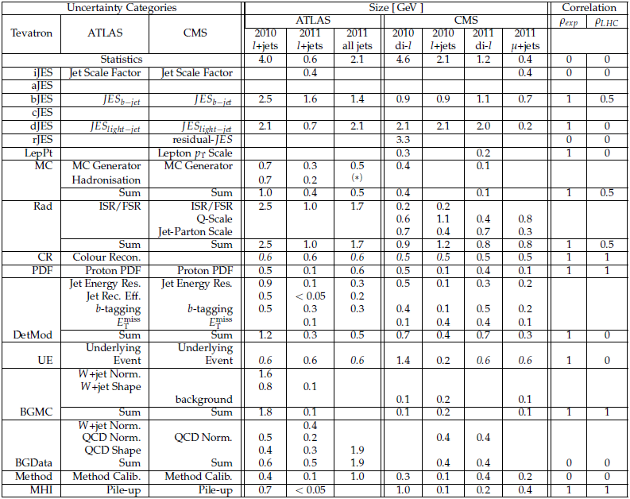
Top mass: systematic errors
JES uncert.s:
use the same
classification
Tevatron used
TH uncert.s
Method specific differences are acceptable

Slide 9
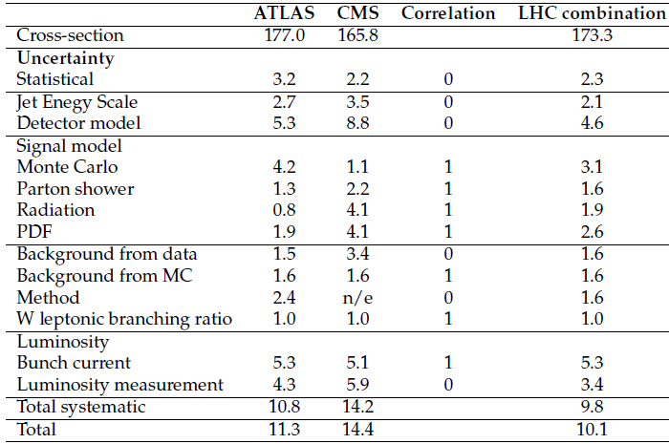
Another example: tt cross section
As for the top mass, it is difficult to match the TH errors in ATLAS and CMS
Also the pattern is not the same as for the top mass
Make assumptions for the correlations of the systematic for the combination
In high correlation regimes assuming ρ=100% is not necessarily conservative !
In those cases make a study as a function of the correlation itself
Apparently different grouping of the systematic errors?

Slide 10
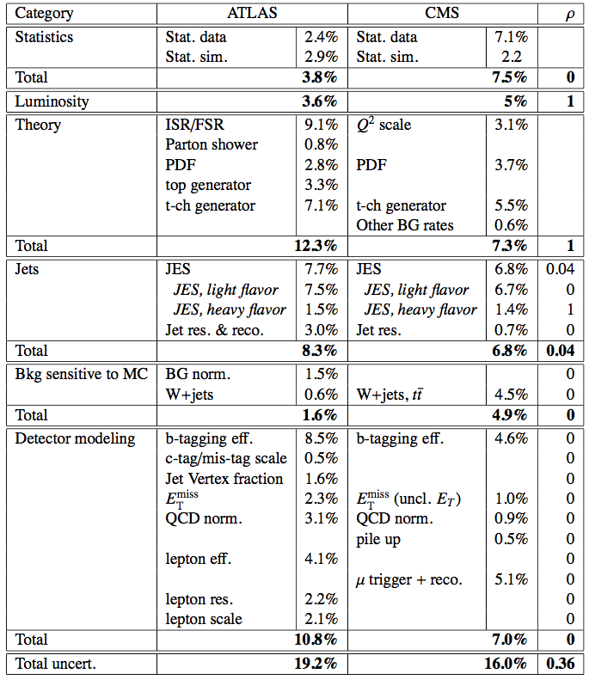
Most spectacularly: single top cross section
Combine only t-channel
This table has effectively stopped the LHC combination !
Analyses are apparently very different in method and sensitivity to systematic errors
Still differences too large (especially TH errors)
Need more accurate insight
Data driven

Slide 11
TH systematic errors
The choice of a generation setup is the main source of the TH error, now becoming dominant in our measurements
The splitting of our TH systematic sources is arbitrary, and done for simplicity
PDFs(*)
Process description + dependence on scales
Parametric dependence on SM parameters
Proton/antiproton remnants(*)
Multiple parton interactions(*)
Initial or final state radiation
Hadronization(*)
Given a setup(**), we need to estimate our systematic error for each of the sources
Proton
PDFs
UE, MPI
Process
MEs
UE
Jets
PS
fragmentation
(*) fit or tuned to data
(**) example: CTEQ6L+ALPGEN+PYTHIA6.4(TUNEZ2+LUND+BOWLER)+TAUOLA
PDF tuning ↔ UE tuning ↔ radiation tuning ↔ fragmentation tuning

Slide 12
Generator setup
See talk by Liza for all details
Choice is to use either ME-PS matched generators or NLO generators for the signal description, and ME-PS matched for the backgrounds (especially W/Z+jets)
Whatever the choice, it is always needed to compare different predictions, at least for the signal (one “reference” and one “crosscheck”)
tt references: MadGraph+PYTHIA (CMS), MC@NLO+HERWIG (ATLAS)
tt crosschecks: POWHEG+PYTHIA, MC@NLO+HERWIG (CMS), POWHEG+HERWIG, ALPGEN+HERWIG, AcerMC+PYTHIA (ATLAS)
Single top references: POWHEG+PYTHIA (CMS), MC@NLO+HERWIG( ATLAS)
Single top crosschecks: CompHep+PYTHIA (CMS), AcerMC+PYTHIA (ATLAS)
W/Z+jets: MadGraph+PYTHIA (CMS), ALPGEN+HERWIG (ATLAS)
PS and UE/MB tunings also differ, and attached to different ME predictions
Need of recipes to assess systematic errors which may be setup dependent

Slide 13
Current choices to define the TH systematic
ATLAS
Generator: MC@NLO vs POWHEG (vs ALPGEN)
Radiation: ACERMC (LO)+Pythia with radiation parameters to model higher or lower radiation
Hadronization (wrongly called “shower model”): POWHEG+Pythia vs POWHEG+Herwig
PDFs: envelop in a given configuration or PDF4LHC
CR: compare reconnection models in PYTHIA
UE: compare different tunes
CMS
Generator: do not (necessarily) quote an extra uncertainty. Use MadGraph vs MC@NLO or POWHEG or ALPGEN for crosscheck
Radiation: change consistently the Q² scale (μ_{R} and μ_{F}) by a factor 2 in the ME and in the PS emission
Matching for ME-PS matching: change the matching threshold
Hadronization: Pythia vs Herwig, but only in the JES errors
PDFs: envelop in a given configuration or PDF4LHC
CR: compare reconnection models in PYTHIA
UE: compare different tunes

Slide 14
Harmonization of TH signal uncertainties
Agreement so far about categories in the TOPLHCWG, but we are not in sync yet
Generator modelling: comparison of central predictions from generators. Differences coming from the use of different (tuned) PS models can also end up in this category whenever it is clear this is not already covered by the systematic error on the description of radiation. Other sources not ending in one of the following categories may end up here.
Radiation description: Q² and I/FSR independent variations (to be agreed for NLO generators) or Q²+PS consistent variations (for matched generators). With Q² we indicate both renormalization and factorization scales, which are therefore changed in a correlated way. The suggested conservative variations correspond to a factor 0.25 and 4 (1/2 and 2 on Q) or constraints on the variations from the data when available.
Matching between ME and PS change matching thresholds, applicable only for matched generators. Thresholds should be "sufficiently" away from zero and "much smaller" than the process scale. The extreme of the variation range should be such that the good properties of the matching still hold (differential jet rates, and other differential cross sections, continuous with continuous derivatives after the matching)
Underlying Event: different UE tunings.
Colour Reconnection: compare tunes with/without a CR model.
Hadronization: compare different hadronization models (included in JES for CMS)
PDFs: proper eigenvalues envelop to be propagated to the error. We advice to use the full LHC4PDF prescription only for those analyses demonstrated to be very sensitive to the description of the PDFs. It is recommended to use NLO PDF with NLO generators.
Top mass: vary the top mass in the generation and quote as an error the propagation of the world average uncertainty on the top mass. Any observable strongly dependent on the top mass (e.g. the total cross sections) should be quoted at the world average value

Slide 15
TH systematic errors: personal (top-CMS) comments
Systematic due to a generator
A TH/modelling systematic error should be associated to the choice of a generator (setup) and be determined in within the same generator (setup) -as theorists do: change scales, PDFs, etc-
Another generator with consistent physics content (but not identical ! E.g. NLO vs matched ME-PS) must be used and verify that the central value of the new result lies in the error envelop of the reference generator:
If this is the case…
it is questionable whether the difference of central values should be added as an extra systematic error!
this would be very conservative and double counting, one should then quote the envelop of all existing generators…
…if this is not the case
either the systematic errors on the reference generator is wrongly determined
or one of the two choices can actually be ruled out with data
if all fails, consider quoting two measurements instead !
Double counting in TH errors
This is ubiquitous! We should try to minimize what is obvious double counting
Differences from different generators can hide scale/matching effects, already included in other errors
Fragmentation and to some extent PS errors are already included in the JES (btag?) uncertainties
LO tunings of radiation likely include effects that would be absent at higher orders
We should use data as much as we can and learn from them !

Slide 16
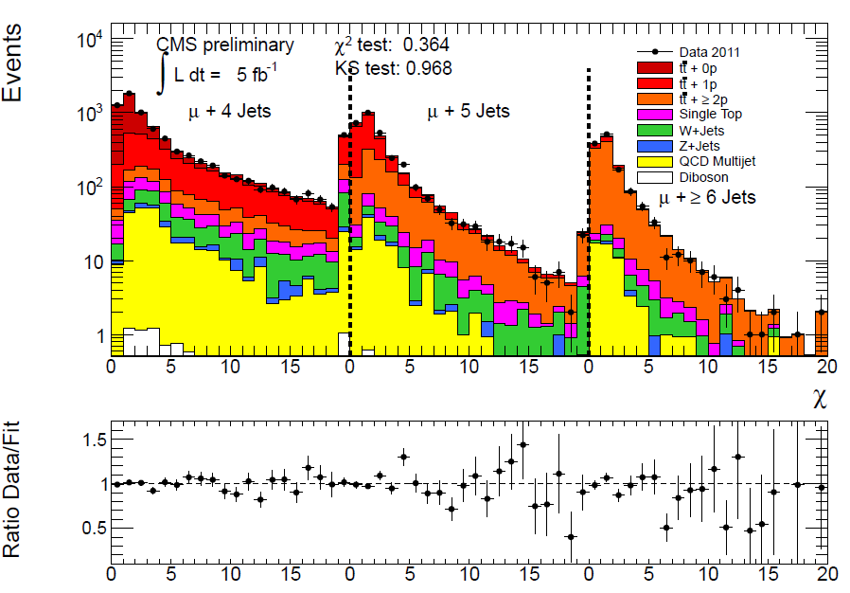
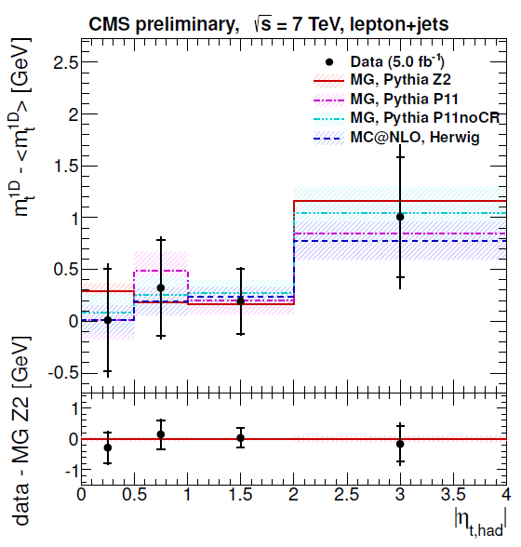
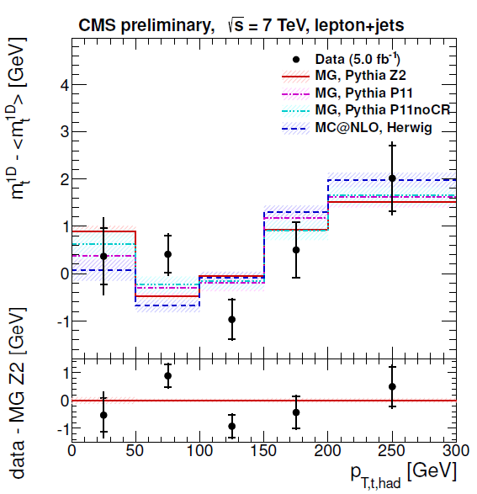
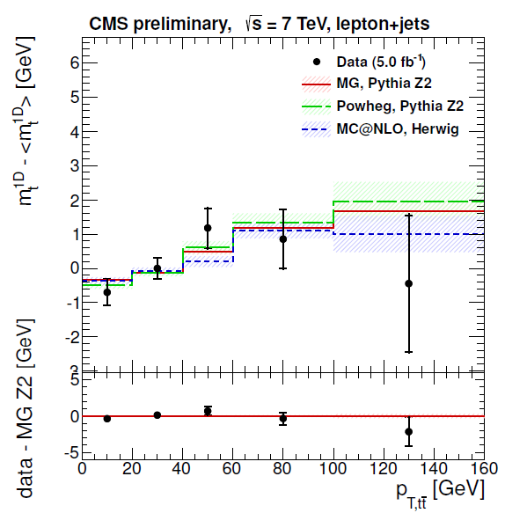
Constraining TH systematic errors with data
ATLAS and CMS will ultimately constrain the TH systematic sources by using data
Radiation
Jet multiplicites, gap fractions (see next slide)
Expand measurements as a function of pt(tt)
Hadronization
Jet shapes?
Colour Reconnection
Top mass as a function of kinematics (pt(top), pt(jet))
Essential to agree on methods to do so
We can compare on an equal footing our sensitivities to systematic s
We can easily assess our correlations for combining our measurements

Slide 17
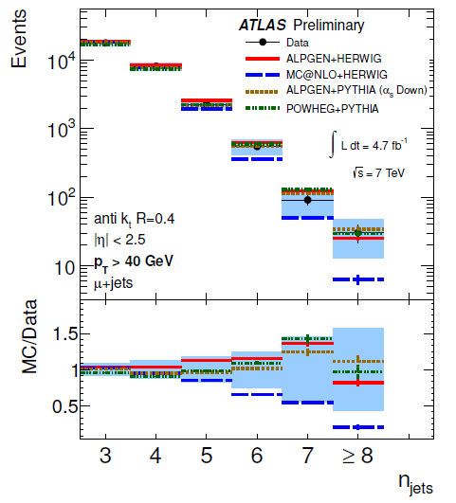
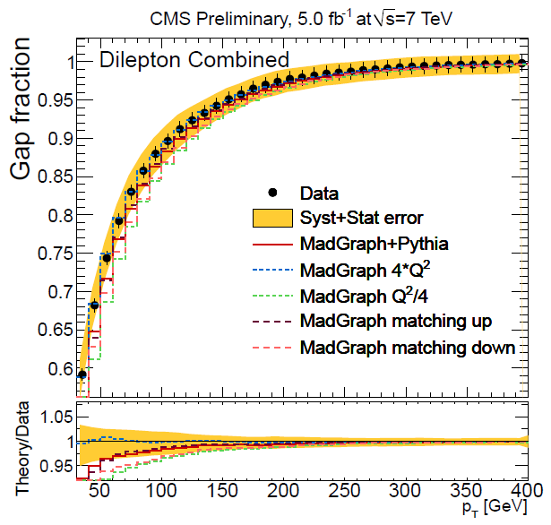
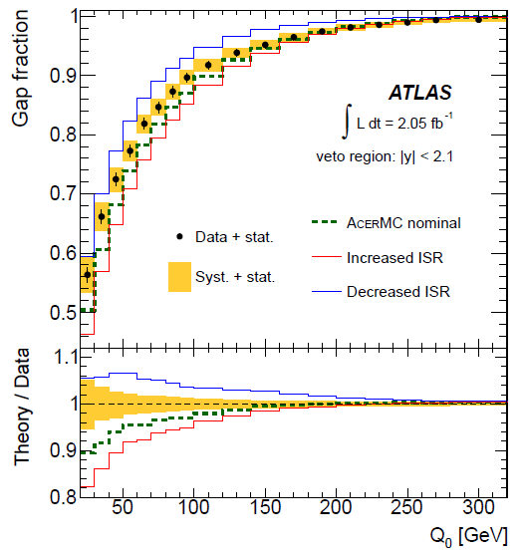
Are systematic errors on radiation conservative?
Explicit test the extra jet production in tt events
Inclusive jet multiplicities, extra jet p_{T}s, ηs,…
Gap fractions:
Compare ATLAS and CMS on equal footing
Constrain parameters of QCD radiation models
I/FSR, scales, ME-PS matching scales…
Reduce the impact of systematic errors
Events without extra jets with transverse momentum > p_{T}
l+jets
ATLAS-CONF-2012-155
CMS-PAS-TOP-12-023
di-leptons

Slide 18
Next steps (from the TOPLHCWG)
General agreements and discussions on measurements
Define common acceptances for fiducial cross sections
Agree on the definition of particle level objects
Agree on splitting of systematic errors, also in view of combinations with the Tevatron
Next questions to be attacked on experimental systematic errors…
Make the splitting of JES uncertainties more standard
Investigate the treatment of the correlated part of the b-tagging uncertainties
…and theory systematic errors
Use data to conclude the constraining of radiation systematic errors
Use data for constraining colour reconnection effects
Factorize out hadronization effects from the JES uncertainties
Agree on the treatment of generator systematic (and final breakdown of TH sources)
Extend the scope of the TOPLHCWG
New combinations in the pipeline
Differential cross sections, Wt, tt+V, W helicity in single top, spin correlations,…

Slide 19
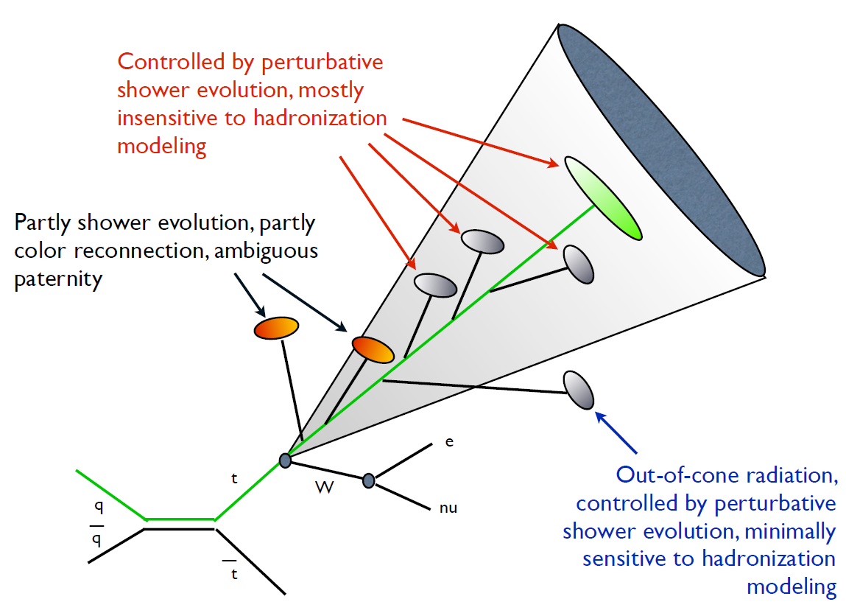
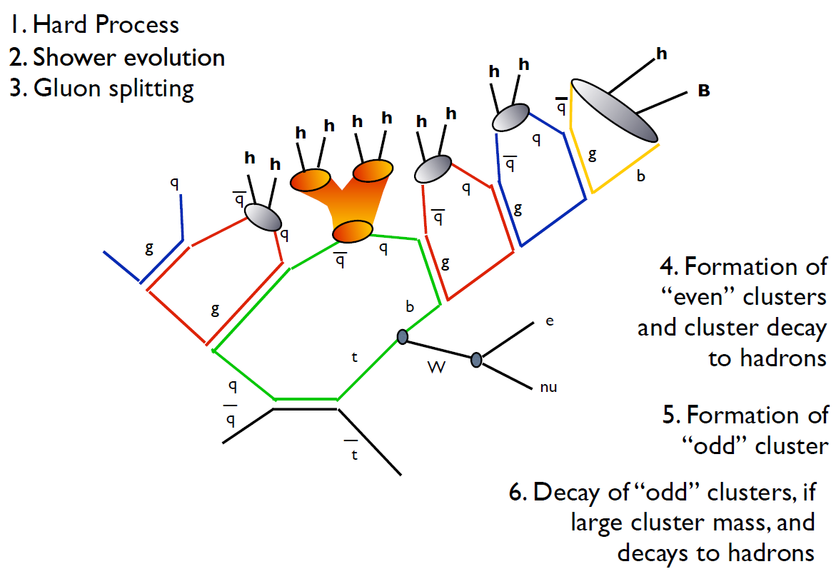
Colour reconnection and the top mass
The root of the problem comes from the fact that the top does not form bound states, and it decays before hadronizing
Need to define a top mass as the Wb mass
The experimental mass does not equal anymore the pole mass
The impact of these
“odd” clusters amounts
to correction of O(GeV)
(Correlated in ATLAS/CMS
/Tevatron)
Constrain with data by
expanding the experimental
mass on kinematic variables

Slide 20
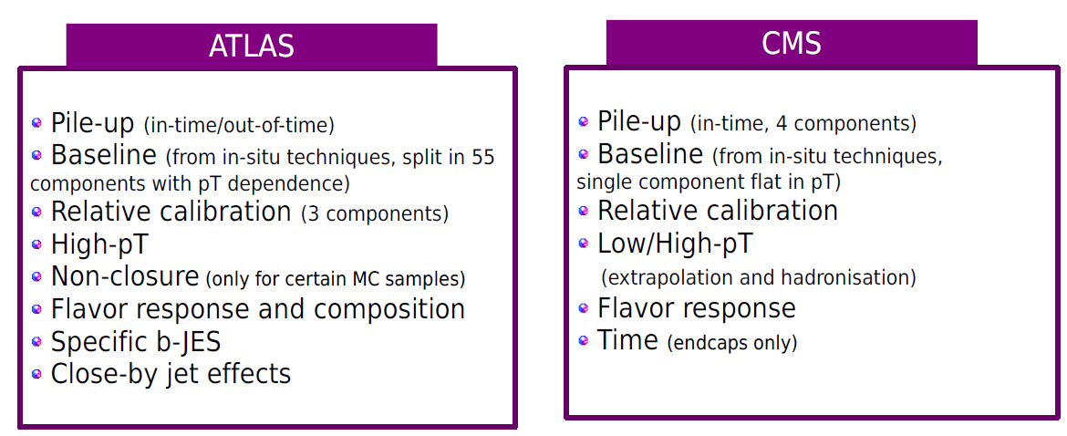
JetMET

