Slide 1
First Results from the CALICE Digital Hadron Calorimetry (DHCAL)
José Repond
Argonne National Laboratory
Calorimetry for the High Energy Frontier CHEF 2013
April 22 - 25, 2013
Paris, France

Slide 2
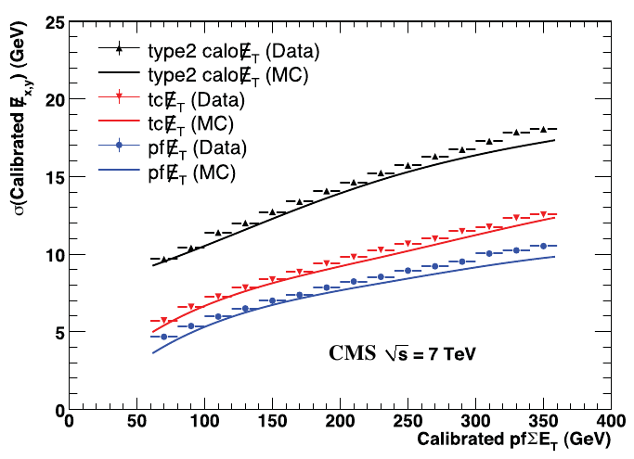
Introduction: PFAs, Calorimetry
K_{L}
HCAL
ECAL
Particle Flow Algorithms (PFAs)
Applied to reconstruct jet energies
Optimal combination of information from all sub-detectors
Measurement of particles individually
Standard tool in CMS ( ← detector not optimized for PFAs)
Future lepton collider (→ detectors to be optimized for PFAs)
Major challenge: classification of calorimeter deposits (charged vs. neutral)
PFA requirements on calorimeters
Largest possible inner radius
Finest possible segmentation
Operation within magnetic field
For CLIC: ns-timing resolution (to reject 2-γ backgrounds)
π⁺
γ

Slide 3
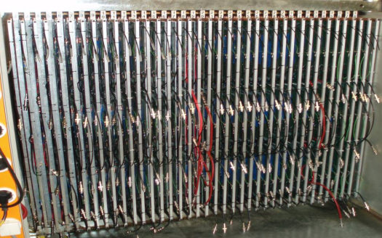
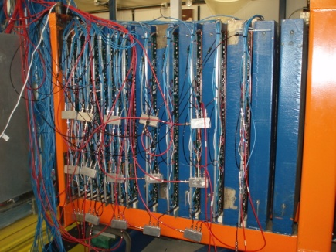
The Digital Hadron Calorimeter (DHCAL)
Active element
Thin Resistive Plate Chambers (RPCs)
Glass as resistive plates
Single 1.15 mm thick gas gap
Readout
1 x 1 cm² pads
1-bit per pad/channel → digital readout
100-ns level time-stamping
Calorimeter
54 active layers
1 x 1 m² planes with each 9,216 readout channels
3 RPCs (32 x 96 cm²) per plane
Absorber
Either Steel or Tungsten

Slide 4
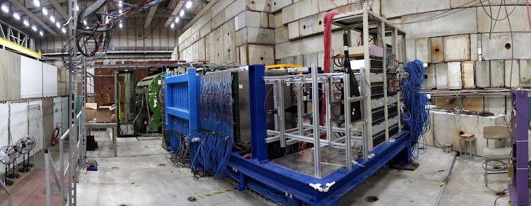
Testing in Beams
Fermilab MT6
October 2010 – November 2011
1 – 120 GeV
Steel absorber (CALICE structure)
CERN PS
May 2012
1 – 10 GeV/c
Tungsten absorber
(structure provided by CERN)
CERN SPS
June - November 2012
10 – 180 GeV/c
Tungsten absorber
RPCs flown to Geneva
All survived transportation
Received financial support from CERN
A unique data sample
Test Beam | Muon events | Secondary beam
Fermilab | 9.4 M | 14.3 M
CERN | 10.0M | 28.8 M
TOTAL | 19.4 M | 43.1 M

Slide 5
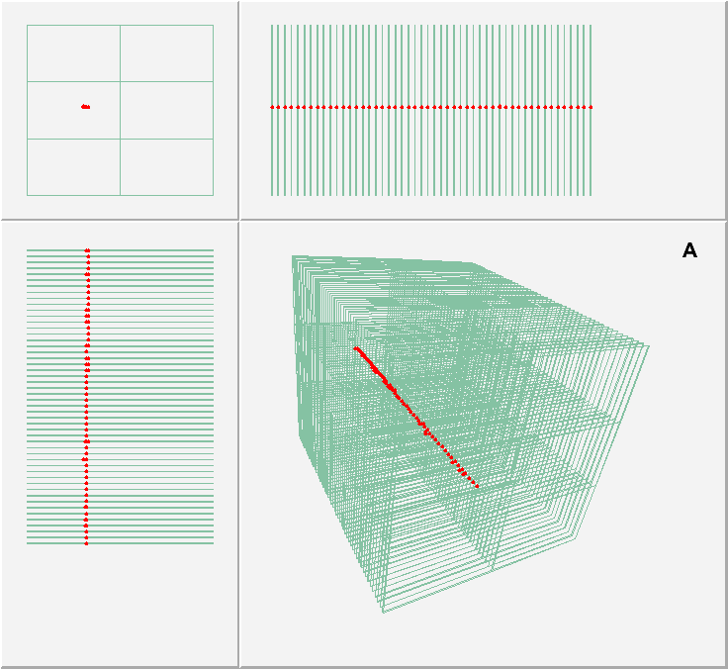
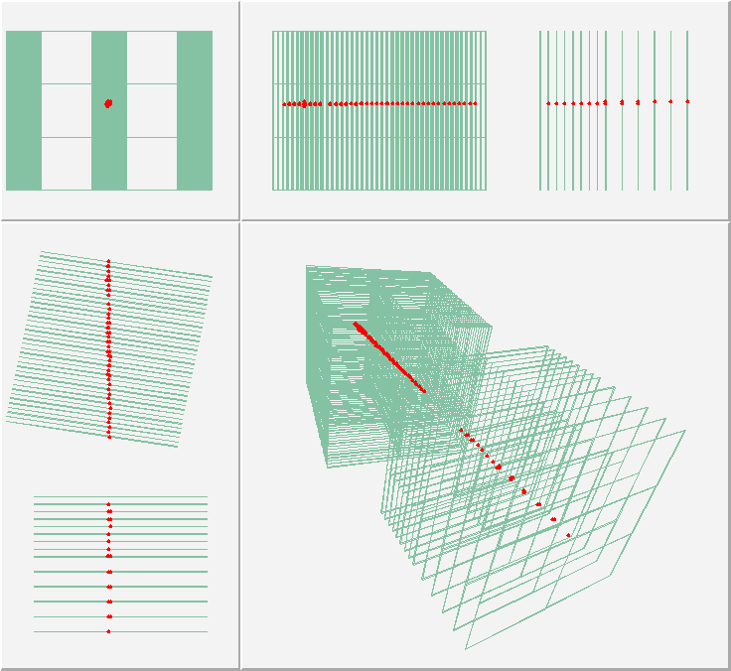
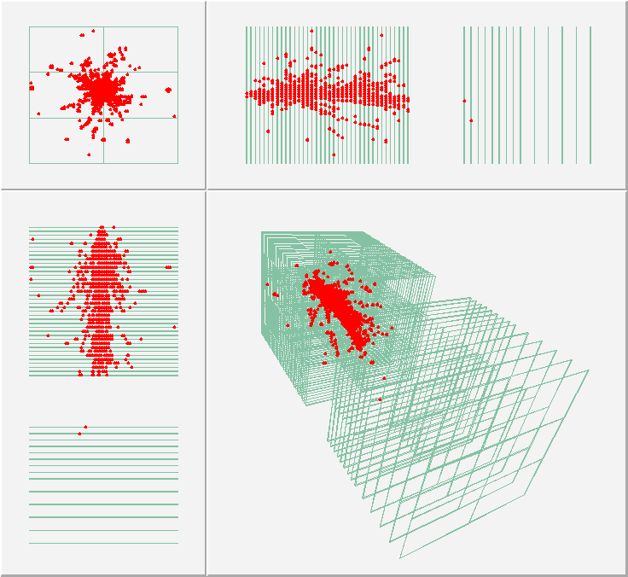
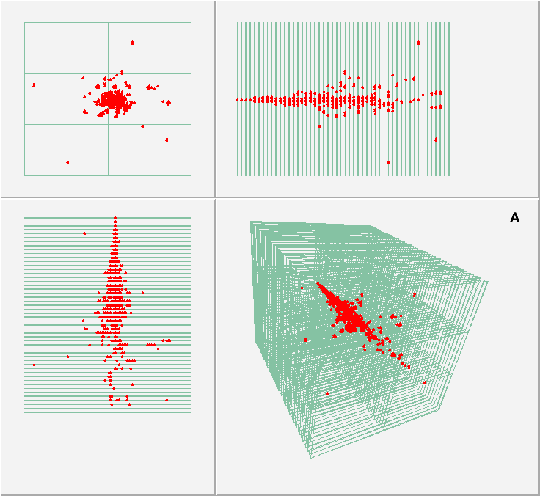
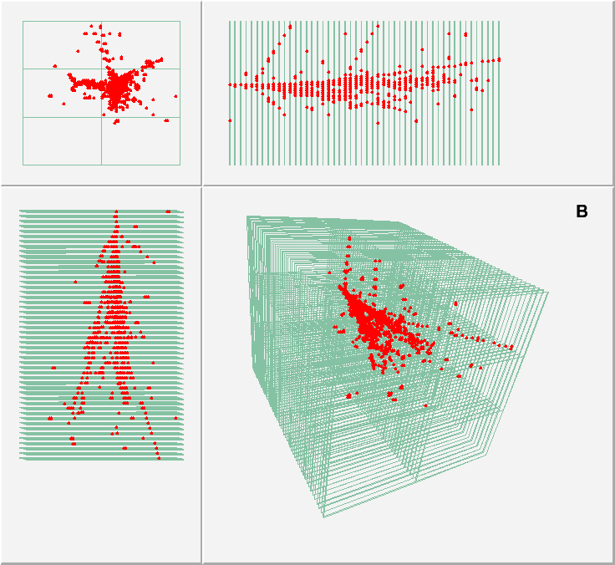
First R&W Digital Photos of Hadronic Showers
μ
120 GeV p
μ
Note: absence of
isolated noise hits
Configuration with minimal absorber
8 GeV e⁺
16 GeV π⁺

Slide 6
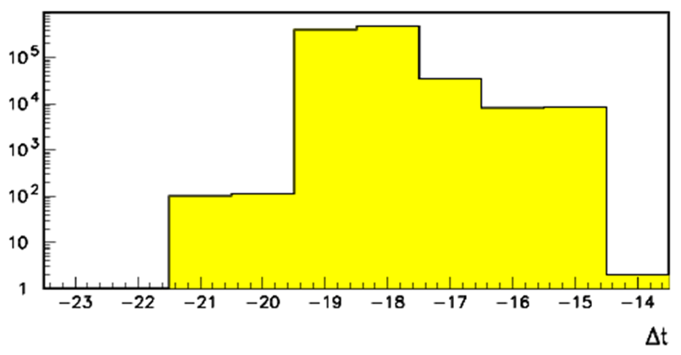
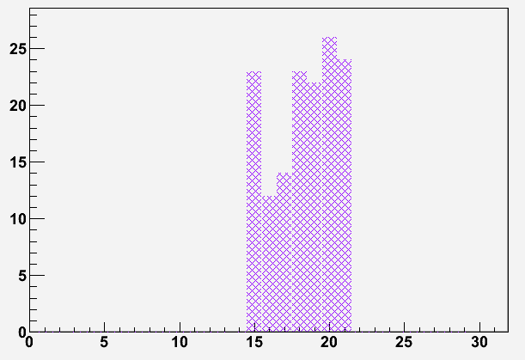
Noise studies
Several data sets
Random trigger runs
Trigger-less runs (all hits recorded)
Triggered data (first 2/7 time bins)
Average noise rate
Depends on temperature and ambient pressure
Impact on analyses/measurements
Noise rate negligible for linearity/resolution
Possible effect on shower shape measurements
→ Requires detailed studies
Time →
N_{noise} = 0.01 ÷ 0.1 hits/event in the entire DHCAL
15 hits correspond to 1 GeV
Time distribution of
hits far from shower axis

Slide 7
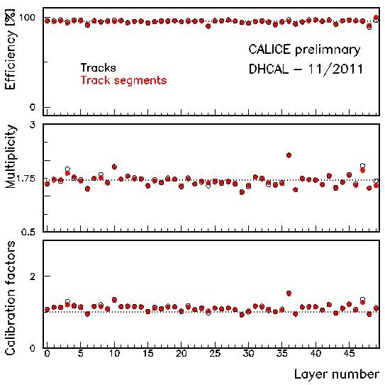
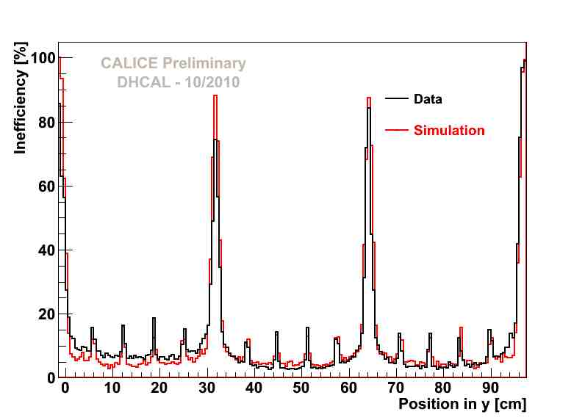
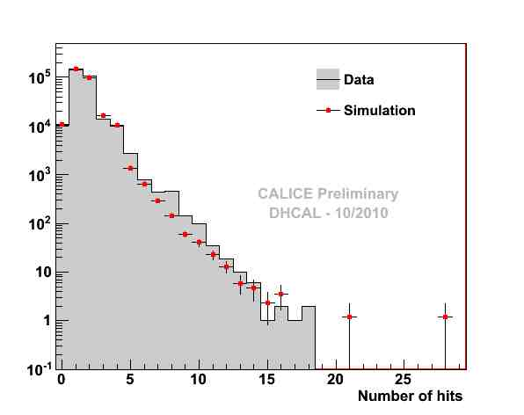
Measurements with Muons
Performance of the chambers
Established through measurement of response to muons
Simulation
RPC response tuned to reproduce signal from muons

Slide 8
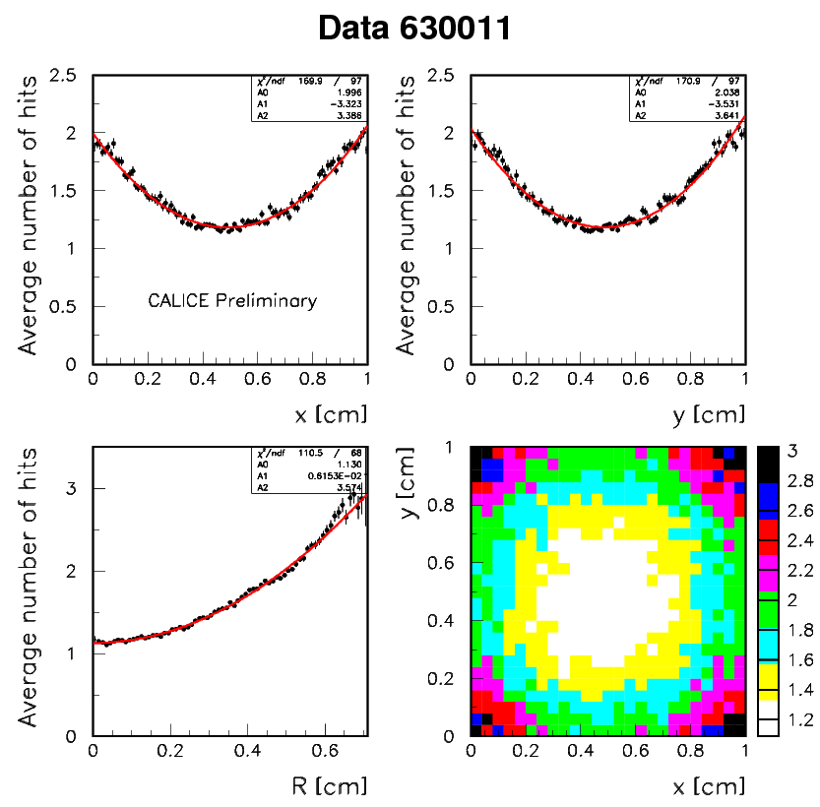
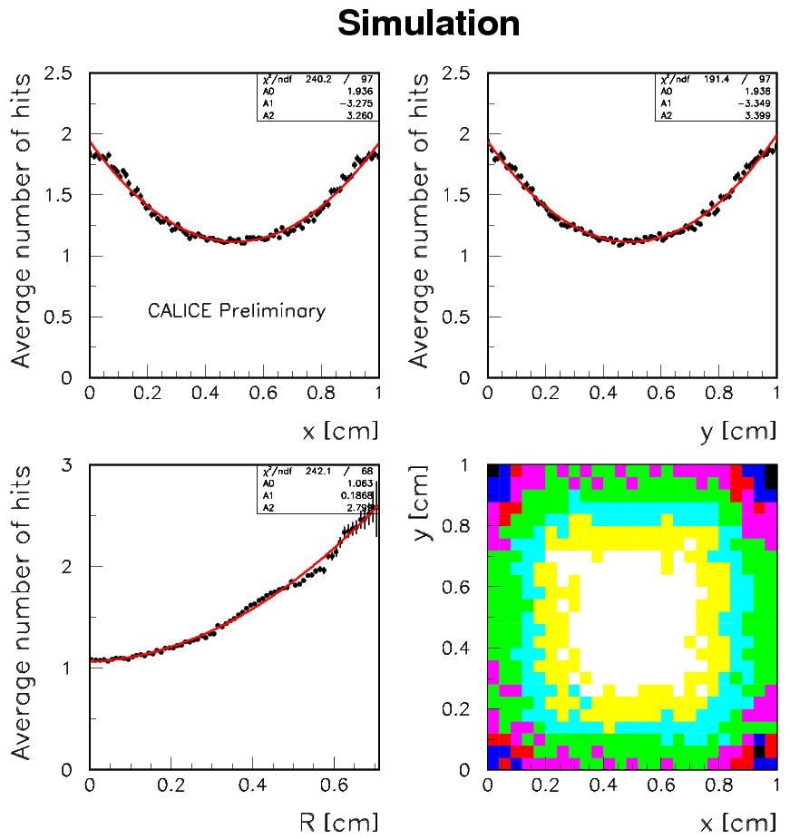
Scan across a single 1× 1 cm² pad
x = Mod(x_{track},1.0) for 0.25 < y < 0.75
y = Mod(y_{track},1.0) for 0.25 < x < 0.75
Note: these features not explicitly implemented into simulation. Result of properly distributing charge over surface of readout pads

Slide 9
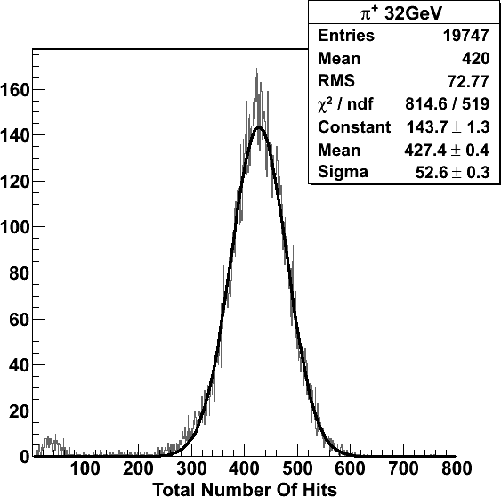
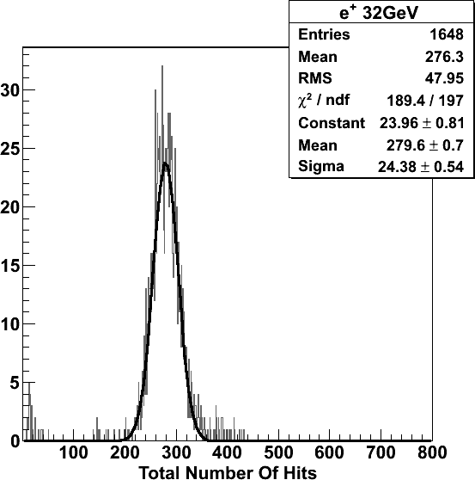
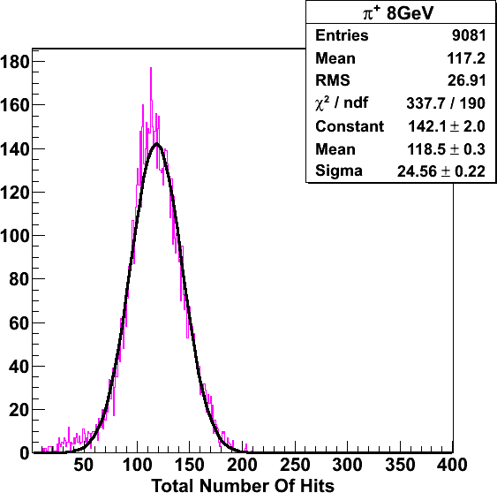
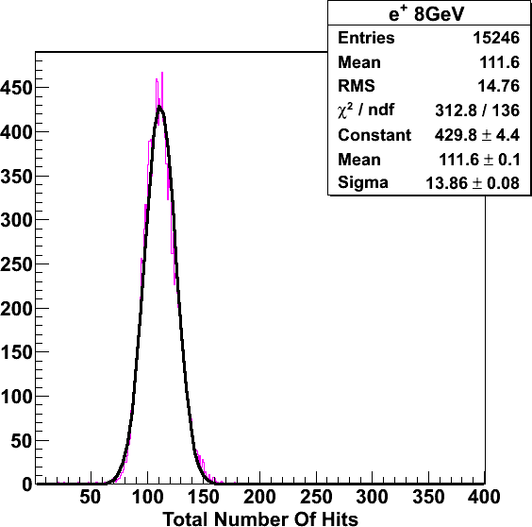
FNAL Fe-DHCAL – Secondary Beam
CALICE Preliminary
CALICE Preliminary
Unidentified μ's, punch through
Gaussian fits over the full response curve
CALICE Preliminary
CALICE Preliminary

Slide 10
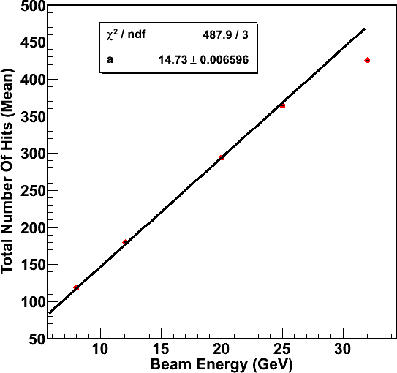
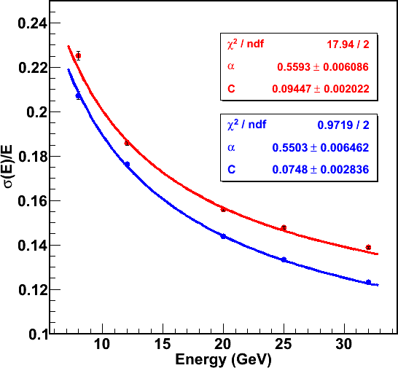
Fe-DHCAL - Pion Selection
CALICE Preliminary
(response not calibrated)
N=aE
16 (off), 32 GeV/c (effects of saturation expected)
data points are not included in the fit.
Standard pion selection
+ No hits in last two layers
(longitudinal containment

Slide 11
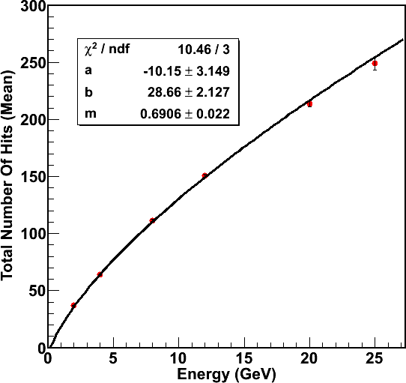
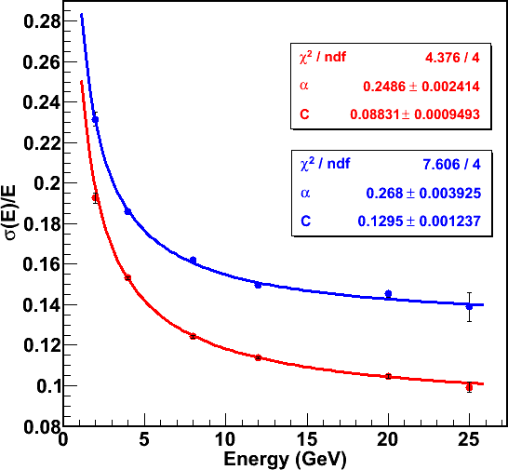
Fe-DHCAL – Positron Selection
CALICE Preliminary
(response not yet calibrated)
N=a+bE^{m}
Correction for non-linearity
Needed to establish resolution
Correction on an event-by-event basis
Uncorrected for non-linearity
Corrected for non-linearity

Slide 12
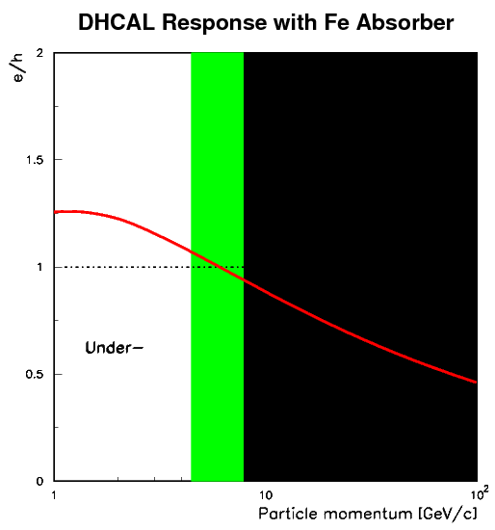
Fe-DHCAL – Response
The DHCAL is different…
Higher order corrections
(Software compensation) might
increase the range of compensation
Over-
Compensation

Slide 13
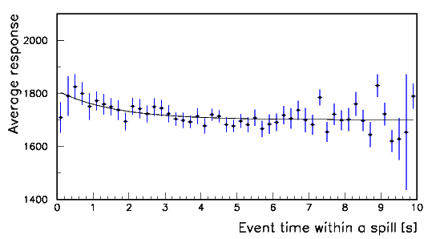
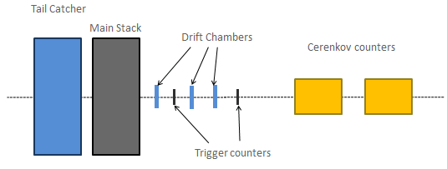
W-DHCAL at CERN
PS
Covers 1 – 10 GeV/c
Mixture of pions, electrons, protons, (Kaons)
Two Cerenkov counters for particle ID
1-3 400-ms-spills every 45 second (RPC rate capability OK)
Data taking with ~500 triggers/spill
SPS
Covers 12 – 300 GeV/c
Mostly set-up to either have electrons or pions (18 Pb foil)
Two Cerenkov counters for particle ID
9.7-s-spills every 45 – 60 seconds
RPC rate capability a problem
(running with limited rate: 250 – 500 triggers/spill)
RPC rate limitations
~6 % loss of hits
(in the following not yet corrected)
Time constant ~ 1 second
300 GeV/c

Slide 14
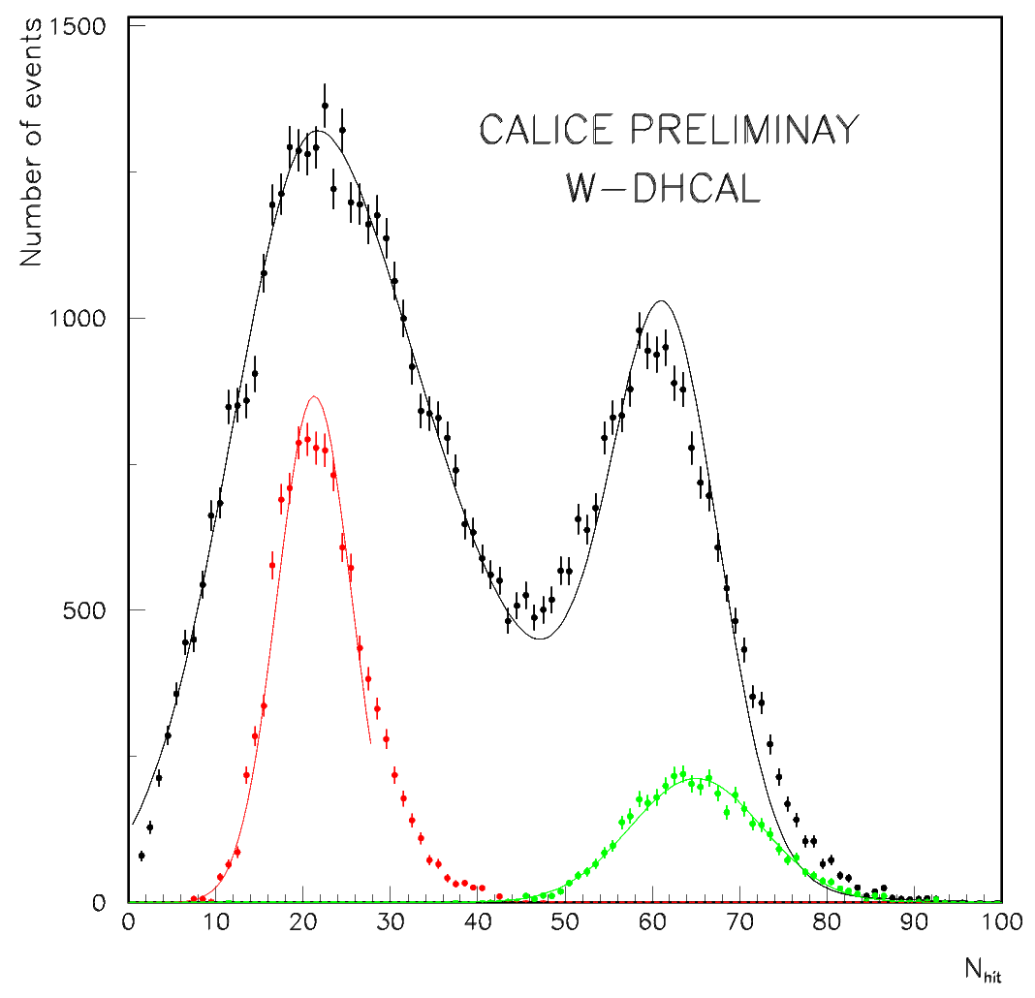
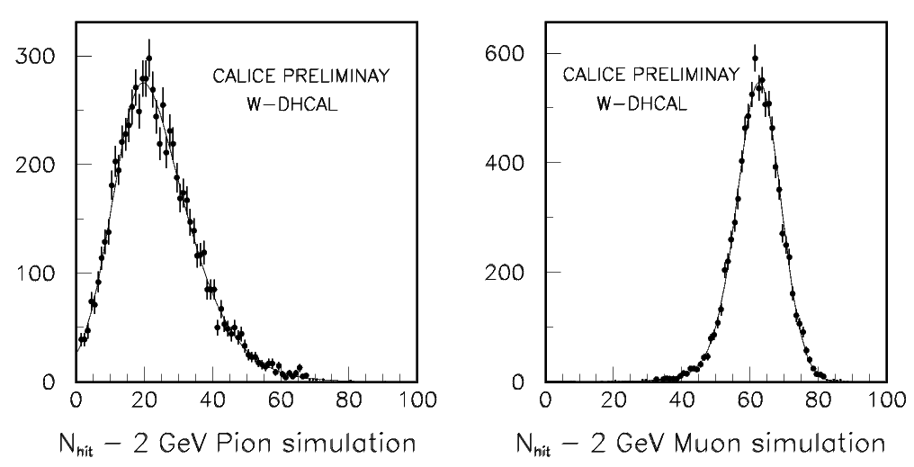
Spectra at -2 GeV/c
Electron selection
Through-going muon selection
Pion selection
Double peak structure due to
2 GeV/c muons and pions
Both range out in the DHCAL
2 component fit adequate
(muon response sensitive to distribution
of angle of incidence)
(pion response adjusted by 10%)
Simulated spectra fit with modified Gaussian
or vice versa

Slide 15
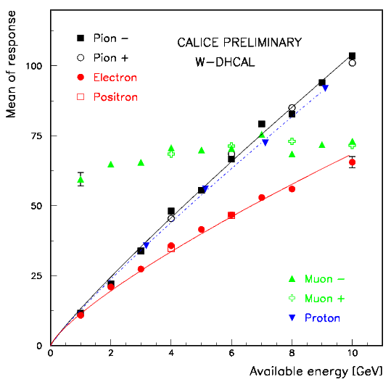
W – DHCAL Response at the PS (1 – 10 GeV)
Fluctuations in muon peak
Data not yet calibrated
Response non-linear
Data fit empirically with αE^{β}
β= 0.90 (hadrons), 0.78 (electrons)
W-DHCAL with 1 x 1 cm²
Highly over-compensating
(smaller pads would increase the
electron response more than the
hadron response)
Remember: W-AHCAL is compensating!

Slide 16
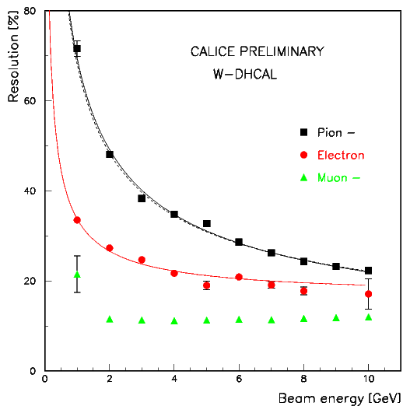
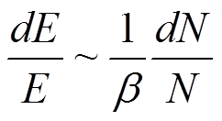
W – DHCAL Resolution at the PS (1 – 10 GeV)
Resolutions corrected for
non-linear response
Data fit with quadratic sum of
constant and stochastic term
Particle | α | c
Pions | (68.0±0.4% | (5.4±0.7)%
Electrons | (29.4±0.3)% | 16.6±0.3)%
(No systematics yet)

Slide 17
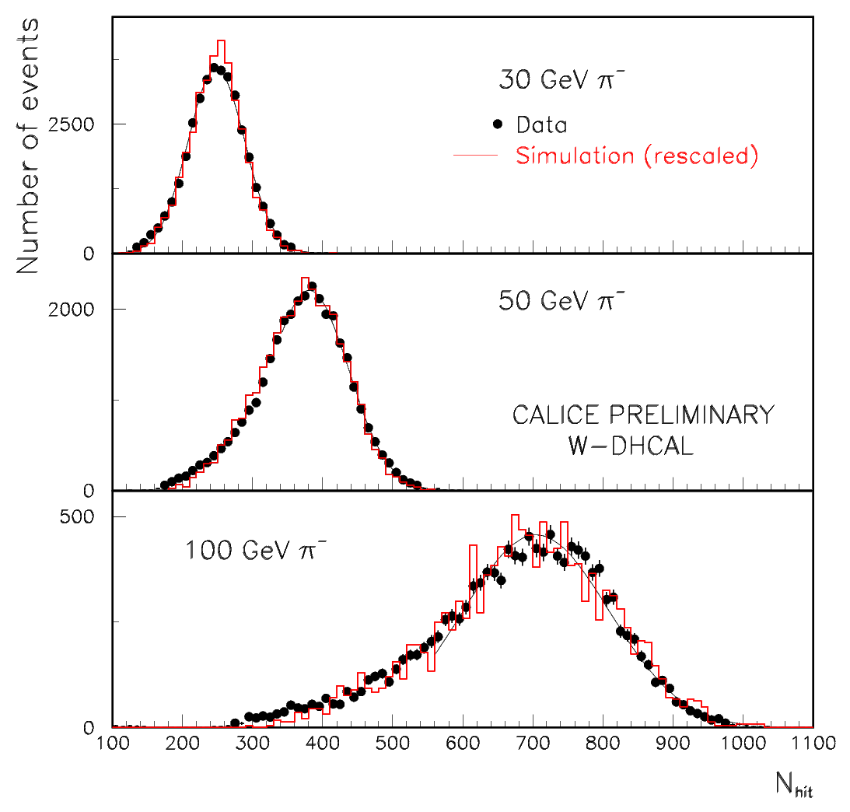
Comparison with Simulation – SPS energies
Data
Uncalibrated
Tails toward lower N_{hit}
Simulation
Rescaled to match peaks
Shape surprisingly well reproduced

Slide 18
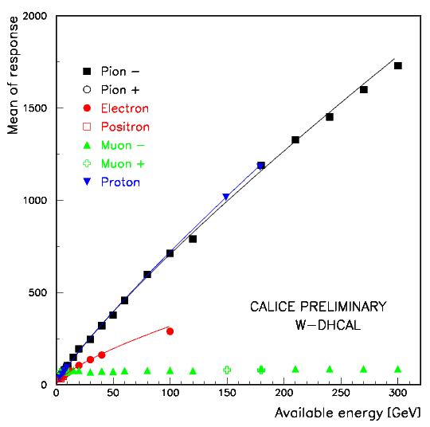
W – DHCAL Response at the SPS (12 – 300 GeV)
Fluctuations in muon peak
Data not yet calibrated
Response non-linear
Data fit empirically with αE^{β}
β= 0.85 (hadrons), 0.70 (electrons)
W-DHCAL with 1 x 1 cm²
Highly over-compensating
(smaller pads would increase the
electron response more than the
hadron response)

Slide 19
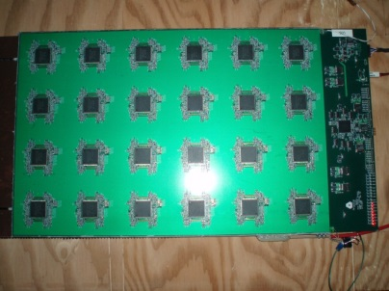
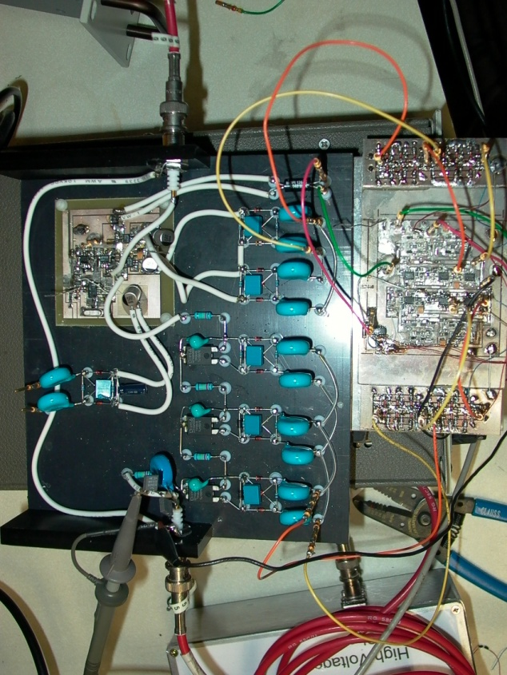
Current/Future activities
While waiting for the ILC…
High-rate RPCs
RPCs loose efficiency at high particle rates
Controlling parameter is the bulk resistivity of the plates
→ Low resistivity Bakelite (together with University of Michigan and USCT)
→ Low resistivity glass (together with COE college)
1-glass RPCs
Offers many advantages: pad multiplicity close to one, thinner, higher rate capability…
Built several large chambers
Tests with Cosmic rays very successful
HV distribution system
Needed for gaseous HCAL
Development of system to control layers individually and monitor their currents
Work done at University of Iowa

Slide 20
Conclusions
Fe-DHCAL: Great data set with 24 Million events spanning 1 – 120 GeV in energy
W-DHCAL: Great data set with 39 Million events spanning 1 – 300 GeV in energy
Detailed systematic studies of the data have begun
→ There is a lot to do and understand
Presented preliminary look at the Fe-DHCAL and W-DHCAL data
● Noise rate (almost) negligible
● Response to muons uniform and well simulated
● Fe-DHCAL response and resolution as expected (compensating around 8 GeV)
● W-DHCAL response non-linear for both pions and electrons
→ Smaller readout pads needed for Tungsten absorbers
● Approximately 50% more hits with Steel than Tungsten absorbers
● Simulations start to look like the data
→ Major features of data understood

Slide 21
The DHCAL Collaboration
Institute | Contribution
Argonne | RPC construction; Electronic system coordination; Front-end boards; LV Power supply; Data taking; Data analysis
Boston University | Data collectors
CERN | Tungsten stack; Test beam; Data taking; Data analysis
COE College | Development of semi-conductive glass
Fermilab | DCAL ASIC design, production and testing; Timing and trigger module; Test beam
IHEP Beijing | DHCAL construction; Data taking; Data analysis
IIT | Data taking; Data analysis
University of Iowa | HV system; Gas mixer; Gas distribution; Data taking; Data analysis
McGill University | Glass spraying; cassette assembly; Data taking; Data analysis
Northwestern University | Gluing of electronics boards; Cassette construction; Data taking
University of Oregon | Data analysis
University of Texas at Arlington | Glass spraying; Data taking; Data analysis

