Slide 1
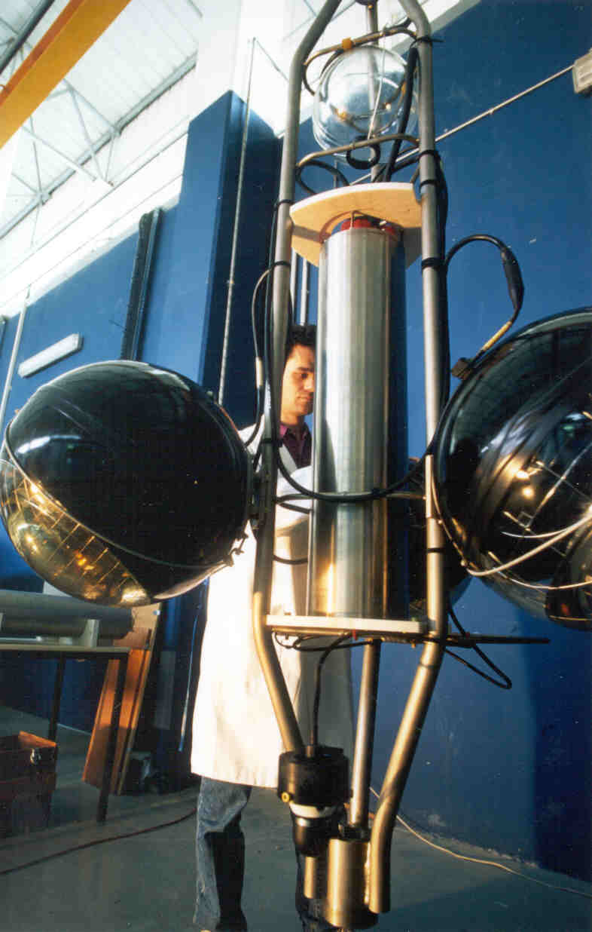
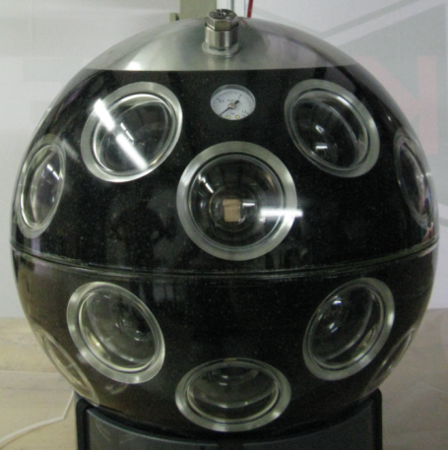
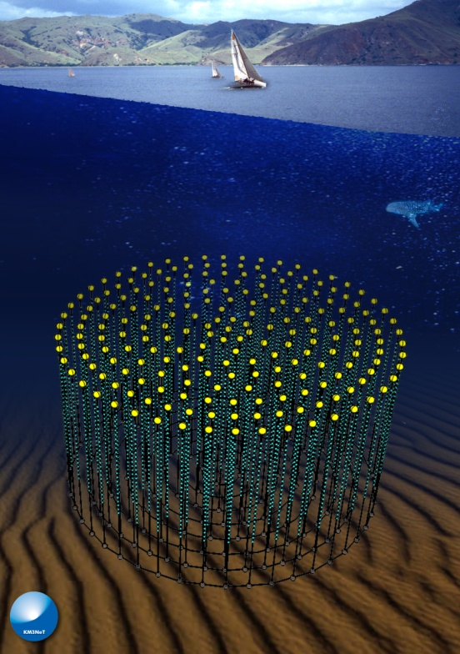
PPM-DOM.
by Jan-Willem Schmelling on behalf of the optical team.
2 Lasers tunable
MODU-LATORS
1λ CW+1λ AC
@1.25Gbps)
λ5
LiNbO3
50/50
λ4
LiNbO3
80/20
λ5
PIN
Antares DWDM crate
VOA
on/off
SPM
λ4
C1
C2
REAM
Junction Box
λ5
2xCu
DOM
APD
C2
C2
λ4
LCM
SS-part
40 km
ILxx

Slide 2
Contents.
An overview of the items showed during the DOM-ReX related to optics and integration.
Optical network.
BEOC
DOM integration
General conslusions
Questions?

Slide 3
Contents.
For more information and the detailed presentations as given during the DOM-ReX meeting on the 18th of December 2012 at Nikhef see:
http://131.188.192.25/MaKaC/conferenceDisplay.py?confId=123

Slide 4
Optical network.
2 Lasers tunable
MOD + Drivers
λ1
λ1
1λ CW+1λ AC
@1.25Gbps)
λ5
LiNbO3
D1
D2
50/50
EDFA
λ4
A&D
A1
λ8
λ8
20
14
80/20
PIN
VOA
λ5
LiNbO3
Antares DWDM crate
on/off
SCM
C1
λ4
REAM
C2
λ1
Junction Box
λ1
λ5
2xCu
DOM
APD
6dB
C2
D4
D3
20/80
A2
λ4
λ5
SS-part
λ8
λ8
LCM
EDFA
40 km
ILxx
Downstream path (shore to DOM)
Upstream path (DOM to shore)
Time calibration: round trip

Slide 5
Optical network.
2 Lasers tunable
MOD + Drivers
λ1
λ1
1λ CW+1λ AC
@1.25Gbps)
λ5
LiNbO3
D1
D2
50/50
EDFA
λ4
A&D
A1
λ8
λ8
80/20
PIN
VOA
λ5
LiNbO3
Antares DWDM crate
on/off
SCM
C1
λ4
REAM
C2
λ1
Junction Box
λ1
λ5
2xCu
DOM
APD
6dB
C2
D4
D3
20/80
A2
λ4
λ5
SS-part
λ8
λ8
LCM
EDFA
40 km
ILxx
Time calibration: optical pulse
> Lab test:

Slide 6
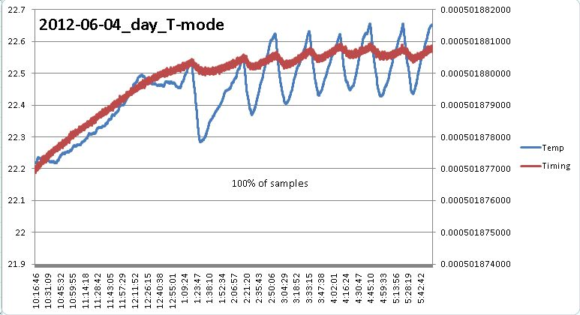
Lab test of optical time calibration.
During lab test it has shown that the optical time calibration:
In principle works very well!
Is sensitive for reflections (for example wet mateable connectors).
Has a low average optical power (small pulse width).
Components show un-expected behavior (reflections).
A long fiber length can measure temperature very accurately. ☺

Slide 7
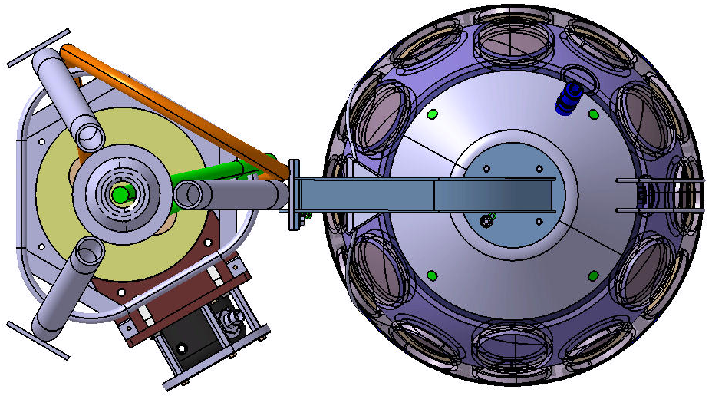
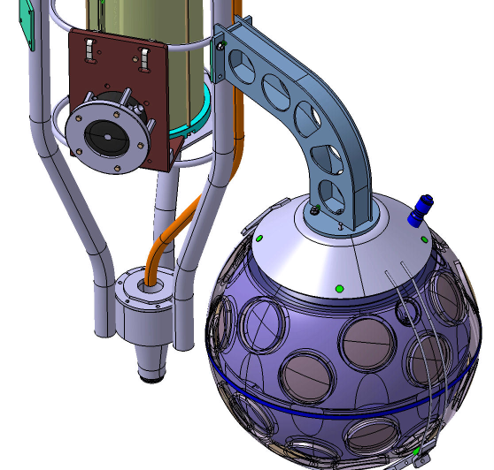
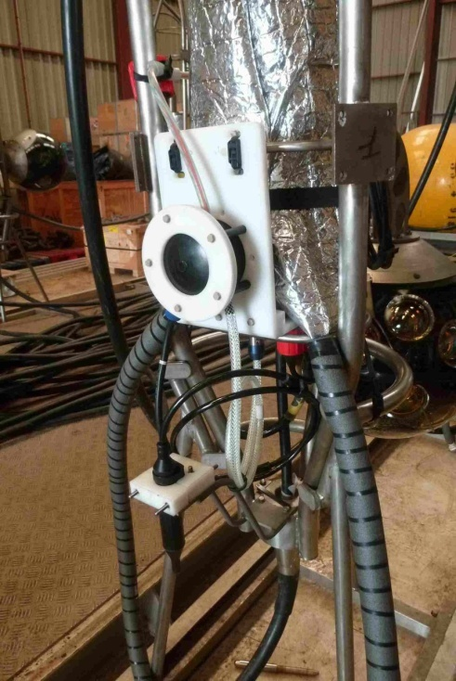
BEOC.

Slide 8
BEOC.
Penetrator into Optical Module 6 electrical wires (1xpower, 2xUTP)
2 fibres BendBright
Dry mateable connector to LCM 2 electrical wires (1 x power)
2 fibres BendBright
1m
C2
1.20m
DC/DC
C1
Dry mateable bulkhead to a satelite
4 electrical wires (2xUTP)
PBOF = Pressure Balanced Oil Filled over pressure test 60 kPa

Slide 9
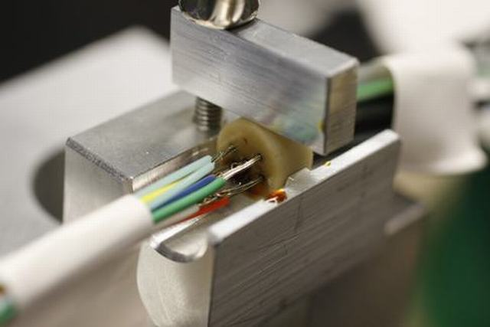
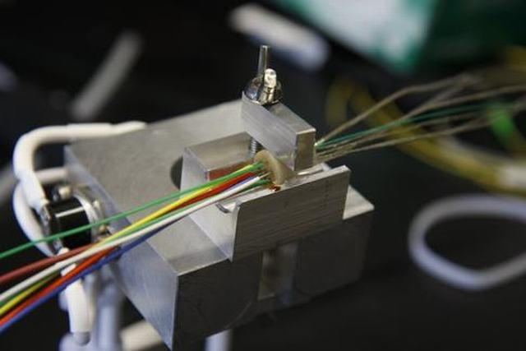
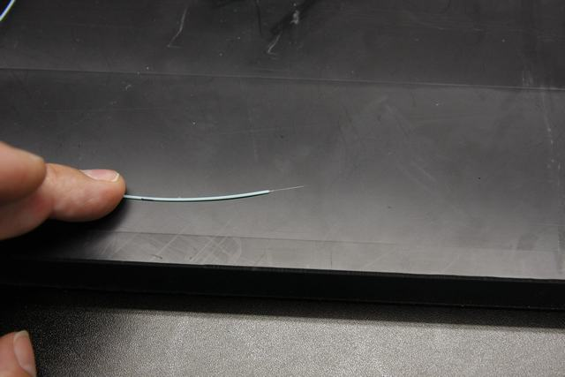
BEOC: Penetrator gluing of the pressure barrier
2 Fibres
2 Fibres in tube
First attempt
Tight buffered fibres (SEACON standard type of fibre) are very fragile when stripped down and glued.
This is caused by scratches due to mechanical stripping of the tight buffer.
Solution: use 2 BendBright fibres.
The coating can be chemically stripped so there is minimal damage to the fibre.

Slide 10
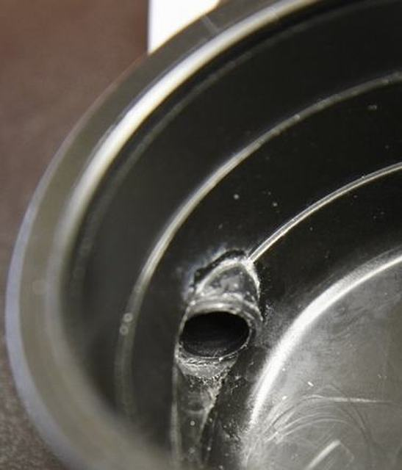
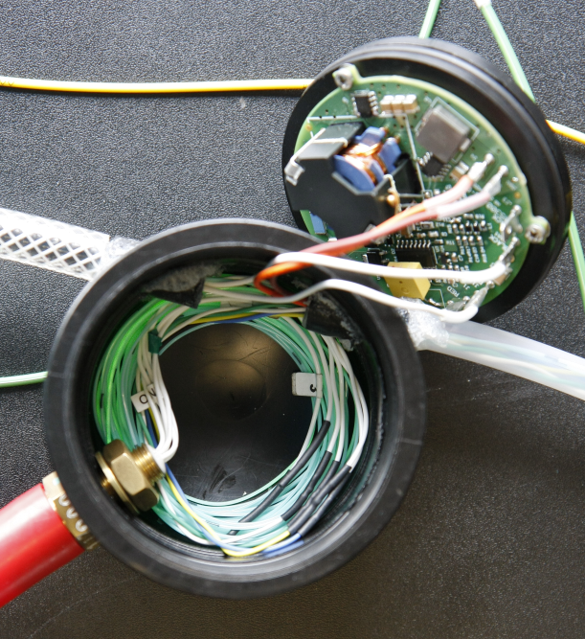
Problems with breakout Box (BOB).
Gluing of the tubes to the BOB was not easy. Both the BOB and tubes are made from polyethylene (PE). This is very hard to glue.
First attempt with primer and “one second” glue.
This failed a dry pressure test at 3 bar. Adding extra glue did not make it leak tight.
3M DP8010 2-component glue did work very good. Despite the strange appearance on the outside.
Close up of glue connection with “one second” glue.
Final BOB. Glued with 3M DP8010 2-component glue

Slide 11
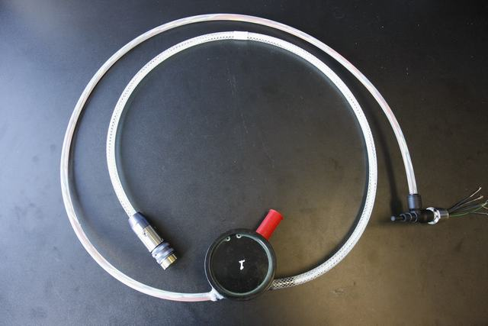
The completed BEOC.

Slide 12
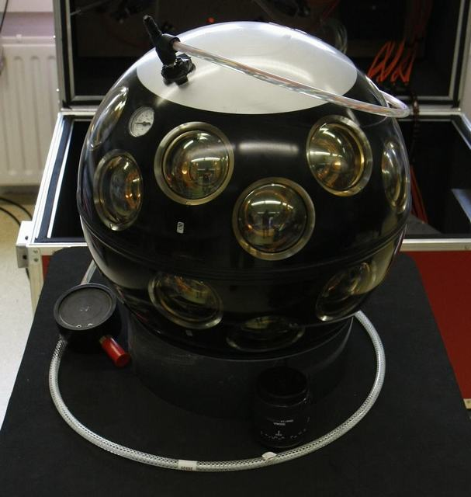
BEOC connected to the DOM.

Slide 13
BEOC: Main problems encountered
After the DOM had been closed the fast fuse inside the BEOC DC/DC converter
blew during tests. This resulted in:
The BOB had to be drained of oil and opened.
The fuse is now short circuited by a wire to prevent this from happening in
the future.
Because the 400V supply from the SPM itself has a limiter, shorting of the fuse
should no problem in-situ.

Slide 14
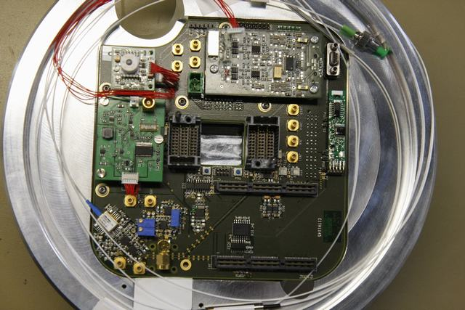
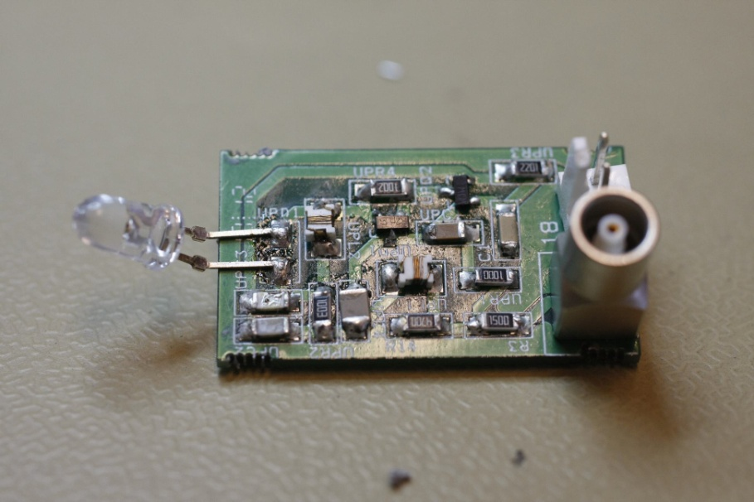
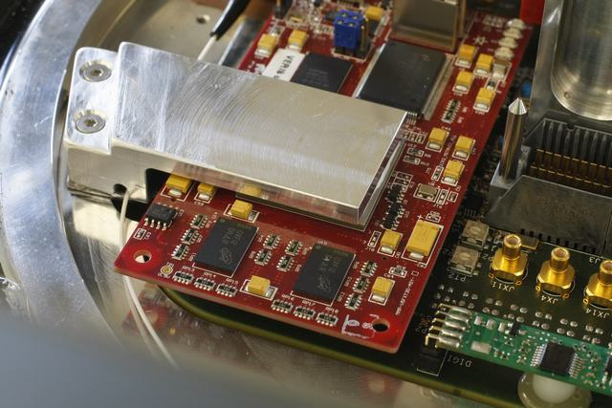
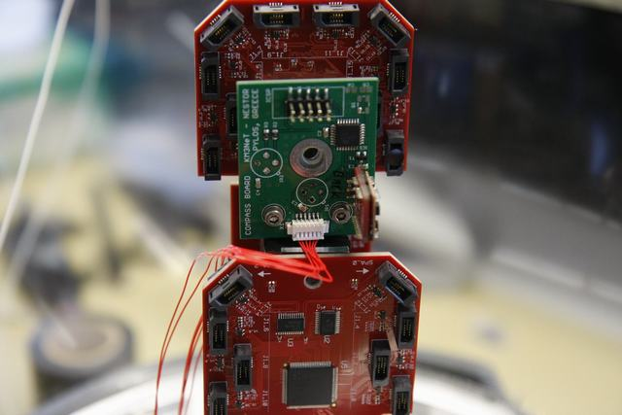
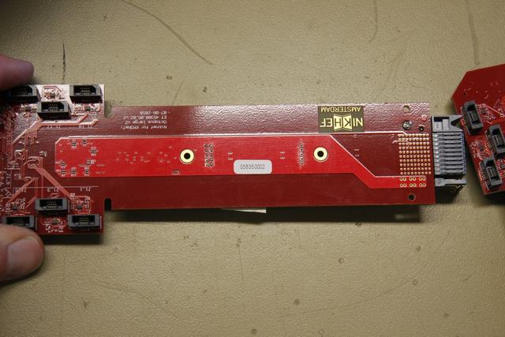
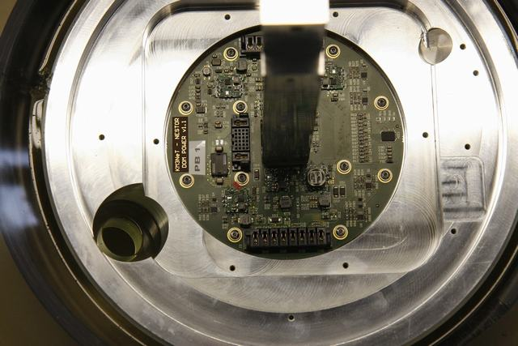
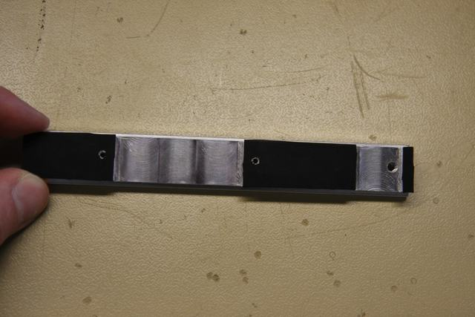
DOM electronics integration.
Integration of the electronics:
Various problems due to mechanical misalignment.
Power board: no problems
CLB: various mounting problems for different reasons. CLB is important ref.
FPGA: cooling major issue, problem to produce a good thermal contact.
Instrumentation: positioning /mounting needs improvement
Octopus board: sliding parts causing a short circuit.
PMT numbering: a consistent way throughout the collaboration is needed.

Slide 15
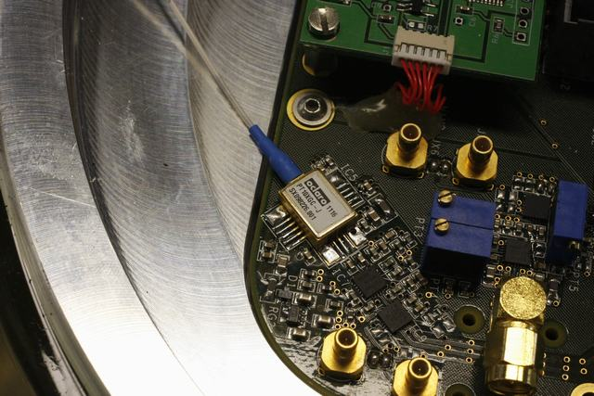
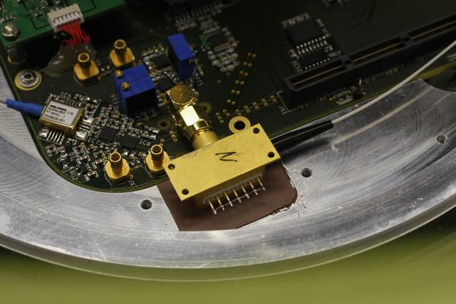
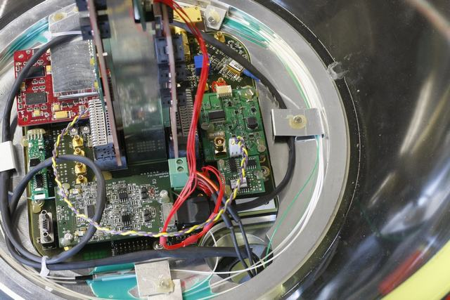
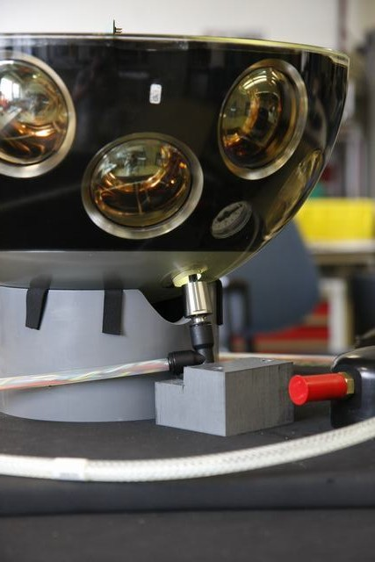
DOM optics integration.
Integration of the optics inside the DOM:
PIN diode fiber: too close to heat shield
REAM: mounting no problem
Fiber routing inside the DOM: more support
Penetrator connection: troublesome as a result of the assembly order.
Penetrator fixed to the glass at the last possible moment, risk of damage during
handling/DOM test.

Slide 16
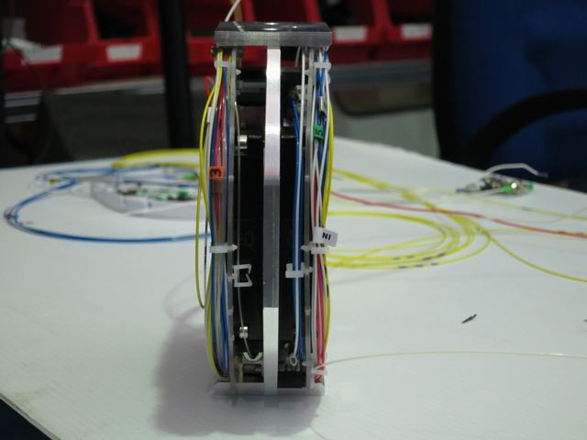
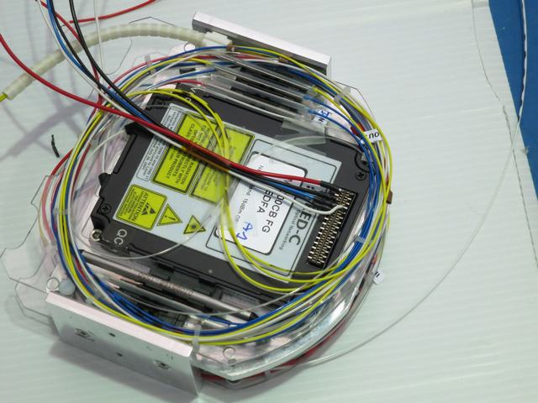
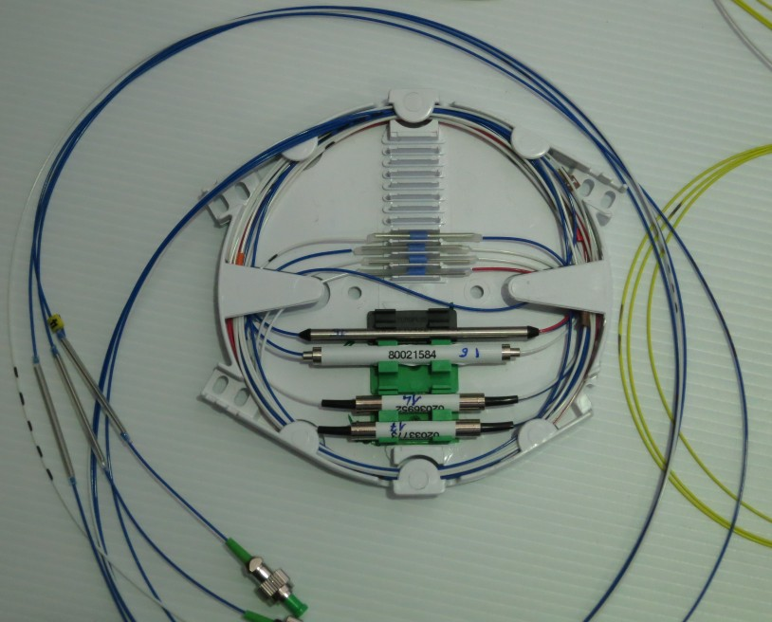
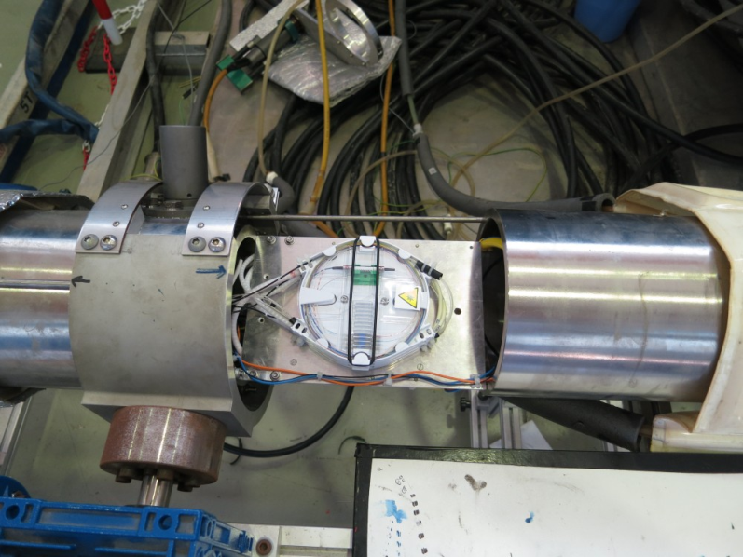
Optical parts integration in LCM.
EDFA’s mounted on cooling plate, together with a part of the optics

Slide 17
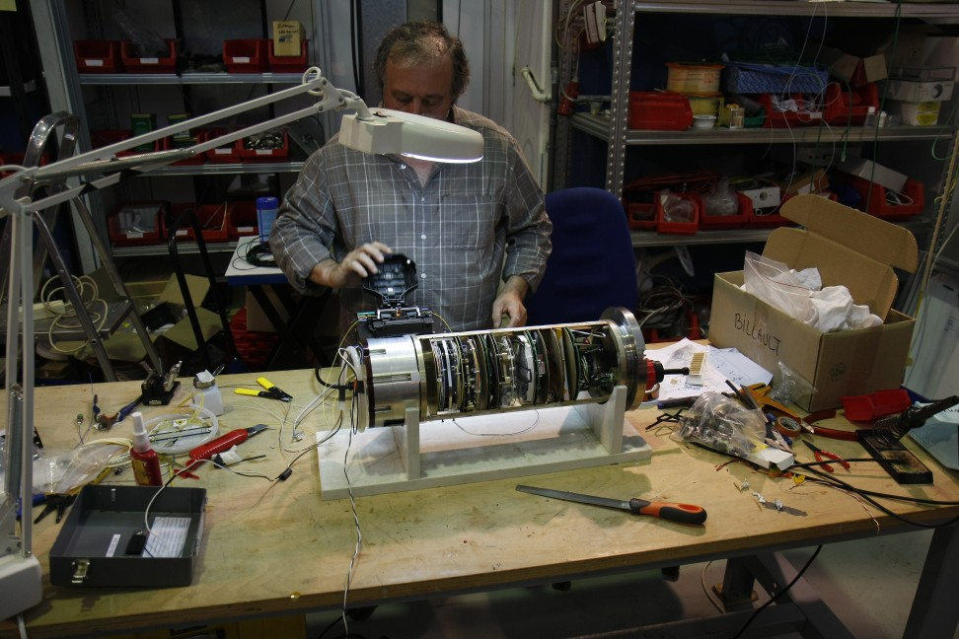
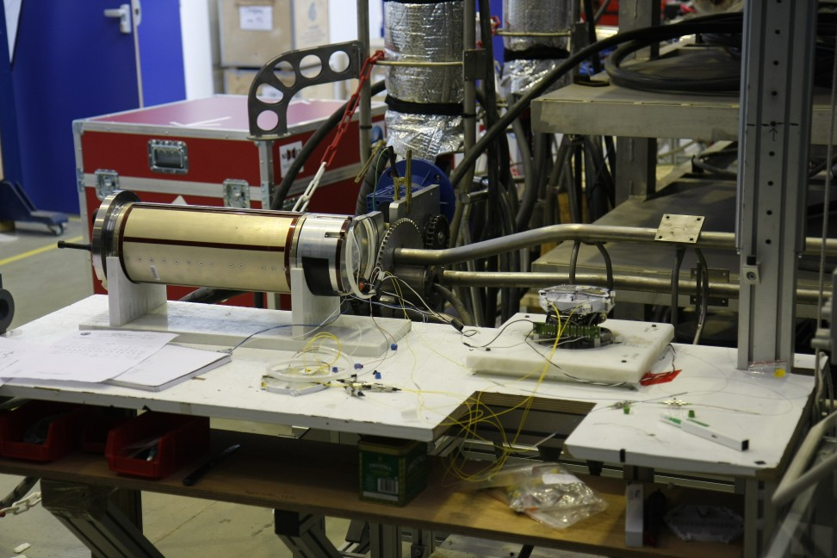
Optical parts integration in LCM.

Slide 18
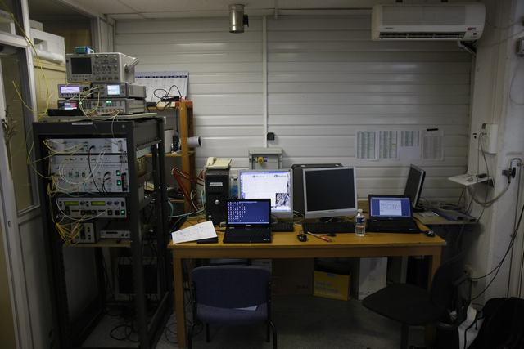
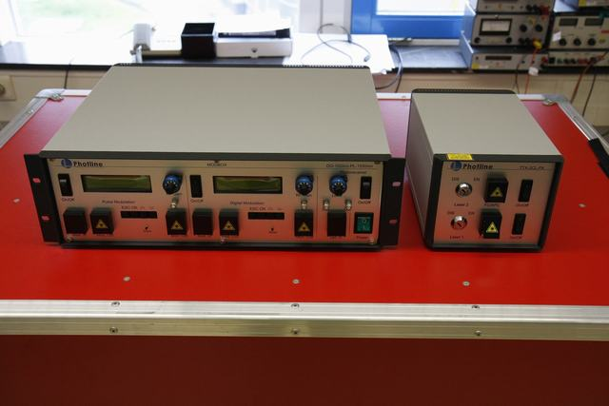
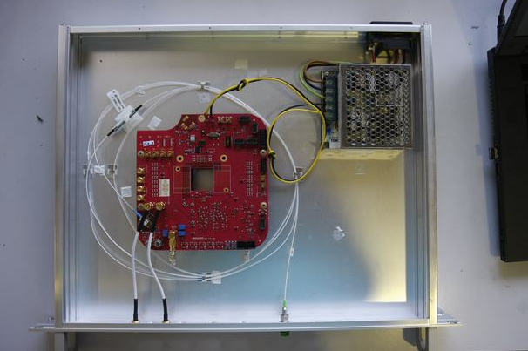
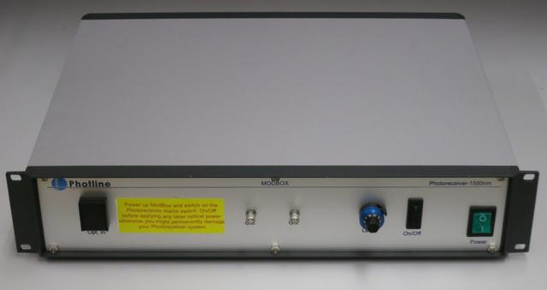
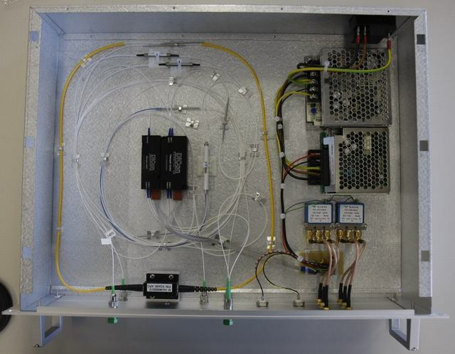
DOM integration @ CPPM.
Shore station equipment:
Build and/or bought
Shore station lasers
Shore station modulators
Shore station receiver (ordered)
Shore station receiver (build) as backup
Shore station optical timing switch crate
The shore station

Slide 19
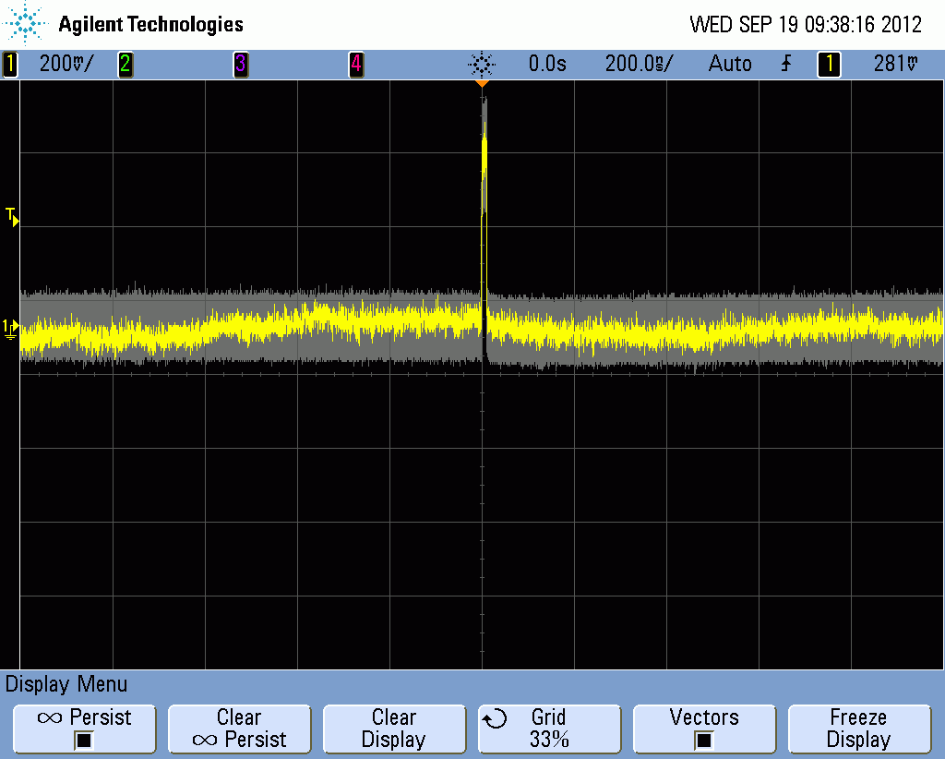
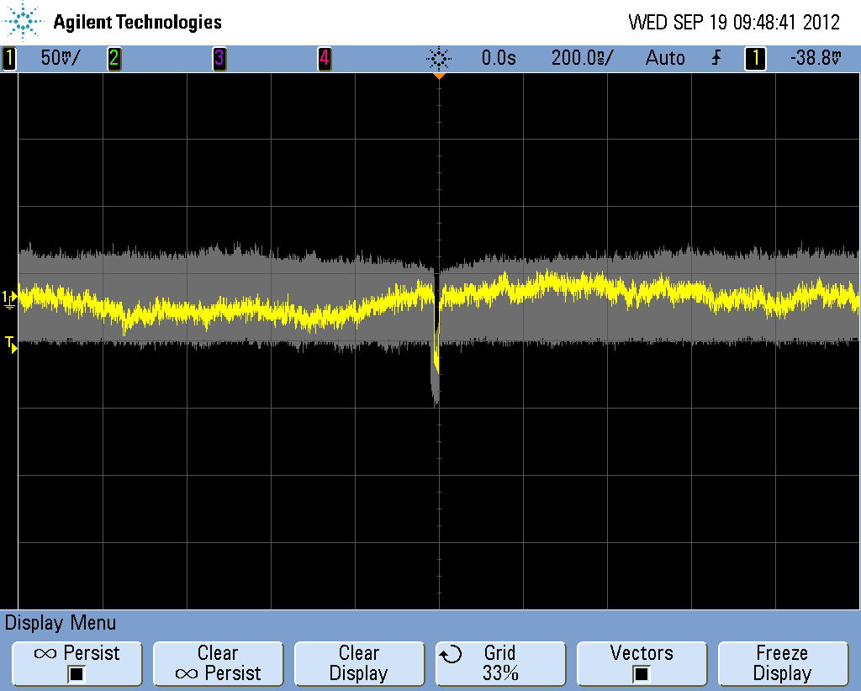
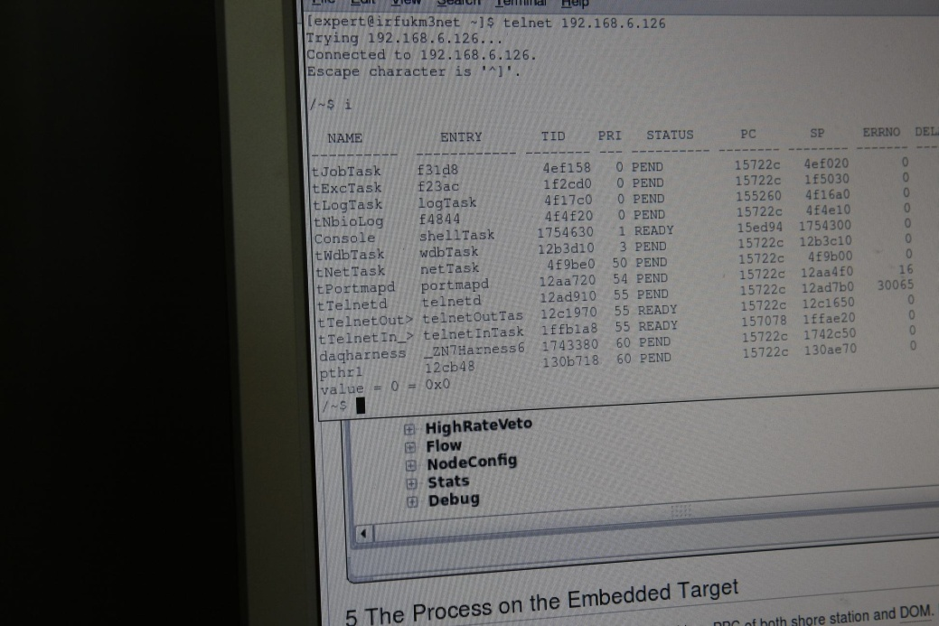
DOM integration @ CPPM, results.
Normal communication no problem.
Problems with optical timing calibration.
Optical margin NOT sufficient for time calibration, receiver sensitivity low.
EDFA slow control not available (would provide more flexibility).
Shore station receiver.
The DOM is alive! ☺

Slide 20
General conclusions:
Optical network is working. However little has been learned for KM3NeT phase 1.
The DOM integration was successful.
Optical time calibration needs a different/modified approach compared to the lab
as it worked in the lab setup, but not in-situ.
During DOM/BEOC assembly a lot of mechanical inconsistencies showed up.
Designs are different from KM3NeT phase-1
The mezzanine board approach works very well in a prototype manner.
The electronics are well tested but their mounting needs to be improved
Bottom line:
we have learned a lot
but……..
We have realized a lot
There’s also still a lot to be done!

Slide 21
A more detailed overview of the PPM-DOM can be found on:
http://131.188.192.25/MaKaC/conferenceDisplay.py?confId=123

Slide 22
The END.
Questions?

