Slide 1
Summary of
Calibration and Instrumentation Session
Robert Lahmann
KM3NeT Collaboration Meeting, CPPM, 31-Jan-2013

Slide 2
Instrumentation Session
Four talks in the session (Tue, Jan 29th 16:30):
Instrumentation for Optical Calibration: Laser Beacon and Nanobeacon (Diego Real)
Acoustic transceivers for the KM3NeT positioning system (Miquel Ardid)
Tests on the acoustic positioning system of the PPM-DOM (Salvo Viola)
Instrumentation Needs for the Calibration Unit (Pascale Keller)

Slide 3


TIME CALIBRATION SYSTEM
Optics (Diego)
Decoupling inter-intra D.U. Calibration systems
INTRA D.U. Calibration:
  Nano-Beacon Upward single LED housed inside all DOMs
  Less expensive and high redundancy
  Can be triggered internally to avoid electronic noise
  Frequency of several kHz depending on the DAQ system (300 Hz @ ANTARES) - Avoid cumbersome synchronization process, only one LED
INTER D.U. Calibration:
  Laser Beacons @ 532 nm
  Higher in intensity and shorter pulses < 1 ns
  No synchronization needed
  More expensive but less redundancy required
  Tunable by Liquid Crystal Optical attenuator
  Collimated beam -> Diffusion device needed
Notes:
3

Slide 4
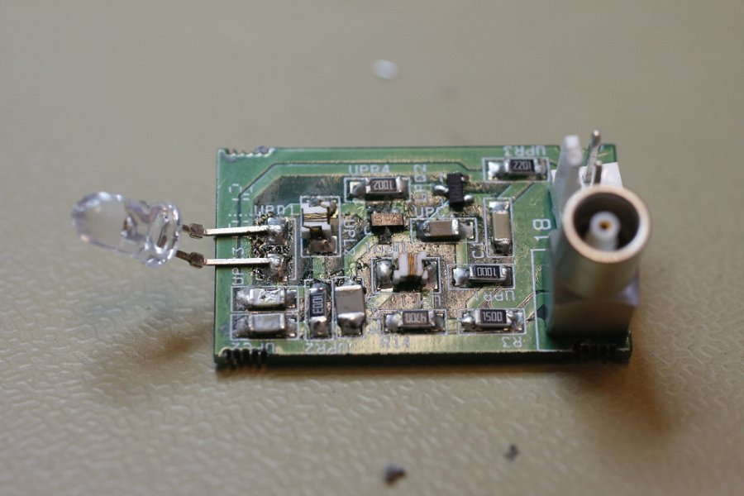
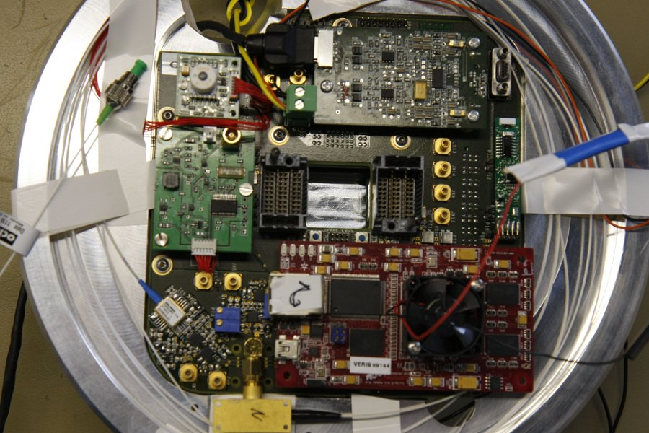
NANOBEACON STATUS - PPM
One Nanobeacon already integrated on the PPM DOM
Three already produced and ready for integration at the PPM DU (@470 nm)
Notes:
4

Slide 5
SUMMARY
1 Nanobeacon integrated on the PPM DOM
3 Nanobeacons already produced and ready for integration in the PPM DU DOMs
8 upwards-orientated LED Nanobeacons of different wavelengths (@ 470-440-400 nm) have been integrated in “Nemo Tower Phase II”
1 laser beacon integrated in the ANTARES IL11 (3.5 µJ)
1 laser beacon integrated in “Nemo Tower Phase II” (3.5 µJ)
Proposal to use a new laser head. More powerful with 25 µJ per pulse
    Before star the development of the electronics it has to be chosen:
      Connector
      Power Supply
      Communications

Slide 6
Acoustic Position System
Talk by Miquel Ardid on emitter part
Development at UPV (Valencia)
Talk by Salvo Viola on receiver part
Development at INFN (external hydrophones)
Development at ECAP (internal hydrophones/piezo sensors)

Slide 7
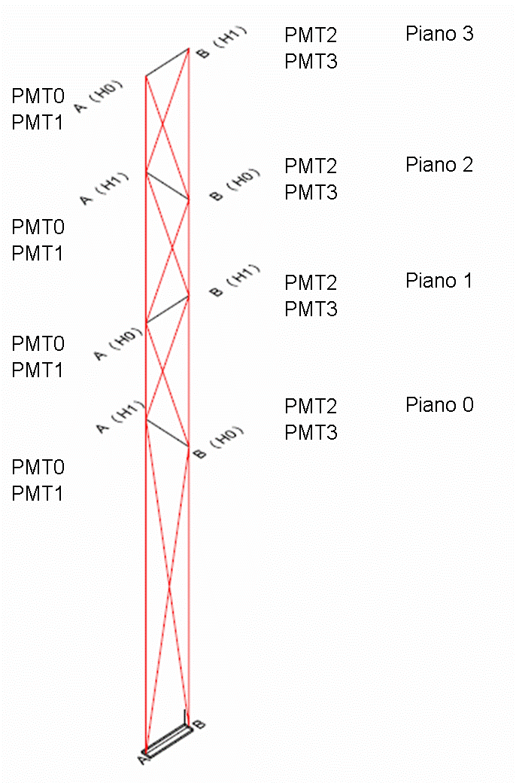


Acoustic positioning system
The acoustic positioning system (APS) is a mandatory subsystem for the detector
KM3NeT APS goals:
  relative positioning accuracy : < 10 cm (less than DOM diametre)
  absolute positioning accuracy: < 1 m to optimize pointing resolution
Key elements :
  Long Baseline of acoustic emitters anchored in known and fixed positions
  Array of acoustic sensors (hydrophones) moving with the mechanical structures
Acoustic receivers at both end of each floor
Measurement Technique:
ToA (Time of Arrival):
T^{Em}(Beacon) – T^{Rec}(Hydro)
2. Geometrical triangulation
Acoustic Beacon

Slide 8
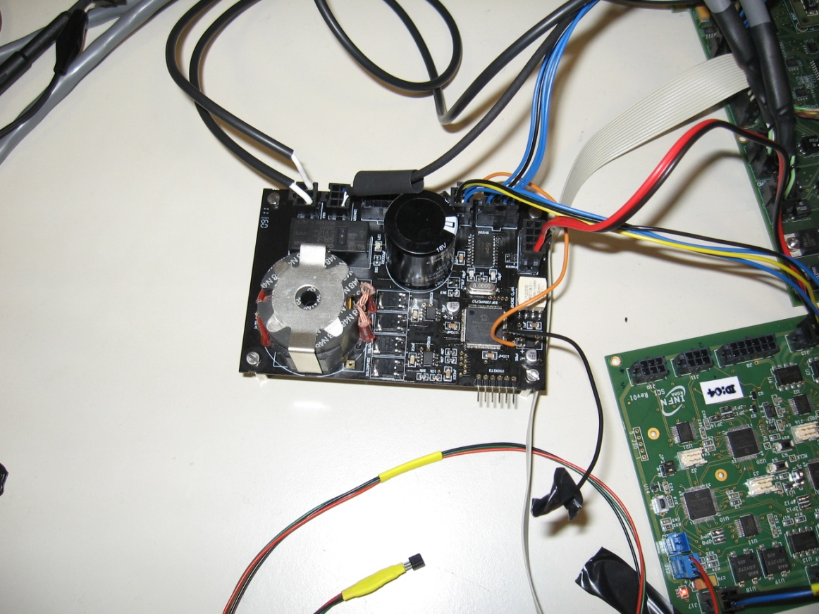
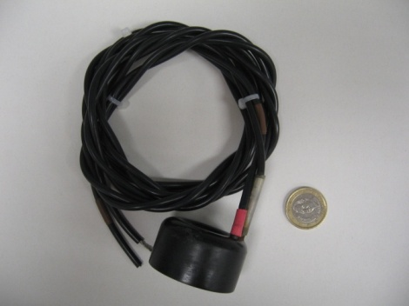
Acoustic Transceiver proposed
Acoustic transducer:
  We have selected the commercial available SX30 Free Flooded Ring from Sensortech, Canada, since it fulfils all the requirements:
    It can operate as emitter and receiver with good efficiencies (20-40 kHz)
    It can stand high power signals and high pressures
    It can be affordable in the large number of units required by KM3NeT
Electronics (Sound Emission Board):
  Especially developed electronics to:
    Fulfill the special requirements of the system: low-power consumption, reliable, configurable from shore, high intensity for emission, arbitrary signals for emission and low intrinsic noise.
    Optimize to the transducer chosen
    Reduce costs
+
Transducer
Sound Emission Board
M. Ardid et al., Sensors 12 (2012) 4113
Miguel Ardid KM3NeT meeting - Marseille January 2013

Slide 9
Conclusions
The system developed at IGIC-UPV has been tested in the laboratory, in the pool and in the harbour accomplishing the requirements imposed by KM3NeT:
  a system with reduced cost, low power consumption, high intensity for emission, low intrinsic noise and arbitrary signals for emission.
  able to obtain a transmitting power of ∼170 dB ref. 1 µPa @ 1m in agreement with the electronic design and specification needed.
  the use of wideband signals, Maximum Length Sequence (MLS) signals and sine sweep signals, results in an improvement of the signal-to-noise ratio, and therefore resulting in an increase in the detection efficiency and in the detection time accuracy.
  the system is very stable and precise in time (better than 1µs).
The system (as emitter) has been integrated in ANTARES IL and NEMO- Phase II successfully. Now ready for deployment and connection for in situ tests.
The transceiver proposed is compatible with the different options for the receiver hydrophones proposed for KM3NeT. It is versatile, so in addition to the positioning functionality, it can be used for other calibration tasks or for acoustic detection of neutrinos and acoustic monitoring studies in deep-sea.
As next steps: a new prototype of the SEB is being designed and developed in order to reach transmitting powers of ∼180 dB ref. 1 µPa @ 1m. We are also setting a new lab and new protocols for testing acoustic sensors in Gandia.
Miguel Ardid KM3NeT meeting - Marseille January 2013

Slide 10
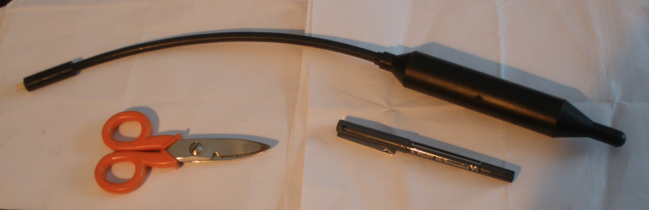
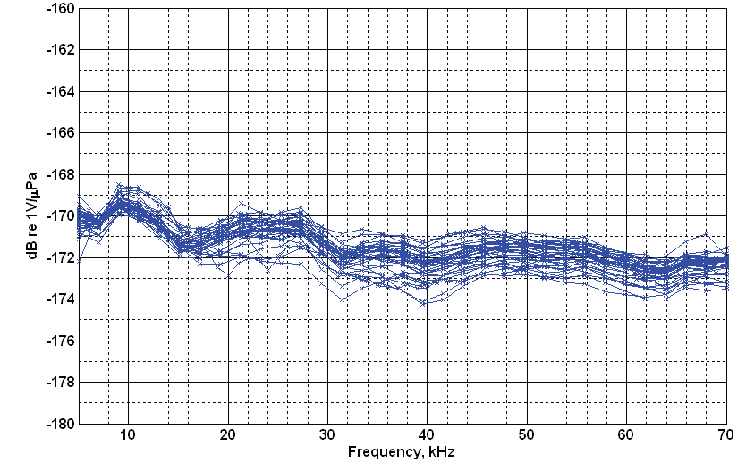
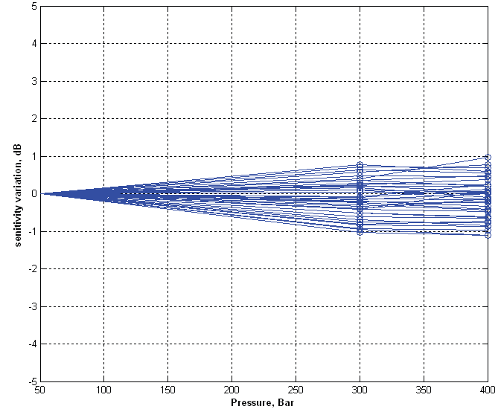
Acoustic sensors in PPM-DOM and PPM-DU
Large bandwidth hydrophone (100 Hz – 70 kHz) developed by SMID and NEMO
Hydrophone +preamplifier calibrated at NATO - URC (40 sensitivity hydrophones)
Relative Hydrophone sensitivity variation with hydrostatic pressure at 20 kHz
300 Bar
400 Bar
Measured variations ≤ ±1 dB
Measured differences ≤ ±2 dB
Custom piezoelectric acoustic sensor developed by ECAP

Slide 11
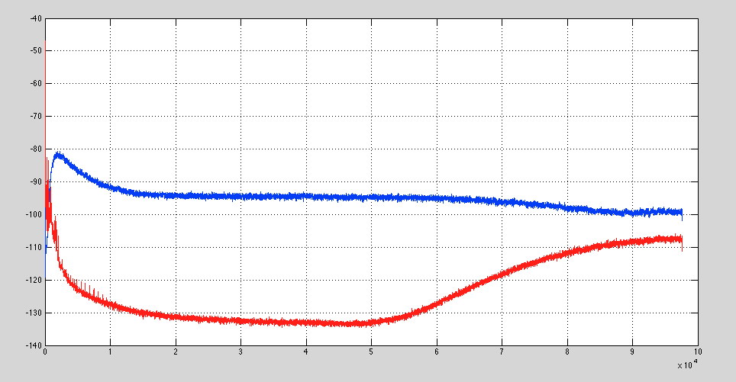
Nikhef Tests 6-9 August
Hydro and Piezo connected
Noise Floor
PMT HV off
Piezo
PSD dB re 1V² / Hz
Preliminary
Hydro (shielded box)
Frequency (Hz )
SMID +preamp sensitivity: -172 dB re 1 V/uPa
Piezo + preamp sensitivity: - 145 dB re 1 V/uPa

Slide 12
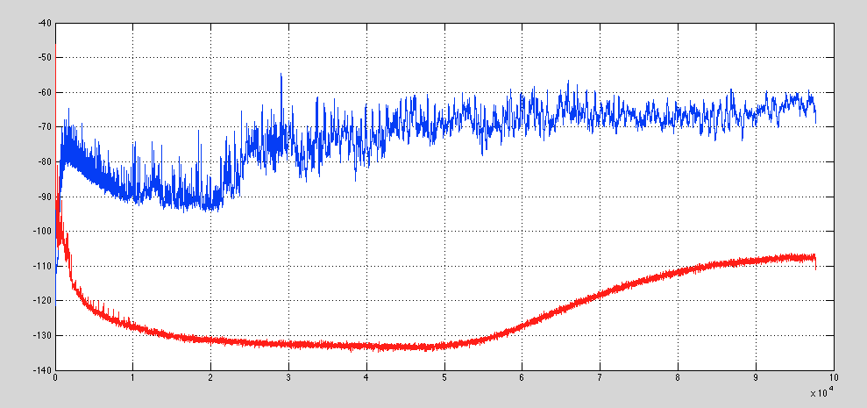
Nikhef Tests 6-9 August
Hydro and Piezo Mounted
Noise Floor
PMT HV on
Piezo
PSD dB re 1V² / Hz
Preliminary
Hydro in shielded box
Frequency (Hz )
SMID +preamp sensitivity: -172 dB re 1 V/uPa
Piezo + preamp sensitivity: - 145 dB re 1 V/uPa

Slide 13
Conclusions
AcouPlug on-board PPM-DOM fully functional and compliant with DAQ
Three (+2 spare) AcouPlugs ready for PPM-DU (2 tested @ Saclay)
Results and improvements:
Read-out (after PPM-DU) new ADC under-test (low noise > 50 kHz)
Hydrophones: reliable technology
e.m. noise reduction: Guard ring implemented for PPM-DU hydros (…if any…!)
Low cost hydrophones under test for positioning + cetaceans (after PPM-DU)
→Piezo: promising technology
Noise is too high: improve signal and power lines coupling (e.g. results in NEMO-Phase II)
Transfer function in deep sea not well known: DOM and Phase II will be test benches
→ Long Base Line: Missing
Must be installed. UPV and CPPM efforts in Km3NeT DS (but test only in NEMO- Phase II)

Slide 14
INSTRUMENTATION NEEDS FOR THE CALIBRATION UNIT
…AS A WORK DOCUMENT
Plan :
  Resume on DOM instrumentation
  Possible instruments for Calibration Units ?
  Some open questions
Pascale Keller KM3Net Meeting CPPM, 29-31 january 2013

Slide 15
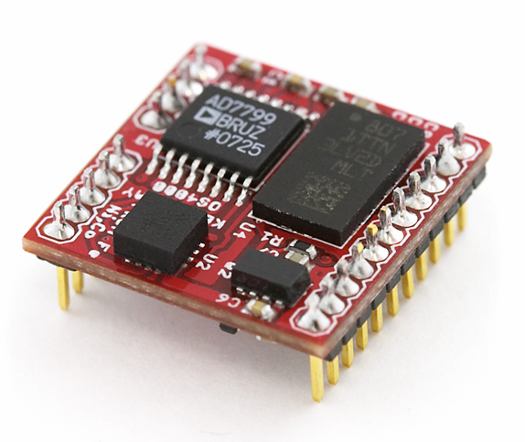
Status on DOM instrumentation (for info)
  Orientation : Tiltmeter and compass (from Tassos)
Measurement Technology, NS-25/DQL2-IXA
tilts accuracy : ±0.1° resolution 0.02°
dimensions : w x d x h 25 x 25 x 16 mm
5 VDC, I = 10 mA
I2C serial link
1 in PPM-DOM
1 per DOM (or perhaps the one of the Ocean Server compas will be accurate enough )
tiltmeter
OceanServer Technology, OS4000-T
heading accuracy : 0.5 degrees, 0.1 resolution
Roll & Pitch full rotation (<1 °)
dimensions : 15 x 15 x 3 mm
3.3V-5V, I < 30 mA
TTL serial communication
1 in PPM-DOM
1 per DOM
heading

Slide 16
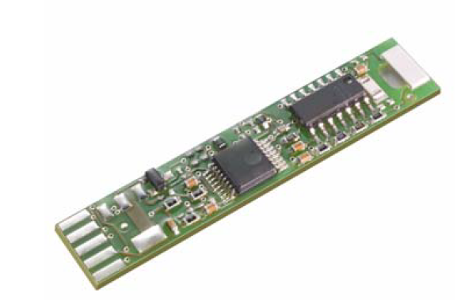
Status on DOM instrumentation (for info)
  Relative Humidity and temperature sensors (from Diego)
IST DigiPicco Basic I2C
accuracy : ± 3%RH ; ± 0.5 °C
dimensions : 10x47x2,8 mm
5 VDC, I < 3 mA
I2C serial link
RH and temperature board
1 in PPM-DOM
needed in each DOM ?
➔ needed in any container (CU) ?

Slide 17
Resume of instrument needs in CU
Device | Fonction needed | Device available for CU | Need continuous data | Backup solution
Acoustic E/R | yes | yes | yes
Currentmeter | yes | yes | yes
LaserBeacon | yes | Yes | yes
Velocimeter | yes | ? | ? | Use CTD sensors or compute SV from a constant ? Travel times on a short known distance ?
Pressure sensor | yes | yes | no | Extra measurement from independant device
Light transmissivity | yes | ? | ? | Analyses from light Beacons or turbidimeter (oceanographic line ?)
Compass/tilt | yes | ? | no | Extra measurement from independant device
RH/Temp. | ? | yes | yes

Slide 18
Summary of Discussion (preliminary)
Optical Calibration:
JJH: Depending on available power per node, one could have more and less powerful lasers or fewer but more powerful lasers
Acoustics:
MdJ: Encourage simulations of acoustic reconstruction and lineshape fits
MdJ: If piezos are “good enough” for positioning, they should be the choice for KM3NeT
General:
MdJ: Need to know footprint (i.e. density) of emitters (optical/acoustic) soon!
MdJ: Could consider equipping CUs with extra instruments for “associated projects” (e.g. acoustic neutrino detection, marine science) might be easier than “one device for all applications” approach.
EH: Power consumption is a critical issue, defines e.g. the cross section of power cables! Have to make difference between peak and average power.
PL: Need to know system parameters soon
JJH: Dedicated Calibration Units could make things more complex than necessary, should also consider installing instruments on DUs(emitters optical/acoustic at the base)

Slide 19
Conclusions
Individual components fairly well defined and developed, work required for:
Readout/analysis of data from PPM-DOM (and PPM-DU)
Which instruments to use in the future
(piezo <-> hydrophones,
which environmental parameters need to be
monitored?)
Planning complete system (seafloor layout)
…and as for the other tasks:
More person power welcome

