Slide 1
Mass hierarchy discrimination with atmospheric neutrinos in large volume ice/water Cherenkov detectors
Vladimir Kulikovskiy on behalf of:
D.Franco, C.Jollet, A.Kouchner, A.Meregaglia, S.Perasso, T.Pradier, A.Tonazzo and V.Van Elewyck
arXiv:1301.4332 [hep-ex]

Slide 2
Overview
development of the new statistical approach
2 unbinned likelihood for hierarchies
2 figures of merit of the experiment:
p-value
false positive fraction
Minimal exposure for the discovery calculation
Testing impact of the model uncertainties
neutrino fluxes
oscillation parameters
…
Testing impact of the detector performance
We were concentrated on muons only (no shower reconstruction was assumed).

Slide 3
Method
True hypothesis. Simulations for a given set of parameters -> test experiments.
Model hypothesis to calculate unbinned likelihood:
Two likelihoods – for IH model and NH model
Test statistic
Notes:
True hypothesis, which we don’t know in the real life. Simulations are done for it using a given set of parameters to obtain test experiments.
For each test experiments one can calculate likelihood using model hypothesis with its PDF.
Actually, there are two likelihoods – one for IH model and one for NH model. The j index corresponds to hierarchy choice.
extended unbinned likelihood, Poisson part with mean number of events from the model mu_j and total number of events in test experiment n
multiplication of the PDFs of each event
Logarithmic ratio of the two likelihoods was used as a test statistic.
PAUSE 10sec.

Slide 4
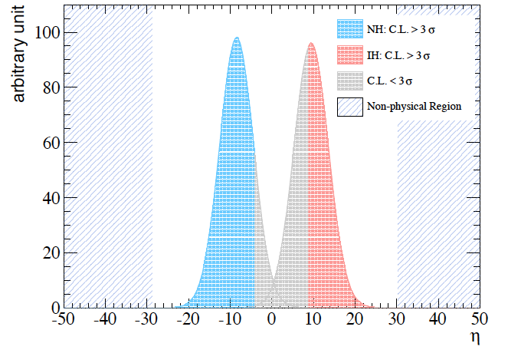
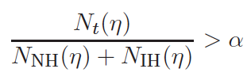
Test statistic distributions
The Gaussianity was demonstrated with dedicated high statistic tests.
Choose sigma for C.L. (3σ, 5σ).
p-value at given C.L. is a fraction of experiments corresponding to
t=NH,IH
α(σ)
Notes:
Here you can see test statistic distributions for two populations of test experiments: one with normal hierarchy TRUE hypothesis (show blue area + gray) and another with inversed hierarchy TRUE hypothesis.
The number of test experiments in both populations is the same.
The Gaussianity of the two distributions was demonstrated with high statistics.
First one should choose a confidence level (3 or 5 sigma).
Using two distributions one can calculate p-value at given confidence level is which is basically a ratio of the areas where one can distinguish hypotheses with a predefined confidence – the blue and red area on the plot to the total area.
PAUSE 10sec

Slide 5
Toy MC
fast MC tool for mass simulations of the detected events (E_{i},θ_{i})
events (E_{i},θ_{i}) are used
to create pdf(E,θ) for the two model hypothesis (IH,NH)
to calculate test statistics for the test experiments
1000 test experiments to plot distributions and calculate p-value

Slide 6
Toy MC scheme
Neutrino fluxes
Propagation in Earth
Simulations is just a fishing from some pre-generated matrixes.
Basic ingredients
flux model
propagator: neutrino oscillation parameters, Earth profile, neutrino cross-sections
detector performance The performance should be parameterized (energy resolution, angular resolution, effective mass)
Neutrino interaction
Detector response
(E_{i},θ_{i})
Notes:
Simulations should use neutrino fluxes, do propagation in Earth with oscillations, neutrino interactions, include detector response and produce for each event its reconstructed energy and zenith angle.
Toy Monte Carlo simulations are just a fishing from the pre-generated matrixes.
And to generate these matrixes we need some basic ingredients: flux model, propagator with neutrino oscillation parameters, Earth profiles and neutrino cross sections and, finally, detector performance.
The performance should be parameterized by energy resolution, angular resolution and effective mass of the detector.

Slide 7
Baseline atmospheric neutrino flux: HONDA et al.(PRD 2005). 2D matrix (E,cosθ)
PREM. 1000 steps for each baseline(θ). Oscillation probabilities calculated for fixed values of cos(θ) ranging from 0 to 1 with 0.02 step (1D matrix).
Cross sections from GloBES. (E, cosθ) matrixes with expected number of nu+anu events using (1)&(2) and assuming 1Mt effective mass. Neutrino muon kinematics simulated with GENIE. 2 distributions E_{μ}(E_{ν}) and θ(E_{ν}). Random fishing from them.
So far track/energy reconstruction of the muons only. Final matrixes for the muons 5 GeV – 40 GeV (reasonable energy and track reconstruction, well known cross-sections).
Neutrino fluxes
Propagation in Earth
Neutrino interaction
Detector response
(E_{i},θ_{i})
Notes:
Now what was done for the parameterization of each step.
HONDA flux was chose for the atmospheric neutrinos. Parameterized as a 2D matrix.
PREM model was used for the Earth density. 1000 steps for each baseline which depends from zenith angle.
Oscillation probabilities calculated for fixed values of cos(θ). A the end 1D matrix was produced.
Cross sections from GloBES. (E, cosθ) matrix was produced using the expected number of neutrino and antineutrino events and previous two steps and assuming 1Mt effective mass.
Random fishing of the neutrino energy and direction from it.
Neutrino muon kinematics simulated with GENIE. 2 distributions E_{μ}(E_{ν}) and θ_{shift}(E_{ν}). Random fishing energy and theta shift from them. So far the track/energy reconstruction is more or less known for the muons only. For this analysis it was decides to use muons from 5 GeV – 40 GeV (because in this range on can expect reasonable energy and track reconstruction and cross sections are well known). Smearing on energy and track direction with a Gaussians was used for the detector systematics study.
Finally for each event reconstructed energy and direction is produced.

Slide 8
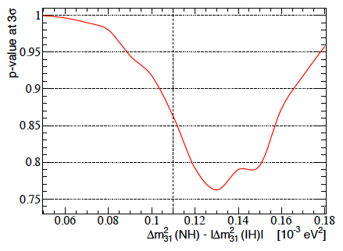
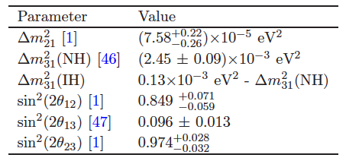
Reference oscillation parameters.
assuming this formalism, the values of Δm²₃₁ are different for IH, NH both from theoretical and experimental view shift is not constrained (CP is not known)
No fit is done. The “worst case discrimination scenario” was chosen for low exposure for this plot (34 Mt x year)
for bigger exposure shift has minor impact
Notes:
We used the following formalism.
assuming this formalism, the values of delta m31 square are different for IH, NH both from theoretical and experimental view shift is not constrained (CP is not known).
There is a shift between them introduced.
For the delta m13 shift simulations with low exposure were done. calculated p-value is presented here as a function of the shift. The minimum is at 0.13 which is different from the best known value 0.11
As no fit was done in this work the “worst case discrimination scenario” was chosen.
For bigger exposure shift has a minor impact.
The chosen reference values are shown in this table.
PAUSE 10s

Slide 9
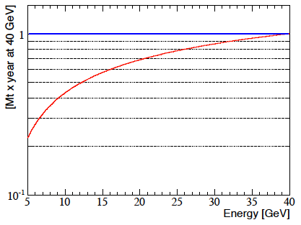
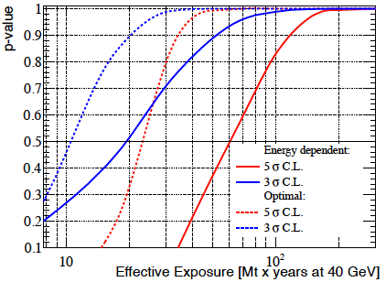
Ideal detector exposure.
Perfect muon energy/track reconstruction
No biases on parameters
Exposure normalized to 1 Mt x year at 40 GeV
optimal
energy dependent
the minimal required effective exposure is 60 Mt × year (p–value threshold at 0.5 at 5 C.L.)
170 Mt × year was chosen for the analysis
Notes:
STRESSS THAT THIS IS THE MAIN RESULT!!!!! This is one of the main results of this work.
A perfect detector reconstructing muons in energy range 5-40 GeV was assumed.
Energy dependence of the detector efficiency was taken from Akhmedov paper on PINGU.
In our work the exposure is always presented in Mt per year normalized at 40 GeV.
PAUSE 10 sec
It was found that the minimal required exposure is 60 Mt × year which has a 0.5 p–value threshold at 5 sigma C.L.
However if one can improve the efficiency at lower energies, the exposure can be decreased at maximum 3 times assuming the optimal flat exposure (show blue curve).
For the further systematic analyses 170 Mt x year was choses which gives p-value 1 for 5 sigma
PAUSE 10 sec

Slide 10
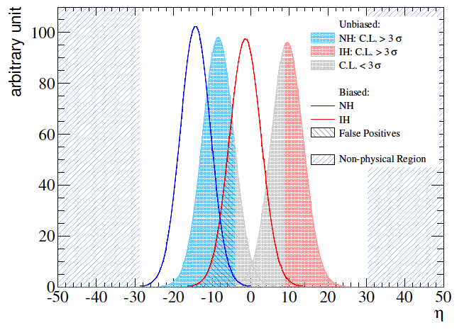
Systematic effects study.
If the true hypothesis is different from the model hypothesis (there is a bias) the η distributions changes (basically shifts).
p-value decreases
an area of false positives appears.

Slide 11
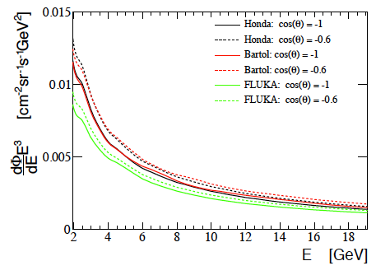
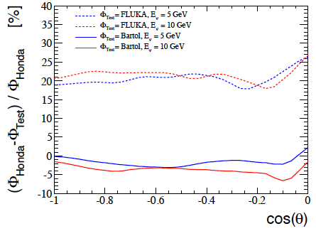
Atmospheric flux uncertainty.
Fluxes from atmflux_new studied:
Honda 1995
FLUKA 2002
Bartol 1995
New fluxes exist (3D calculations, etc.). But the main uncertainties: interaction of CR with light nuclei and CR flux measurements remains unchanged introducing ~20% uncertainty.
FLUKA and Honda are ~20% different in the normalization.
The shape differences ~5%
Notes:
Now the systematic effects study.
First the atmospheric flux uncertainties were studied.
Fluxes from atmflux_new were used: HONDA 1995, Fluka 2002, Bartol 1995
Actually they are not so new =) Recent HONDA fluxes of the last year may be found in publications, more over all the modern fluxes are 3 D fluxes, so not only theta depended as these ones.
However since 90s there are no better measurements of CR fluxes and cross sections with light nuclei exists. So uncertainties remains on lever of 20%
The differences between fluxes are presented on the left.
Fluka and Honda are 20% different in normalization.
The shape differences are about 5% for all 3 models

Slide 12
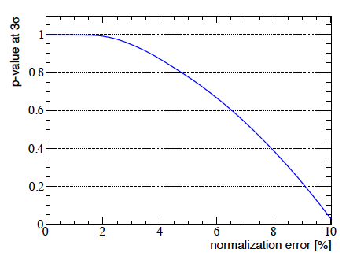
Atmospheric flux models.
Bartol-Honda p=0.851 at 5 σ FLUKA-Honda p=0 at 5 σ
Normalize the flux to the area where there are no oscillations?
Notes:
The introduced bias by changing HONDA to Bartol in TRUE model is shown on the left as blue and red DOTTTED lines. Basically it reduces p-values from 1 to 0.851 at 5 sigma.
Instead the change on Fluka reduces p-value almost to 0
For Fluka the decrease is mainly due to the normalization.
To study the impact of the normalization, the Honda flux was slightly renormalized in true model.
The effect is shown on the left. Basically till 2% of the normalization bias p-value doesn’t change, after there is a rapid decrease and at 10% normalization bias the p-value is going to 0.
It’s possible to renormalize the fluxes using some area where are no oscillations are expected (E>20GeV).

Slide 13
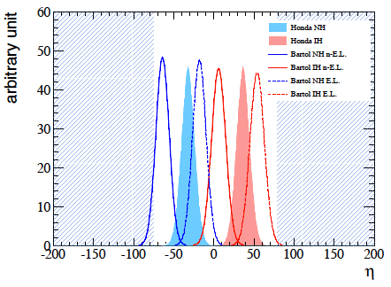
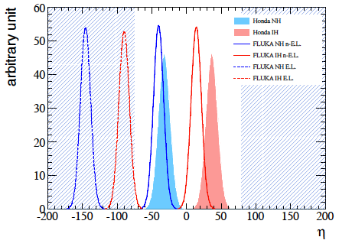
if normalization still has uncertainty > 2%
non-extended likelihood Bartol-Honda p=0.502 FLUKA-Honda p=0.655
extended likelihood
Bartol-Honda p=0.851
FLUKA-Honda p=0
Notes:
If normalization still has uncertainty > 2%
To get rid of the normalization problem the non-extended likelihood may be used.
Using the non-extended likelihood Bartol-Honda p-value decreases from 0.851 to 0.502 by using it, but Fluka-Honda from 0 p-value increases to 0.655.

Slide 14
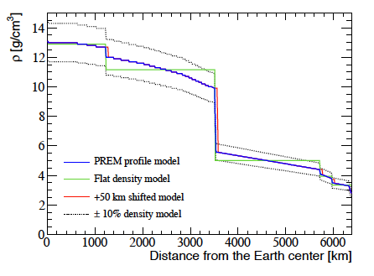
Earth density profile.
50 km limit shift – no impact
assumption of the flat density profile – no impact (p=0.999 at 3 σ)
reducing the overall density by 10% - p=0.996
density is increased by 10% - p=0.872
varying the overall density factor by 1% - no effect
introduced biases are larger than the known uncertainties or even unphysical
Notes:
Second the Earth density profile was studied.
50km layers shift has no impact on the p-value
assumption of the flat density profile – no impact as well
reducing the overall density by 10% no impact
increasing the density by the same value – small impact
and finally varying the overall density factor by 1% - no impact
4 different biases were introduced which are basically larger than known uncertainties or even unphysical.
PAUSE

Slide 15
Neutrino oscillation parameters
each oscillation parameter value is biased in the true hypothesis, by ±1 σ from the central value while keeping unaltered the model hypothesis.
biasing simultaneously with other parameters have minor impact (maximum variation ±8% for biasing together with Δm²₃₁ for 34 Mt x year)
almost no impact while biasing solar parameters (bias on θ₁₂ and Δm²₁₂ has maximum spread of 0.1% at 3 σ level). No degradation in combination with Δm²₃₁
Notes:
each oscillation parameter value is biased in by one sigma from the central value while keeping unaltered the model hypothesis
biasing the mass shift simultaneously with other parameters has minor impact
almost no impact while biasing solar parameters
PAUSE

Slide 16
Reactor sector.
m²₃₁
θ₁₃ [σ]
p-value at 3 σ C.L.
θ₂₃ [σ]
m²₃₁-1σ
m²₃₁+1σ
θ₁₃ [σ]
θ₁₃ [σ]
θ₂₃ [σ]
θ₂₃ [σ]
Notes:
In reactor sector the impact is significant instead
3 p-values tables. top– delta m 13 unchanged. theta 13 and theta 23 are changed by 1 sigma. Biggest effect with p-value 0.8 while they both are decreased by 1 sigma.
Bottom left delta m 13 is decreased by 1 sigma. Biggest effect with p-value almost 0 by increasing both angles.
Bottom right delta m is increased by 1. Biggest effect is here with p-value 0.3
Also fraction of false positives is presented in the similar tables below. Basically the worst p-values cells correspond to the biggest fraction of false positives

Slide 17
Reactor sector.
m²₃₁
fraction of false positives at 3 σ C.L.
θ₁₃ [σ]
θ₂₃ [σ]
m²₃₁-1σ
m²₃₁+1σ
θ₁₃ [σ]
θ₁₃ [σ]
θ₂₃ [σ]
θ₂₃ [σ]
Notes:
Also fraction of false positives is presented in the similar tables below. Basically the worst p-values cells correspond to the biggest fraction of false positives

Slide 18
CP phase.
θ₂₃ [σ]
p-value at 3 σ C.L.
m²₃₁ [σ]
θ₁₃ [σ]
Notes:
CP violation phase was studied together with the parameters in the solar sector. No big impact was found.

Slide 19
Detector performance.
p-value at 3 σ and 5 σ C.L.
Notes:
To study detector performance angular and energy resolution was parameterized.
As no proper evaluation exist yet it was decided to use a 5, 10, 15 degrees of the smearing for the angle and 15, 30, 50 % smearing for the energy.
The results are presented for 3 sigma and 5 sigma.
p-value decreases drastically for 5 sigma CL, while stays on acceptable level of more than 0.5 for 3 sigma CL

Slide 20
Detector performance.
p-value at 3 σ and 5 σ C.L. for 1 GeV muon energy thresholds.
Notes:
Also if threshold for muons is decreased to 1 GeV it’s possible to get back p-value almost to 1 at the most positive scenario.
However energy and angular resolution may be much worse in this area and also known systematic uncertainty of 20% in this area wasn’t included in this calculation.

Slide 21
Conclusions
Minimum required exposure was found to be 60 Mt x year at 40 GeV (for a 50% discrimination probability at 5 σ )
This number can be significantly reduced by
improving the detection efficiency in the 5–10 GeV muon energy region
going down below 1 GeV has less impact and hard to achieve
Minor uncertainties impact
Earth density
Atmospheric fluxes shape
CP phase
shift between m²₃₁(NH) and m²₃₁(IH)
θ₁₂ and m²₁₂
Overall normalization of atmospheric flux is critical
anchoring the flux at high energies
using non extended liklihood
An important dependence of the NMH determination on the values of θ₁₃, θ₂₃ and m²₃₁ .

Slide 22
More.
The software written for this work is a great tool for evaluating detector performance.
It maybe used for:
Detector configuration optimization.
Realistic energy and track reconstruction
Effective mass performance for ORCA
Reconstruction software evaluation.
Modification of software is possible for:
including the shower reconstruction
fit oscillation parameters

Slide 23
THANK YOU FOR ATTENTION

