Slide 1
Update on effective volumes and energy reconstruction
A. Trovato, INFN - LNS

Slide 2
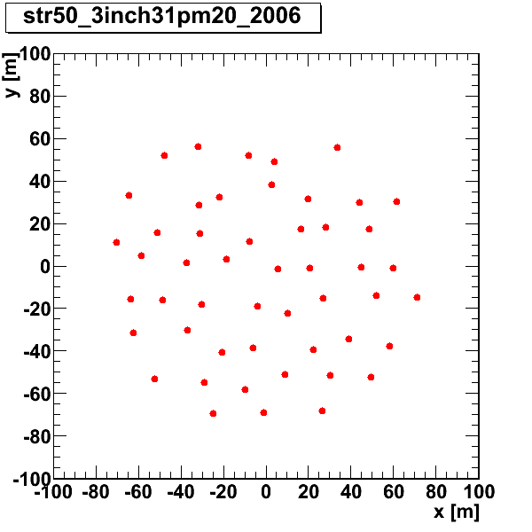
Detector layout
50 Strings
OM=31 3”PMTs
20 OM in each string
6 m vertical distance between OM
20 m average distance between strings
Instrumented volume = 1.75 Mt

Slide 3
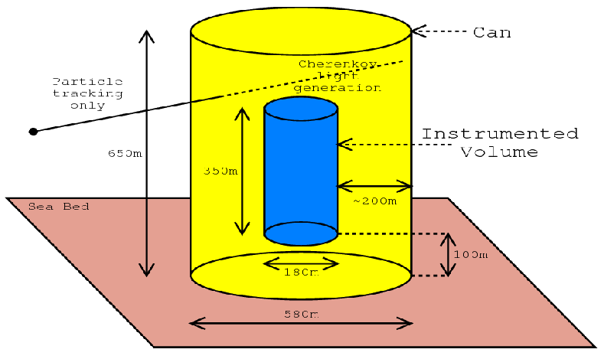
Simulation chain
Genhen (v6r10 seawiet)
Neutrino generator
GENDET
geometry
KM3 (v4r4)
Light & hits
GEASIM (v4r13seawiet)
Light & hits
MODK40
(v4r13seawiet)
⁴⁰K Background hits
RECO
Reconstruction code
(see my talk in the software session)
Notes:
----- Note riunione (06/12/12 00:42) -----
lunghezze di assorbimento o attenuazione

Slide 4
Simulation chain
detector info
Genie
Neutrino generator
Light & hits from muon
Light & hits from hadronic shower
⁴⁰K Background hits
Reconstruction code
Notes:
----- Note riunione (06/12/12 00:42) -----
lunghezze di assorbimento o attenuazione

Slide 5
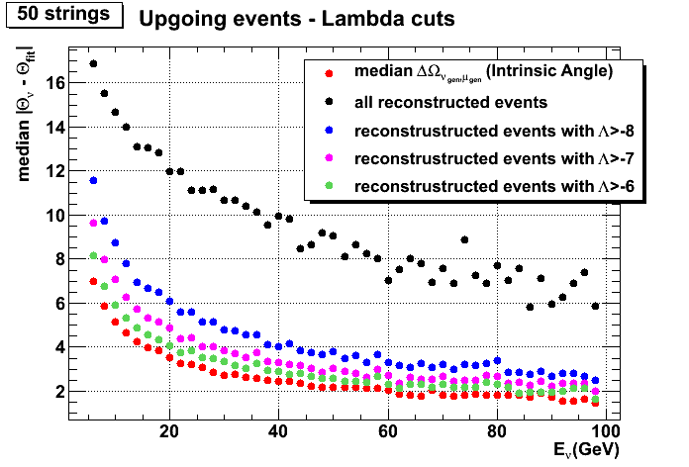
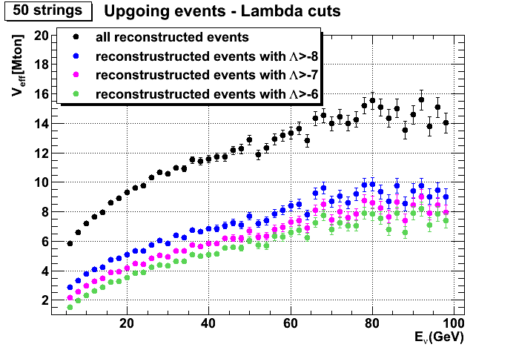
Effective volumes and angular error
θ
With more stringent cuts both the angular error and the effective volumes are reduced
Only events generated inside the can volume (≈100 Mton)
Preliminary

Slide 6
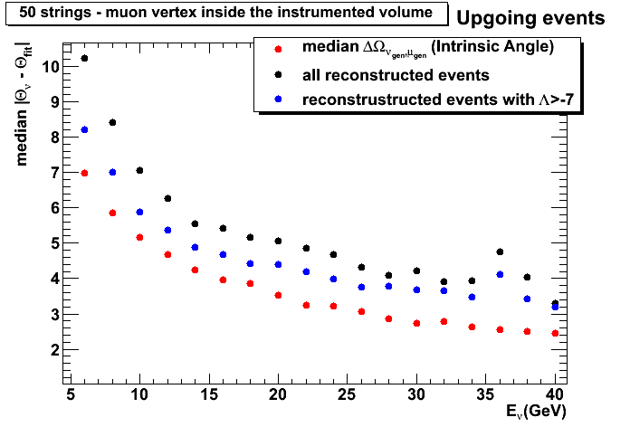
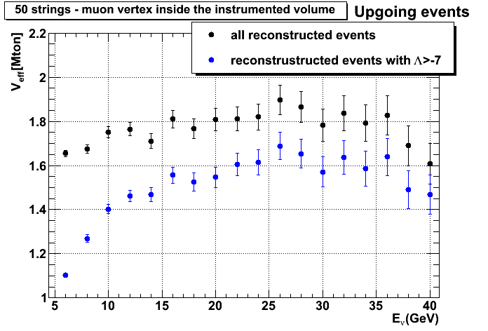
Effective volumes and angular error
Only events with the muon vertex inside the instrumented volume
θ
Public plots?
Preliminary

Slide 7
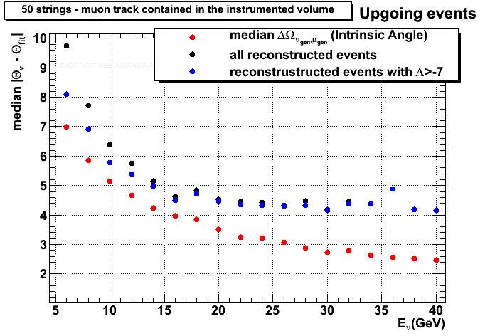
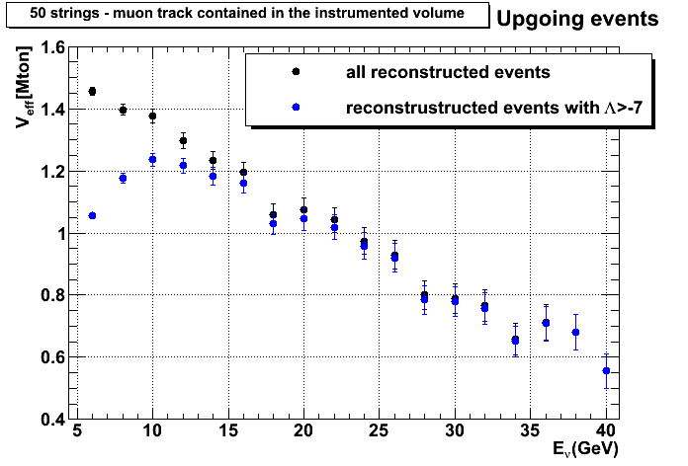
Effective volumes and angular error
θ
Only events with the muon track full contained in the instrumented volume
Probably this condition is too stringent: considering the high absorption length of light in water, an energy estimate will be possible even if the track goes outside the detector
Preliminary

Slide 8
Muon Track length estimate
Results presented in Catania too optimistic: I used unwittingly info about the vertex from the MC truth!
New procedure described in the following slides:
First estimate of the muon track length based on the hits projection on the track ➔ track length overestimated because of hits from hadronic shower
Study of the hadronic shower
Attempt to calculate the vertex from hadronic shower

Slide 9
Muon Track length estimate – part I
From the position P*_{i} and the time t*_{i} of each hit, the photon emission point P_{i} and the emission time t_{i} can be calculated
The distance between the first point P₀ and the last point P_{n} is an estimate of the muon track length
Hit
Hit
Hit
Cherenkov
photon
P*₁,t*₁
P*₂,t*₂
P*_{n},t*_{n}
P₀,t₀
P₁,t₁
θ_{C}
P₂,t₂
θ_{C}
P₃,t₃
P_{n},t_{n}
θ_{C}
Reconstructed Muon track
θ_{C}
θ_{C}
Photon emission point
Hit
P*₃,t*₃
P*₀,t*₀
Hits used:
Hits selected with time residual -10ns<Δt_{res}<10ns
High density of points P_{i} along the track required (1Point/2meter)
Hit

Slide 10
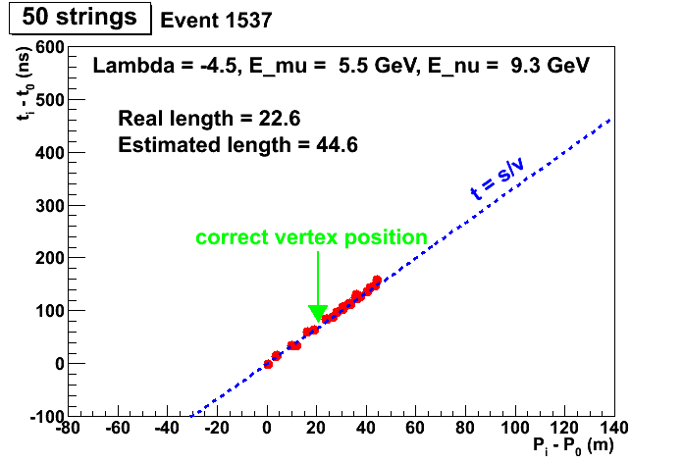
Muon Track length estimate – part I
Hit
Hit
Hit
Cherenkov
photon
P*₁,t*₁
P*₂,t*₂
P*_{n},t*_{n}
P₀,t₀
P₁,t₁
θ_{C}
P₂,t₂
θ_{C}
P₃,t₃
P_{n},t_{n}
θ_{C}
Reconstructed Muon track
θ_{C}
θ_{C}
First vertex estimate
Hit
P*₃,t*₃
P*₀,t*₀
Hit
Track length often overestimated because of hits from hadronic shower
A different vertex estimate in needed

Slide 11
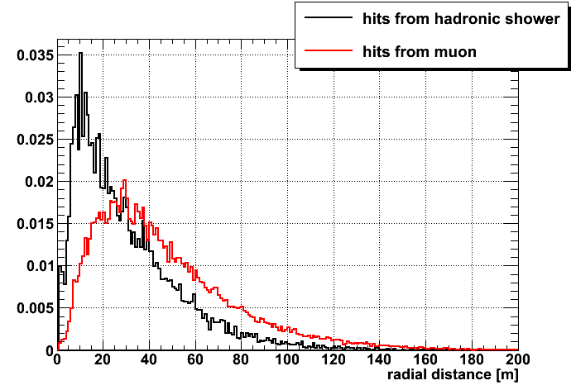
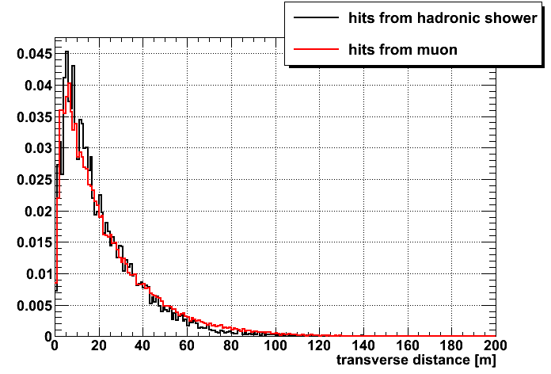
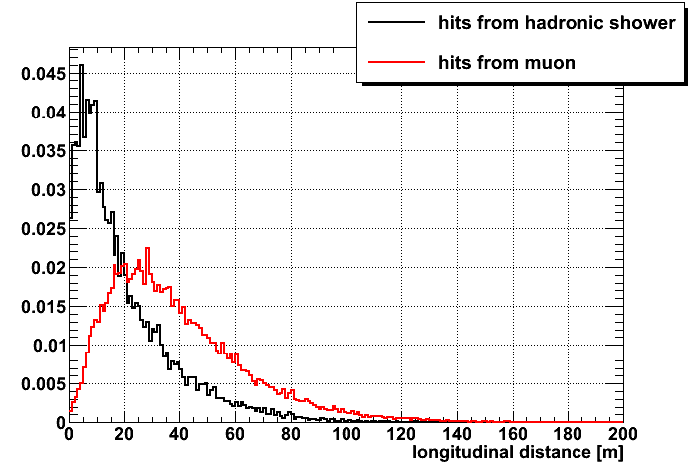
Hadronic shower analysis
Output from geasim ➔ no ⁴⁰K background
Hit
Transverse distance
ORCA detector, E_{ν} < 20 GeV
Radial distance
Muon track
Integrals normalized to 1
90% of hits from hadronic shower have a radial distance <60m
Longitudinal distance
Vertex
ORCA detector, E_{ν} < 20 GeV
ORCA detector, E_{ν} < 20 GeV
Integrals normalized to 1
Integrals normalized to 1
Preliminary

Slide 12
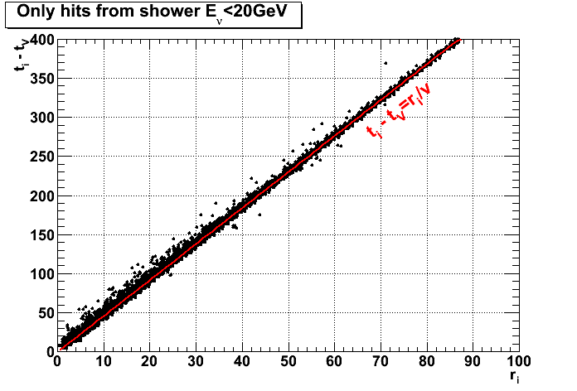
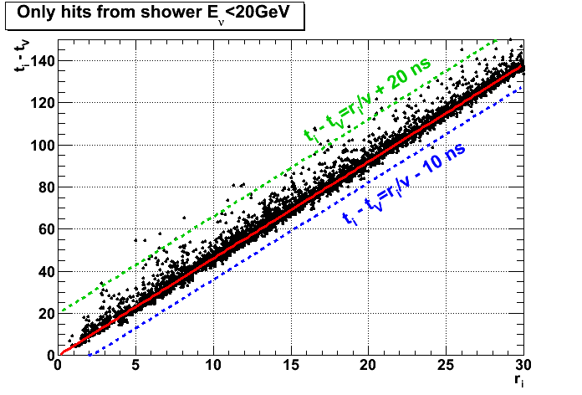
Hadronic shower analysis
Output from geasim ➔ no ⁴⁰K background
Assuming the evolution of the shower as a spherical wave, each hit time should be:
t_{i} = t_{vertex} + r_{i}/v
light speed in water
Radial distance
hit-vertex
zoom
Defining a “time residual” as
Δt = recorded – expected time = t_{i} – (t_{V}+r_{i}/v),
99% of hits from shower have -10ns<Δt<20ns
Preliminary

Slide 13
Hadronic shower vertex
Assuming the evolution of the shower as a spherical wave, each hit time should be:
t_{i} = t_{vertex} + r_{i}/v
From this equation an estimate of the vertex position can be calculated expressing r_{i} and t_{vertex} as a function of the distance along the track between the vertex and the position P’ of the muon at an arbitrary time t’
light speed in water
Radial distance
hit-vertex
Shower Hit
P_{i},t_{i}
r_{i}
Muon track
If vx, vy, vz are the director cosines of the muon track and P’=(x’,y’,z’)
x_{v} = x’ - d*vx
y_{v} = y’ - d*vy
z_{v} = z’ - d*vz
t_{v} = t’ - d/c
Shower Hit
P_{j},t_{j}
P’,t’
d
r_{j}
Muon position at an arbitrary time
Vertex
Shower Hit
P_{v},t_{v}
r_{k}
P_{k},t_{k}
d can be calculated analytically for each hit solving a quadratic equation: 2 solution
Preliminary

Slide 14
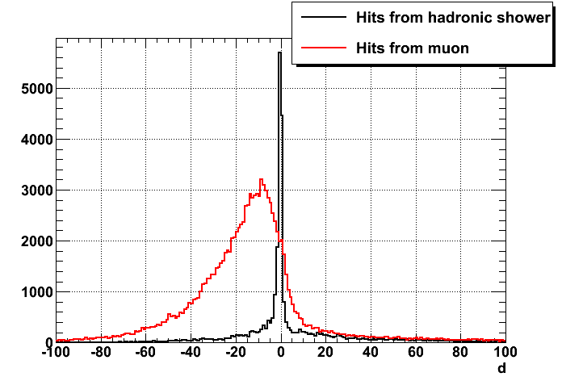
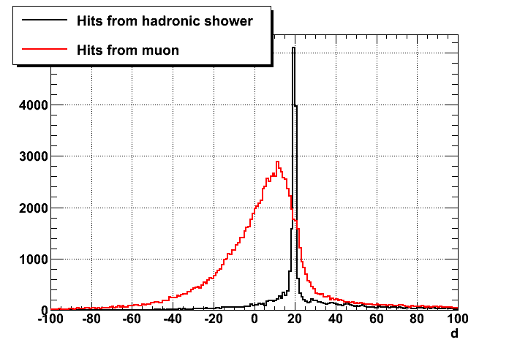
Hadronic shower vertex
Output from geasim ➔ no ⁴⁰K background
To test the calculation of d described before, I used as reference the real muon track
ORCA detector, E_{ν} < 20 GeV
Test I: P’= real vertex ➔ d should be = 0
ORCA detector, E_{ν} < 20 GeV
Test II: P’= real vertex moved of 20 m along the muon track ➔ d should be = 20
Preliminary
13

Slide 15
Vertex + track length estimate
Same procedure applied to the reconstructed track with all hits
Find a peak in the d distribution is complicated because you have a sum of hits from shower + hits from muon + hits from ⁴⁰K
When the peak is not clear I try to clean my hit list using what I learnt about the radial and temporal distribution from the MC truth
Vertex estimate is possible with this method only for 30% of events that have the muon track contained in the instrumented volume and that permit a first estimation of the muon track length with the projected hits (5GeV<E_{ν}<20GeV)
If this method fails, I use the first vertex estimate described before from the first photon emission point
The track length is estimated as the distance between the estimated vertex and the last photon emission point accepted
Preliminary

Slide 16
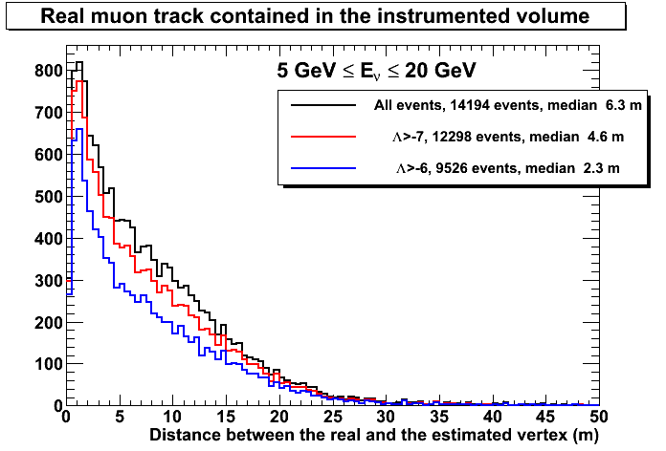
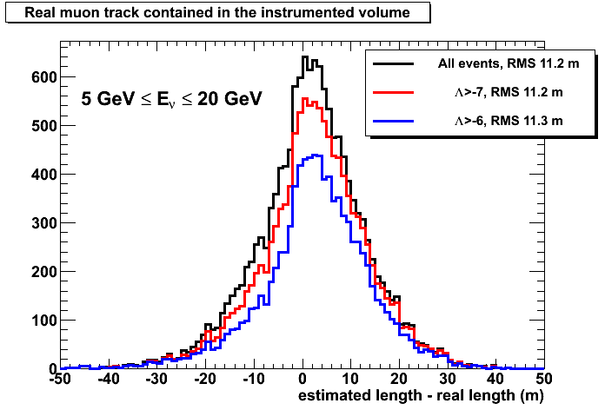
Results: vertex + track length estimate
Events generated with 5GeV<E_{ν}<20GeV and the real muon track fully contained in the instrumented volume:
N_{gen} =16380 events generated with at least 5 signal hits
N_{rec} = 15397 reconstructed events
14149 events permit the track length estimate (L>0)
12298 events permit the track length estimate and have Λ>-7
9526 events permit the track length estimate and have Λ>-6
 | % w.r.t. Nrec
L>0 | 92%
L>0 &&Λ>-7 | 80%
L>0 &&Λ>-6 | 62%
Preliminary

Slide 17
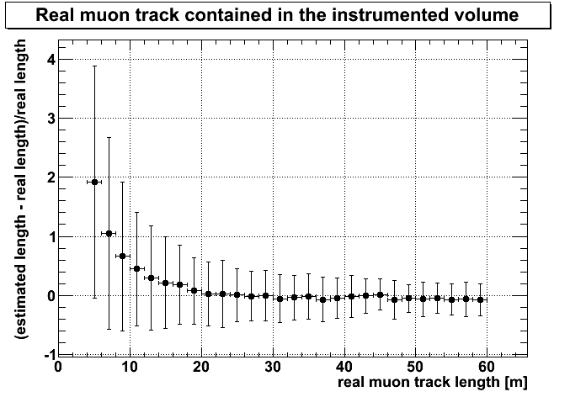
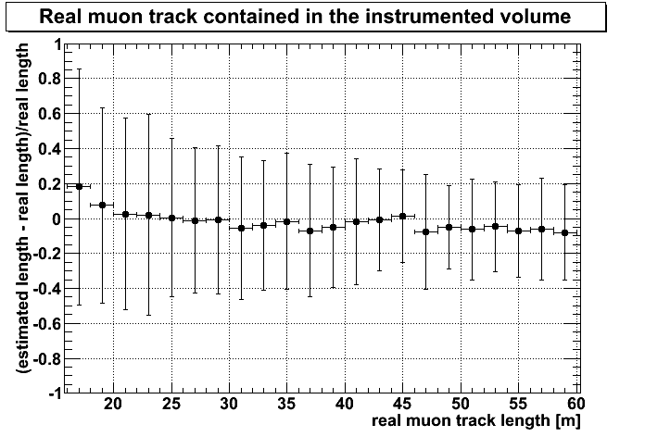
Muon Track length estimate
Only events with E_{ν}<20GeV and the muon track fully contained in the instrumented volume (1.75 Mton)
Horizontal errors: only to highlight each bin range
Vertical errors: standard deviation from the mean value
Events with positive estimated length (L>0)
5 GeV < E_{ν} < 20GeV
Λ>-7
zoom
Preliminary

Slide 18
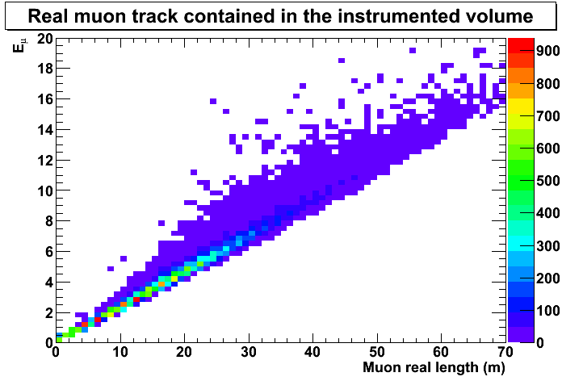
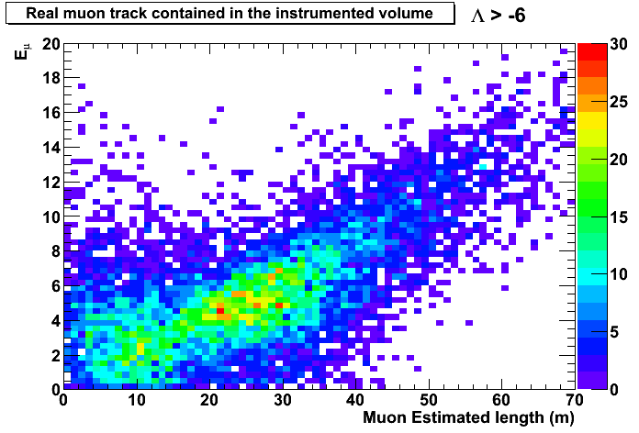
Muon Track length estimate
Only events with E_{ν}<20GeV and the muon track fully contained in the instrumented volume (1.75 Mton)
Preliminary

Slide 19
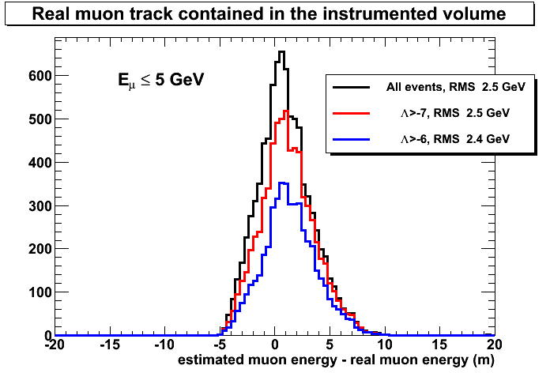
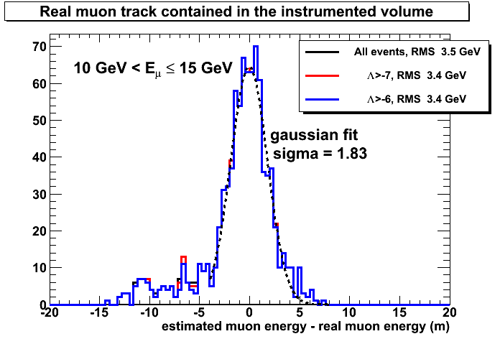
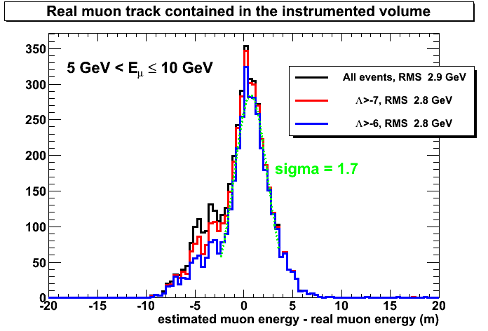
Muon energy estimate
Only events with E_{ν}<20GeV and the muon track fully contained in the instrumented volume (1.75 Mton)
Muon energy calculated from the track length
Preliminary

Slide 20
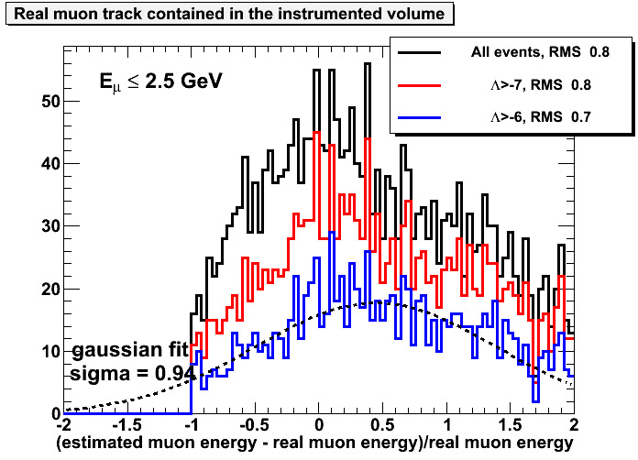
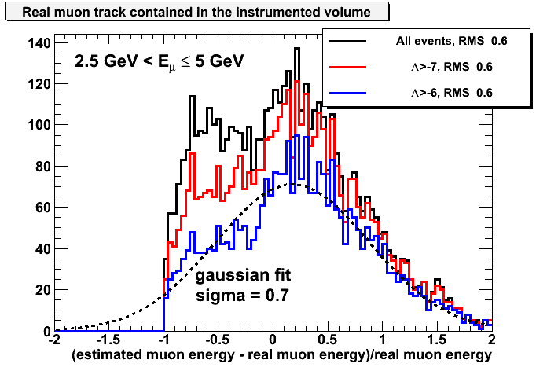
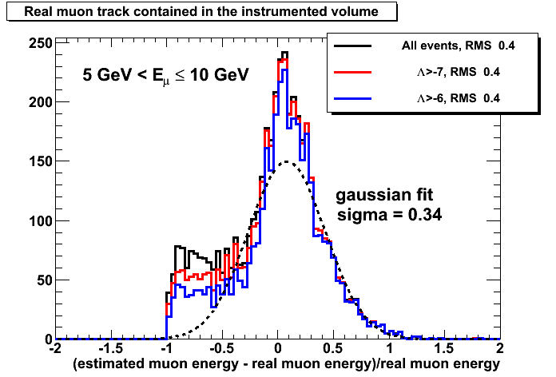
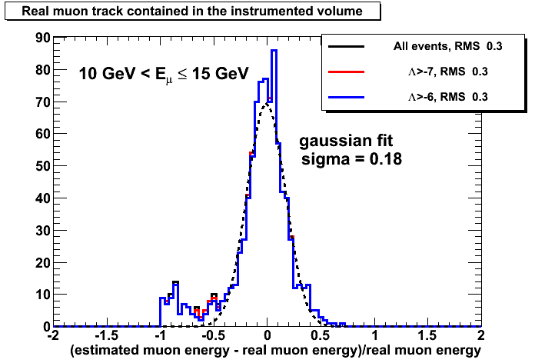
Muon energy estimate
E_{ν}<20GeV
Preliminary

Slide 21
Outlook
Improvement on the interaction vertex estimate using a minimization instead of the analytical solution
Try to estimate the shower energy
Containment conditions and veto
Simulations with genie

Slide 22
Backup slides

Slide 23
Old Muon Energy Reconstruction
Hit
P₂,t₂
For each hit, P₁ and t₁ can be calculated from P₂ and t₂
The relation between d and t = (t₁-t₀) should be d/t = muon speed = c
Maximum value of d=P₁-P₀ can be used to estimate the muon track length
Reconstructed Muon track
θ_{C}
d
P₁,t₁
P₀,t₀
Muon reconstructed position at an arbitrary time
ATTENTION: In my first calculation I’ve used P₀ as an estimate of the vertex position but it’s not correct!
The track reconstruction gives the position P₀ at an arbitrary time t₀=0 and in the simulation t=0 is the interaction time so P₀ is a good estimate of the vertex position only in the simulation!
The vertex position can be estimated from the first P₁ or from the distribution of the hits in the hadronic shower.
Preliminary

Slide 24
