Slide 1

Optical and Power Systems
Eric Heine
Summary;
Optical network issues in MEUST P.Lamare
Progress and outcomes for DWDM optical systems A.D’Amigo
Global overview of the Optical Network for KM3NeT Phase 1 S.Mos
Presentation of CNRS FOTON laboratory M.Gay
MEUST infrastructure power system and control/command M.Acheron
Progress on the Vertical Electro-Optical Cable P.Kooijman

Slide 2
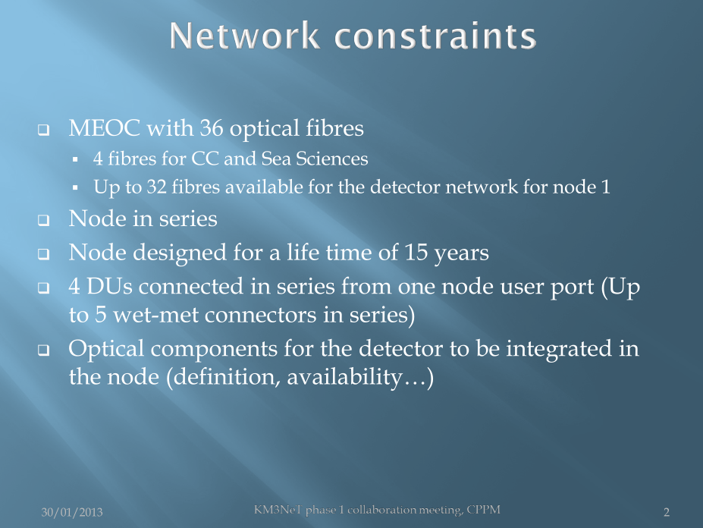
Optical network issues in MEUST
( OALC-7)
Summary, Optical and Power Systems, KM3NeT 310113

Slide 3
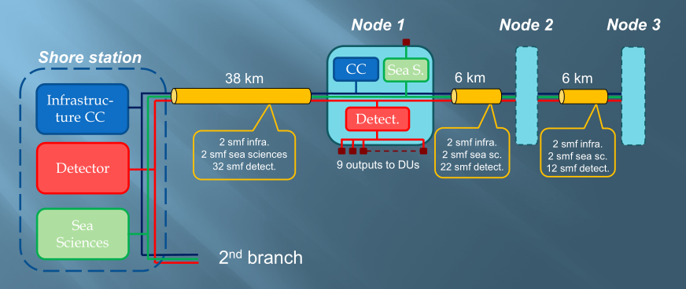
Network set-up
Minimize active components in the nodes;
To minimize the dependecy of the DUs optical network network (different timescale)
To allow network adaption before deployment
Some parts moved from node to DU
Cc = infrastructure control

Slide 4
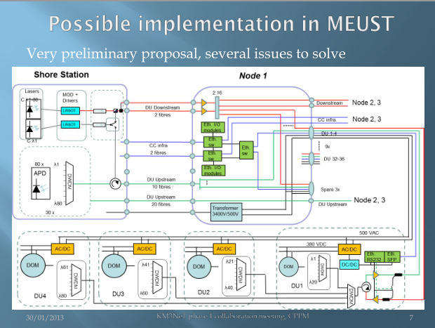

Slide 5
Status
Answers needed;
Definition of DU optical network
Definition of components to be integrated in the node
Validation of the DU in series concept
Planning;
Construction of the infrastructure underway
Design done to be flexible… with some limits!!!
Several issues to be solved
Critical;
For infrastructure development
  DU optical network
  Validation of DUs in series

Slide 6


Progress and outcomes for DWDM optical systems
Km3NeT COLLABORATION meeting
CPPM – MARSEILLE – 29-31/1/2013
A. D’Amico

Slide 7
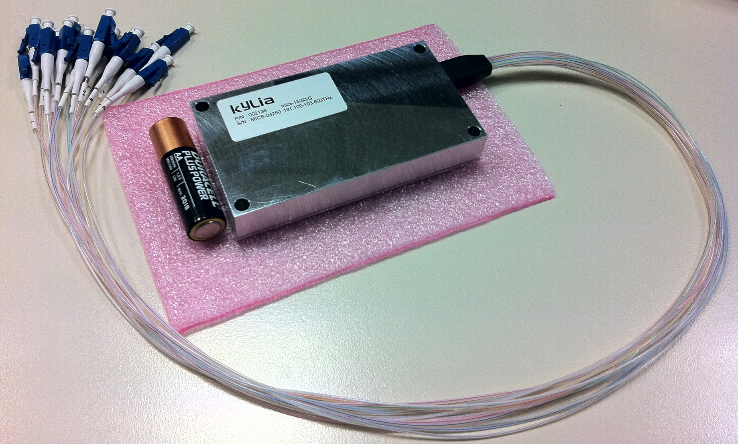
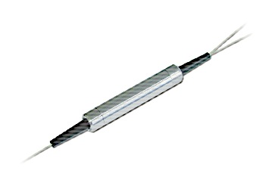
Device properties
DWDM Optical Transport in C-Band and L-Band
  Bandwidth, channel capacity, laser sources, simulation
Passive devices: DWDM multiplexers and Band couplers
Active devices: Amplifiers
Multiplexing for KM3NeT-It DUs
Infrastructure Capacity
Data transport loopback measurements @ Capo Passero
15 channel DWDM multiplexer
15 channel band coupler
Well known device
Already deployed off-shore in NEMO phase 1 Junction box (2005)
First 2 units have been already delivered to LNS for preliminary tests

Slide 8
Active devices: amplifiers
Amplification:
  Raman: bandwidth can be adapted on project requirements
    Gain is typical 15 dB and depends on:
      fibre type and total span length
      amount of optical pumps power coupled into the transmission fibre
      Could be used on-shore to supply a distributed gain along the transmission fibre
  EDFA: fixed and limited bandwidth
      1529 nm to 1565 nm C-Band
      1568 nm to 1604 nm L-Band
      High output power stage for booster EDFA is required as the number of channels increases
      Could be used both off-shore or on-shore
number of channels | booster output power | booster output power | photodiode sensitivity | power budget | available margin | available marging
 | total [dBm] | per channel [dBm) | @ 1G | per channel [dB] | after 100 km fiber | after 50 km fiber
1 | 26 | 26 | -34 | 60 | 41 | 50
2 | 26 | 23 | -34 | 57 | 38 | 47
4 | 26 | 20 | -34 | 54 | 35 | 44
8 | 26 | 17 | -34 | 51 | 32 | 41
16 | 26 | 15 | -34 | 49 | 30 | 39
32 | 26 | 12 | -34 | 46 | 27 | 36
64 | 26 | 9 | -34 | 43 | 24 | 33
These margins are then available for passive mux-demux, routing and connectors
A. D’Amico

Slide 9
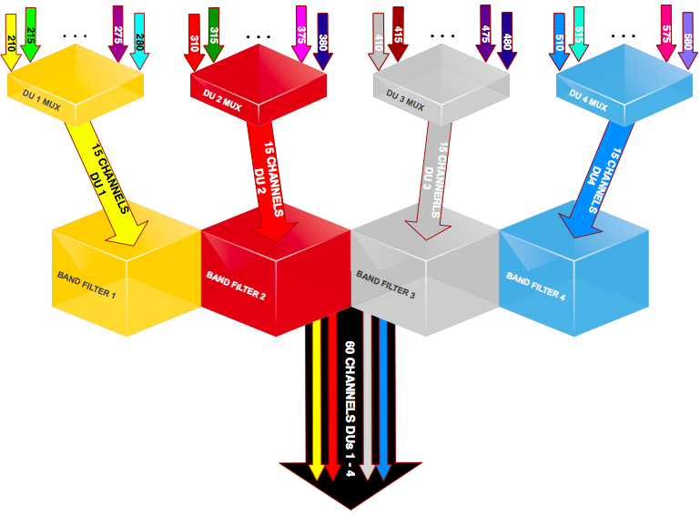
MULTIPLEXING FOR KM3NeT-IT DUS
Optical MUX
15 colours
50 GHz grid
Junction Box BAND MUX
15 colours
each sub-band
ITU ch.21-28
ITU ch.31-38
ITU ch.41-48
ITU ch.51-58
Submarine Cable
4 DUs over 1 fibres
60 colours per fibre
A. D’Amico

Slide 10
Status
Progress and outcomes for DWDM optical systems;
DWDM Optical Transport in C-Band and L-Band (Bandwidth, False channel products)
Passive devices: DWDM multiplexers and Band couplers (spacing. fanout, channel overlap)
Active devices: Amplifiers (Raman, EDFA)
Multiplexing for KM3NeT-It DUs
Infrastructure Capacity
Data transport loopback measurements @ Capo Passero
Activity Status:
DUs:
  multiplexer/demultiplexer has been already delivered
  SFP laser should be ordered (same class used in NEMO phase-2 but on 50 GHz grid)
Junction box:
  band coupler has been defined (same deviced used in NEMO phase-1 Junction box) and should be ordered soon:
    The market survey has shown that maximum 4 band couplers can be used to work on the same fibre in the DWDM spectral region (C-BAND)
    Each coupler can mux/demux maximum 15 channels @ 50 GHz spacing
    1 and 2 imply → 60 channels per fibre
On-shore optical amplifier (booster and preamp) have already been successfully operated for NEMO phase-2

Slide 11
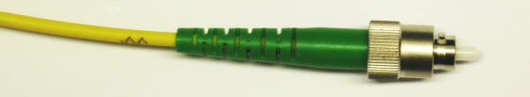
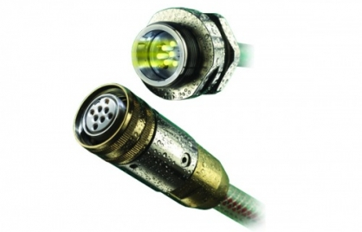
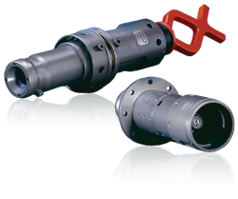

Global overview of the Optical Network for KM3Net Phase 1
FC/APC connector
Dry mateable connector
Wet mateable connector
Use as less connectors in an optical path as possible!
Attenuation
Backreflection
Handling
When properly done a fusion splice is the most reliable connection.
Fusion Splice

Slide 12
Global overview of the Optical Network for KM3Net Phase 1
Amount of amplification depends on input signal levels
Amplification is wavelength dependant
Input
Output
Optical power
Optical power
Optical power
Optical power
Optical channels
Optical channels
Wavelengths
Wavelengths
Shaping of the input spectrum to correct for wavelength- and optical power- dependent amplification

Slide 13
Redundant or segmented network?
1 Downstream fibre
1 Redundant downstream fibre
Shorestation
Junction Box
DU
DU
DU
DU
Return fibres
OR
N Downstream fibres for N segments
Shorestation
Junction Box
DU
DU
DU
DU
Return fibres
Segment 1
Segment N+1

Slide 14
Preliminary Design for Phase 1 with 40 / 80 Channels
Design with redundant optical paths
Lasers
MOD + Drivers
40-80λ CW +
1λ AC
@1.25Gbps)
Solidstate Switches
λ81
2:16
2 x
2:16
LiNbO3
λ1-80
Redundant fibre
16x
Redundant fibre
16x
LiNbO3
2:16
2:16
SMA
BNC
λ81
16x
λ81
16x
SMA
SMA
λ1
40 - 100 km
14 x
APD
16 x
λ1-80
D1
C2
N fibres
16 fibres
λ80
First Node
Last Node
Shorestation
C-Band 1528-1568 nm
L-Band 1568-1610 nm
λ81
1:4
Channel
50/50
[1,5…77] + 81
[2,6…78] + 81
1:20
[3,7…79] + 81
λ81
[4,8…80] + 81
50-200 GHz
λ1
on/off
D
DOM
50-200 GHz
Channel
λ20
DU-String
λ1
[1,5…77]
[2,6…78]
200 GHz + 50GHz DWDM
[3,7…79]
[4,8…80]
Intermediate optical unit

Slide 15
Overview
Optical connectors are the most troublesome and unreliable parts in an optical network.
Use as less connectors in an optical path as possible!
The number of EDFA’s that can be connected in series is limited by the OSNR.
A system with 40 channels is foreseen for the first stage and this will later be extended to 80 channels.

Slide 16
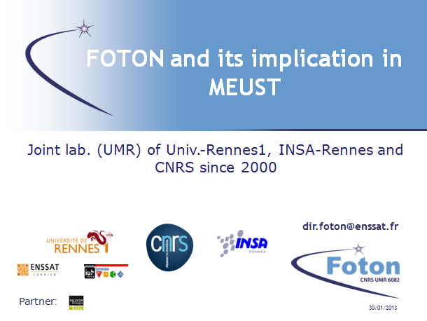
FOTON and its implication in MEUST

Slide 17
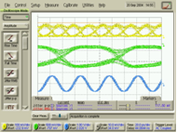
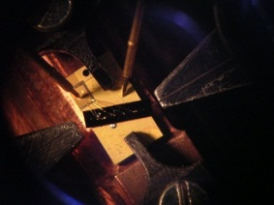
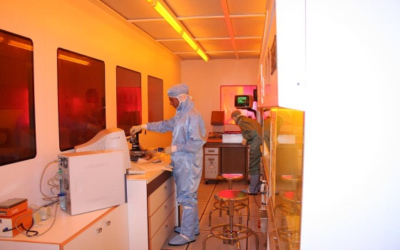
Main research fields
17
Cutting-edge research where Physics (optics & photonics) meets ICT Science (Telecom systems and sensors networks)
Broad research area from materials and basic research to optical transmissions, including also several application domains (Life science, security, industry, etc.).
  Photonics for Telecom network systems
  Semi-conductor nanostructures for Photonics
  Technologies & Photonics devices: Integrated optics and sensors
30/01/2013
30/01/2013
Clean room class 100 and mask aligner

Slide 18
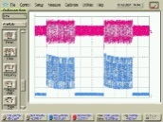
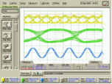
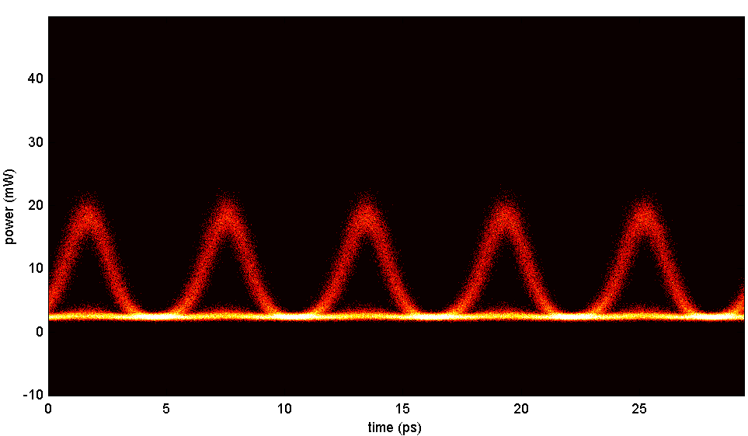
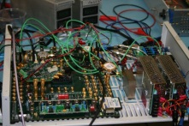

PERSYST platform
Platform for tEst and Research on optical telecommunications SYSTems (2004)
Public structure offering test-bed facilities for the characterization of components for optical communications.
Its expertise :
  Optical transmission systems
    10 Gbit/s : optical access network (transmitter/receiver)
    40 Gbit/s : WDM recirculation loop (40 channels, 100 GHz spacing); Modulation formats (NRZ, RZ, CSRZ, DPSK, DQPSK(56 Gbit/s))
    160 Gbit/s : Advanced optical functions, recirculation loop
  Characterisation of photonic and opto-electronic components in system environment
    Chip characterisations (static and dynamic)
    High speed electronic interfaces up to 112 Gbit/s (receivers, transeivers based on FPGA, electronics functions for TDM, etc)
    Bring electronics capability close to optics
30/01/2013

Slide 19
FOTON role in Meust
Recently contacted by CPPM for system validations:
  Lab experiments (march 2013):
    Minimum 2 λ - 50 GHz spacing - in the C-band
    Equivalent loss and chromatic dispersion of worst case
    Continuous data stream at 1 or 10 Gbit/s of Pseudo Random Bit Sequence (2³¹-1 bits) - Non Return to Zero data
    Use of the REAM of the project (provided by CPPM): condition of use must be defined (Vpp – rising and falling time etc)
    Based on the architecture of the final system (need information on place and type of amplification, receiver information etc.)
    Bit Error Rate, eye diagram analysis
  Final system validation assistance : at CPPM with 80 λ and the full system (true transmitter, receiver) (summer 2013)
  Study of the possibility to use ‘Antares’ cable for nodes 4 to 6 (summer 2013)
KM3NeT meeting

Slide 20
MEUST infrastructure power system and control/command
Power system
Onshore
New power hut
UPS
Variable power
Offshore
Artery cut
Local energy
DU supply
Integration
Control Command
Onshore
Power hut organisation
Offshore
Technology
Network
Network redundancy
Internal organisation
Hardware redundancy
Optics
Local energy management
Software
Stéphane Théraube Michel Ageron Km3Net meeting CPPM 2013 jan 30th

Slide 21
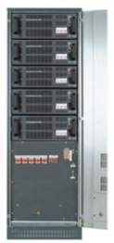
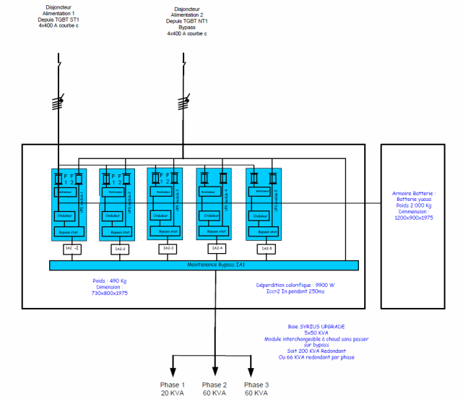
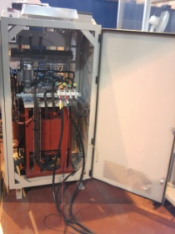
Shore station
Presently we have 3 x 30kVA modules
We can supply one full node
Micvar 3kW
Micvar 3kW
Thermo-magnetic circuit breaker
Thermo-magnetic circuit breaker
Thermo-magnetic circuit breaker
Variable power 54kVA
230V / 1 033 V – 3 720 V
Thermo-magnetic circuit breaker
Thermo-magnetic circuit breaker
Self
Adjustable compensation inductance
From 1,1H to 1,47H
Self.
Thermo-magnetic circuit breaker
Outlets
(phone, computer, …) 230V, 16A
Lighting 230V, 500W
3 air conditioning 230V, 15kW
Seabed network1
Seabed network 2

Slide 22
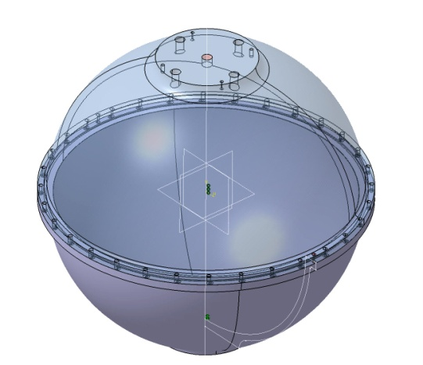



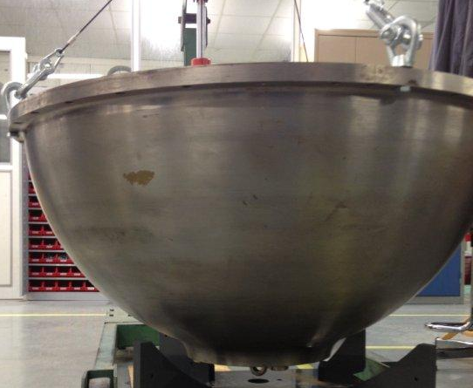

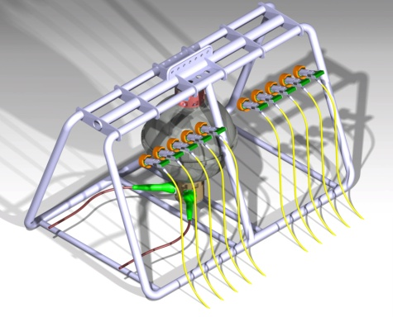
Node block diagram
Previous node
CM2
Next node
K2
K1
Electrode
Q15
Q16
Q17
Q18
Q20
Q19
CM1
Battery charger
Battery charger
Legend
Current monitor not secured
Current monitor secured
Voltage monitor not secured
Voltage monitor secured
AC/DC
Redundant AC/DC
30V
27.2 tension de maintien 28.8V charge
CM1
3400V
24V ?
test connector 24V
CM7
T1
CM4
VM3
500V
230V
VM2
VM4
VM1
VM3
Battery 24V
VM1
CM5
VM5
K7
K8
CM3
CM6
CM7
DUs optics
not secured
secured
Qx Breaker
Kx Switch
Ctrl/cmd infra
Instru-mentation
External pression = 350bars
K3
K4
K5
K6
CM7
CM8
CM9
CM10
CM11
CM12
CM13
CM14
CM15
CM16
CM17
CM18
CM19
CM20
Q1
Q2
Q3
Q4
Q5
Q6
Q7
Q8
Q9
Q10
Q11
Q12
Q13
Q14
Manifold 1
Moved manifold 2
Manifold 3
Sea sciences

Slide 23
Power: project status
 | Done | In work | To do
General | Network study in steady state | MEOC modeling | Network study in transient state Study of start / stop system sequence
Power hut | Infrastructure building UPS ordered Variable power ordered and tested | Electrical installation Air conditioning Safety equipments | Equipment installations
Node | Cut artery defined and tested AC/DC converters delivered | Step-down transformer Protection system Battery backup Current sensors | Voltage sensors HV test with cable simulator
DU |  |  | Study of the AC/DC converter

Slide 24
Progress on the Vertical Electro-Optical Cable
P.Kooijman
UU/UVA/Nikhef

Slide 25
Present design
Two halves
6.3 mm LDPE tube
12 Draka G.657 single mode Bend Bright fibres
2 AWG18 copper conductors (insulated)
Siemens Midel 7131 oil.
Bottom of String Module
Break-out Electro-Optical cable
DOM
Optical Fan-out Module
1 fibre
penetrator
2 fibre
penetrator
Break-Out Box
11 fibre
penetrator
Bottom Half
Top Half

Slide 26
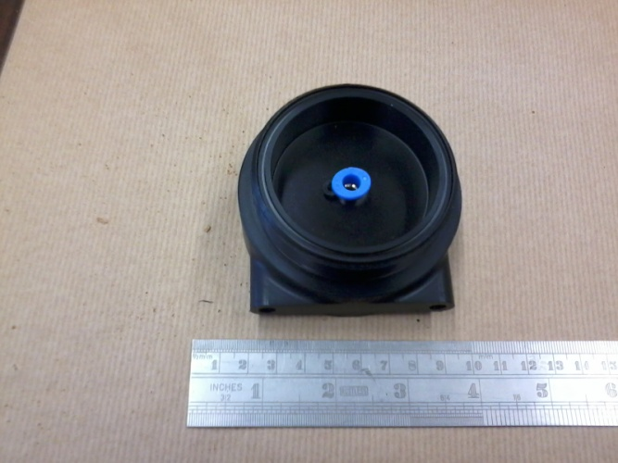
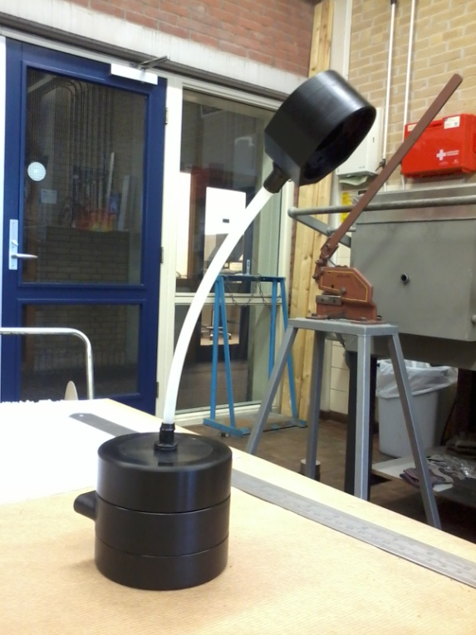
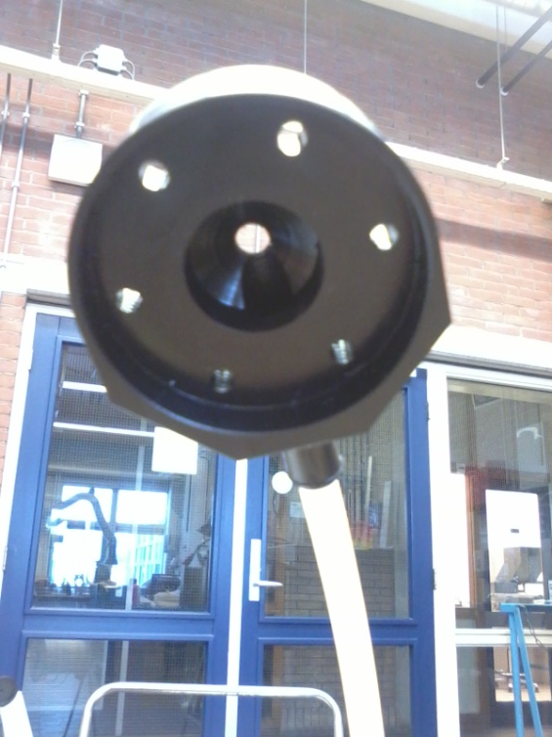
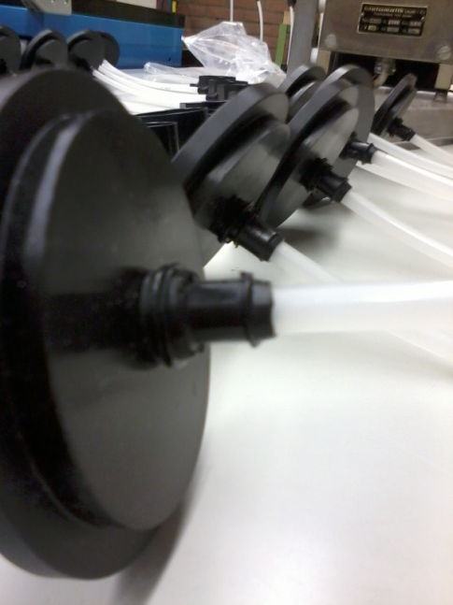
BOB in real life
Fibre container with oil filler
BOB total
Top of Penetrator
BEOC flange

Slide 27
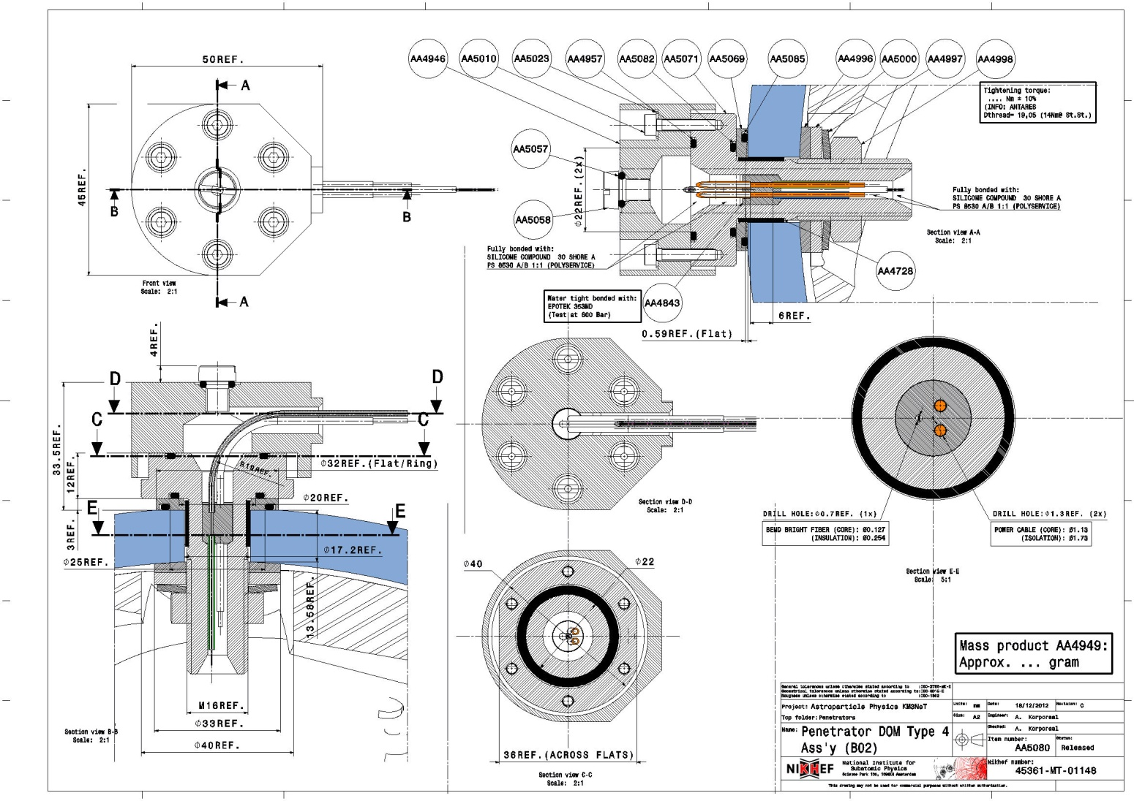
Penetrator
Decided to go with conventional nut secured penetrator rather than conical plug
Main reasons are for ease of assembly
Also plug turns out to be quite fragile (scratches)
HIER WERKTEKENING

Slide 28
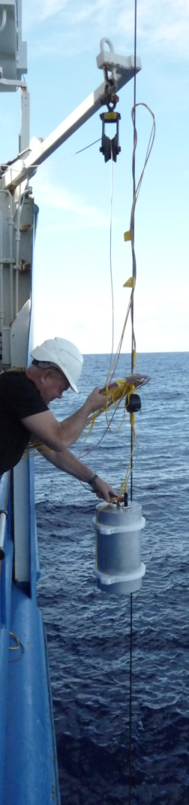
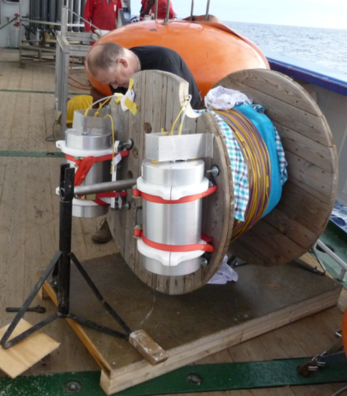
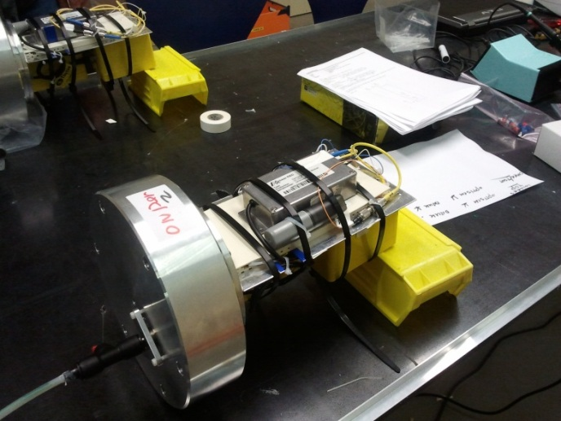
Test at 5000 m
Deployed vertically at 5000 m depth in Atlantic
Measured attenuation in fibres
Checked for leaks
Pressure distribution over cable

Slide 29
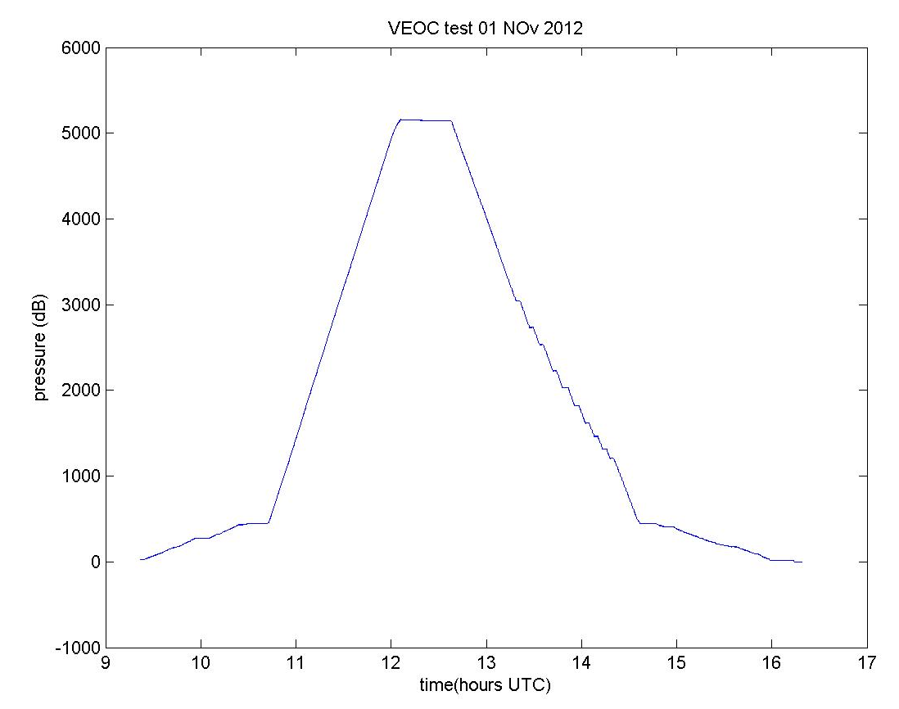
Test – 1A
5000 m
Pressure has effect but....
  One side affected before submersion
  Test while dismantling boxes showed return to ~0db when other container was opened
  Fibres inside containers were probably pinched and were very sensitive fibre
  Effect could be mostly reproduced in the lab
The cable survived in tact and did not leak
Doesn’t need kit gloves
bar
2
1
0
-1
0
-1
-2
-3
-4
-5
-6
db

Slide 30
Schedule
At present 3 cables (i.e. 6 halves) are being prepared for the deployment tests in April
  Two will have only copper for the first mechanical tests
  One with fibre also and with full breakout to DOM Spheres
PPM-DU cable follows

Slide 31
Summary
Optical components
Capo Passero network tests going on
Increase of Interpretation of component properties
Expert field (manpower) is increasing
Design effort (manpower) has to increase (planning)
Simulation software is improved and available (commercial)
Power components
MEUST network (ac) is calculated, reviews going on
MEUST infra control under design, up to reviews
MEUST network components on schedule
VEOC, validation phase
DU in series has to be validated

