Slide 1
The PPM Session ppm DOM project– Patrick Lamare REX on PPM DOM – Jan willem SCHmelling PPM DU project – sylvain henry PPM DU optical network - Jan willem SCHmelling PPM DOM calibration – Konstantin Yatkin MINI DOM – vlad popa
Sylvain Henry

Slide 2
PPM DU: what is it?
A step in the in situ validation program of the strings
VEOC prototype in Atlantic - nov 12
PPM DOM on ANTARES IL12 - feb13
LOM qualification deployment method / PPM VEOC
/ Full length DU - apr13
PPM DU – June13 ↔October13
Deployment with LOM
Real VEOC/BEOC
Power board, acoustic piezo, compass/tilt meter and nanobeacon
PMT ETL & Hamamatsu
Measurement of PMT single & coïncidence rates, time residuals,
synchronisation between DOM
No instrumentation in DU foot
No Optical fan out module
Obsolete generation of CLB v1
Engineering DU →2014

Slide 3
PPM DOM

Slide 10
PPM DOM
CLB v1
2 λ for
SC & data
Instead of 1

Slide 11
PPM DOM Meas.

Slide 12
PPM DOM Meas.

Slide 13
PPM DOM Meas.

Slide 14
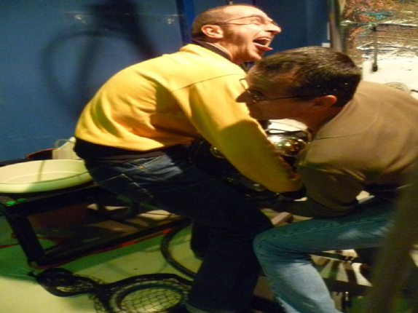
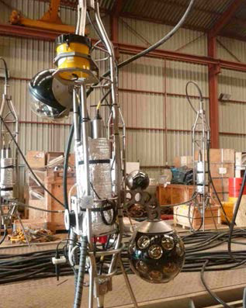
PPM DOM

Slide 15
PPM DU: Configuration
Buoy
Floor 6
DOM
Requirements
Validation of the nanobeacon
Promote inter-DOM coincidences
rather than water column investigation
Length limited # ANTARES line
for safety
2 fibers /DOM
Possibly external hydrophones
40m
Floor 5
DOM
Floor 4
#400m
Floor 3
DOM
Floor 2
Floor 1
Base container
AC/DC converter – Off shore optical network
DW
Allow for a safe recovery (ROV assisted) of the DU
Notes:
CTD Conductivity Temperature Depth sensor
ADCP Acoustic Doppler Current Profiler: int and direction of sea current
CT:conductivity and temperature of the sea water
C-STAR: light attenuation of the water

Slide 16
CLB v1
2 λ for
SC & data
Instead of 1

Slide 18
PPM DU Planning
 | Jan13 | Feb13 | Mar13 | Apr13 | May13 | Jun13 | Jul13 | Aug13 | Sep13
Sea qualification (mech. DU) |  |  |  | xx..
DOMs assembly |  | .. xx | xxxx | xxxx
Optical network | xxxx | xxxx | xxxx | xx
Anchor design |  | xxxx | xxxx | xxxx
Base container |  | xxxx | xxxx | xxxx
VEOC production | xxxx | xxxx | xx..
DU lab. tests |  |  |  |  | xxxx
Assembly |  |  |  |  |  | xxx.
Deployment |  |  |  |  |  | …x | x…
Operations |  |  |  |  |  |  | xx | xxxx | xxxx

Slide 19
+
Modify soft for 3 DOM
+
Tests & characterization of 3 DOMs
Modify ANTARES
DARK ROOM ?

Slide 20
« PPM PMT »
miniDOM

Slide 21
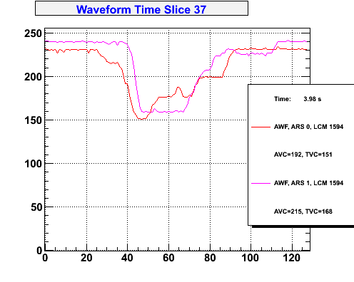
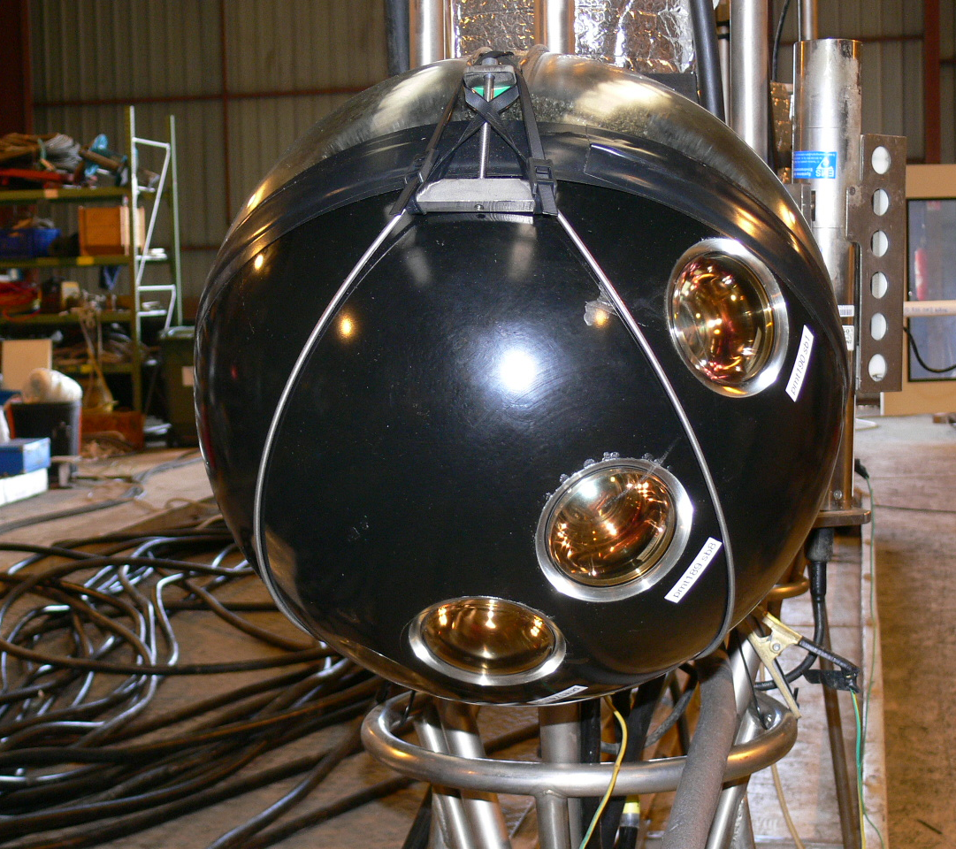
« PPM PMT »

Slide 22
PPM DU
2011-2013
→ 2014
Mini DOM
ENGINEERING DU
Fully Phase 1
nominal
PPM DOM

