Slide 1
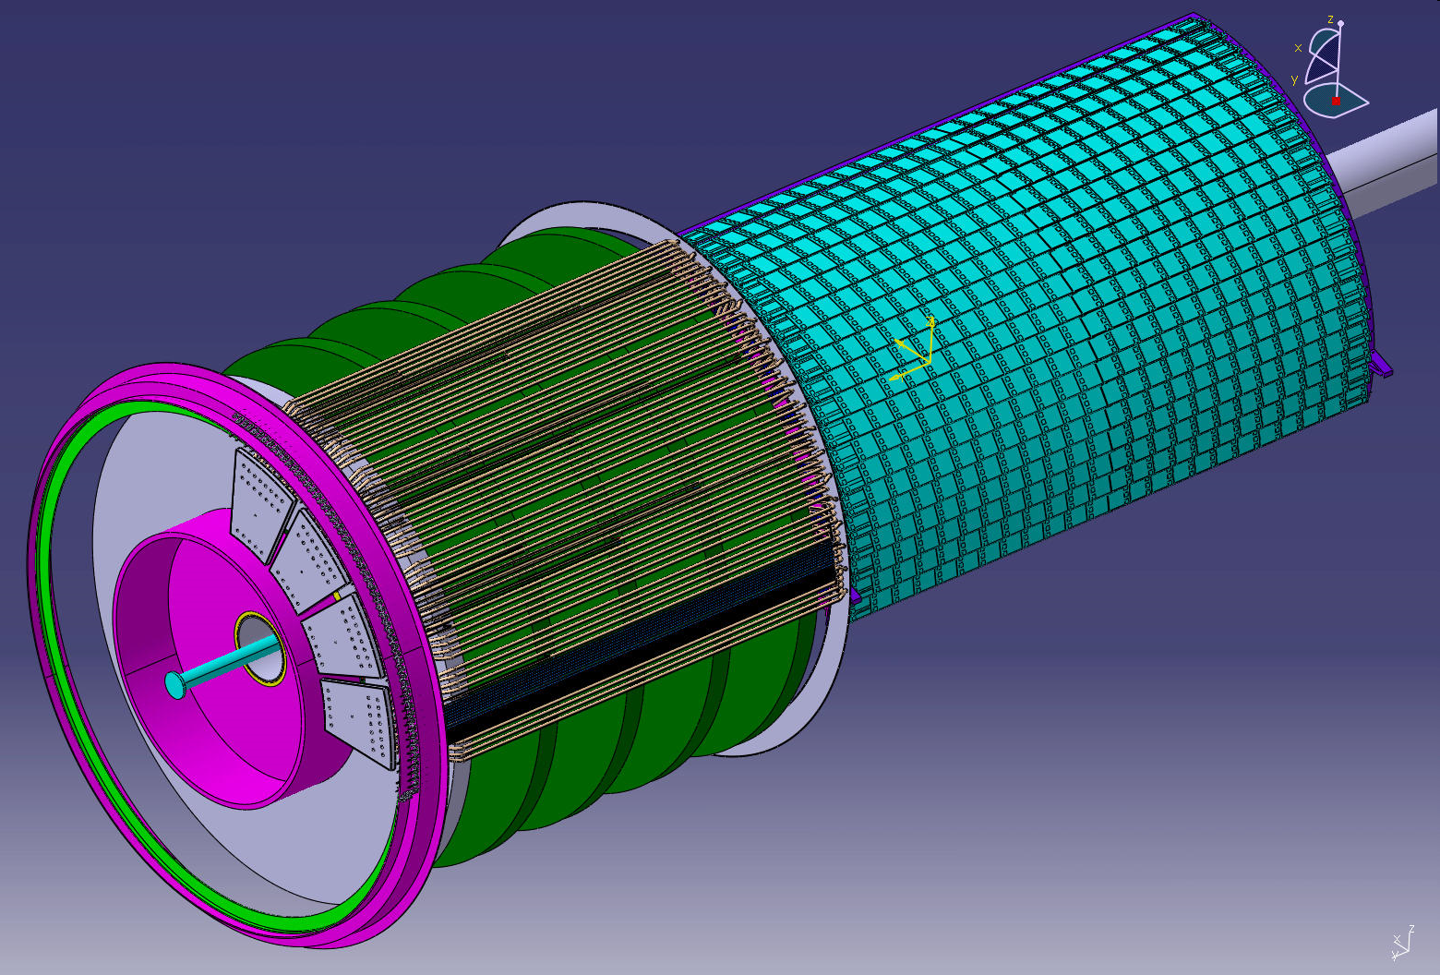
PP1 developments at LAPP Nicolas Massol, on behalf of the LAPP team ATLAS Upgrade Week CERN, Nov 20th 2012

Slide 2
PP1 design
Based on a moveable PCB :
patch-panel + cables rerouting + environmental barrier

Slide 3
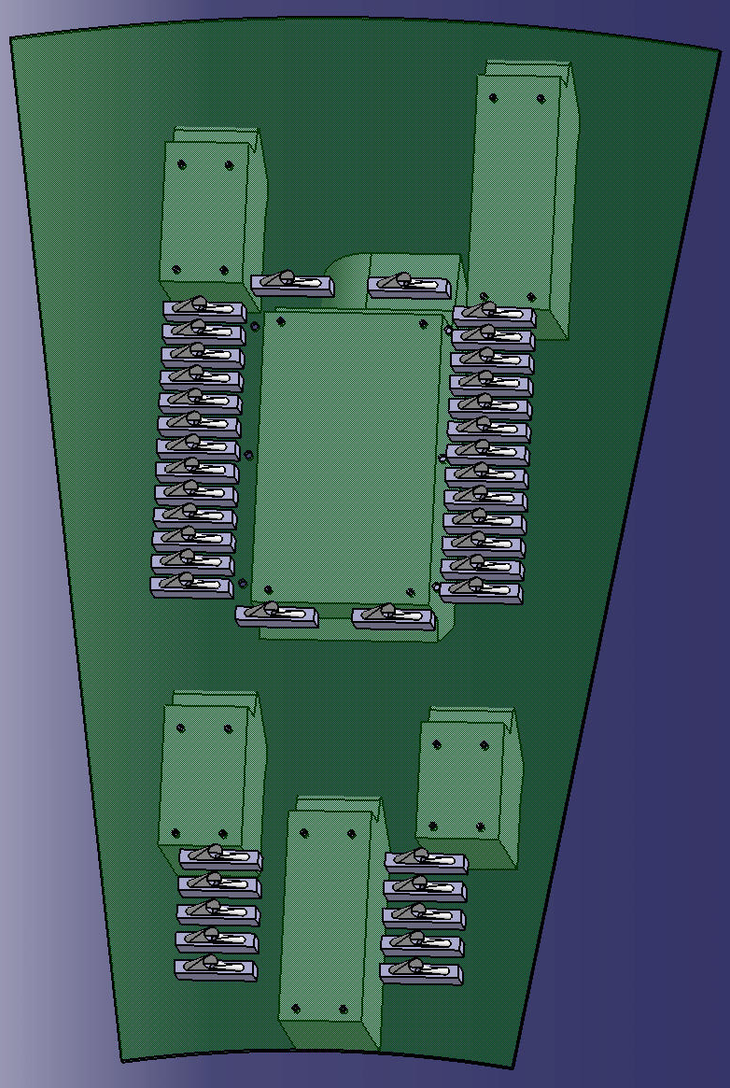
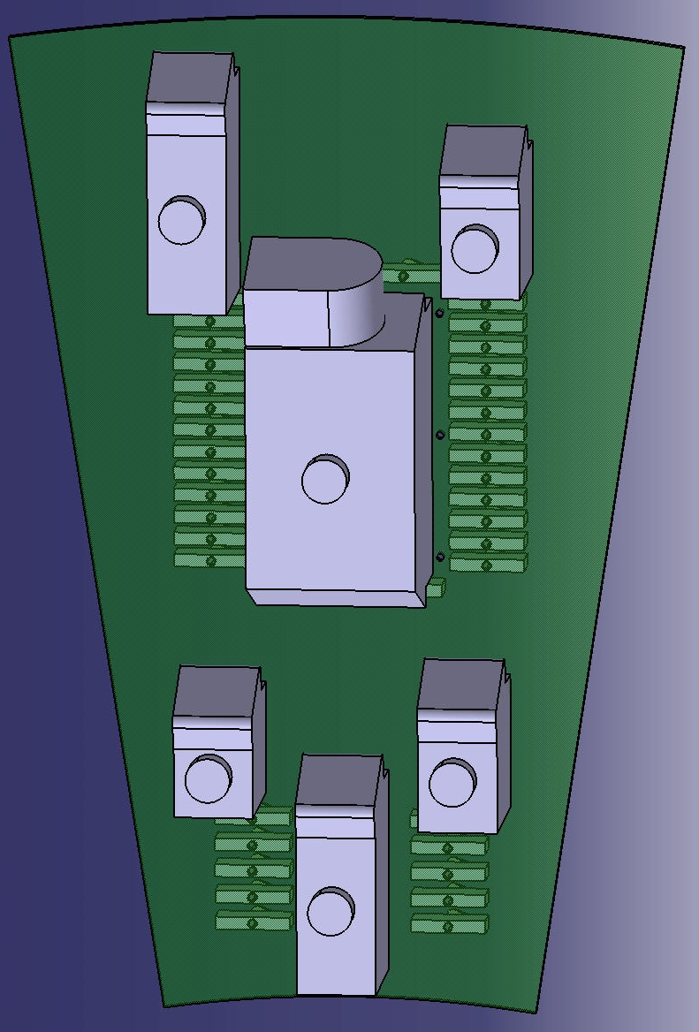
PP1 based on a PCB
Type I side
Type II side
AXON hybrid nano-D
Hypertac

Slide 4
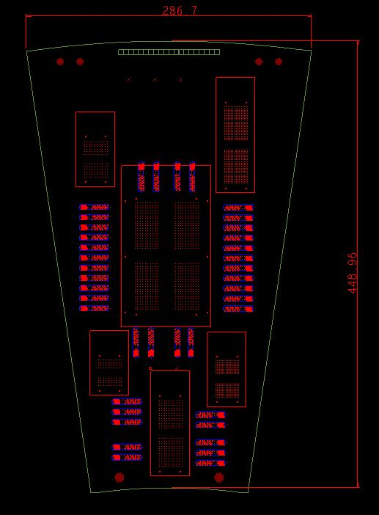
The MAPP (Moveable ATLAS Patch-Panel) Board
Specifications :
20 Layers
Total thickness : 2,76mm
Top and Bottom layers for LV signals
8 Inner layers for the HV signal
10 Inner layers for DCS differential pairs
Components :
6 Hypertac connectors
40 Axon nano-D connectors

Slide 5
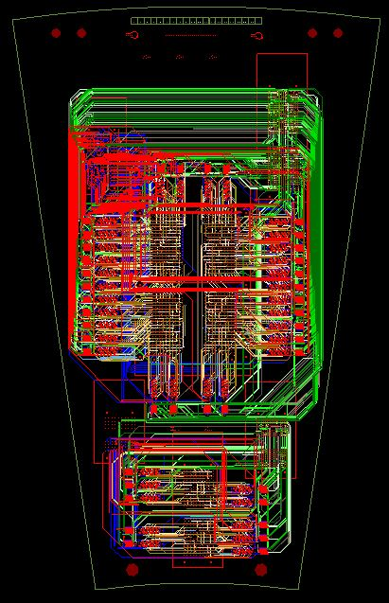
The MAPP Board : routing
Number of pins :
DCS : 1600
HV : 1920
LV : 320
GND : 228
PCB area : ~1000 cm² (including mechanics)
Electrical part area: ~600 cm²
PCB produced and received, not yet tested

Slide 6
The Axon type I harness: new version
Electrical tests on the first version:
HV spark on the 12 channels: around 1.5kV → safety margin not big enough
Weak point in this design : distance between pins row and metallic shell
Air gap between male and female inserts is also a weakness
Modification of the current design:
Before After
Wall thickness of the female metallic shell / length of the male metallic shell decreased
Mechanical tolerance on the insert part removed → tolerance now on the shells
New order placed for a new harness

Slide 7
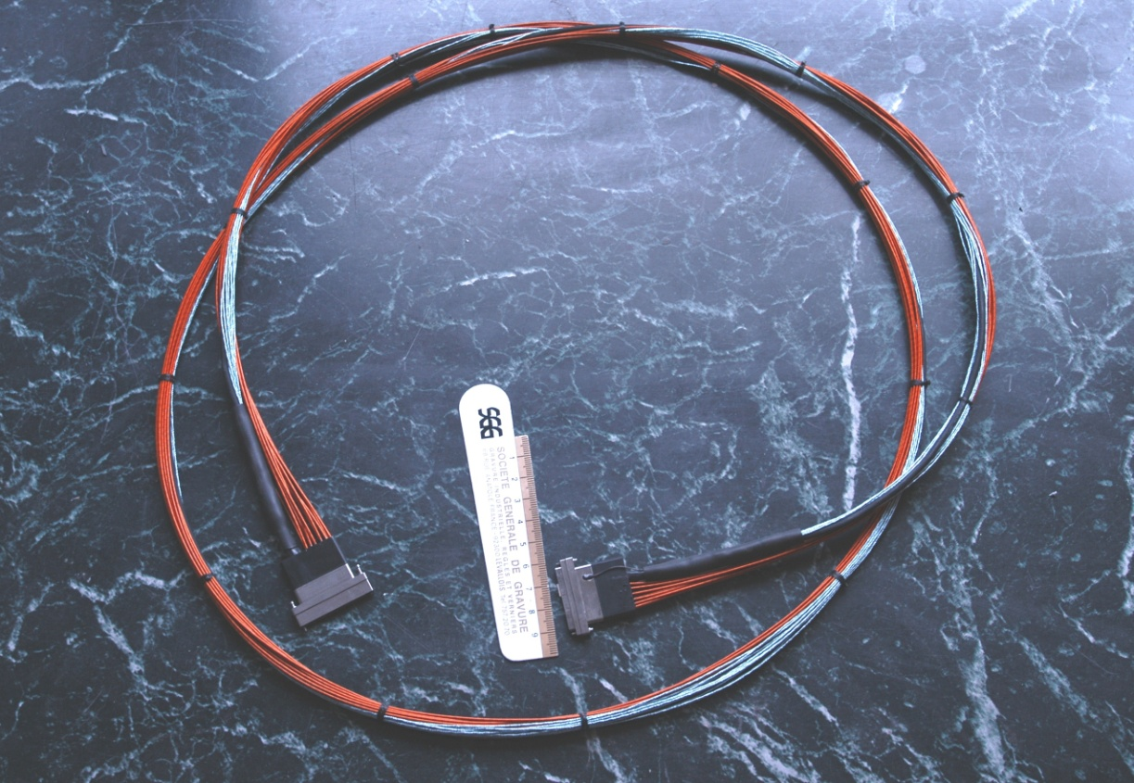
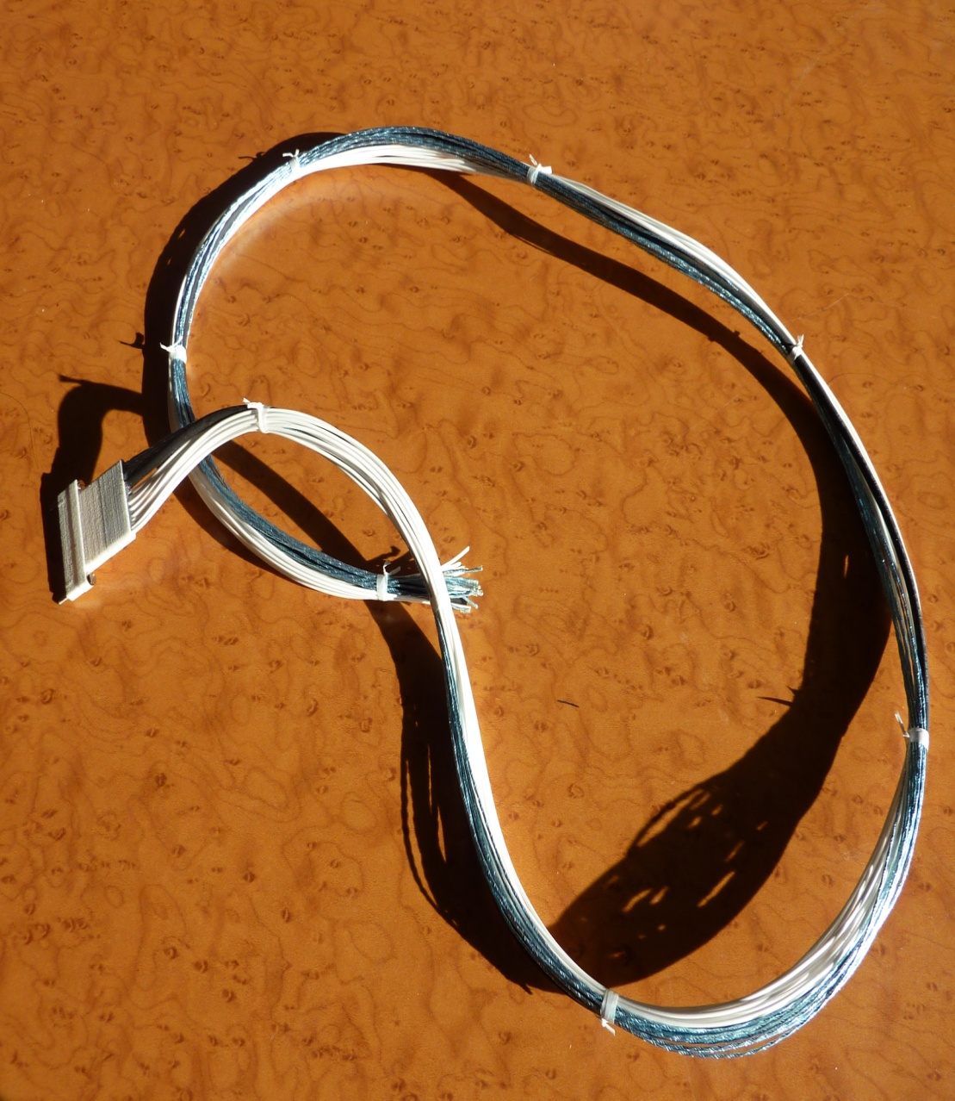
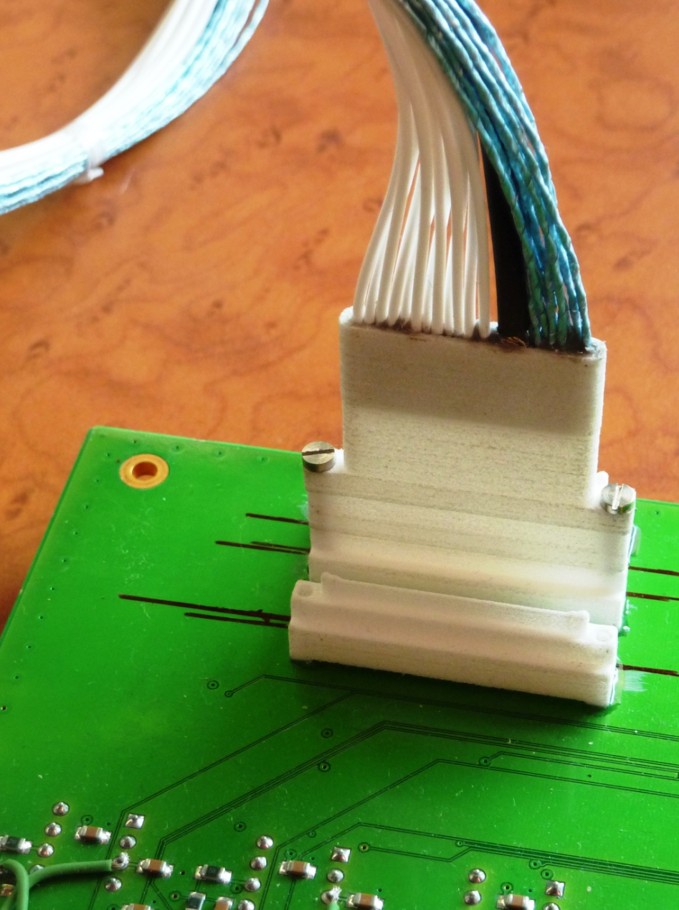
Fake harnesses
Fake type I harnesses manufacturing: 40 per PCB
Fake cables based on the real prototype harness specs
Hybrid nanoD connectors made in rapid prototyping
Real screws + standoffs to study the plug locking and the accessibility

Slide 8
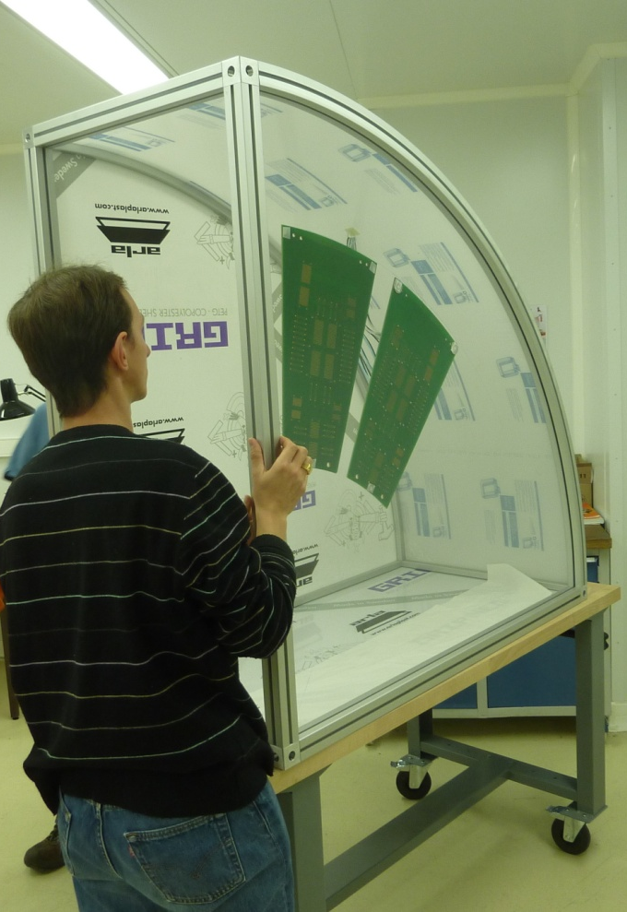
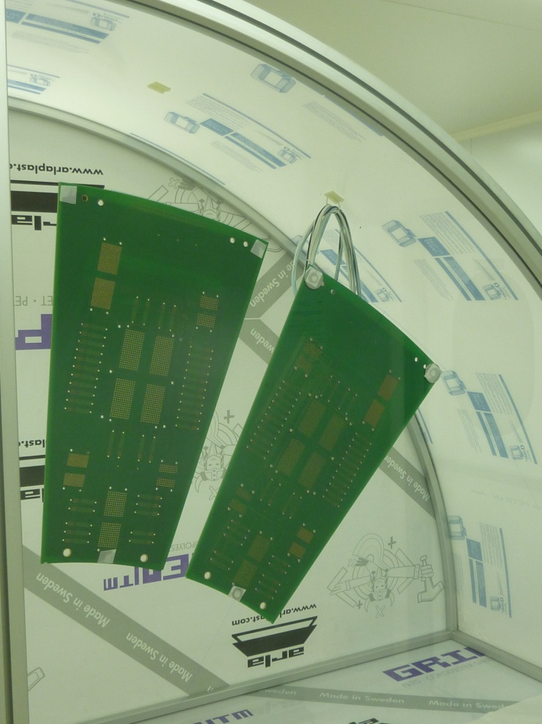
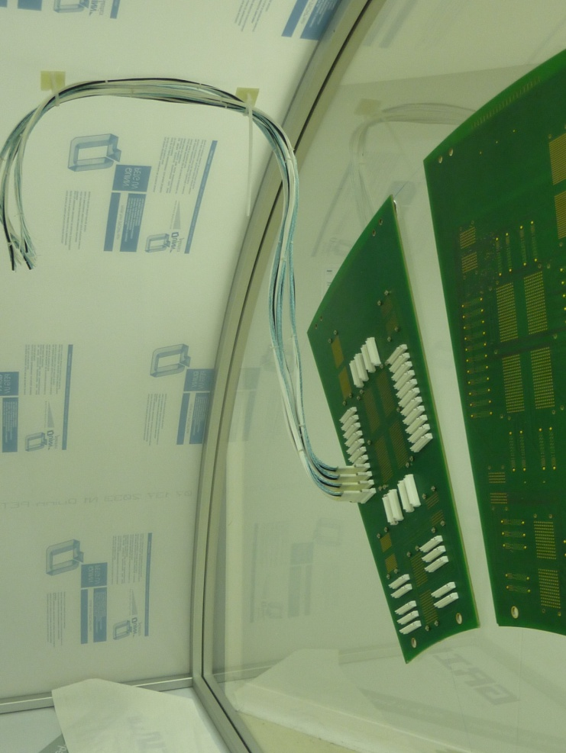
PP1 region mockup
Transparent box to simulate the tracker volume
Direct vision on the bundles behaviour during the PP1 closing
Possibility to pressurize the box to measure the PP1 tightness
All the material available but the full assembly not yet started

