Slide 1
Alpine, very forward, EOS…
Teddy Todorov for the LAPP-ATLAS team,
21/11/2012
AUW ITK modules/ladders meeting

Slide 2
Alpine and LoI layouts on equal footing is standalone simulation
Alpine pixel layout for Letter of Intent comparisons
4.6 m² pixel area
Letter of Intent baseline pixel layout
8.2 m² pixel area

Slide 3
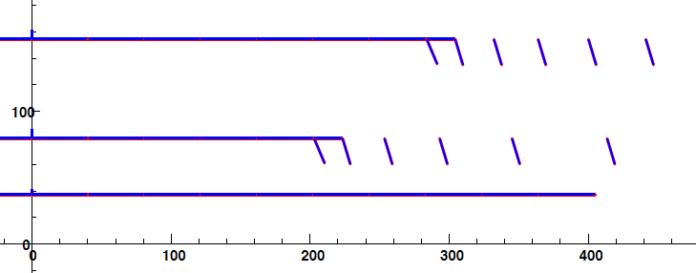
Material assignment on Alpine layout
All material on staves, staves extend to full eta acceptance
Material on surfaces (planes and cylinders), not in volumes
Track crossing angle amplifies the material
0.5% X/X0 on barrel stave
0.5% X/X0 on endcap stave
0.5% X/X0 on endcap blocks
1.0% on all modules

Slide 4
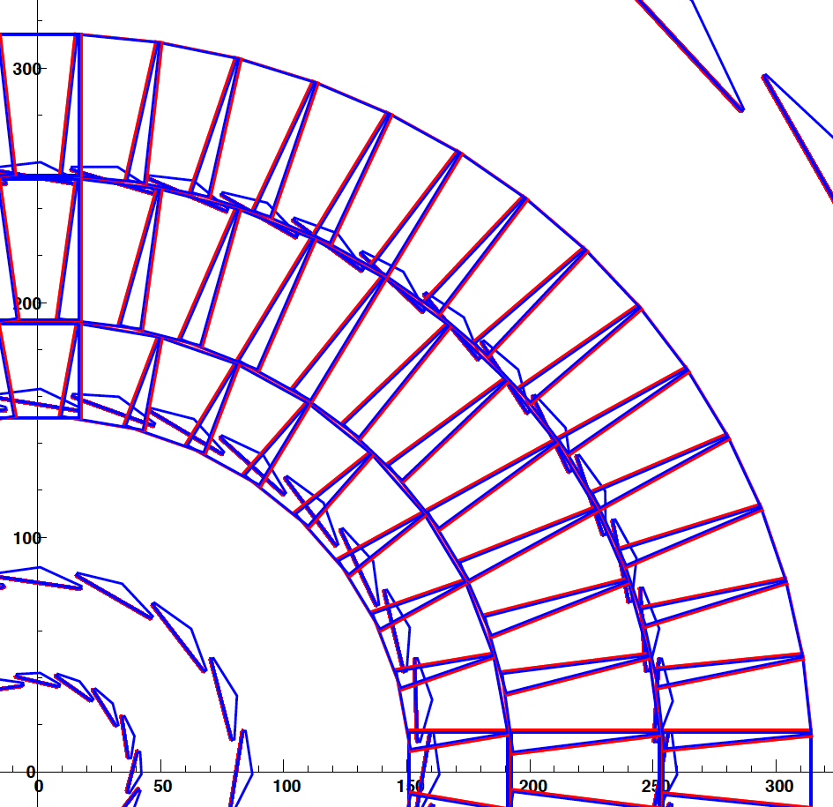
LoI Pixel detector material assignment
All modules have 1.0% X/X0
Barrel staves have 0.5% (same as Alpine)
Endcap disks have two parts: front and back
Both halves have 0.5% X/X0 to account for more complex mechanics and services than on barrel staves
End-Of-Stave cards have 5% X/X0 Over 120 mm length just after the last module
No EOS cards for disks yet
No service material yet
X-Y projection of LoI Pixel barrel + first disk

Slide 5
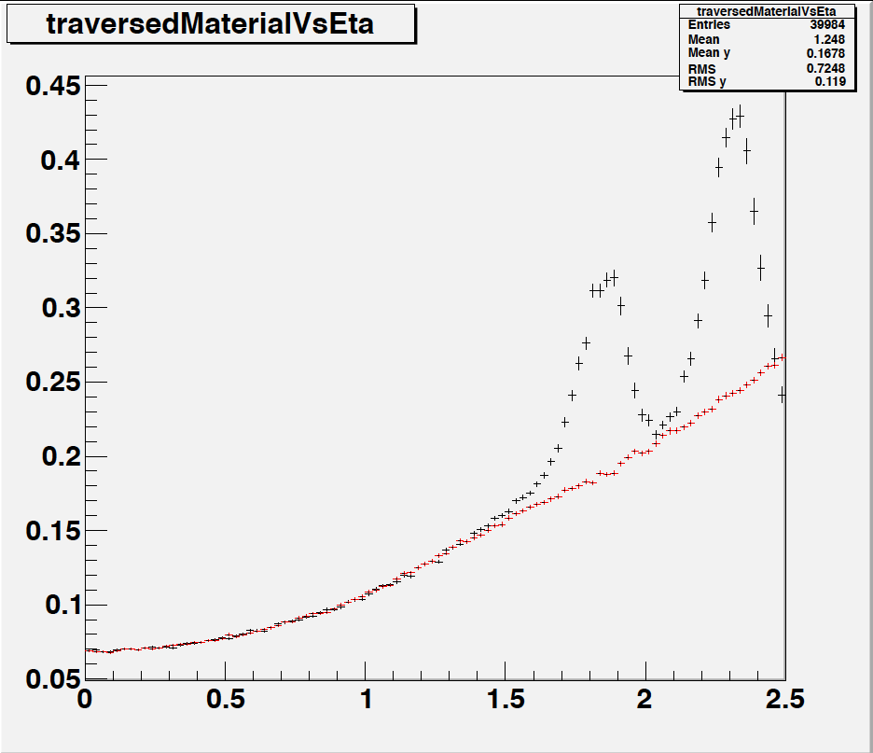
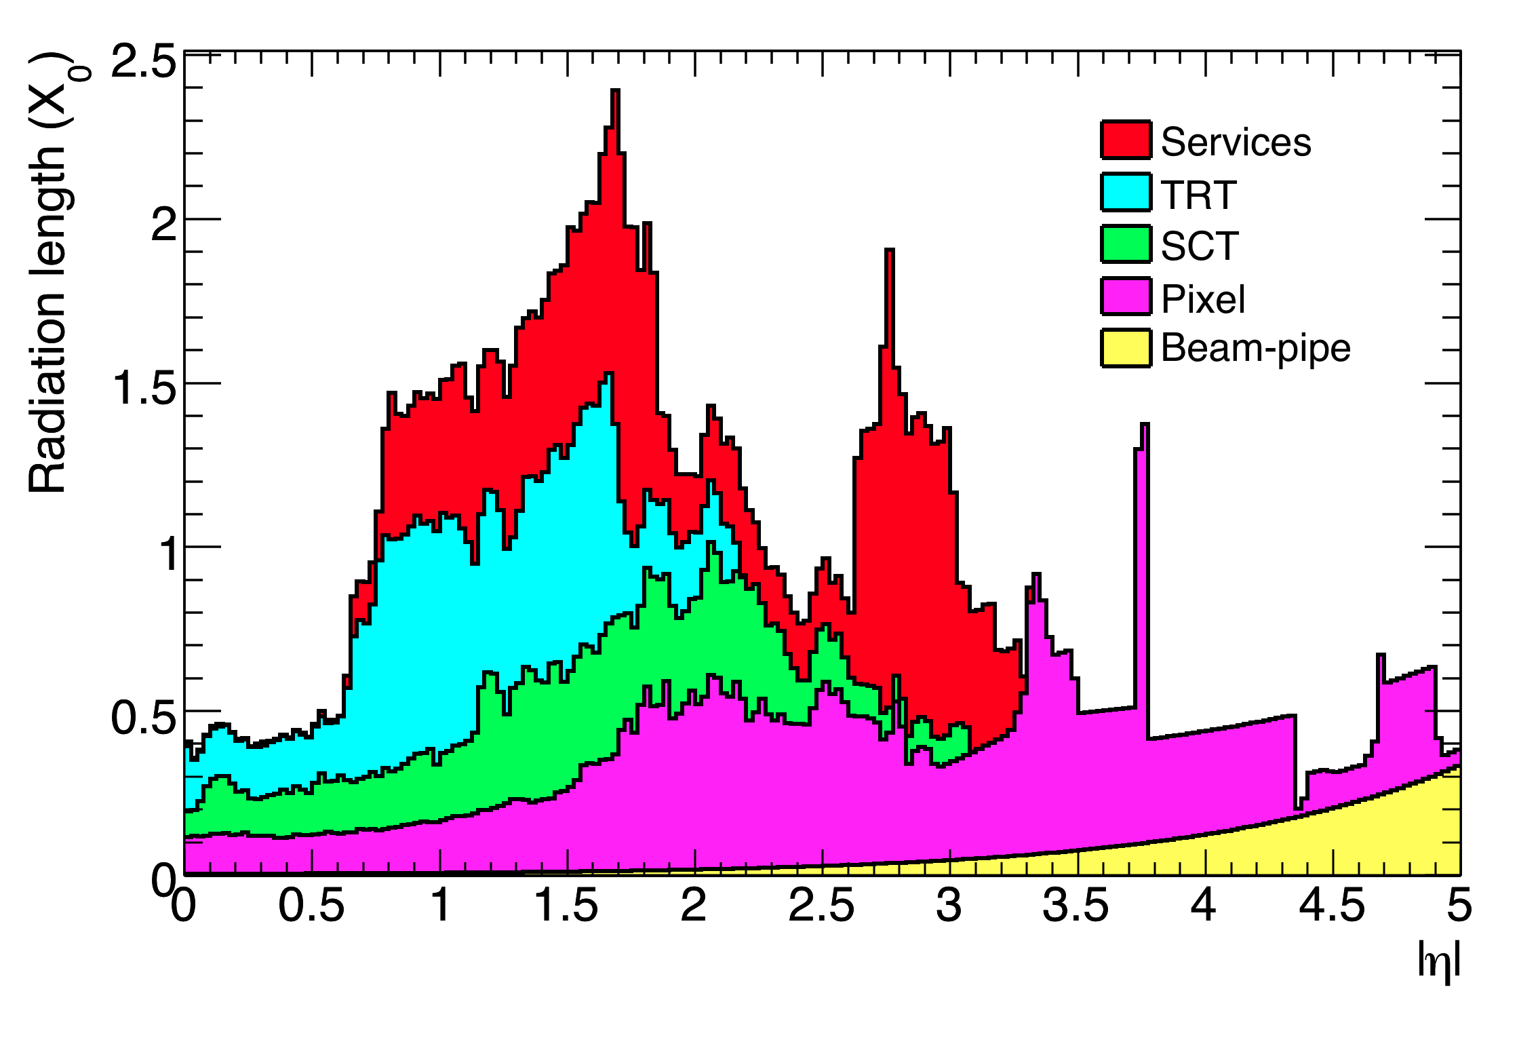
Material comparison
In the Alpine layout all material is on the stave
In the LoI layout the services material is playing a big role
LoI
Current ATLAS
Alpine
LoI: EOS cards only, no cables, no pipes

Slide 6
Single track performance comparisons
Alpine versus LoI
Very similar track parameter resolutions
As expected from geometry and material
Even if we look at pixel-only tracks
Don’t have the services material yet
Except for End-Of-Stave cards
Will degrade LoI pixel performance a bit, but not Alpine

Slide 7
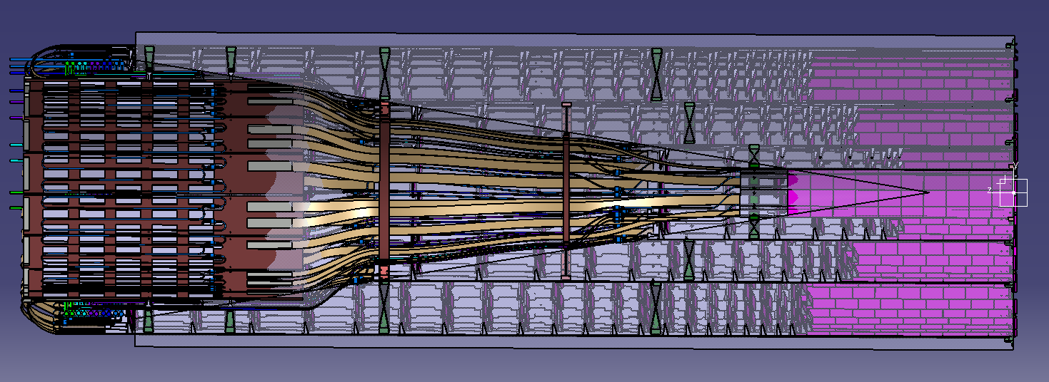
All services out of tracking acceptance!
(lines correspond to eta=2.5 from z=-15cm)

Slide 8
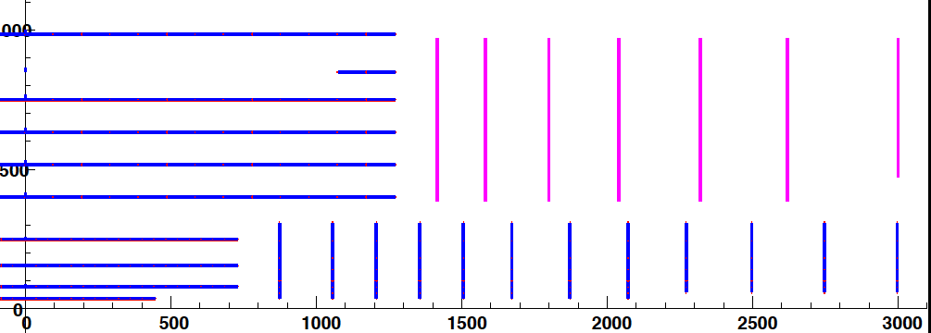
First look at Very Forward tracking – LoI like
Main physics motivation: very forward jet rejection based on primary vertex association

Slide 9
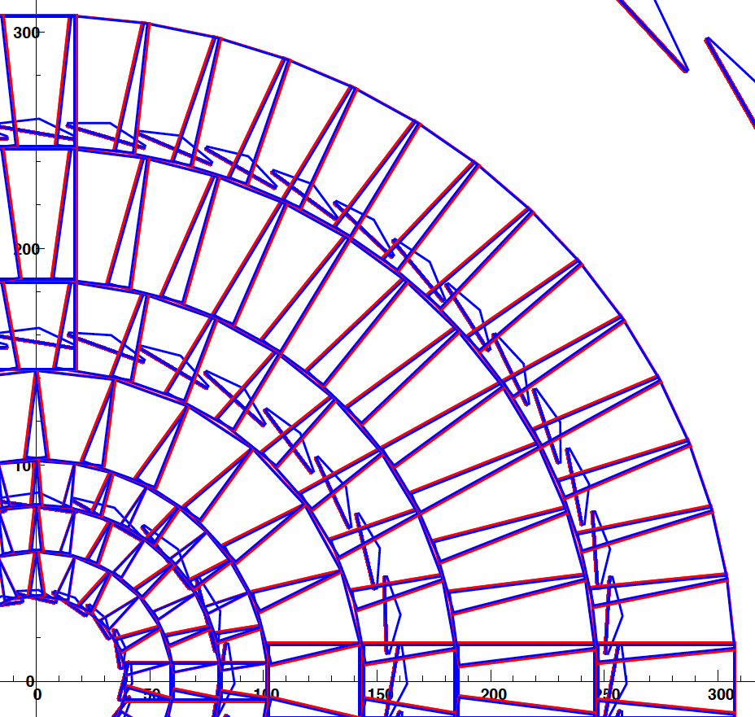
Very forward tracking – maxi disks
Very complex disk
Modelled with 2% of X/X0 to reflect services/support complexity

Slide 10
Very-very preliminary resolutions (last Friday)
Looked promising!
Non-optimized pixel sizes (bad for Z0)

Slide 11
Pt measurement at large eta
Color code:
Black – with EOS
Red – no EOS
Blue – no material at all

Slide 12
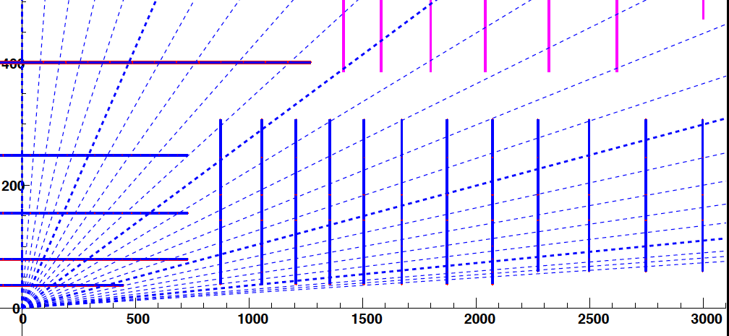
Eta coverage
1.0
2.0
3.0
4.0

Slide 13
Hit coverage

Slide 14
Pitch choice
250u pixel eta pitch
50u pixel eta pitch
Go for 50x50 microns on the following plots

Slide 15
End-Of-Stave problem
EOS card modelled as 12cm long, stave width, 5% X/X0
EOS material
No EOS

Slide 16
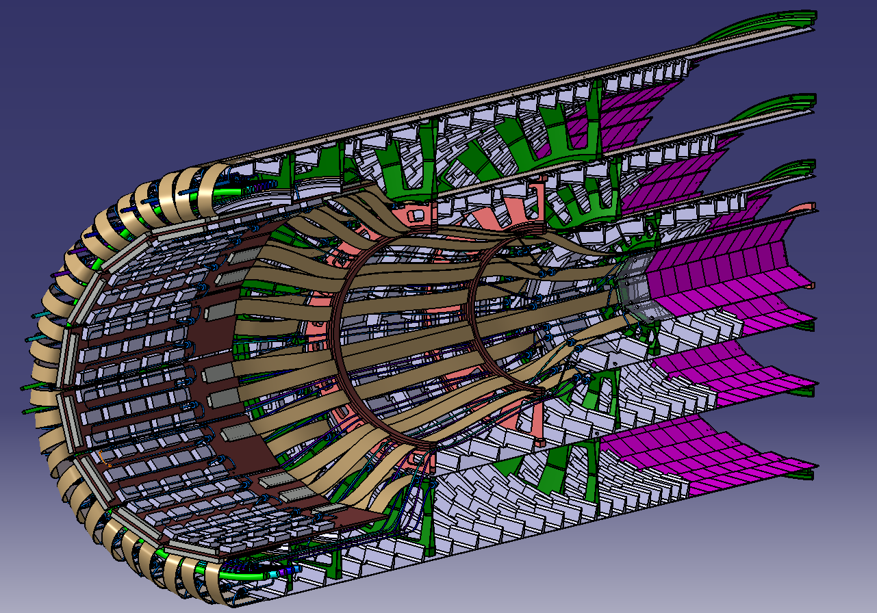
¼ view (half in Z and half in phi

Slide 17
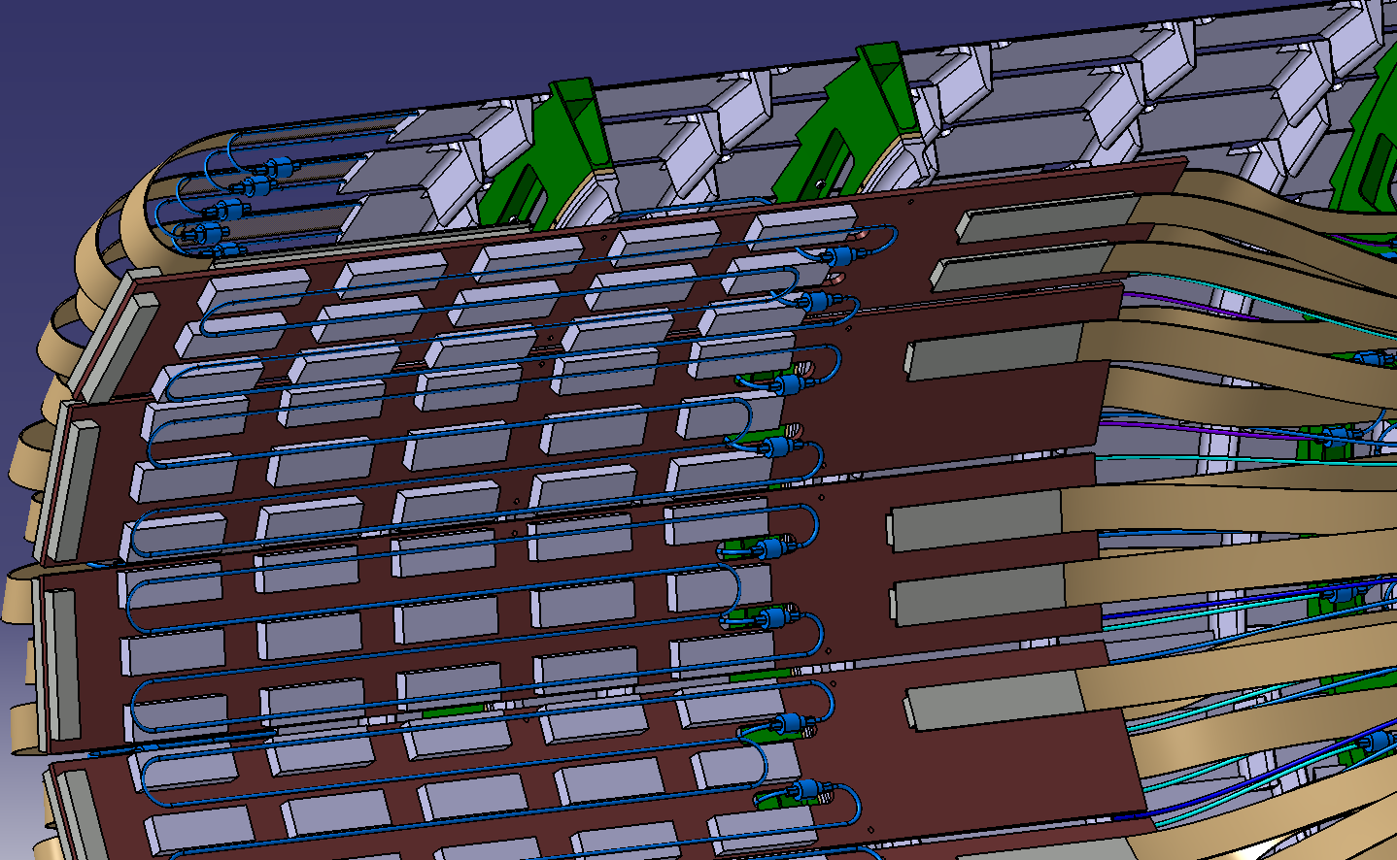
Pixel package interconnection board
(Name contest still open)
Stave flexes run to board without break at EOS
Board at R>20cm, compatible with opto converters
Strongly reduced number of external connectors

Slide 18
Transverse impact parameter resolution 5 GeV MIP
Color code:
Black – with EOS
Red – no EOS
Blue – no material at all

Slide 19
Longitudinal impact parameter resolution 5 GeV MIP
Color code:
Black – with EOS
Red – no EOS
Blue – no material at all

Slide 20
Pt resolution 5 GeV MIP, constant 2 T field
Color code:
Black – with EOS
Red – no EOS
Blue – no material at all
We must measure Pt to distinguish between low and high momentum for multiple scattering treatment in the track fit

Slide 21
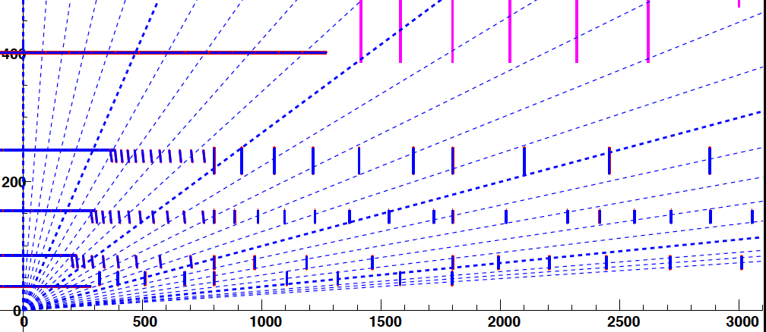
Very-very preliminary: Very Forward Alpine layout
No track fit yet
Lots of new ideas, need some time to settle down
Main principle: hermetic cylindrical surfaces up to > 3m
Silicon area advantage over disks preserved at large eta

Slide 22
Summary
Alpine layout up to eta 2.5 engineered in some detail
Interconnection boards with opto-converters in pixel package
Very forward tracking (up to eta = 4.3 – 4.4) looks promisin on single track level
Need feedback from physics groups if/how much to pursue this
Alpine-like layout at large eta in progress

