Slide 1
Alpine layout simulation
Teddy Todorov
19/11/2012
AUW ITK simulation meeting

Slide 2
Alpine and LoI layouts on equal footing is standalone simulation
Alpine pixel layout for Letter of Intent comparisons
4.6 m² pixel area
Letter of Intent baseline pixel layout
8.2 m² pixel area

Slide 3
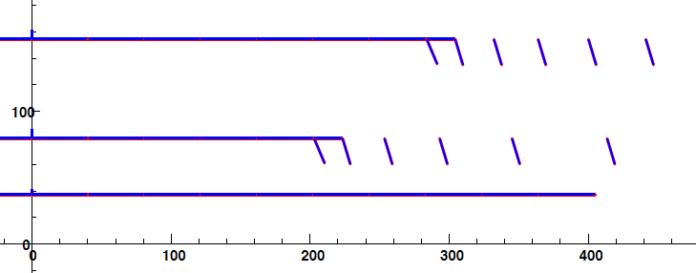
Material assignment on Alpine layout
All material on staves, staves extend to full eta acceptance
Material on surfaces (planes and cylinders), not in volumes
Track crossing angle amplifies the material
0.5% X/X0 on barrel stave
0.5% X/X0 on endcap stave
0.5% X/X0 on endcap blocks
1.0% on all modules

Slide 4
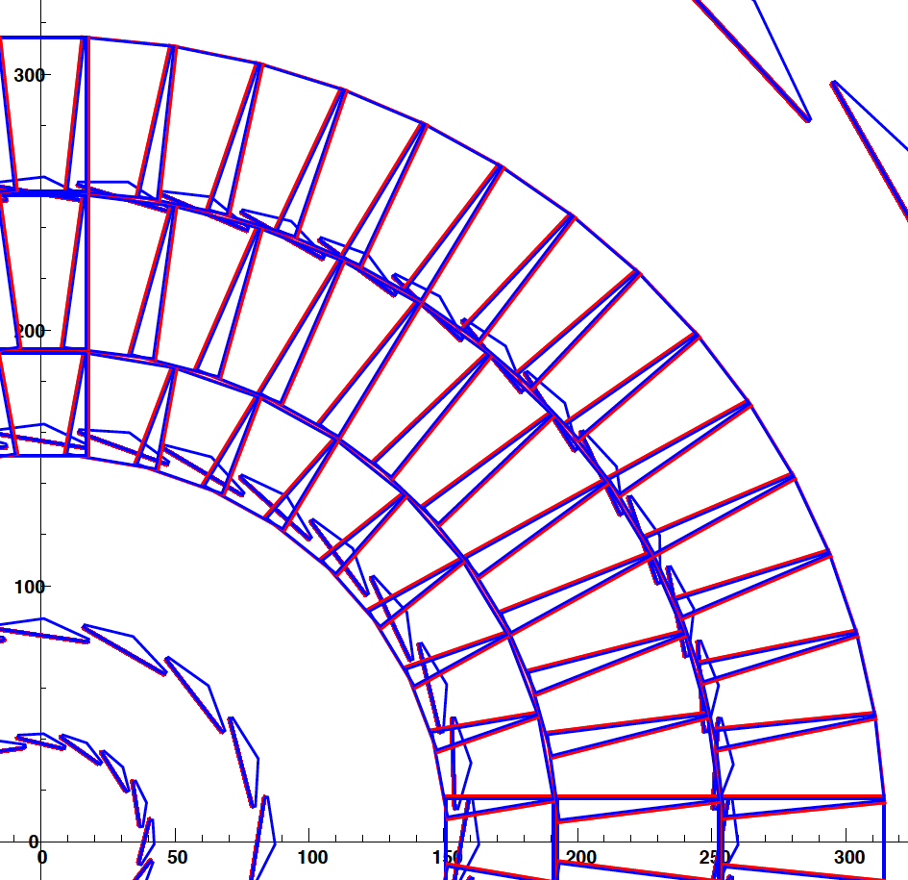
LoI Pixel detector material assignment
All modules have 1.0% X/X0
Barrel staves have 0.5% (same as Alpine)
Endcap disks have two parts: front and back
Both halves have 0.5% X/X0 to account for more complex mechanics and services than on barrel staves
End-Of-Stave cards have 5% X/X0 Over 120 mm length just after the last module
No EOS cards for disks yet
No service material yet
X-Y projection of LoI Pixel barrel + first disk

Slide 5
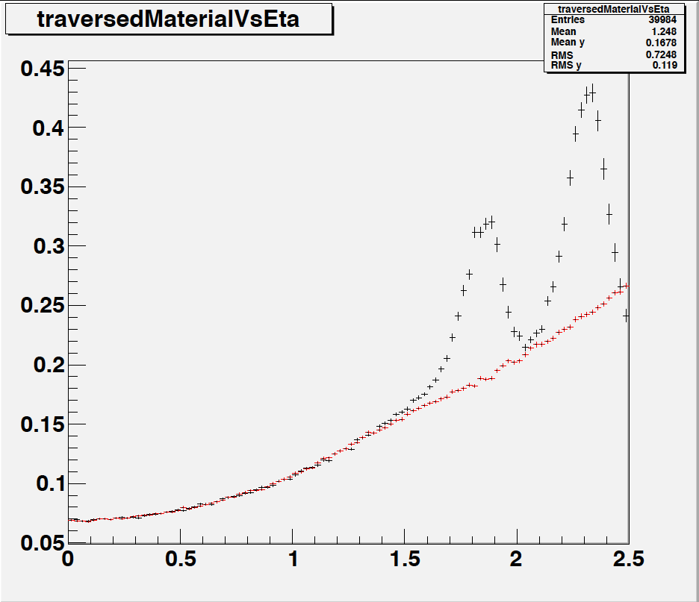
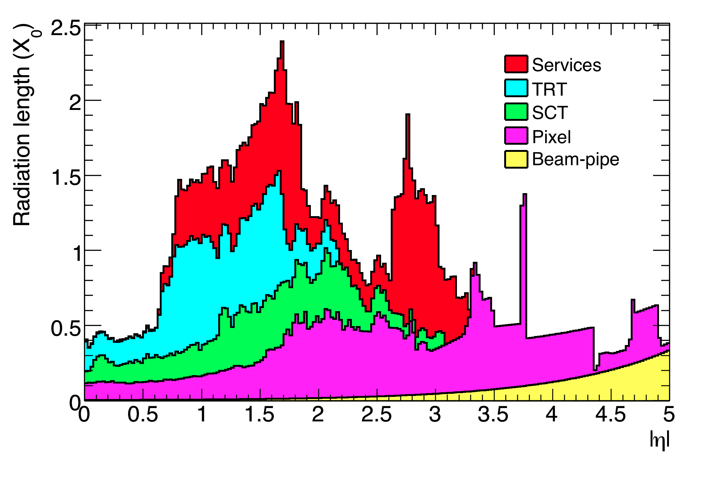
Material comparison
In the Alpine layout all material is on the stave
In the LoI layout the services material is playing a big role
LoI
Current ATLAS
Alpine
LoI: EOS cards only, no cables, no pipes

Slide 6
Track fit details
Tracks propagated through all surfaces
On each surface:
a “SimHit” is recorded
The track is scattered randomly according to multiple scattering and energy loss Gaussian models
The SimHits are Gaussian smeared according to sensor pitch
Pitch/4 for pixel and precise strip coordinate
Barrel strip sensors simulated as pixel sensors with very big eta pitch
To get ~correct resolution
Endcap strip rings make pure R.phi – R measurements
Kalman Filter track fit using all “Hits”
Similar in spirit to a subset of FATRAS

Slide 7
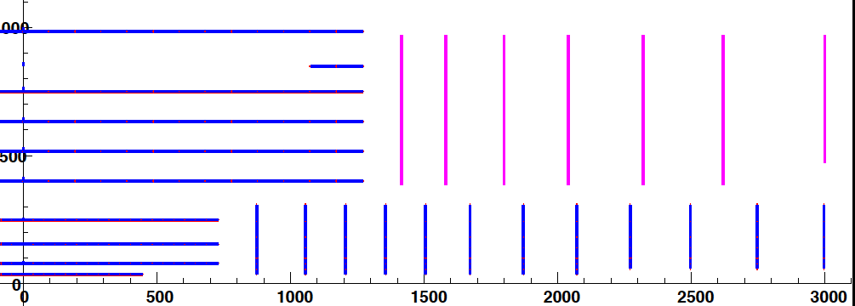
Very Forward tracking – LoI like

Slide 8
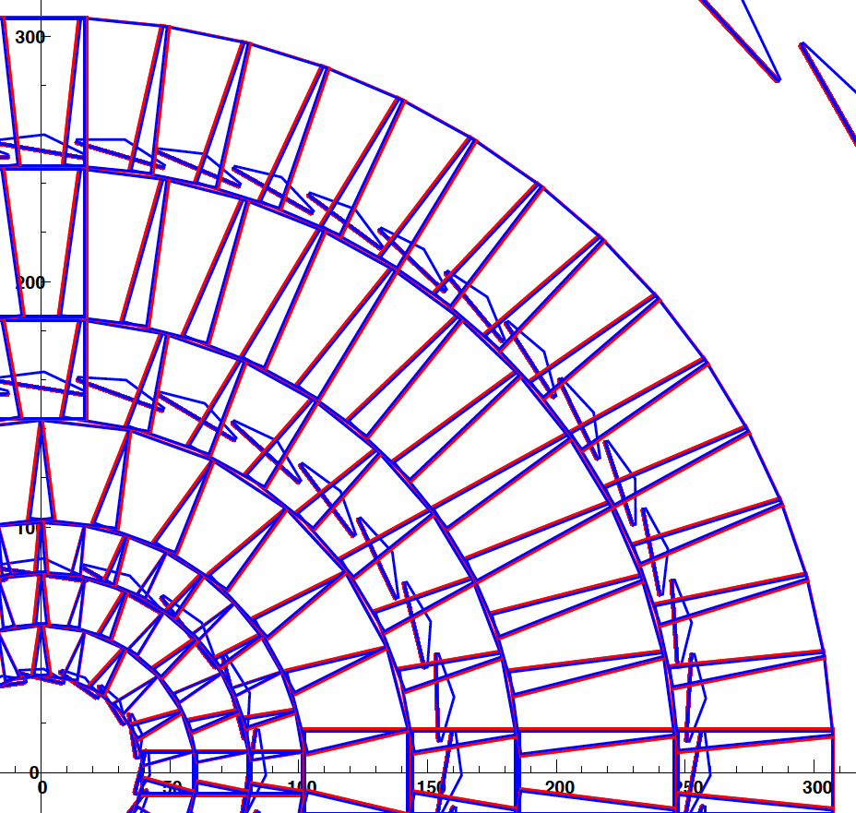
Very forward tracking – maxi disks
Very complex disk
Modelled with 2% of X/X0 to reflect services/support complexity

Slide 9
Very-very preliminary resolutions
Non-optimized pixel sizes (bad for Z0)

Slide 10
Summary
Standalone simulation starts to be useful
Limited to single track performance
Performance between the Alpine and the LoI layout depends strongly on the service material assumptions in the LoI layout
Very forward tracking looks possible
Just starting…

