Slide 1
Systematic Error on Slepton and Gaugino Masses
OUTLINE
Estimate systematic error on Slepton and Gauginos masses due to the knowledge of the luminosity spectrum:
Reminder
Guineapig distribution and Luminosity function F(√s,Pn) for nominal parameters
Luminosity functions F(√s,Pi) for nominal
parameters and for nm ± 0.5σ and nm ± 5σ
Fit results and sensitivity to errors on the
luminosity function parameters
Conclusion

Slide 2
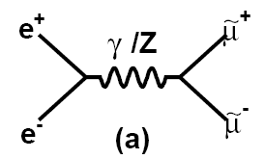
Reminder
μ̃->μ χ̃₁⁰; two body kinematic decay =>
dN/dE is a uniform distribution with
EL, EH bounds fixed by √s, mμ̃ and mχ̃₁⁰.
But √s is not a delta function, box
distorted by ISR and beamstrahlung.
ISR is a QED process => well known.
Beamstrahlung unknown, requires
measurement => potential source of
systematic error

Slide 3
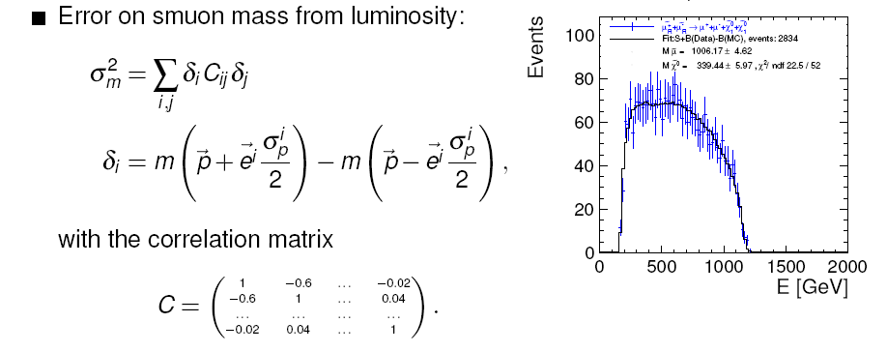
Reminder
A:S,Produced Bhabha events e⁻ e⁺-> e⁻ e⁺ (-> Data set) with CLIC beam spectrum (Guineapig) as input, -> beam spectrum G(E1,E2)
Modelel the beam spectrum with a function L(x1,x2) , x ₁,₂=E₁,₂/√s.
E₁,₂ is the energy of the particles before ISR; taking into account
the longitudinal boost and the correlation between the two particle energies -> Model with 19 parameters: F=L(x1,x2,pi)
Fit F to Data to extract pi using the energy of the e⁺ e⁻ and their acollinearity -> dN/d√s’=L(Pn). Fit mμ̃ and mχ̃₁⁰ using L(Pn), L(Pn, Pi+xσ), L(Pn,Pi-xσ), i=1,19

Slide 4
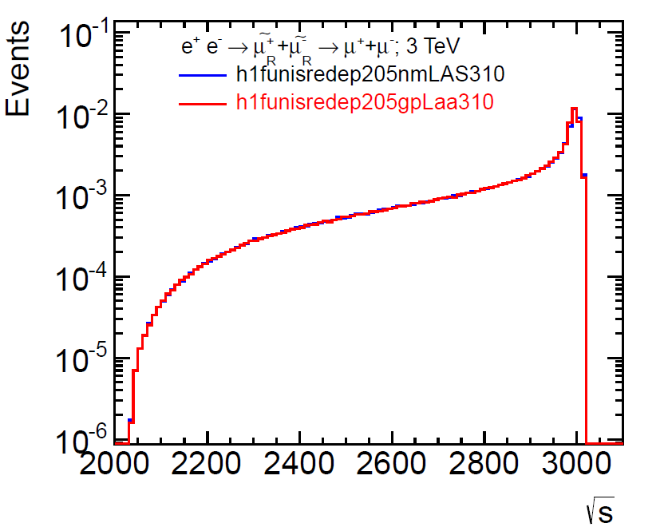
Lumi Fit Function
F(√s’,Pi)=L(√s’,Pn) x ISR x σ(√s’)
Pn=1,19 nominal values
Guineapig, F(√s’,Pn) distribution
well known difference in peak
region due to the non
gaussian CLIC beam spread.
Improvement requires a
larger number of parameters.
Fits with GP an F(√s’,Pn) =>

Slide 5
Fit results with GP and F(√s’,Pn)
Process | Slepton Mass with GP GeV | Slepton Mass Nominal Pi GeV | GauginoMass With GP GeV | Gaugino Mass Nominal Pi GeV
e⁻ e⁺-> μ̃⁻ μ̃⁺ | 1004.8± 5.0 | 1005.01± 5.0 | 339.5 ± 6.0 | 339.4 ± 6.0
e⁻ e⁺-> ẽ⁻ ẽ⁺ | 1010.5± 1.8 | 1010.3 ± 2.0 | 340.6 ± 2.6 | 341.0 ± 2.6
e⁻ e⁺-> ν̃e ν̃e | 1097.2± 3.7 | 1097.4 ± 3.7 | 643.8± 3.7 | 644.0± 3.7
Δm is the statistical error, m(GP) –m(F) < 1 GeV
Non Gaussian CLIC beam spread is not an issue for Slepton mass determination.

Slide 6
Lumi Fit Function
F(√s’,Pn)=L(√s’,Pn) x ISR x σ(√s’)
Impact of variations of F(√s’,Pn)?
Generate a set of 38 lumi functions
19, F(√s’,Pn, Pj + 0.5 σ ) and 19 F(√s’,Pn, Pj – 0.5 σ) ;
and another with
19 F(√s’,Pn, Pj + 5 σ ) and 19 F(√s’,Pn, Pj – 5 σ )
Compare nm, and ± 0.5 σ or nm, and ± 5 σ => plots

Slide 7
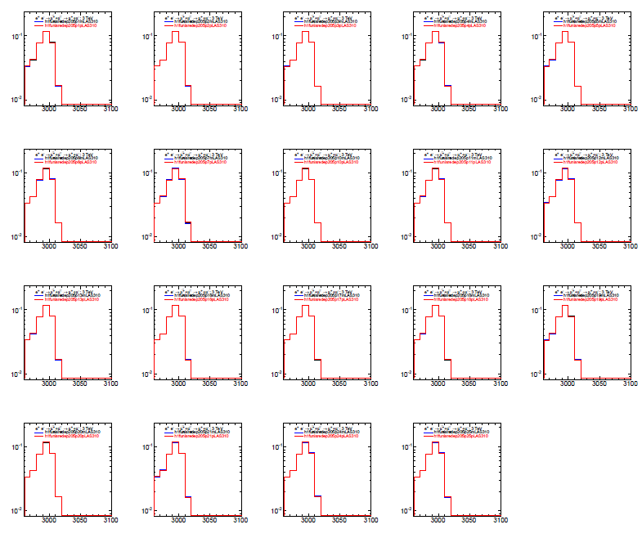
F(√s’,Pn) and ± 0.5 σ
No very visible
Difference for nominal and ± 0.5 σ
plots
L(Pi) x ISR x σ(√s’) ; i=1,19

Slide 8
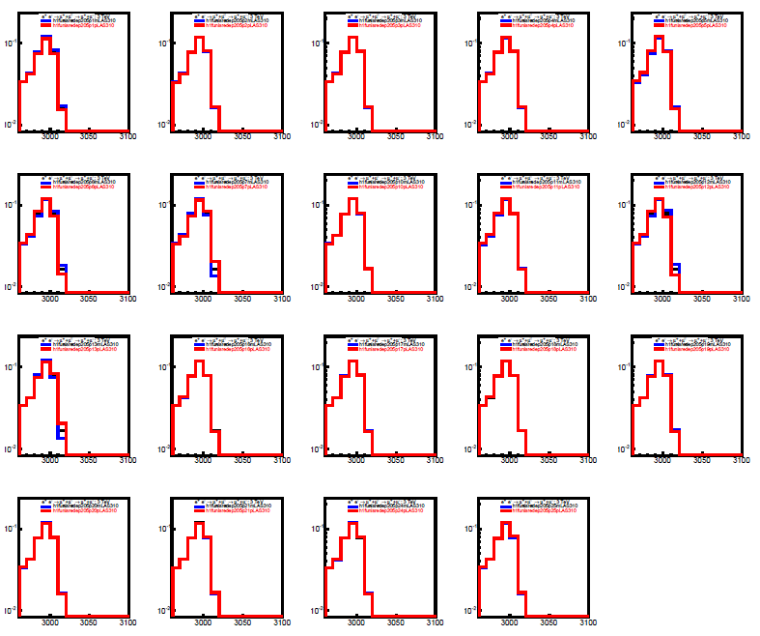
F(√s’,Pn) and ± 5 σ
Difference for nominal and ± 5 σ
Plots, P1, P5, P6, P7
P9, P10, P11
L(Pi) x ISR x σ(√s’) ; i=1,19

Slide 9
Fit Results with Pn and Pi+0.5/5 σ
Process | Pi Error σ | Slepton Mass With CorM | Slepton Mass No CorM | GauginoMass With CorM | Gaugino Mass No CorM
e⁻ e⁺-> μ̃⁻ μ̃⁺ | ±0.5 | 1005.1 ± 0.7 | 1005.1 ± 0.7 | 339.4 ± 0.8 | 339.4 ± 0.8
e⁻ e⁺-> μ̃⁻ μ̃⁺ | ±5 | 1005.1 ± 0.8 | 1005.1 ± 1.1 | 339.4 ± 1.1 | 339.4 ± 2.1
e⁻ e⁺-> ẽ⁻ ẽ⁺ | ±0.5 | 1010.1 ± 0.8 | 1010.1 ± 0.8 | 341.0 ± 1.0 | 339.9 ± 1.0
e⁻ e⁺-> ẽ⁻ ẽ⁺ | ±5 | 1010.6 ± 1.0 | 1010.6 ± 1.4 | 340.1 ± 1.3 | 340.1 ± 2.6
e⁻ e⁺-> ν̃e ν̃e | ±0.5 | 1097.4 ± 0.6 | 1097.4 ± 0.6 | 644.0 ± 0.6 | 644.0± 0.6
e⁻ e⁺-> ν̃e ν̃e | ±5 | 1097.2± 0.8 | 1097.2 ± 1.1 | 643.9 ± 0.9 | 643.9 ± 1.4
Δm is the systematic error due to the luminosity function
The errors are not very sensitive to the variation of the error on the parameters, why ? => Analyze variations of F(√s’,Pi)
Variation of <√s> for Pi + 0.5/5 σ and Pi – 0.5/5 σ
Variation of the peak content for Pi + 0.5/5 σ and Pi – 0.5/5 σ

Slide 10
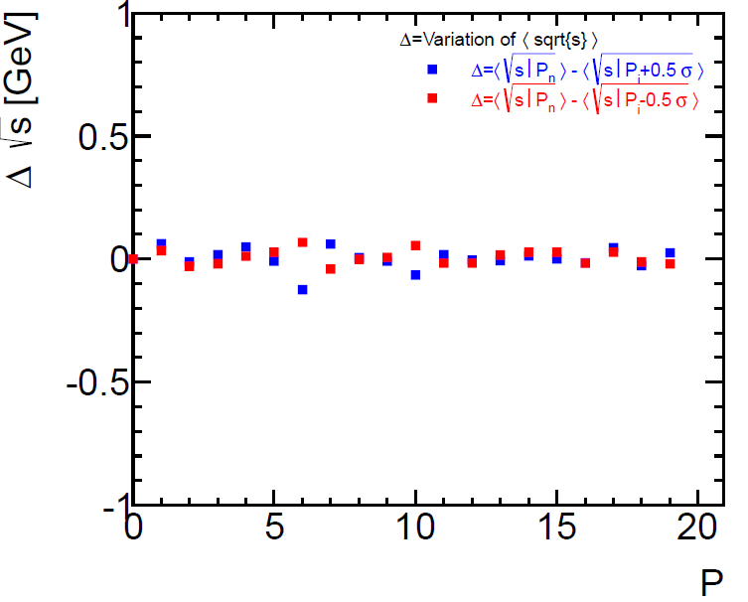
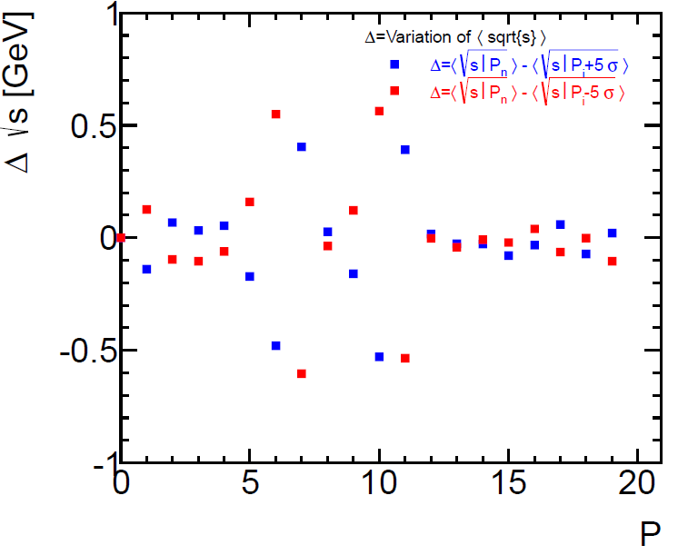
Variation of <√s> vs Pi
For ± 5 σ errors, the variation on <√s> is between 0.1 and 0.6 GeV
The most sensitive parameters are P1, P5, P6, P7, P9, P10, P11
The ± variations are symmetric ; P6, P7 are anti-correlated
P10, 11 as well

Slide 11
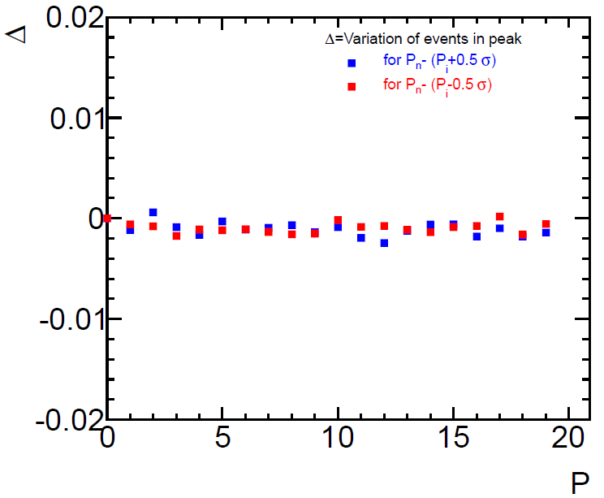
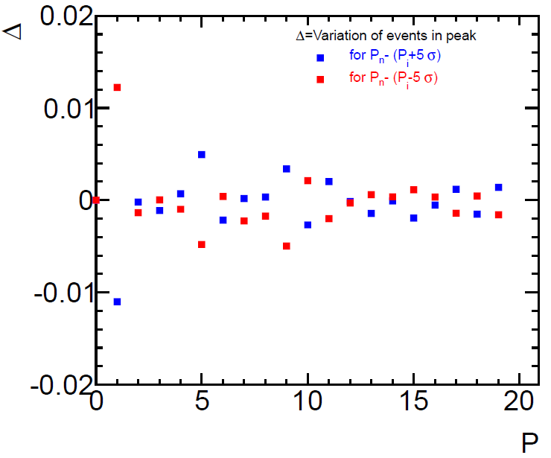
Variation of Peak Content vs Pi
For ± 5 σ errors, the variation of events in peak is about:
1.2% for P1, 0.5% for P5 and 0.4% for P9
P1 and P5, P9 are anti-correlated

Slide 12
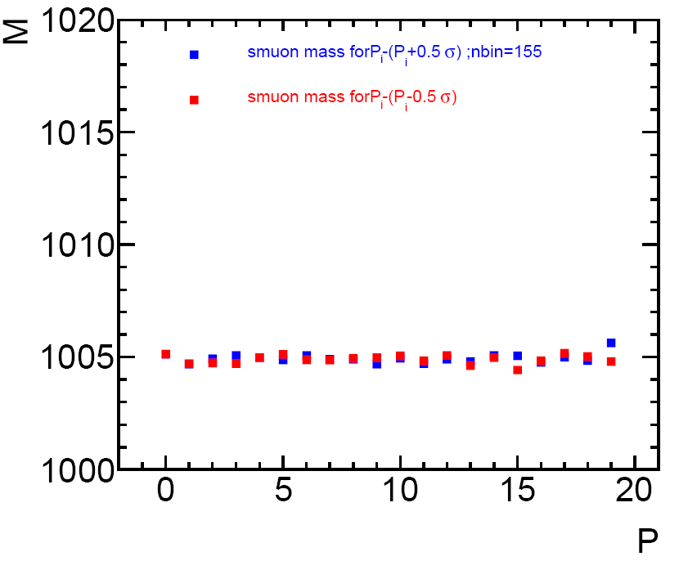
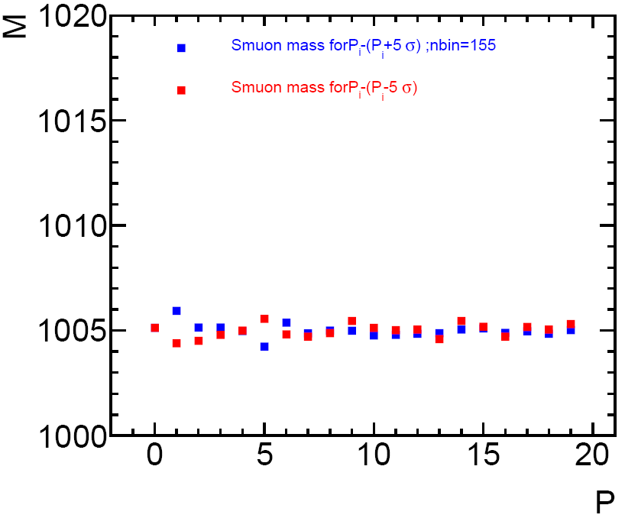
μ̃ mass vs Pi
With ±0.5 σ errors, no correlation between mμ̃ an Pi
With ± 5 σ errors, correlation with some parameters, P1, p5

Slide 13
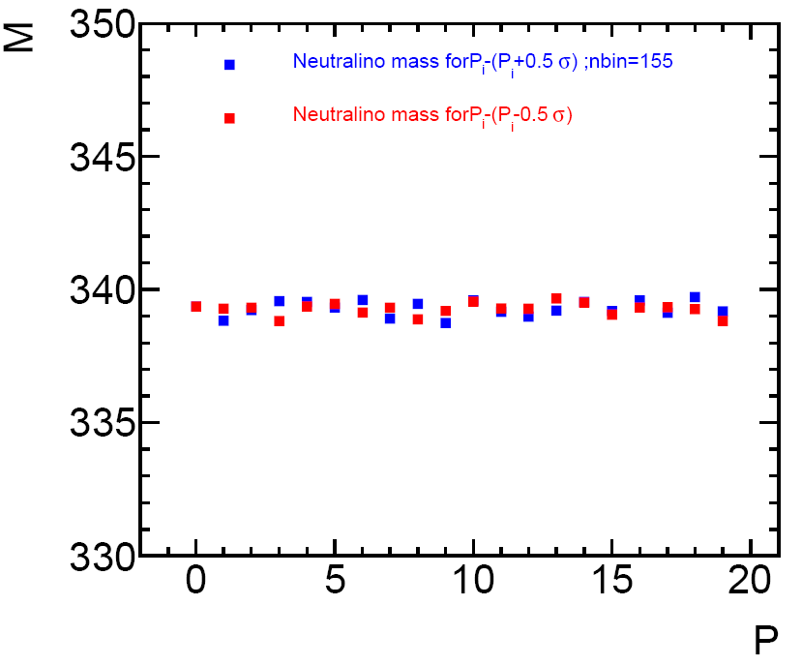
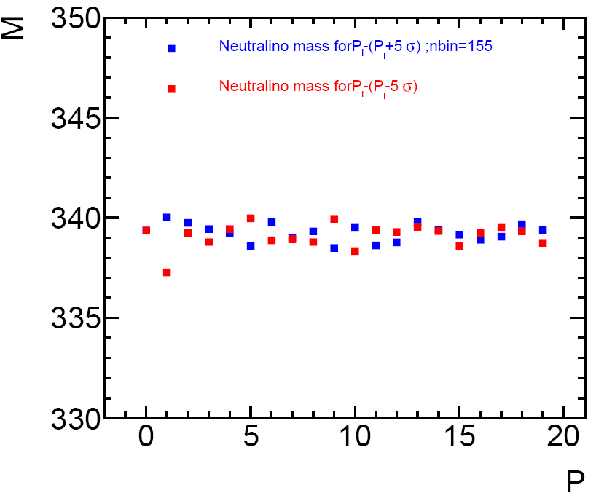
χ̃₁⁰ mass vs Pi
With ±0.5 σ errors, no strong correlation between mμ̃ an Pi
With ± 5 σ errors, correlation with parameters, P1, P5, P6, P9, P10.
P5 and P6 are anti-correlated, P9, P10 as well.

Slide 14
Conclusion
The one σ systematic errors induced by the knowledge of the luminosity spectrum are computed using the fits with ± 5 σ variation of the parameters: σm²=Σ(δm/10 Cij δm/10)²
These results are ~ 10 times better than the ones in the CDR but consistent. For the CDR the variation of the events in the peak was
± 5% , here the sum of the variation of the parameters is ~ ± 2% and the one σ error is quoted.
Process | Slepton Mass | CDR | Gaugino Mass | CDR
e⁻ e⁺-> μ̃⁻ μ̃⁺ | 1005.1 ± 0.2 (0.02%) | 0.2% | 339.4 ± 0.2(0.06%) | 0.6%
e⁻ e⁺-> ẽ⁻ ẽ⁺ | 1010.1 ± 0.2 (0.02%) | 0.2% | 340.1 ± 0.2 (0.06%) | 1%
e⁻ e⁺-> ν̃e ν̃e | 1097.2 ± 0.2 (0.02%) | 0.2% | 643.9 ± 0.2 (0.03%) | 0.4

