Slide 1
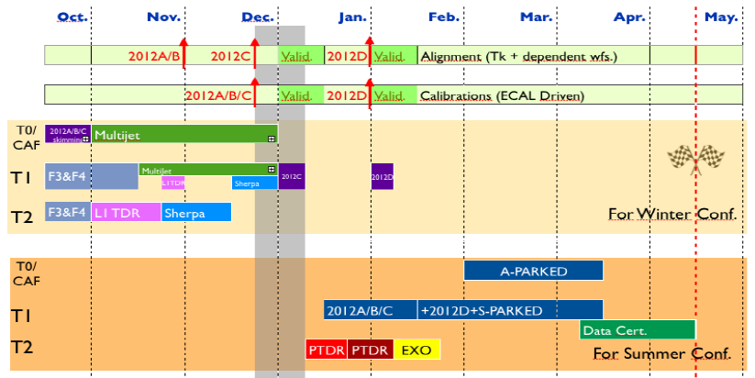
Calendar
CMS:
Stop pp data taking: 17December 2012
“Restart data taking”: 5 November 2014
[Normally end of data taking 1st December 2014]
Restart collisions April 2015
End of Jose thesis: 31st October 2015
[only ~85% for physics]+5fb⁻¹ at 7 TeV
Moriond
Reprocessing of data with best of our knowledge
EPS

Slide 2
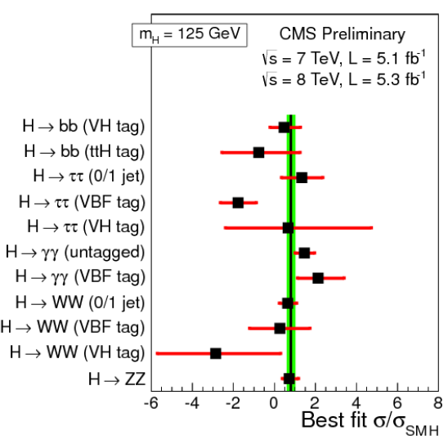
New Boson Status

Slide 3
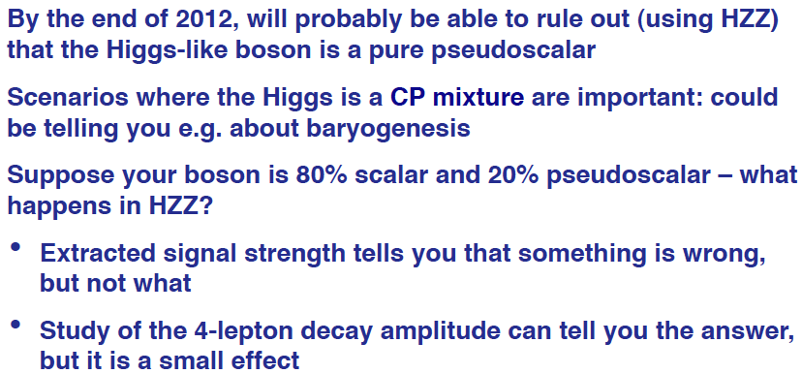
Discussion CMS - Theory

Slide 4
What are the plans…
For 2013 and beyond: Not too much yet in Exotica/Beyond Two Generations/Susy
Exotica 2012:
Search for LQ with top+tau pairs: LQ3->top+tau
Search for LQ3 with b+tau: LQ3/stop -> b+tau
Stopped Particles
ST scaling in l+jets: Model-independent search in events with lepton+jets using ST scaling
Susy:
Light Stop searches

Slide 5
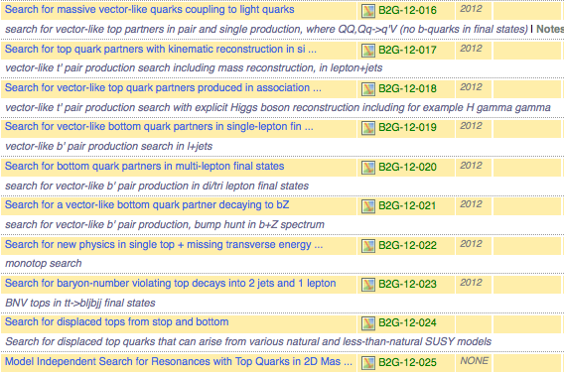
What are the plans…
B2G:

