Slide 1

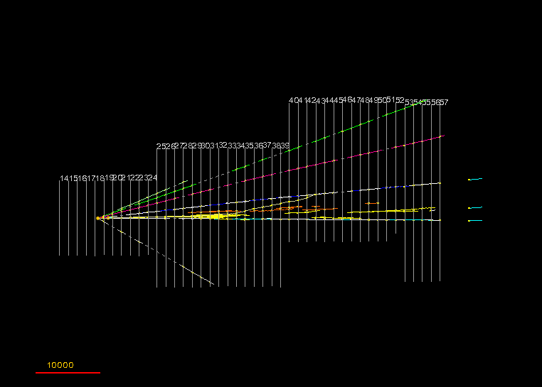

Results from OPERA
Pablo del Amo Sánchez
(LAPP-IN2P3-CNRS / Université de Savoie)
for the OPERA collaboration
µm

Slide 2
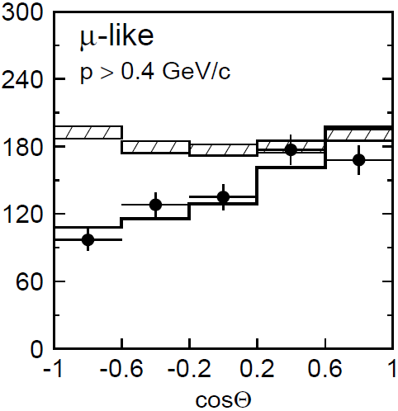
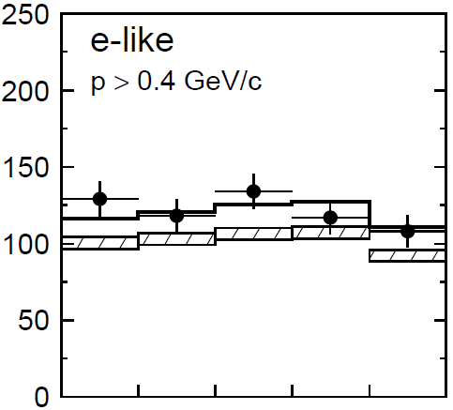
Physics case
Super-Kamiokande (1998):
atmospheric ν_{µ} disappearance,
ν_{µ} → ν_{e} => ν_{µ} → ν_{τ} ?
ν oscillation picture prediction of
appearance of different ν flavour not tested
Most experimental results on disappearance.
OPERA’s goal: observe ν_{τ} appearance in ν_{µ} beam
(confirms oscillation framework and atmospheric ν_{µ} → ν_{τ} oscillation)
ν_{μ}
Neutrino Oscillation
ν_{τ}
ν_{τ}
decay
τ ⁻
μ⁻, h⁻ ,e⁻
ν_{τ} CC int

Slide 3
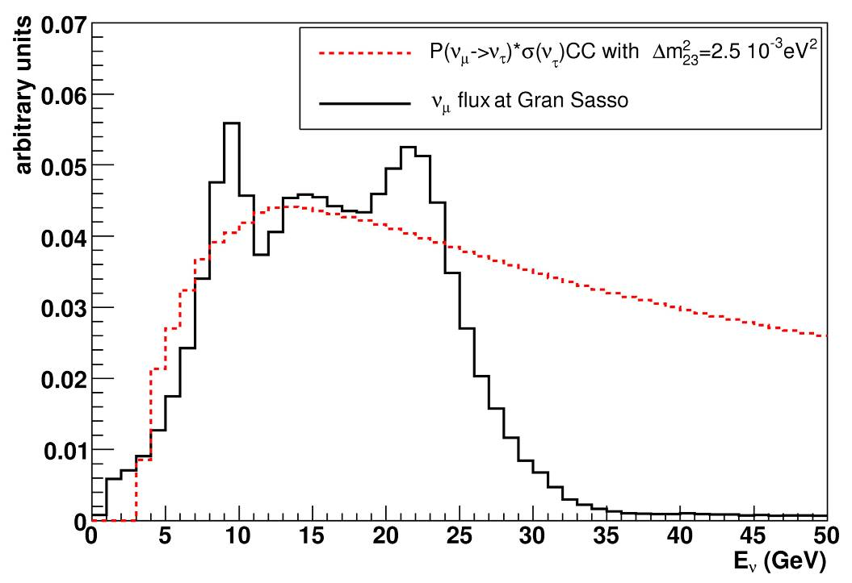
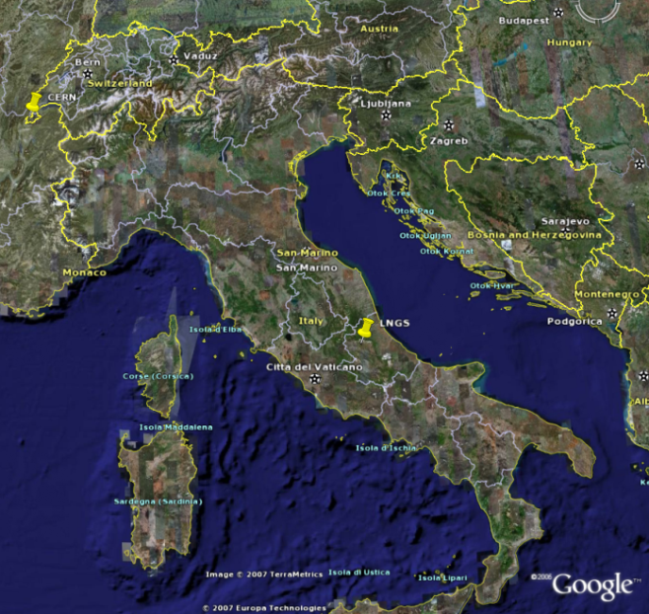
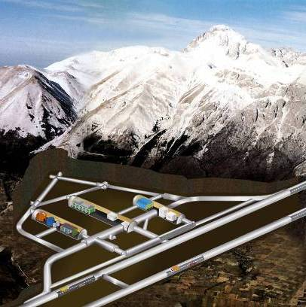
CERN Neutrinos to Gran Sasso
CERN ν_{µ} beam to INFN Gran Sasso underground lab
High <Eν> to boost σ(ν_{τ} ChargedCurrent)
Delivered 18.0 × 10¹⁹ PoT
CERN
730 km
LNGS
<E_{ν}> | 17 GeV
L | 730 km
P(ν_{µ} → ν_{τ}) ≈ 1.7%
(ν_{e} CC + ν_{e} CC)/ ν_{µ} CC | 0.89%
ν_{µ} CC/ν_{µ} CC | 2.1%
prompt ν_{τ} | negligible
Under 1400 m of rock
(3800 m water equiv)

Slide 4
Detection principle
ECC brick
1 mm
electronic
trackers
τ
ν_{τ}
Pb
emulsion layers
Cleanest signature: kink topology
Hybrid detector: nuclear emulsions (“ECC”) & electronic detectors
Micrometric resolution: σ(position) < 1 µm, σ(angle) ≈ 2 mrad
Emulsions & Pb plates grouped in “bricks” (8.3 kg, 10 X₀)
Electronic detectors trigger, select brick, measure muon momentum & charge
interface films (CS)

Slide 5
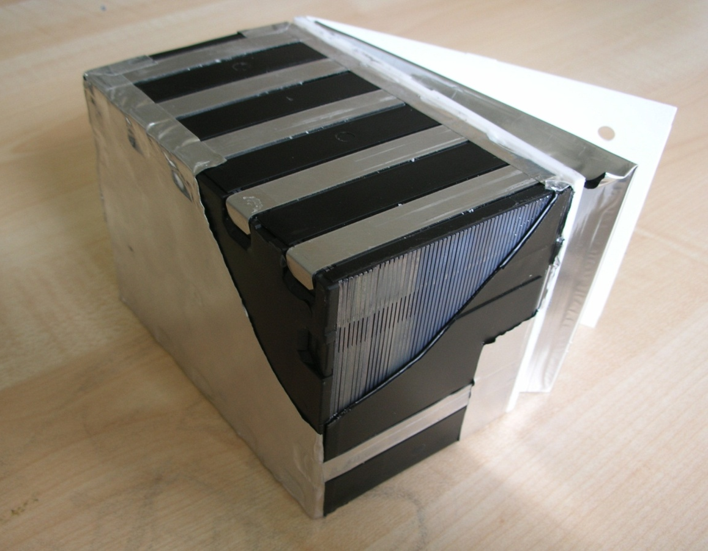
Detection principle
7.5 cm
ECC brick
12.5 cm
1 mm
electronic
trackers
τ
ν_{τ}
10 cm
Pb
emulsion layers
Cleanest signature: kink topology
Hybrid detector: nuclear emulsions (“ECC”) & electronic detectors
Micrometric resolution: σ(position) < 1 µm, σ(angle) ≈ 2 mrad
Emulsions & Pb plates grouped in “bricks” (8.3 kg, 10 X₀)
Electronic detectors trigger, select brick, measure muon momentum & charge
interface films (CS)

Slide 6
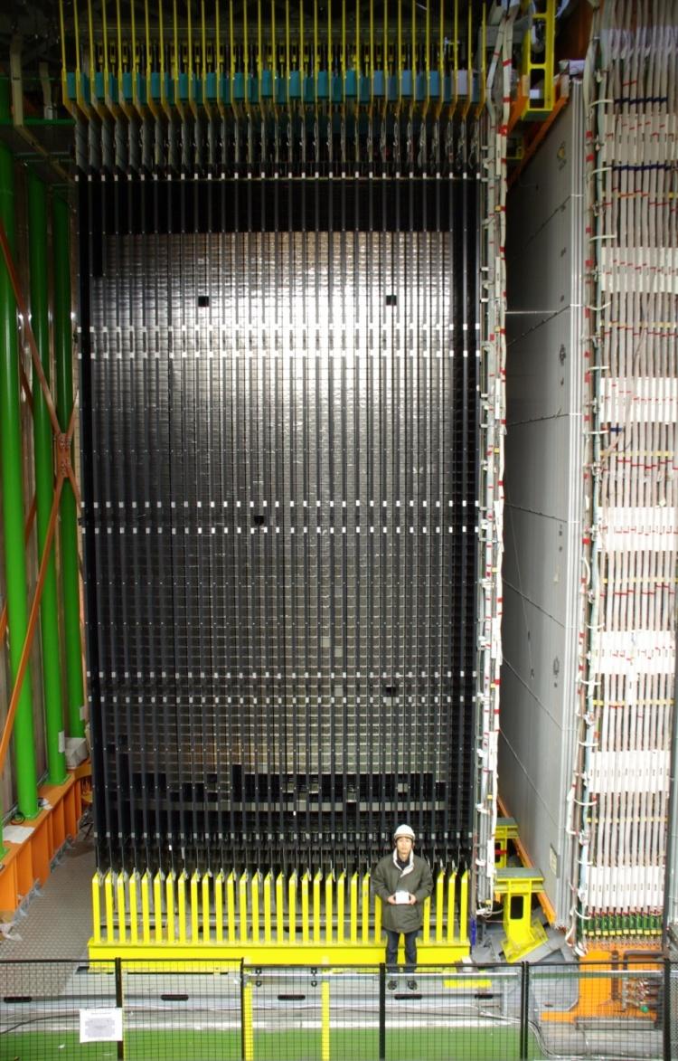
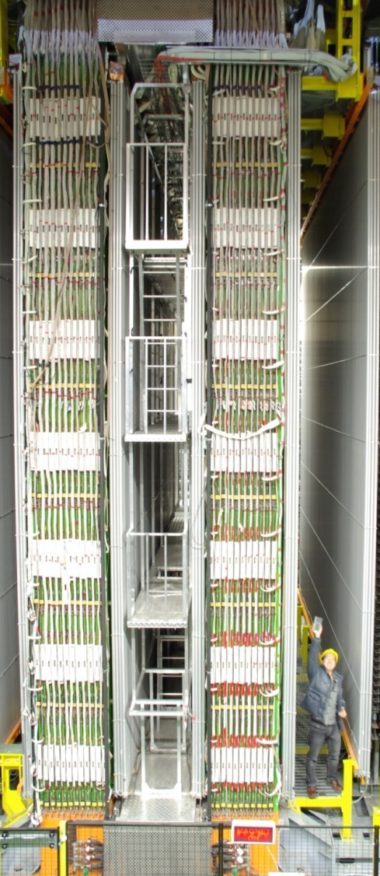
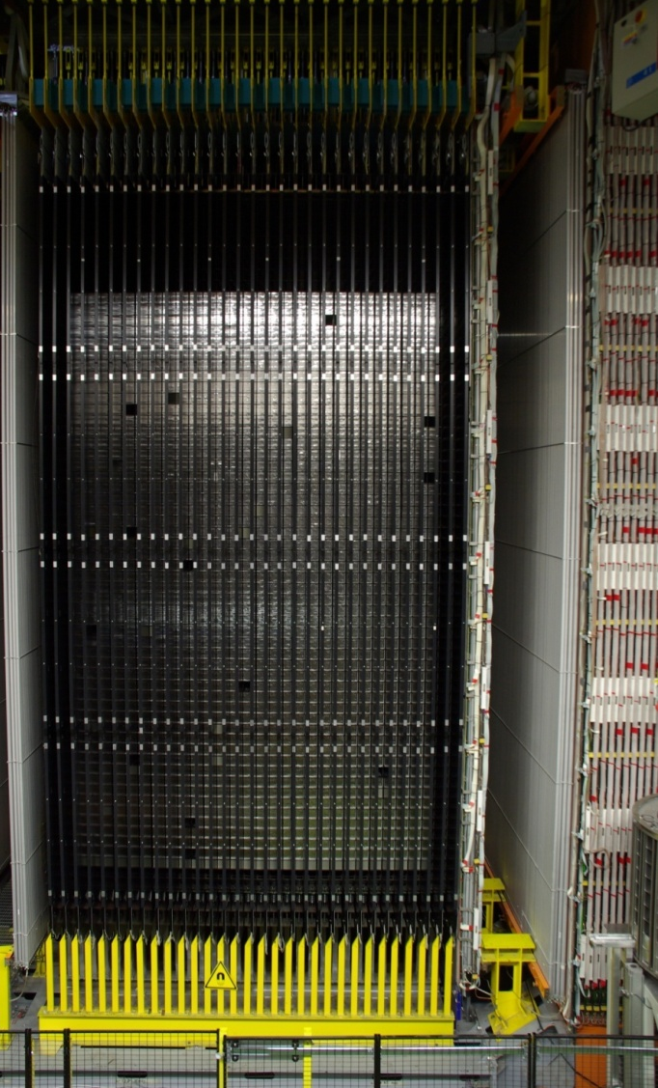
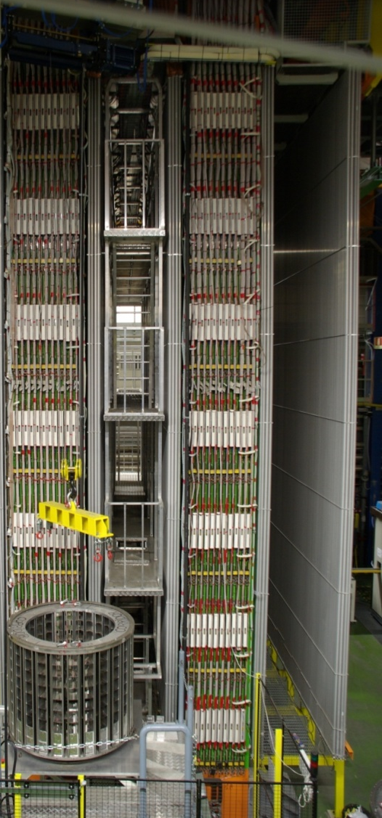
Detector
Muon spectrometer Δp/p ~ 20%
JINST 4 (2009) 04018
Total mass, EleDet, BMS, muon spectrometer
ν
Target area
Target area
~150000 bricks = 1,25 kton in total
31 Target Tracker planes
Brick Manipulating System

Slide 7
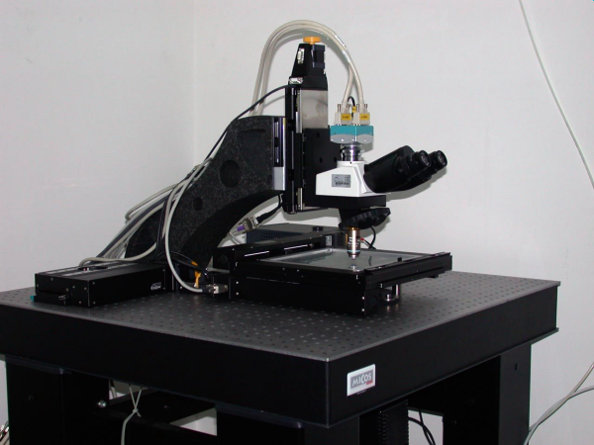
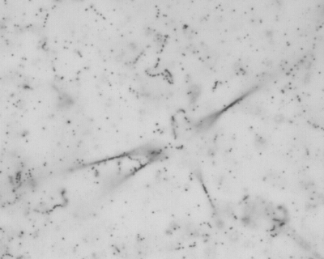
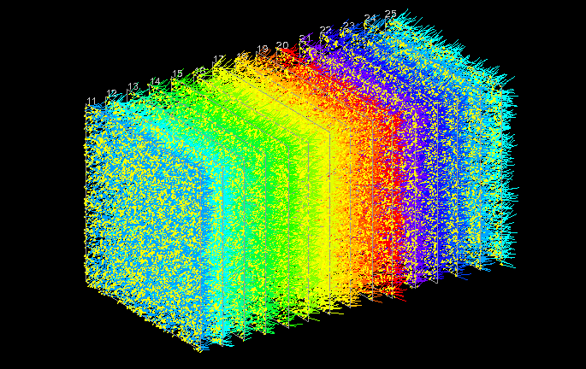
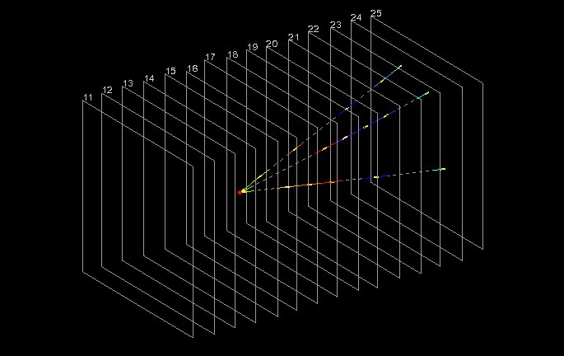
Scanning
Developed emulsion
Automated microscope
European Scanning System
1 cm
1 cm
Low energy & random tracks
High energy tracks connecting across the lead

Slide 8
Momentum and PID
Momentum measured via Multiple Coulomb Scattering of tracks in lead
MCS method developed with test beam bricks,
checked with soft muons & muon spectrometer
Some particle ID:
dE/dx (=grain density along track, nuclear fragments),
showering (electrons),
track following in emulsion (nuclear interaction,
hadrons), and Electronic Detector (range, muons)
New J.Phys. 14 (2012) 013026

Slide 9
Backgrounds
ν_{μ,e}
μ⁻,e⁻
μ⁺
e⁺
h⁺
Backgrounds to kink topology:
  ν_{µ} CC charm production (4% of CC), with µ mis-id’d
  (similar lifetime, missing E_{T} decays)
  large angle coulomb scattering of µ
  nuclear interactions of hadrons (0.2% of NC)
Kinematical variables to reduce background:
  Flight length
  Total p_{T} of τ daughters wrt τ direction
  Missing p_{T} at 1ary vertex
  φ = angle of τ wrt hadronic shower in transverse plane to beam
D⁺
ν_{μ}
μ⁻
ν_{μ}
ν_{μ}
h±
h±
Signal :
φ =180º
X (hadron shower)
BG:
small φ
x
φ
kink
ν_{τ}N τ⁻X
π⁻
τ⁻
τ-decay
π⁻
ν_{τ}
π⁻
ν_{μ}N ν_{μ}π⁻X
ν_{μ}

Slide 10
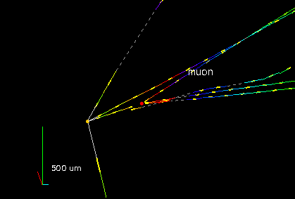
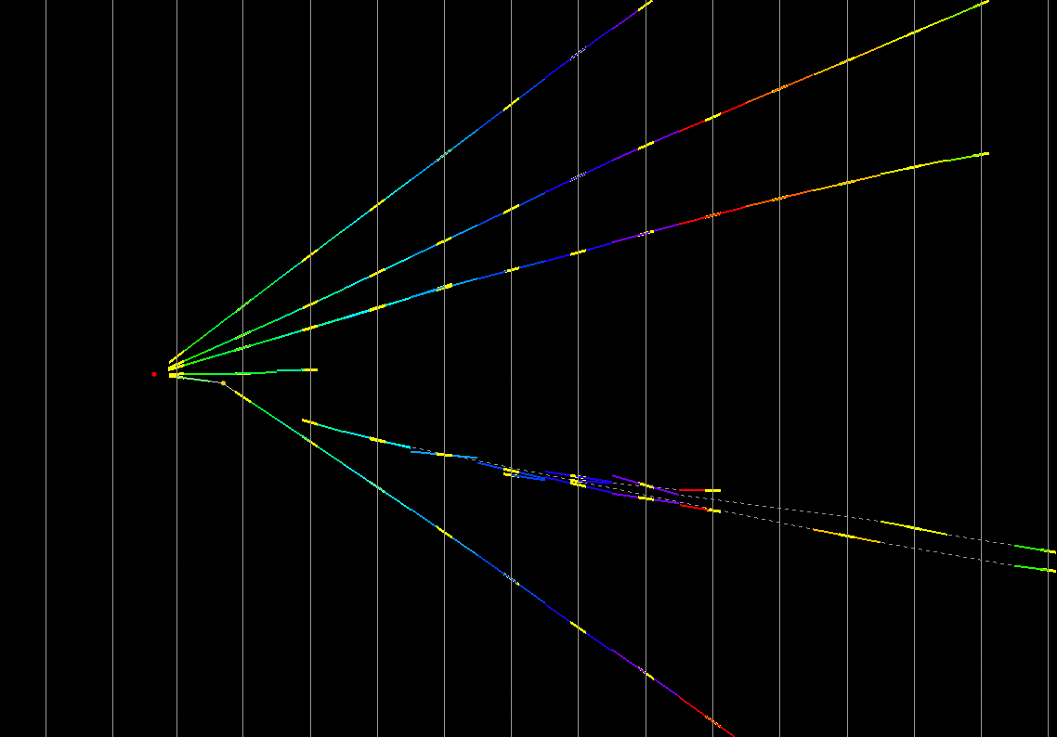
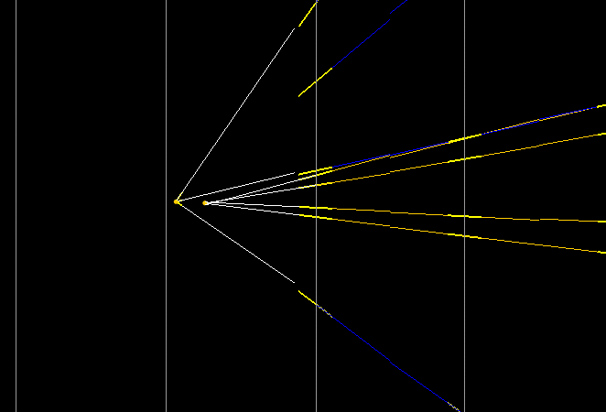
Control sample: charm
Same decay topologies & lifetimes as τ signal
A few examples of charm candidates
(muon at 1ry vertex, phi value or both):
x-view
1ry muon
3-prong
1ry
vertex
Flight length = 4350 µm
di-muon
kink
4 mm
1.3 mm
1-prong
daughter muon
Flight length = 1330 µm
D⁰ 4-prong
φ = 173°
Flight length = 313 µm

Slide 11
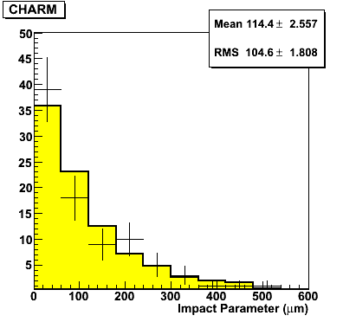
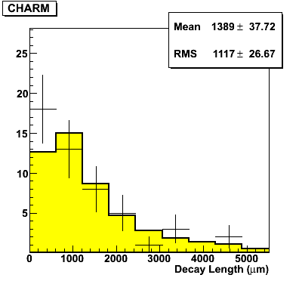
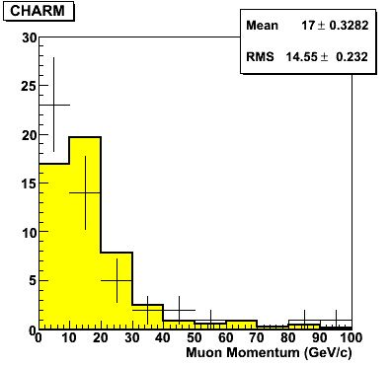
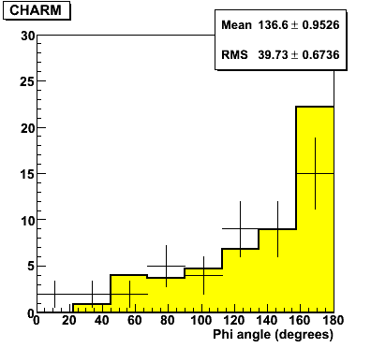
Control sample: charm
Topology | Expected from MC | Observed in Data
1-prong | 28.5 | 19
2-prong | 22.1 | 22
3-prong | 8.2 | 5
4-prong | 1.2 | 4
Total | 60 ± 8 | 50

Slide 12
ν_{τ} candidates
Status of scanning:
Expected number of signal and background events in analysed sample
Years | PoT (x10¹⁹) | Status | # of Decay Searched events
2008-2009 | 5.27 | Completed | 2783
2010-2011-2012 | 12.7 | In progress | 1722
Total | 18.0 |  | 4505
Signature | BR (%) | Observed candidates | Signal | Background | Charm | Mu scattering | Hadrons
τ– → µ– | 17.7 |  | 0,49 | 0,02 | 0,01 | 0,02 | 0,00
τ– → e– | 17.8 |  | 0,68 | 0,05 | 0,05 | 0,00 | 0,00
τ– → h– | 49.3 | 1 | 0,56 | 0,06 | 0,03 | 0,00 | 0,03
τ– → h–h⁺h– | 15.2 | 1 | 0,18 | 0,05 | 0,05 | 0,00 | 0,00
Total |  | 2 | 1,91 | 0,18 | 0,14 | 0,02 | 0,03

Slide 13
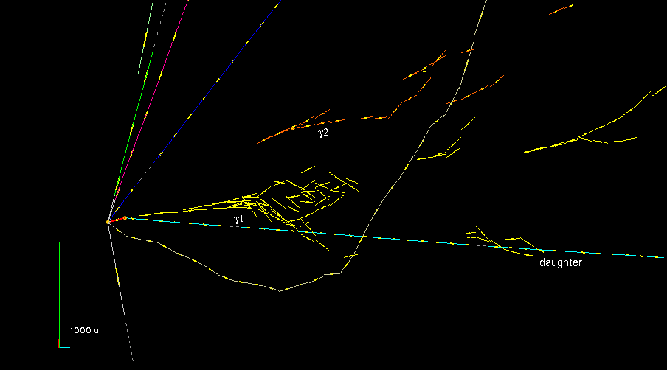
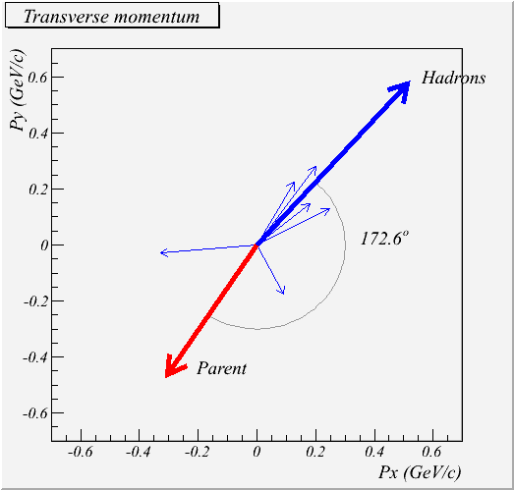
1st ν_{τ} candidate
φ
τ– → ρ– ν_{τ} , ρ– → π– π⁰ , π⁰ → γγ
Selection criteria | Measurements
Kink > 20 mrad | 41 ± 2
Flight length < 2600 µm | 1335 ± 35
p daughter > 2 GeV/c | 12 ⁺⁶₋₃
p_{T} daughter > 300 MeV/c | 470 ⁺²³⁰₋₁₂₀
missing p_{T} < 1 GeV/c | 570 ⁺³²⁰₋₁₇₀
ϕ > 90° | 173 ± 2
m(π⁰) = 120 ± 20(stat.) ± 35(syst.)
Phys.Lett. B691 (2010) 138-145

Slide 14
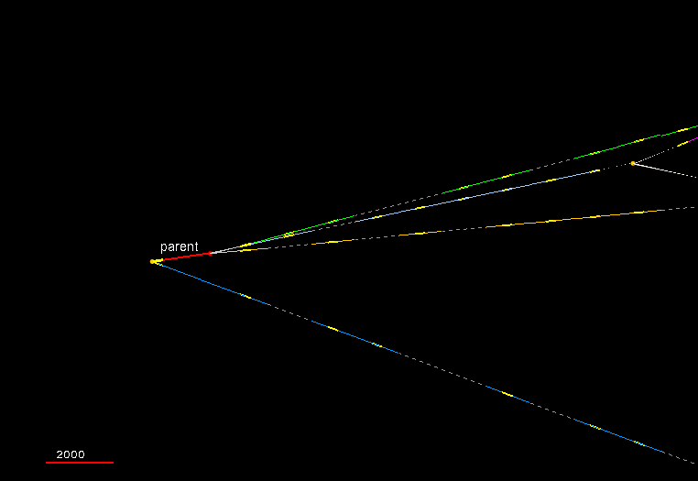
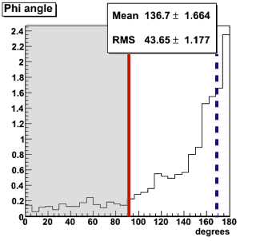
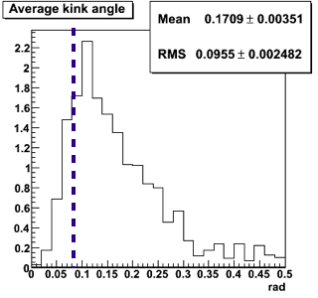
2nd ν_{τ} candidate
Interaction Vertex in lead plate
1 nuclear fragment
Primary Track
φ = (167.8 ± 1.1)°
µm
Flight length 1.54 mm
d2
τ
Decay point
In Plastic Base
No nuclear fragment
d3
d1
φ
Kink angle
(rad)
Secondary Interaction
In Emulsion
4 nuclear fragments
degrees

Slide 15
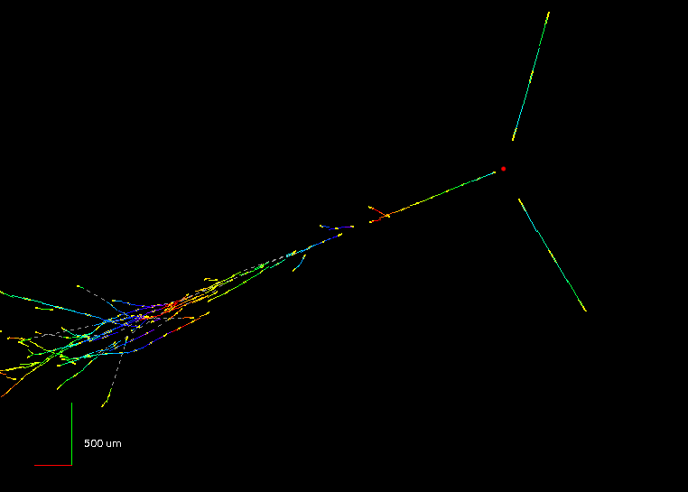
ν_{e} appearance search
ν_{µ} → ν_{e} appearance search in 2008+2009 sample (5.25 x 10¹⁹ PoT)
E_{ν} = 16 GeV

Slide 16
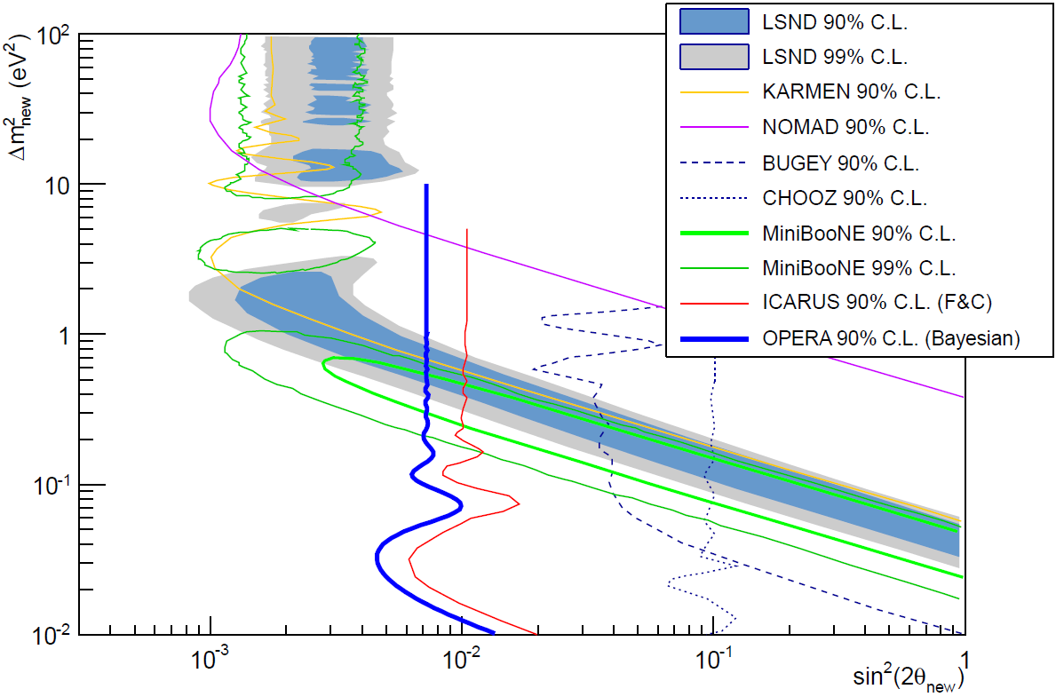
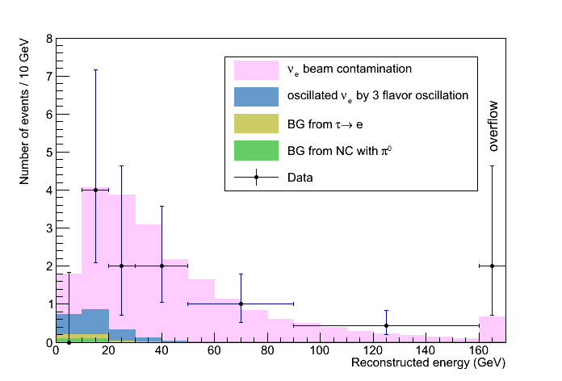
ν_{e} appearance search
Expected ν_{e} events :
ν_{e} beam contamination 19.3 ± 2.8
Background τ → e + mis-id’d π⁰ 0.5 ± 0.2
→ Observed 19 events sin²(2θ₁₃) < 0.44 @ 90% CL
ν_{µ} → ν_{e} 1.4 evts (sin²(2θ₁₃) = 0.098)
→ Upper limit on non standard ν oscillations sin²(2θ_{new}) < 7.2 x 10⁻³ 90% CL where
P = sin²(2θ_{new}) sin2(1.27 Δm²_{new} L/E)

Slide 17
Summary and conclusions
OPERA has recorded events corresponding to 18.0 x 10¹⁹ PoT delivered by the CNGS beam from 2008 to 2012
Scanning (“second data-taking”) and analysis ongoing. ~50% completed!
ν_{µ} → ν_{τ} appearance search:
2 candidates observed, 1.9 signal + 0.2 background expected
ν_{µ} → ν_{e} oscillation search:
non standard ν oscillations sin²(2θ_{new}) < 7.2 x 10⁻³ @ 90% CL
More interesting events in the pipeline... Stay tuned!

Slide 18
BACK UP SLIDES

Slide 19
Event Location in the ECC
Changeable
Sheet
ECC
Large Area Scanning
~5cm x 5cm
ν
Lead
film
Lead
film
Lead
film
Lead
film
Lead
film
Lead
film
Lead
film
Lead
film
film
film

Slide 20
Event Location in the ECC
Changeable
Sheet
ECC
Small area scan
~0.1mm*0.1mm
ν
Read-out films around the stopping point
Lead
film
Lead
film
Lead
film
Lead
film
Lead
film
Lead
film
Lead
film
Lead
film
film
film

