Slide 1
The Discrete Road to lepton masses and mixings
Daniel Hernandez
ICTP
D. H. and A. Yu. Smirnov, ;
arXiv:1204.0445, arXiv:1212.2149
and some yet unpublished work

Slide 2
SOME RELEVANT NAMES
E. Ma, K. Babu, C.S. Lam, G. Altarelli, F. Feruglio, C. Hagedorn, L. Merlo, S. King, W. Grimus, S. Morisi, F. Bazzocchi, S.F. Ge…

Slide 3
$$SU(3)$$
$$SU(2)$$

Slide 4
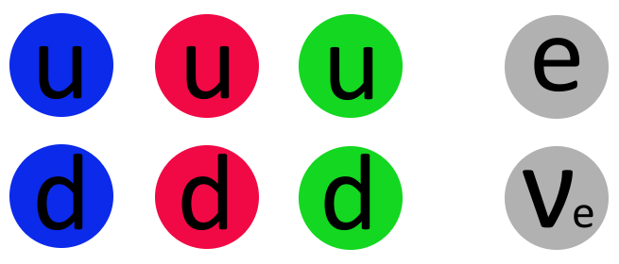
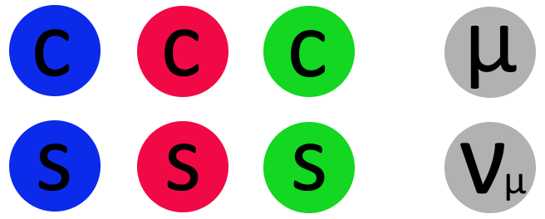
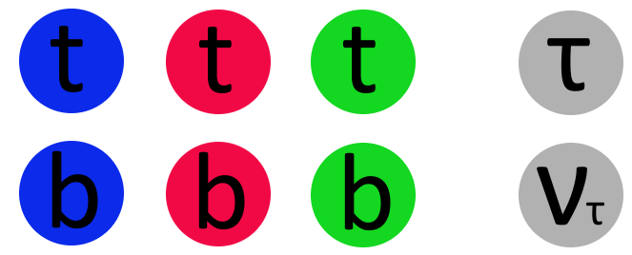

Slide 5
Flavor Puzzle
Explain why 3 families
Explain masses
Explain mixings
Are masses and mixings telling us
something about the theory behind
the 3 generations?

Slide 6
Focus on the leptons
ASSUMPTION: Neutrinos are Majorana

Slide 8
A possible theory of flavor
A theory of masses: One that predicts a structure for Y and M independently without saying anything about the other
A theory of mixing: One that predicts the misalignment between Y and M without necessarily speaking about the eigenvalues of each.
DISCRETE SYMMETRIES provide a theory of mixing
AND an organization principle for 3 families

Slide 9
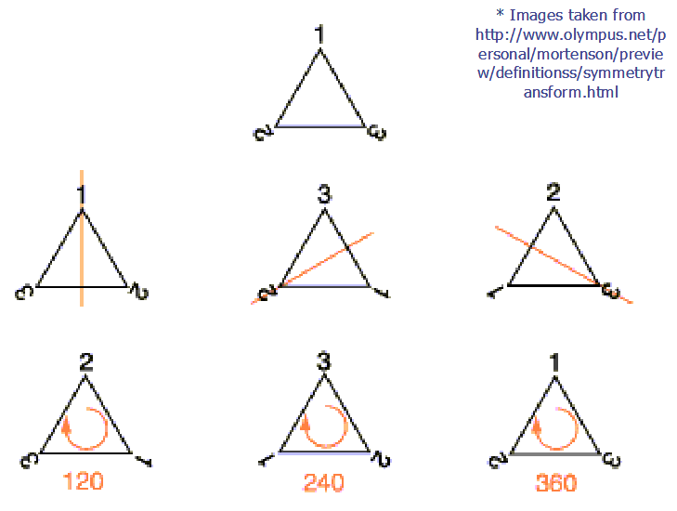
What are these (nonabelian) discrete symmetries?
Reflections(P)
120º Rotations(O)
Do not commute.
$$PO≠OP$$
Raised to some power, equal the identity
$$P^{2}=O^{3}=1$$

Slide 10
A4: symmetry group of the tetrahedron
S4:Full permutation symmetry of 4 elements
A5: Symmetry group of the icosahedron
……………………………………………………….
Important fact: These symmetries have 3-dimensional representations that account for the presence of 3 families

Slide 11
Weren’t discrete symetries DEAD?
I mean, didn’t they predict $θ_{13}=0$?

Slide 13
$$θ_{13}≠0$$
In specific cases, discrete symmetries can fit the observed angles (well inside the 1σ region) and predict the CP phase.
General constraints on mixing from discrete symmetries are obtained in an elementary way with NO mention of models whatsoever

Slide 14
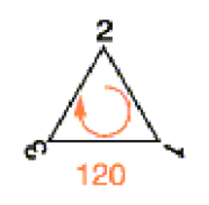
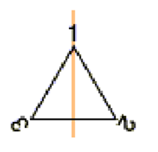
Flavor Symmetry
symmetry
symmetry
Charged Leptons
breaking
Neutrinos
breaking
Residual symmetries
Take the symmetry of the equilateral triangle

Slide 15
Left conserved in charged lepton sector
Left conserved in neutrino sector
IF

Slide 16
n=3
An example
For n=3, eigenvalues of PO are
,
,
2 constraints on mixing

Slide 17
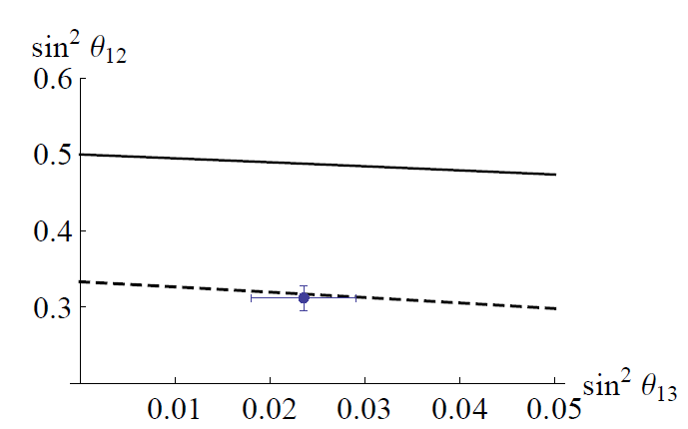
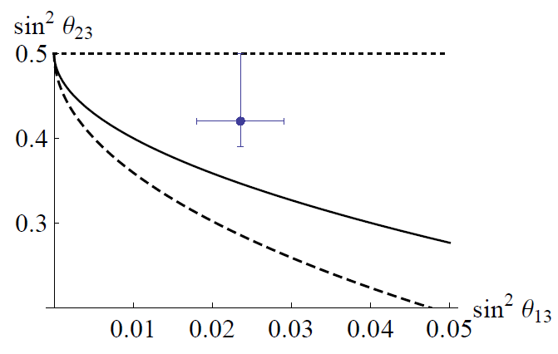
S4
BM
TBM
Fogli, et al

Slide 18
If we impose that a larger symmetry is preserved by the neutrino mass matrix, predictions are stronger

Slide 19
Conclusions
Discrete symmetries applied to the lepton sector can give an excellent fit to the mixing parameters
Notice I DON’T SAY MODELS. These constraints can be obtained in a model-independent way

Slide 20
Notes:
In the last slides I want to mention two extensions of the program I have outlined

Slide 21
Discrete symmetries and lepton mixing
Daniel Hernández
D.H, A. Yu. Smirnov; 1204.0445
D.H, A. Yu. Smirnov; in prep.
Notes:
Feels weird, who is going to take care if I have a problem with the presentation I wonder. Anyway, I will be speaking about discrete symmetries and lepton mixing, a work that Alexei and I started some months ago. Being our community small as it is, some of you have already seen the zeroth order talk in Florence. To those of you that have I say, be patient and bear with me because I am going to present now the first order perturbation. To the rest, well, I guess you won’t notice that I am repeating the jokes.
In this talk I will be interested exclusively in the lepton sector. I say this so you know that any question regarding the quark sector will be promptly dismissed. Also, I will be only interested in the possibility that neutrinos are Majorana.

Slide 22
It all begins with large mixing angles in the leptonic sector
TriBimaximal Mixing
Harrison, Perkins, Scott, 2002
Even before and for different reasons, Bimaximal mixing had been proposed
Bimaximal Mixing
Vissani, 1997
Notes:
Anyway, it all begins with the observation that the entries of the mixing matrix in the lepton sector are large. What you see here is what I would call a mixing matrix for theorists, sort of a matrix one would use in order of magnitude calculations. Each entry here is obtained by taking the absolute value squared of the best fit for the mixing matrix elements and rounding up. Despite of the rounding, I think I have actually managed to get all the rows and all the columns to sum 1. Moreover, when rounding to the first decimal digit, only these two entries here turn out to be equal. You see you have, 0, 0.1, .2, .3 and .4 in the off-diagonal elements, while .5, .6 and .7 are in the diagonal.
The fact that this matrix has large values here and the fact that it is so different from the quark mixing matrix suggests the idea that those big values are there for a reason. If there is a reason to them, they must be special in some sense. This line of thought takes us to the bimaximal and tribimaximal mixing matrices. I believe I don’t I have to introduce them in this audience, you also heard of them from Harry and I think there are workshops just to discuss the many secrets that they hide. The important point in any case about this matrices is twofold, first, their entries are more or less good approximations to the entries of this measured mixing matrix here and two, they are ‘special’ in a sense that will be clear in a moment.

Slide 23
Do TBM or BM have something to do with the actual neutrino mass matrix??
Is is possible to reproduce those mixing patterns from a fundamental Lagrangian??
Yes! Using discrete symmetries
Is is possible to produce a realistic theory?
This is rather difficult.
Notes:
Ok, so these special mixing matrices have values that approach the measured ones, but do they really have something to do with the measured mixing matrix. From a theorist point of view there are two aspects of this question. One is whether it is possible to produce these special numbers from a Lagrangian. The answer to this question is a definite yes. TBM and BM have been proven to be derivable from a fundamental Lagrangian. An important piece of most of these models, in particular for TBM, is the imposition of a discrete non-abelian symmetry which is going to be the subject of my talk.
A whole other story is that of producing a model that more than just using discrete symmetries to get an adequate lepton mixing gives a realistic theory of all flavor. This is rather difficult and it is going to be the subject of some other talks here in this conference.

Slide 24
Can we make model-independent statements about the use of discrete symmetries in flavor??
Notes:
Now the question that Alexei and I found ourselves discussing at some point in his office was linked to item number 1. I remember at some point he asked, so Dani, what have we learned about discrete symmetries? We wanted to understand what exactly do discrete symmetries provide? In the end, it all came down to what we can say in a model-independent way about the issue.

Slide 25
General framework
Flavor Group
Charged Leptons
symmetry
symmetry
Neutrinos
breaking
breaking
Bottom-up approach: Identify and with accidental symmetries of the mass terms. Use them to define the flavor group
Bottom-up approach: Identify and with accidental symmetries of the mass terms. Use them to define the flavor group
old game!
Notes:
Of course, being completely model independent is a hard thing. However, there is a very general framework that might not be completely model independent but still encompasses many of the models that have been discussed in the literature. And the idea is the following, you start at some high energy with a flavor group and then you are going to break it, in principle spontaneously. The breaking of the symmetry is usually complete, that is no subgroup of the original flavor group remains conserved. However, a subgroup does remain if one looks at the sector of the theory that is linked to the charged leptons and another, different subgroup remains if one looks at the sector connected to the neutrinos.
What one would like as a model builder is to know first of all what the flavor group is. Then one can write a theory that is invariant under it and break it in the way that I show here. There is a bottom-up approach that allows us to build the flavor group. That is, we can turn the previous argument upside down and look at the accidental symmetries of the charged lepton and neutrino mass terms. These symmetries will correspond to Gl and Gnu and which can in turn be combined to define Gfl.
So, here we have another example of an old game, that is we identify some accidental symmetries in the Lagrangian and hypothesize that they are actually fundamental ones. This is not new, and it is for instance what one is doing when one gauges lepton number and the like

Slide 26
Identifying the accidental symmetries
Focus on the mass terms
Charged Leptons
is invariant under
accidental
Notes:
So let’s play the game. As I just said, I assume that a subgroup of the full flavor group is conserved by the mass term. (WORK IN THE MASS BASIS) That is, looking at the charged lepton mass matrix, it is left invariant under a U(1)^3 transformation by the LH lepton fields and the RH lepton fields. This symmetry is simply electron, muon and tau lepton number. In a moment we are going to choose a subgroup of it to be part of the high energy flavor group.

Slide 27
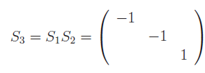
Identifying the flavor symmetry
Focus on the mass terms
Neutrinos
invariant under
accidental
,
,
Notes:
In the neutrino sector we do the same thing. Since we are assuming Majorana neutrinos, the same field appears squared in the mass term and the accidental symmetries are already discrete. It is a Z_2x Z_2 in which each of the Z_2s is a transformation that leaves invariant one of the neutrino mass states and changes the sign of the other 2. For instance S_1 leaves invariant nu_1 and changes the sign of nu_2 and nu_3 and so on

Slide 28
Enter mixing matrix
Change of basis
Take
Invariance of
with
under
Still
accidental
Notes:
Of course, all of this holds in the mass basis which is corrrect for describing the physics below the EW breaking scale. At high-energies however, a flavor basis is more appropriate in which the current term is diagonal and the mass terms are not. Still the mass terms remain invariant under the accidental symmetries just discussed. Actually, it can be proven that the resuls I am about to discuss do not depend on how one makes the division of U_PMNS between V and U. Therefore, without losing generality, I am going to assume that all of U_PMNS is absorbed by U and that V is equal to 1 thus leaving the charged lepton mass term diagonal. As I just said, the Z2 symmetries are preserved and the matrices that represent them are similar to the S_i matrices introduced before through the transformation U.

Slide 29
Choosing the flavor subgroups
For the neutrinos
Just choose at least one of the
Notes:
Once we have identified the accidental symmetries of the mass matrices we can proceed to build the flavor group. The first thing is choosing the subgroups in both sectors that will become part of the flavor group. For the neutrinos is easy, we choose at least one of the S_iu matrices as a generator of the neutrino subgroup. Thus the neutrino sector contributes to with at least a Z_2 subgroup

Slide 30
Choosing the flavor subgroups
For charged leptons, use a discrete abelian subgroup of as part of the group of flavor
Impose ,,
unitary
Notes:
For the charged leptons we use a discrete subgroup of U(1)^3 and for that we impose T^m = 1. Moreover, we assume that T is special unitary, that is, that is determinant is equal to 1. We can thus parametrize it as

Slide 31
Defining the flavor group
Focus on one-generator subgroups
Choose one of the and a
Define a relation between and
We had ,
Add
Notes:
Now that we have found the corresponding subgroups, how do we determine the flavor group. In order to make S and T elements of a non-abelian group we require another relation that combines the two abelian subgroups to complete the group definition in terms of its generators. There is no unique way for choosing such a relation in principle, however one that leads to the great majority of the models that have been considered so far is that there exists a p such that (ST)^p = 1. So we have the three defining relations S^2 = T^n = (ST)^m = 1. For given m, n, p values these define a group, the von Dyck group D(m,n,p)

Slide 32
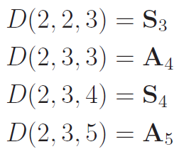
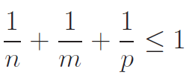
The relations
define the von Dyck group
is the dihedral group
Notice that if
The von Dyck group is infinite
Notes:
The smallest von Dyck groups are well known finite groups.
It is a well known mathematical fact that von Dyck groups that fulfill the relation* are infinite.

Slide 33
Now you know the flavor group and the symmetry breaking pattern, go and construct a model

Slide 34
Constraints on the mixing matrix
cubic equation with
with
Two equations, one for the real and one for the imaginary part of
TWO CONSTRAINTS ON THE MIXING MATRIX
Notes:
However, already at this level you can say that there are constraints imposed on the mixing matrix that you will get from such scheme…. The characteristic equation for W is fulfilled by some lambdas which are pth roots of unity. If I restrict to the case in which one of the eigenvalues of W is equal to 1, then the characteristic equation has this form with only one independent coefficient a and a is a real number. Now, this trace is a function of the mixing matrix so by determining, I get constraints on the entries of the mixing matrix.
I will show now that the relation (ST)^p = 1 imposes somewhat strong constraints on the mixing matrix. Moreover let me assume that one of the eigenvalues of T is 1, that is, that one of the charged leptons actually transforms trivially under the remaining group over there. (None of this is strictly necessary). Now, since (ST)^p= 1, all the solutions of the equation Det[…] = 1 must satisfy lambda^p = 1

Slide 35
So, the constraints on the entries of the mixing matrix depend on
and which S_{i} is chosen

Slide 36
Constraints on the mixing matrix
p=3
p=4
p=5
For instance, for
or
Notes:
So how does one determines a? It is just a case study really. Since the eigenvalues of W are entire roots of unity, a only gets discrete values.

Slide 37
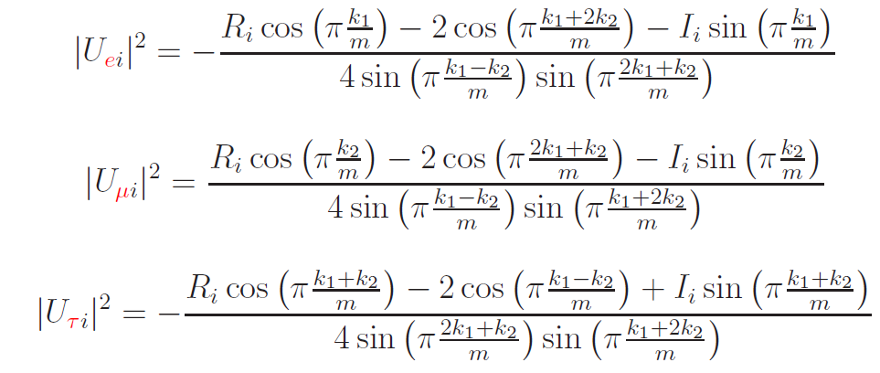
The absolute values squared of one column are determined
(two constraints plus unitarity)
S₁
S₂
S₃
Notes:
Finally, the constraints themselves. It turns out that the two constraints on the mixing matrix are enough to determine the absolute values squared of one column of it. Which column is determined by

Slide 38
A particular case for T (the ‘lazy’ case!)
Remember
Hence in this case, either or
Actually, we have shown that this case is unavoidable if the von Dyck group is finite!
Notes:
An interesting particular case happens when one of the eigenvalues of T is 1 equal to 1. This was essentially the case I described at Florence. Then one can define the matrices T_alpha where alpha runs over the electron, the muon and the tau and simbolizes or is linked to the position in the diagonal of the eigenvalue equal to 1.

Slide 39
Recapitulating: What I have shown (under some - mostly harmless - assumptions)
After a number of choices have been made
The T-charge of the charged leptons (k₁ and k₂ value)
The order of T (m value)
The S-charges of the neutrinos
The eigenvalues of ST (a value)
A two-dimensional surface is cut in the parameter space of the mixing matrix.
Is it possible to fit the measured values of the PMNS matrix??
Notes:
So, let me recapitulate what I have shown. Under assumptions that I consider mostly harmless, in the sense that they go very little against generality, one can build models of flavor if one fixes these things here. Choosing these guts a two dimensional surface in the parameter space of the mixing matrix.

Slide 40
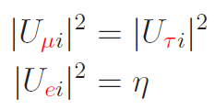
Either or
Choose in the ‘lazy’ case
Substituting the standard parameterization for
S.F. Ge et al
And for

Slide 41
Choose in the
‘lazy’ case
Taking
Solid: m = 4, p = 3. k=1 and from , a=0 . Group is S₄
Dashed: m = 3, p = 4. k=1, a=-1. Group is S₄
BM
TBM
Altarelli, Feruglio, Hagedorn, Merlo,…

Slide 42
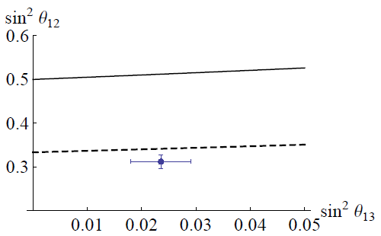
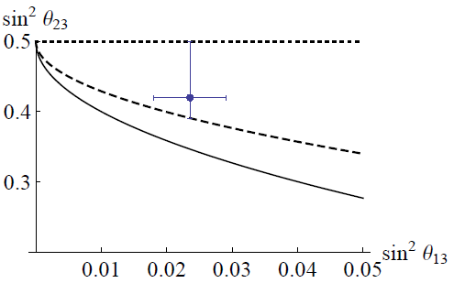
Choose in the
‘lazy’ case
Taking
Dashed: m = 3, p = 3. k=1 and a=0 . Group is A₄
Solid: m = 4, p = 3. k=1, a=-1. Group is S₄
BM
TBM
Ma, Babu, Valle, Altarelli, Feruglio, Merlo,…

Slide 43
Choose in the
‘lazy’ case
Hence, either or
For the case of
For the case of
Unexplored

Slide 44
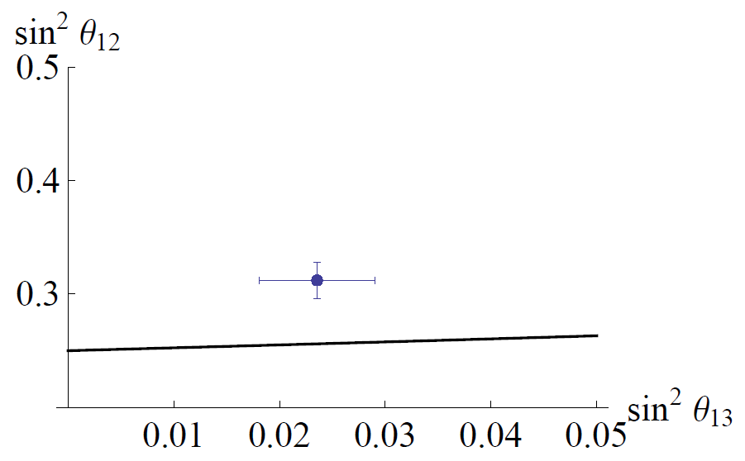
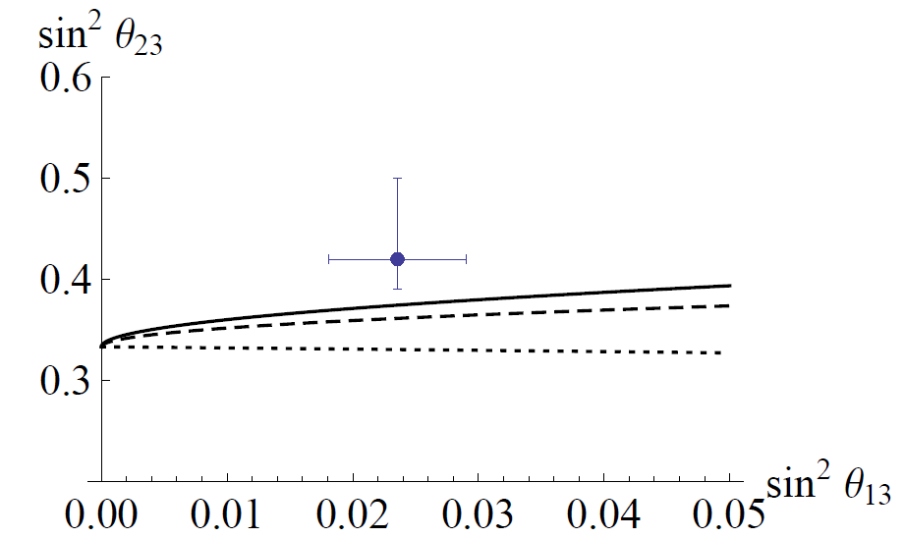
Choose in the ‘lazy’ case
Flipped Bimaximal

Slide 45
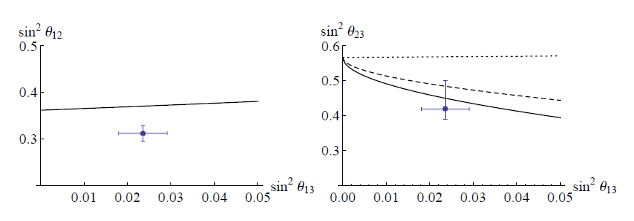
:

Slide 46
A few words about TBM
If one imposes that the two Z2 symmetries of the neutrino mass matrix should belong to the flavor group, then 4 relations appear between the entries of the mixing matrix
If they are compatible, they will fix all parameters of the mixing matrix.
TBM is indeed one solution for the case of S₄.
This could be an argument pro TBM.
C. S. Lam

Slide 47
If
Other Groups
the von Dyck group is infinite
Von Dyck group (may now be
infinite)
Add
Modular group Г₇, Δ(96)
Same strategy, for
very preliminar!
has discrete values
De Adelhart, Feruglio, Hagedorn
Notes:
Here is another new part to my talk, this is so new in fact that I think not even Alexei has seen it.

Slide 48
With these new groups one can put to use the mixing patterns that appear from the infinite von Dyck groups
The lazy are not wanted anymore (the cases in which no eigenvalue of T is 1 are realized)
very preliminar!

Slide 49
Conclusions
Recipe for model building: upgrade the accidental symmetries of the mass terms by making them subgroups of the flavor group.
The minimal choice of generators (one Z₂ for neutrinos and one Z_{N} for charged leptons) leads to non-abelian discrete groups of the von Dyck type.
In this scheme, at least two relations are imposed on the leptonic mixing matrix.
One case with S₄ shows a very good agreement with the measured values.
Experimenting with other groups ongoing.

Slide 50
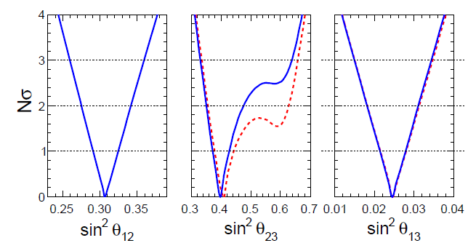
TBM now disfavoured
Fogli et al., 1205.5254
Notes:
Moreover, as it turns out, what was once thought to be a good approximation to lepton mixing, is actually not so good. The «flamante» measurement of theta_13 by T2K and reactor experiments implies that the perturbation required for TBM is not so small. Best fits on theta_23 now are also claiming to deviate from maximal by a rather large amount. So

Slide 51
Choosing the flavor subgroups
For charged leptons, use a discrete subgroup of as part of the group of flavor
Impose
Define
,
,
Notes:
For the charged leptons we use a discrete subgroup of U(1)^3 and for that we impose T^m = 1. Moreover, we assume that T is special unitary

Slide 52
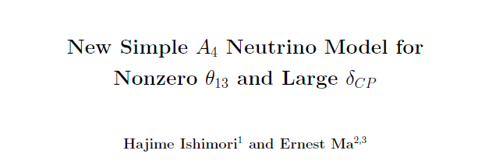

Slide 53
Remember
Hence, either or
Notes:
Relations depend on alpha and i. alpha comes from the charged lepton sector, i comes from the neutrino sector.
First equation only depends on this choice and, in particular, it is independent of the value of a and the eigenvalues of the T matrix
Second equation depends on these 2 things in the other hand.

Slide 54
Recapitulating: What we assume
First and foremost
The general framework for building a model with discrete symmetries
Other ‘minor’ assumptions
Neutrinos are Majorana.
The flavor symmetry is a subgroup of SU(3).
The remaining symmetry in each sector is a one-generator group
Open to discussion!!
Notes:
Minor in the sense that we believe they can be easily changed, at least

