Slide 1


Time-like electromagnetic baryonic transitions form factors investigation with HADES
Orsay, 6 December 2012
B. Ramstein, IPN Orsay

Slide 2
Outline
Introduction:
  General context of HADES experiments
  In-medium modifications of vector mesons
  Interest of elementary reactions
  Sensitivity to electromagnetic Time-Like form factors
Results from pp and dp reactions with HADES
  inclusive/exclusive dilepton channels
  exclusive hadronic channels
Perspectives with the GSI pion beam
Conclusions

Slide 3
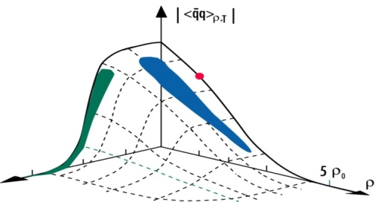
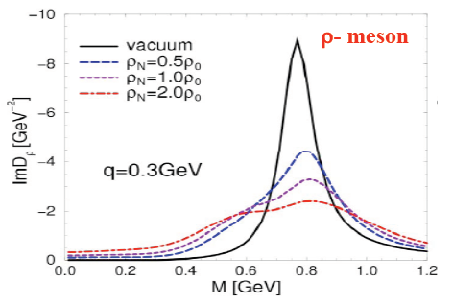
In-medium vector meson modifications:
see e.g. Leupold ,Metag,Mosel Int. J. of Mod. Phys. E19 (2010) 147 for a recent review
Chiral Symetry Restoration
“melting of quark condensate “
Klimt, Lutz , Weise, Phys.Lett.B249 (1990) 386
→ Modifications of hadron masses ?
Brown-Rho PRL66(1991) 2720
Hatsuda and Lee PRC46 (1992) 34
Connexion of vector meson spectral function to quark condensates
via QCD sum rules
« in-medium broadening »
N*
π
ρ
ρ
ρ
ρ
Δ(1232)
+
+ ...
N⁻¹
N⁻¹
In-medium spectral function depends on ρ NN* coupling
Rapp and Wambach EPJA 6 (1999) 415
Rapp, Chanfray and Wambach NPA 617, (1997) 472
3
Notes:
3
So, these effects should be seen in the dilepton spectra

Slide 4
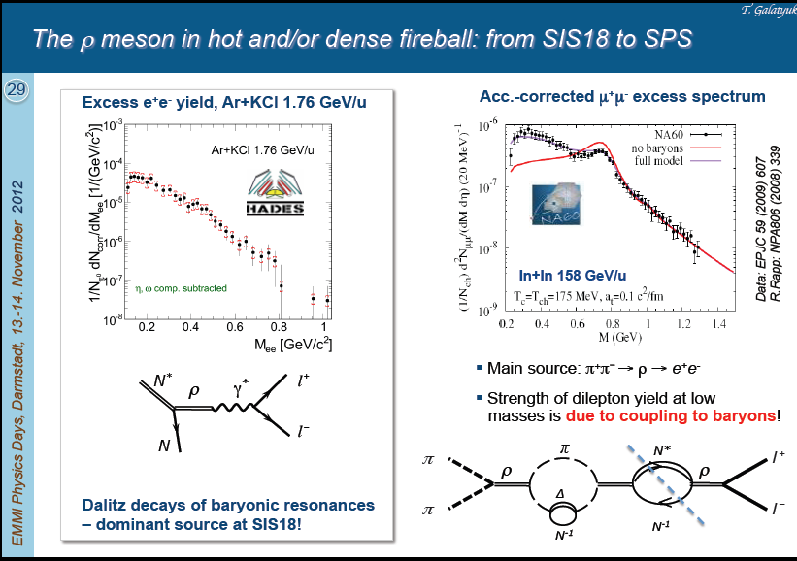
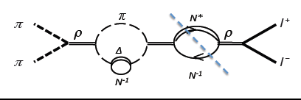
The ρ meson in hot and dense hadronic matter from SIS18 to SPS
Source of ρ mesons
Source of ρ mesons
NN →NR →NNρ
πN →R →Nρ
π
Source of ρ mesons
Source of ρ mesons
π⁺π⁻ →ρ
Depends on RNρ coupling
Notes:
Dileptons can also be produced by Dalitz decay of the resonances, but according to VDM, this is the same process

Slide 5
Vector meson dominance for baryonic transitions
Dalitz decay of baryonic resonances
ρ meson decay
γ∗
R
γ∗
R
e⁺
ρ, ω,φ
e⁺
e⁻
e⁻
electromagnetic
elastic or transition
form factors
Meson
cloud structure
N
N
Coupling constants

Slide 6
Hades « strategy »
Study dilepton emission in dense and hot matter (cf. DLS/Berkeley)
A+A reactions in the 1-2 AGeV energy range
C+C, Ar+KCl, Au+Au (2012), Ag+Ag(2013?)
cold matter at normal nuclear density p+Nb 3.5 GeV
(cf KEK, Jlab, CBELSA/TAPS)
Elementary collisions pp, dp and (in future) π⁻p
  reference to heavy-ion spectra
  understand dilepton production mechanism (exclusive channels)
  dilepton emission is probing time-like electromagnetic structure of hadronic transitions!
Simultaneous measurements of hadronic channels (pp →NNπ, pp →NNππ)
Cross-checks on known channels, detailed information on baryonic resonance production
…. strangeness measurement program: K⁻ , K⁰,φ, Σ(1385), Λ(1405)

Slide 7

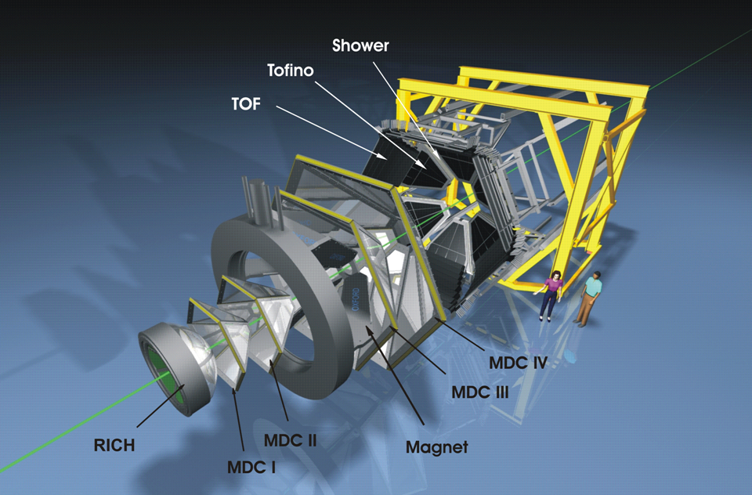

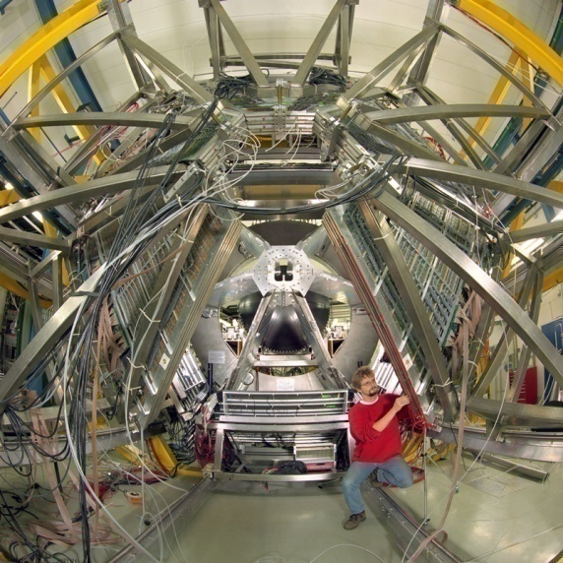
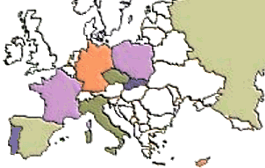

The Collaboration
Catania (INFN - LNS), Italy
  Cracow (Univ.), Poland
    Darmstadt (GSI), Germany
      Dresden (FZD), Germany
        Dubna (JINR), Russia
        Frankfurt (Univ.), Germany
        Giessen (Univ.), Germany
        Milano (INFN, Univ.), Italy
        München (TUM), Germany
        Moscow (ITEP,MEPhI,RAS), Russia
        Nicosia (Univ.), Cyprus
        Orsay (IPN), France
      Rez (CAS, NPI), Czech Rep.
    Sant. de Compostela (Univ.), Spain
  Valencia (Univ.), Spain
Coimbra (Univ.), LIP, Portugal
GSI
SIS
IPN Orsay, 17/10/2011
Béatrice Ramstein
7
Notes:
7
The HADES detector is installed on the GSI facility, but HADES is a european collaboration. Actually 150 persons working in about 156institutions all over Europe. 15” tot 45”

Slide 8

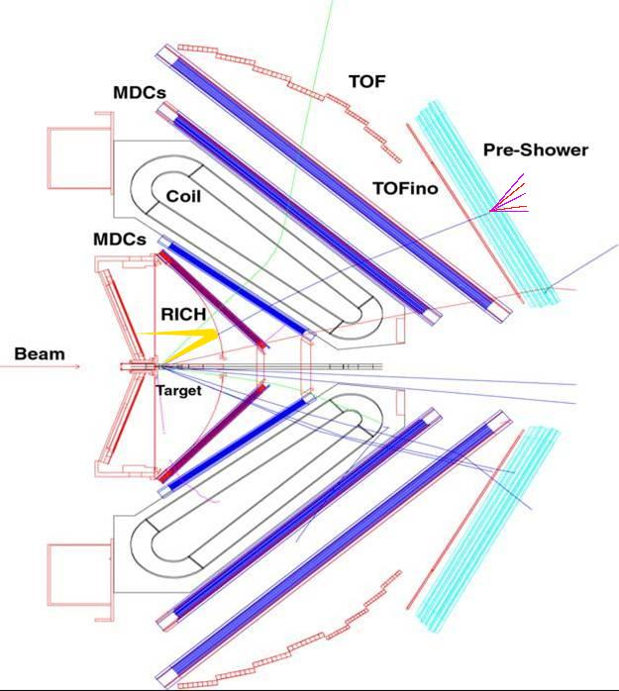
HADES
2nd generation dilepton
spectrometer
Side View
Acceptance: Full azimuth, polar angles 18º - 85º
Pair acceptance ≈ 0.35
Particle identification:
RICH, Time Of Flight, Pre-Shower (pad chambers & lead converter) ( also MDC (K±))
Trigger:
1st Level: charged particle multiplicity (~10 kHz)
2nd Level: single electron trigger (~2.5 kHz)
Momentum measurement
  Magnet: ∫Bdl = 0.1- 0.34 Tm
  MDC: 24 Mini Drift Chambers
  Leptons: Δx~ 140 μ per cell, Δp/p ~ 1-2 %
  ΔM/M ~ 2% at ω peak
Upgrade (2010)
New DAQ ~20 kHz
new MDCs for plane 1
RPC θ <45°
FW
START
θ < 7°
8
Notes:
8
Consists of 6 sectors,

Slide 9

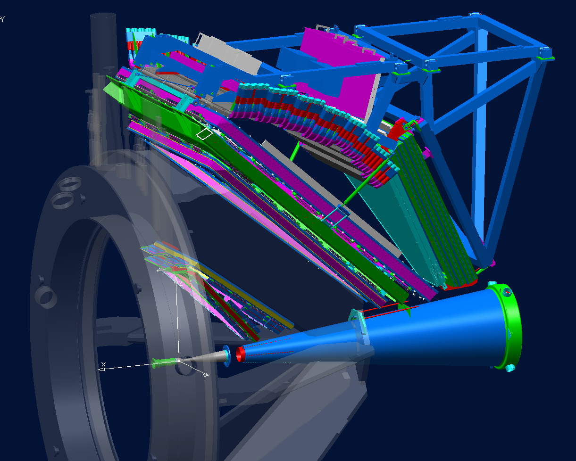
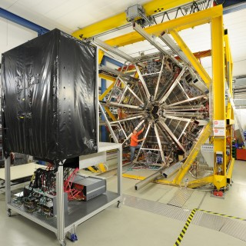
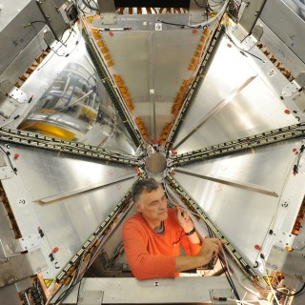
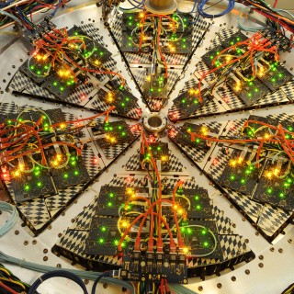
Technical layout of HADES
HADES cave
HADES sector
TOF
inner MDC
Cryostat
Pre-Shower
outer MDC
outer MDC
RPC
B field
region
inner MDC
He pipe
RICH readout
beam
Start + target
9
Lecture III: 9

Slide 10
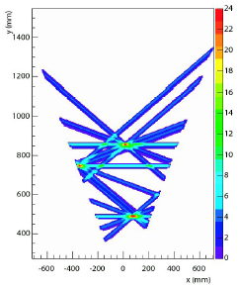
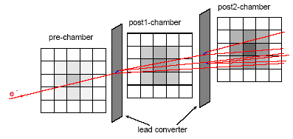
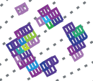
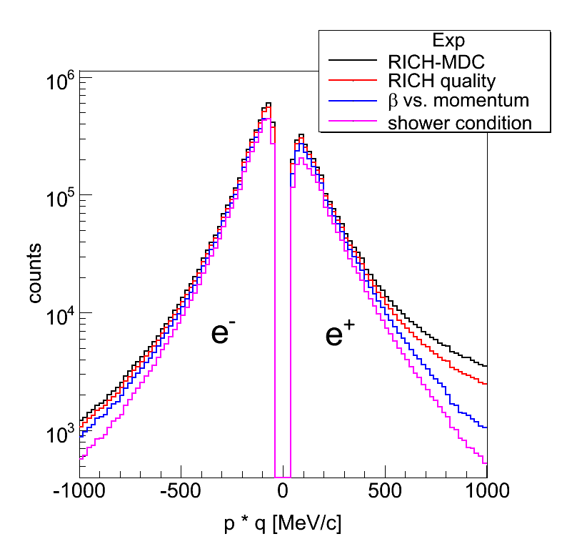
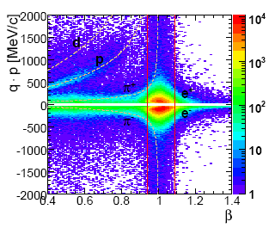
Lepton Identification with HADES
Drift Chamber:
Track reconstruction
RICH pattern
Pre-Shower condition
e⁻
+
+
+
momentum % velocity
momentum ∙ charge
C+C 2 AGeV

Slide 11
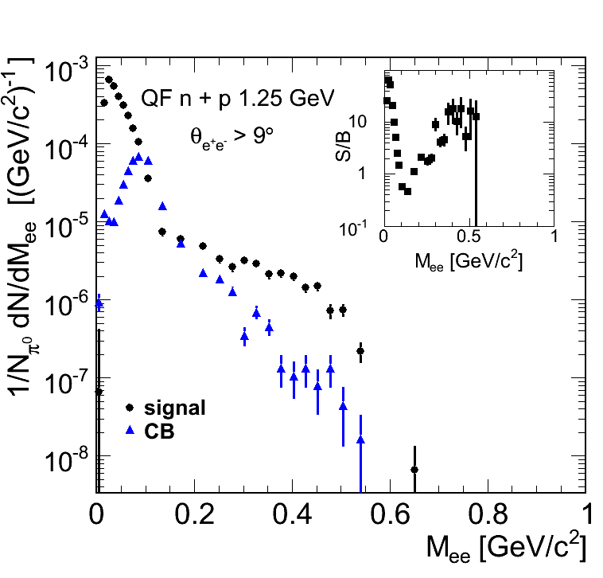
Analysis steps : one example
Forward Wall (np selection):
1. Mult > 0
2. search for particle with
1.6 GeV < p < 2.6 GeV
(e⁺,e⁻) pair cuts:
1. track and ring quality
2. identification
3. background rejection cuts
4. opening angle > 9°.
Combinatorial background: like sign pairs
efficiency corrections:
preliminary
normalisation by elastic scattering measurement
(syst.error ~ 11 %)

Slide 12
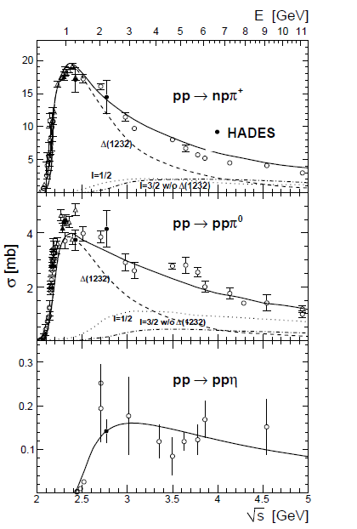
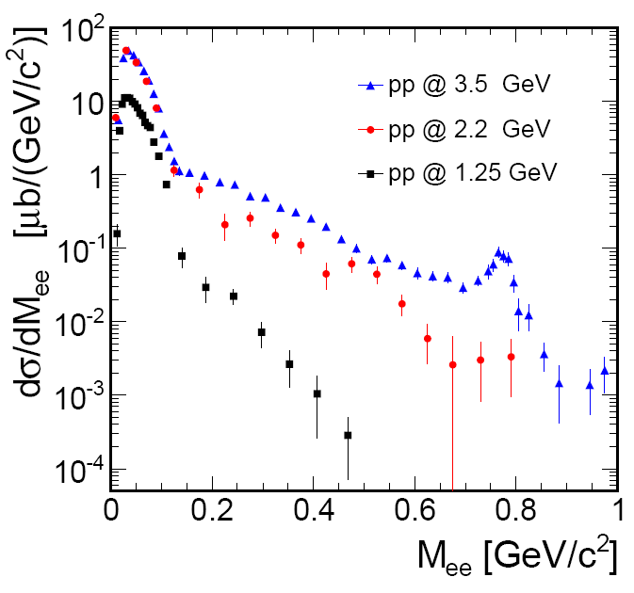
HADES measurements in pp E=1.25 GeV, 2.2 GeV ,3.5 GeV
Exclusive meson production in hadronic channels
Inclusive dilepton production
HADES:EPJA 48 (2012)74
π°→γ e⁺e⁻
η→e+e-γ
ω→e⁺e⁻
(η, Δ)
Δ→Ne⁺e⁻
PRC85 054005 (2012)
Dominance of pp→NΔ below 2 GeV
and higher resonances above 2 GeV
ρ/ω production at 3.5 GeV
12

Slide 13
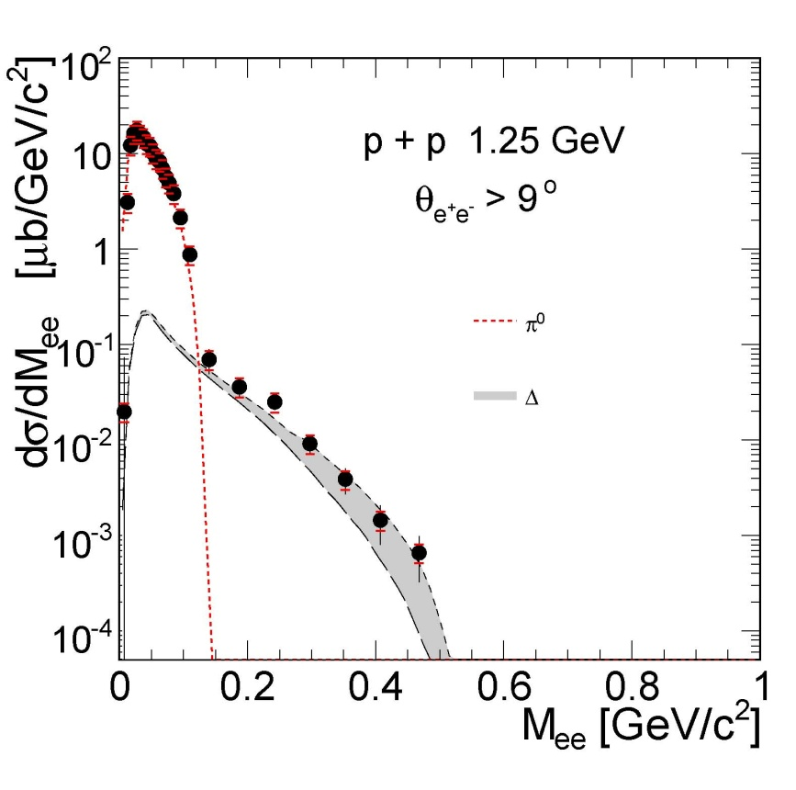

Dilepton production in pp reaction at 1.25 GeV
below η threshold
only 2 dilepton sources
HADES: Phys.Lett.B690 (2010)118
π° Dalitz decay σ_{π°} =4.5 mb
branching ratio π° → γe⁺e⁻ 1.2 %
non resonant contribution expected to be small
Δ Dalitz decay :
branching ratio Δ → Ne⁺e⁻ (QED :4.2 10⁻⁵)
Time-like N- Δ transition electromagnetic
form factors ?
Resonance model results:
π° Dalitz
Dalitz)+ effect of Iachello FF
Notes:
13
Mettre ref Iachello, ref portugais

Slide 14
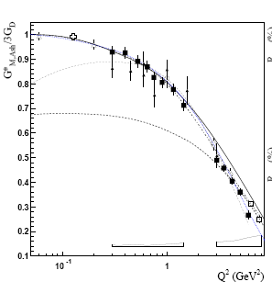
Ν−Δ transition electromagnetic form factors
Δ(J=3/2)−N(J=1/2) transition
exact QED calculation :
3 amplitudes: e.g. Magnetic, Electric
and Coulomb
Krivoruchenko et al. Phys. Rev. D 65 (2001) 017502
Froehlich et al EPJA45:401-411,2010
q²≥0 : « Time like « region complex functions
G_{M}(0)=3, G_{E}(0)=0.04, G_{C}(0)=0.2 known from
γN → Δ → πN (q²=0 )
Unknown at finite q²
p
Δ⁺
γ*
e⁺
Δ⁺ → γp
e⁻
use models fitted on space like data
q²=M²_{inv}(e⁺e⁻)=M²_{γ*} >0
q² < (M_{Δ}-M_{p})2
Δ⁺
p
e⁺
γ
Complementary to Space-Like region:
e⁻
q² = 0
„pion cloud”
Δ⁺
Radiative decay
BR=0.56%±0.04%
q²=M²_{γ*} <0
γ*
p
quark core
Data: Mainz, Jlab
I.G. Aznauryan, V.D. Burkert
Prog. Part. Nucl. Phys. 67, 1 (2012)
Béatrice Ramstein
14
Notes:
14

Slide 15
Dilepton production in pp reaction at 1.25 GeV
below η threshold
only 2 dilepton sources
HADES: Phys.Lett.B690 (2010)118
π° Dalitz decay σ_{π°} =4.5 mb
branching ratio π° → γe⁺e⁻ 1.2 %
Δ Dalitz decay :
branching ratio Δ → Ne⁺e⁻ (QED :4.2 10⁻⁵)
non resonant contribution expected to be small
Time-like N- Δ transition electromagnetic
form factors
G_{M}(q²)
Resonance model results:
π° Dalitz
Dalitz)+ effect of Iachello FF
0.6m²_{ρ}
Wan and Iachello Int. J Mod. Phys. A20 (2005) 1846
G. Ramalho and T. Pena arxiv: 1205.2575v1 (2012)
Béatrice Ramstein
Notes:
15
Mettre ref Iachello, ref portugais

Slide 16
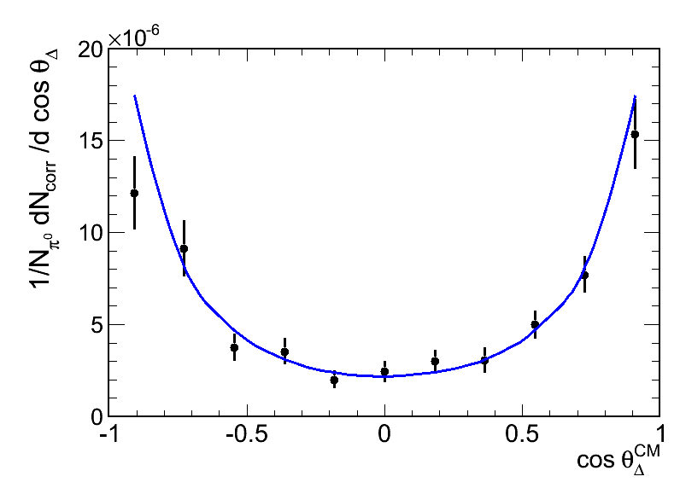
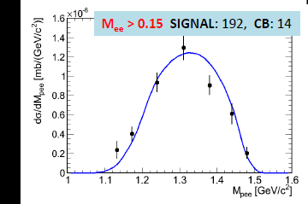
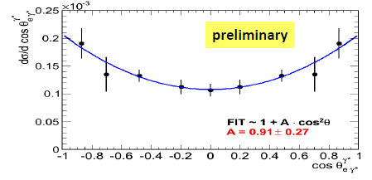
Exclusive analysis : pp→ppe⁺e⁻ at 1.25 GeV using pe⁺e⁻ events
Good agreement with
simulation of
Δ production + Dalitz decay
(cf hadronic channels)
In HADES acceptance
acceptance corrected
preliminary
preliminary
p
p
First measurement of Δ Dalitz decay!
Dalitz decay branching ratio in agreement
with QED value (4.2 10 ⁻⁵)
1
p₂
p
Δ⁺
e⁺
(p,e⁺,e⁻) invariant mass (GeV/c²)
cos(θ^{CM}_{pe+e-})
q²=M²_{inv}(e⁺e⁻)=M²_{γ*}
e⁻
Helicity distributions γ* → e⁺e⁻
dσ/dΩ_{e}~ 1+cos²α
α
e⁻
W. Przygoda’s analysis
Cracow
γ*
e⁺
Δ
cosα
N

Slide 17
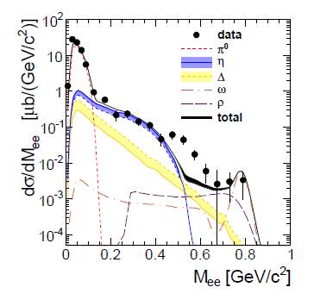
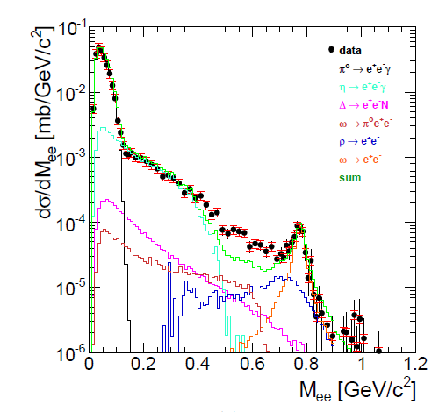
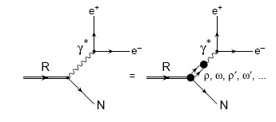
pp→e⁺e⁻X E=2.2 GeV,3.5 GeV
Comparison to cocktail of dilepton sources
Direct production of ρ/ω
Dalitz decay of Δ resonance (point-like)
E=2.2 GeV
E=3.5 GeV
Hades collab.,
EPJA48 (2012) 64
Hades collab.,
PRC85 054005 (2012)
Effect of electromagnetic form factors / Coupling of ρ to baryonic resonances ?

Slide 18
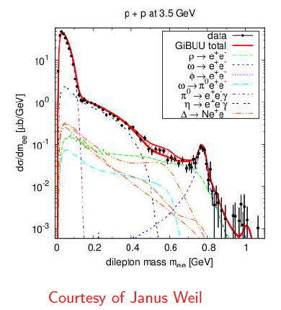
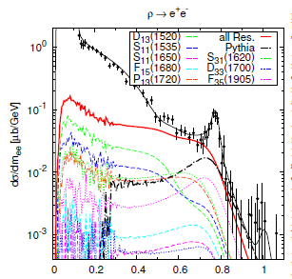
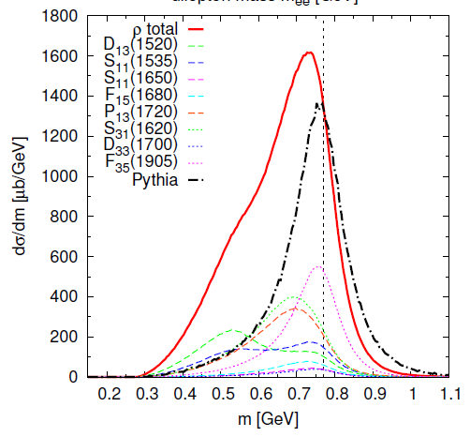
Dilepton production in pp reactions
“ electromagnetic form factor approach”:
“ρ production approach”:
ρNR couplings
VDM
pp 3.5 GeV
Hades data, Eur.Phys.J. A48 (2012) 64
N-Δ Form Factor:G.Ramalho and T. Pena
Phys. ReV. D85,113014 (2012)
ρ
ρ mass distribution strongly modified in pp due to the coupling to baryonic resonances
J. Weil, H. van Hees and U. Mosel, EPJA 48, 111 (2012)

Slide 19
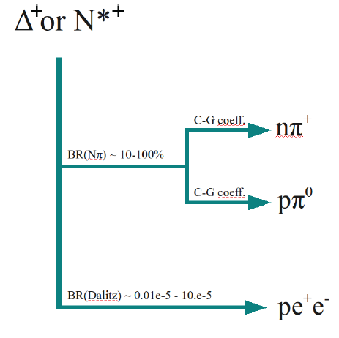
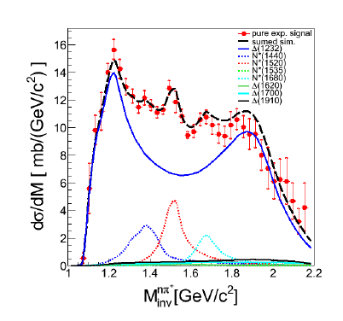
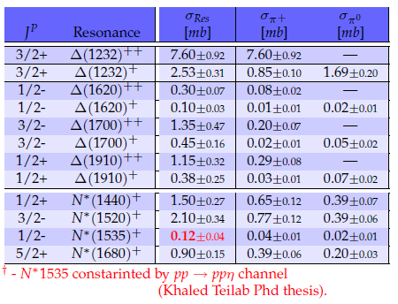
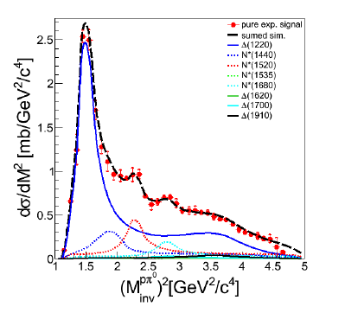
Fixing resonance contribution : exclusive hadronic channels in p+p @ 3.5 GeV
Many differential
distributions studied
for ppπ⁰, pnπ⁺ ,ppη,
ppω
pnπ⁺
A. Dybczak, Cracow
Preliminary
ppπ⁰

Slide 20
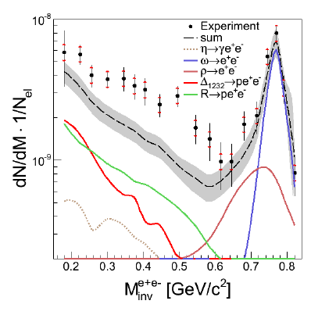
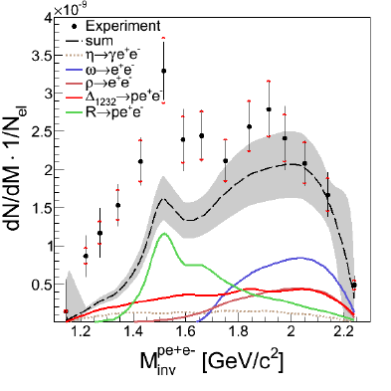
Exclusive pe⁺e⁻ channel
Cross sections and angular distributions for baryonic resonances
from hadronic channel analysis
Direct production of ρ,η,ω with cross sections from hadronic analysis
(of η/ω →π+π⁻π⁰) and σ_{ρ}= 1/2σ_{ω}
Constant form factors ( taken at q²=0) M. Zetenyi and G. Wolf Heavy Ion Phys. 17 (2003) 27
Missing yield related to light baryonic resonances (N(1520) ?)
ppe+ e-
A. Dybczak, Cracow

Slide 21
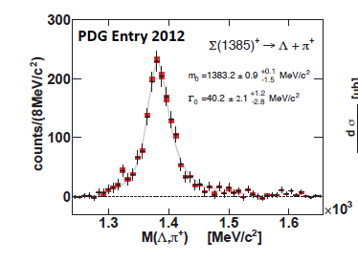
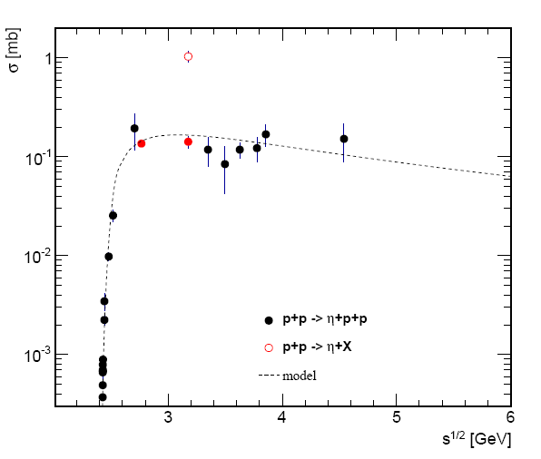

Data base entries from HADES measurements
Using both leptonic and hadronic channels
ρ/ω inclusive cross sections pp→ppρX and pp→ppωX E=3.5 GeV
pp E=3.5 GeV
η inclusive/exclusive cross sections
ᵒ
O inclusive
pp E=2.2 and 3.5 GeV
• exclusive

Slide 22
More results in pp reactions…
π⁰ and η Dalitz decay reconstruction in pp reactions
Exclusive dilepton production in pn → pne⁺e⁻ , pn → pde⁺e⁻
Strange channels: Σ(1385),Λ(1405),…
Phys.Rev. C85 (2012) 035203
Nucl.Phys. A881 (2012) 178-186
Partial wave analysis for pp→ NNπ and pp → pKΛ: collaboration with A. Sarantsev (Bonn-Gatchina)
2π production in pp→ppπ⁺π⁻, pn→pnπ⁺ π^{-,} pn →dπ ⁺π⁻
Γ(N*→Δπ)/ Γ(N*→Nσ) and sensitivity to N* and double Δ production mechanisms
……

Slide 23
Perspectives of pion beam experiments
23

Slide 24
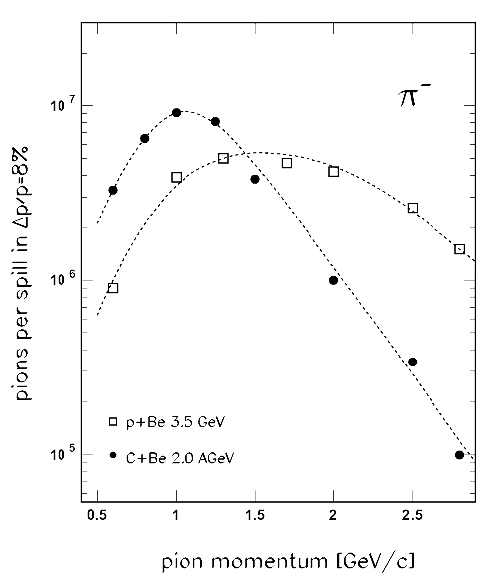
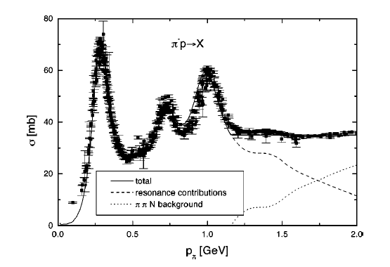
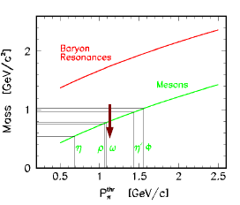
GSI pion beam
Expected Intensities for Space Charge Limit
and 100% extraction efficiency
I ~ 10⁶/s
Pion momentum 0.6 < p <1.5 GeV/c
√s
1.21
1.52
1.68
η
ω
24
Notes:
24
24

Slide 25
Motivations of πN experiments with HADES:
Dilepton channels
  well-known production mechanism
  fixed resonance mass M_{R}=sqrt(s)
  exclusive π ⁻ p → n e⁺e⁻ channels (η contribution can be rejected )
Time-Like electromagnetic form factors
Space-Like electromagnetic form factors
π ⁻
R
n
e⁺
q² <0 fixed
γ*
Inverse pion electroproduction
e⁺
γ*
R
p
q² > 0
variable
e⁻
e⁻
π⁻
e⁻⁻
p
studied at JLab/CLAS
N
R
γ∗
e⁺
Vector Dominance Model
→ ρ/ω coupling
ρ, ω,φ
N(1520)
e⁻
ρ
ρ
More direct access to Time-Like em transition form factors than in pp
+ ...
N⁻¹
25
Notes:
25

Slide 26
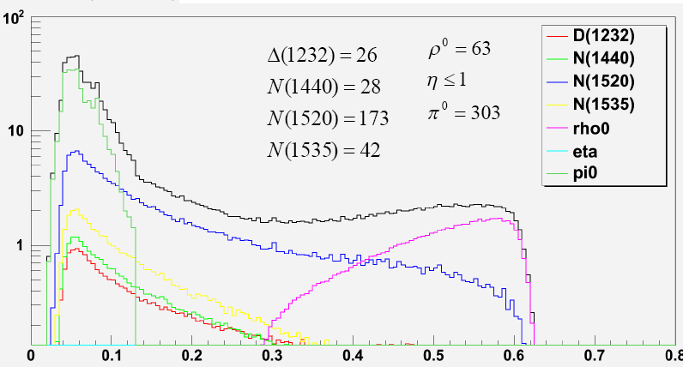
Simulations for dilepton production below ω threshold
Simple resonance model:
Dalitz decay of different baryonic resonances with constant form factors
+ meson contribution
Efects of electromagnetic form factors ?
Important interference effects expected
between I=0 (ω) and I=1 (ρ) channels
Linked to coupling to baryonic resonances
H. Kuc PhD Orsay/Cracovie
P=0.8 GeV/c
after missing mass cut
π⁻p→e⁺e⁻ n
Calculations based on hadronic couplings
M. Lutz, B. Friman, M. Soyeur, NPA 713 (2003) 9
Titov and Kämpfer EPJA 12 (2001) 217
Very new calculation based on VDM transition form factors by Zetenyi and Wolf arXiv:1208.5671v1 [nucl-th]
M_{ee}(GeV/c²)
26

Slide 27
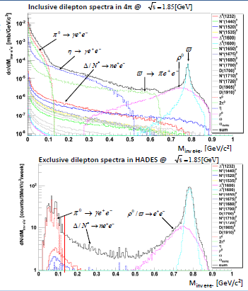
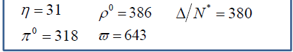
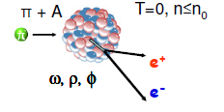
ρ/ω production in π⁻p→e⁺e⁻n reaction
p=1.3 GeV/c √s=1.85 GeV/c
In HADES acceptance
after missing mass cut
π⁻p→e⁺e⁻ n
1 week beam time
Reference for cold matter effect : dilepton production in π⁻A reactions
e+
W.Schoen et al.
Acta Phys.PolB27(1996)2959
π⁻
ω
²⁰⁸Pb
e-

Slide 28
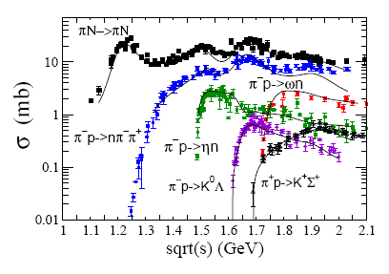
πN→ππN: present status
Two-pion production is the most
important inelastic channeland not
so well measured !
All what we know about N* couplings to ρN, Δπ, σN is due to
Manley, Arndt, Goradia, Teplitz PRD 30 (1984) 904.
dased on the analysis of 240000 events (bubble chamber < 1980)
New data highly needed
Dynamical models are now available → a new combined PWA analysis of all pion and photoproduction channels will be possible.

Slide 29
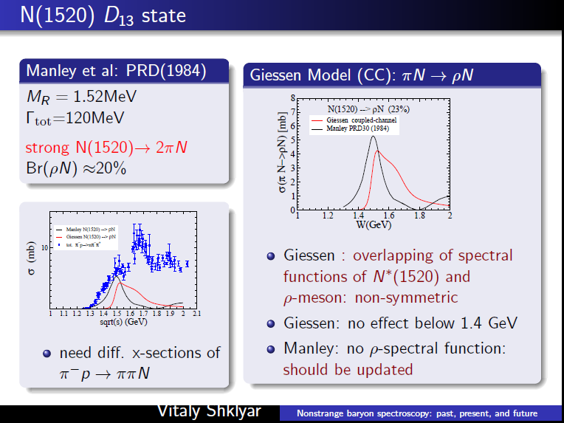

Slide 30
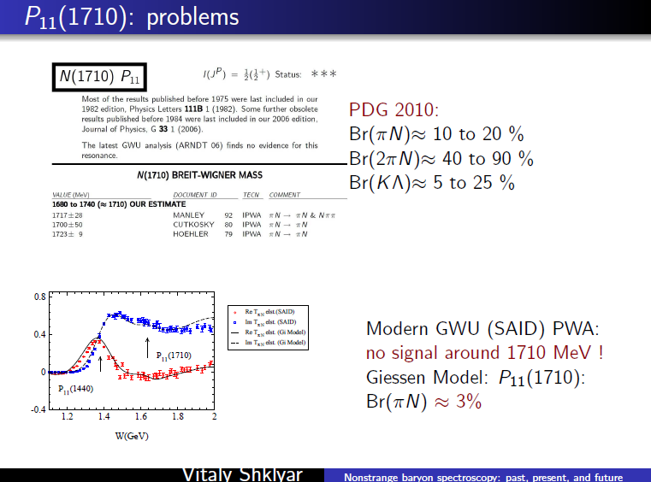

Slide 31
Motivations for πN→ πN and πN →πNN measurements
Need for a high statistics energy scan in the region W > 1.3 GeV to provide πN and πNN differential cross sections
Complete existing very precise photoproduction data
Improve knowledge of baryonic resonances, M_{R}, Γ(N*→Nπ), Γ(N*→Nππ)
Important for baryonic structure issues (Constituent Quark Models, Lattice QCD)
Regions of interest/open issues:
N(1440) P₁₁
Branching ratios to πΔ and (π π)_{s} N
ρ
N(1520)
ρ
N(1520) D₁₃
Branching ratios to πΔ and ρN, important for
ρ in-medium calculations
N⁻¹
N(1710) P₁₁
Not seen in the latest PWA analysis
BR(2π) =40 to 90 % (PDG 2010)

Slide 32

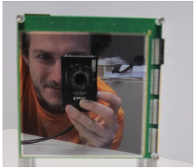



Pion Beam tracker
Laura, Rafaul, Robert, Eliane, Johannes, Joana, Martin
and others…
10x10 cm²
2x128 channels
300 μ Si detector

Slide 33
Conclusions: HADES experiments
Elementary reaction program
  reference for medium effects
  Selective study of dilepton processes, cross section measurements
  Time-like electromagnetic structure of baryonic resonances/coupling to vector mesons
  connection with PANDA !
  hadronic channels (consistency with dilepton channels)
perspectives of pion beam experiments (→ oct. 2013)
  Dilepton channels in πN→ unique chance to study Time-Like electromagnetic structure of higher lying resonances (complementary to pion electroproduction)
  Two pion and kaon production:new data highly needed for Partial wave Analysis → baryonic resonance properties
  strangeness channels Σ(1385), Λ(1405), Φ
Before HADES moves to FAIR !
GSI pion beam is unique in world at present to provide the missing data
Béatrice Ramstein
33

Slide 34



πN→ Nπ π : Existing data
30
SAID, data base, CNS, GWU http://gwdac.phys.gwu.edu
15
nπ⁺ π⁻
114 kevents
pπ⁻ π⁰
72 kevents
30
pπ⁺π⁰
15
69 kevents
nπ⁺π⁺
7.3 kevents
More recent data (TRIUMF,LAMPF,BNL) do not cover the region between 1.32 and 1.9 GeV
→ high statistics differential distributions are needed
1.4
1.6
1.8
2.
W (GeV)

Slide 35




Constrains on Δ production by hadronic channels pp→ pnπ⁺ ,ppπ⁰ at E=1.25 GeV
one pion exchange model
(Dmitriev et al., Nucl. Phys. A459, 503 (1986))
n
θ_{n}
in 4π
Λ_{π}=0.63 GeV
p
p
Δ⁺⁺
π°
π°
T. Liu’s PhD Orsay
Λ_{π}= 0.75 GeV gives better description also for pp→ppπ⁰
In HADES acceptance
HADES data EPJA 48 (2012)74
Model A:
original resonance model
+N* angular distribution + NN FSI
Model B: taking into account the experimental
Δ angular distribution

