Slide 1

Oscillation Physics with
Big Neutrino Telescopes
A. Yu. Smirnov
International Centre for Theoretical Physics, Trieste, Italy
Exotic physics with Neutrino Telescopes 2013,
April 5, 2013

Slide 2
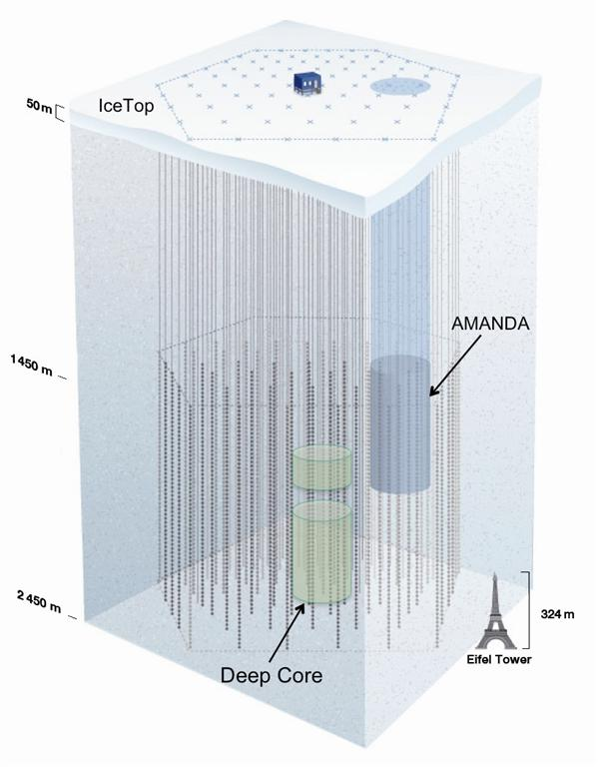
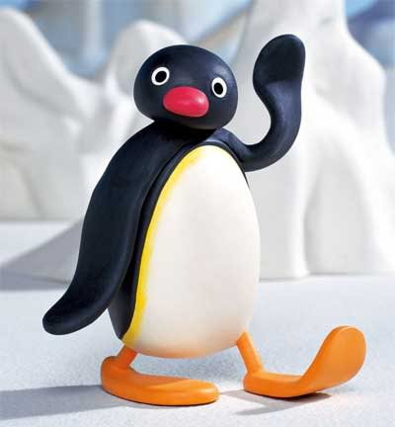
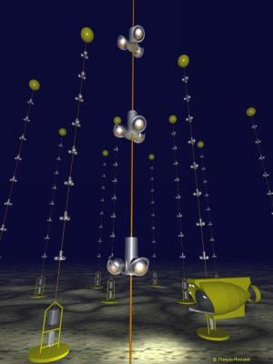
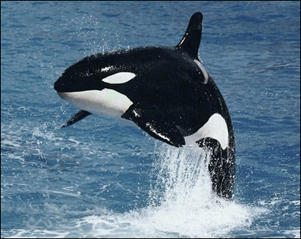
PINGU
Precision
IceCube
Next
Generation
Upgrade
Ice Cube
ANTARES
ORCA
Oscillation
Research with
Cosmics with the
Abyss

Slide 3
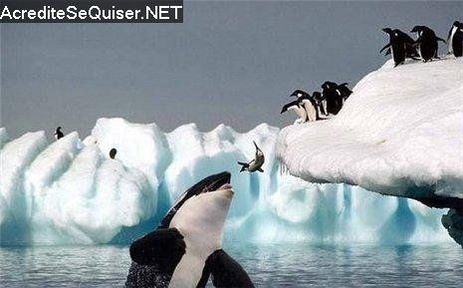
PINGU and ORCA

Slide 4
Outline
Oscillation effects and Oscillograms
Hierarchy, 2-3mixing, CP
Sterile neutrinos
Nonstandard interactions

Slide 5
Oscillation effects and
Oscillograms
P. Lipari ,
T. Ohlsson
M. Chizhov,
M. Maris,
S .Petcov
T. Kajita
and physics of oscillations

Slide 6
Mixing and flavors
ν_{e}
ν_{μ}
ν_{τ}
|U_{μ3}|²
|U_{τ3}|²
Mixing parameters
ν₃
tan²θ₁₂ = |U_{e2}|² / |U_{e1}|²
|U_{e3}|²
sin²θ₁₃ = |U_{e3}|²
mass
Δm²₃₁
tan²θ₂₃ = |U_{μ3}|² / |U_{τ3}|²
|U_{e2}|²
ν₂
ν₁
Δm²₂₁
|U_{e1}|²
Mixing matrix:
flavor
ν_{f} = U_{PMNS} ν_{mass}
ν_{e}
ν_{μ}
ν_{τ}
ν₁
ν₂
ν₃
Normal mass hierarchy
= U_{PMNS}
Δm²₃₁ = m²₃ - m²₁
Δm²₂₁ = m²₂ - m²₁
U_{PMNS} = U₂₃I_{δ} U₁₃I_{−δ} U₁₂

Slide 7
Flavor in matter
ν_{e}
ν_{μ}
ν_{τ}
Density (energy) increase →
Normal mass hierarchy, neutrinos
ν_{3m}
ν_{2m}
ν_{1m}
1-2 resonance
1-3 resonance

Slide 8
Flavor in matter
ν_{e}
ν_{μ}
ν_{τ}
Density increase →
Inverted mass hierarchy, neutrinos
ν_{2m}
ν_{1m}
ν_{3m}
1-2 resonance

Slide 9
Flavor in matter
ν_{e}
ν_{μ}
ν_{τ}
Density increase →
Normal mass hierarchy, antineutrinos
ν_{3m}
ν_{2m}
ν_{1m}

Slide 10
Flavor in matter
ν_{e}
ν_{μ}
ν_{τ}
Density increase →
Inverted mass hierarchy, antineutrinos
ν_{2m}
ν_{1m}
ν_{3m}
1-3 resonance

Slide 11
``Set-up''
θ_{ν}
zenith
angle
Θ = π − θ_{ν}
Θ
- nadir angle
Oscillations in
multilayer medium
core-crossing
trajectory
Θ = 33º
Applications:
flavor-to-flavor transitions
- accelerator
- atmospheric
- cosmic neutrinos
core
mantle
9

Slide 12
Physics
Two layer transitions
vacuum-matter
(atmosphere-Earth)
Interference
Parametric
enhancement
of oscillations
Oscillations in matter
with nearly constant
density (mantle)
Smallness of θ₁₃ and
Δm₂₁²/Δm₃₂²
Mantle – core - mantle
in the first approximation:
overlap of two 2ν–patterns
due to 1-2 and 1-3 mixings
constant density
+
corrections
Parametric resonance
→ parametric peaks
interference
(sub-leading effect)
Low energies:
adiabatic approximation
interference
of modes
Peaks due to resonance
enhancement of oscillations
CP-interference

Slide 13
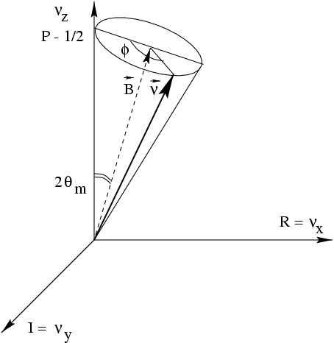
Graphical representation
Equation of motion
(= spin in magnetic field)
z
d P
dt
= (B x P)
ν_{e}
B
P
where ``magnetic field’’ vector:
2π
l_{m}
B = (sin 2θ_{m}, 0, cos2θ_{m})
ν_{τ},
P = (Re ν_{e}⁺ ν_{τ}, Im ν_{e}⁺ ν_{τ}, ν_{e}⁺ ν_{e} - 1/2)
x
Phase of oscillations
φ = 2πt/ l_{m}
y
P_{ee} = ν_{e}⁺ν_{e} = P_{Z} + 1/2 = cos²θ_{Z}/2
Probability to find ν_{e}

Slide 14
Resonance enhancement in mantle
1
mantle
1
2
mantle
2

Slide 15
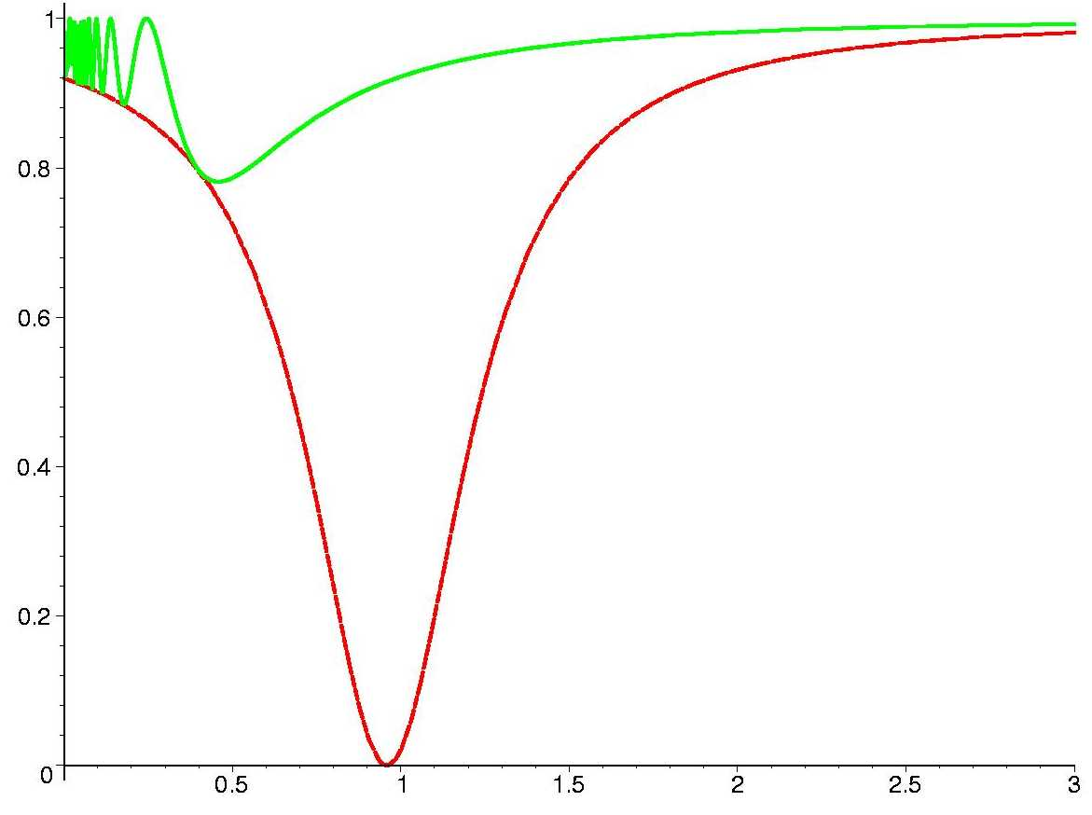
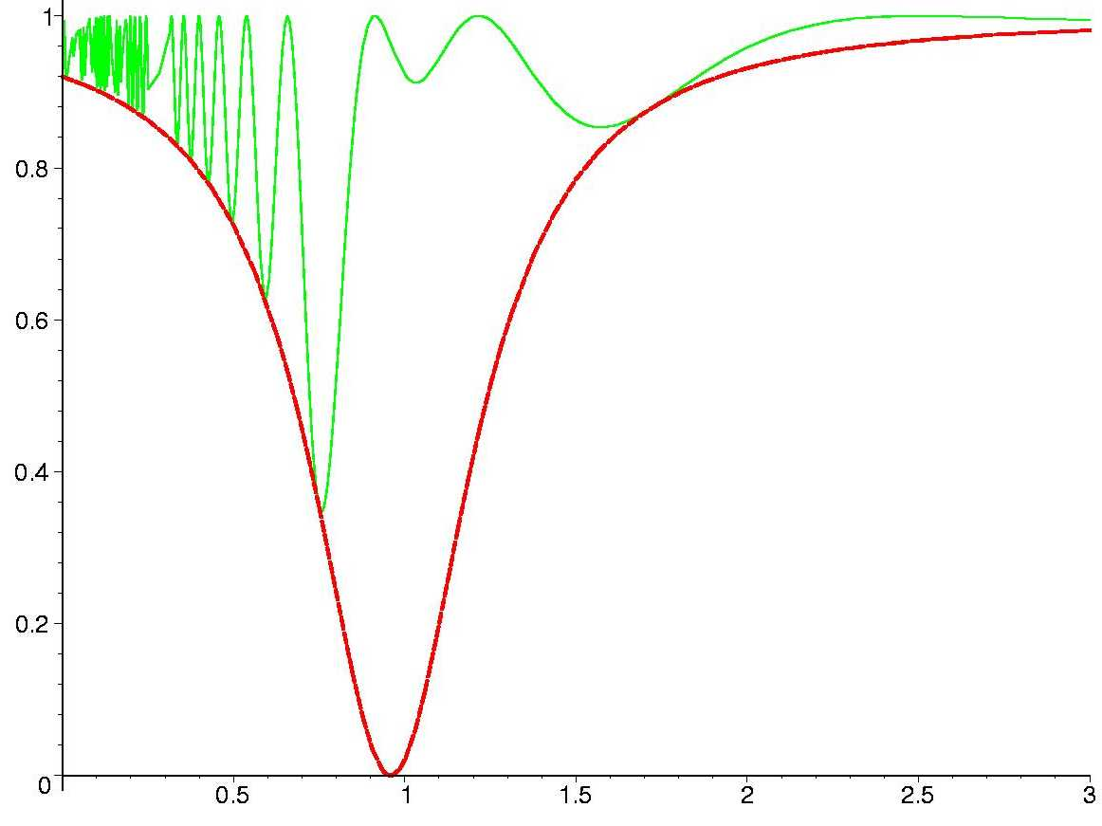
Small mixing sin²2θ = 0.08
thin layer
k = 1
thick layer
k = 10
F (E)
F₀(E)
sin² 2θ_{m}
E/E_{R}
E/E_{R}

Slide 16
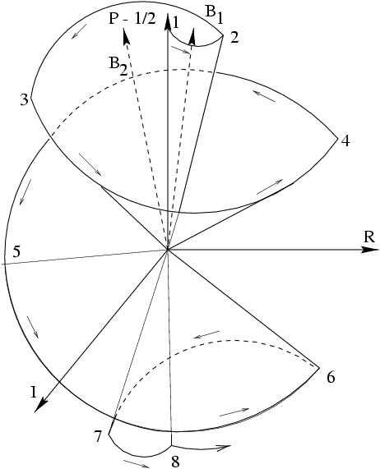
Parametric enhancement
of oscillations
Enhancement associated to certain
conditions for the phase of oscillations
Φ₁ = Φ₂ = π
Another way of getting strong transition
No large vacuum mixing and no matter
enhancement of mixing or resonance
conversion
2θ₂^{m}
2θ₁^{m}
V. Ermilova V. Tsarev, V. Chechin
E. Akhmedov
P. Krastev, A.S., Q. Y. Liu,
S.T. Petcov, M. Chizhov
V
Φ₁
Φ₂
θ₁^{m}
θ₂^{m}
1 2 3 4 5 6 7
``Castle wall profile’’
18

Slide 17
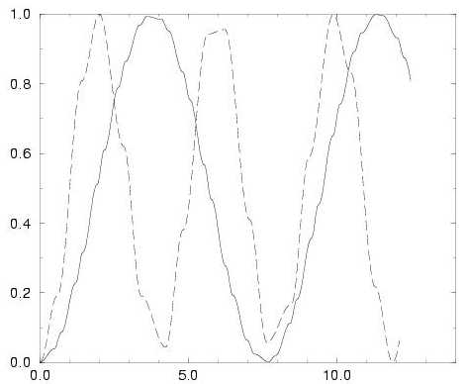
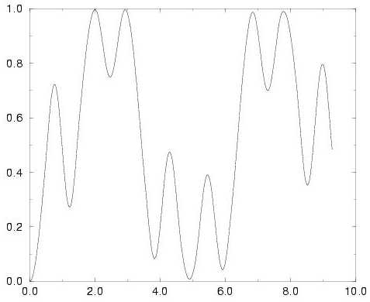
Parametric resonance
s_{i} = sinφ _{i},
c_{i} = cosφ_{i}, (i = 1,2)
half-phases
s₁c₂cos2θ₁^{m} + s₂c₁cos2θ₂^{m} = 0
E. Kh. Akhmedov,
transition probability
distance
distance
c₁ = c₂ = 0
(φ₁ = φ₂ = π/2)
General case: certain correlation
between the phases and mixing angles

Slide 18
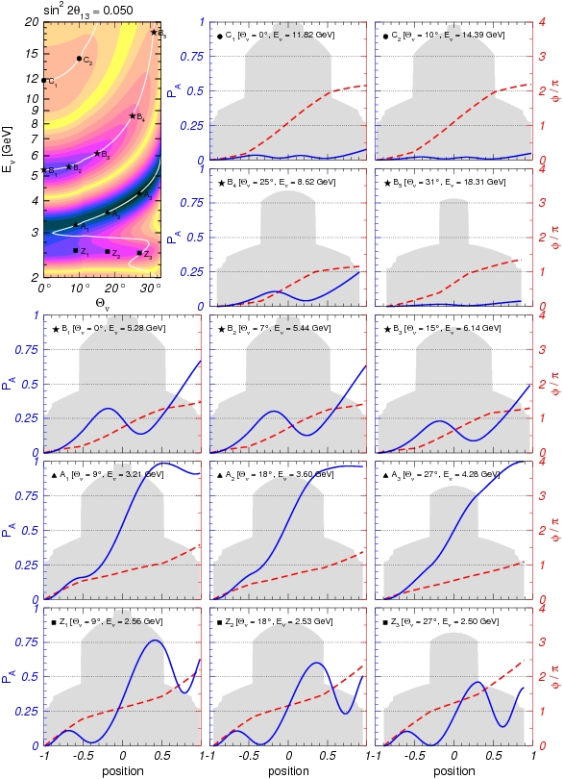
Parametric enhancement
1
mantle
2 3
1
4
core
2
mantle core mantle
3
mantle
4
22

Slide 19
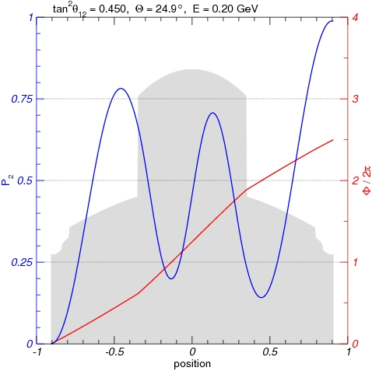
Parametric enhancement of 1-2 mode
mantle
1
core
3
4
2
2
mantle
4
3
1
23

Slide 20
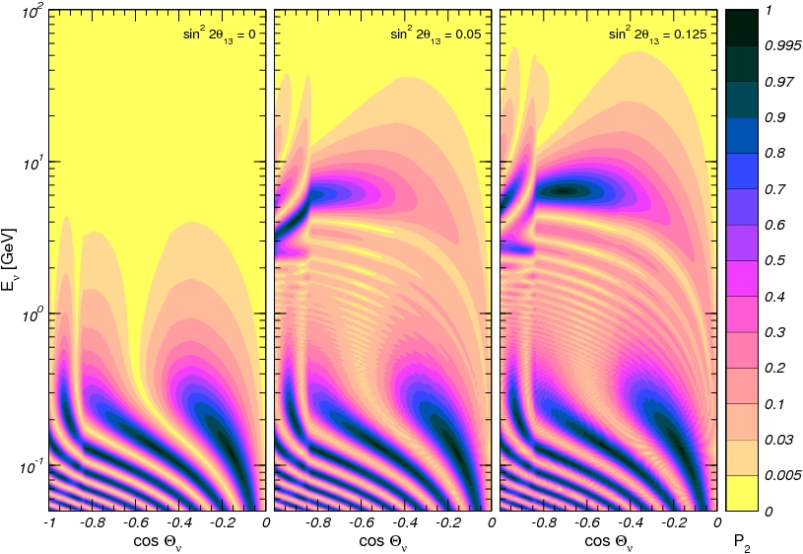
1 - P_{ee}
MSW-resonance
peaks 1-3 frequency
excluded
Parametric
ridges
1-3 frequency
Parametric peak
1-2 frequency
MSW-resonance
peaks 1-2 frequency
5π/2 3π/2 π/2

Slide 21
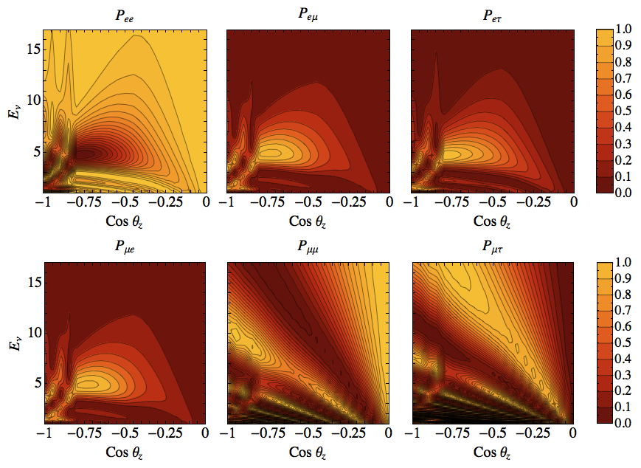
Oscillograms of the Earth
E. Kh. Akhmedov,
Razzaque,
A.S.
NH, neutrinos
Oscillations test dispersion relation for neutrinos

Slide 22
Evolution
For E > 0.1 GeV
CP-violation and 2-3 mixing
are excluded from dynamics
of propagation
Propagation
basis
~
ν_{f} = U₂₃I_{δ} ν
I_{δ} = diag (1, 1, e^{iδ} )
ν_{e}
ν_{e}
ν_{e}
ν_{e}
A_{e2}
ν_{μ}
~
~
ν_{μ}
ν₂
ν₂
A_{e3}
~
~
ν_{τ}
ν_{τ}
ν₃
ν₃
projection
propagation
projection
CP appears in
projection only
A₂₂
A₃₃
A₂₃
For instance:
A(ν_{μ} → ν_{μ}) = cosθ₂₃ A_{e2}e^{iδ} + sinθ₂₃A_{e3}

Slide 23
CP-interference
Due to specific form of matter potential matrix (only V_{ee} = 0)
P(ν _{e} → ν_{μ}) = |cos θ₂₃ A_{e2}e ^{iδ} + sin θ₂₃A_{e3}|²
``solar’’ amplitude
``atmospheric’’ amplitude
dependence on δ and θ₂₃ is explicit
For maximal 2-3 mixing
P(ν_{e} → ν_{μ})^{δ} = |A_{e2} A_{e3}| cos (φ - δ )
φ = arg (A_{e2}* A_{e3})
P(ν_{μ} → ν_{μ})^{δ} = - |A_{e2} A_{e3}| cosφ cos δ
P(ν_{μ} → ν_{τ})^{δ} = - |A_{e2} A_{e3}| sinφ sinδ
Σ = 0

Slide 24
``Magic lines"
V. Barger, D. Marfatia,
K Whisnant
P. Huber, W. Winter,
A.S.
Explicitly
P(ν_{e} → ν_{μ}) = c₂₃²|A_{e2}|² + s₂₃²|A_{e3}|² + 2s₂₃c₂₃|A_{e2}||A_{e3}|cos(φ + δ)
φ = arg (A_{S} A_{A}*)
P_{int} = 2s₂₃c₂₃|A_{e2}||A_{e3}|cos(φ + δ)
Dependence on δ disappears, interference term is zero if
A_{S} = 0
- solar magic lines
P_{int} = 0
A_{A} = 0
- atmospheric magic lines
(φ + δ ) = π/2 + 2π k
- interference phase condition
φ (E, L) = - δ + π/2 + π k
depends on δ
31

Slide 25
``Magic lines''
For ν_{μ}→ ν_{μ} channel
P_{int} ~ 2s₂₃c₂₃|A_{S}||A_{A}|cosφ cosδ
- The survival probabilities is CP-even functions of δ
no CP-violation
dependences on phases factorize
Dependence on δ disappears
A_{S} = 0
P_{int} = 0
A_{A} = 0
φ = π/2 + π k
interference phase
does not depends on δ
Form the phase line grid

Slide 26
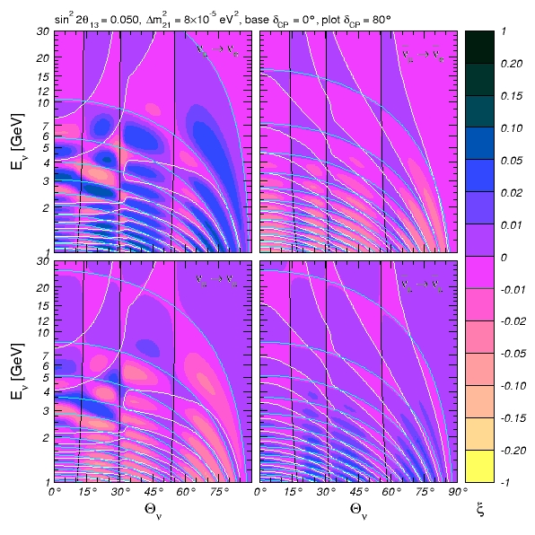
Int. phase
line moves
with δ-change
Grid (domains)
does not
change with δ
ΔP

Slide 27
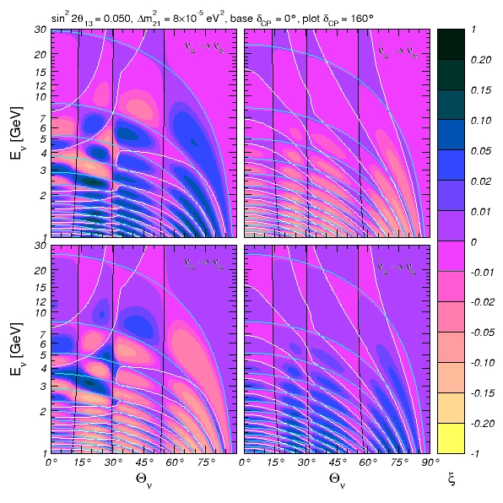
ΔP

Slide 28
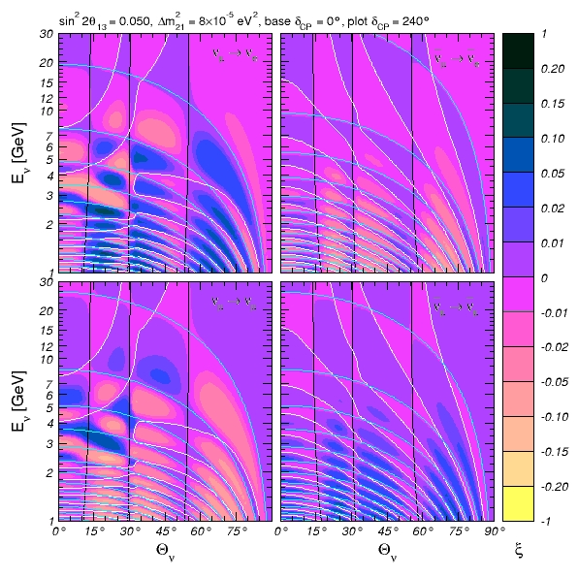
ΔP

Slide 29
Oscillograms
contours of constant oscillation
probability in energy- nadir
(or zenith) angle plane
100
ν_{e}→ ν_{μ} , ν_{τ}
IceCube
NuFac 2800
0.005
0.03
CNGS
IC Deep Core
0.10
10
LENF
E, GeV
MINOS
NOvA
PINGU-1
T2KK
T2K
HyperK
ICAL, INO
1
LAr
OK for CP
0.1

Slide 30
Mass hierarchy
2-3 mass & mixing
CP-violation

Slide 31
Mass hierarchy
ν_{e}
ν_{μ}
ν_{τ}
FLAVOR
FLAVOR
ν₃
ν₂
Δm²₂₁
ν₁
MASS
MASS
Δm²₃₂
Δm²₂₃
ν₂
ν₁
Δm²₂₁
ν₃
Normal mass hierarchy
(ordering 1-2-3)
Inverted mass hierarchy
(ordering 3-1-2)
with cyclic permutation
- Mass states are marked by amount of the electron flavor
- For non-zero δ_{CP} the antineutrino spectrum is different
(distribution of the ν_{μ} and ν_{τ} - flavors in ν₁ and ν₂)

Slide 32
Hierarchy, neutrinos and antineutrinos
Inversion of mass hierarchy is related
to neutrino – antineutrino transition
In matter
neutrino → antineutrino
V → -V
In 2ν approximation
Δm² → - Δm²
inversion of mass hierarchy
Under simultaneous transition
2EV
Δm²
is invariant
NH → IH
nu → antinu
Mixing does not change
Moduli of the oscillation
phase does not change
Hierarchy asymmetries for neutrinos and antineutrinos
have opposite signs
P^{NH} = P^{IH}
P^{IH} = P^{NH}

Slide 33
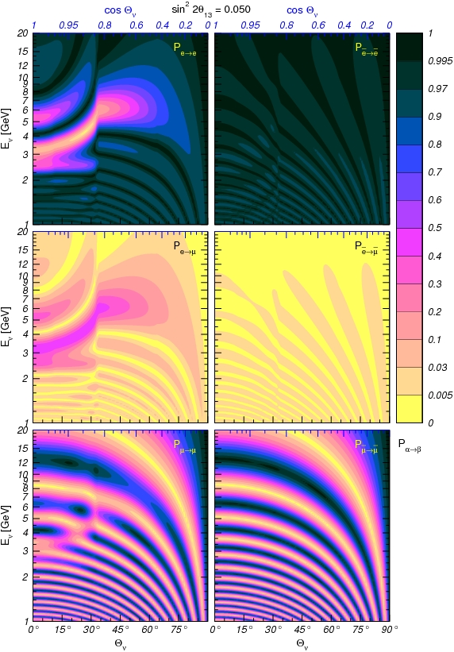
Inverting
mass hierarchy
e - e
e - e
e - μ
e - μ
For 2ν system
normal → inverted
neutrino → antineutrino
μ − μ
μ − μ
25

Slide 34
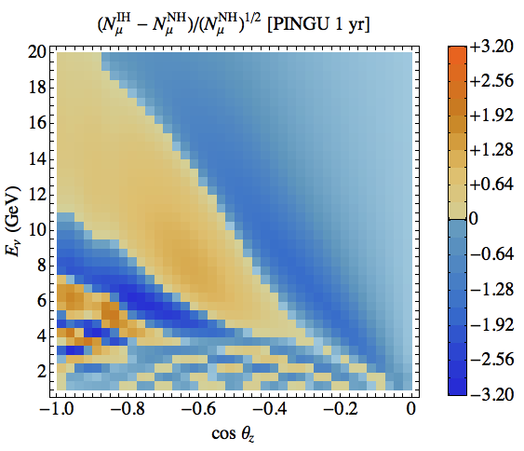
Hierarchy asymmetry
Estimator of sensitivity
S – asymmetry
|S| - significance
S =
Quick estimation of total significance
S_{tot} ~ s n^{1/2}

Slide 35
Inelasticity
Mathieu Ribordy, A. Y .S., i1303.0758 [hep-ph]
and sensitivity
E_{ν} - E_{μ}
E_{ν} + m_{N}
E_{h} - m_{N}
E_{μ} + E_{h}
fraction of total energy transferred into hadrons
y = =
1. Separation of neutrino and antineutrino signals
N_{ν} ~ 1, N_{ν} ~ (1 - y)²
for each bin y – distribution allows to extract fractions of nu and nubar
2. Better reconstruction of the neutrino direction
reduction of the kinematic smearing
x y m_{N} (E_{ν} + m_{N} )
2 E_{ν} E_{μ}
selecting events with small y reduces
possible angles between ν and μ
sin ² β/2 =
3. Better control over systematics
4. Reduction of degenerasy

Slide 36
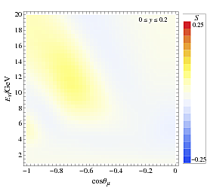
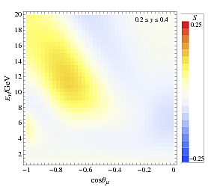
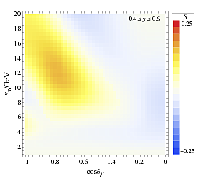
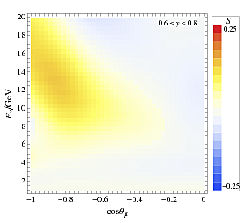
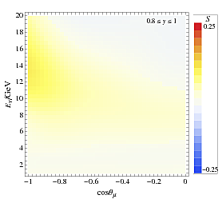
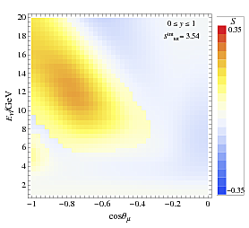
H - asymmetries for different y
with experimental smearing
σ_{E} = (0.7 E_{ν})^{1/2}
ψ₀ = 20º
bad nu – nubar separation
bad angular resolution
y-integrated

Slide 37
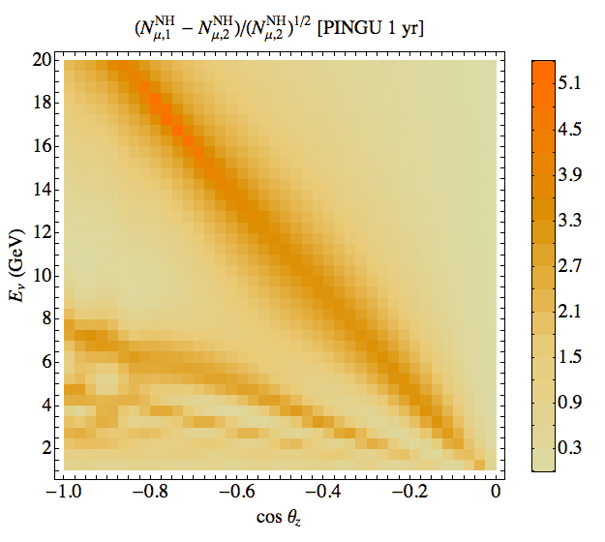
Theta_23
sin² θ_{32, fit} = 0.50
sin² θ_{32, true} = 0.42
Future measurements – improve accuracy of determination of the angle
Effect has the same sign
Regions of strong effects of the angle and hierarchy do not overlap significantly
Large effect is in he region of small number of events

Slide 38
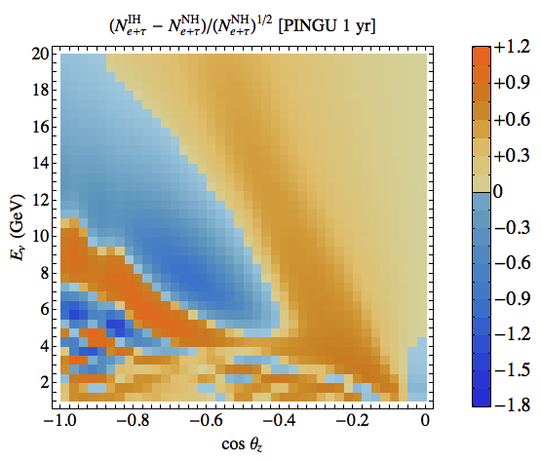
Cascade events e + nutau
Integrating over the zenith angle
Energy dependence of the cascade events
S. Razzque and A.Y.S.,
in preparation

Slide 39
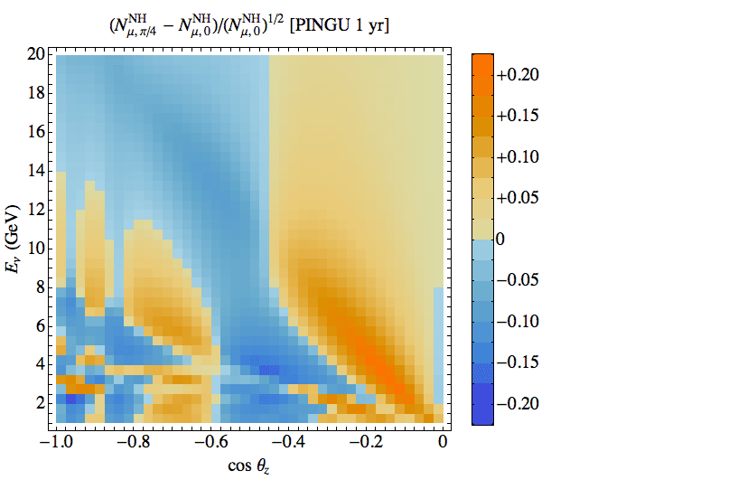
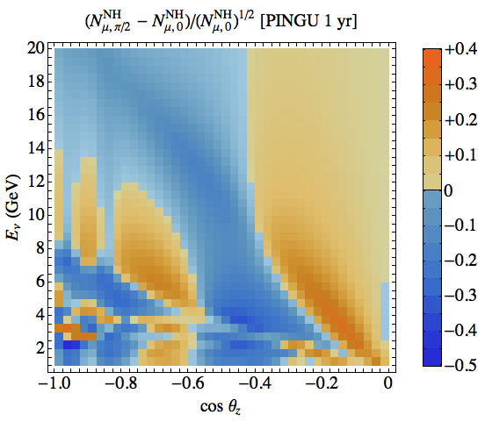
CP asymmetry
Shape does not change
the amplitude changes
Large significance at low energies

Slide 40
Sterile neutrinos

Slide 41
(3 + 1) scheme
ν_{e}
ν_{s}
ν_{μ}
ν_{τ}
LSND/MiniBooNE: vacuum oscillations
ν₄
P ~ 4|U_{e4} |²|U_{μ4} |²
restricted by short baseline exp.
BUGEY, CHOOZ, CDHS, NOMAD
mass
Δm²₄₁
For reactor and source experiments
ν₃
Δm²₃₁
ν₂
P ~ 4|U_{e4}|² (1 - |U_{e4}|²)
ν₁
Δm²₂₁
- additional radiation in the universe
- bound from LSS?
Δm₄₁² ~ 1 eV²
U_{μ4} = 0.2

Slide 42
Looking for sterile in ice
IceCube
H Nunokawa O L G Peres
R Zukanovich-Funchal
Phys. Lett B562 (2003) 279
ν_{μ} - ν_{s} oscillations with Δm² ~ 1 eV²
are enhanced in matter of the Earth in energy range 0.5 – few TeV
This distorts the energy spectrum
and zenith angle distribution of the
atmospheric muon neutrinos
S Choubey JHEP 0712 (2007) 014
S Razzaque and AYS ,
1104.1390, [hep-ph]

Slide 43
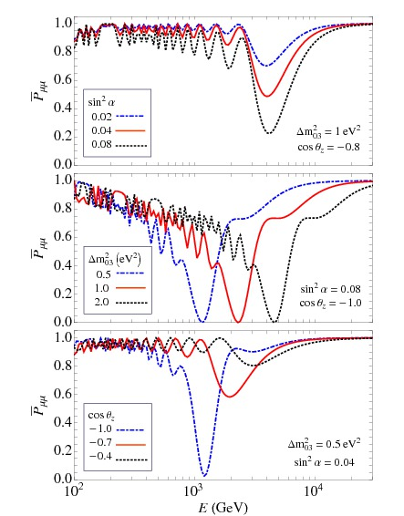
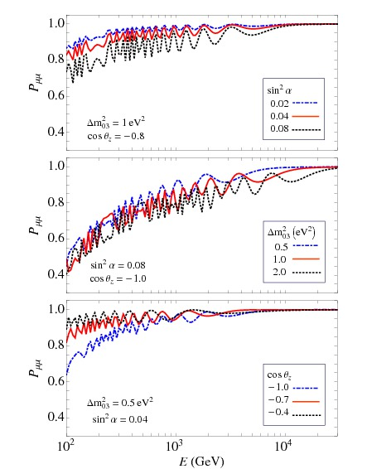
Survival probability
Effect of phase shift
for the ν_{μ} − ν_{τ} oscillations
due to matter effects
antineutrinos
neutrinos
MSW resonance dip

Slide 44
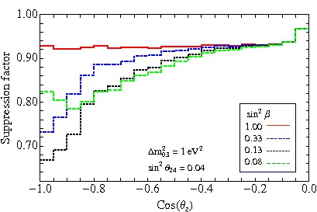
Zenith angle distributions
In general
For different
mixing schemes
Varying |U_{τ0}|²
< 3% stat. error
Zenith angle distribution depends on admixture of ν_{τ} in 4th mass state

Slide 45
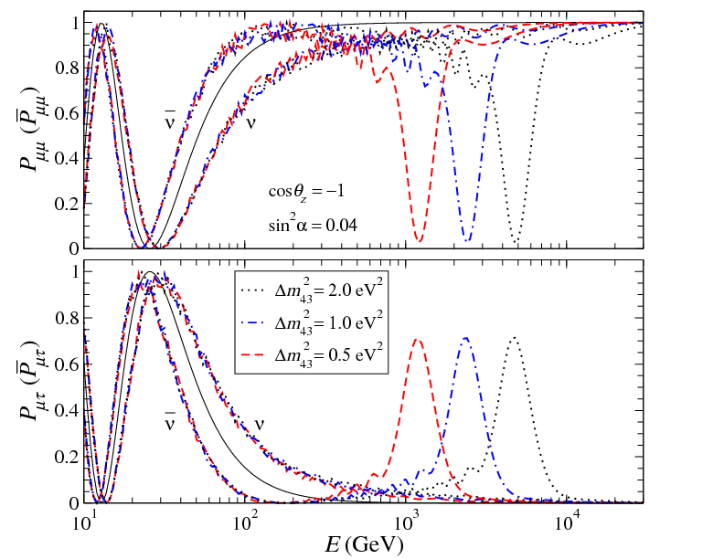
Deep Core IC
S Razzaque, A Y S
arXiv:1203.5406
Shift of phase quantifies effect of sterile neutrino

Slide 46
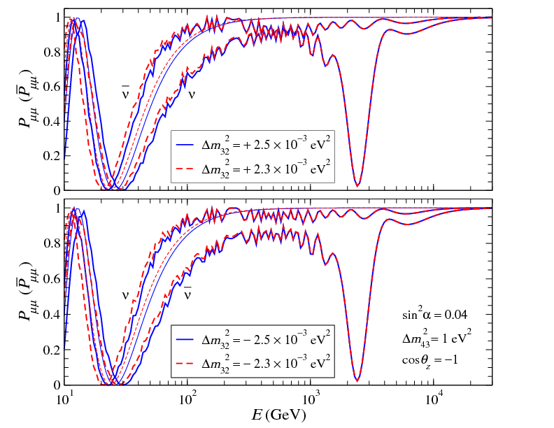
Dependence on the mass hierarchy

Slide 47
Another possibility
ν_{s}
ν_{e}
ν_{μ}
ν_{τ}
Very light sterile neutrino
ν₃
m₀ ~ 0.003 eV
DE scale?
M²
M_{Planck}
M ~ 2 - 3 TeV
Δm²₃₁
mass
ν₂
Motivated by
Δm²₂₁
- solar neutrino data
ν₀
ν₁
Δm²_{dip}
additional radiation
in the Universe if mixed in ν₃
no problem with LSS
(bound on neutrino mass)
sin² 2α ~ 10⁻³
sin² 2β ~ 10⁻¹
can be tested in atmospheric
neutrinos with DC IceCube

Slide 48
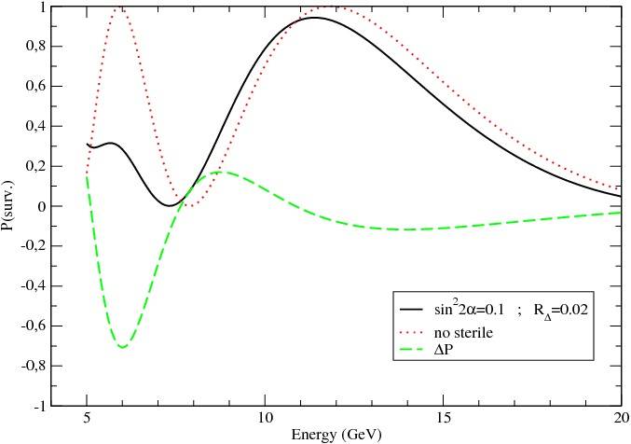
Atmospheric neutrinos
ν_{τ}’ – ν _{s} resonance
E_{R} ~ 12 GeV
ν_{μ} → ν _{s} resonance peak at 6-8 GeV
Interplay of ν_{μ} → ν _{s} and ν_{μ} → ν_{τ} oscillations
P. De Holanda, A. S.
Phase shift and decrease of
amplitude of oscillations:
with sterile
difference
IceCube Deep Core
~ 20 % suppression of rate
of events in the muon
energy bins 5 – 15 GeV

Slide 49
Asymmetries
No smearing
Smearing 1
Smearing 2

Slide 50
Non-standard interactions

Slide 51
NSI Strength parameters
Δm₃₁²
2E
0 0
0 1
0 ε_{μτ}
ε_{μτ} ε’
H = U(θ₂₃) U*(θ₂₃) + R₀
2EV_{d}
Δm₃₁²
R₀ =
V_{d} -potential due to scattering on d-quarks
V_{NSI} = V_{d} [4 ε_{μτ}² + ε’² ] ^{0.5}
Δm₃₁²
2E
V_{NSI} ~
resonance, strong NSI effect
ε_{μτ} , ε’ ~ 0.01
E_{R} ~ 60 – 100 GeV

Slide 52
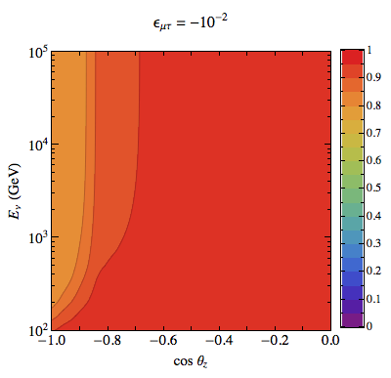
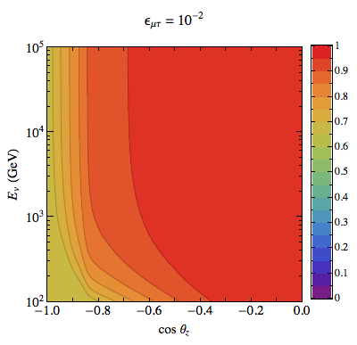
Oscillograms
P(ν_{μ} → ν_{μ})
Arman Esmaili, AYS
resonance

Slide 53
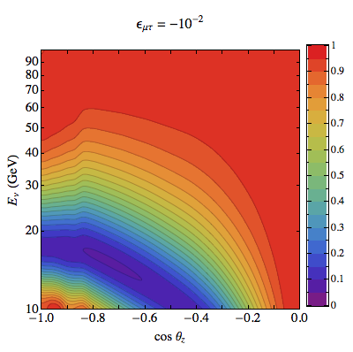
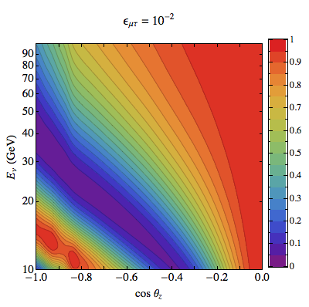
Oscillograms
P(ν_{μ} → ν_{μ})

Slide 54
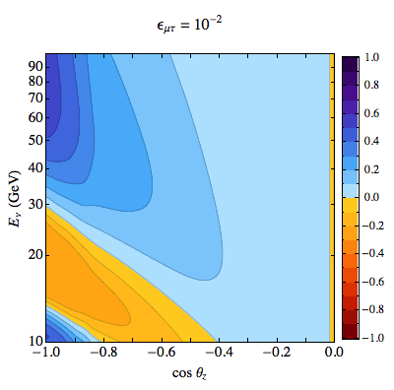
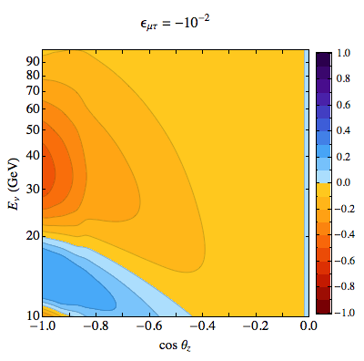
Difference of probabilities
P(ν_{μ} → ν_{μ})

Slide 55
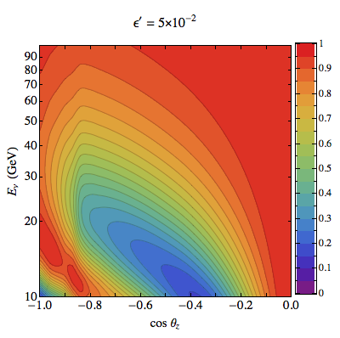
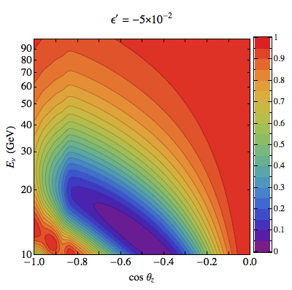
Oscillograms
P(ν_{μ} → ν_{μ})

Slide 56
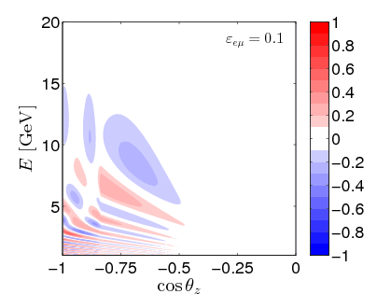
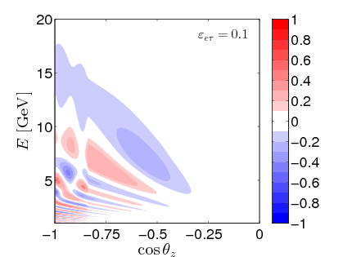
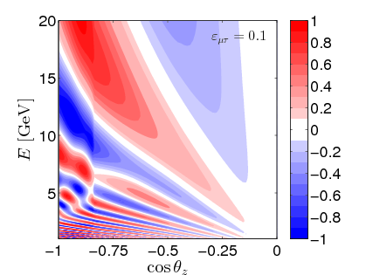
Difference of probabilities
T. Ohlsson, He Zhang , Shun Zhou, 1303.6130 [hep-ph]
(ν_{μ} → ν_{μ})

Slide 57
Summary

Slide 58
Physics with BigNT
Tomography
General
Measurements
Searches for
knowledge
of neutrino
new physics
parameters
Neutrino images of the Earth
mass hierarchy
deviation of 2-3 mixing
from maximal one
CP violation
- sterile neutrinos
- tests of fundamental
symmetries
non-standard
interactions
Probe of nature of
neutrino mass
(soft-hard);
Atmospheric vs. LBL

Slide 59
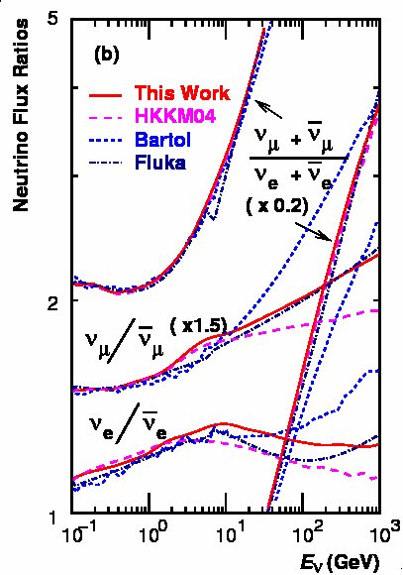
Energy spectra
M. Honda et al
astro-ph/0611418
1.33
1.00
Neutrino fluxes averaged
over all directions
Flavor ratios
Charge asymmetries
39

Slide 60
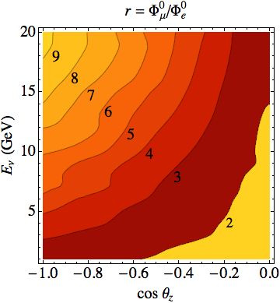
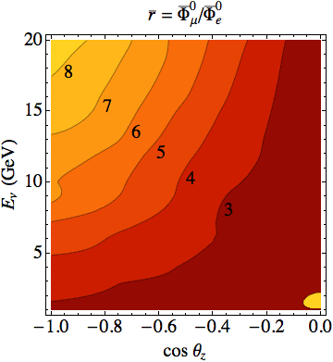
Ratios of fluxes

Slide 61
Other possibilities

Slide 62

Violation of fundamental symmetries
Violation of Lorentz
invariance: different
asymptotic (E → infty)
values of velocity of two
neutrino components
δc/c = 10⁻²⁷
maximal mixing
M. C. Gonzalez-Garcia
F. Halzen
M. Maltoni,
Hep-ph/0502223
Vertically upgoing atmospheric neutrinos taking into
account effects of violation of Lorentz invariance
70

Slide 63


Absorption tomography
Radiography
of the Earth
core and mantle
M. C. Gonzalez-Garcia
F. Halzen, M. Maltoni,
H. Tanaka
arXiv:0711.0745 [hep-ph]
Ratio of zenith angle distribution
of expected events for PREM
model and for homogeneous
Earth matter distribution
(stat. error)
Zhenith angle distribution of events in IceCube
for different energy thresholds for PREM model
71

Slide 64

Sub-subGeV neutrinos
Main features:
Enlarging the energy range
Two components:
directly produced by ν_{e} and ν_{e}
from invisible muon decay
Flavor ratio decrease with
energy and deviates from 2
2.1 → 1.6
weaker screening effect
Seasonal variations,
variations with solar activity
Background for diffuse SN fluxes
O. Peres, A.S,
[arXiv:0903.5323]
FLUKA
61

Slide 65
Evolution
For sub-subGeV events
Propagation
basis
ν_{f} = U₂₃I_{δ} U₁₃ν
I_{δ} = diag (1, 1, e^{iδ} )
ν_{e}
ν_{e}
ν_{e}
ν_{e}
ν_{μ}
ν₂
ν₂
ν_{μ}
ν_{τ}
ν₃
ν₃
ν_{τ}
projection
propagation
projection
3ν → 2ν

Slide 66


Oscillation effects
O. Peres, A.S
Effect of 2-3 mixing
Effect of 1-3 mixing and CP-phase
62

Slide 67

Oscillation effects
O. Peres, A.S
Effects on neutrinos
from invisible muon
decays
Atmospheric neutrinos
with E ~ 150 – 300 MeV
produce (in the detector
and around it)
ν_{μ} ◊ μ
Muons with E < 150 MeV:
no Cherenkov lights.
They stop in a detector
and decays:
μ ◊ ν_{e}
Ratio of total number of events as functions
of 2-3 mixing for different values of θ₁₃ and δ
63

Slide 68

Future measurements
Energy spectrum of e-like
events in Hyper-Kamiokande
(540 kt, 4 years) for two
Values of CP-phase
Sensitivity to 2-3 mixing
~ 10 – 15 % effects
O. Peres, A.S
64

Slide 69

Future measurements
Energy spectrum of e-like
events in Hyper-Kamiokande
(540 kt, 4 years) for two
Values of CP-phase
Sensitivity to 13-mixing
and δ-phase
~ 5 - 10 % effects
O. Peres, A.S
65

Slide 70
From SAND to HAND
Huge Atmospheric
Neutrino Detector
Measuring oscillograms with atmospheric neutrinos
with sensitivity to the resonance region
E > 2 - 3 GeV
0.5 GeV
Better angular and energy resolution
Spacing of PMT ?
V = 5 - 10 MGt
Should we reconsider a possibility to use atmospheric neutrinos?
develop new techniques to detect atmospheric neutrinos
with low threshold in huge volumes?

Slide 71

Graphical
representation
a).
b).
a). Resonance in the mantle
b). Resonance in the core
c). Parametric ridge A
c).
d).
d). Parametric ridge B
e). Parametric ridge C
f). Saddle point
e).
f).

Slide 72

TITAND
- Proton decay searches
- Supernova neutrinos
- Solar neutrinos
Totally Immersible Tank
Assaying Nucleon Decay
Y. Suzuki
Modular structure
Under sea deeper
than 100 m
Cost of 1 module 420 M $
TITAND-II: 2 modules:
4.4 Mt (200 SK)

Slide 73

TITAND
Totally Immersible Tank
Assaying Nucleon Decay
Y. Suzuki
Module:
- 4 units,
one unit: tank 85m X 85 m X 105 m
- mass of module 3 Mt,
fiducial volume 2.2 Mt
- photosensors 20% coverage
( 179200 50 cm PMT)
TITAND-II: 2 modules: 4.4 Mt
(200 SK)

Slide 74
Neutrino images of the Earth
1 - P_{ee}
ν_{e}→ ν_{μ} ,ν_{τ}
P. Lipari ,
T. Ohlsson
M. Chizhov,
M. Maris,
S .Petcov
T. Kajita
excluded
Michele
Maltoni
oscillograms
Contours of constant oscillation probability
in energy- nadir (or zenith) angle plane

Slide 75






Evidences?
Δm₄₁² = 1 - 2 eV²
SAGE
LSND
MiniBooNE
Double-Chooz
G.Mention et al,
arXiv: 1101.2755
Gallex,GNO

Slide 76
Implications
m₀ ~ 0.003 eV
M²
M_{Planck}
m₀ =
M ~ 2 - 3 TeV
mixing
h v_{EW}
M
sin² 2α ~ 10⁻³
α ~
h = 0.1
v_{EW}
M
sin² 2β ~ 10⁻¹
β ~

Slide 77

The earth density profile
PREM model
A.M. Dziewonski
D.L Anderson 1981
Fe
inner
core
Si
outer
core
transition
zone
(phase transitions in
silicate minerals)
lower
mantle
crust
upper
mantle
R_{e} = 6371 km
solid
liquid

Slide 78
Salient features
of oscillograms
1-3 mixing:
1. One MSW peak in the mantle domain
2. Three parametric peaks (ridges) in the core domain
3. MSW peak in the core domain
1-2 mixing:
1. Three MSW peaks in the mantle domain
2. One (or 2) parametric peak (ridges) in the core domain
1D → 2D - structures
regular behavior

Slide 79
CP violation domains
Interconnection
of lines due to
level crossing
factorization
is not valid
solar magic lines
atmospheric magic lines
relative phase lines
Regions of different sign of ΔP

Slide 80
Problem?
Q_{Ar}^{exp} <
Q_{Ar}^{LMA}
2.55 +/- 0.25 SNU
> 3.1 SNU
No turn up of the spectrum in SK
P. de Holanda, A.S.
Phys. Rev. D69 (2004)
113002 hep-ph 0307266
Light sterile neutrino
R_{Δ} = Δm₀₁² / Δm₂₁² << 1
<< 1 - mixing angle of sterile- active neutrinos
→ dip in survival probability
Motivation for the low energy solar neutrino
experiments BOREXINO, KamLAND …

Slide 81




Up-turns
sin²2α = 10⁻³ (red), 5 10⁻³ (blue)
SK-I
SNO-LETA
P. De Holanda, A.S.
SK-III
Borexino
SNO-LETA
R_{Δ} = 0.2
Δm² = 1.5 10⁻⁵ eV²

Slide 82
Large 1-3 mixing
Strong suppression of
the neutronization peak:
NH
ν_{e} → ν₃
Flavor evolution
of neutrino states
is highly adiabatic
Permutation of the electron and
non-electron neutrino spectra
Earth matter effects
Shock wave effect
Normal mass hierarchy:
in the antineutrino channel only
Adiabaticity is broken in shock front
if the relative width of the front:
Inverted mass hierarchy:
in the neutrino channel only
ΔR/R < 10⁻⁴
→ 10 km
If the earth matter effect is
observed for antineutrinos
NH is established!
if larger – no shock wave effect:
probe of the width of front

Slide 83
Enormous physics potential
which is not completely explored
and largely unused
Energy range: 0.01 – 10⁵ GeV
Baselines: 0 – 13000 km
Matter effects: 3 – 15 g/cm³
Flavor content nue, numu
which change with energy and zenith
angle
Lepton number nu - antinu
Achievements:
Discovery of neutrino oscillations
Measurements of 2-3 mixing and mass splitting
Bounds on new physics
- sterile neutrinos
- non-standards interaction
-violation of fundamental symmetries, CPT

Slide 84
IC, DeepCore and PINGU
Digital Optical Module
IceCube :
86 strings (x 60 DOM)
100 GeV threshold
Gton volume
Deep Core IC :
- 8 more strings (480 DOMs)
- 10 GeV threshold
- 30 Mton volume
PINGU:
18, 20, 25 ? new strings
(~1000 DOMs)
in DeepCore volume
Existing IceCube strings
Existing DeepCore strings
New PINGU strings
D. Cowen

Slide 85
CP-violation
domains
Solar magic lines
Three grids
of lines:
Atmospheric magic lines
Interference phase lines

Slide 86


Electron and tau neutrinos

Slide 87
Limitations:
Uncertainties of
original fluxes
Flavor identification
Reconstruction
of direction
Statistics
High statistics solve
the problems
Energy resolution
from LAND to HAND
TITAND?
Y. Suzuki
E. Kh Akhmedov M. Maltoni A.Y.S.
JHEP 05, (2007) 077 [hep-ph/0612285]
JHEP 06 (2008) 072 [arXiv:0804.1466]
PRL 95 (2005) 211801 arXiv:0506064
unpublished, see M Maltoni talks
Developments
of new detection
methods?
A.Y.S. , hep-ph/0610198.
E. Kh Akhmedov, S Razzaque, A.S. in preparation
E Kh Akhmedov, A Dighe, P. Lipari, A Y. Smirnov , Nucl. Phys. B542 (1999) 3-30 hep-ph/9808270

Slide 88
Suppression of effects
different flavors:
ν_{e} and ν_{μ}
Screening
factors
(1 - r s₂₃² )
Original
fluxes
neutrinos and
antineutrinos
(1 - κ_{e} )
(1 – κ_{μ})
Reduces CP-asymmetry
Integration
averaging
averaging and smoothing effects
reconstruction of neutrino energy
and direction
Detection
identification of flavor

Slide 89
Probabilities
E Kh Akhmedov,
S Razzaque,
A. Y.S.
for hierarchy determination
P(ν_{e} → ν_{μ}) = s₂₃²|A_{e3}|²
½
P(ν _{μ} → ν_{μ}) = 1 – ½ sin² 2θ₂₃ - s₂₃⁴|A_{e3}|² + ½ sin² 2θ₂₃ (1 - |A_{e3}|²) cos φ
Reduces
the average
probability
Reduces the depth
of oscillations
interference
Modifies
phase
φ = arg (A₂₂ A₃₃*)
½
P(ν _{μ} → ν_{τ}) = ½ sin² 2θ₂₃ - s₂₃² c₂₃²|A_{e3}|² - ½ sin² 2θ₂₃ (1 - |A_{e3}|²) cos φ

Slide 90
Numbers of events
Triple suppression
N_{e}^{IH} - N_{e}^{NH} ~ (P_{A} - P_{A}) (1 – κ_{μ} ) [r s₂₃² - (1 – κ _{e})/(1 - κ_{μ})]
CP asymmetry
Neutrino - antineutrino factor
Flavor suppression
(screening factors)
can be avoided
unavoidable
P_{A} = |A_{e3}|²
κ_{α} = (σ Φ_{α})/(σ Φ_{α})
N_{μ}^{IH} - N_{μ}^{NH} ~ (P_{μμ} - P_{μμ}) (1 – κ_{μ}) - r⁻¹(1 – κ_{e}) (P_{eμ} - P_{eμ})]

Slide 91
Uncertainties of
original fluxes
Reconstruction
of direction
Statistics
Energy resolution
Flavor
identification
High statistics solves the problems?
+ mild technological
developments ?
E. Kh Akhmedov M. Maltoni A.Y.S.
JHEP 05, (2007) 077 [hep-ph/0612285]
JHEP 06 (2008) 072 [arXiv:0804.1466]
PRL 95 (2005) 211801 [arXiv:0506064]
unpublished, see M Maltoni talks.
TITAND?
Y. Suzuki
A.Y.S. , hep-ph/0610198.
E Kh Akhmedov, A Dighe, P. Lipari, A Y. Smirnov , Nucl. Phys. B542 (1999) 3-30 hep-ph/9808270
E. Kh Akhmedov, S Razzaque, A. Y. Smirnov
JHEP 1302 (2013) 0.82, [1205.7071 [hep-ph]]
PINGU, ORCA
M. Ribordy and A.Y. Smirnov, 1303.0758 [hep-ph]

Slide 92


Oscillation probabilities
MSW
resonance
in core
2nd and 3rd parametric peaks
ν_{e}
ν_{τ}
ν_{μ}
MSW resonance
in mantle

Slide 93


Probabilities
neutrinos
antineutrinos
NH – solid
IH – dashed
x = μ - blue
x = e - red

Slide 94

excluded

Slide 95



Difference of probabilities
With and without NSI
T. Ohlsson, He Zhang , Shun Zhou, 1303.6130 [hep-ph]
(ν_{e} → ν_{μ})

Slide 96


Cascade events

Slide 97
Sensitivity to CP phase
δ - true (experimental) value of phase
δ_{f} - fit value
Interference term:
Δ P = P(δ) - P(δ_{f})
= P_{int}(δ) - P_{int}(δ_{f})
For ν_{e} → ν_{μ} channel:
ΔP = 2 s₂₃ c₂₃ |A_{S}| |A_{A}| [ cos(φ + δ) - cos (φ + δ_{f})]
A_{S} = 0
(along the magic lines)
Δ P = 0
A_{A} = 0
(φ + δ ) = - (φ + δ_{f}) + 2π k
int. phase
condition
φ (E, L) = - ( δ + δ_{f})/2 + π k
depends on δ

Slide 98


The best scenario

Slide 99


The best scenario

Slide 100


Zenith angle distribution

Slide 101
Probability differences
Effects of 1-3 mixing and sterile neutrino as compared with 2ν - mixing case
| |
| |

Slide 102
Probability differences

Slide 103

Suppression
factor
S = N(osc.)/N(no osc.)
E_{th} = 0.1 TeV

Slide 104

Level crossing scheme
Normal mass hierarchy in
the flavor block; m₀ ~ 1 eV
Three new level crossings
|U_{e4} |² |U_{μ4} |²
are large enough, so that
level crossings are adiabatic
V_{e} - V_{s} = 2 G_{F} (n_{e} – n_{n} /2)
Resonance in the antineutrino cannel

Slide 105

Survival probability
- dip
- wiggles

Slide 106
The best scenario

Slide 107

Nu-mu - events
E. Akhmedov, S. Razzaque, A. Y. S.
arXiv: 1205.7071
ν_{μ} + n → μ + h
muon track
cascade
Measurements
E_{μ}
θ_{μ}
E_{h}
Reconstruction
E_{ν} = E_{μ} + E_{h}
E_{h} E_{μ} θ_{μ} → θ_{ν}
Effective volume
ρ V_{eff} = 14.6 [log(E /GeV )]^{1.8} Mt
~ 10⁵ events/year

