Slide 1


Status of SUSY and Implications for DM
Leszek Roszkowski*
National Centre for Nuclear Research (NCBJ)
Warsaw, Poland
*On leave of absence from
University of Sheffield

Slide 2
SUSY AD 2013
Opinion I:
SUSY is almost dead!
Opinion II:
SUSY is more likely than ever!

Slide 3
Outline
Introduction: essentials of SUSY
SUSY after LHC Run I
Implications of Higgs with mass~126 GeV
Probe SUSY with DM searches
Comments on g-2
Summary

Slide 4

Many BSM ideas waiting to be tested…
Supersymmetry of several sorts
Large/warped extra dimensions
Low-scale gravity, microscopic black holes
Little Higgs framework
Higgs-less models
Extra gauge bosons
Extra fermions
Extra interactions
…
…by far most attractive

Slide 5
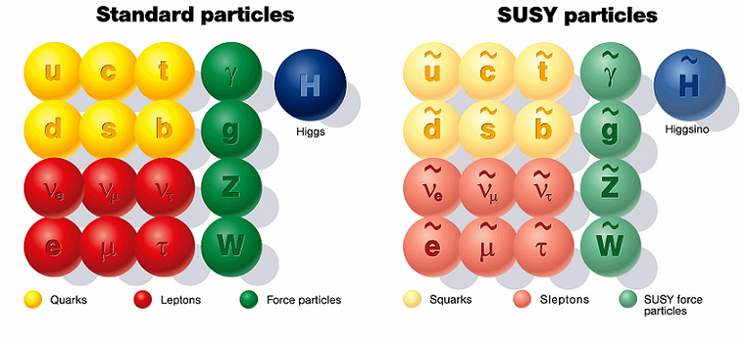
Supersymmetry
SUSY: superpartners of known SM particles;
mass expected at ~1 TeV

Slide 6
Supersymmetric dark matter?
Part of ordinary SUSY spectrum:
Neutralino: mass state of
bino, wino, higgsinos
Add gravity: gravitino LSP
Add axion: axino LSP
LSP – Lightest SUSY particle:
Weakly interacting
Neutral (electric+color)
Massive
Stable
Possible candidates for LSP:
Sneutrino – not good (LEP, DM searches)

Slide 7
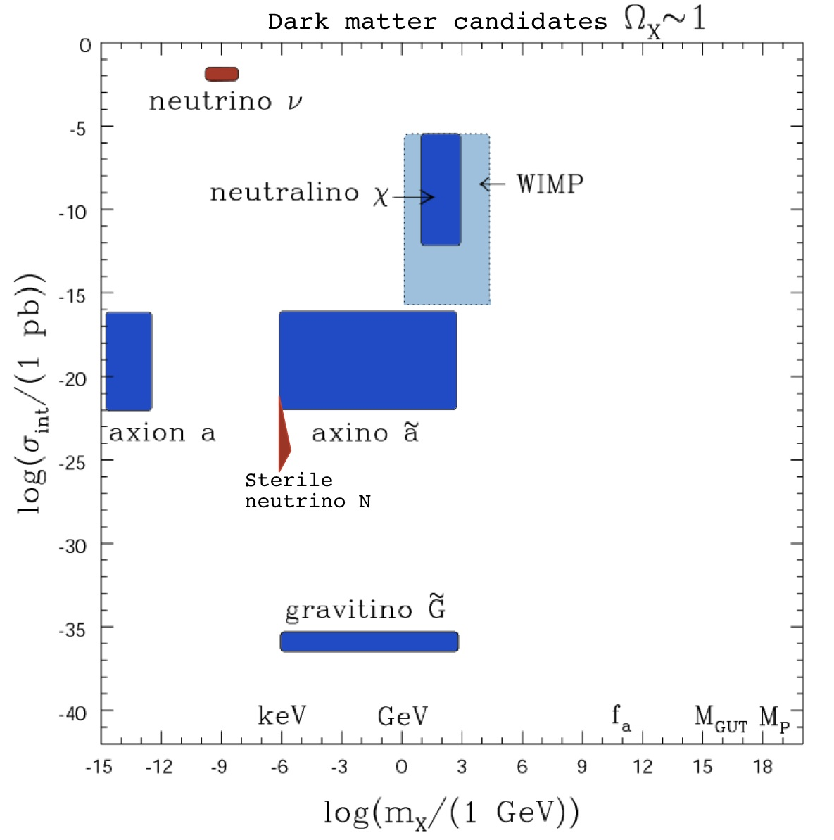
Dark matter – the big picture
LR (2000), hep/ph-0404052
neutrino – hot DM
sterile neutrino – warm/cold DM
neutralino
generic WIMP
axion
axino
gravitino
Interaction with detector (pb)
S
U
S
Y
Cold DM
mass
Vast ranges of masses (~20 orders of mag.) and interactions (~35 orders of mag.)
Different production mechanisms in the early Universe (thermal, non-thermal)
Need to go beyond the Standard Model
WIMP candidates testable at present or forseable future
EWIMPS (gravitino, axino, sterile neutrino): not directly testable

Slide 8
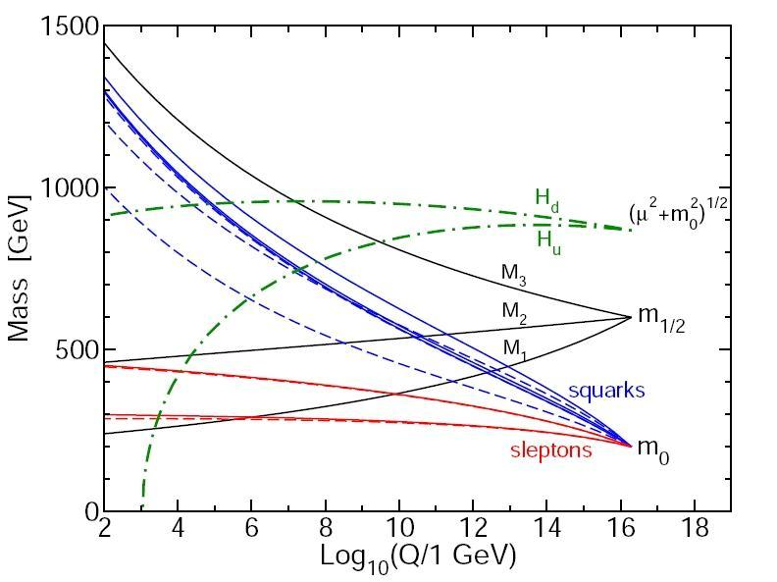
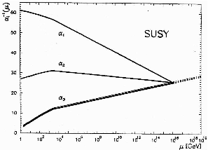
SUSY: Constrained or Not?
Constrained:
Phenomenological:
Low-energy SUSY models with
grand-unification relations among
gauge couplings and (soft) SUSY mass parameters
Supersymmetrized SM…
Features:
Many free parameters
Broader than constrained SUSY
MSSM
CMSSM
Virtues:
Well-motivated
Predictive (few parameters)
Realistic
figure from hep-ph/9709356
Many models:
general MSSM – over 120 params
MSSM + simplifying assumptions
pMSSM: MSSM with 19 params
p9MSSM, p12MSSM, pnMSSM, …
Many models:
CMSSM (Constrained MSSM): 4+1 parameters
NUHM (Non-Universal Higgs Model): 6+1
CNMSSM (Constrained Next-to-MSSM) 5+1
CNMSSM-NUHM: 7+1
etc

Slide 9
Main news from the LHC so far…
…a BSM theorist’s perspective:
Higgs(-like) particle at ~126 GeV
No (convincing) deviations from the SM
Stringent lower limits on superparner masses
SUSY masses close to 1 TeV scale…

Slide 10
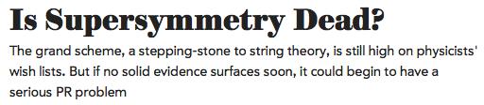

…and from the media…
April 2012

Slide 11
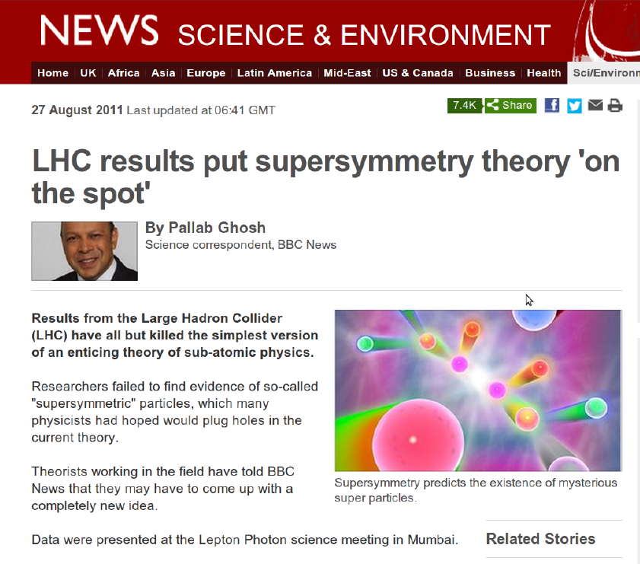
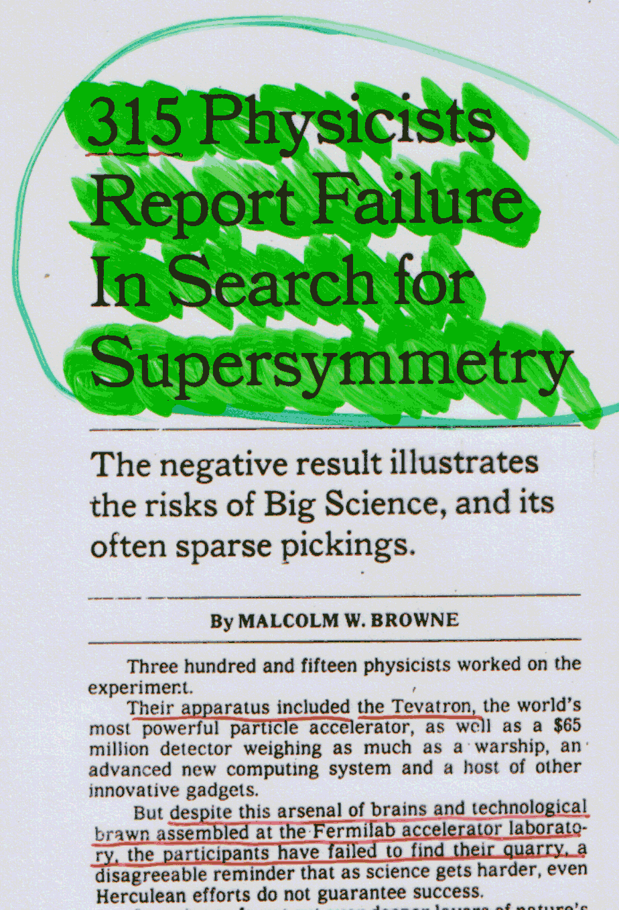
Nothing new…
Energy, luminosity and the number of physicist failing to find SUSY have increased by factor of 10...
CDF, ~2003

Slide 12
The 126 GeV Higgs Boson and SUSY
A blessing or a curse?

Slide 13
The 126 GeV Higgs Boson and SUSY
A blessing…
Fundamental scalar -> SUSY
Light and SM-like -> SUSY
SUSY prediction: SM-like Higgs with mass up to ~132 GeV

Slide 14
The 126 GeV Higgs Boson and SUSY
A curse…
-> Multi-TeV scale of SUSY
Only m_h~126 GeV and CMS lower bounds on SUSY applied.

Slide 15
A 126 GeV Higgs in the CMSSM
Include only m_h~126 GeV
and lower limits from direct
SUSY searches
~126 GeV Higgs mass implies multi-TeV SUSY masses
NO tension with LHC direct lower limits
If lighter Higgs: lower M_SUSY, partly in tension with LHC limits

Slide 16
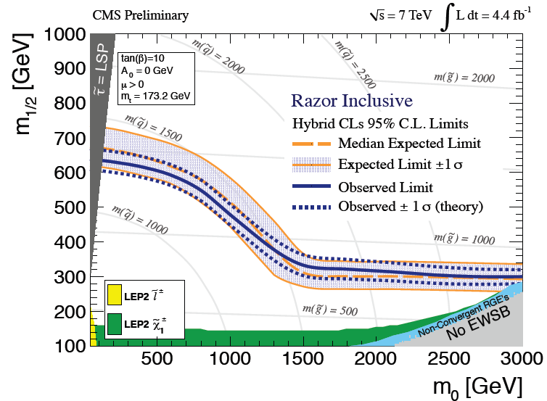
SUSY - most important constraints:
Higgs mass
Direct search limits
Lower limit…
Dark matter density
Positive measurement, inconsistent with SM
B_s -> mu mu
LHCb (Nov 2012)
Other flavor (b to s gamma, etc)
EW observables (M_W,…)
(g-2)_muon

Slide 17
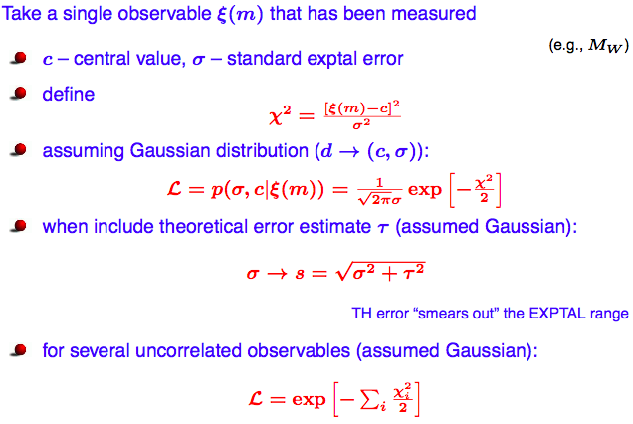
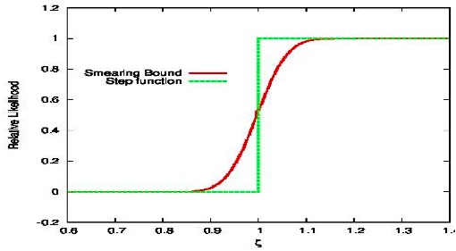
The Likelihood function
Central object: Likelihood function
Positive measurements:
Limits:
Smear out bounds.
Add theory error.
LHC direct limits:
Need careful treatment. Typically use Poisson.

Slide 18
CMSSM: numerical scans
Perform random scan over 4 CMSSM +4 SM (nuisance) parameters simultaneously
Use Nested Sampling
algorithm to evaluate
posterior
Use 4 000 live points
Very wide ranges:
Use Bayesian approach (posterior)

Slide 19
Hide and seek with SUSY
?
10 dof

Slide 20
SUSY - most important constraints:
Higgs mass
Direct search limits
Lower limit…
Dark matter density
Positive measurement, inconsistent with SM
B_s -> mu mu
LHCb (Nov 2012)
Other flavor (b to s gamma, etc)
EW observables (M_W,…)
(g-2)_muon

Slide 21
Dark matter density
Unified SUSY: neutralino relic density is typically 1-2 orders of magnitude too large
Remaining mechanisms of reducing it to correct range:
                neutralino-stau coannhilation
                pseudoscalar Higgs A resonance
                focus point/hyperbolic branch region
                (~1 TeV higgsino LSP at larger MSUSY)
                Plus (very rare) LSP-stop coannihilation
Scan with all other relevant
constraints imposed
CMSSM: these are the only DM-favored regions

Slide 22
Light Higgs in the CMSSM
Likelihood function
…with all relevant constraints imposed
~126 GeV Higgs at/near lowest chi2 (S.C./AF) and at X_SUSY>> 1TeV

Slide 23
Higgs vs stop mass
stop_1 mass at
or above 1 TeV
Best fit to ~126 GeV Higgs
-> M_SUSY~ or >> 1 TeV
Dark matter relic density: selects some regions

Slide 24
Can multi-TeV ranges of parameters
be tested experimentally?

Slide 25
LHC?
gluino mass
LHC reach:
Gluino: ~2.7 GeV
Squarks: ~3 TeV
Squark mass (1st or 2nd gen)
…signal not guaranteed

Slide 27
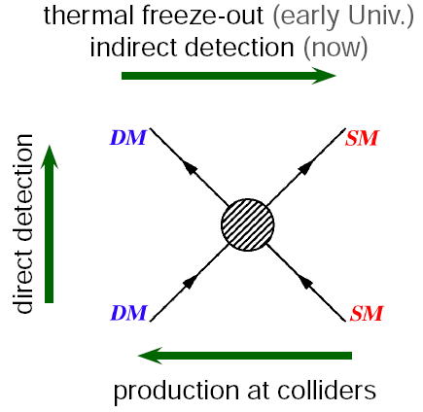

Slide 28
Direct Detection AD 2011 - Before LHC
Confusion region
motivated by theory (SUSY)
MasterCode, BayesFITS

Slide 29
CMSSM and 1-tonne DM detectors
1-tonne DM detectors to cover most of CMSSM predictions
…over ALL multi-TeV ranges of mass parameters
Generic prediction of multi-TeV SUSY:
~1TeV LSP (higgsino)
(Except for some cases at mu<0)
LUX (2014) to improve sensitivity by ~1 decade

Slide 30
General MSSM
M_SUSY >~ (or even >>) 1 TeV favored by ~126 GeV Higgs: true in both unified and general SUSY
CMSSM (and other simple GUT-constrained models): heavy superpartners, low DM rates
In less unified models somewhat lower SUSY masses are allowed (but not by much)
Consistent with all relevant constraints, except for g-2, R(gamma gamma)
…except for very fine tuned corners

Slide 31
~126 GeV Higgs in general MSSM
More free parameters, more freedom
…here 9 parameters
(p9MSSM)
BayesFITS (in prep)
~126 GeV Higgs still implies heavy superpartners
stop_1 mass
…except for very fine tuned corners
which allow much lighter staus, stops,
charginos
Higgs mass

Slide 32
Direct Detection in MSSM
BayesFITS (2013)
PRELIMINARY
Wide scan over 9 parameters (p9MSSM)
MSSM: signal could be anywhere

Slide 33
DD in the MSSM
Other grups: similar results
Han et al., March 2013

Slide 34
Neutrino Telescopes and the MSSM
Wide scan over 9 parameters (p9MSSM)
PRELIMINARY
Even in the MSSM predicted neutrino rates are LOW at best

Slide 35
SUSY - most important constraints:
Higgs mass
Direct search limits
Lower limit…
Dark matter density
Positive measurement, inconsistent with SM
B_s -> mu mu
LHCb (Nov 2012)
Other flavor (b to s gamma, etc)
EW observables (M_W,…)
(g-2)_muon

Slide 36
(g-2)_muon
The anomalous magnetic moment of the muon
>~ 3 sigma deviation
Need new physics?
Moskal@Moriond QCD’13
SUSY:
Need sneutrino/chargino and/or smuon/neutralino in ~ few hundred GeV range
This is the only result pointing towards low superparner masses!
Notes:
Had contr dominates uncertainty
Kloe: pi contr to lbl

Slide 37
(g-2)_muon and SUSY
– A curse or a blessing?
GUT-constrained SUSY (CMSSM and similar): sleptons are unified with squarks and are too heavy => g-2 anomaly not reproduced
Typically one order of magnitude too low
g-2 anomaly is INCONSISTENT with simple unified SUSY models
General MSSM: if (g-2)_muon anomaly is true:
expect light sleptons/chargino/neutralino
In few hundred GeV range
Notes:
Had contr dominates uncertainty
Kloe: pi contr to lbl

Slide 38
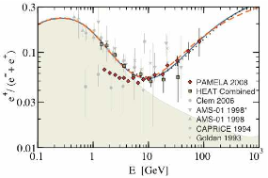
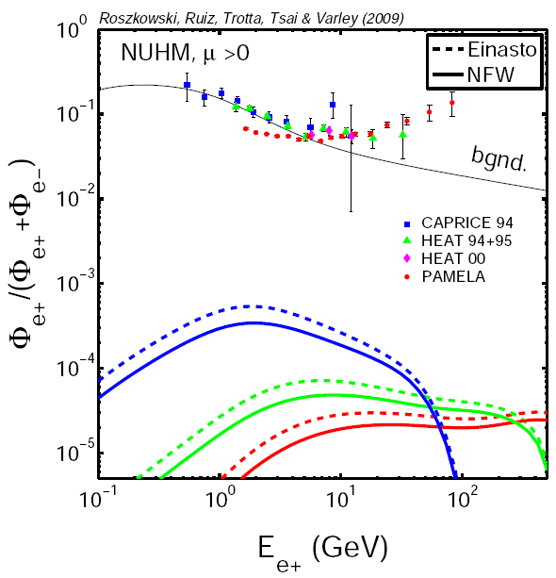
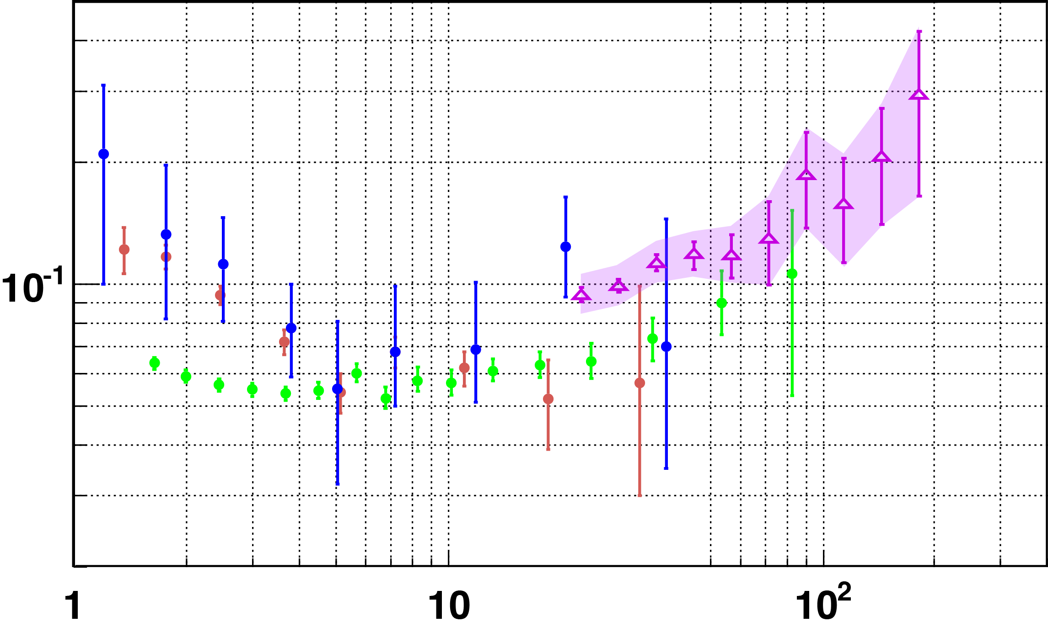
SUSY DM and positron flux
Pamela (2008)
error size
AMS-II (coming)
SUSY does not explain positron excess!
AMS to settle the issue (?):
if isotropic: DM (?)
If directional: pulsar (?)
Also true for wino LSP (Hryczuk et al)

Slide 39
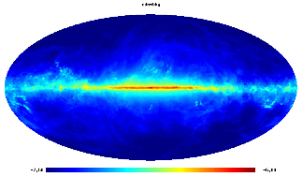
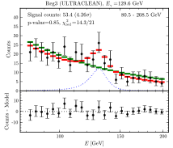
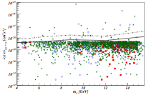
SUSY DM and 130 GeV gamma line from GC
Gamma ray total + background
Weniger (arXiv:1204.2797)
Confusing situation
SUSY:
- an `explanation’ of the `signal’
very fine-tuned (and contrived?)
Chalons (1204.45910)

Slide 42
We need a WIMP signal…
… from both LHC and DM searches

Slide 43
Summary
LHC: Higgs discovery --> hint for SUSY
Higgs mass of 126 GeV --> M_SUSY typically at multi-TeV scale
1-tonne DM detectors to probe most of (C)MSSM parameters.
Lighter superpartners allowed in general MSSM
Indirect detection rates (neutrino telescopes): at best LOW
Plus a window of light stop_1 (~1TeV) – best fit region (stau coann.)
Far beyond direct LHC reach.
Other simple constrained SUSY models: similar story.
And some are necessary if g-2 anomaly is true.

Slide 44
Think BIG!!!

