Slide 1
Tools for simulations
Event Generators at sqrt(s)=115 GeV
Opening the discussion …
Sarah Porteboeuf-Houssais
LPC
Clermont-Ferrand
Physics at A Fixed Target ExpeRiment (AFTER) using the LHC beams
3-13 Febuary 2013 ECT Trento

Slide 2
Outline
Event generators physics
Why to use them?
Questions raised by AFTER
Non-exhaustive overview of event generators on the market
Which one to do what?
Conclusions

Slide 3
Event generators physics
Goal (dream ?) :
to reproduce entirely an event : particles in final state with all properties
with all steps and physics features (soft, hard, interplay between the two, hydro?, all observables, …)
Should give access to exclusive observables
Different from a calculation/computation usually inclusive and for one observable
(for example pT spectrum in pp-> J/Ψ +X)
Strategy :
Initial state
Elementary interactions : soft, hard, both?
Radiation
Remnants
Multiple interactions
Underlying events
Particle production (string picture?)

Slide 4
Why to use them?
Simulate events for detector/analysis purpose
For this,
do you need a sophisticated baseline model of your event generator ?
Generate events for corrections
Test an analysis process on MC data prior to real data
Test your comprehension of your detector (MC = Event generation + Geant simulation of detector)
Model Comparison
If you look at pure inclusive observables, maybe there is a model on the market that will be more adapted
If you start looking at exclusive staff : particle correlations, soft vs. hard, ...
Event generators trying to reproduce all aspects of the event could be of interest

Slide 5
Questions raised by AFTER
Fixed target
Various possible targets with two beams (p or Pb)
Various systems : pp, pA, AA
-4,8 < Y_cms <1
Do you want one single event generator for all systems?
Energies : sqrt(s) = 72-115 GeV
Between SPS and RHIC
You need an event generator that gives consistent simulations at SPS and RHIC.
Do you need all new features developed for Tevatron and LHC?
Observables : photons, jets, Quarkonia and open heavy flavors, identified soft particles
Various observables either soft and hard
Do you want one single event generator for all?

Slide 6
Non-exhaustive Overview of event generators on the market
pp event generators
PYTHIA
Specialization, complement
Based on pQCD approach : the hard interaction is the basis of the framework
Herwig
ALPGEN : include detailed multiple hard processes
Jimmy
EPOS
Based on Gribov-Regge approach, multiple interactions are the basis of the framework
Cascade : hard process with parton evolution
Sherpa
pp, pA, AA
Hijing
Based on PYTHIA, with emphasize on minijet, include nuclear shadowing
AMPT
Hijing for initial condition, add final state scattering to generate elliptic flow
EPOS
Picture of Elementary parton-parton interactions viewed as color flux tube extended to all system, with shadowing and hydro evolution
Hydjet++
Hydro evolution (only AA?)
https://karman.physics.purdue.edu/OSCAR-old/models/list.html
http://en.wikipedia.org/wiki/Event_generator

Slide 7
A completely biased selection
In the following :
PYTHIA
EPOS
A bit of Hijing and AMPT

Slide 8
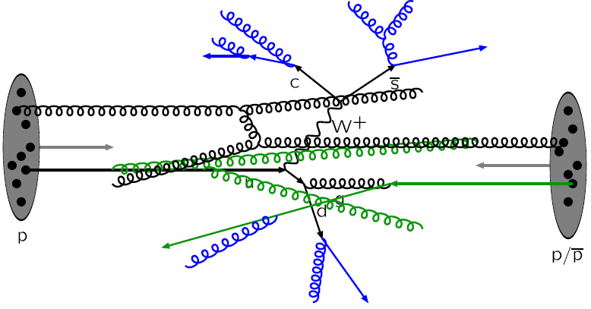
PYTHIA Physics : ref 6.4 Manual
http://arxiv.org/abs/hep-ph/0603175
1) The first hard interaction is the first step of event machinery :
Computed in pQDC framework with factorization, possibility to select hard process : charm, bottom, jets, photon -> can tune this step
! At this step only partons are produced
2) MPI (Multiple Parton Interaction) : other processes (soft or hard) can happen in parallel:
PYTHIA model : the first hard interaction is particular, other are reconstructed afterward, ordered in hardness, in PYTHIA 6, only g,u,d,s available in other interaction,
In PYTHIA 8 : second hard can include charm and bottom

Slide 9
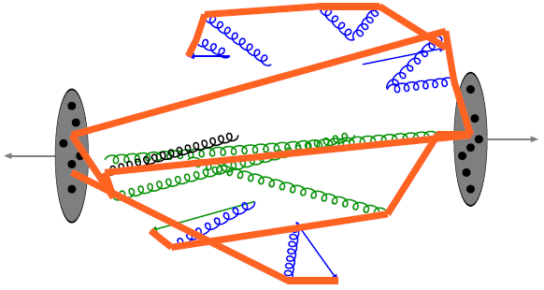
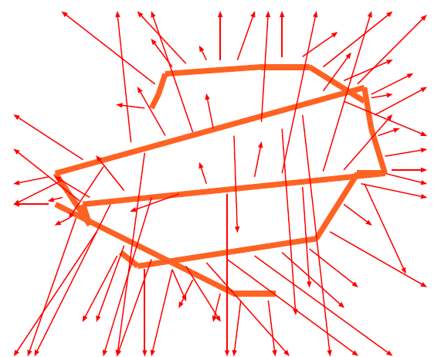
PYTHIA Physics : ref 6.4 Manual
All produced partons (in hard process, ISR/FSR (Initial State Radiation/Final State Radiation), MPI, remnants, …) are connected via strings : the LUND procedure,
Resonance let out of the machinery
Formed strings decay into hadrons
(fragmentation via qqbar pairs, pop-corn to produce baryons)
qqbar : u,d,s,c (c is suppressed but available), heavier not implemented

Slide 10
How to produce heavy state in PYTHIA?
In the 2->2 hard sub-process : Hard production
1) Open heavy flavor
2) Resonnance production
p
p
To be checked : can a pre-resonnan state decay into D meson?
c/b
c/b
c/b
c/b
Pre-resonant state (NRQCD):
decay into J/Psi or Upsilon
Partons, connected to strings
p
p
Gluon splitting (g->QQbar, gluon originated from ISR/FSR)
p
p
c/b
cc cluster decay into J/Ψ
c/b
Any hard 2->2
sub-process (gg->gg for example)
Any hard 2->2
sub-process (gg->gg for example)
Other c/b connected to strings
Partons, connected to strings
p
Color reconnection make this contribution available with only one g->Qqbar : artificial enhancement of this contribution in PYTHIA6.4
p
( N.B : Cluster : small peace of string : decay directly into hadrons)

Slide 11
How to produce heavy state in PYTHIA?
String fragmentation
An event can still produce J/Psi and D mesons via string fragmentation
u
cc pair production suppressed as compare to u, d, s, but available : limit at high energy?
c
c
u
D0
D0
Higher state not available
How to tag the origin of heavy state?
easy for resonance : direct information via the mother!
Due to final string procedure : difficult for open charm and open beauty : they all finally comes from strings
For open charm and open beauty is there really a physical sense for differentiation?

Slide 12
PYTHIA 8
http://arxiv.org/pdf/0710.3820.pdf
http://home.thep.lu.se/~torbjorn/pythia8/worksheet8160.pdf
In C++
The actual developed code (PYTHIA 6 maintained, but not developed)
MPI scenario : possibility of charm and bottom in the hard process of second hard interaction : user can play with this!!!
PYTHIA +
A bit of everything, even if the physics model is not perfect
Extensively used, tuned, debugged, interfaced to other codes
PYTHIA -
Only pp
A bit of everything, even if the physics model is not perfect (eg. quarkonia)
Not PYTHIA, but PYTHIAS : many many tunes, one single framework?

Slide 13
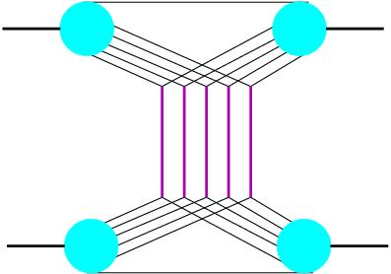
EPOS for pp
Parton-based Gribov-Regge Theory
Mixed approach between parton model and Gribov-Regge
Energy shared between all elementary interactions
Same formalism for cross section computation and particle production
EPOS
theoretical framework
Elementary interaction =
soft
Semi-hard
soft: parameterized
hard: parton model
Energy conserving quantum mechanical multiple scattering approach based on :
semi-hard: soft pre-evolution before the hard part
Partons, parton ladders, strings
Off-shell remnants
Splitting of parton ladder
S. Ostapchenko, T. Pierog, K. Werner, H.J. Drescher, M. Haldik Phys. Rep. 350 (2001)

Slide 14
EPOS for pp
MPI@LHC 2011, DESY, Hamburg, Klaus WERNER, Subatech, Nantes

Slide 15
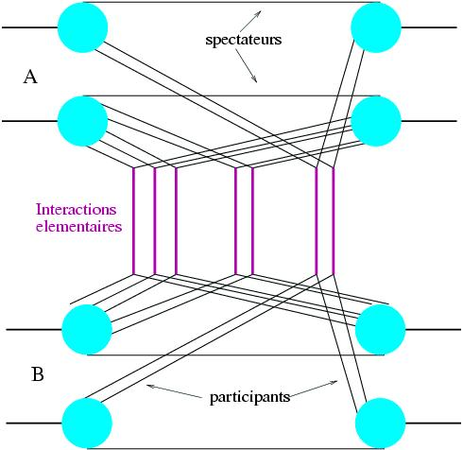
EPOS for heavy ion
Same framework extended
pp
AB

Slide 16
EPOS for heavy ion
EPOS 2 : with hydro
In heavy ion collision / or very high energy pp collision :
The usual procedure has to be modified, since the density of strings will be so high that they cannot possibly decay independently
Some string pieces will constitute bulk matter, which expands as a fluid, others show up as jets
Event by event hydro-evolution
EPOS 2, not yet public, should be available by 2013!
!
Initial condition given by flux tube picture
“Event-by-Event Simulation of the Three-Dimensional Hydrodynamic Evolution from Flux Tube Initial Conditions in Ultrarelativistic Heavy Ion Collisions” arXiv: 1004.0805
“Jets, Bulk Matter, and their Interaction in Heavy Ion Collisions at Several TeV.” arXiv : 1203.5704

Slide 17
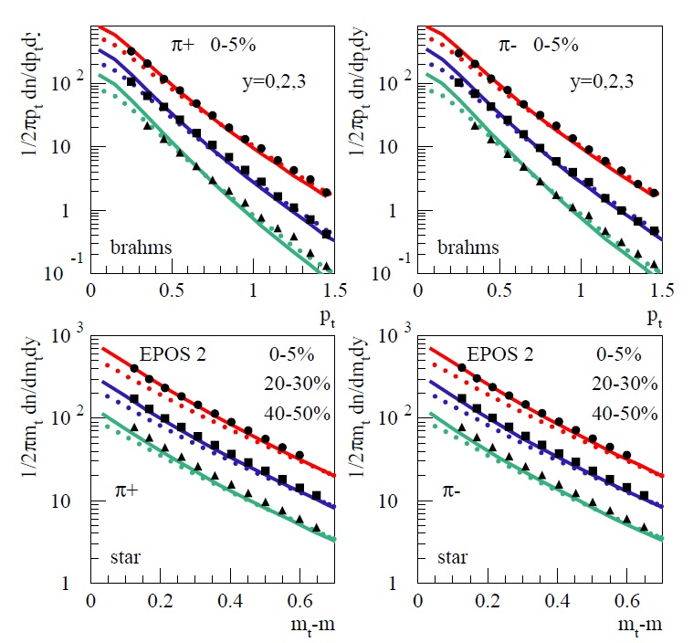
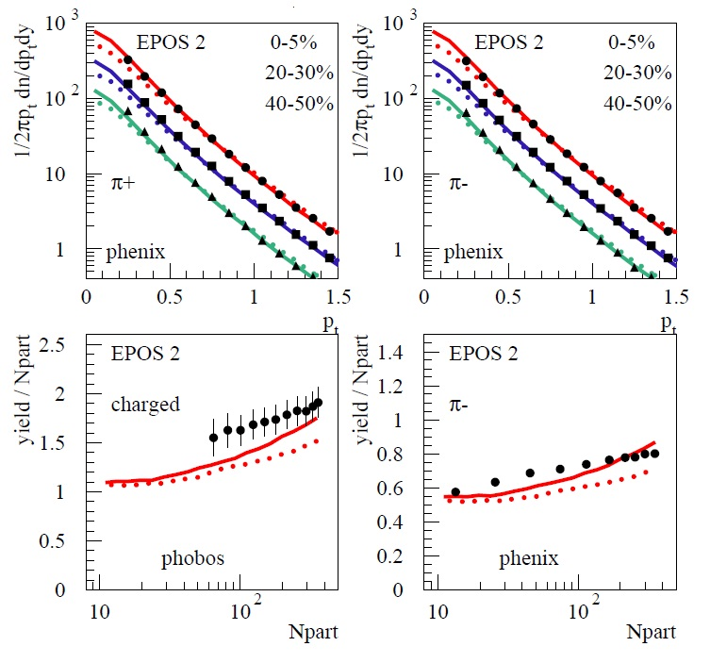
EPOS for heavy ion
Pions at RHIC : AuAu, sqrt(s)=200 GeV
“Event-by-Event Simulation of the Three-Dimensional Hydrodynamic Evolution from Flux Tube Initial Conditions in Ultrarelativistic Heavy Ion Collisions” arXiv: 1004.0805

Slide 18
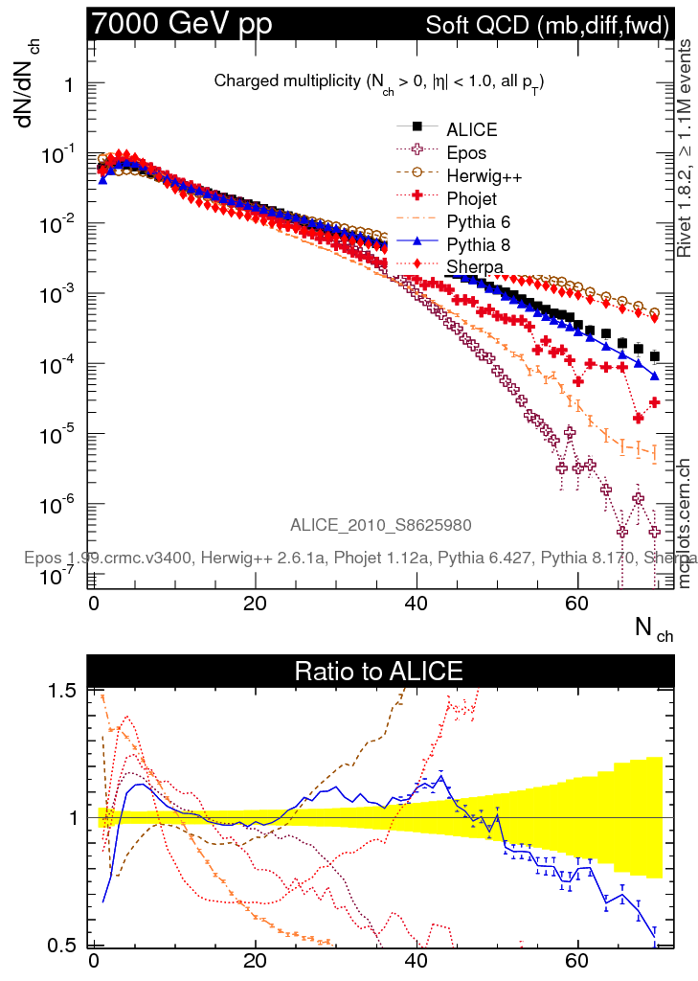
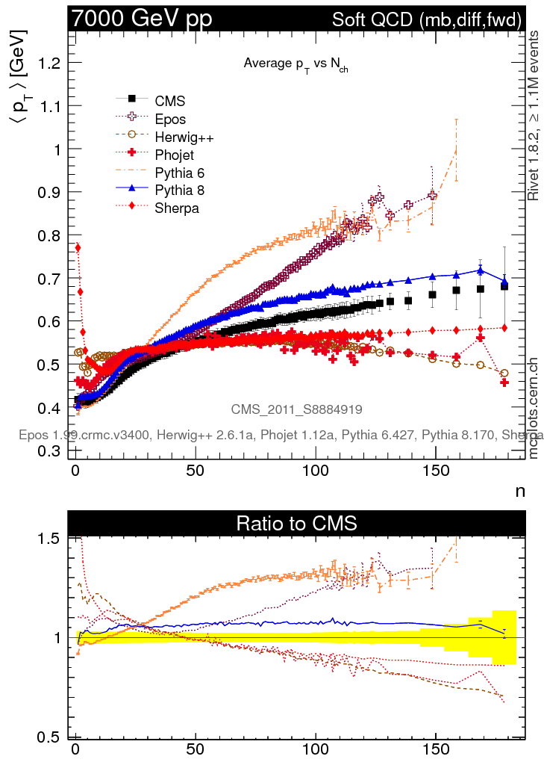
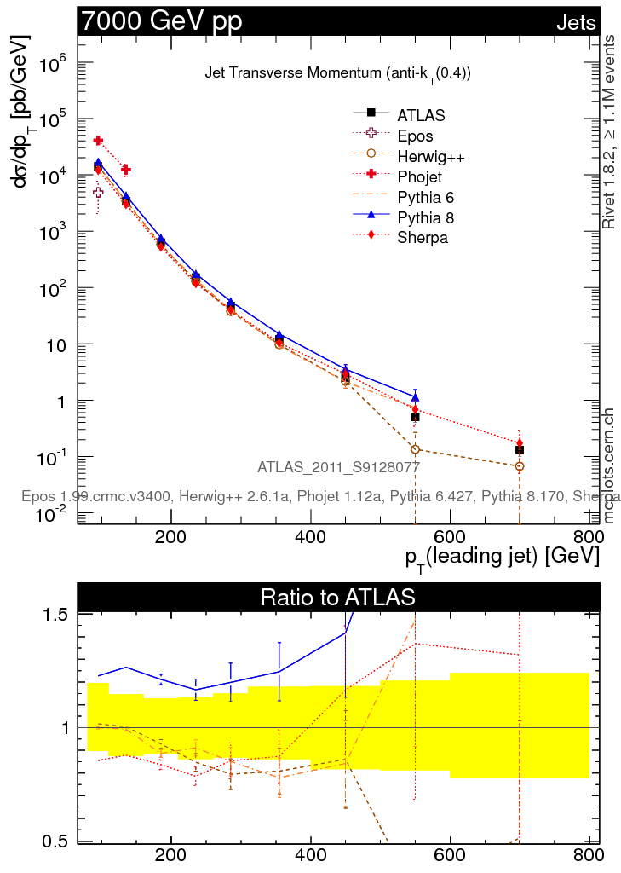
Comparison plots for pp data
http://mcplots-dev.cern.ch/
!
MC versions and tuned used!
Online “repository of MC plots comparing High Energy Physics event generators to a wide variety of available experimental data, for tuning and reference purposes.”

Slide 19
HIJING
« HIJING 1.0: A Monte Carlo program for parton and particle production in high-energy hadronic and nuclear collisions. » nucl-th/9502021,LBL-34246. Comput.Phys.Commun. 83 (1994) 307 e-Print: nucl-th/9502021
« Hadron production in p+p, p+Pb, and Pb+Pb collisions with the HIJING 2.0 model at energies available at the CERN Large Hadron Collider » Published in Phys.Rev. C83 (2011) 014915 e-Print: arXiv:1008.1841 [hep-ph]
Main features of HIJING :
Multiple mini-jet production according to an eikonal formalism for each nucleon-nucleon collision at given impact parameter b.
Kinematic of each pair of jets + their ISR/FSR done by PYTHIA model
Events without jet production (with pT>p0) and underlying soft parton interaction in event with jet production are modeled by excitation of quark-diquark strings with gluon kinks (FRITIOF and DPM model) + multiple low-pT exchange
Nuclear modification of the PDF inside the nuclei with a set of impact-parameter dependent parton distribution functions, Version2 with more modern parameterized PDF
Simple model for jet-quenching (jet-medium interaction in AA)

Slide 20
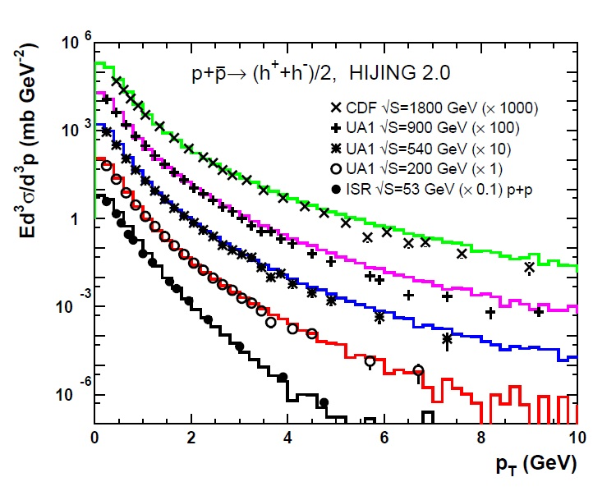
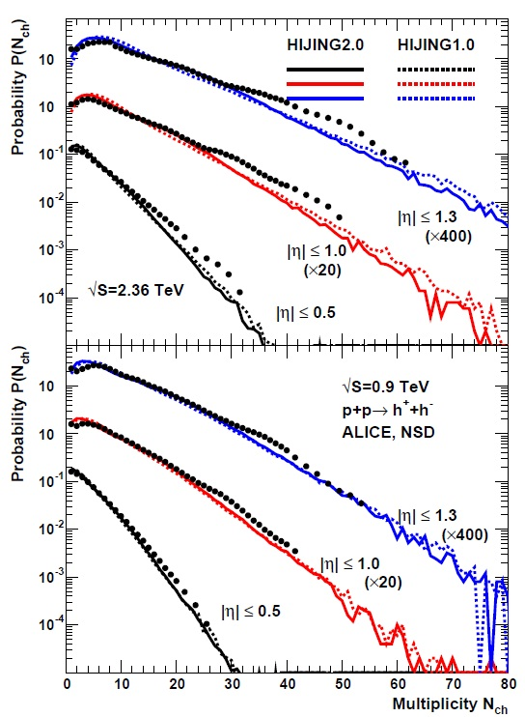
HIJING
« Hadron production in p+p, p+Pb, and Pb+Pb collisions with the HIJING 2.0 model at energies available at the CERN Large Hadron Collider » Published in Phys.Rev. C83 (2011) 014915 e-Print: arXiv:1008.1841 [hep-ph]

Slide 21
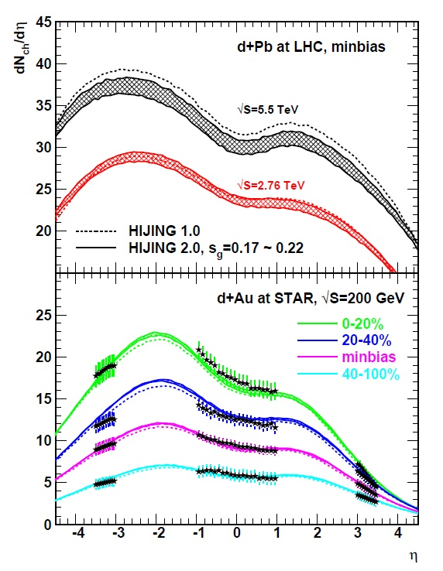
HIJING
« Hadron production in p+p, p+Pb, and Pb+Pb collisions with the HIJING 2.0 model at energies available at the CERN Large Hadron Collider » Published in Phys.Rev. C83 (2011) 014915 e-Print: arXiv:1008.1841 [hep-ph]

Slide 22
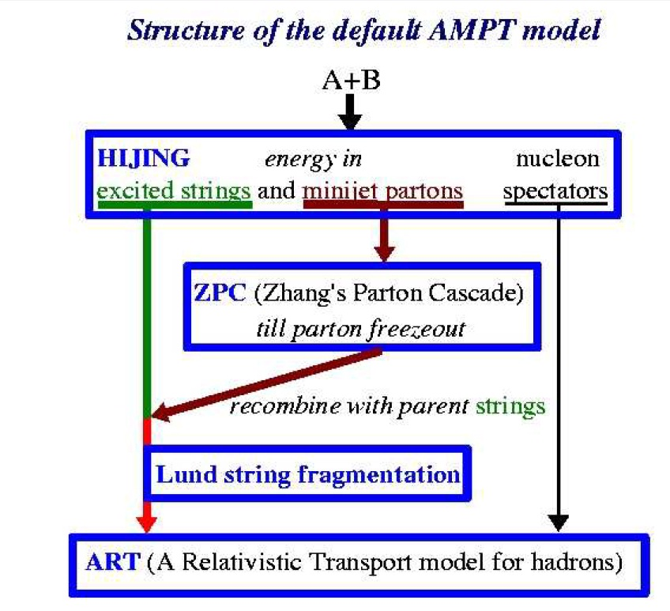
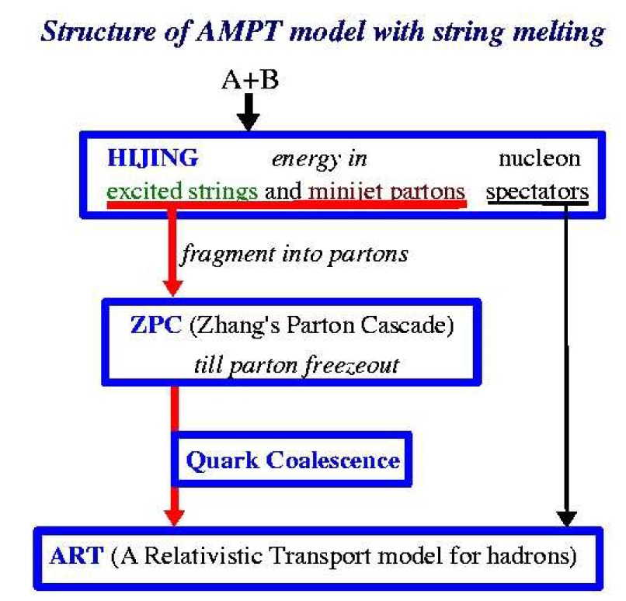
AMPT
« Pb-Pb collisions at $\sqrt{s_{NN}}=2.76$ TeV in a multiphase transport model » arXiv 1101.2231
« A Multi-phase transport model for relativistic heavy ion collisions. »
Published in Phys.Rev. C72 (2005) 064901 e-Print: nucl-th/0411110
An hybrid model, 2 versions

Slide 23
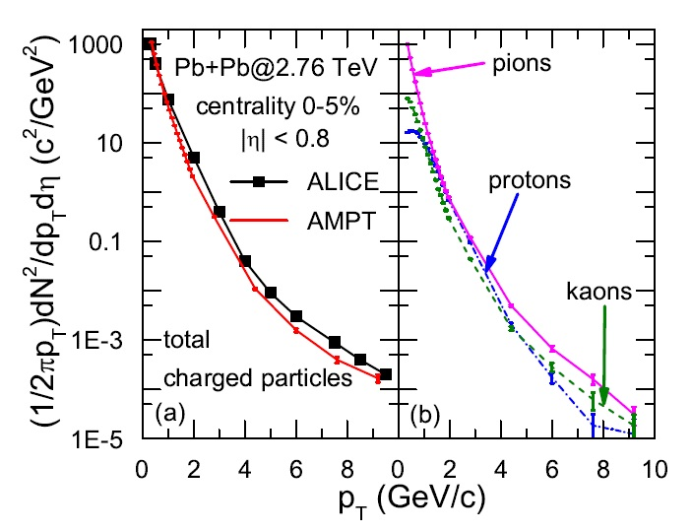
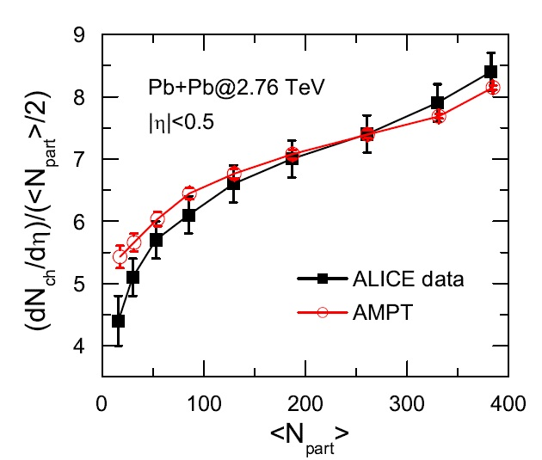
AMPT
« Pb-Pb collisions at $\sqrt{s_{NN}}=2.76$ TeV in a multiphase transport model » arXiv 1101.2231

Slide 24
Which one to do what?
model
EPOS
PYTHIA
Hijing
AMPT
systems
pp, pA, AA
pp
pp, pA, AA
pp?, pA, AA
Baseline
Multiple Interaction
Hard process
PYTHIA 5,3? + minijet + nuclear structure
HIJING + transport model
(ZPC parton cascade)
MPI
Parton-based Gribov-Regge Theory
Reconstructed after the hard process. Interaction ordered in hardness. In the new model : color reconnection
modeled by exitation of quark-diquark strings with gluon links + multiple low-pT exchange
Hard and semi-hard ladder with soft pre-evolution
Based on inclusive cross section
Hard process
PYTHIA 5,3
Almost everything, if not in the code, can couple with extra code
u, d, s, g, gamma, c in progress
Quarkonia
In progress
Yes : model to be taken with caution.
?
?

Slide 25
Which one to do what?
model
EPOS
PYTHIA
Hijing
AMPT
Initial and Final state radiation
Iterative procedure from partons in hadrons to 2->2 process
A posteriori reconstruction
Available for MPI in the new model (6.4)
PYTHIA 5,3
Yes, available with string density, eg. for all systems if energy density high enough. Event by event hydro in EPOS2
Collectivity
No
Simple model for jet-quenching (jet-medium interaction in AA)
transport model
Hadronization
String model with area law, diquark for baryon production
String model with fragmentation function, popcorn for baryon production
PYTHIA 5,3
Remnant
Yes
Off-shell treatment
Yes
PYTHIA 5,3
Total by construction : several ladders soft or hard, energy conservation and color connection
modeled by excitation of quark-diquark strings with gluon links + multiple low-pT exchange
Connection between hard processes and MPI
With color reconnection (6,4), final state effect
?

Slide 26
Conclusions
The first question you should ask yourself : what do I want to do with my event generator?
In pp at sqrt(s)=115 GeV, do you need all theory development needed for tevatron and LHC?
If your goal is to study pA and AA : do you gain to have one single event generator (one physical framework and computing framework) for all systems and energies ?
Do you gain to have one single event generator for all observables ?
For quarkonia : at present moment there isn’t a full event generator for pp, pA, AA with quarkonia implemented in a single framework (see Smbat and Cynthia’s work)
The field is evolving quickly, improved MC will certainly be available when AFTER will be in operation, stay tuned
There isn’t one easy answer, it depends on your preferences!

Slide 27
Backup

Slide 28
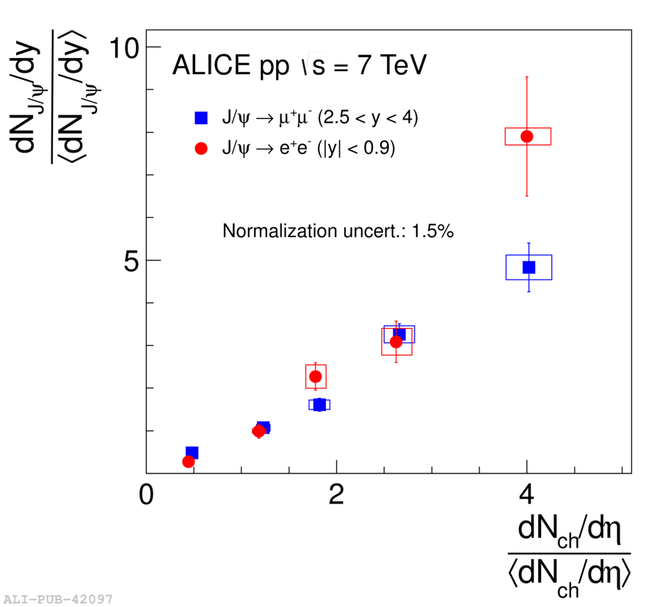
J/Psi vs. mult in pp @ 7 TeV
At LHC : looking at more exclusive observables in pp@ 7 Tev
Phys.Lett. B712, 165-175, 2012 / ArXiv:1202.2816
Will you look with AFTER at such observables, or quarkonia+correlations?

Slide 29
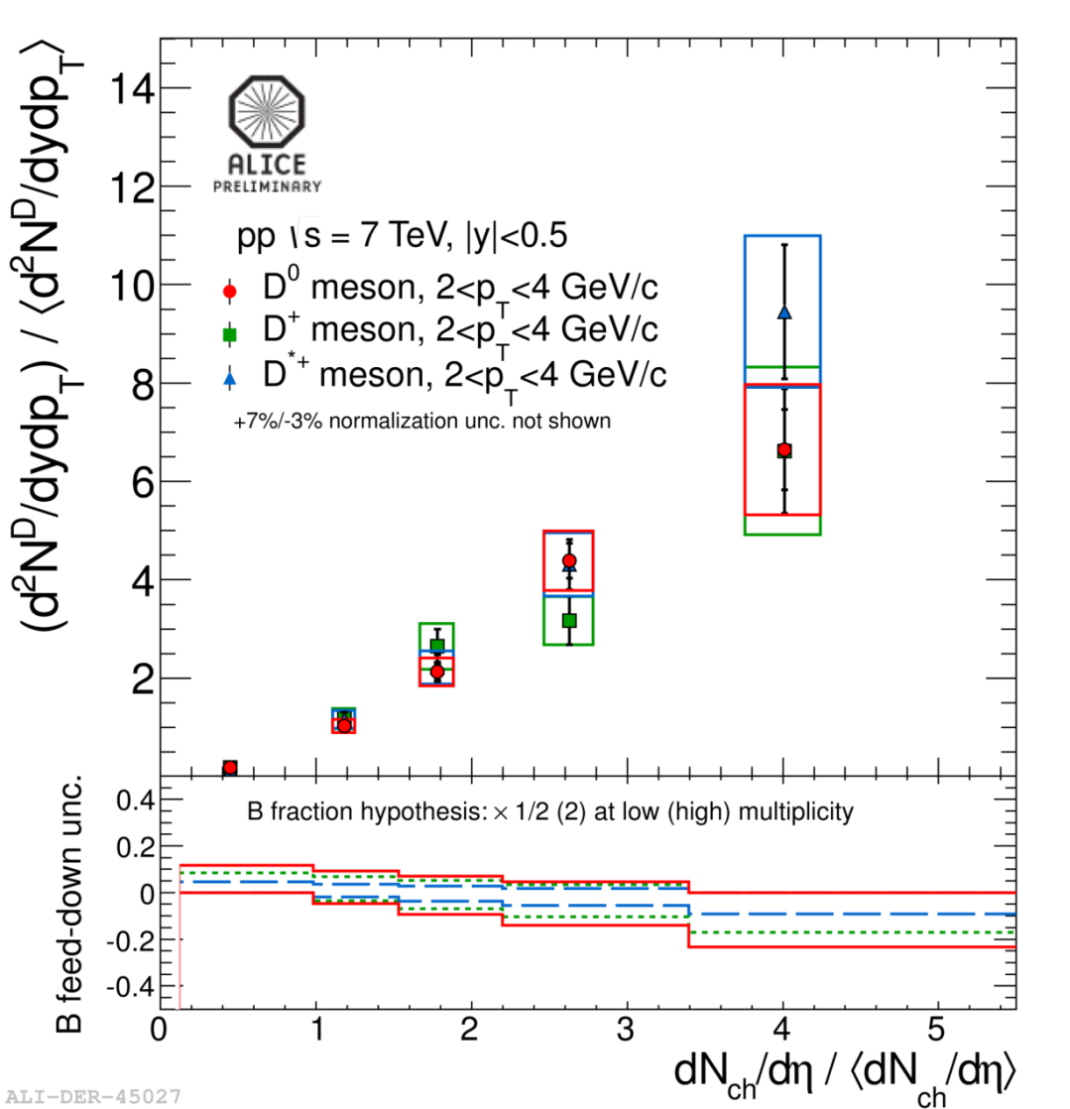
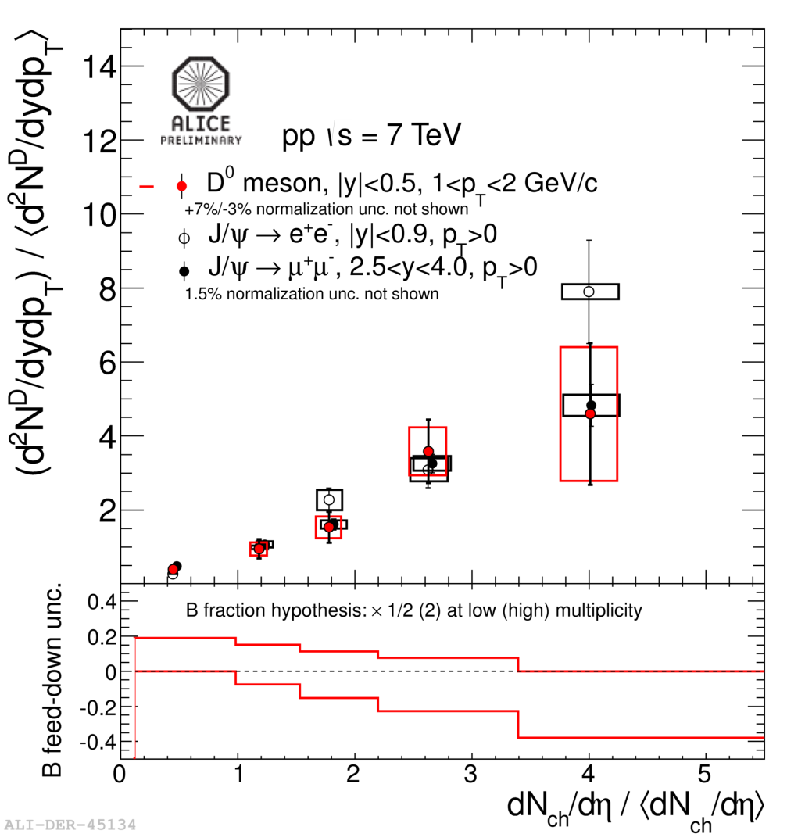
D vs. mult in pp @ 7 TeV

Slide 30
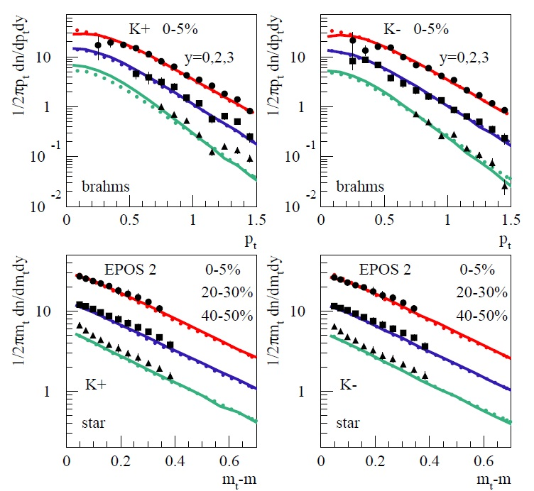
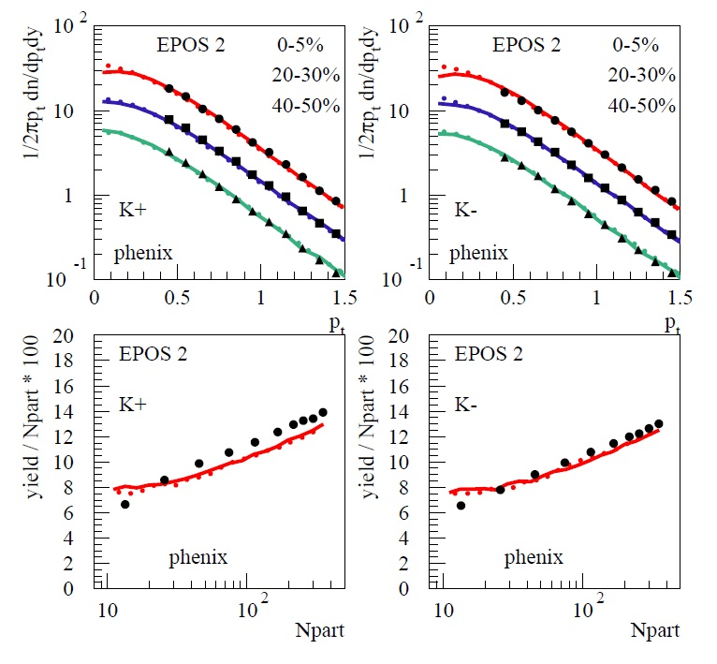
EPOS for heavy ion
Kaons at RHIC : AuAu, sqrt(s)=200 GeV
“Event-by-Event Simulation of the Three-Dimensional Hydrodynamic Evolution from Flux Tube Initial Conditions in Ultrarelativistic Heavy Ion Collisions” arXiv: 1004.0805

Slide 31
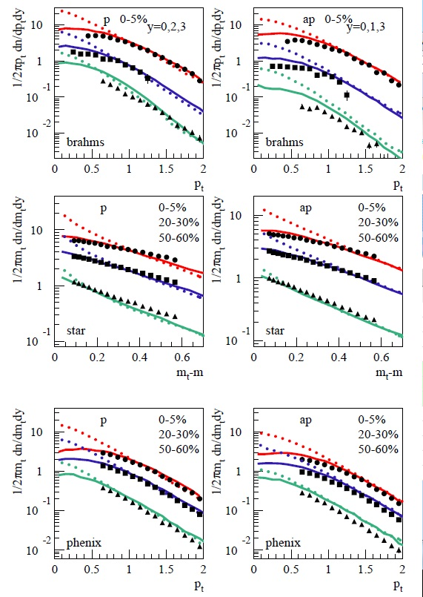
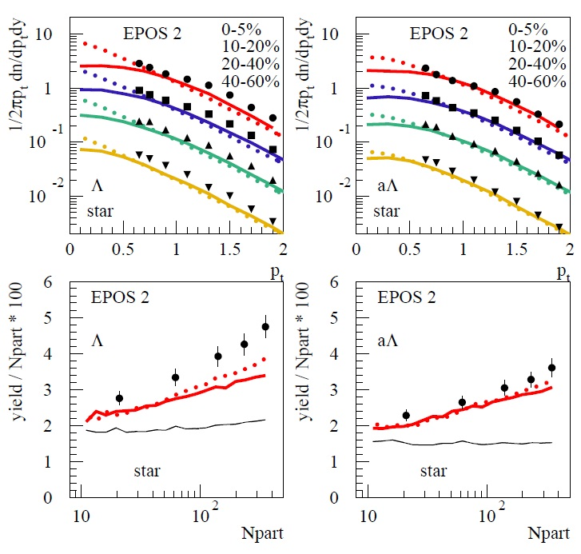
EPOS for heavy ion
Protons and lambda at RHIC : AuAu, sqrt(s)=200 GeV
“Event-by-Event Simulation of the Three-Dimensional Hydrodynamic Evolution from Flux Tube Initial Conditions in Ultrarelativistic Heavy Ion Collisions” arXiv: 1004.0805

Slide 32
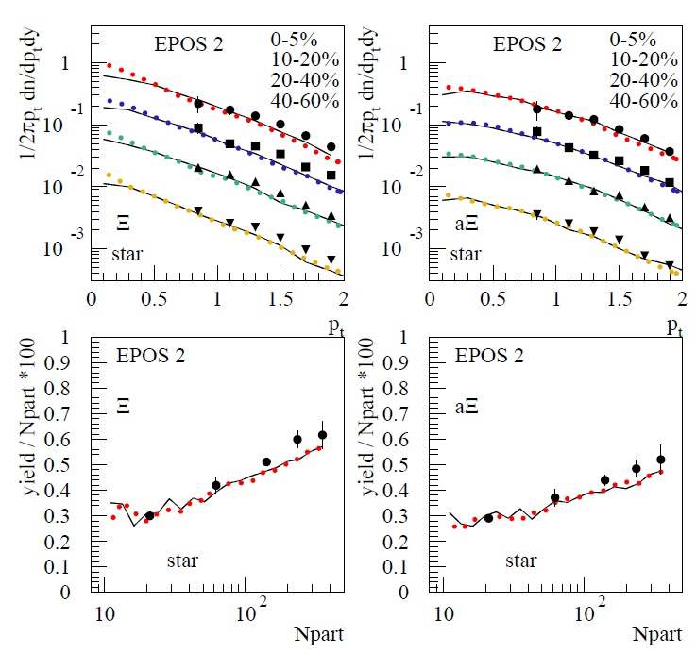
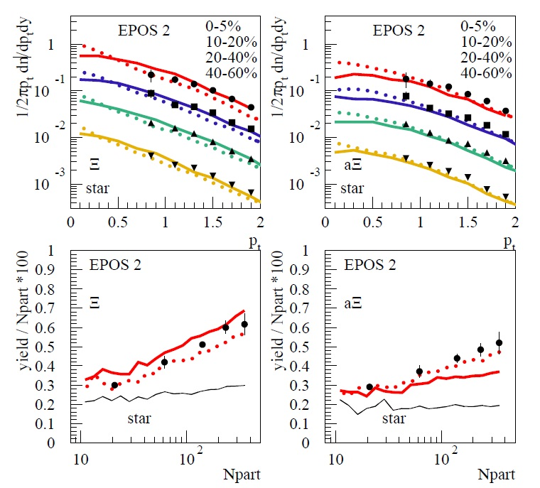
EPOS for heavy ion
Xi and Omega at RHIC : AuAu, sqrt(s)=200 GeV
“Event-by-Event Simulation of the Three-Dimensional Hydrodynamic Evolution from Flux Tube Initial Conditions in Ultrarelativistic Heavy Ion Collisions” arXiv: 1004.0805
Many other variables and energies available in literature

