Slide 1
RHIC and EIC the way to unravel the mystery about the spin of the proton

Slide 2
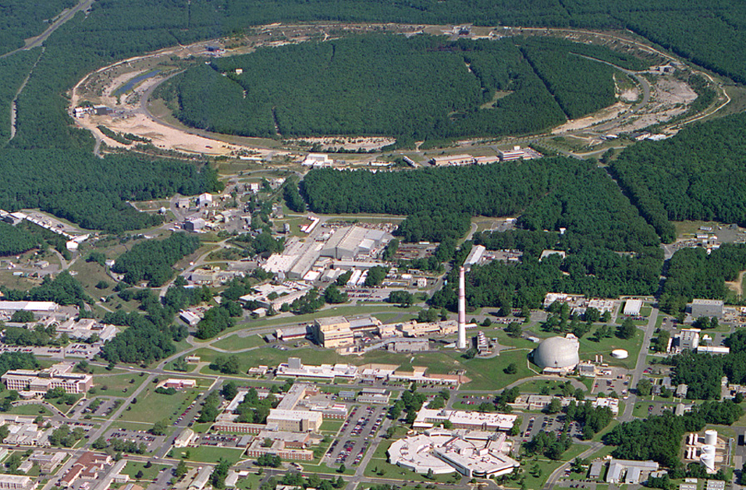
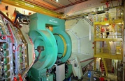
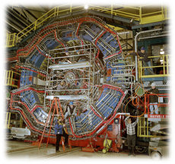

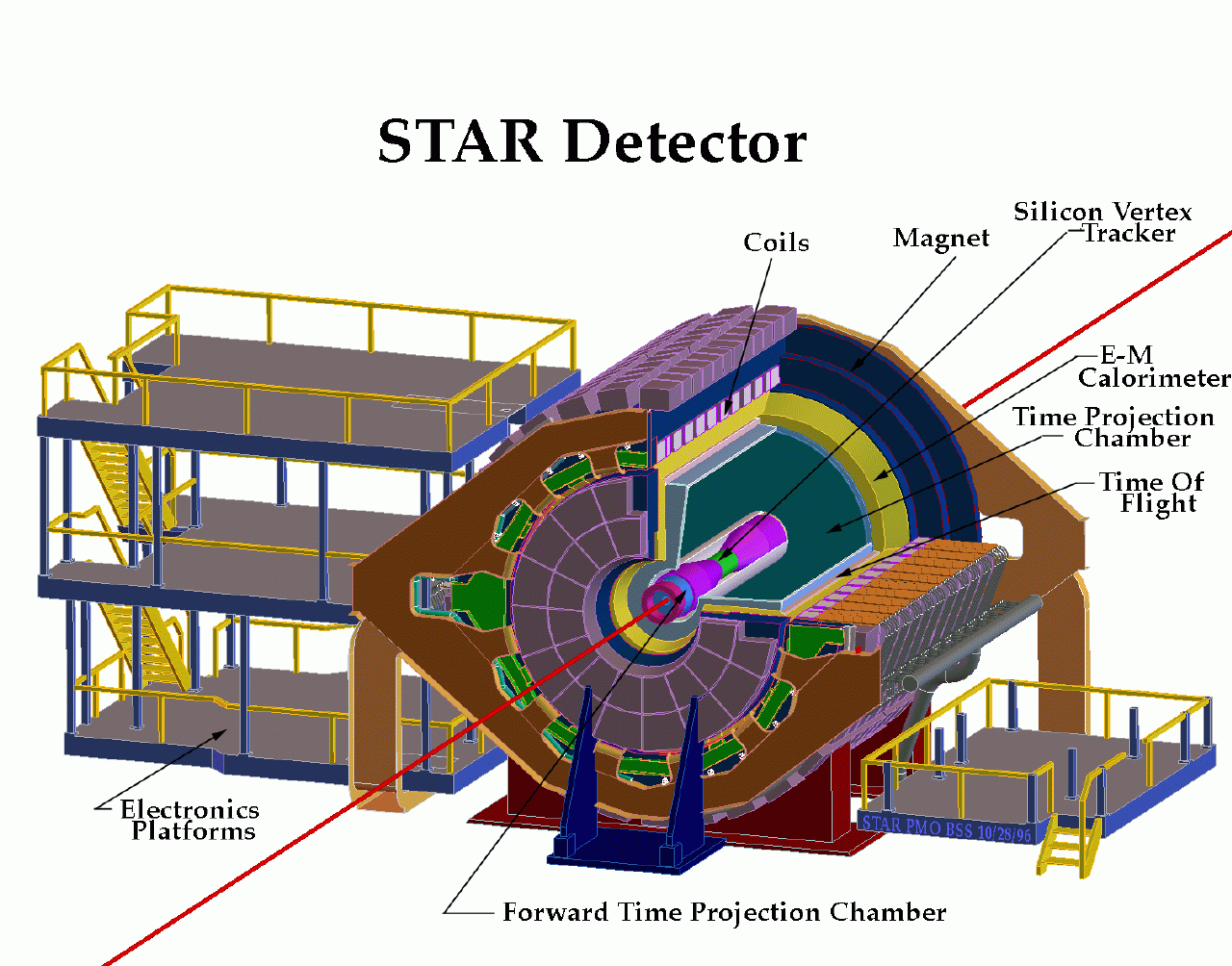
RHIC@BNL Today
Electron-Lenses
Jet/C-Polarimeters
RHIC
CeC-TF
Beams: √s 200 - 500 GeV pp;
50-60% polarization
Lumi: ~10 pb⁻¹/week
PHENIX
RF
STAR
LINAC
NSRL
STAR
EBIS
Booster
ERL Test Facility
AGS
Tandems

Slide 3
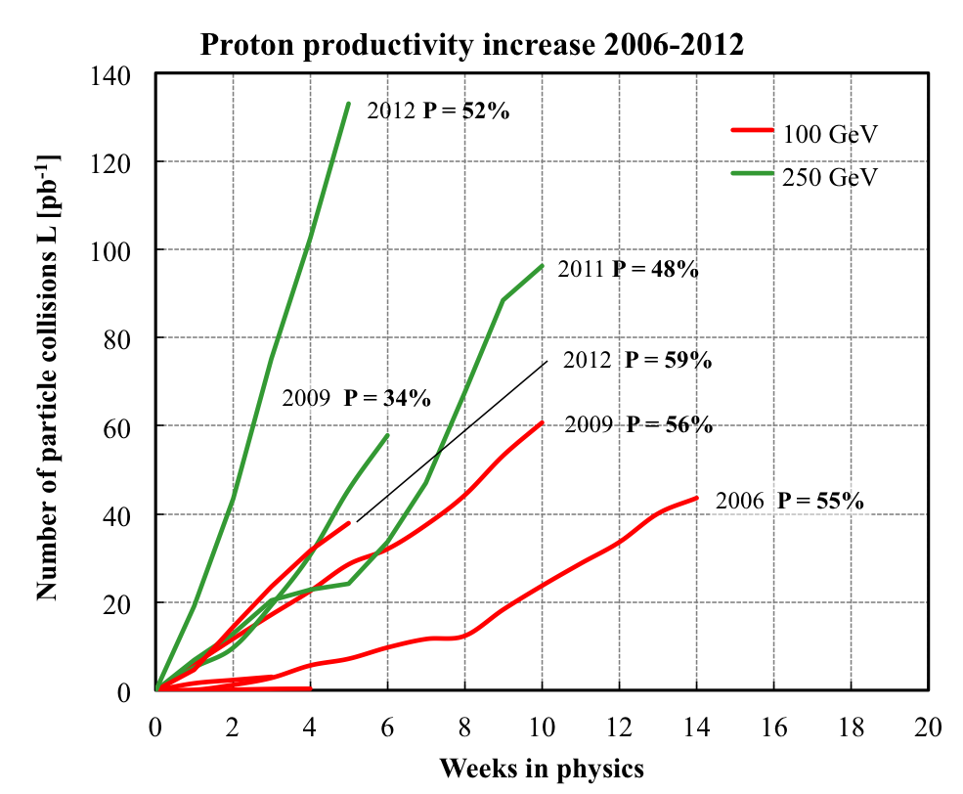
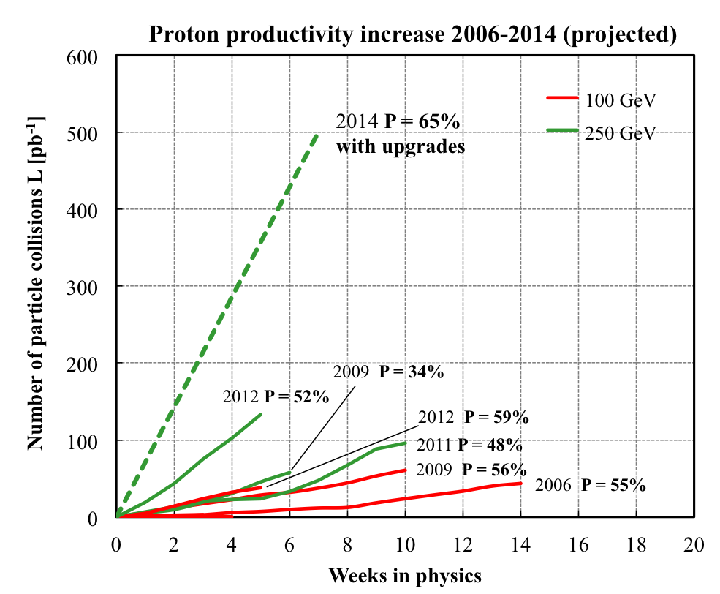
RHIC polarised p+p performance
2012:
golden year for polarized
proton operation
100 GeV:
new records for L_{peak}, L_{avg}, P
255 GeV:
new records for L_{peak}, L_{avg}, P
highest E for pol. p beam
L_{avg}: +15%
P_{avg}: +8%
What will come:
increased Luminosity and
polarization through
OPPIS new polarized source
Electron lenses to
compensate beam-beam
effects
many smaller incremental
improvements
will make luminosity
hungry processes,
i.e. DY, easier accessible

Slide 4
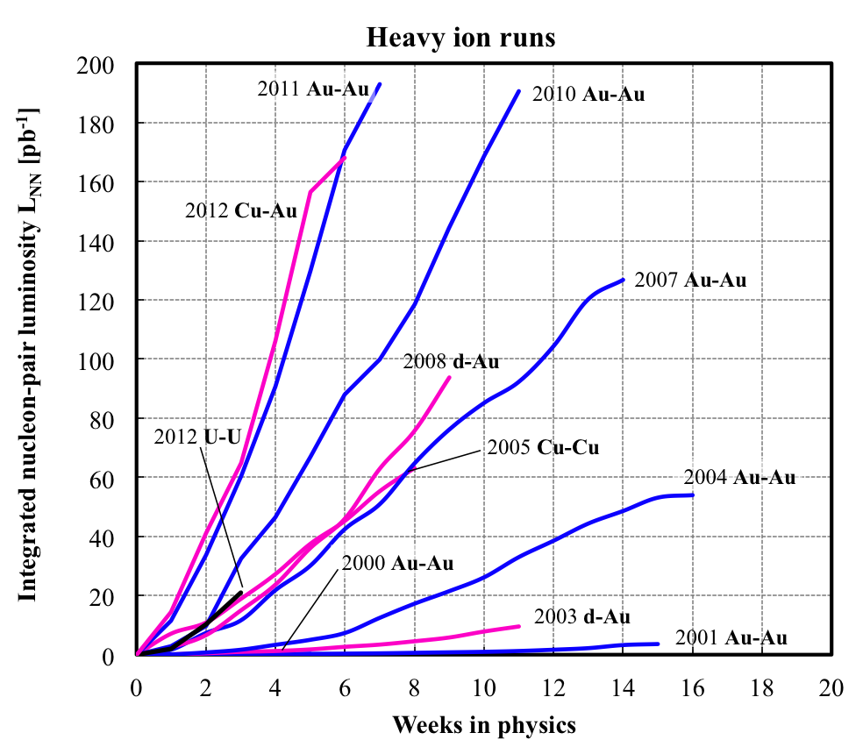
Heavy Ion Performance

Slide 5



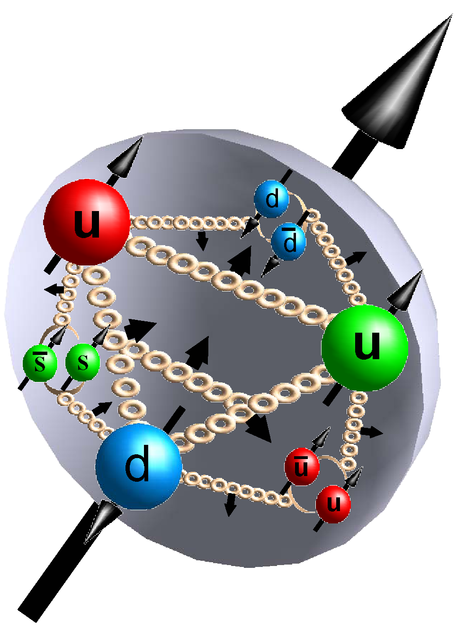



How do the partons form the spin of protons
Is the proton looking like this?
ΔG
Σ_{q}L_{q}
L_{g}
Σ_{q}Δq
Σ_{q}L_{q}
δq
δq
Σ_{q}Δq
ΔG
L_{g}
“Helicity sum rule”
gluon
spin
Where do we stand
solving the “spin puzzle” ?
total u+d+s
quark spin
angular
momentum

Slide 6

http://www.bnl.gov/npp/docs/RHIC-Spin-WriteUp-121105.pdf

Slide 7
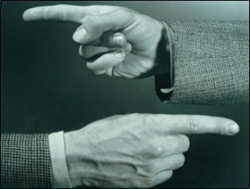
Helicity Structure
Can ΔΣ and ΔG explain it all ?

Slide 8
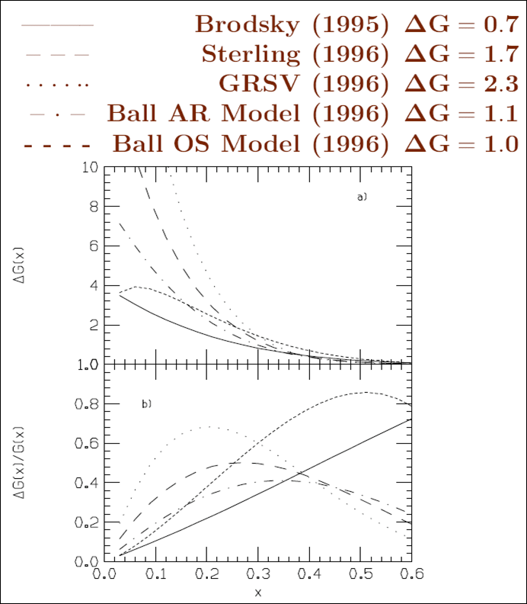
The Gluon Polarization
theory predictions before RHIC
Theoretical Predictions

Slide 9
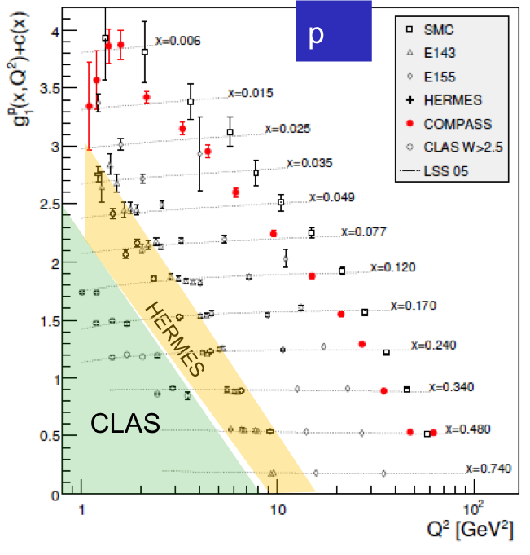
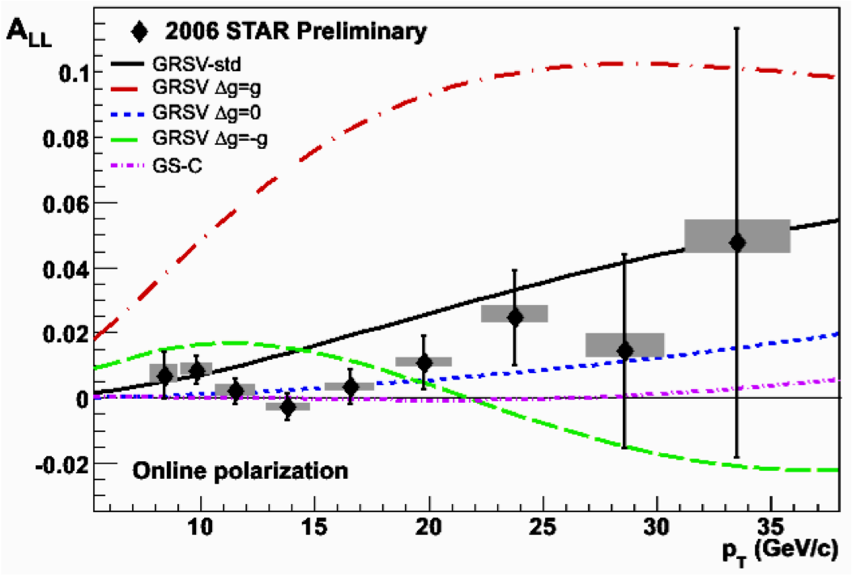
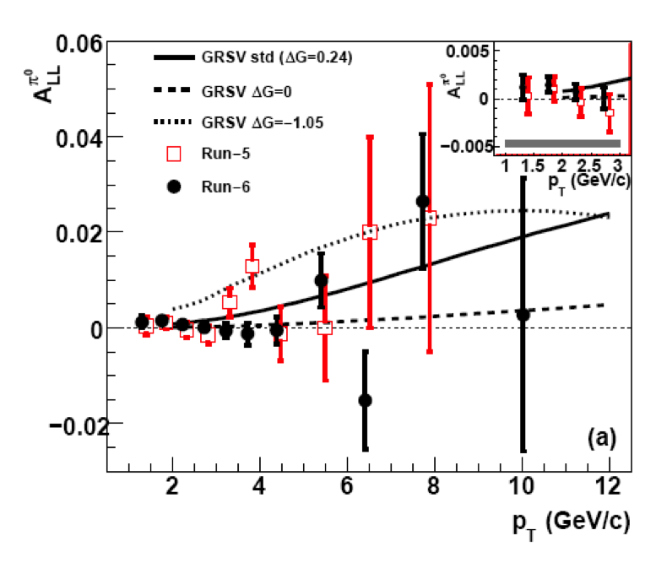
Δg from inclusive DIS and polarized pp
xΔg
RHIC
200 GeV
DIS
Scaling violations of g₁
(Q²-dependence) give indirect access to the gluon distribution via DGLAP evolution.
RHIC polarized pp collisions at midrapidity direct access to gluons (gg,qg)
Rules out large ΔG for 0.05 < x < 0.2
Integral in RHIC x-range:

Slide 10

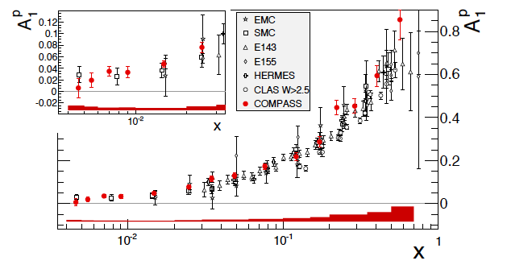
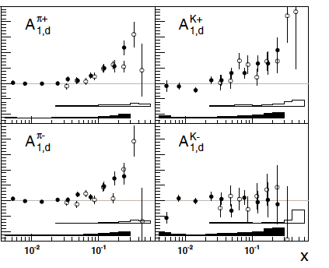

meanwhile, new data became available …
how well are we doing ?
refit/new analysis necessary ?
impact on uncertainties ?
DIS: A₁^{p} from COMPASS
arXiv:1001.4654
SIDIS: A_{1,d}^{π,K} from COMPASS
arXiv:0905.2828
SIDIS: A_{1,p}^{π,K} from COMPASS
arXiv:1007.4061
extended x coverage w.r.t. HERMES

Slide 11
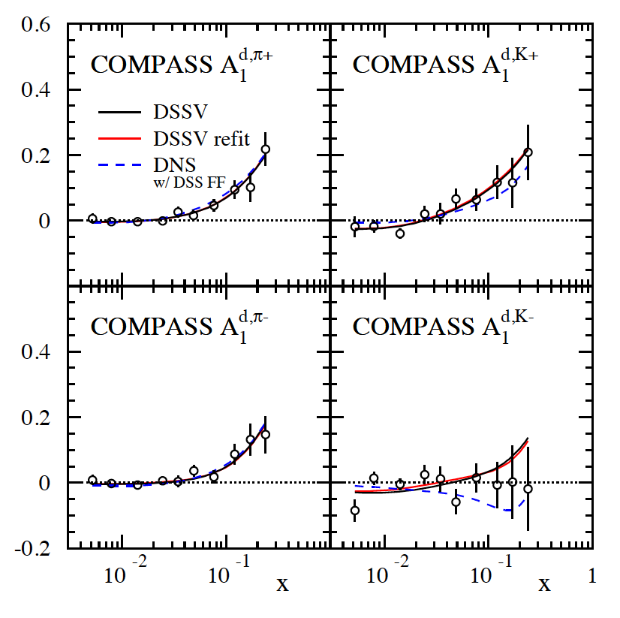
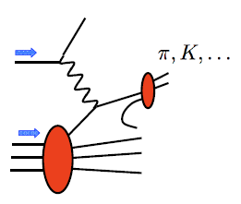
coping with new data: SIDIS A₁^{d,π,K}
x-range
not covered
by HERMES
DSSV works well:
no surprises at small x
χ² numerology:
 | DSSV 08 data sets | with A₁^{d,π,K}
DSSV 2008 | 392.5 | 420.8
DSSV+ |  | 418.9
arXiv:0905.2828

Slide 12
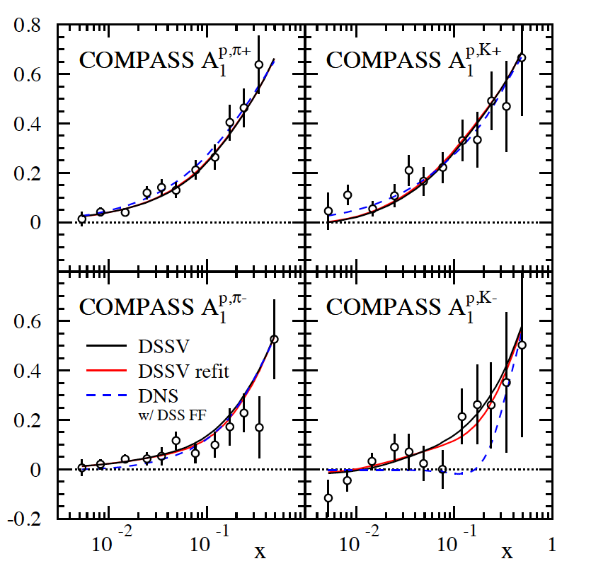
coping with new data: SIDIS A₁^{p,π,K}
1st kaon data on p-target
(not available from HERMES)
x-range
not covered
by HERMES
χ² numerology:
 | DSSV 08 data sets | with A₁^{p&d,π,K}
DSSV 08 | 392.5 | 456.4
DSSV+ |  | 453.0
arXiv:1007.4061
no refit required
(Δχ²=1 does not reflect
faithful PDF uncertainties)
trend for somewhat less
polarization of sea quarks;
less significant

Slide 13
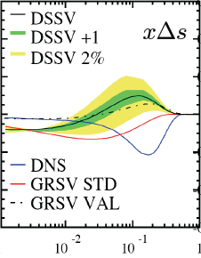


Are Strange Quarks STARNGE?
Δq’s (x,Q²)
known: quarks contribute much less to proton spin
than expected from quark models
large uncertainties in ΔΣ from unmeasured small x
surprisingly small/positive Δs from SIDIS: large SU(3)
breaking?
_
_
flavor separation not well known, e.g., Δu - Δd

Slide 14
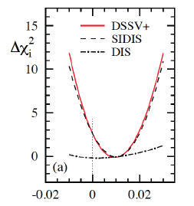
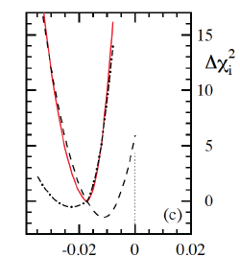


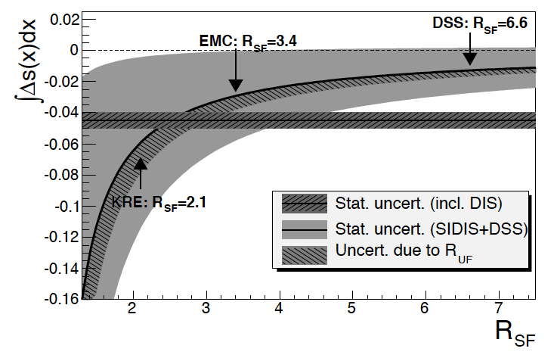
Δs revisited: impact of COMPASS data
current value for ΔΣ strongly depends on assumptions on low-x behavior of Δs
new COMPASS data support
small/positive Δs(x) at x > 0.01
they also prefer a sign change
at around x=0.01
>0
<0
but large negative 1st moment entirely driven by assumptions on SU(3)
caveat: dependence on FFs
COMPASS
0.004 < x < 0.3

Slide 15
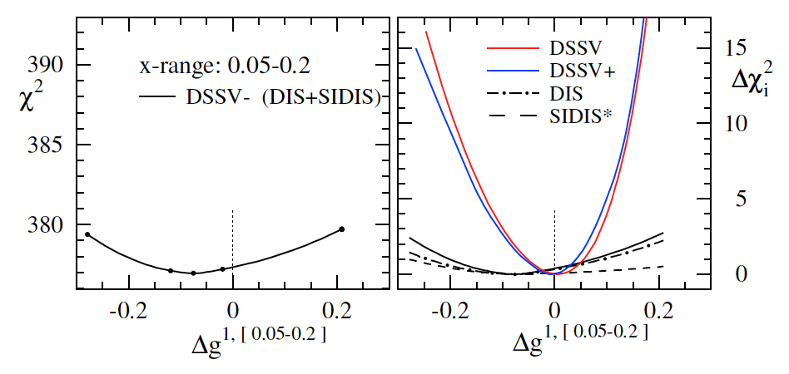
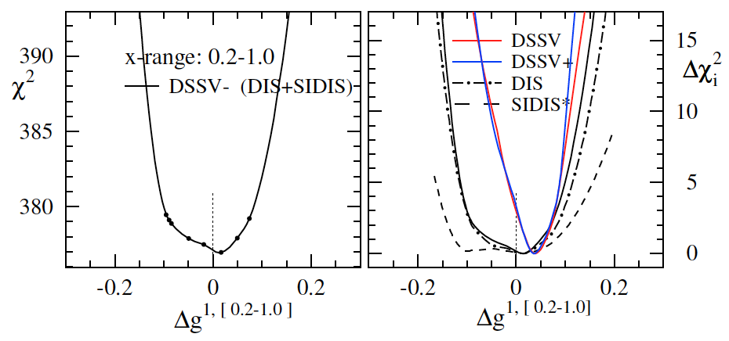
Δg and the relevance of RHIC data
truncated moment
(“RHIC pp region”)
DSSV: Phys.Rev.D80:034030,2009
DSSV+: DSSV+new DIS/SIDIS data
truncated moment
(“high x”)
bottom line:
RHIC pp data clearly needed (current DIS+SIDIS data alone do not constrain Δg)
new (SI)DIS data do not change much for Δg
trend for positive Δg at large x (as before)

Slide 16
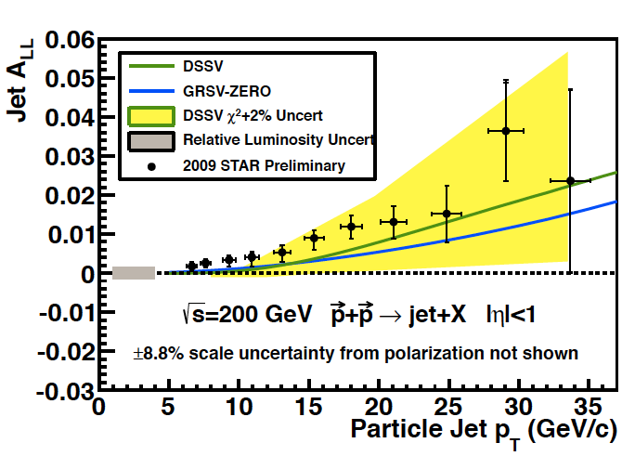
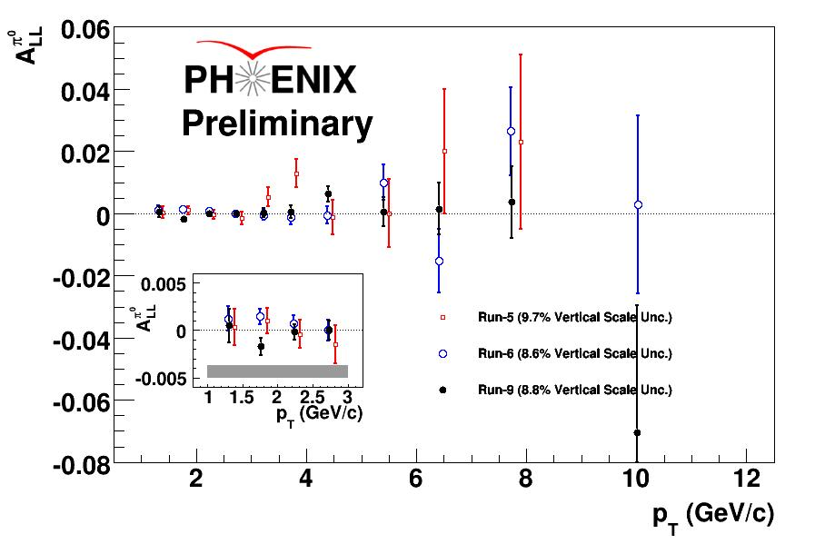
High Precision 2009 RHIC DATA→∫Δg(x)
DSSV: arXiv:0904.3821
DSSV+: DSSV+COMPASS
DSSV++: DSSV+ & RHIC 2009
strong constrain on
first
completely consistent with
DSSV+ in Δ𝛘²/𝛘²=2%
QCD
fit
PHENIX & STAR
fully consistent

Slide 17

What is the Impact on ∫Δg(x)
DSSV: arXiv:0904.3821
DSSV+: DSSV+COMPASS
DSSV++: DSSV+ & RHIC 2009
DSSV
Getting significantly closer to understand the gluon contribution to the proton spin
BUT
need to reduce low-x (<10⁻²) uncertainties for ∫Δg(x)
Do things add up?
First time a significant
non-zero Δg(x)
Spin of the proton
forward η
RHIC
500 GeV
DIS
RHIC
200 GeV

Slide 18
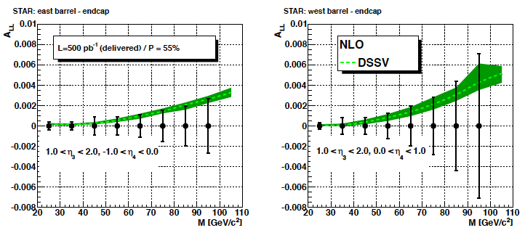

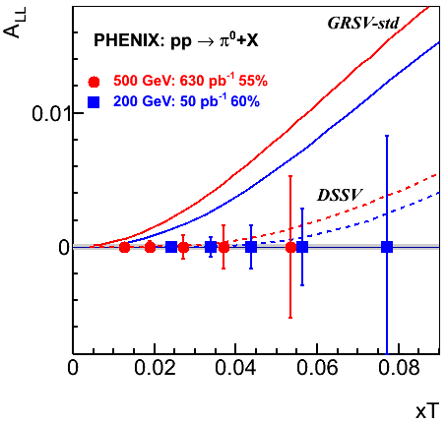
Theme for the Future
Reduce uncertainties and go to low x
measure correlations (di-jets, di-hadrons) → constrain shape of Δg(x)
A_{LL} π⁰ and jet at √s = 500 GeV → x_{min} > 0.01
measure A_{LL} at forward rapidities → x_{min} > 0.001
Experimentally Challenging
A_{LL} ≲ 0.001
high Lumi
good control of systematics
Run 2009 - 2014:
Many more probes:
π± → sign of Δg(x)
direct photon
heavy flavour
…..
theoretically clean
luminosity hungry

Slide 19
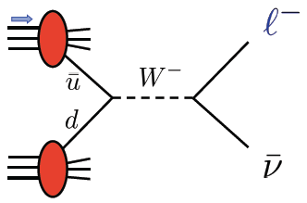



THE Beauty of Colliders: Kinematic Coverage
novel electroweak
probe
0.05<x<0.4
Evolution
RHIC pp data
constraining Δg(x)
0.05 < x <0.2
data plotted at x_{T}=2p_{T}/√s

Slide 20
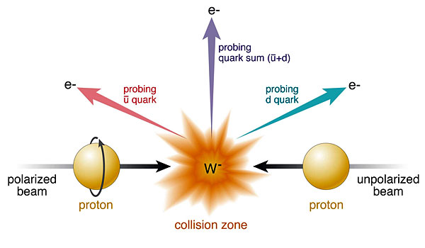
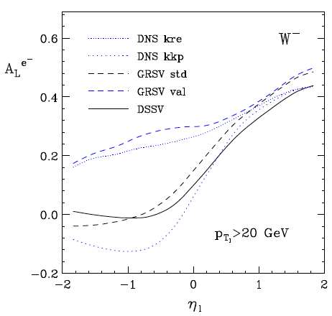
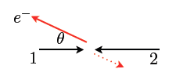
Δq: W Production Basics
Since W is maximally parity violating
→ W’s couple only to one parton helicity
large Δu and Δd result in large asymmetries.
Complementary to SIDIS:
very high Q2-scale
extremely clean theoretically
No Fragmentation function
backward
forward
x₁ small
t large
x₁ large
u large

Slide 21
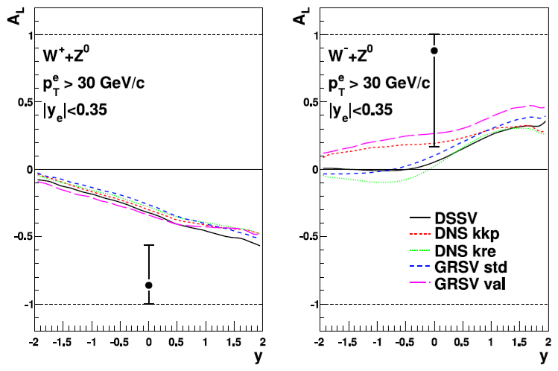

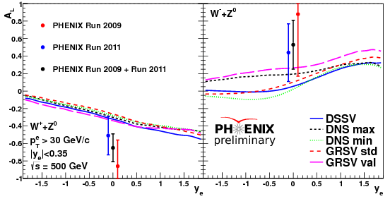
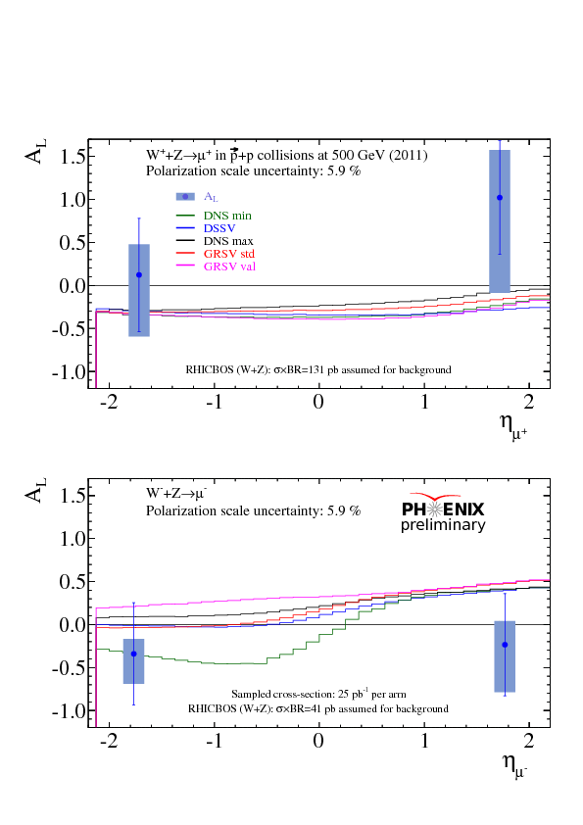
Current W-Results
Run-2009:
And then came Run-2012
∫L_{del} = 130 pb⁻¹ and P_{B} ~ 55%
Run-2011:
first result from
muon arms

Slide 22
2012 ReSULTS
DSSV
Already Run-2012 data alone
have a significant impact on
and
DSSV+: DSSV+COMPASS
DSSV++: DSSV+ & STAR-W 2009
DSSV++: DSSV+ & RHIC-W proj.

Slide 23
Future W-Results
pseudo-data randomized around DSSV
RHIC W±-data will constrain
and
DSSV+: DSSV+COMPASS
DSSV++: DSSV+ & STAR-W 2009
DSSV++: DSSV+ & RHIC-W proj.

Slide 24
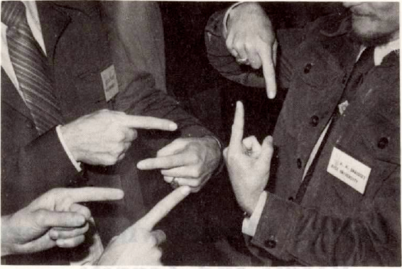
Transverse SPin Structure

Slide 25
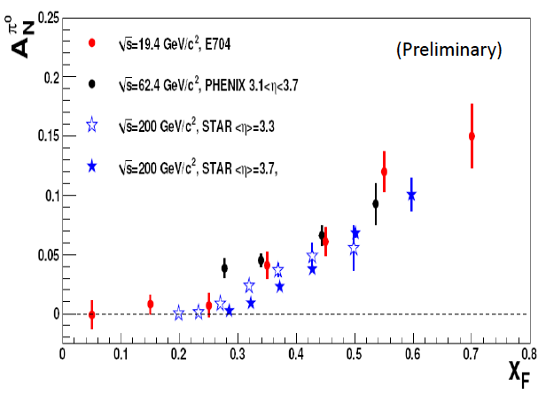
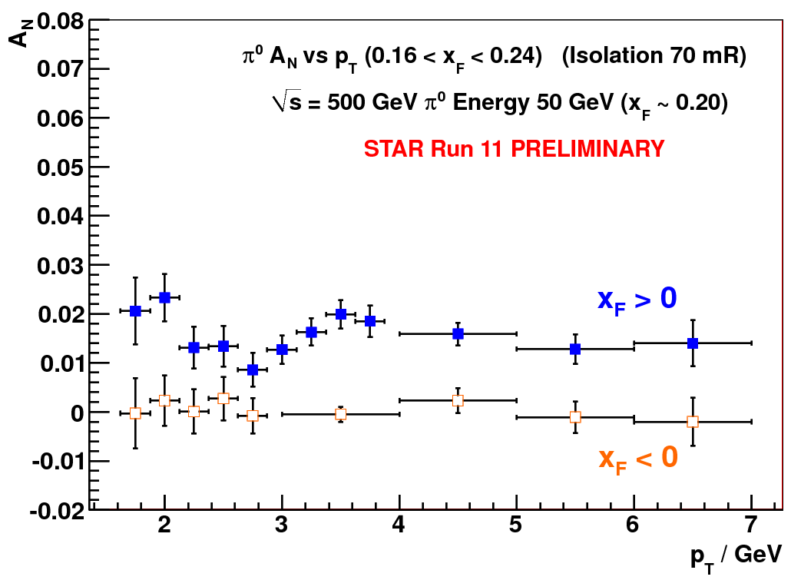
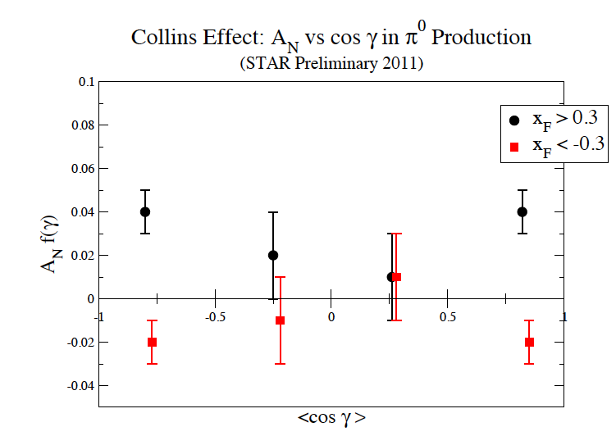
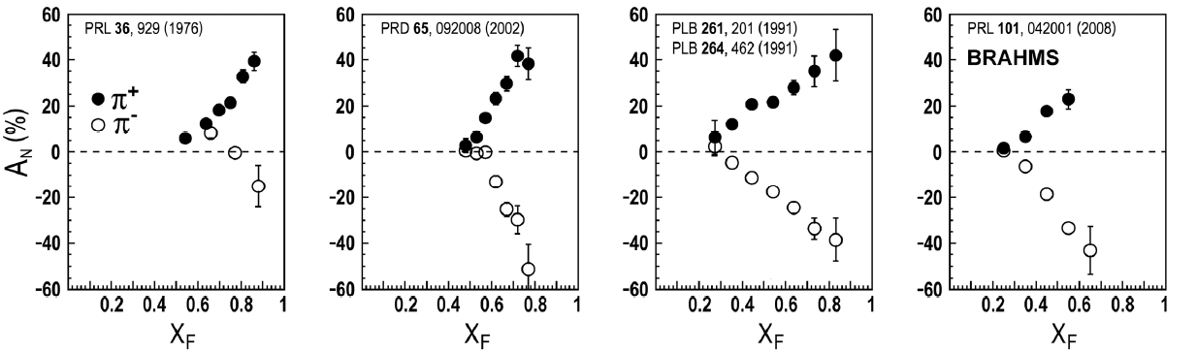
New puzzles in forward physics: large A_{N} at high √s
Big single spin asymmetries in pp !!
Naive pQCD (in a collinear picture)
predicts A_{N} ~ α_{s}m_{q}/sqrt(s) ~ 0
Do they survive at high √s ? YES
Is observed p_{t} dependence as expected
from p-QCD? NO
What is the underlying process?
Sivers / Twist-3 or Collins or ..
till now only hints
Left
Right
ANL ZGS
√s=4.9 GeV
BNL AGS
√s=6.6 GeV
FNAL
√s=19.4 GeV
BRAHMS@RHIC
√s=62.4 GeV
FPD:
Not jet corrected for
kinematic smearing

Slide 26
Sivers and Collins effects in pp collisions
Sivers/twist-3 mechanism:
asymmetry in jet or γ production
Collins mechanism:
asymmetry in jet fragmentation
S_{P}
S_{P}
k_{T,q}
p
p
p
p
Sensitive to proton spin – parton transverse motion correlations
S_{q}
k_{T,π}
Sensitive to transversity
Signatures:
  A_{N} for jets or direct photons
NOT universal
  Sign change from SIDIS to DY
Signatures:
  Collins effect
  Interference fragmentation functions
Believed to be universal

Slide 27
Transverse PHYSICS: What else do we know
Collins / Transversity:
  conserve universality in hadron hadron interactions
  FF_{unf} = - FF_{fav} and δu ~ -2δd
  evolve ala DGLAP, but soft because no gluon contribution (i.e. non-singlet)
Sivers, Boer Mulders, ….
  do not conserve universality in hadron hadron interactions
  k_{t} evolution → can be strong
    till now predictions did not account for evolution
  FF should behave as DSS, but with k_{t} dependence unknown till today
  u and d Sivers fct. opposite sign d >~ u
  Sivers and twist-3 are correlated
    global fits find sign mismatch, possible explanations,
    like node in k_{t} or x don’t work

Slide 28
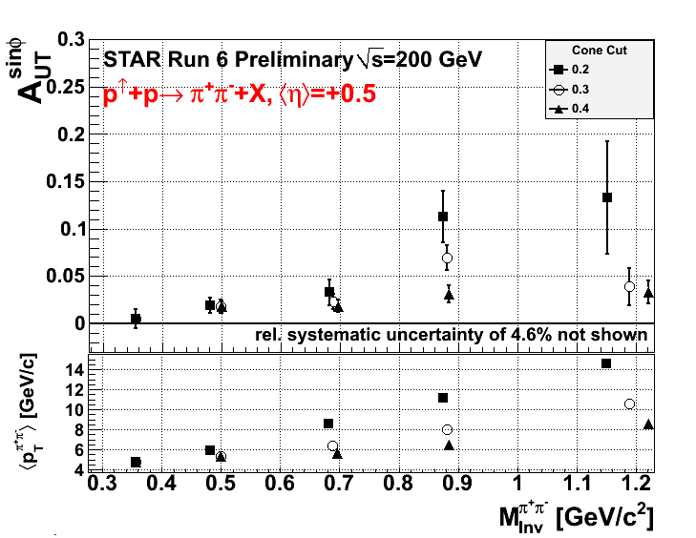
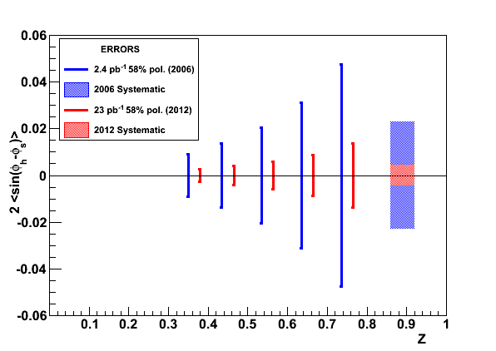
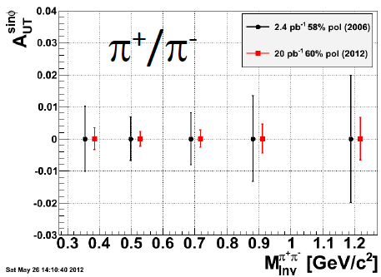
A_{N}: How to get to THE underlying Physics
SIVERS
Transversity x Collins
Rapidity dependence of
A_{N} for π⁰ and eta with increased p_{t} coverage
A_{N} for jets
A_{N} for direct photons
A_{N} for heavy flavour → gluon
π^{+/-}π⁰ azimuthal distribution in jets
Interference fragmentation function
TransversityxInterference FF

Slide 29
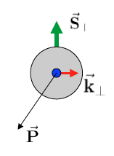
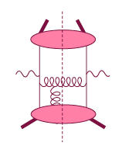
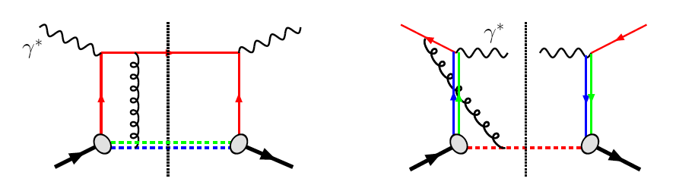
HP13: The sign change of the Sivers fct.
Intermediate Q_{T}
Q>>Q_{T}/p_{T}>>Λ_{QCD}
Transverse
momentum
dependent
Q>>Q_{T}>=Λ_{QCD}
Q>>p_{T}
Collinear/
twist-3
Q,Q_{T}>>Λ_{QCD}
p_{T}~Q
Efremov, Teryaev;
Qiu, Sterman
Sivers fct.
Q_{T}/P_{T}
Λ_{QCD}
<<
Q_{T}/P_{T}
<<
Q
critical test for our understanding of TMD’s and TMD factorization
QCD:
DIS:
attractive FSI
Drell-Yan:
repulsive ISI
Sivers_{DIS} = - Sivers_{DY} or Sivers_{W} or Sivers_{Z0}

Slide 30
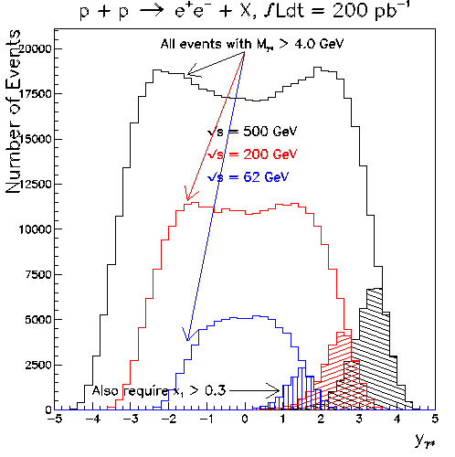
Collision Energy Dependence of DY Production
Comments…
partonic luminosities increase with √s
net result is that DY grows with √s
largest √s probes lowest x
⇒ Consider large-x_{F} DY at √s=500 GeV

Slide 31
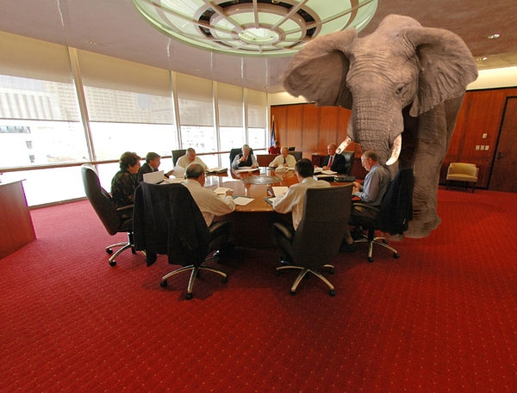
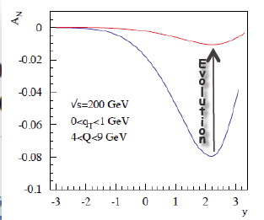
What Can PHENIX and STAR DO
Delivered Luminosity: 500pb⁻¹ (~6 weeks for Run14+)
STAR A_{N}(W):
-1.0 < y < 1.5
W-fully reconstructed
PHENIX A_{N}(DY):
1.2<|y|<2.4
Muon-Arms+FVTX → S/B ~ 0.2
The pink elephant in the room is
what are the evolution effects for A_{N}^{DY}
→ lets see what we know
Extremely clean measurement of δA_{N}(Z0)+/-10%
for <y> ~0
Caveat:
potentially large evolution effects on
A_{N} for DY, W, Z₀ not yet theoretically
full under control and accounted for

Slide 32
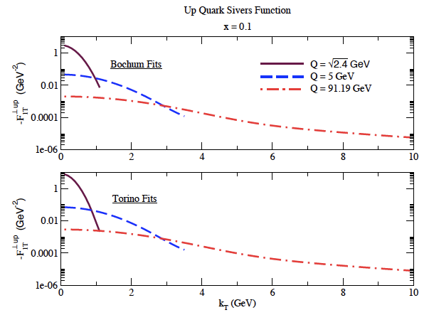

Directly working on TMDs
Aybat-Collins-Qiu-Rogers, 2011
Aybat-Prokudin-Rogers, 2011
Needs a cross check !
under way F. Yuan showed
first results on pA workshop

Slide 33
THE RHIC SPIN Program > 2015
polarised p↑A / pp↑
→ unravel the underlying sub-processes to A_{N}
getting the first glimpse of GPD E for gluons
  A_{UT}(J/ψ) in p↑A
going forward:
precision measurements in transverse spin effects
  Sivers, Collins, IFF
  precision measurements of A_{N}(DY)
precision measurements Δg(x) at low-x
polarised pHe

Slide 34
A_{N} in p↑A or Shooting Spin Through CGC
Yuri Kovchegov et al.
strong suppression of odderon STSA in nuclei.
Q_{s}=1GeV
r=1fm
Very unique RHIC possibility p↑A
Synergy between CGC based
theory and transverse spin physics
A_{N}(direct photon) = 0
r=1.4fm
r=2fm
The asymmetry is larger for peripheral collisions,
and is dominated by edge effects.
x_{f}=0.7
x_{f}=0.9
x_{f}=0.9
x_{f}=0.7
cut of
large b
x_{f}=0.6
x_{f}=0.6
x_{f}=0.5
x_{f}=0.5

Slide 35



Beyond form factors and quark distributions
Generalized Parton Distributions
X. Ji, D. Mueller, A. Radyushkin (1994-1997)
Proton form factors, transverse charge & current densities
Structure functions,
quark longitudinal
momentum & helicity
distributions
Correlated quark momentum
and helicity distributions in
transverse space - GPDs

Slide 36

The Hunt for Orbital Angular Momentum
Study of hard exclusive processes
allows to access
a new class of PDFs
Generalized Parton Distributions
possible way to access
orbital angular momentum
DIS: ~0.3
Spin Sum Rule in PRF:
exclusive:
all reaction products are detected
missing energy (ΔE) and
missing Mass (M_{x}) = 0

Slide 37



GPD Introduction
How are GPDs characterized?
unpolarized polarized
conserve nucleon helicity
flip nucleon helicity
not accessible in DIS
quantum numbers of final state select different GPD
DVCS
pseudo-scaler mesons
vector mesons
π⁰ | 2Δu+Δd
η | 2Δu−Δd
ρ⁰ | 2u+d, 9g/4
ω | 2u−d, 3g/4
φ | s, g
ρ⁺ | u−d
J/ψ | g
Q²= 2E_{e}E_{e}’(1-cosθ_{e’})
x_{B} = Q²/2Mν ν=E_{e}-E_{e’}
x+ξ, x-ξ long. mom. fract.
t = (p-p’)²
ξ ≅ x_{B}/(2-x_{B})

Slide 38


From ep tp pp to γ p/A
Get quasi-real photon from one proton
Ensure dominance of g from one identified proton
by selecting very small t₁, while t₂ of “typical hadronic
size”
small t₁ ←→ large impact parameter b (UPC)
Final state lepton pair ←→ timelike compton scattering
timelike Compton scattering: detailed access to GPDs
including E^{q/g} if have transv. target pol.
Challenging to suppress all backgrounds
Final state lepton pair not from γ* but from J/ψ
  Done already in AuAu
  Estimates for J/ψ (hep-ph/0310223)
transverse target spin asymmetry → calculable with GPDs
information on helicity-flip distribution E for gluons
golden measurement for eRHIC
Z²
A²
Gain in statistics doing polarized p↑A

Slide 39





Forward Proton Tagging at STAR/RHIC
at 55-58m
at 15-17m
J.H. Lee
Roman Pot detectors to measure forward scattered protons in diffractive processes
Staged implementation to cover wide kinematic coverage
Phase I (Installed): for low-t coverage
Phase II (planned) : for higher-t coverage
    8(12) Roman Pots at ±15 and ±17m
    2π coverage in φ will be limited due to
    machine constraint (incoming beam)
No special β* running needed any more
→ 250 GeV to 100 GeV
scale t-range by 0.16

Slide 40
EIC/eRHIC: Bright Future For SPIN Physics
http://arxiv.org/pdf/1212.1701v1

Slide 41

What is eRHIC
RHIC
Existing = $2B
Electron accelerator
to be build
p
Polarized protons
50-250 GeV
Unpolarized and
polarized leptons
5-20 (30) GeV
e⁻
Light ions (d,Si,Cu)
Heavy ions (Au,U)
50-100 GeV/u
e⁻
e⁺
70% e⁻ beam polarization goal
polarized positrons?
Polarized light ions He³ 166 GeV/u
Center mass energy range: √s=30-200 GeV; L~100-1000xHera
longitudinal and transverse polarization for p/He³ possible
protons
electrons

Slide 42



EIC@BNL: eRHIC
All energies scale proportionally by adding SRF cavities to the injector
0.02 Eo
Polarized
e-gun
0.6 GeV
Beam
dump
27.55 GeV
New
detector
 | e | p | ²He³ | ⁷⁹Au¹⁹⁷ | ⁹²U²³⁸
Energy, GeV | 20 | 250 | 167 | 100 | 100
CM energy, GeV |  | 141 | 115 | 89 | 89
Number of bunches/distance between bunches | 74 nsec | 166 | 166 | 166 | 166
Bunch intensity (nucleons) ,10¹¹ | 0.24 | 2 | 1.3 | 0.79 | 0.83
Bunch charge, nC | 3.8 | 32 | 10 | 5.2 | 5.2
Beam current, mA | 50 | 420 | 140 | 67 | 67
Normalized emittance of hadrons , 95% , mm mrad |  | 1.2 | 1.2 | 1.2 | 1.2
Normalized emittance of electrons, rms, mm mrad |  | 32 | 48 | 80 | 80
Polarization, % | 80 | 70 | 70 | none | none
rms bunch length, cm | 0.2 | 8.3 | 8.3 | 8.3 | 8.3
β*, cm | 5 | 5 | 5 | 5 | 5
Luminosity per nucleon, x 10³⁴ cm⁻²s⁻¹ |  | 0.97 | 0.65 | 0.39 | 0.41
Linac
Coherent e-cooler
0.9183 Eo
Linac 2.45 GeV
Eo
0.8367 Eo
0.7550 Eo
0.6733 Eo
0.5917 Eo
E/Eo
0.0200
0.1017
0.1833
0.2650
0.3467
0.4283
0.5100
0.5917
0.6733
0.7550
0.8367
0.9183
1.0000
0.5100 Eo
0.4286 Eo
0.3467 Eo
0.2650 Eo
0.1017 Eo
0.1833 Eo
30 GeV
All magnets would installed from day one and we would be cranking power supplies up as energy is increasing
All staging in lepton Beam RF
ePHENIX
eSTAR
100 m
30 GeV
Notes:
We returned to developing cost effective and ECO-friendly eRHIC option with ERL located in the existing RHIC tunnel. We plan to install all magnets for 6 passes and 30 GeV from the start and then build up SRF linac from 1 GeV to 5 GeV per pass.
In this case electrons will pass through the detector halls in the way to the top energy, will collide in up to 3 IRs. Then they will be decelerated to the injection energy and damped.

Slide 43



Most Compelling Physics Questions
spin physics
imaging
what is the polarization of gluons at
small x where they are most abundant
what is the spatial distribution of
quarks and gluons in nucleons/nuclei
what is the flavor decomposition of
the polarized sea depending on x
understand deep aspects of gauge
theories revealed by k_{T} dep. distr’n
determine quark and gluon contributions
to the proton spin at last
possible window to
orbital angular momentum
physics of strong color fields
quantitatively probe the universality of
strong color fields in AA, pA, and eA
understand in detail the transition to the non-linear
regime of strong gluon fields and the physics of saturation
how do hard probes in eA interact with the medium

Slide 44
The DVCS Phase Space
HERA results on GPDs
very much limited by
lack of statistics
imaging in
valence region
but limited t-range

Slide 45



DVCS at eRHIC
e’
γ
e
γ_{L}*
(Q²)
DVCS: Golden channel
theoretically clean
wide range of observables
(σ, A_{UT}, A_{LU}, A_{UL}, A_{C})
to disentangle different GPDs
x+ξ
x-ξ
~
~
p
H, H, E, E (x,ξ,t)
p’
t
DVCS data at end of HERA
D. Mueller, K. Kumericki
S. Fazio, M. Diehl and ECA
needs
100 fb⁻¹
Fourier
Transform
large t
small t
needs
10 fb⁻¹
+ Roman Pots

Slide 46
Different DVCS Asymmetries
D. Mueller

Slide 47
What will we learn about 2d+1 structure of the proton
GPD H and E as function of t, x and Q²
GPD H and E 1d+1
A global fit over all pseudo data was done, based on the GPDs-based model:
[K. Kumerički, D Müller, K. Passek-Kumerički 2007]
Known values q(x), g(x) are assumed for H^{q}, H^{g} (at ξ=0, t=0 forward limits E^{q}, E^{g} are unknown)
Excellent reconstruction of H^{sea}, H^{sea} and good reconstruction of H^{g} (from dσ/dt)
GPD H and E 2d structure for quarks
Plots from D. Mueller

Slide 48
GPD H^{g}: J/ψ
M. Diehl, ECA
To improve imaging on gluons
add J/ψ observables
cross section
A_{UT}
…..
Fourier
Transform

Slide 49


What else can be done
Xiangdong Ji
The Spin Sum Rules
Jaffe & Manohar
The Holy Grail

Slide 50
present vs EIC kinematic coverage
RHIC pp data
constraining Δg(x)
in approx. 0.05 < x <0.2
data plotted at x_{T}=2p_{T}/√S
likewise for Q²
5 x 100 GeV eRHIC stage-1
20 x 250 GeV eRHIC
EIC extends x coverage
by up to 2 decades
(at Q²=1 GeV²)
lowest x so far 4.6 x10⁻³ COMPASS

Slide 51
present vs EIC kinematic coverage
cross section:
pQCD scaling violations

Slide 52



example: projected DIS data for g₁^{p}
hep-ph:1206.6014
3 sets of [eRHIC] energy settings studied:
E_{e}×E_{p} [GeV] | √s [GeV] | x_{min} for y_{max} = 0.95 and Q² = 1 GeV² Q² = 2 GeV²
5 x 100 | 44.7 | 5.3 x 10⁻⁴ 1.1 x 10⁻³
5 x 250 | 70.7 | 2.1 x 10⁻⁴ 4.2 x 10⁻⁴
20 x 250 | 141.4 | 5.3 x 10⁻⁵ 1.1 x 10⁻⁴
5 x 250 starts here
4 [5] bins/decade in Q² [x] (spaced logarithmically)
bands reflect current uncertainties on g₁^{p}
DSSV+ estimate
5 x 100 starts here
COMPASS data
start here
taken from
Blumlein,
Bottcher

Slide 53

impact of EIC data on helicity PDFs
DIS scaling violations mainly determine Δg at small x
in addition, SIDIS data provide detailed flavor separation of quark sea
includes only “stage-1 data”
[even then Q²_{min} can be 2-3 GeV²]
can be pushed to x=10⁻⁴ with
20 x 250 GeV data
[still one can play with Q²_{min} ]
uncertainties determined with
both Lagrange mult. & Hessian
“issues”:
(SI)DIS @ EIC limited by
systematic uncertainties
need to control rel. lumi, polarimetry,
detector performance, … very well
QED radiative corrections
need to “unfold” true x,Q²
well known problem (HERA)
BNL-LDRD project to sharpen tools

Slide 54
progress towards spin sum rule
combined correlated uncertainties for ΔΣ and Δg
“Helicity sum rule”
gluon
spin
✔
results obtained with two
Lagrange multipliers
Hessian method consistent
current data
access through
Twist-3 GPDs
more theoretical
work needed
✔
angular
momentum
total
quark spin
similar improvement
for 0.0001-1 moments
needs 20 x 250 GeV data
“X. Ji sum rule”
✔
w/ EIC data
difficult,
but should be
possible in
GPD models
can expect approx. 5-10%
uncertainties on ΔΣ and Δg
but need to control systematics

Slide 55
Summary
The unique pA / eA program of
RHIC/eRHIC
could not be discussed to due time constrains
ΔG
Σ_{q}L_{q}
L_{g}
Σ_{q}Δq
Σ_{q}L_{q}
δq
δq
Σ_{q}Δq
ΔG
L_{g}
eRHIC SPIN Program
the unique science program addresses
all important open questions in spin physics
uniquely tied to a polarized pp/ep-collider
never been measured before & never without

Slide 56
ADDITIONAL Material

Slide 57
Hermes SSA in PhotoProduction
c.m-frame:
Hermes is fixed target and has only instrumentation in the lepton beam direction

Slide 58
The sPHENIX forward Upgrade
Detector Layout for forward physics studies
Use open sPHENIX central barrel geometry to introduce
tracking
charged particle identification
electromagnetic calorimeter
hadron calorimeter
muon detection
→ Use existing equipment where possible

Slide 59
STAR Forward Instrumentation UpGrade
Forward instrumentation optimized for p+A and transverse spin physics
– Charged‐particle tracking
– e/h and γ/π⁰ discrimination
– Possibly Baryon/meson separation

Slide 60

What pHe³ can teach us
Polarized He³ is an effective neutron target → d-quark target
  Polarized protons are an effective u-quark target
Therefore combining pp and pHe³ data will allow a full
quark flavor separation u, d, ubar, dbar
Two physics trusts for a polarized pHe3 program:
Measuring the sea quark helicity distributions through W-production
  Access to Δdbar
  Caveat maximum beam energy for He³: 166 GeV
    Need increased luminosity to compensate for lower W-cross section
Measuring single spin asymmetries A_{N} for pion production and Drell-Yan
  expectations for A_{N} (pions)
    similar effect for π± (π⁰ unchanged)
³He: helpful input for understanding
of transverse spin phenomena
Critical to tag spectator protons from 3He with roman pots

Slide 61

The RHIC SPIN PROGRAM Milestones

Slide 62

A_{N}: Z0
300 pb⁻¹ -> ~10% on a single bin of A_{N}
Generator: PYTHIA 6.8
Clean experimental momentum reconstruction
Negligible background
electrons rapidity peaks within tracker acceptance (|η|< 1)
Statistics limited

Slide 63




Spectator proton from ³He with the current RHIC optics
Momentum smearing mainly due
to Fermi motion + Lorentz boost
Angle <~3mrad (>99.9%)
Angle [rad]
Study: JH Lee
generated
Passed DX aperture
Accepted in RP
The same RP configuration with the current RHIC optics (at z ~ 15m between DX-D0)
Acceptance ~ 98%

Slide 64
Collected Luminosity with longitudinal Polarization
Year | √s [GeV] | Recorded PHENIX | Recorded STAR | Pol [%]
2002 (Run 2) | 200 | / | 0.3 pb⁻¹ | 15
2003 (Run 3) | 200 | 0.35 pb⁻¹ | 0.3 pb⁻¹ | 27
2004 (Run 4) | 200 | 0.12 pb⁻¹ | 0.4 pb⁻¹ | 40
2005 (Run 5) | 200 | 3.4 pb⁻¹ | 3.1 pb⁻¹ | 49
2006 (Run 6) | 200 | 7.5 pb⁻¹ | 6.8 pb⁻¹ | 57
2006 (Run 6) | 62.4 | 0.08 pb⁻¹ |  | 48
2009 (Run9) | 500 | 10 pb⁻¹ | 10 pb⁻¹ | 39
2009 (Run9) | 200 | 14 pb⁻¹ | 25 pb⁻¹ | 55
2011 (Run11) | 500 | 27.5 / 9.5pb⁻¹ | 12 pb⁻¹ | 48
2012 (Run12) | 500 | 30 / 15 pb⁻¹ | 82 pb⁻¹ | 50/54

Slide 65
Collected Luminosity with transverse Polarization
Year | √s [GeV] | Recorded PHENIX | Recorded STAR | Pol [%]
2001 (Run 2) | 200 | 0.15 pb⁻¹ | 0.15 pb⁻¹ | 15
2003 (Run 3) | 200 | / | 0.25 pb⁻¹ | 30
2005 (Run 5) | 200 | 0.16 pb⁻¹ | 0.1 pb⁻¹ | 47
2006 (Run 6) | 200 | 2.7 pb⁻¹ | 8.5 pb⁻¹ | 57
2006 (Run 6) | 62.4 | 0.02 pb⁻¹ |  | 53
2008 (Run8) | 200 | 5.2 pb⁻¹ | 7.8 pb⁻¹ | 45
2011 (Run11) | 500 | / | 25 pb⁻¹ | 48
2012 (Run12) | 200 | 9.2/4.3 pb⁻¹ | 22 pb⁻¹ | 61/58

