Slide 1
The COMPASS experimental setup
Requirements, implementation, performances
(with a few physics examples)
  Stephane Platchkov
  IRFU/SPhN, CEA-Saclay

Slide 2

The COMPASS experiment at CERN
LHC
COMPASS
SPS

Slide 3
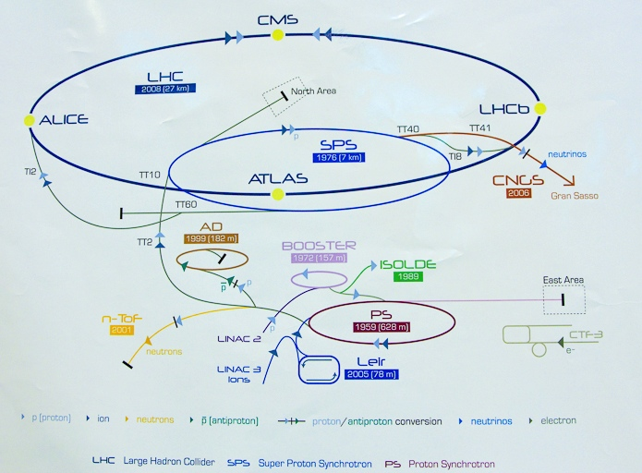
CERN accelerators (not to scale)
Compass

Slide 4
COMPASS – some facts
Located at CERN North Area beam line
  Possible beams: µ+, µ-, π+, π-, e- => Several physics programs
Experiments with muon beam
  Spin structure, Gluon polarization
  Flavor decomposition
  Transversity
  Transverse Momentum-dependent Distributions
  DVCS and HEMP
  Unpolarized SIDIS and TMDs
Experiments with hadron beams
  Pion polarizability
  Diffractive and Central production
  Light meson spectroscopy
  Baryon spectroscopy
  Pion and Kaon polarizabilities
  Drell-Yan studies
COMPASS - I (2002 – 2011)
COMPASS - II (2012 – 2017)

Slide 5
COMPASS – some facts
Located at CERN North Area beam line
  Possible beams: µ+, µ-, π+, π-, e- => Several physics programs
Experiments with muon beam
  Spin structure
  Polarized target (L & T)
  DVCS
  Long LH₂ target
Experiments with hadron beams
  Hadron spectroscopy
  Small LH₂ or nuclear targets
  Drell-Yan studies
  Polarized target (T)
COMPASS - I (2002 – 2011)
COMPASS - II (2012 – 2017)
Reconfigurable target region - versatile experimental setup!

Slide 6
Requirements for a COMPASS detector 1/2
Detect several particles in coincidence:
  Incident and scattered beam particle
  Two or more outgoing charged hadrons
  Neutral particles (photons)
Large angle and momentum acceptance
  Momentum: 1 GeV/c to >50 GeV/c
  Angular acceptance: ± 180 mrad
Exclusivity
  Detect recoil protons : momentum: < 1 GeV/c
Particle identification
  RICH detector: separate π, K, p;
  Hadronic and Electromagnetic calorimeters
  Muon identification

Slide 7
Requirements for a COMPASS detector 2/2
Tracking
  Good space and/or time resolution
  High counting rate,
  From small to really large size detectors
  Low material budget, cost, etc...
Polarized target
  Large target size for reaching high luminosity
  Oppositely polarized cells
Large data flow capabilities
  Trigger rates: from few to 30 kHz
  More than 250 000 detectors channels

Slide 8
COMPASS Beams
Muon beam
  Energy: 160 GeV
  Intensity: 2x10⁸/spill
  Polarization: 80%
Hadron beams
  Pions(97%), kaons(2.6%), anti-p(0.6%)
  Energy: 190 GeV
  Intensity: up to 10⁸/spill
Electron beam
  40 GeV, few 10³/spill, used for calibration

Slide 9
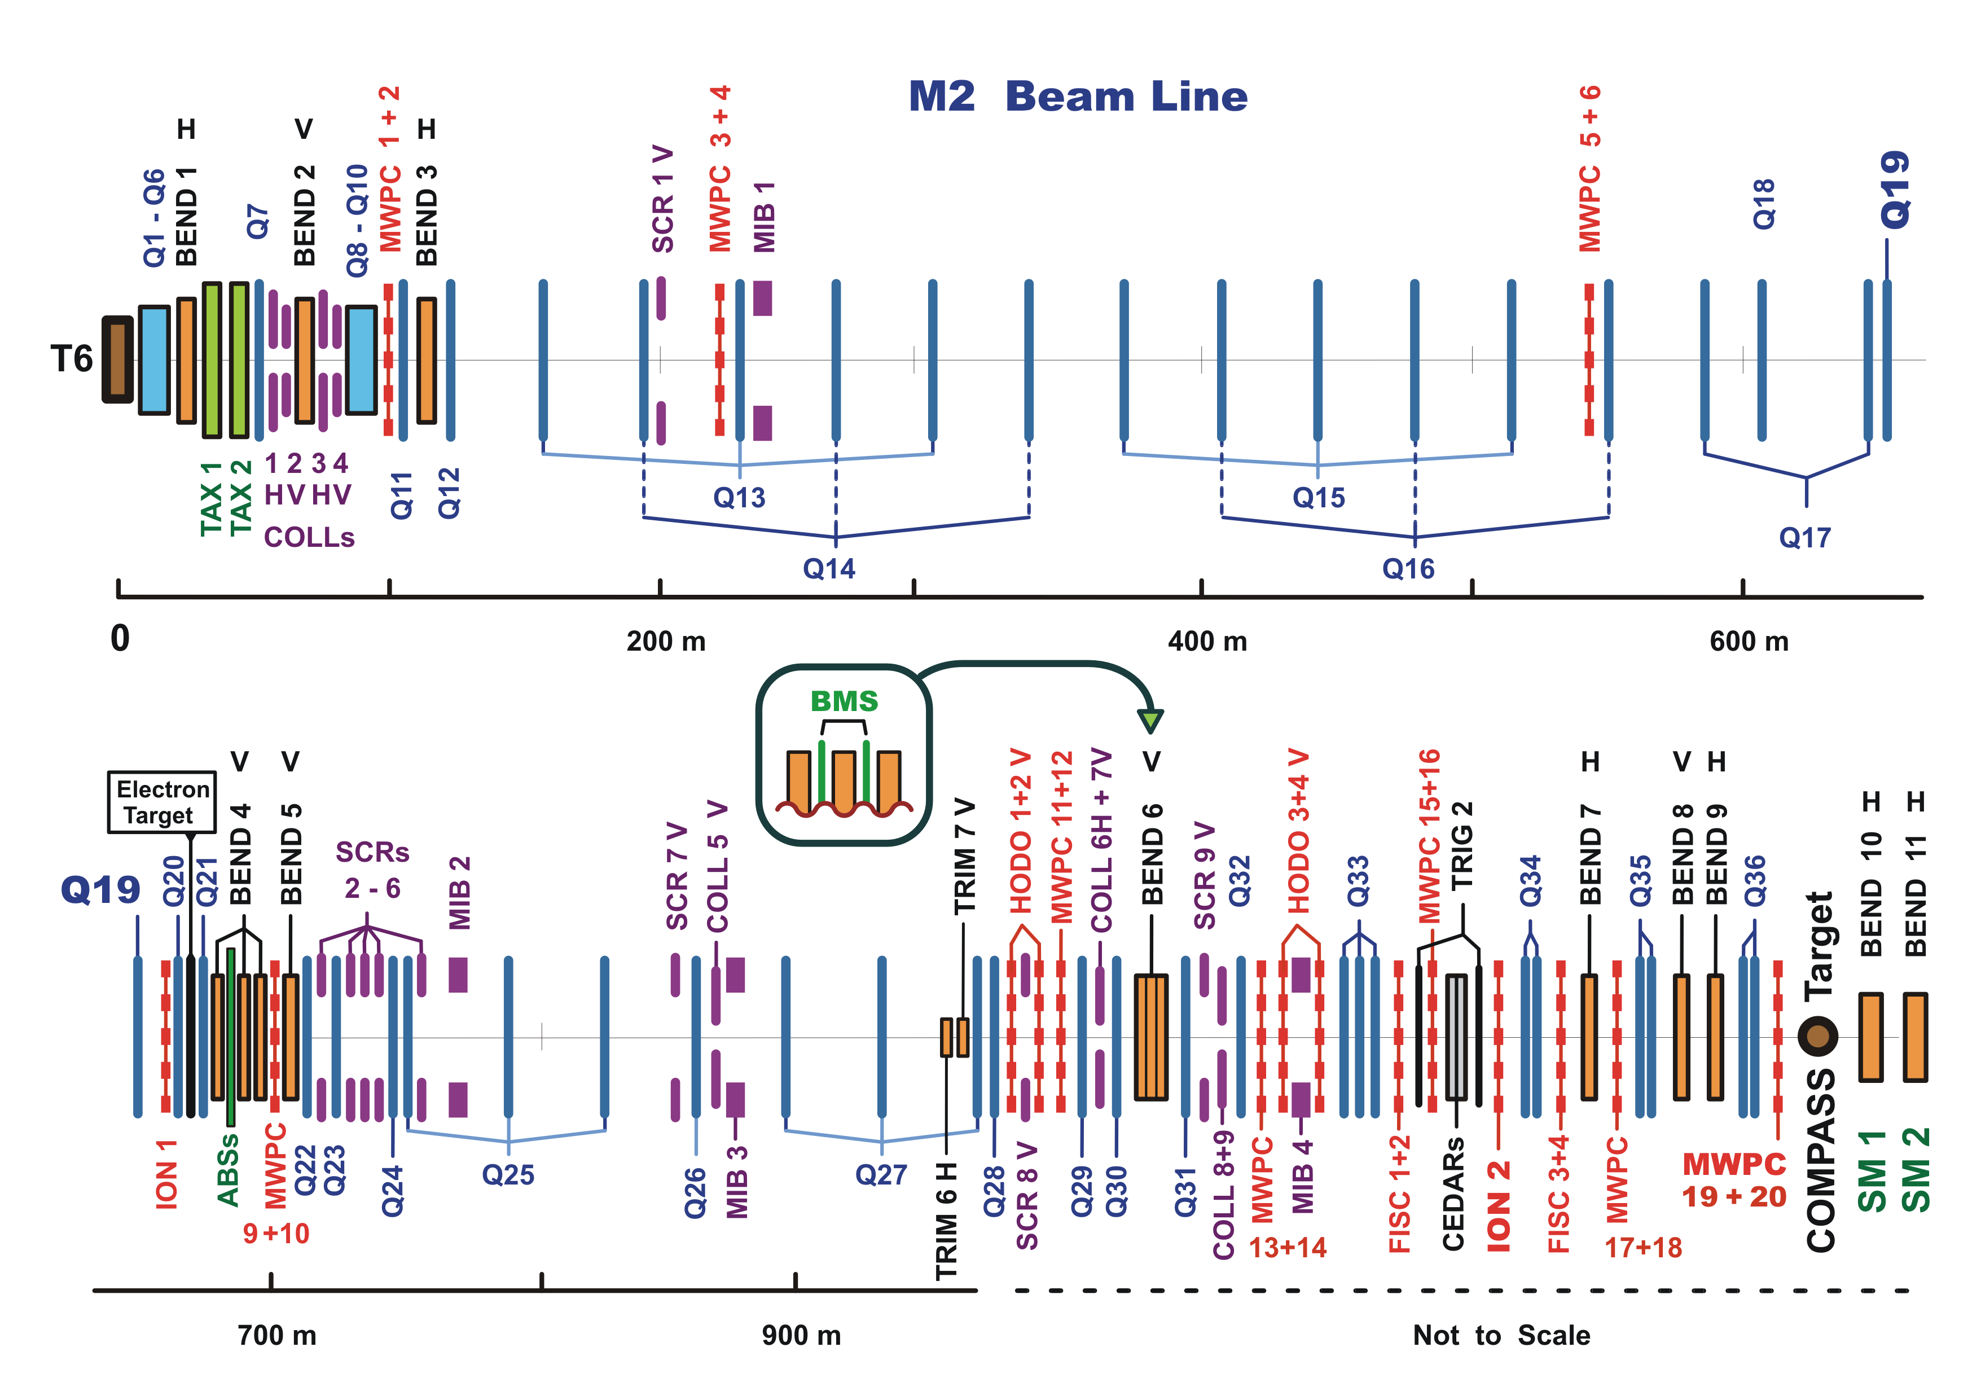
COMPASS Beam Line
Protons from SPS
Compass
Target
A very long beam line, to allow for good secondary and tertiary beams

Slide 10
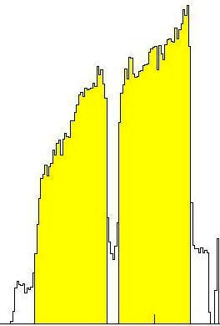
COMPASS Polarized target
Specifications
  Superconducting solenoid : 2.5 T
    16 trim coils
    Field homogeneity: 10⁻⁴
  Dipole filed: 0.5 T
  Temperature: ~50 mK (frozen)
  Materials: NH₃, ⁶LiD
  Dilution factor: ~0.4
Performances
  Polarization: >50%, >90%
  Field reversal: 8h, 24h
Two 60 cm oppositely polarized cells
Largest polarized target in the world

Slide 11
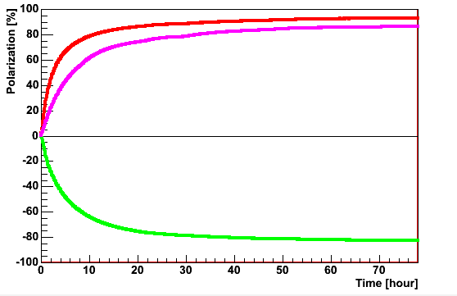
Polarization build-up
NH₃ material
⁶LiD material
1 day
2 days
  Build-up time : ~1-2 days
  Relaxation time : 0.05-0.2%/d (2.5T)

Slide 12
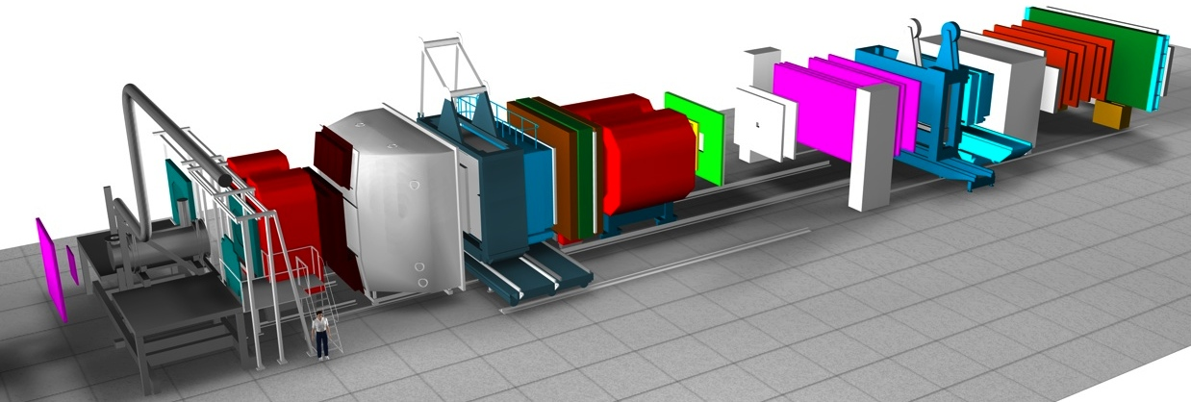
The COMPASS setup – Three main parts
Target
region
Large
Angle
Spectrometer
Small
Angle
Spectrometer
4 Tm
1 Tm
SM2
SM1
50m

Slide 13
The COMPASS setup – Space resolution
Target
region
Large
Angle
Spectrometer
Small
Angle
Spectrometer
SM2
SM1
10 µ 100µ 200µ 500µ 1 mm
  Space resolution is function of the distance to the target

Slide 14
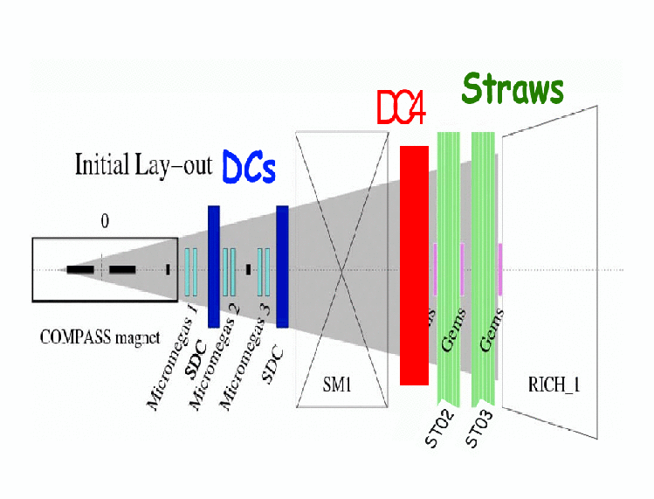
Large Angle Spectrometer
Drift Tubes
Straw chambers
ECAL1
SDC
SM1
RICH
Beam
Opening angle = ±180 mrad

Slide 15
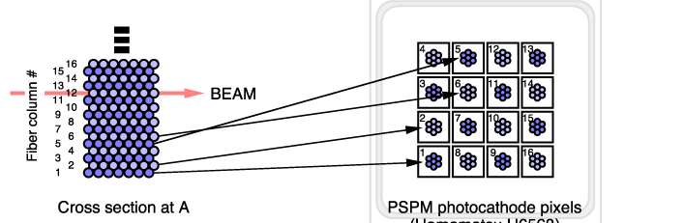
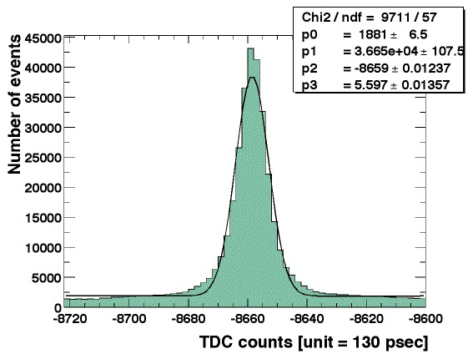
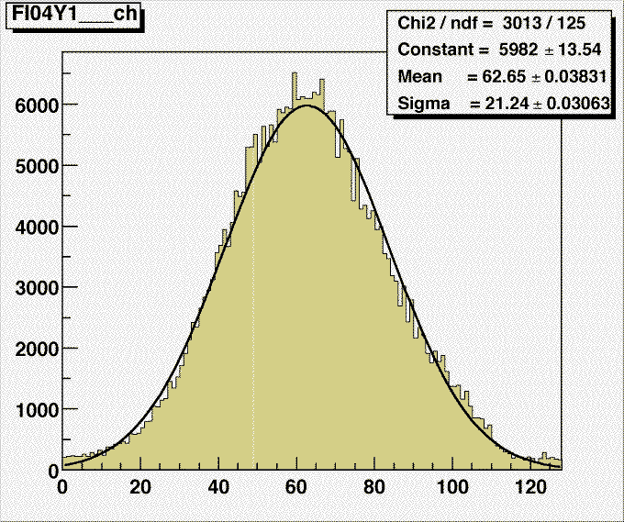
Very Small Angle Trackers - Scintillating Fibers
Specifications
  9 stations, 21 coordinates
  0.5, 0.75 and and 1.0 mm fibers
  2668 channels
  8-14 layers per projection
Performances
  Time resolution: 350-400 ps
  Spatial resolution: 130-210 µm
  Efficiency: 97-99%
  High-rate capability
Very good time resolution, high-rate capability

Slide 16
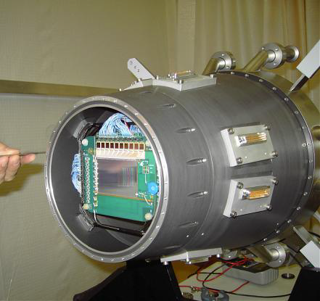
Very Small Area Trackers - Silicons
Specifications
  5x7 cm², 1280 and 1024 strips
  5 N-cooled stations
  52 µ and 55 µ pitch
  2 projections per detector
  Designed for high fluencies
  R/O: APV25 chip, 128 ch
Performances
  Time resolution: 1.4 ns
  Spatial resolution: 6 – 11 µm
preliminary
preliminary
Very good spatial resolution

Slide 17
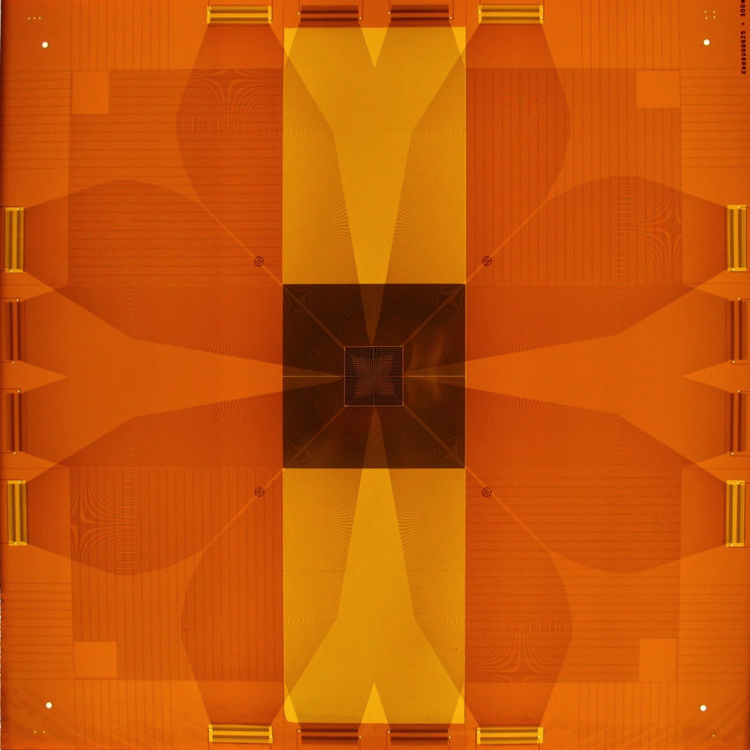
Very Small Angle Trackers - PixelGEMs
Specifications
  Active size: 100x100 mm²
  Strip: 2 x 512, pitch=400 µ
  Pixel area: 32x32 mm²
  Pixel size: 1 mm²
  APV chip R/O, 128 ch.
Performances
preliminary
preliminary
preliminary
Good space resolution, minimized material along the beam

Slide 18
Small Area Trackers - GEM detectors
Specifications
  3 GEM stages
  Active area: 31x31 cm²
  Dead area diameter: 5 cm
  Minimal material budget
  11 stations (22 planes)
  Two sets of 768 perpendicular strips
  400 µ pitch X and Y
Specific features
  2-dim read-out
  Very large integration
      APV chip = 128 ch

Slide 19
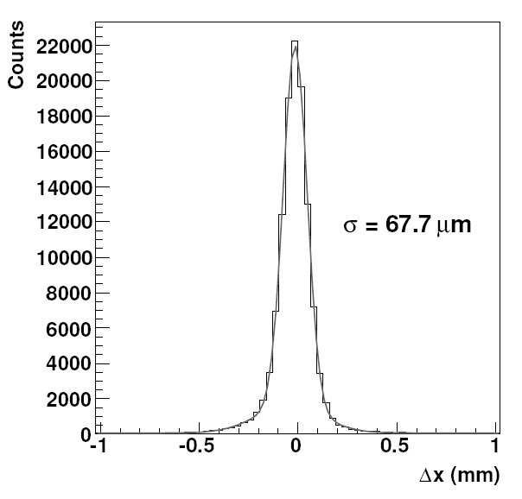
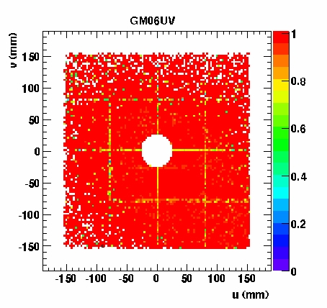
Small Angle Trackers - GEM detectors
Performances
  Space resolution: 68 µ
  Time resolution: 12 ns
  Efficiency: > 97%
First GEMs detectors used in a High Energy Experiment

Slide 20
Small Angle Trackers - Micromegas
Specifications
  Large active area: 40x40 cm²
  3 stations (12 detectors)
  Dead area diameter: 5 cm
  Pitch: 360µ, 420µ
  4 planes per station: X, Y, U, V
Specific features
  High magnetic field (up to 0.2 T)
  High-rate environment
      450 kHz/cm²; 200 kHz/ch
  Large detector
  Custom Front-end chip SFE16
      peaking time: 85 ns
      Leading+Trailing edge
Performances
  Efficiency: > 97%
  Space resolution: ~90 µ
  Time resolution: <10 ns
σ = 92 µm

Slide 21
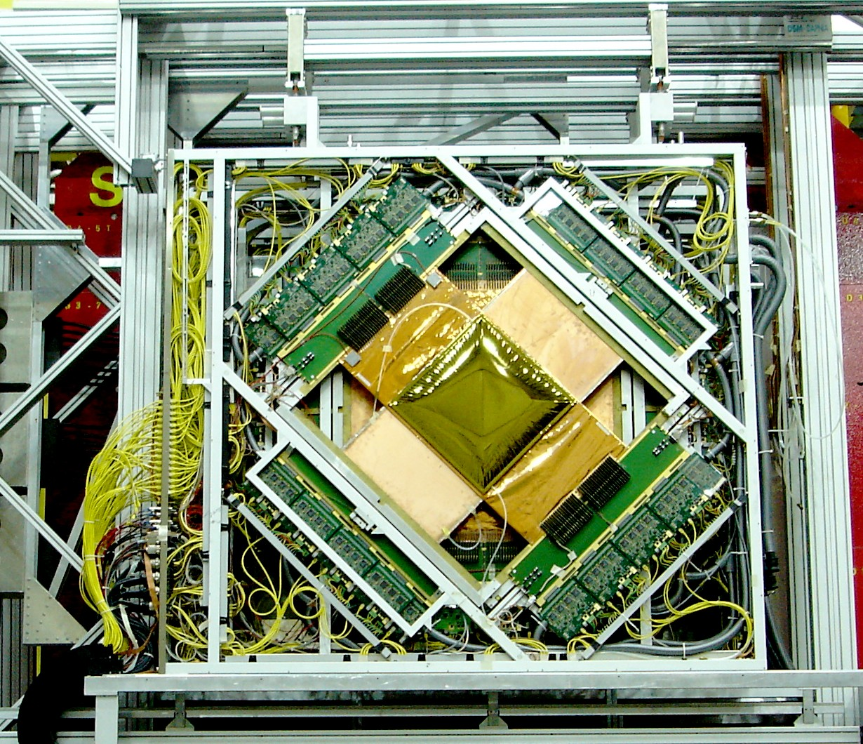
Micromegas in COMPASS
Detector
40x40 cm²
Electronics
First Micromegas used in a High Energy Experiment

Slide 22
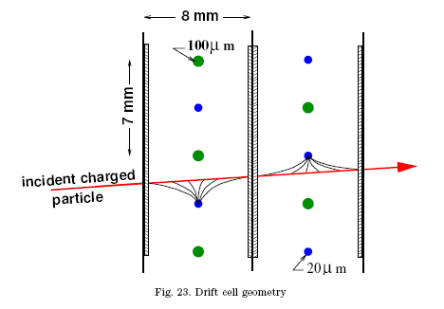
Large Angle Trackers – Drift Chambers
Specifications
  Sensitive area: 180x127 cm²
  3 stations (8 planes/station)
  Dead area diameter: 30 cm
  Drift cell: 7mm(pitch) x8 mm²
Performances
  Efficiency: > 97%
  Space resolution: 170 µ
Specific features
  Located near high magnetic field
      (up to 0.3 T)
  Operate in a high-rate environment
700 kHz
  Large areas. Very high-rate capability -- up to 700 kHz/ch!

Slide 23
Electromagnetic calorimeters (x2)
ECAL1
  1500 channels
  Pb0 modules (3 dimensions)
    18-20 X₀
  Energy range: 0.2-60 GeV
ECAL2
  2180 Pb0 type modules
  888 “Shashlik” type (Pb/Scint)
    (radiation hardness)
  Energy range: 1-200 GeV
  Detect photons and electrons = maximize RADIATION Length

Slide 24
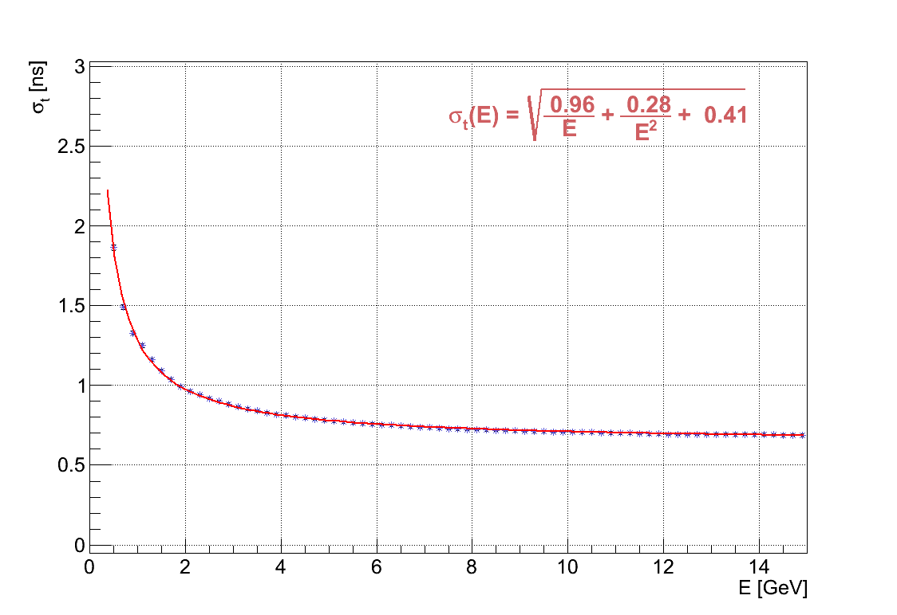
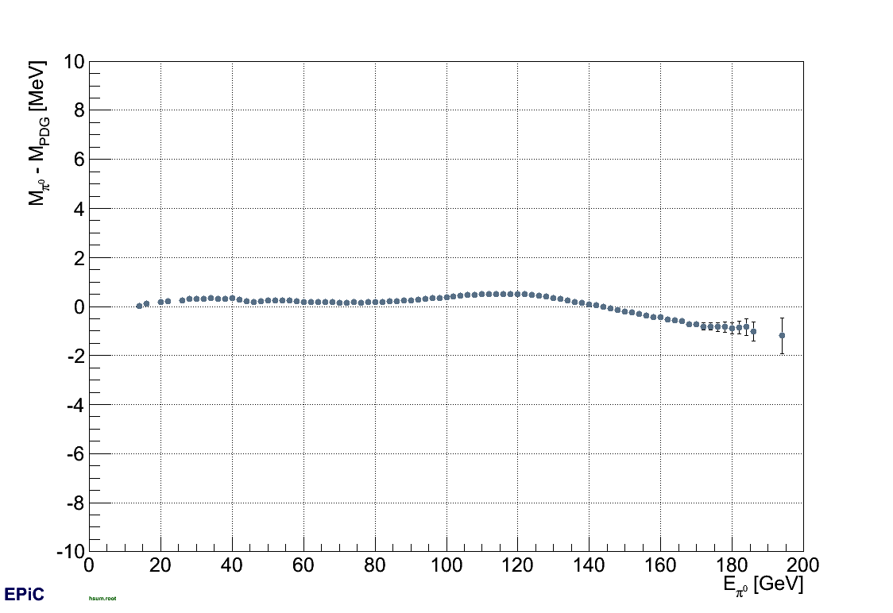
ECAL performances
ECAL1
ECAL2
σ_{E} = 7.8 MeV
σ_{E} = 3.9 MeV
preliminary
preliminary
π⁰ linearity (±1 MeV)
preliminary
Δt = 1 ns
preliminary
  Good time resolution, reasonable energy resolution

Slide 25
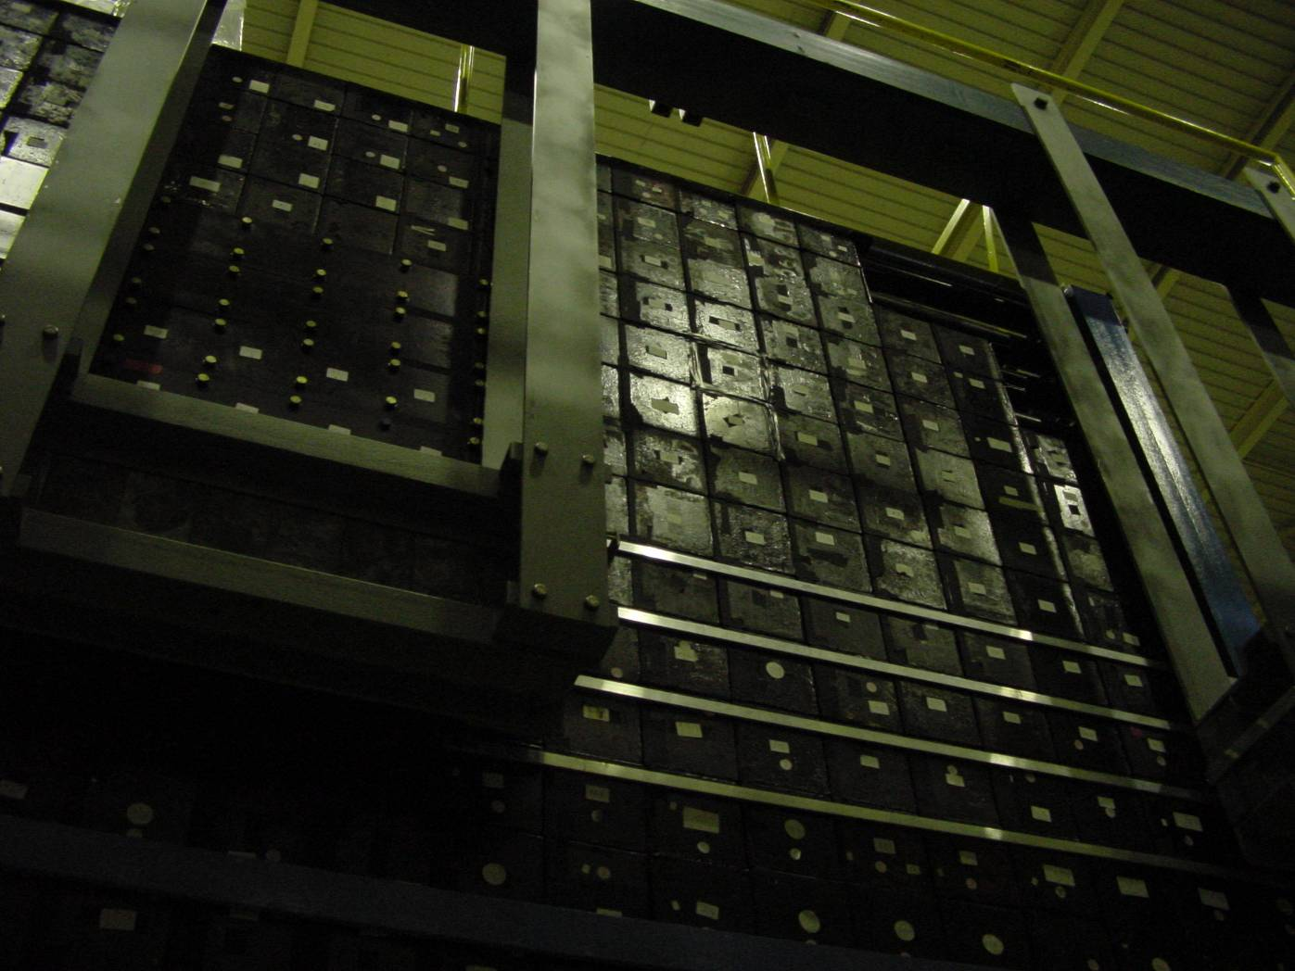
Hadron calorimeter
Fe-Scintillator sandwich (x40)
Hadron calorimeters (x2)
  HCAL1: 480 channels (20x28)
    Each block: 15x15 cm²
  HCAL2: 216 ch (22x10)
    Each block: 20x20 cm²
.
  Detect hadrons = maximize INTERACTION Length

Slide 26
COMPASS RICH
Requirements
  Identification range: 5 – 50 GeV/c
  Angular acceptance:
  Photon detectors outside acceptance
Implementation
  C₄F₁₀ radiator gas (n=1.0015)
    Needed: controlled purity, constant pressure, temperature.
  Large volume vessel: 80 m³
  Large mirror system: 21 m², R_{c}=6.6 m
    Total detection area of 5.6 m²
    VUV domain: 150 – 210 nm
  Two detector technologies
    MWPC/CsI photon detectors
    MAPMTs
5.5 m
3.3 m

Slide 27
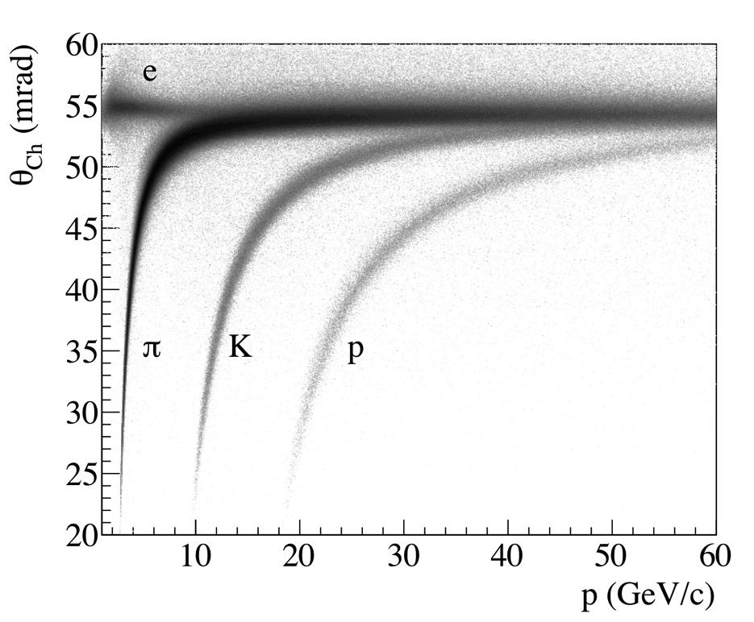
COMPASS RICH
Performances:
  Cherenkov angle: 25 – 54 mrad
  Photons (VUV) per ring (rec): 5 – 60
  Typical efficiency: ~80%
  Typical purity: ≤70%
preliminary

Slide 28
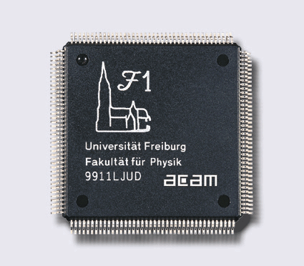
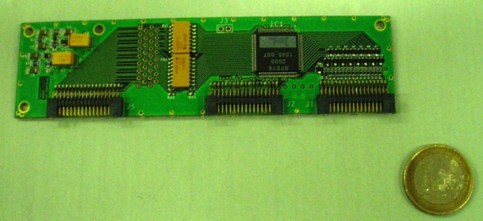
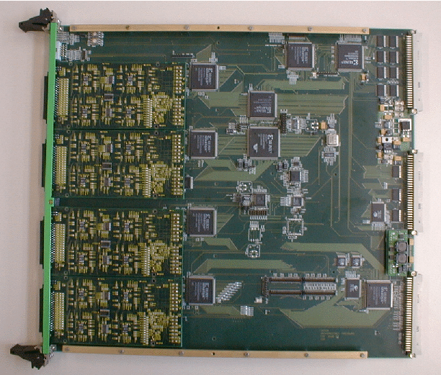
Dedicated electronics developments
F1-TDC chip – for most detectors
  8ch, 130/65 ps resolution
  22 ns dpr, 160 pins, etc…
ANALOG R/O SFE16 chip for Micromegas
  16 ch, low noise (<1000 e-)
  Peaking time 80 ns, L+T edge
CATCH VME R/O driver module
  9U, 16 inputs, clock dist’on,
  event framing
  Hotlink input, S-link output,
SADC for ECAL and HCAL
  32 ch, 80 kHz sampling rate
  12b, Latency compensation
  0-suppression, hotlink output
Spill buffer
  512 MB SDRAM (S-link to PCI)
Many Front-End cards…etc..

Slide 29
COMPASS DAQ
Readout requirements
  Total number of channels : 250 000
  Event size : 40 – 45 kB
  Minimal dead time: 3 µs
Rate requirements
  Trigger rates: 5 – 30 kHz
  Data rates: 1 – 10 GB/spill
  Throughput to R/O buffers: 250 MB/s
Online filtering
  Decrease amount of transmitted and stored data
beam extraction
off spill
9.6 sec
~42 sec
Implementation – main features
  Custom readout-driver modules
  Buffering of bursts
  Pipelined readout
  Network event-building (Gigabit Ethernet)
  Synchronization: TCS (adapted from LHC)
  Dead Time: 15% at 30 kHz

Slide 30
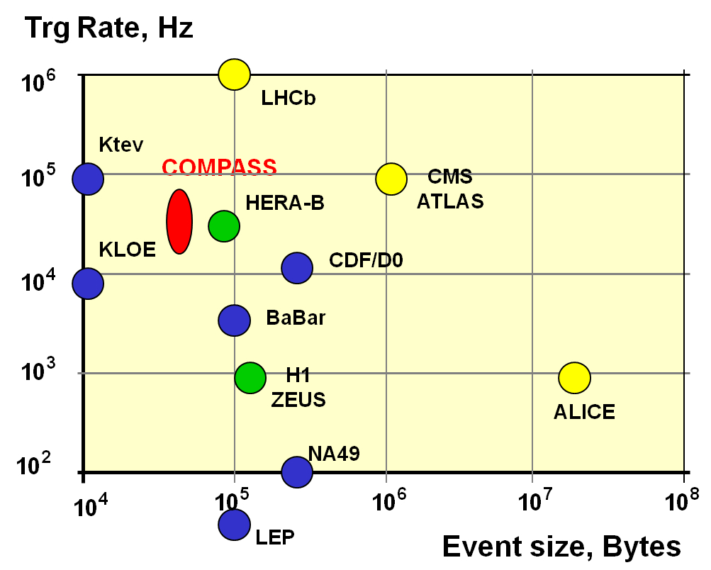
Compass DAQ: Trigger rate vs Event size

Slide 31
Some specific examples:
DVCS
Hadron spectroscopy
Drell-Yan

Slide 32
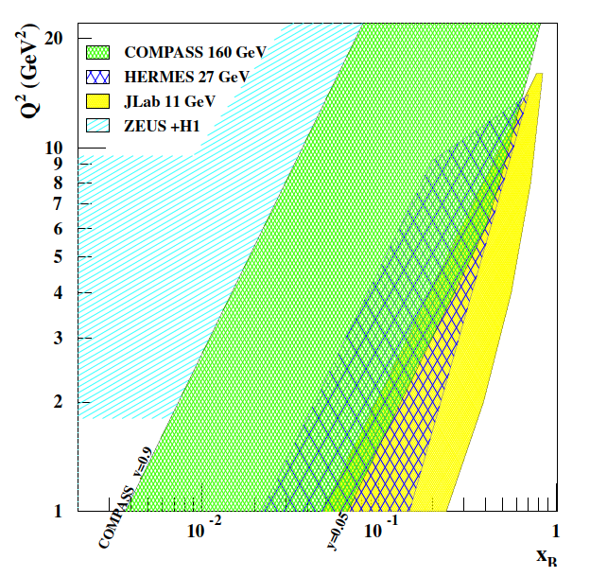
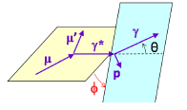
DVCS – COMPASS kinematical coverage
Beams
  100 – 190 GeV
  Polarization: ~80%
  Both μ⁺ and μ⁻ beams
x-Q² region: ≈ 0.01 – 0.1
  Between HERA – Jlab/Hermes
Detect both outgoing photon and recoiling proton

Slide 34
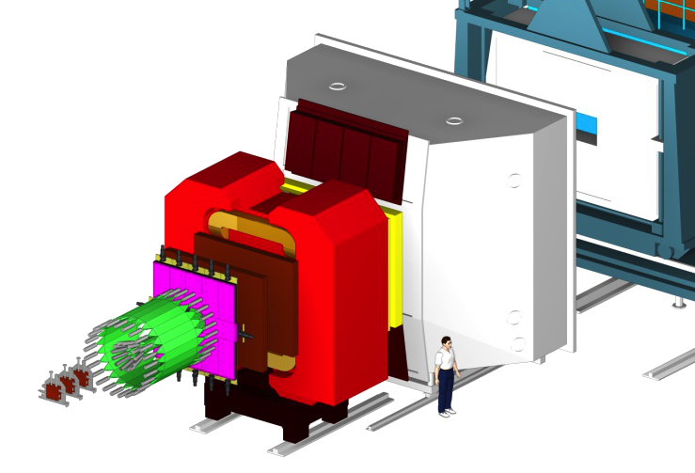
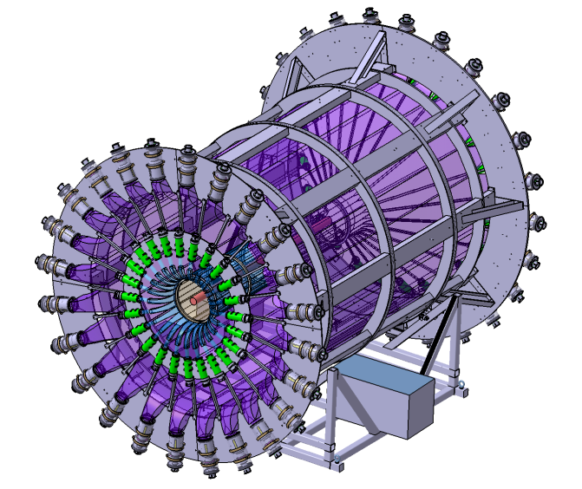
DVCS : μ p → μ’ p γ
μ
μ’
p
γ
New :
2.5m LH2 target
4m TOF CAMERA
ECAL0
CAMERA
ECAL0

Slide 35
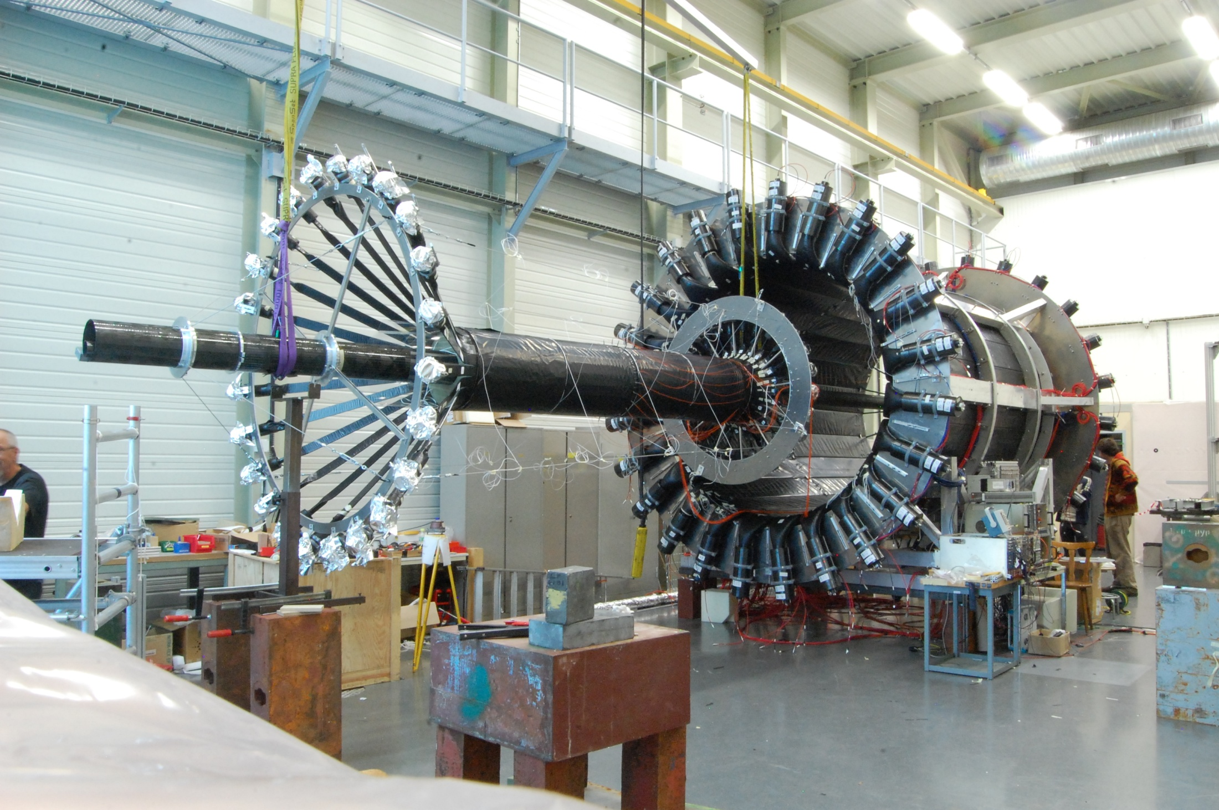
CAMERA (TOF Recoil Proton Detector)
Ring B
Ring A

Slide 36
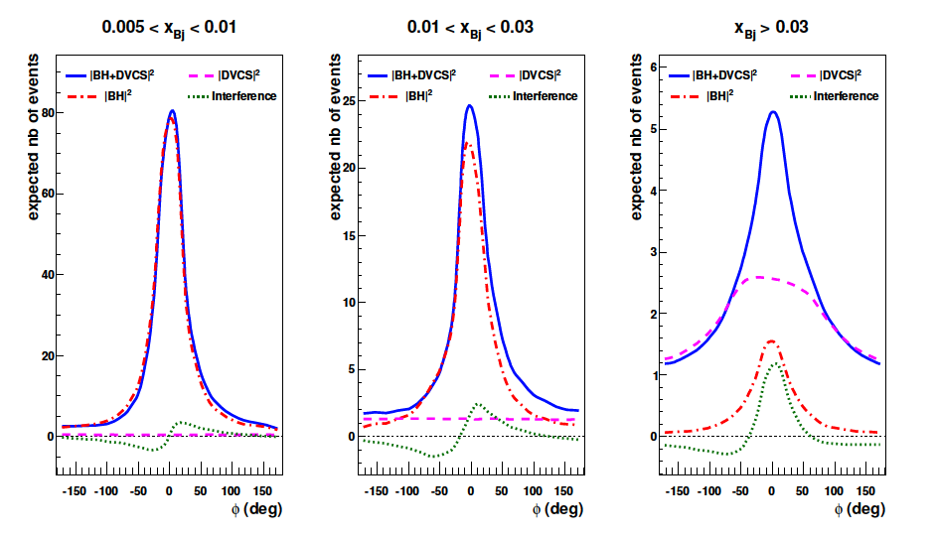
DVCS – COMPASS x_{B} regions – SIMULATION
Relative amplitude dramatically changes as a function of x

Slide 37
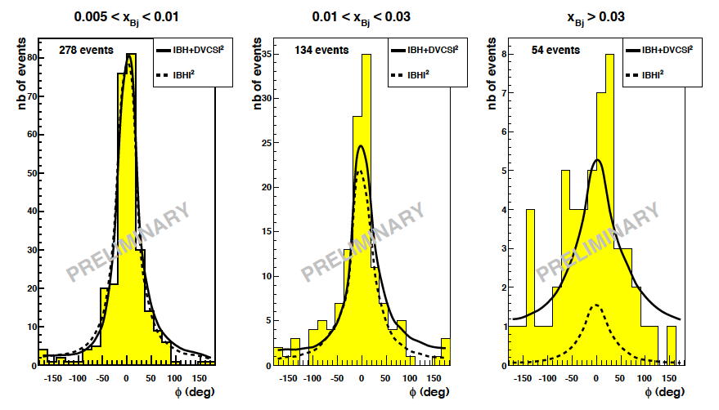
DVCS – COMPASS x_{B} regions – REAL DATA
278 ev.
134 ev.
54 ev.
DVCS
44 ev.
BH
10 ev.
Clear signal from DVCS
Test runs in 2009 – 40 cm long H₂ target

Slide 38
Hadron beam: Primakoff and spectroscopy
Target
LH2/Nuclear
inside
Recoil Proton Detector
Si stations

Slide 39
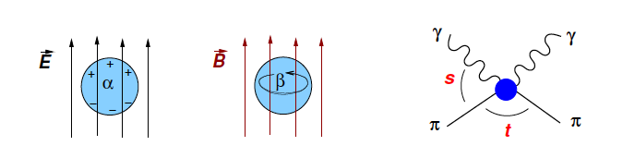
Primakoff and pion polarizability
Primakoff scattering: on the Coulomb field of the nucleus
Measure exclusivity:
  ΔE = E_{beam} – E_{γ} –E_{π}
  Beam energy
  Scattered pion energy
  Energy of the recoiling photon

Slide 40
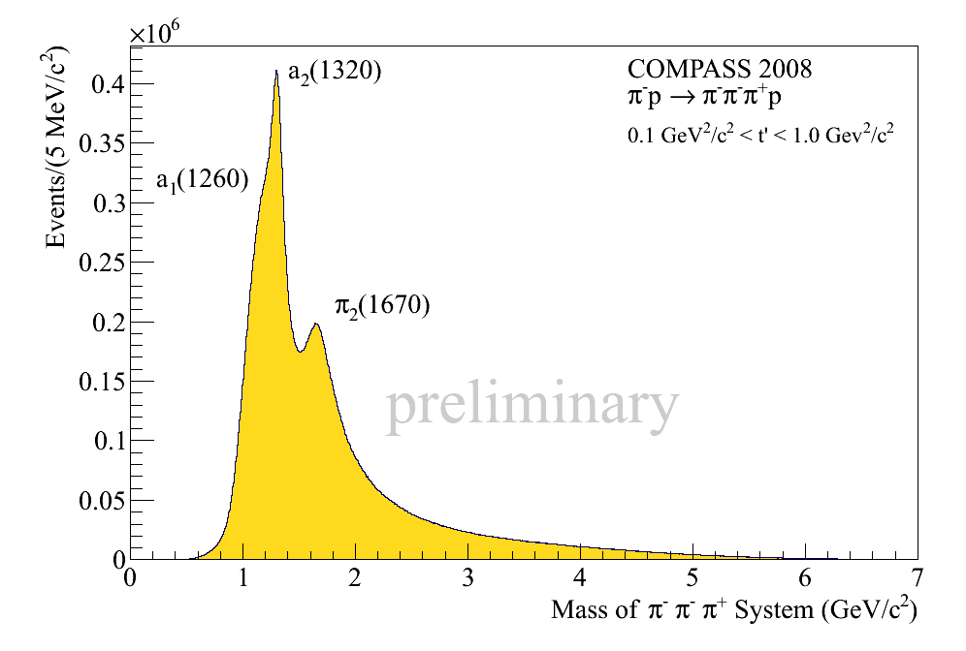
Some final states (pion beam)
charged
neutrals
π⁻p → π⁻π⁻π⁺p
π⁻p → π⁻π⁰π⁰p
charged AND neutrals
η
a₂
π-p → π⁻π⁻π⁺π⁰p
η’
π-p → π⁻π⁻π⁺ηp
ω

Slide 41
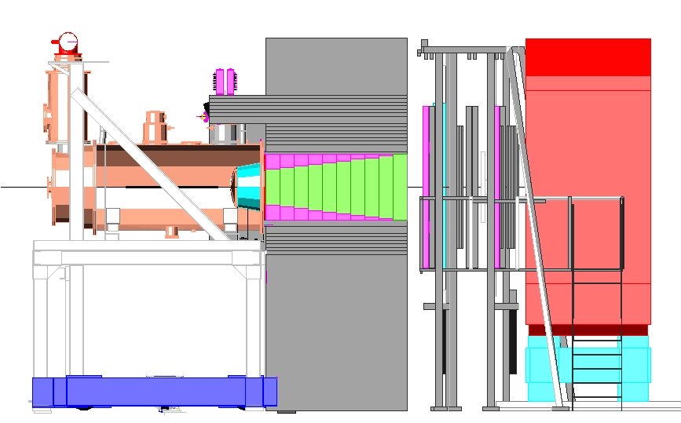
Hadron beam: Drell-Yan setup
Thick hadron absorber/beam dump
Vertex detector
Beam telescope

Slide 42
DY test in 2009 : 3 days of data taking
Vertex reconstruction
Mass reconstruction
2-cell polyethylene target, hadron absorber

Slide 43
A long road ahead
Towards a setup for AFTER – tentative agenda
  Identify the relevant physics processes
  Perform simulations – consider kinematics
  Estimate the magnetic field (Tm)
  Implement the relevant types tracking detectors
  PID detectors (hadrons, neutrals?)
  Consider background processes...
  Go To 2
  Add absorbers, simulations again
  Do not forget about triggers (L1, L2,... ), event rates, throughput, radiation protection, etc...
  Come back here next year....

Slide 44
Thank you

Slide 45
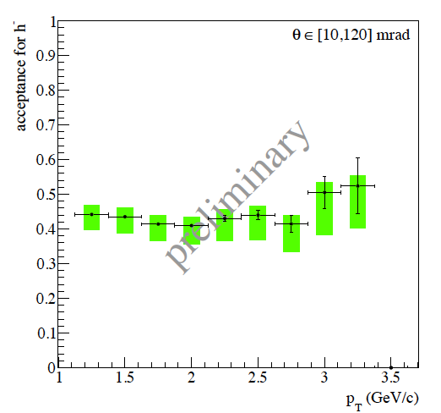
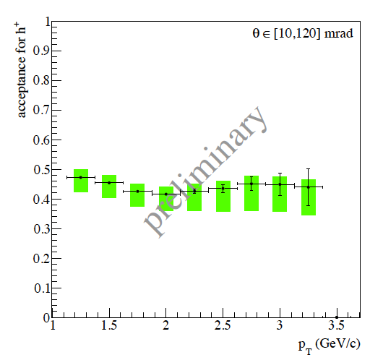
Compass acceptances
Production of high-pt hadrons (muon program)
Diffractive dissociation of pions (hadron program)
Negative hadrons
Positive hadrons

Slide 46
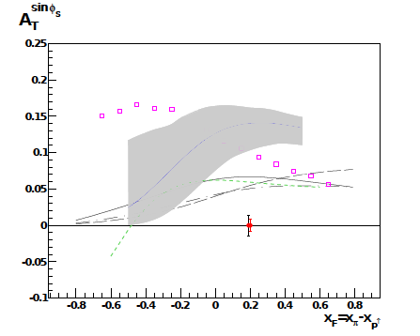
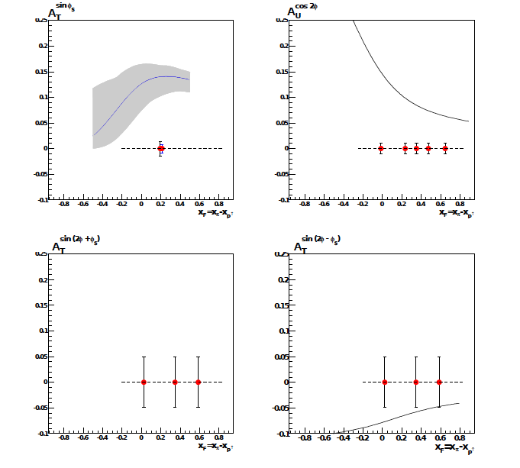
Polarized DY – expected results
2 x 5 months of data taking
6.10⁸ pions/spill
1.1 m NH₃ target
Mass: 4<M_{μμ}<9 GeV
Sivers
Boer-Mulders
Pretzelosity
Transversity

Slide 47
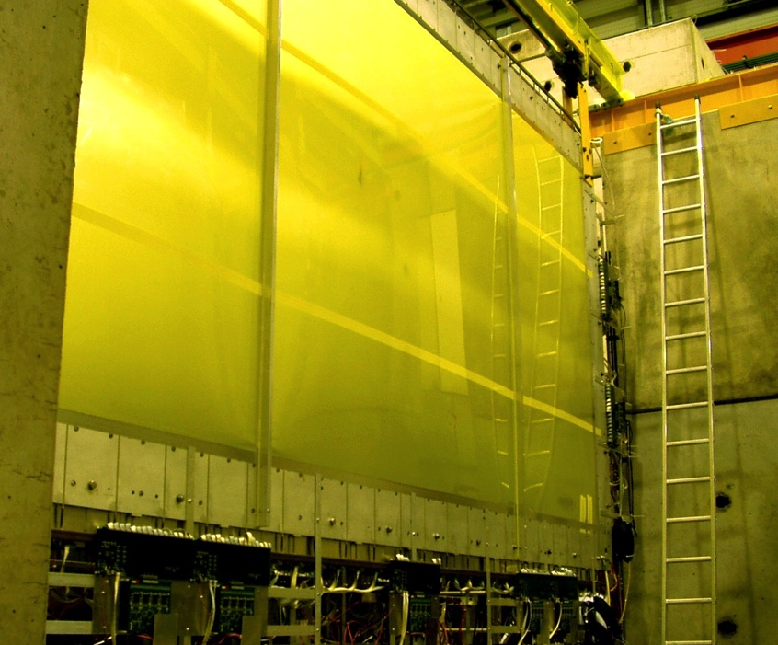
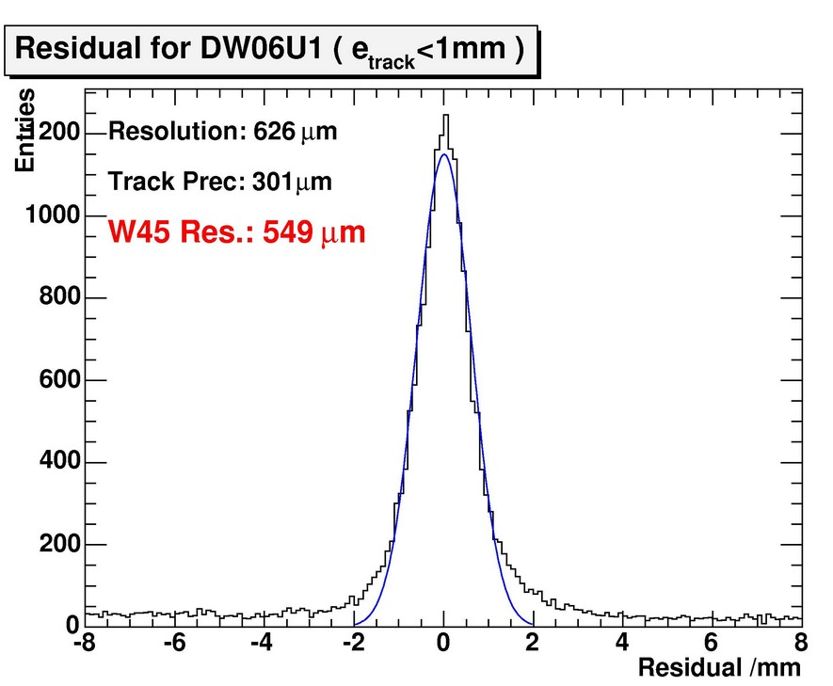
Large Area Trackers – Large Drift Chambers
Specifications
  Large active area: 500x250 cm²
  6 stations (18 double planes)
  Dead area diameter: 50, 100 cm
  Pitch: 4 cm
  Anode-Cathode gap: 1 cm
Performances
  Efficiency: > 93%
  Space resolution: ~500 µ

