Slide 1
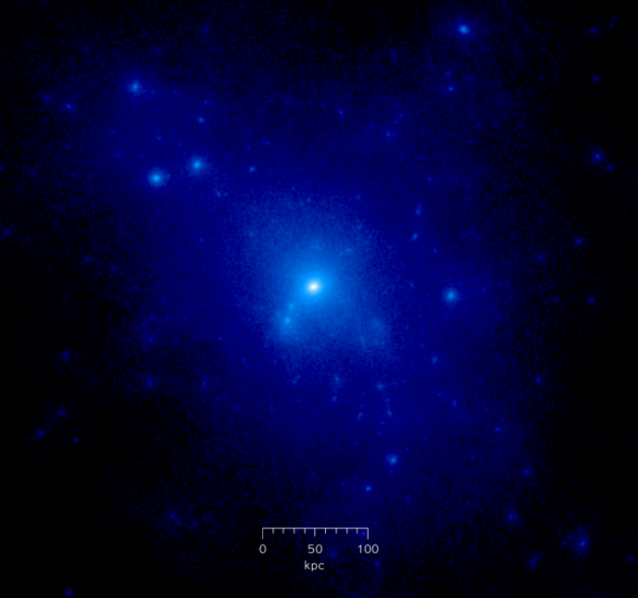
Dark Matter Searches
with the ATLAS detector
Mono-ANYTHING ?
ENIGMASS – 11.10.2012
Marie-Hélène Genest – LPSC ; Helenka Przysiezniak – LAPP

Slide 2
While astrophysical observations provide convincing proof
for the existence of a non-baryonic dark component to the Universe
and precise measurements concerning its abundance,
they offer no clue as to the mass of dark matter (DM) particles,
how they fit into the SM
or even whether or not the dark matter has interactions beyond gravitational
The most persuasive vision of dark matter is
a weakly interacting massive particle (WIMP)
which offers the possibility to understand
the relic abundance of dark matter
as a natural consequence of the thermal history of the Universe

Slide 3
The large interactions of WIMPs with SM particles may imply
1. Detectable rates of WIMP annihilations into SM final states
−Indirect searches −
2. Scattering of WIMPs with heavy nuclei
− Direct searches −
and
3. Production of WIMPs
− colliders −

Slide 4
Low mass particles are particularly accessible to searches at colliders
since cross sections at the LHC fall dramatically with the mass of produced states.
Light states can thus be produced with very large rates
In the case of a WIMP,
stability on the order of the lifetime of the Universe implies (arXiv:1008.1783v2)
that pair production must highly dominate over single production
and prevents the WIMP from decaying within the detector volume
WIMPs therefore appear as missing energy in our detectors
In order to make the search possible
one relies on the presence of a (single) identifiable object in the event
e.g. from ISR
Mono : photon, Z, W, jet

Slide 5
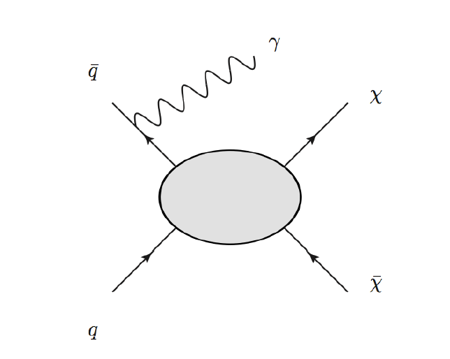
WIMP pair production (+ ISR) at the LHC : mono-something !
g, γ, Z or W
Assumptions about red bubble needed to interpret measurements in terms of χ
and to relate measurements to other fields of DM searches

Slide 6
What exactly do we search for in our detector ?
Mono photon
or
Mono jet
or
Mono W
or
Mono Z
(tag)
+
MET
→ Non-resonance excess in large MET region

Slide 7
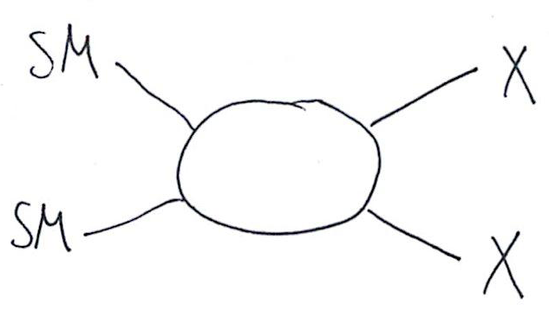
Considering the situation where the WIMP is the only new particle
in the energy ranges relevant for current experiments
the WIMP will couple to the SM particles
through higher dimensional operators
presumably mediated by particles of the dark sector
which are somewhat heavier than the WIMP itself
One can have a contact operator approach to WIMP pair production

Slide 8
One can have a contact operator approach to WIMP pair production
Effective field theory approach
χ−SM coupling set by m_{χ} and Λ (cutoff scale)
χ is a Dirac fermion
LHC limit on cutoff scale can be translated to direct or indirect detection plane
Convert LHC limits to WIMP-nucleon cross sections

Slide 9
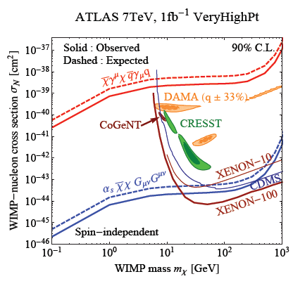
Limits on spin-independent Nucleon-WIMP scattering cross-section
• LHC measurement translates
into one line per operator
• Low-mass LHC reach complementary
to direct detection experiments
• LHC limits don’t suffer from
astrophysical uncertainties

Slide 10
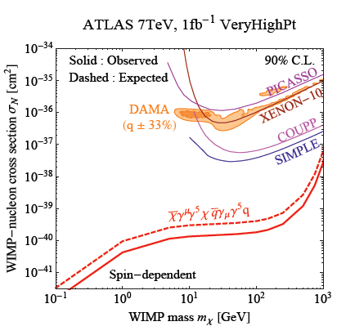
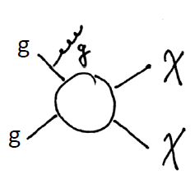
Limits on spin-dependent Nucleon-WIMP scattering cross-section
• LHC reach complementary
to direct detection experiments
ove the full mass range

Slide 11
Why search for WIMPs at the LHC?
Experimental limits will push theory forward
(and vice versa)
Plots of WIMP-nucleon (or annihilation cross section limits)
will be referenced by direct and indirect detection experiments
(and theory papers)
Interpretation provides a language to probe DM parameters
and
compare to other DM fields

Slide 12
What else can we wring out of a mono-something signal?
Interpretation in the context of
Compressed SUSY scenarios
e.g. arXiv:1205.1463v1
Geneviève Bélanger (LAPTH), Matti Heikinheimo and Verónica Sanz
Particles too soft to be reconstructed
produced in the decay chain of a new particle
ADD extra dimensional model
KK graviton escapes into the bulk and a SM particle (photon or jet) is emitted

Slide 13
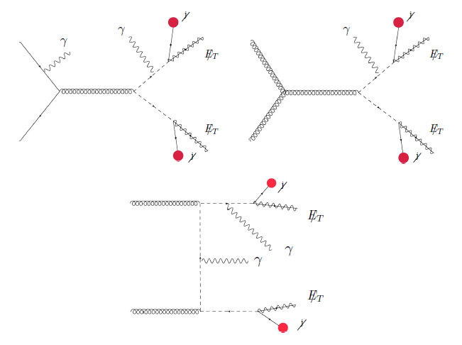
Compressed SUSY scenarios
arXiv:1205.1463v1
Geneviève Bélanger, Matti Heikinheimo and Verónica Sanz

Slide 14
Arkani-Hamed−Dvali−Dimopoulos extra dimensional model
Non interacting-graviton escaping the detector accompanied by a photon or a jet
gg → qG
qqbar → gG
qg → qG
qq → γG

Slide 15
So, why an ENIGMASS postdoctoral fellow ?
DM is an important enigma in particle physics
Direct, indirect and collider searches are complementary in the understanding of it
Coherent with LAPP and LPSC projects (ENIGMASS + ANR)
ATLAS Exotics mono-photon/W/Z/jet effort is underwomanned/undermanned
Presently ∼ 4 people
Calling for contributors
LPSC is deeply involved in the ATLAS-Exotics group
and in particular in analyses with photon final states
Marie-Hélène has been greatly involved in SUSY (ex-Etmiss convenor) and DM searches
and would be interested in looking into the compressed SUSY interpretation
as discussed by Bélanger etal from LAPTH
My (HP) ongoing work is with the ATLAS SUSY and Exotics groups
1 or 2 photon final states + MET
Involved in extra dimensions (Randall Sundrum + UED) since 2003

Slide 16
Why an ENIGMASS postdoctoral fellow ?
Because
we need more people searching for DM in ATLAS
(and in the world!!)
LPSC and LAPP have competent people working in the field

Slide 17
Backup slides

Slide 20
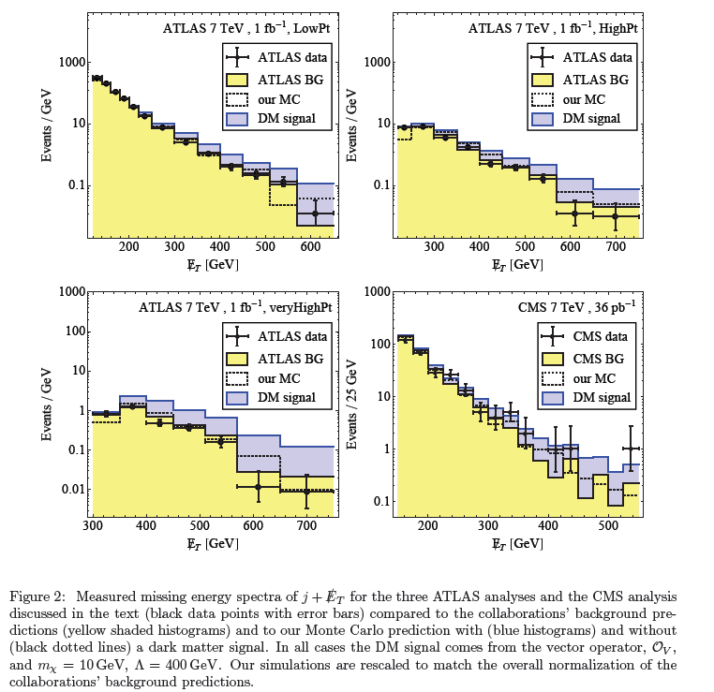

Slide 21
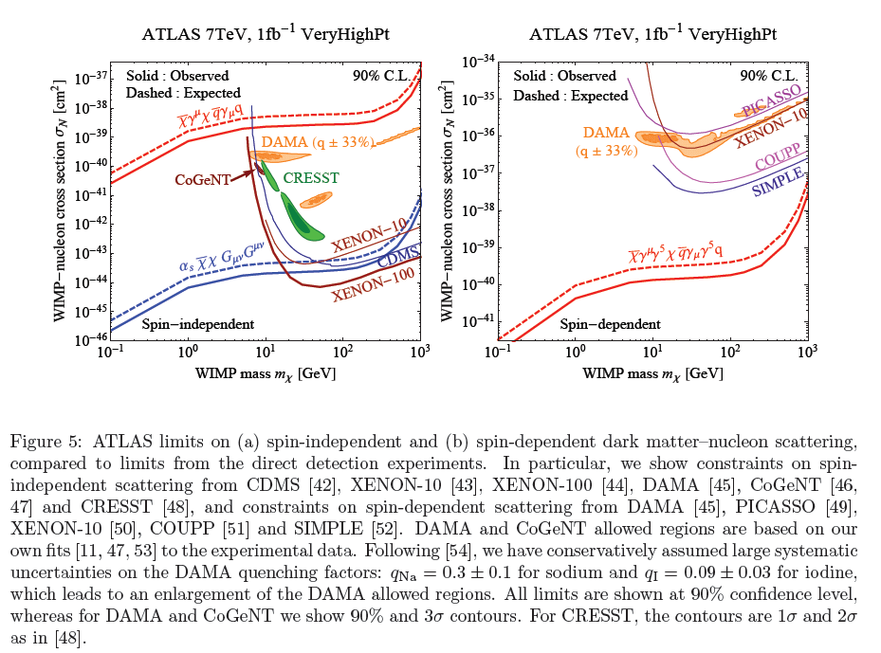

Slide 22
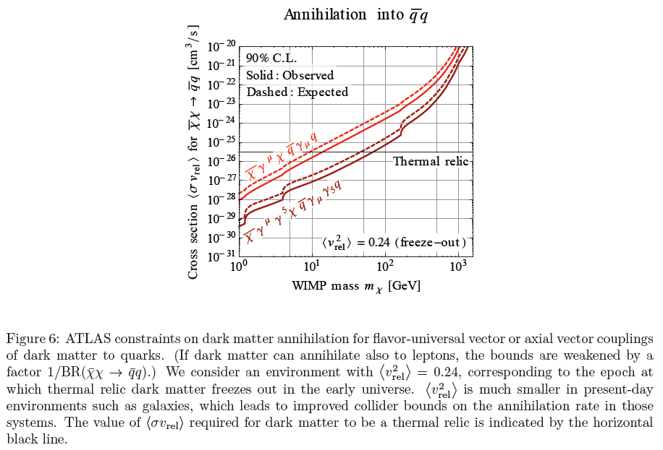

Slide 23
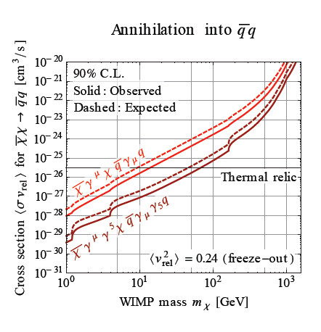
Limits on annihilation cross section
• DM annihilation at freeze-out
temperatures
• Assume DM couples to quarks
only (otherwise weaker bounds)
• Assume effective field theory
approach is viable

Slide 24
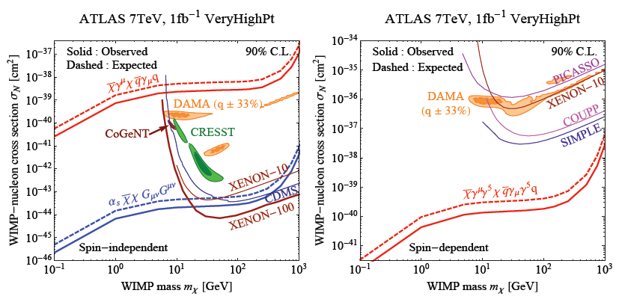
ATLAS limits on (a) spin-independent (red:D5; blue: D11)
and (b) spin-dependent (D8) dark matter−nucleon scattering
compared to limits from the direct detection experiments.
All limits are shown at 90% confidence level,
except for DAMA and CoGeNT are shown 90% and 3σ contours.
For CRESST, the contours are 1σ and 2σ

Slide 25
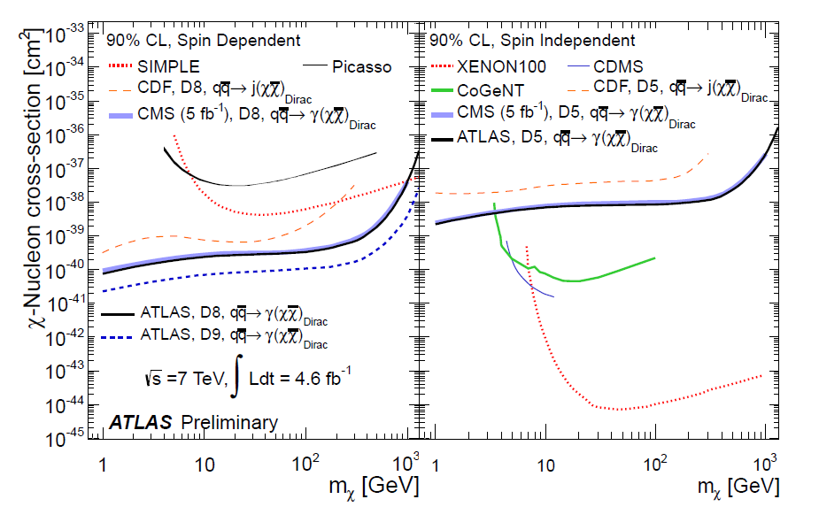
ATLAS-CONF-2012-085

Slide 26
Here we have assumed that DM is a Dirac fermion,
the case of a Majorana fermion would not greatly alter our results,
except in the case of the vector operator O_{V} (vector, s-channel),
which vanishes if χ is a Majorana fermion.

Slide 28
Constraints on Dark Matter from Colliders
arXiv:1008.1783v2
Our results are qualitatively similar to our previous paper. In general collider constraints
are very strong for lighter dark matter and fall off when the dark matter mass exceeds the
typical energy reach of the collider. The constraints also depend on the coupling of the dark
matter; if the dark matter primarily couples to gluons, the constraints from colliders become
especially strong.
One of the most interesting results is that collider constraints on spin dependent interac-
tions are stronger than direct searches over a significant portion of parameter space.

Slide 29
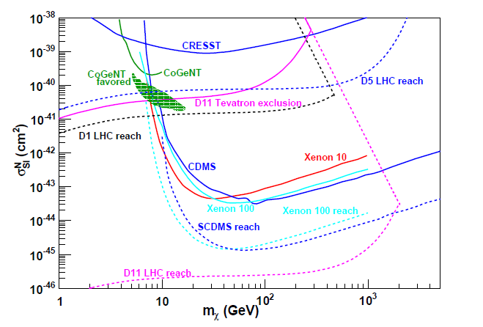

Slide 30
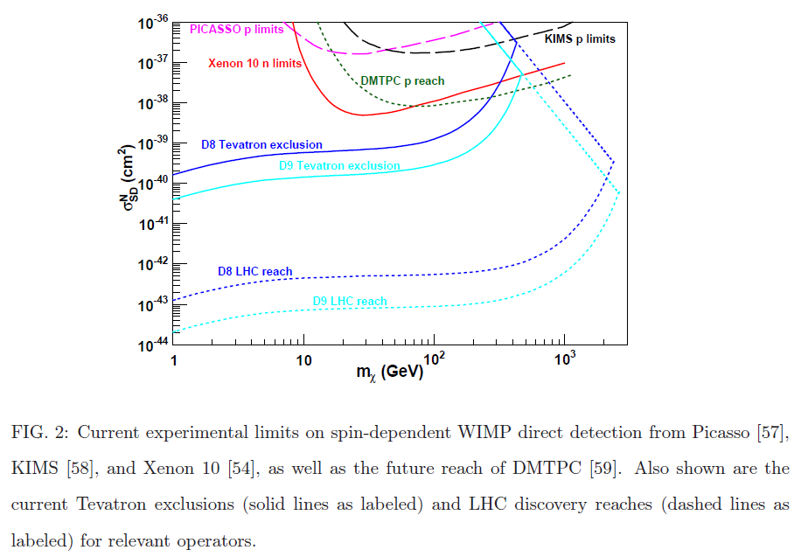

Slide 31
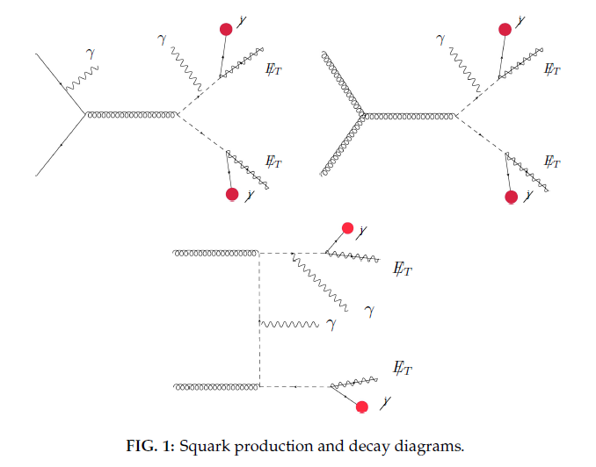
Compressed SUSY spectrum

Slide 32
References
Consider WIMP pair production at colliders, idea goes back to:
– Birkedal et al (hep-ph/0403004)
– Beltran et al: Maverick Dark Matter (hep-ph/1002.4137)
Latest papers based on LHC results:
– Fox et al, arxiv:1109.4398, arXiv:1202.1662, arXiv:1203.1662 (FNAL crew, monojets and razor)
– Rajamaran et al, arxiv:1108.1196 (UCI crew, monojets)
– etc.
−Constraints on Dark Matter from Colliders : arXiv:1008.1783v2
− Model-Independent Bounds on Squarks from Monophoton Searches : arXiv:1205.1463v1
(Bélanger etal)
− Missing Energy Signatures of Dark Matter at the LHC : arXiv:1109.4398v1
− Search for dark matter candidates and large extra dimensions in events
with a photon and missing transverse momentum in pp collision data at
√s =7 TeV with the ATLAS detector : ATLAS-CONF-2012-085

