Slide 1
The
Tianshan
Radio
Experiment for
Neutrino
Detection
a Sino-French project for the radio-detection of Extensive Air Showers induced by neutrinos.
Olivier Martineau-Huynh, NAOC & CNRS-IN2P3 – Sept.15, 2012, Lijiang – 21CMA workshop

Slide 2
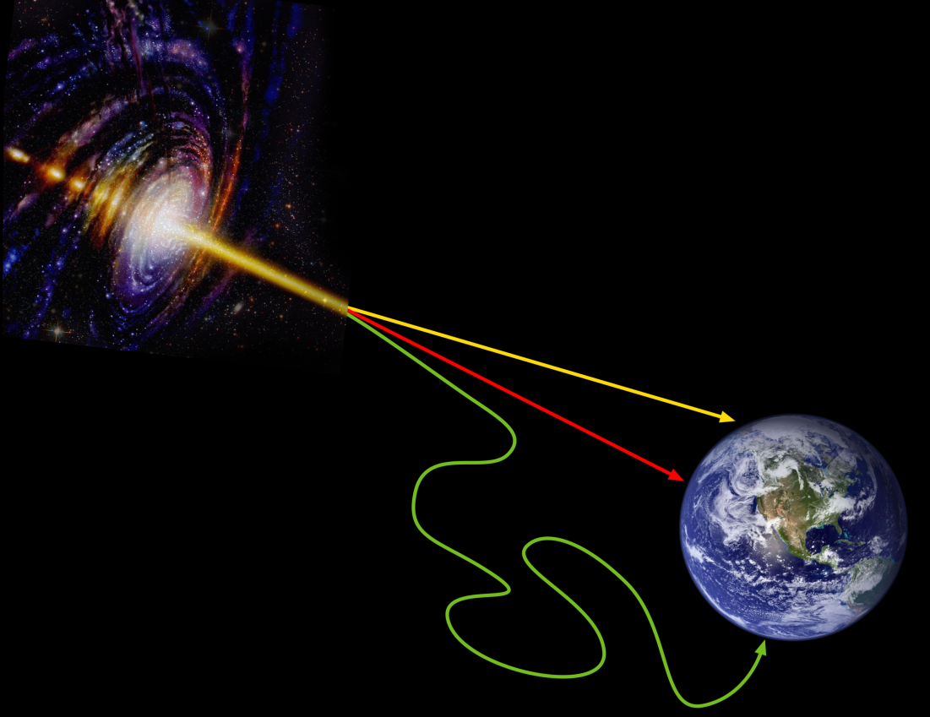
Why neutrino astronomy?
No deflection (≠ cosmic rays) and no attenuation (≠ elm radiation): great probe for astronomy & cosmology
Signature for hadronic processes: clean messengers.
After elm radiation and cosmic rays, 3rd window on the Universe…
Vast perspectives ahead.
«X-ray scanner of the Universe»
G. Gelmini et al., Scientific American 302, 2010.
ν
γ
cosmic
rays

Slide 3
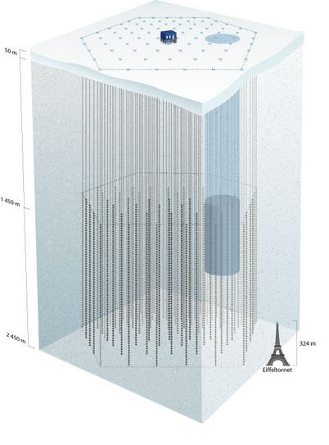
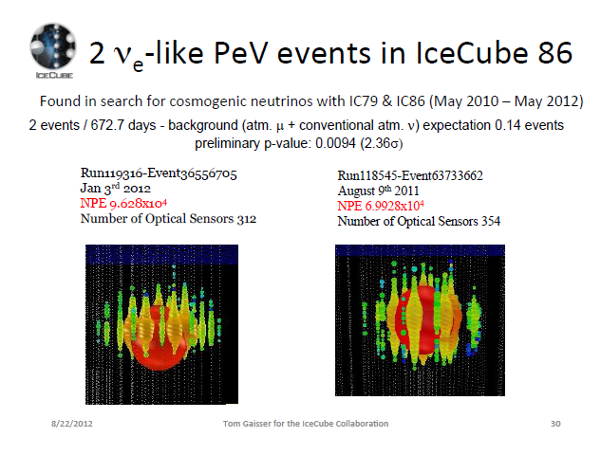
Cosmic neutrinos: experimental status
Km³ neutrino telescopes: ANTARES-KM3NET (deep sea, France) & AMANDA – IceCube (ice, Antartica).
Sensitivity ~ high range of predictions
IAU2012: 2 candidates in 2 years of data (bckgd: 0.14)
Neutrino astronomy within reach!
But will requires larger detection potential.
Could radio detection be the solution?
ICECUBE

Slide 4
Radio detection of Extensive Air Showers
1- Principles & context

Slide 5
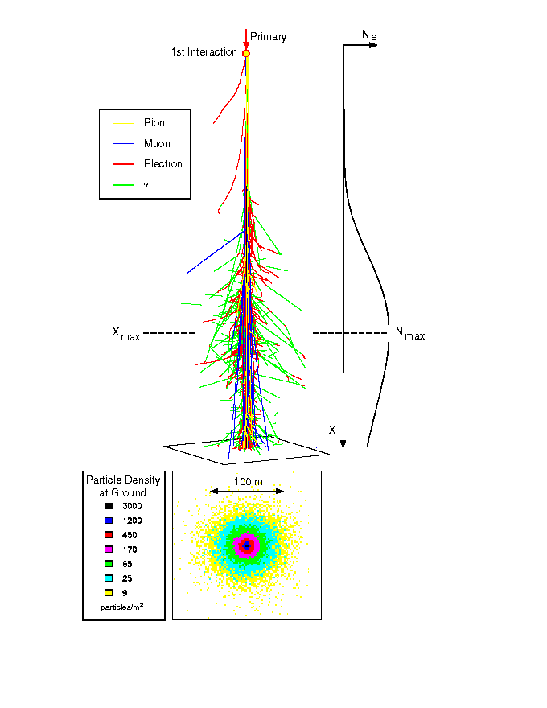
Radio detection of UHE cosmic particles
B_{geo}
⊗
High energy particles generate Extensive Air Showers in the atmosphere.
Lorentz force on charged particles in the EAS by the Earth magnetic field (Kahn & Lerche, 1965): electromagnetic emission (geosynchrotron)
F = qv∧B_{geo}
e⁻
e⁺
Coherent effect
detectable radio emission

Slide 6
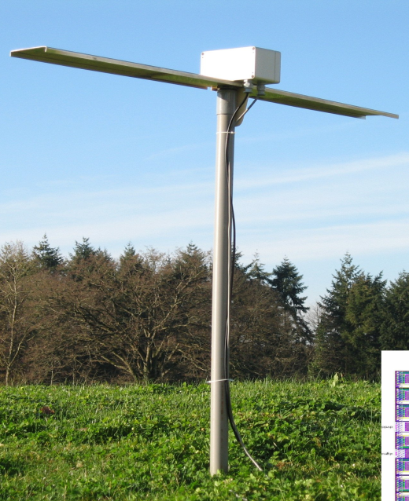
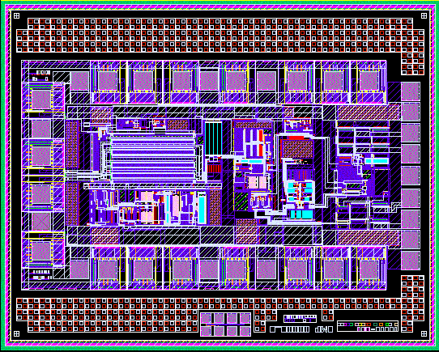
Radio detection of EAS: experimental status
Measurement of EAS direction of origin, energy, nature of primary (LOPES & CODALEMA, 2004-2010)
Well adaptated to giant arrays: easiness of deployment, stable (passive detectors), low cost (<10kRMB/unit).
~1m
Only 2 established setups (LOPES & CODALEMA)
  <30 antennas: low stat (<1000 showers)
  Slave-triggered to standards EAS detectors
Full understanding of EAS radio signal ?
Self-triggering?
The TREND prototype phase was initiated in 2008 in order to first adress these issues, with neutrino detection as the long-term perspective.

Slide 7
Radio detection of Extensive Air Showers
2- The TREND prototype phase

Slide 8
The TREND collaboration
China: CAS
  NAOC: Pr. WU XiangPing, DENG JianRong,
  GU JunHua, Thomas Saugrin (now in Nantes)
  IHEP: HU HongBo, LIU Zhen’An, …
France: CNRS-IN2P3
  LPNHE: Olivier Martineau-Huynh
  SUBATECH: Pascal Lautridou, Olivier Ravel, …
  LPC: Valentin Niess
  CC: Fabio Hernandez

Slide 9
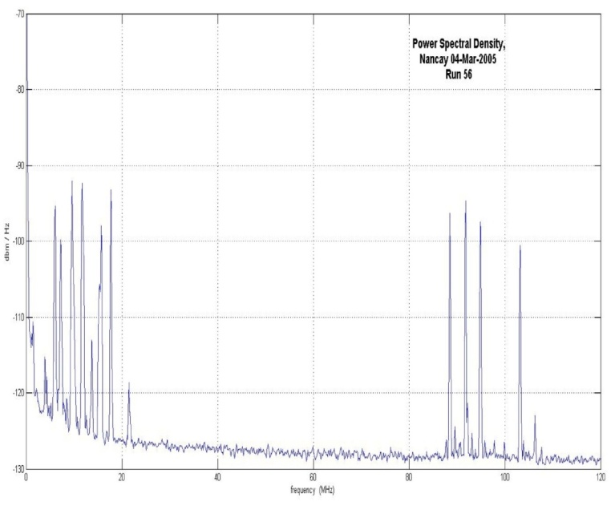
Tianshan Radio Experiment Neutrino Experiment @ Ulastai, XinJiang
Very clean radio environnement above 20MHz.
AM emitters
TREND
@ Ulastai
AM emitters
FM emitters
Nançay
RadioObservatory

Slide 10

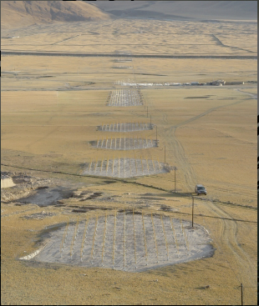
The 21cm array
North
21CMA infrastructures, equipments and staff fully available for TREND!
Very fast deployment & very modest cost for the development phase.
4 km
West
East
DAQ
3 km
South

Slide 11
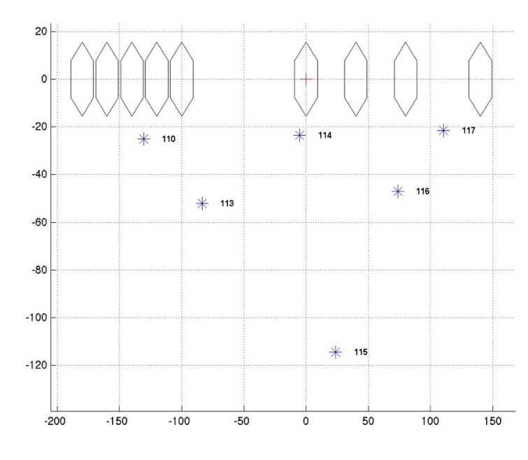
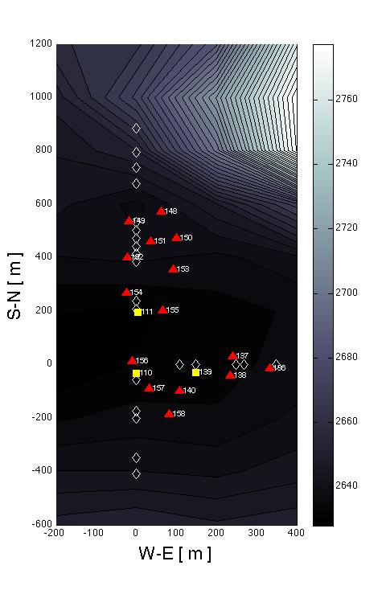
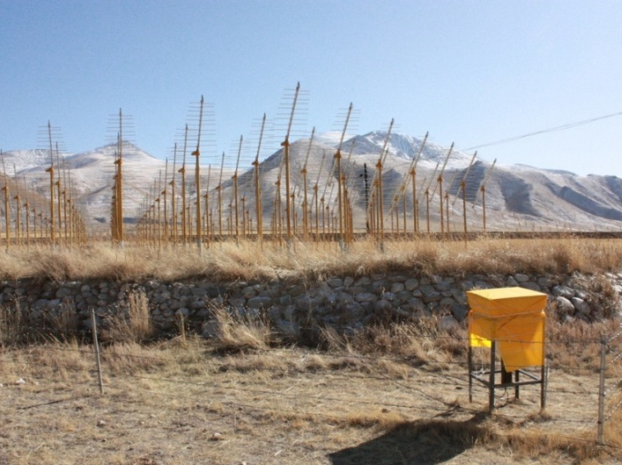
TREND prototype
250 m
2009 :
Prototype of 6 log-periodic antennas.
Test of EM signal arrival direction econstruction.
Test of EAS identification.
100 m
N
Proof of feasability of the TREND concept
2010 :
15 log-periodic antennas + 3 particle detectors.
independant trigger & independant analysis of antenna & scintillator data.
Hybrid antenna/scintillator coincidences found.
First EAS identification with autonomous radio array
800 m
(see Ardouin et al., Astropart Phys 34, 2011 <arXiv:1007.4359>)
400 m

Slide 12
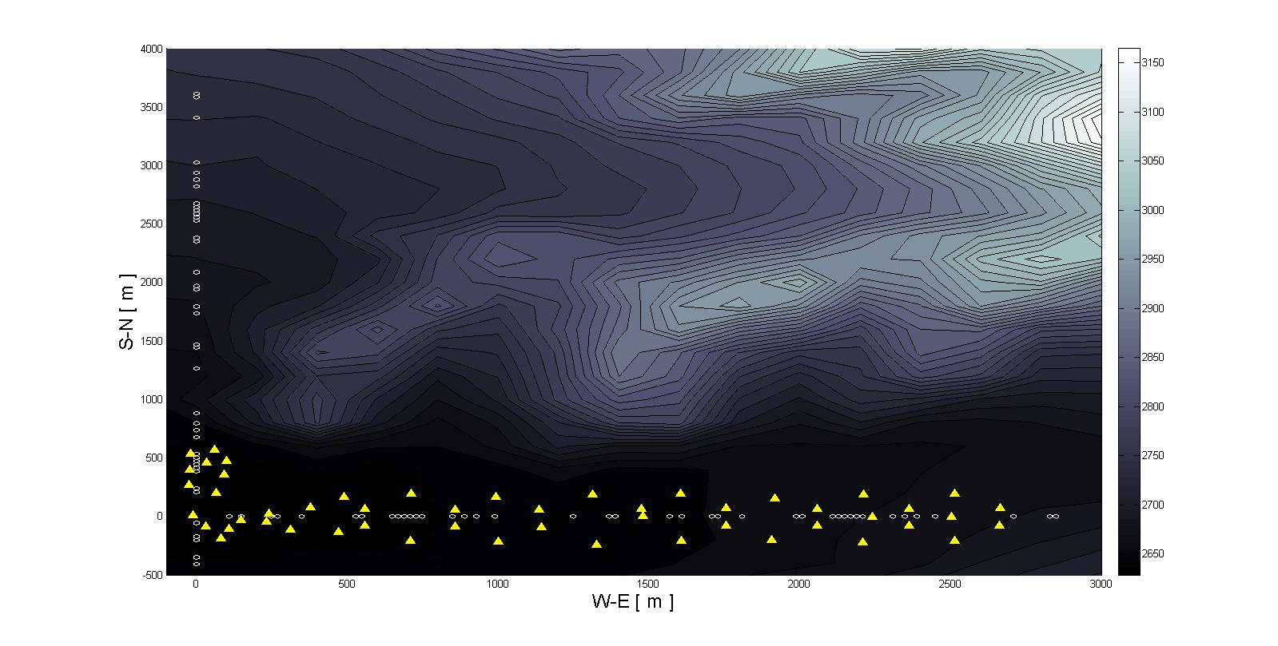
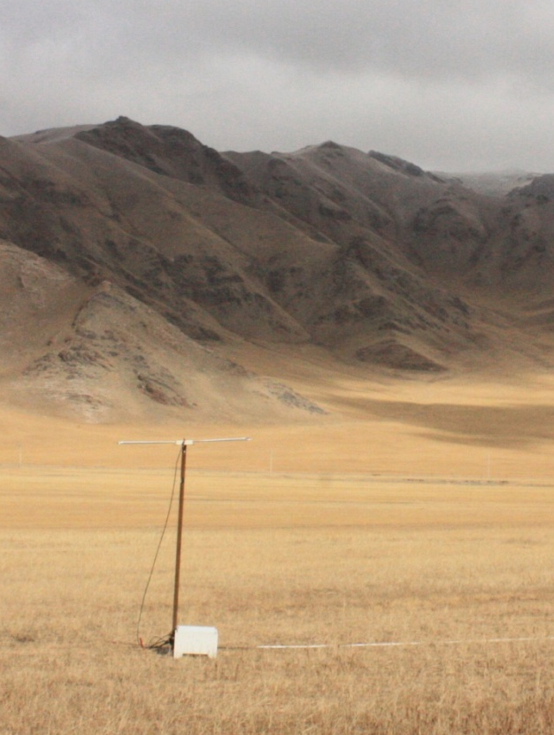
The TREND-50 setup
50 butterfly antennas deployed in summer 2010, making TREND the largest EAS radio-array for EAS detection in the world.
Stable operation since March 2011. 240 live days of acquisition (75% of possible time) so far. On average 80% of array up during this period.
~3 km
~1.5 km²

Slide 13
EAS identification
EAS signal:
Isolated events,
focused ground pattern
& plane wavefront
Algorithm to select EAS candidates among radio events
  Time & direction distrib
  Wave front
  Ground pattern & amplitude profile
Shower axis

Slide 14
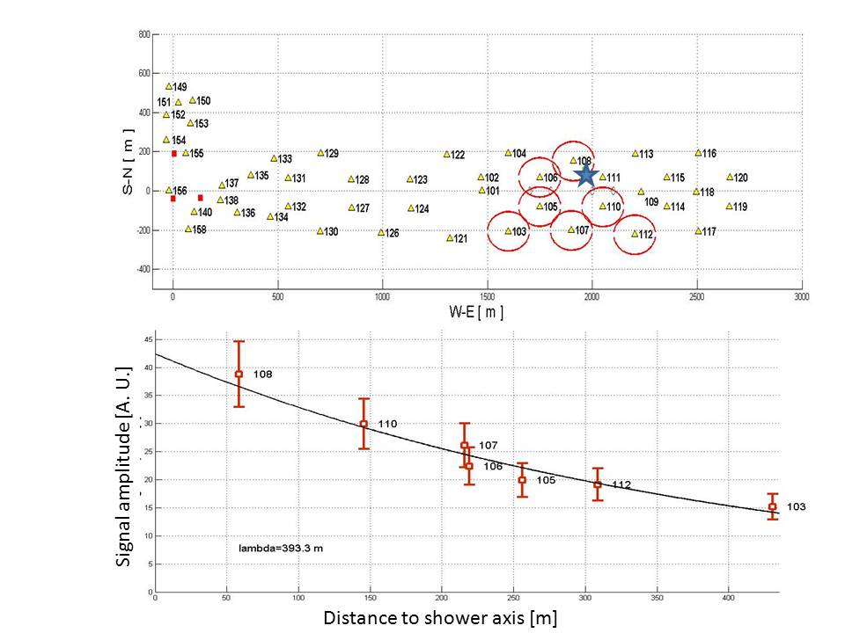
EAS identification
Background signal:
focused pattern &
spherical wavefront (close source)
Extended pattern & plane wavefront (distant source)
One TREND EAS radio-candidate
Algorithm to select EAS candidates among radio events
  Time & direction distrib
  Wave front
  Ground pattern & amplitude profile

Slide 15
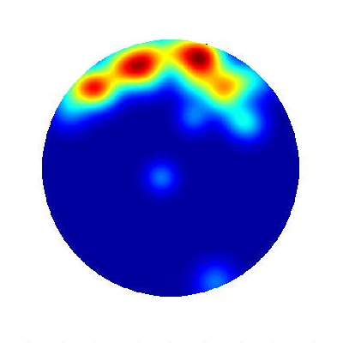
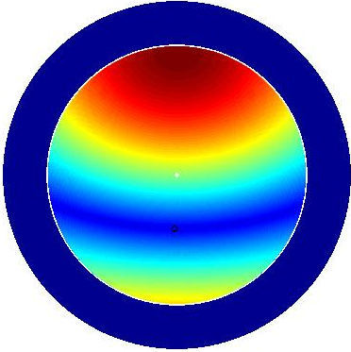
TREND-50 results (preliminary)
104 live days analyzed. 33 EAS candidates identified with θ<65°.
Significant North-South assymetry.
North
TREND efficency map to EAS
still to be computed, but already experimental skymap distribution compatible with geosynchrotron effect |E_{ew}|= |v˄B_{geo} |. x
|E_{ew}|= |v˄B_{geo} |.x
East
B_{geo}
B_{geo}
South

Slide 16
To Do
Within coming months (weeks):
Acquire more data.
Extend analysis to larger zenith angles.
Complete analysis of remaining 140 days of data.
Refine cuts for EAS selection.
Increased statistics, down to large zenith angles (80° ?)
Perform statistical study of EAS candidates (skymap & evolution with E, lateral profile & evolution with θ & E, …)
This work will complete the prototype phase of TREND and validate the concept of autonomous detection & identification of EAS with radio antennas.

Slide 17
Neutrino detection with TREND

Slide 18
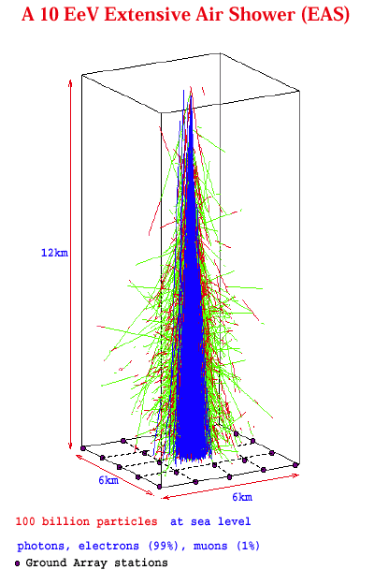
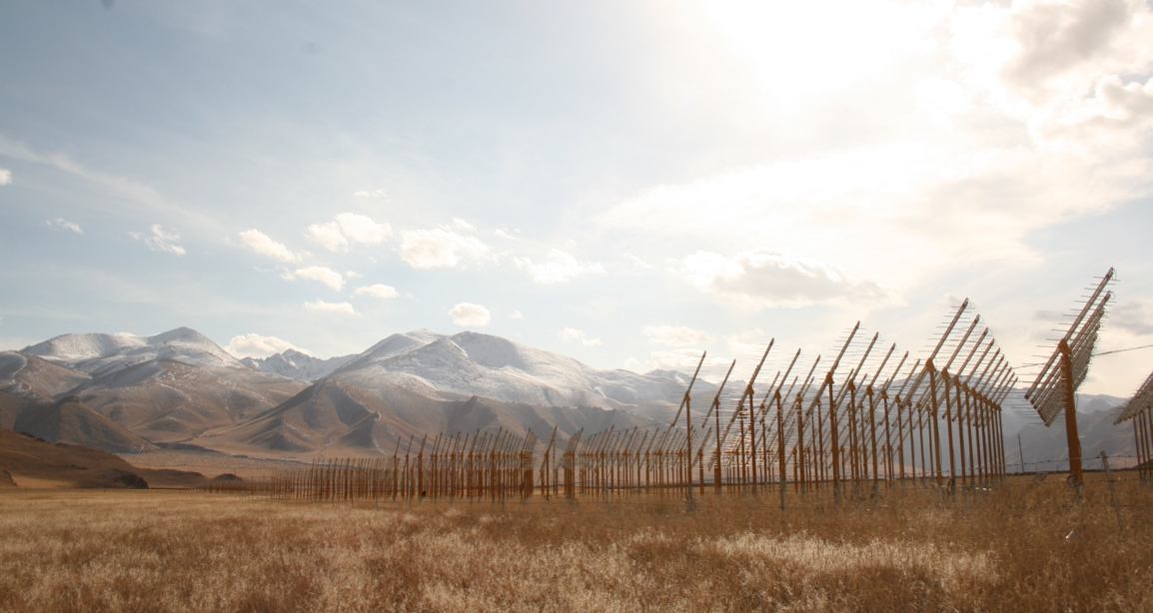
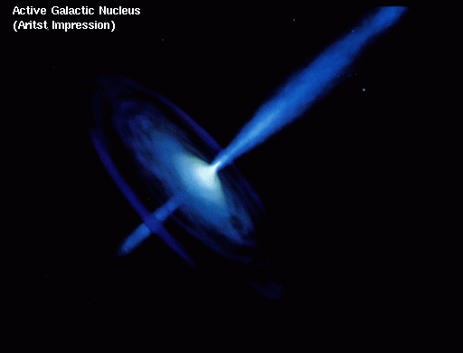

UHE neutrino detection
~horizontal shower
τ
ν_{τ}
Chalenges:
rate of neutrino showers (~ few per year )
background rejection (~few per second)

Slide 19
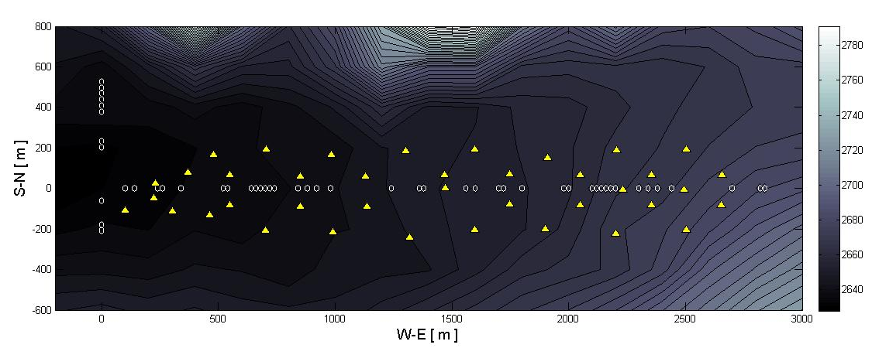
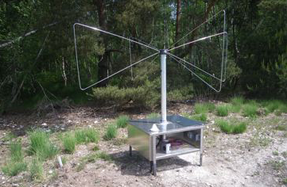
Background rejection
Rejection factor has to be >10⁷.
Ground pattern/wavefront cuts hardly applicable for horizontal showers.
Key parameter could be polarization:
E ⊥ B_{geo} & E ⊥ direction of propagation (at 1st order).
Prototype setup to be installed at Ulastai:
Double polar antennas
+ vertical scintillators for CR validation
CODALEA double polar antenna
… available for TREND

Slide 20
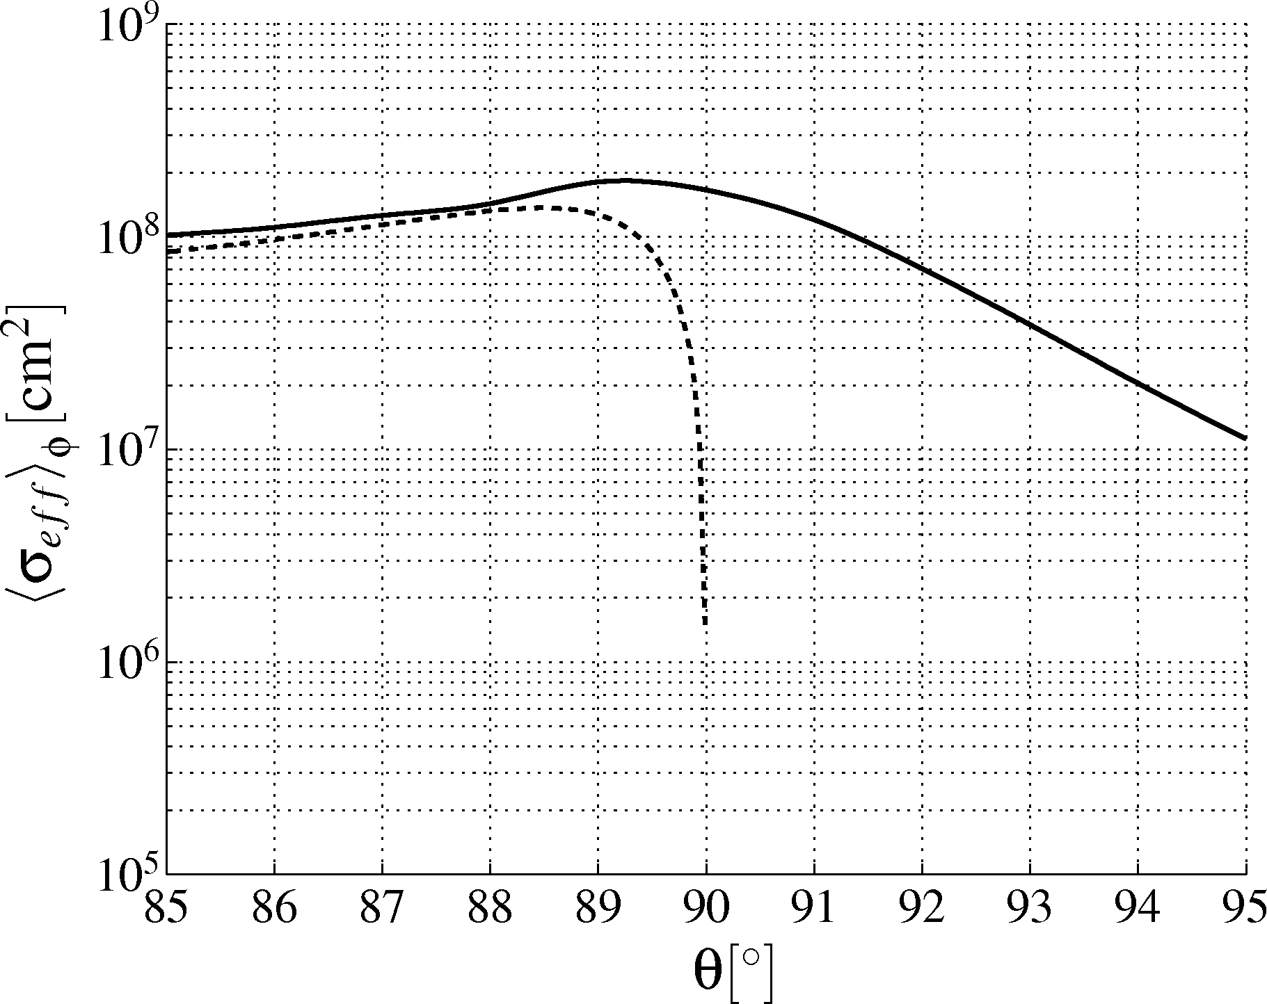
Neutrino event rate
Giant array required (>>100km²).
Size & layout to be determined through end-to-end MC simulation. Already completed: Neutrino interaction in rock, tau energy loss, tau decay and shower generation, antenna response & trigger. Radio signal generation on the way.
x
x
x
x
x
x
x
x
x
x
x
x
x
x
x
x
Mountains correspond to additionnal target: flux doubles vs flat site.
Mountains also screen standard CR showers.
Mountains = very attractive sites for detection:
  Increased efficency
  Better geometry
E_{ν} = 10¹⁸ eV
Averaged over φ
TREND site topology
Flat site
Upward going
Downward going

Slide 21
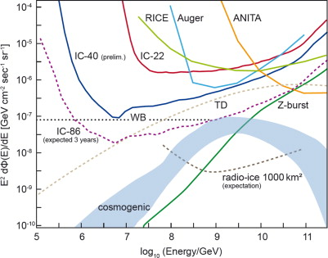
TREND sensitivity
What does it cost to build the world most sensitive neutrino telescope?
Size of the array is the key parameter (provided backround rejection is OK).
TREND?
… How large can we go? 1’000 km²? 10’000 km²?
technical capacity: OK in principle.
Installation cost :~ few10⁶ RMBs.
Site?

Slide 22
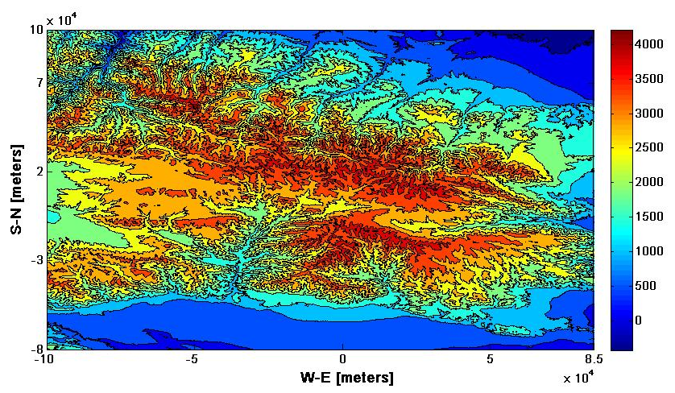
Ulastai
25’000 km² of lowly populated mountains are within reach…

