Slide 1
Upgrade Spectromètre à muon d’ALICE
Groupes ALICE de Clermont-Lyon-Nantes-Orsay-Saclay

Slide 2
Motivation de Physique (L. Massacrier QGP-France)
Upgrade du trajectographe à muons (inputs de Bruno et Alberto)
Upgrade du trigger muon (inputs de Pascal)

Slide 3
Scénario de prise des données
Running the LHC with heavy ion at high luminosities
  Reach high statistic for high precision measurement
  High rate operations after 2018 long shutdown (LS2)
  Collecting data until mid-2020’s
  LHC running scenarios and ALICE data taking
Approved scenario
Upgrade scenario
Collect Pb-Pb data up to an integrated
luminosity of : L_{int} = 1 nb⁻¹
  2013-14 : LS1 (completion TRD
  and CALs)
  2015 : Pb-Pb at √s_{NN} = 5.1 TeV
  2016-17 : Pb-Pb at √s_{NN} = 5.5 TeV
  2018 : LS2
  2019 : Ar-Ar high luminosity run
  2020 : p-Pb comparison run at full
  energy
  2021 : Pb-Pb run
After LS2 : increase of the luminosity
of the Pb beam
  50 kHz interaction rate
  Instantaneous luminosity :
  L = 6 × 10²⁷ cm⁻².s⁻¹
  Integrated luminosity
  collected in ALICE :
  L_{int} = 10 nb⁻¹ (8 × 10¹⁰ events)
  Collection of pp reference data
    200 kHz interaction rate
    Lint = 6 pb⁻¹ (1.4 × 10¹¹ events)
Notes:
pp reference data with a statistical significance comparable to Pb-Pb (at the same center of mass energy)
1nb-1 ca correspond a : 10⁹ interactions pour les evenements trigges, 10⁸ interactions MB
2021 : Pb-Pb run to complete initial ALICE program
2019 a 2021 : order and choice of nuclei may change
Luminosite instantanee en 2011 : 10^24 cm-2.s-1 quand 1 bunch par faisceau
2.5*10^26 cm-2.s-1 quand 336 bunch interagissant par faisceau

Slide 4
Motivations
Study of quarkonia and open heavy flavours production mechanism
    Does recombination of cc pairs play a role in charmonia production mechanisms at LHC energies? New measurements to confirm it are needed : high precision measurement of J/ψ v₂
    High precision measurement (10 nb⁻¹) will then be crucial to distinguish different recombination scenarii: statistical hadronization vs transport model. 2 different pictures with 2 different underlying physics
    Accessing high pT open heavy flavour domain at large rapidities
    Studying Upsilon familiy at large rapidities
Several physic cases motivates the high luminosity upgrade:
    Nuclear modification factor of J/ψ
    Elliptic flow of J/ψ
    Polarization of J/ψ
    Electromagnetic production of J/ψ in UPC and in hadronic collisions
    ψ’ measurement
    Single muons at high p_{T}
    Upsilon R_{AA} in the forward region
Notes:
All charmonium states generated exclusively at hadronization or part of J/psi yields originating from deconfined charm and anti-charm quarks

Slide 5
Preliminary remarks
All the numbers and plots of this presentation are extracted from the ALICE upgrade Letter of Intent, publicly available at the following link: https://cdsweb.cern.ch/record/1475243/files/LHCC-I-022.pdf
Estimations in the following slides based on the current Pb-Pb data at √s_{NN} = 2.76 TeV
Estimations for integrated luminosities of 1nb⁻¹ and 10nb⁻¹
Central barrel (dielectron channel): estimation based on a minimum bias data taking trigger scheme. TPC used for electron identification. TRD used on the basis of its current performances
Muon spectrometer (dimuon channel): estimation based on triggered events sample (2011 Pb-Pb run trigger scheme)
Estimation given for statistical uncertainties (assuming systematic uncertainties to match the statistical one)
Focus on J/ψ and ψ’. More studies needed for ϒ and feasability of a χ_{c} analysis

Slide 6
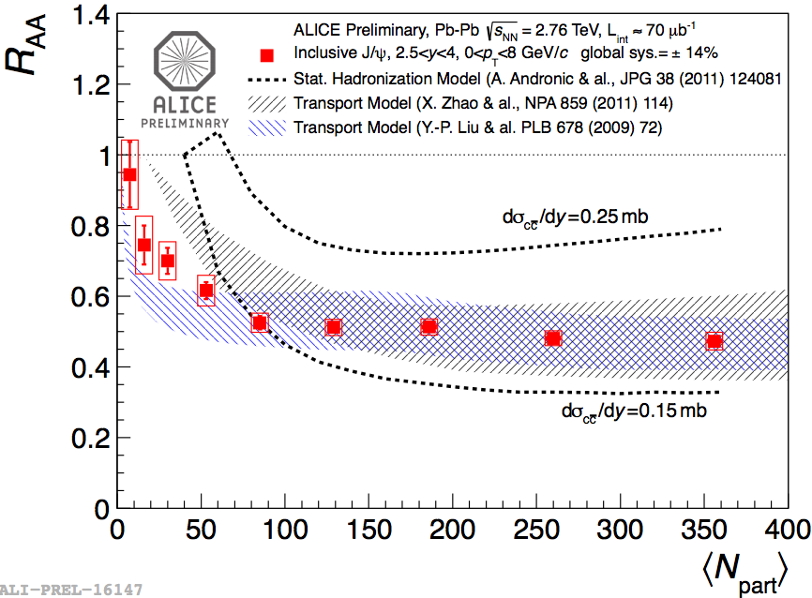
Nuclear modification factor of J/ψ
J/ψ R_{AA} vs <N_{part}>
  Different pattern of J/ψ suppression
  between RHIC and LHC at forward and
  mid-rapidity vs <N_{part}> (all p_{T})
  Less suppression observed at LHC
  Transport model and statistical hadronization
  can reproduce the data
  J/ψ production mechanism at LHC
  determined by regeneration in the QGP or by
  generation at chemical freeze-out
  J/ψ R_{AA} vs p_{T}
    - Transverse momentum dependence of J/ψ
    R_{AA} different between RHIC and LHC
    Less suppression at low p_{T} at the LHC
    Transport model assuming 50% of low p_{T} J/ψ
    produced by recombination of charmed
    quarks in the QGP can describe the data

Slide 7
Elliptic flow v₂ of J/ψ
J/ψ elliptic flow vs p_{T} and centrality
  - Recombination and statistical hadronization models require
  thermalization of charm quark in the QGP → non zero elliptic flow
  expected for charmed hadron and quarkonia
  First measurement of elliptic flow at LHC energies
  Hints for non-zero J/ψ elliptic flow in the p_{T} range 2-4 GeV/c, centrality range
  20-60% (significance 2.2σ). Flow magnitude described by transport models.
  Significance of 3σ reached in the p_{T} range 2-6 GeV/c, centrality 20-40%
  Hints for non-zero integrated J/ψ flow in the centrality range 5-40%
  Precision data needed to extract information on the QGP properties and the
  amount of regeneration

Slide 8
Elliptic flow v₂ of J/ψ
Muon spectrometer
L_{int} = 1nb⁻¹ will improve a lot the present measurement, allowing to measure a non-zero flow at 5σ in 0-6 GeV/c p_{T} range
upgrade data needed for a precise measurement of v₂(p_{T}) as a function of the rapidity
Central barrel
J/ψ elliptic flow measurement only possible with the 10nb⁻¹ data from the upgrade
Notes:
Measurement as a function of the rapidity (even in the rapidity bin 3.7 < y < 4 low detector acceptance and cross sections)

Slide 9
Polarization of J/ψ
Distribution of J/ψ decay products expressed as:
θ and ϕ polar and azimuthal angles, λ parameter
describing the spin state of J/ψ in a given reference frame
First polarization measurement in pp collisions: : λ_{θ} and λ_{ϕ}
consistent with 0 in helicity and Collins-Soper reference
frames
Challenging measurement of J/ψ polarization parameters
in Pb-Pb collisions at low p_{T}: 10nb⁻¹ upgrade needed
Phys. Rev. Lett. 108 (2012) 082001
Absolute error on λ_{θ} and on λ_{ϕ} parameters lower than 0.1
(factor 3-4 improvement in the upgrade scenario with respect to the 1nb⁻¹ scenario)

Slide 10
Electromagnetic production of J/ψ
In ultra-peripheral collisions :
First measurement at LHC of J/ψ photoproduction in UP Pb-Pb collisions
Pb + Pb → Pb + Pb + J/ψ arXiv:1209.3715 [nucl-ex]
Coherent J/ψ production measured. Cross section in 2.6 < y < 3.6 :
dσ/dy = 1.00 ± 0.18 (stat) ± 0.25 (syst) mb
- Probe the nuclear gluon distribution, explore the low-x region
  In the muon spectrometer :
- L_{int} = 1nb⁻¹ : 4000 reconstructed J/ψ in p_{T} range 0-300 MeV/c. Statistical
precision 2-4%. Improvement on the relative error of a factor 5 with respect to the present measurement
- L_{int} = 10 nb⁻¹ : study the photoproduction of ψ’ for the first time : 400 ψ’ expected
(corresponding statistical error : 8%)
Study also feasible in the central barrel
Notes:
Qu est ce qu’il peut etre fait dans le central barrel avec les triggers ultra-peripheriques?
Muon spectrometer (10-2 et 10-5 donne 10-2)
Central barrel (10-3)

Slide 11
Electromagnetic production of J/ψ
In hadronic Pb-Pb collisions
Low p_{T} exces observed below 300 MeV/c in Pb-Pb nuclear collisions
Understanding the phenomena : coherent J/ψ photo-production during the nuclear
collision? How can coherent photo-production and hadronic interaction cohabit?
How photo-produced J/ψ can interact with the QGP?
Study with better precision the low p_{T} exces observed versus the centrality of the
collision
Low-p_{T} exces can be studied in most central collisions with L_{int} = 10 nb⁻¹
Notes:
j/psi can be produced both hadronically and electromagnetically. The spectator fragments act as photon-emitters and targets, like in ultra-peripheral collision.
The photo produced J/psi’s have roughtly the same rapidity distributions as hadroproduced J/psi’s, but have lower transverse momenta and are transversly polarized.

Slide 12
Ψ’ measurement
ψ’ over J/ψ double ratio vs N_{part}
CMS measurement (3 < pt < 30 GeV/c) enhancement of ψ’ production with respect to J/ψ in Pb-Pb compared to pp collisions. ALICE data seems to disfavore the enhancement
No firm conclusion on ψ’ enhancement or suppression with centrality within current statistical and systematic uncertainties
Key measurement which allows to disentangle between statistical model and transport model

Slide 13
Ψ’ measurement
Challenging measurement due to low cross sections and small branching ratio in dileptons
2 scenarios considered for the estimations of the relative statistical error on ψ’ in the muon spectrometer :
  Production yields given by statistical models
  Scaling from pp collisions to Pb-Pb with the number of binary collisions
Good precision reached in the upgrade scenario even in an hypothesis of low ψ’ production in thermal model scenario
Possibility to study ψ’
elliptic flow

Slide 14
Résumé des “Physics Cases”
Ecoulement elliptique du J/ψ ➔ Précision.
Polarisation du J/ψ ➔ Mesure.
Production électro-magnétique de J/ψ ➔ Mesure en central, précision en périphérique.
Production du ψ’ ➔ Mesure ou Précision en fonction de la physique.
Et aussi: Single muon à haute p_{T} et Upsilon RAA ➔ Unique au LHC à l’avant.

Slide 15
Muon tracking Upgrades

Slide 16
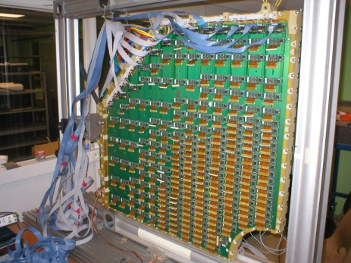
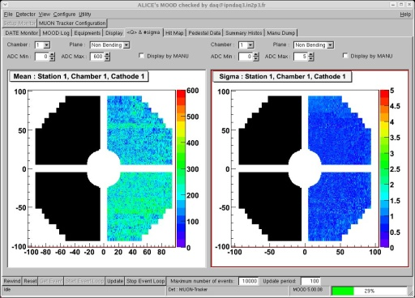
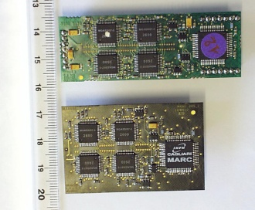
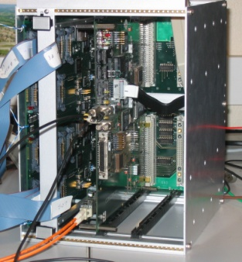
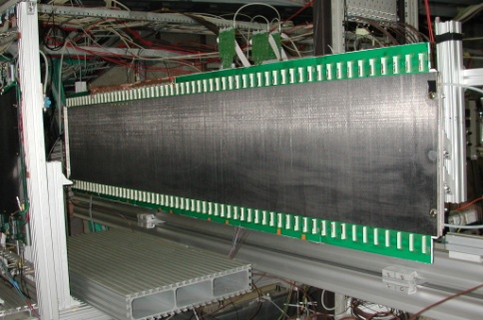
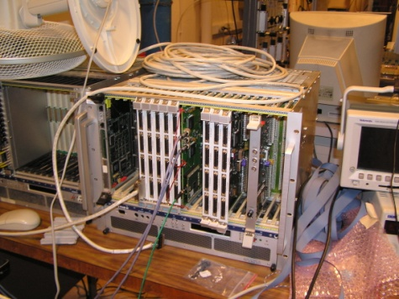
Upgrades électronique MUON tracking
DAQ
ECS
Slow Control
Problématique : Design actuel -> taux d'acquisition maximal à 1kHz
Avec les spares :
~ 20000 cartes MANUS
~ 900 bridges et 1200 translateurs plus les bus
22 CROCUS
1 système de distribution des triggers
Coût total de la production, hors coût des MARC et MANAS : ~ 900 k€
Estimation coût MARC et MANAS ~ 500 k€
Read-out prévu à au moins 5kHz de triggers dimuons. Temps de lecture < 20 μs pour avoir un temps mort de ~ 10% à 5kHz.
Projet d'upgrade de cette électronique décrit dans la LOI des upgrades d'ALICE.
ST12
MANU : FEE
CROCUS : Readout
ST345
TCI : distribution du trigger et gestion des Busy

Slide 17
Proposition d'upgrade de l'électronique.
Plusieurs étapes :
Upgrade des CROCUS : passage à des CROCUS à base de FPGA récents -> simplification de l'architecture et augmentation des performances. Objectif que les CROCUS n'aient pas d'impact sur le temps de lecture. Cet upgrade seul ne permettra pas de descendre en dessous de 60 μs. Projet approuvé par la direction de l'IPNO. Coût ~ 200 k€. (3 ETP)
Changement des bus. Passage à des bus en LVDS permettant des débits jusqu'à 2,5 Gbits/s (160 Mbits/s actuellement en LVTTL avec nouveau CROCUS) + fractionnement des ces bus. Gain espéré : passage pour les buspatch les plus chargés de 22 μs de temps de lecture (avec nouveau CROCUS) à 1,4 μs (avec nouveau CROCUS et nouveau MANUs). Actuellement en discussion. Participation INFN Cagliari. Coût ? ETP?
Changements des MANUs : temps de traitement des données par le MANU de 40 μs. Actuellement incompressible. Objectif réaliser de nouveaux MANUs avec un temps de lecture bien inférieur à 20 μs (10 μs ?) pour avoir un budget temps total < à 20 μs. Actuellement en discussion. Coût, nouveaux ASIC : ~1,1 M€. ETP?

Slide 18
Muon Trigger Upgrades

Slide 19
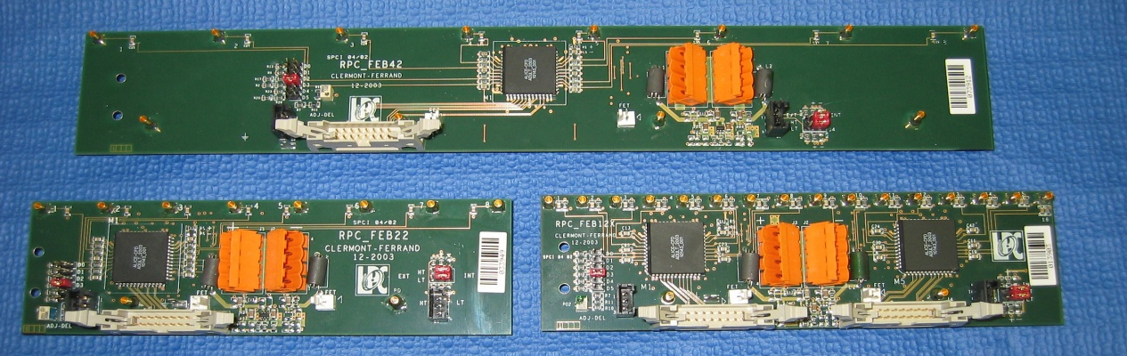
Upgrade du FEE du Muon Trigger
Forts taux de comptage attendus sur les détecteurs RPCs => vieillissement rapide des RPCs dans le mode de fonctionnement actuel (“avalanche saturée”)
Afin de limiter le vieillissement des RPCs => passage en mode de fonctionnement “avalanche” des RPCs
  Signaux beaucoup plus petits : ~ 30-50 fC (vs ~1000 fC actuellement)
  Nécessite le remplacement du FEE => ajout d’un étage d’amplification
  Nécessite une R&D (~1 an) pour étudier le bruit, fixer gain et seuil, etc
2384 (+ spares) cartes FEE
  Pas de solution (ASIC) disponible clé en main (!)
  La R&D a commencée depuis mai 2012 (2 cartes prototype en construction, étude d’un ASIC)
Projet approuvé au LPC
Support de nos collègues italiens
Projet décrit dans la LOI des upgrades d’ALICE
19

Slide 20
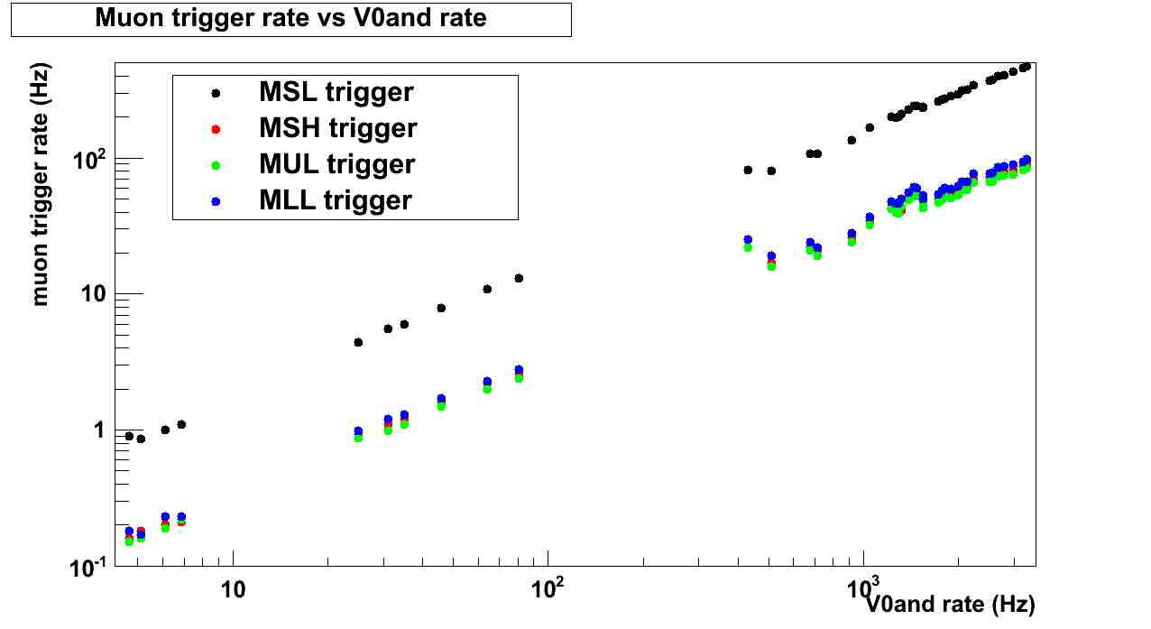
Upgrade Electronique de Readout
du Muon Trigger
Readout plus rapide pour répondre à l’augmentation des taux de trigger
  5 kHz max. de triggers (di-)muons attendus en Pb-Pb
  Temps de readout ~100 µs actuellement => 30% deadtime à 5 kHz !!
  But = temps de readout de ~10 µs => < 10% deadtime à 5 kHz
  Remplacement des 16 cartes de décision Regional
  Remplacement des 2 cartes de readout DARC
  Projet pris en charge par Subatech
⇒ Extrapolation :
50 kHz MB PbPb
⇓
<5 kHz (di-)muons
cocktail
Pb-Pb 2011
Pb-Pb 2011

Slide 21
Coût et Manpower
de l’upgrade du Muon Trigger
Manpower Services Techniques
  LPC (FEE)
    1 FTE Electronique sur la durée
    < 1 FTE micro-électronique en 2013-2014
  Subatech (Readout)
    1.2 FTE (PCB+FPGA).
    0.5 FTE (software). A voir: implication software read-out MFT.
Evaluation (LOI) du Budget de construction (hors R&D)
 | 2013 (kCHF) | 2014 (kCHF) | 2015 (kCHF) | 2016 (kCHF) | 2017 (kCHF) | TOTAL (kCHF) | TOTAL (k€)
FEE (LPC) | 0 | 50 | 120 | 70 | 0 | 240 | 200
Electronique de Readout (Subatech) | 12 | 0 | 51 | 72 | 0 | 135 | 113
Gas system (Italie) | 0 | 30 | 50 | 40 | 0 | 120 | 100
Total | 12 | 50 | 171 | 142 | 0 | 375 | 313
R&D
  LPC (FEE) : 0 K€ (2012, sur reliquats), 15 k€ (2013)
  Subatech (Readout): 10 k€ (2013) et 15 k€ (2014)
Coûts nouvelles interfaces CPT et DAQ difficile à budgétiser. Missions au CERN seront nécessaires pour valider avec le banc de test officiel d’ALICE.
21

Slide 22
Prevision des moyens techniques de l’UPGRADE du SpectromEtre

Slide 23
Prévision Moyens Techniques
 | Clermont |  | Nantes |  | Orsay |  | Total
Projets | Trak | Trig | Trak | Trig | Trak | Trig | Trak | Trig
2013 | 0 | 2 | 0 | 1.2 | 3 | 0 | 3 | 3.2
2014 | 0 | 2 | 0.5 | 1,7 | 3 | 0 | 3.5 | 3.7
2015 | 0 | 1 | 0.5 | 1.7 | 3 | 0 | 3.5 | 2.7
2016 | 0 | 1 | 0.5 | 0.5 | 3 | 0 | 3.5 | 1.5
Unités: Equivalent Temps Plein
Core upgrade Muon tracking 1300 k€
Core upgrade Muon trigger 313 k€
Total 1.6 M€.

