Slide 1
Review on experimental results on quarkonium production
Javier Castillo
CEA Saclay – Irfu/SPhN

Slide 2
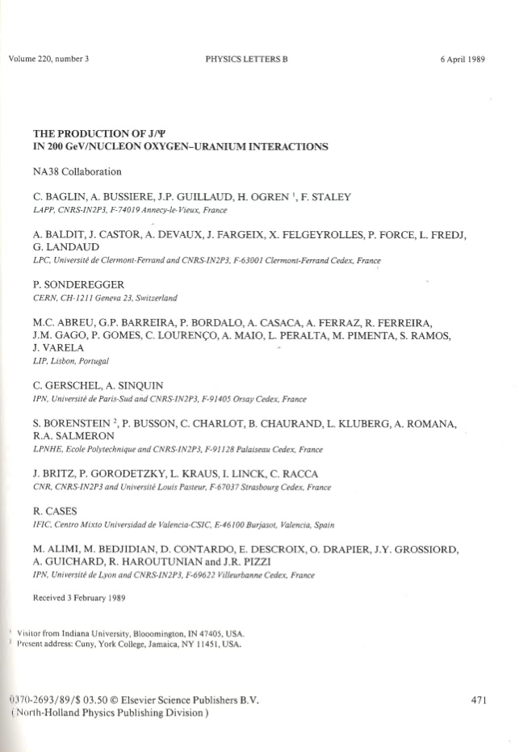
It all started back in 1986 …

Slide 3
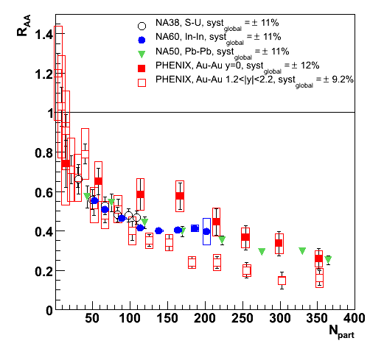
… but let’s take this as starting point
Two big open questions
  SPS vs. RHIC: Similar suppression pattern and magnitude
  RHIC: Stronger suppression at forward rapidity
Interplay of three “mechanisms”:
Cold Nuclear Matter effects
Sequential suppression by colour screening
Recombination of deconfined c quarks – anti-quarks

Slide 4
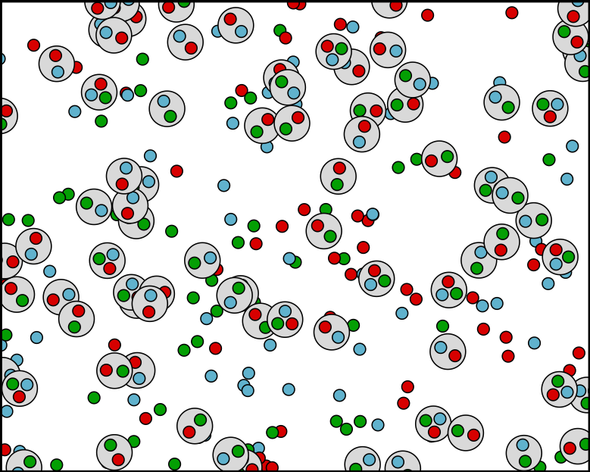
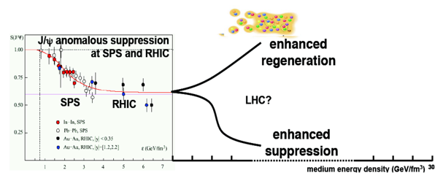
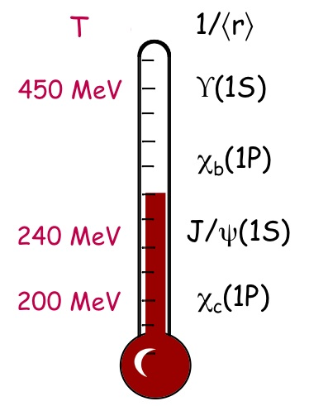
Quarkonia, heavy ions and the QGP?
If c-cbar pairs are abundantly produced and thermalize with the medium, recombination could compensate or exceed colour-screening suppression
“Cold Nuclear Matter” effects could alter the quarkonium yields: nuclear absorption, gluon shadowing, …
Matsui & Satz,
PLB168 (1986) 415
Sequential quarkonium suppression by colour-screening could provide a measurement of the QGP initial temperature
ϒ(1S)
χ_{b}
J/ψ, ϒ(2S)
χ_{c}, χ’_{b}, ψ’, ϒ(3S)
Mocsy, EPJC61 (2009) 705
BNL workshop in June

Slide 5
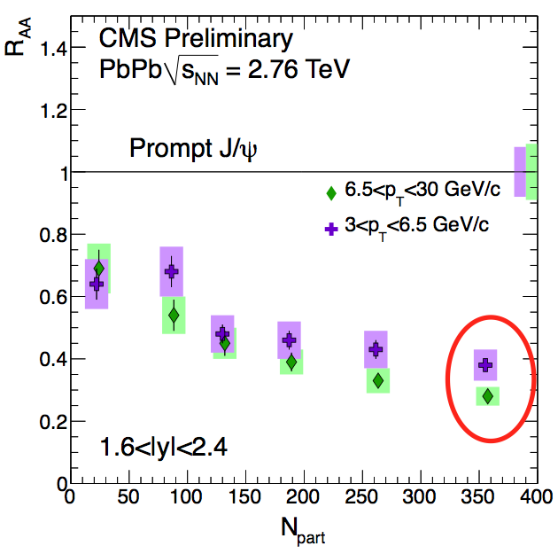
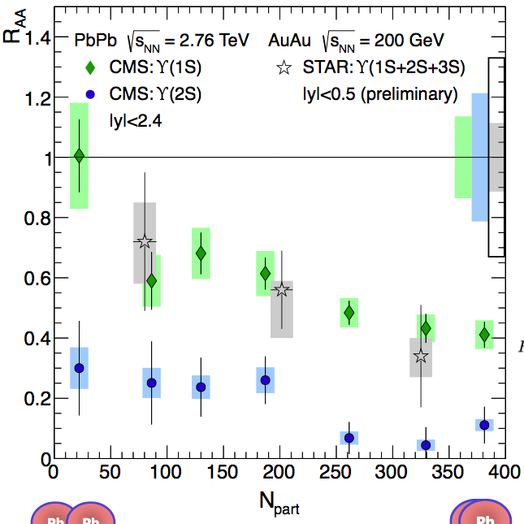
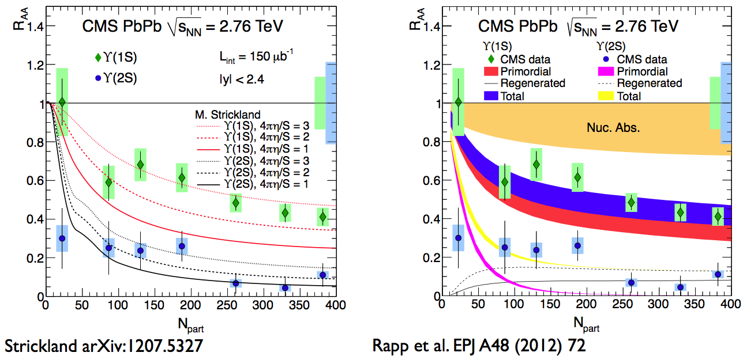
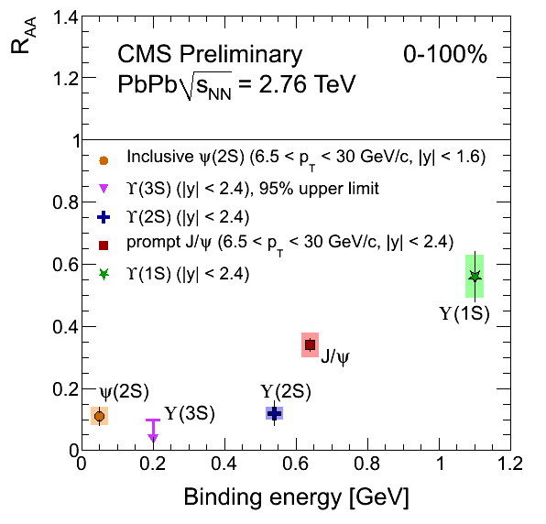
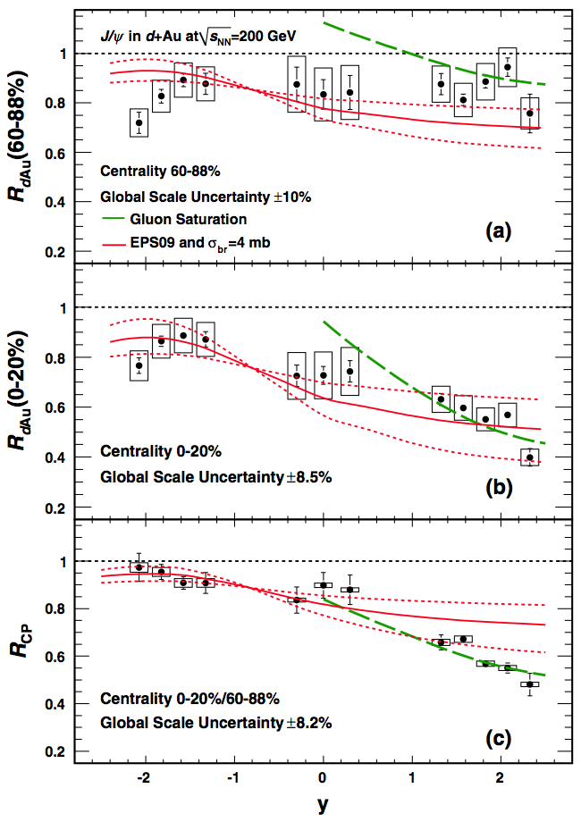
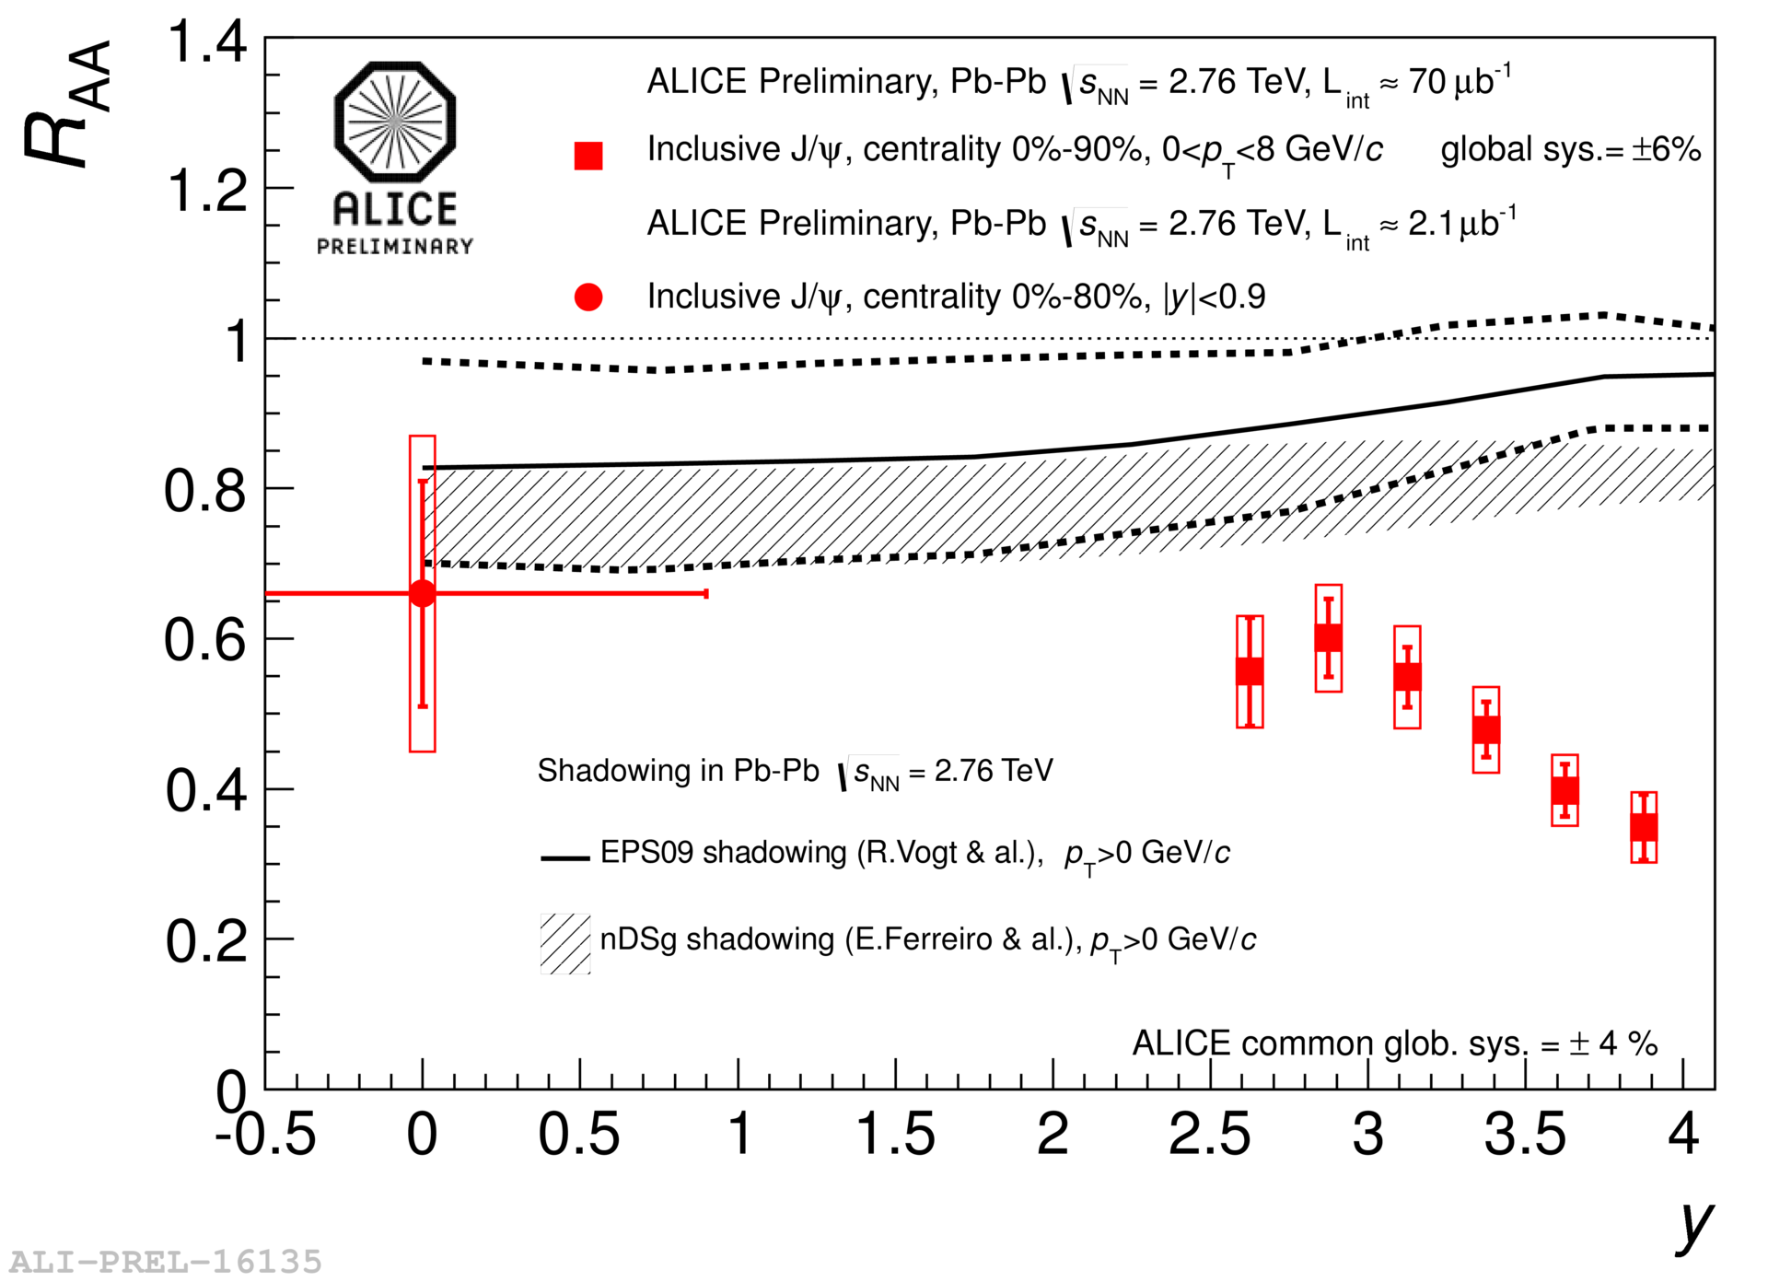
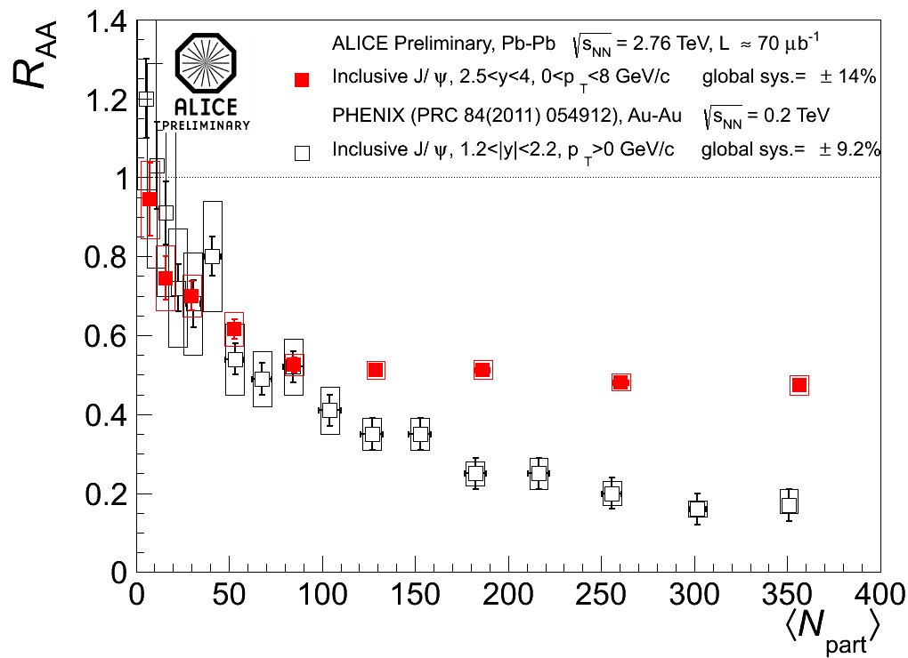
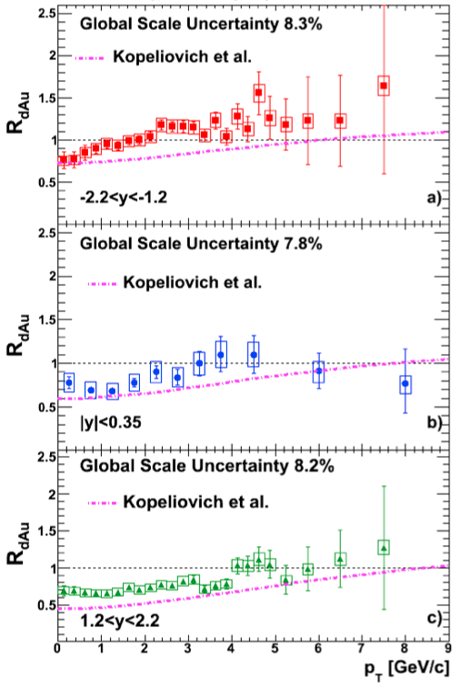
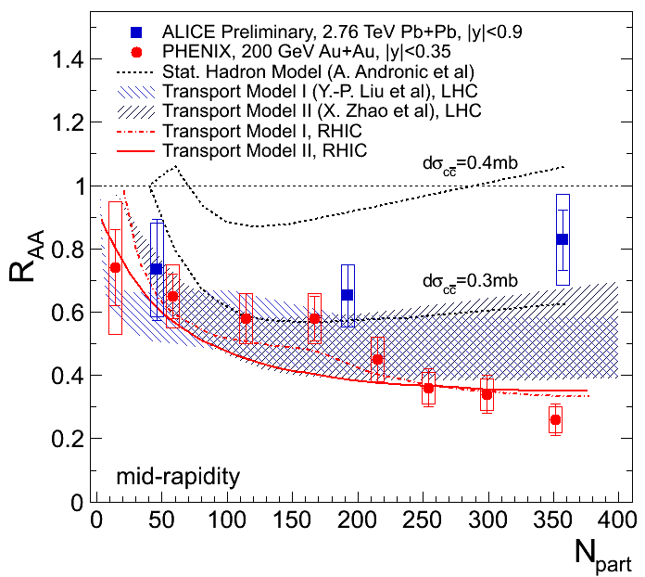
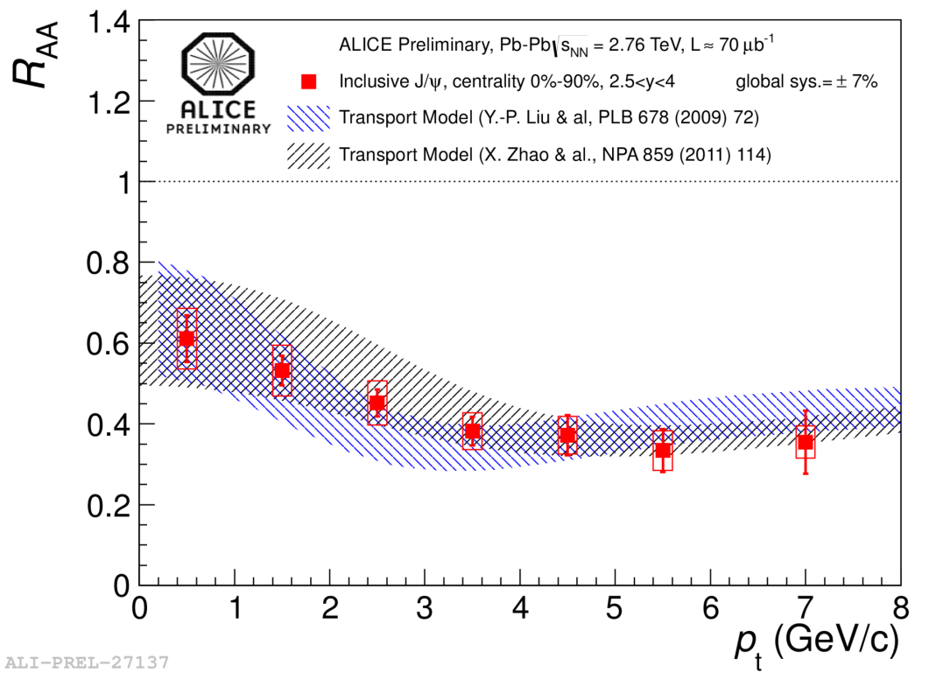
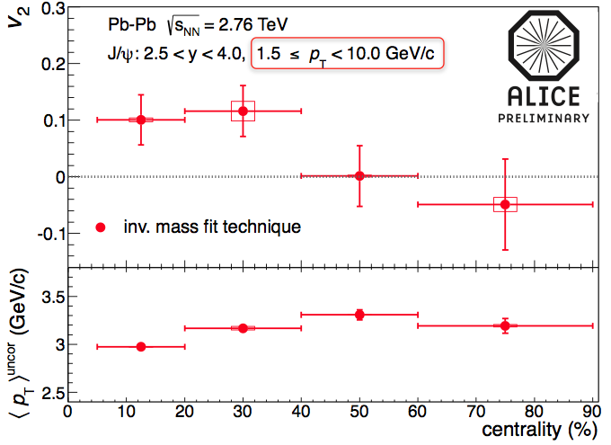
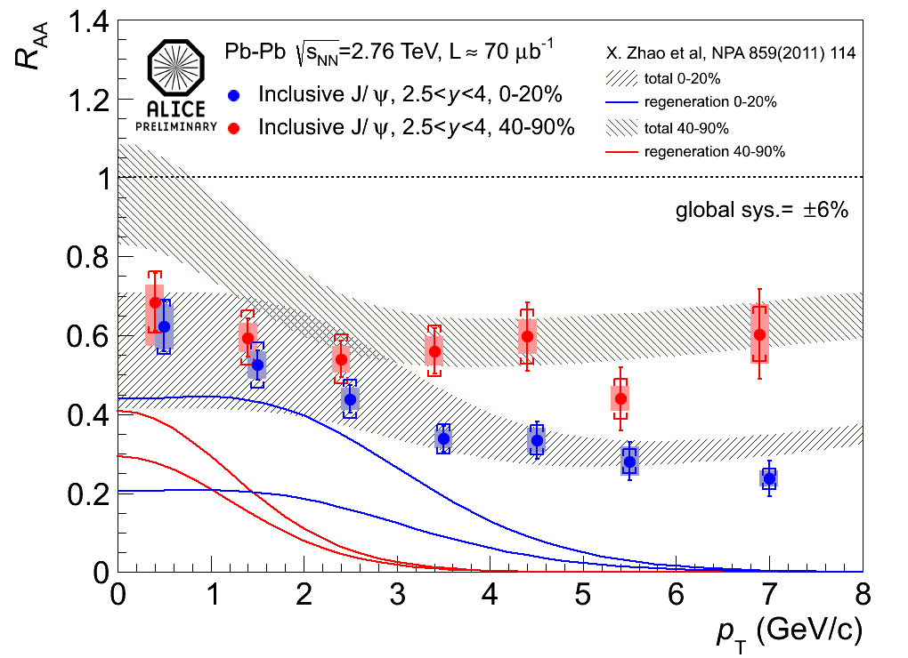
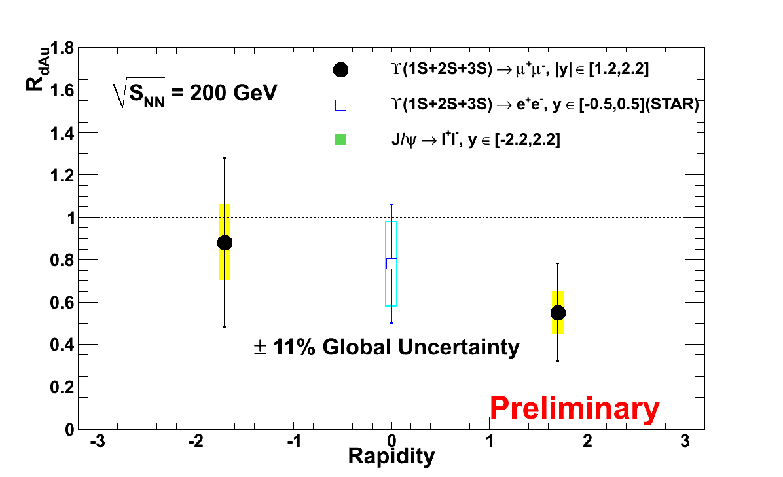
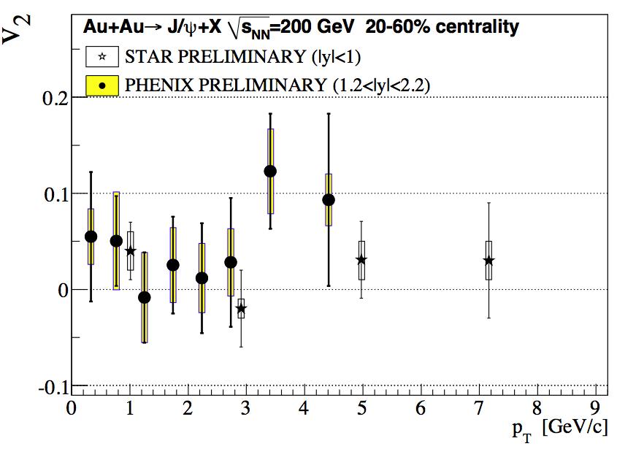
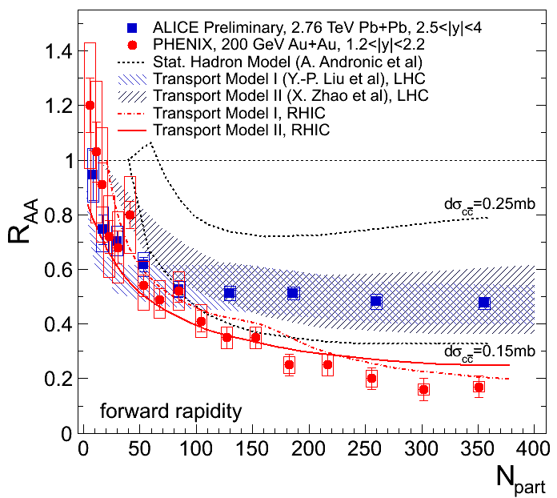
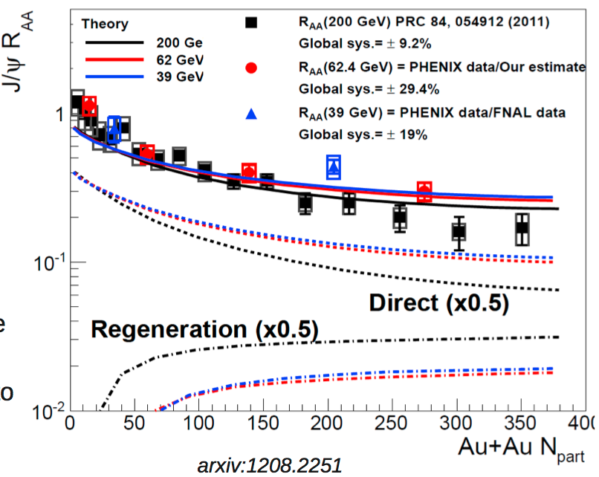
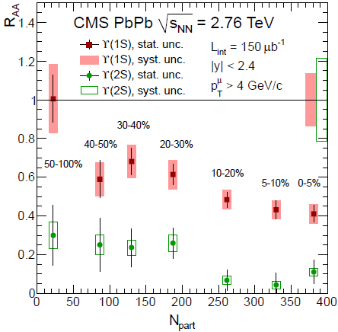
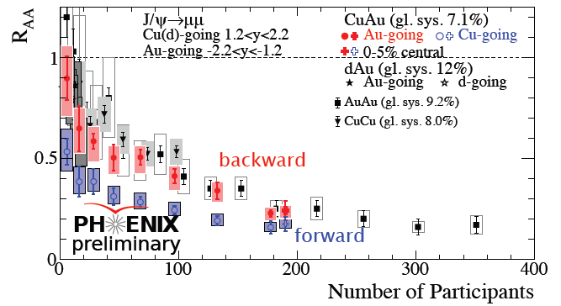
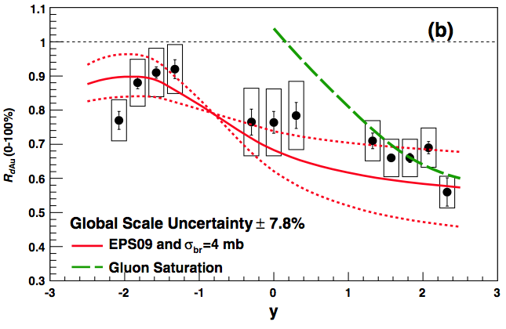
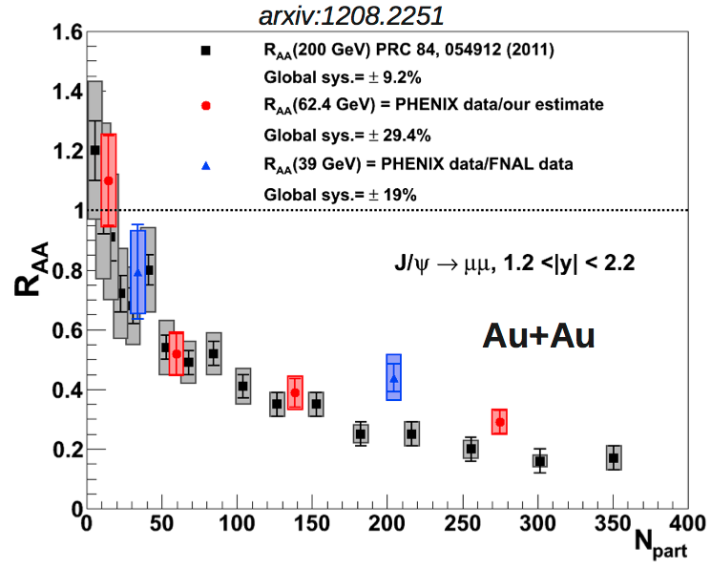
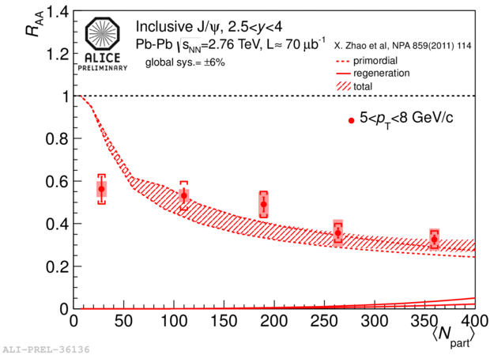
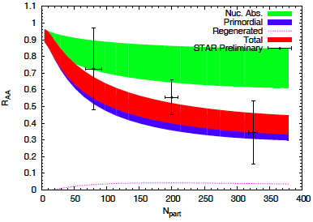
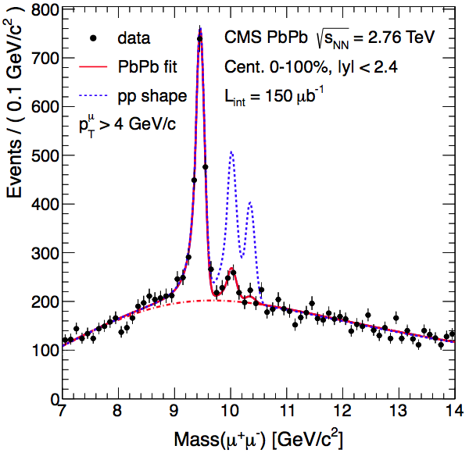
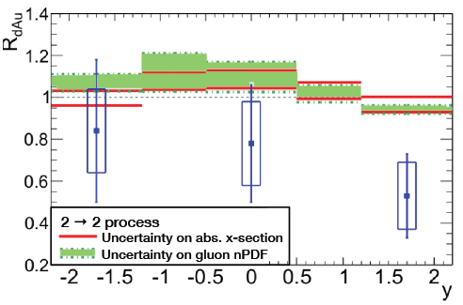
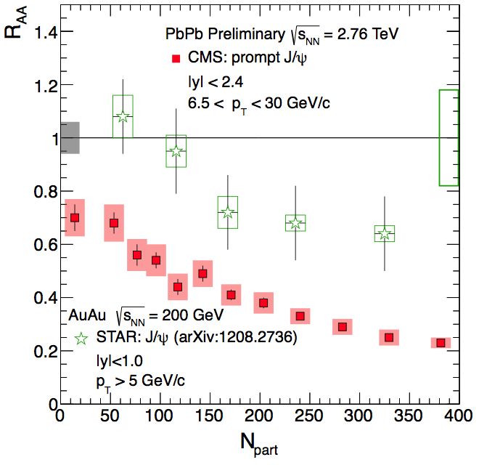
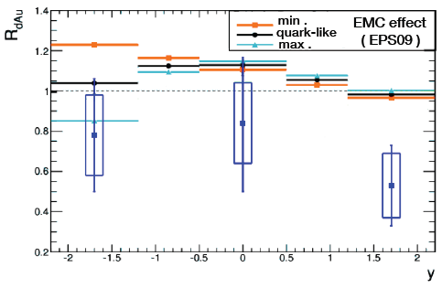
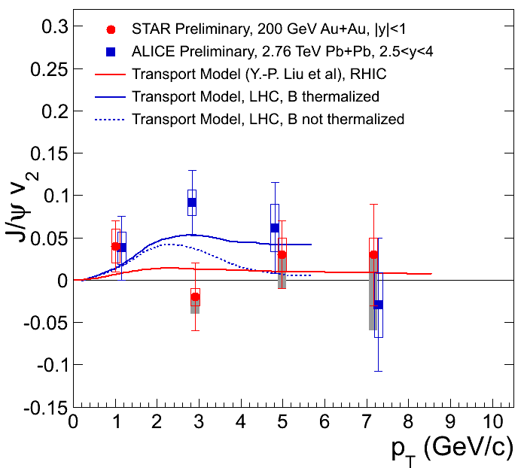
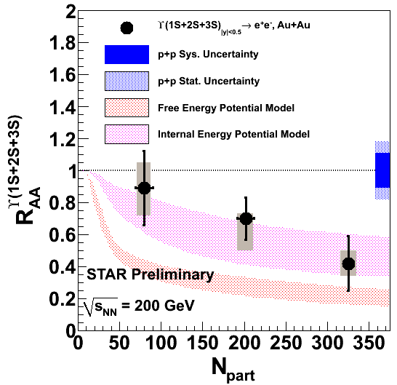
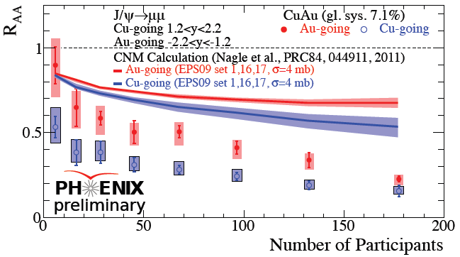
Here is the review of experimental results …
recombination

Slide 6
How to sort them out?
By collider? RHIC, LHC
By experiment? PHENIX, STAR, ALICE, CMS
By energy? 39, 62, 200, 2760 GeV
By colliding system? dAu, CuAu, AuAu,PbPb
By quarkonium? J/psi family, Upsilon family
By observable? R_{dAu}, R_{AA}, double ratio, v₂, …

Slide 7
… or by “mechanism”
CNM
Sequential Suppression
Regeneration
recombination

Slide 8
About Cold Nuclear Matter Effects

Slide 9
CNM: figure of merit
High precision J/ψ data in dAu @ RHIC by PHENIX!
Long awaited data to establish a solid baseline for CNM suppression at RHIC … did we?
PRL 107 (2011) 142301

Slide 10
PHENIX J/ψ R_{dAu} @ 200 GeV
MinBias R_{dAu} versus rapidity
With some tension, EPS09 nPDF with σ_{br}=4 mb does a reasonable job
PRL 107 (2011) 142301

Slide 11
Centrality dependence of J/ψ R_{dAu}
Strong centrality dependence of J/ψ R_{dAu}
Unexplained by EPS09 with single nuclear breakup cross-section
Described well by CGC at forward rapidity.
  Unclear how valid CGC model is in peripheral events?
PRL 107 (2011) 142301

Slide 12
J/ψ R_{dAu} vs. pt vs. theory
Calculations from Kopeliovich et al. (Nucl. Phys. A 864, 203 (2011))
  Nuclear Shadowing → nDSg nPDF set.
  Nuclear Break-up → frozen dipole approximation.
  Not parameterized from RHIC data. Includes Cronin Effect.
What about backward rapidity?

Slide 13
Upsilon R_{dAu} @ 200 GeV
There is a rapidity dependence of the ϒ R_{dAu}
Which is not really well understood by models
arXiv:1207.6649
NPA855 (2011) 440

Slide 14
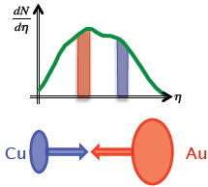
J/ψ results in 200 GeV Cu+Au
Hollis @ QM
In Cu+Au collisions:
R_{AA}(Au-going) > R_{AA}(Cu-going),
qualitatively described by CNM but not quantitatively
Additional suppression suggests hot, dense medium effect
Notes:
14

Slide 15
About Sequential Suppression

Slide 16
Sequential suppression: figure of merit
arXiv:1208.2826
○(1s) suppression magnitude consistent with excited states suppression.
○(2S) strongly suppressed
○(3S) completely melted.
Notes:
16

Slide 17
J/ψ R_{AA} @ RHIC vs. energy
arxiv:1208.2251
Zhao & Rapp
arxiv:1208.2251
Observe similar suppression at 200 & 62 & 39 GeV
Combined QGP effects are similar at each energy
  Direct suppression changes by ~50%
  Regeneration compensates for the change.
CNM effects expected to be different at the different energies.

Slide 18
J/ψ suppression at high p_{T}
CMS-PAS-HIN-12-014
J/psi at high p_{T}
  Stronger suppression at LHC than at RHIC
  Or in “plain” stronger suppression with higher T
Arnaldi @ QM
Transport models, including colour screening, describe the data with a negligible contribution from recombination
recombination
Notes:
18

Slide 19
ϒ suppression
ϒ (1S+2S+3S) also suppressed at RHIC energies
  R_{AA}(ϒ (1S+2S+3S)) = 0.56±0.21+0.08-0.16
At LHC
  R_{AA}(ϒ (1S+2S+3S)) ~ 0.32
Similar suppression pattern
arXiv:1208.2826
Trzeciak @ QM
Notes:
19

Slide 20
ϒ R_{AA} @ RHIC vs. models
Trzeciak @ QM
Incorporating lattice-based potentials, including real and imaginary parts (M. Strickland, PRL 107, 132301 (2011))
  Internal energy: Consistent with data vs. N_{part}
Includes sequential melting and feed-down
  ~50% feed-down from χ_{b}
Dynamical expansion, variations in initial conditions (T₀, η/S), data indicate:
  428 < T₀ < 442 MeV at RHIC
  for 3 > 4πη/S > 1
“Strong” binding (Emerick, Zhao & Rapp. EPJ A (2012) 48:72):
  Mostly consistent with data
  Little regeneration: Final result ~ Primordial suppression
  Large uncertainty in nuclear absorption. Need dAu, pPb.
  T ≈ 300 MeV
    Would like to see sensitivity to initial temperature.

Slide 21
ϒ R_{AA} @ LHC vs. models
arXiv:1208.2826
Strickland, arXiv:1207.5327
  Difficulties to simultaneously describe Υ(1S) and Υ(2S) with the same η/S value
Rapp et al., EPJ A48 (2012) 72
  Regeneration and nuclear absorption could be significant also for bottomonia!

Slide 22
The propaganda plot
Mironov @ QM
Notes:
22

Slide 23
About Regeneration

Slide 24
Regeneration: figure of merit
Phys. Rev. Lett. 109 (2012) 072301
arXiv:1208.5601
J/ψ at low p_{t}
  Smaller suppression at LHC than at RHIC!
  Or in “plain”, more recombination at higher c-cbar pair density
  At LHC, no centrality dependence of R_{AA} for N_{part} > 100

Slide 25
J/ψ R_{AA} vs. centrality
Inclusive J/ψ with p_{t} > 0 GeV/c
  For both, mid- and forward rapidity smaller suppression at LHC than at RHIC
  Reasonable description by models including a significant regeneration component
arXiv:1210.5818
PRL 98, 232301 (2007)
arXiv:1208.5601
PRC 84, 054912 (2011)
Notes:
25

Slide 26
J/ψ R_{AA} vs. p_{t}
Regeneration component is expected to contribute mainly at low transverse momentum
0-90%
arXiv:1211.2578
0-20% vs 40-90%
total
recombination
Suppression is stronger for high p_{T} J/ψ
Splitting in centrality bins we observe that the difference low vs high p_{T} suppression is more important for central collisions

Slide 27
Prompt J/ψ
CMS measures prompt J/ψ at mid rapidity and high transverse momentum
Restricting their y range allows them to lower the pt reach
Slightly less suppression in most central collision at low p_{T} than at high p_{T}
Mironov @ QM

Slide 28
Inclusive J/ψ R_{AA} vs. rapidity
The y-dependence of inclusive J/ψ R_{AA} can’t be accounted for by current shadowing model calculations
At mid-rapidity current shadowing estimations leave almost no room to any suppression. In other words a strong regeneration is required.
arXiv:1210.5818

Slide 29
J/ψ elliptic flow
If c quarks participate to the collective motion of the QGP, then they will acquire some elliptic flow
Regenerated J/ψ will inherit their elliptic flow
Non-zero J/psi v₂ observed at intermediate p_{T} for semi-central collisions at LHC
Qualitatively described by models including regeneration
arXiv:1211.0799
arXiv:1208.5401
JPG38, 124107 (2011)
Notes:
29

Slide 30
J/ψ elliptic flow @ RHIC
New v₂ preliminary measurement from PHENIX
  Hint of non-zero v₂?
  Disagreement with STAR preliminary result?
  Hint of regeneration?
Maybe this plot should be moved to the next section …
da Silva @ IWHQP
JPG38, 124107 (2011)
Notes:
30

Slide 31
Unexpected and Unexplained

Slide 32
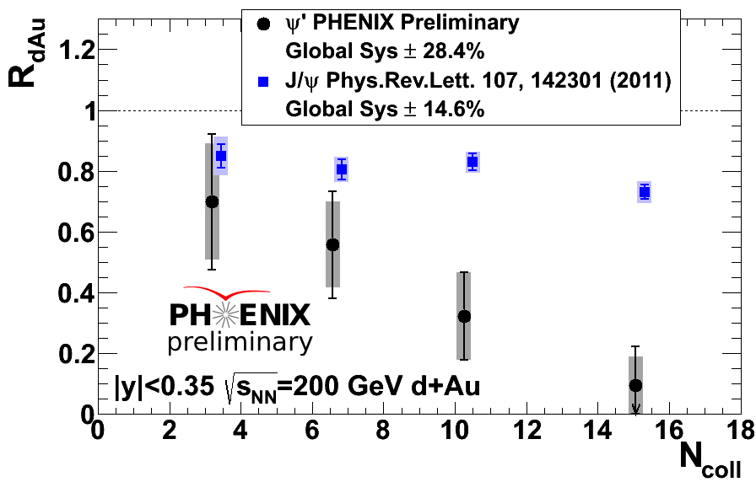
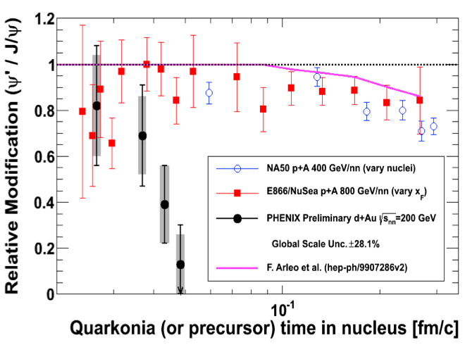
ψ’ suppression in dAu @ RHIC
Strong suppression with increasing N_{coll}!
Centrality dependence of suppression much stronger than J/ψ result at mid-rapidity.
R_{dAu}(ψ’) < R_{dAu}(J/ψ) by a factor of 5 in most central dAu
Such effect already seen at lower energy
  Not as strong
  Same explanation (based on formation time) does not hold at RHIC
McGlinchey @ QM
Notes:
32

Slide 33
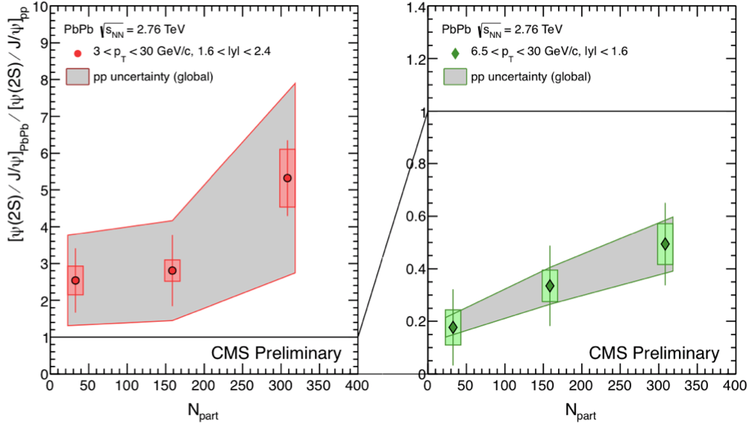
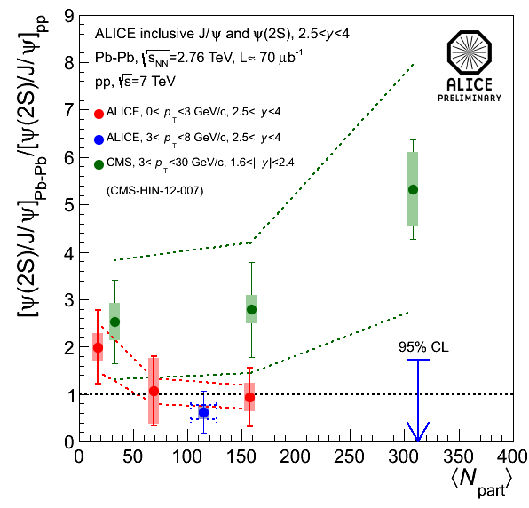
Again surprising ψ’ … at LHC
Dahms @ IWHQP
ALICE
No sign of large ψ(2S) enhancement
CMS
For p_{T} > 3 GeV/c and 1.6 < |y| < 2.4:
  ψ(2S) seems less suppressed than J/ψ
For p_{T} > 6.5 GeV/c and |y| < 1.6:
  ψ(2S) are more suppressed than J/ψ
Don’t panic yet, more data is needed!
arXiv:1211.2578

Slide 34
Summary
Sequential suppression of quarkonium resonances is observed
  Upsilon family
  High transverse momentum charmonia?
The regeneration mechanism do play an important role in charmonium production
  J/ψ R_{AA} at low transverse momentum is higher at LHC than at RHIC
  Centrality, p_{T} and y dependence of J/ψ R_{AA}
  Non-zero J/ψ v₂
“Cold Nuclear Matter” effects are (still) the usual supects
  High precision dAu is here, but do we understand it?
  (Should we) look forward for the pPb data at LHC (?)

