Slide 1
TREND DAQ meeting
IHEP, September 7, 2012

Slide 2
Agenda
DAQ status & implementation
Limitations & upgrades
Automatization (Fabio)
DAQ treatment vs writing speed… Can we improve it?
Online monitoring
Pretreatment @ Ulastai
Offline software
Structure modification with pretreatment@Ulastai
Move to France-Asia VO
(+ job management with Dirac)?

Slide 3
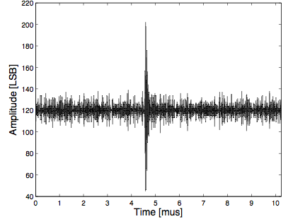
Trigger principle / Buffer analysis
T0:
On each machine uNANT (NANT in 101-158):
For every new buffer, compute σ_{noise} over 1024 samples of 1st sub-buffer.
If sample i with amplitude A_{i} > N x σ_{noise} , trigger of level T0 on this antenna. 6<N<10.
T1:
If at least 4 antennas have T0 triggers within a causal time window (Δt<ΔL/c), then data is sent to disk on machine u183 for all antennas with T0s
to data file R[NRUN]_A[NANT]_data.bin: 1024 samples centered on sample i
to time file R[NRUN]_A[NANT]_time.bin :
UNIX second of sample i
Buffer index of sample i
Subbuffer index of sample i
Position of sample i in subbuffer.
Code in C. Master program in python.
Ν x σ_{noise}
σ_{noise}
5

Slide 4
DAQ structure
Odd buffer
ADC writes:
2²⁸ samples at 200MSamples/s : ~ 1.34s
Even buffer
CPU reads:
Selects T0s
Sends to master (u183)
Receives T1 decisions
Writes to u183 disk

Slide 5
DAQ: data process time
Averaged over Feb-June 2012 (70 days acquisition)
Very preliminary analysis
Full process time ()~ ADC write time
T1 () is (very) fast… mostly waiting for all antennas to send their T0s.
T0 () large on some slow antennas (110, 111, 117, 118, 133, 138, 153, 157).
Fraction of buffer skipped () is ~20% at crosspoint, <10% at East.
10 antennas with T0 rate> 256/buffer for 20% of time ()
Acquisition close to limit!

Slide 6
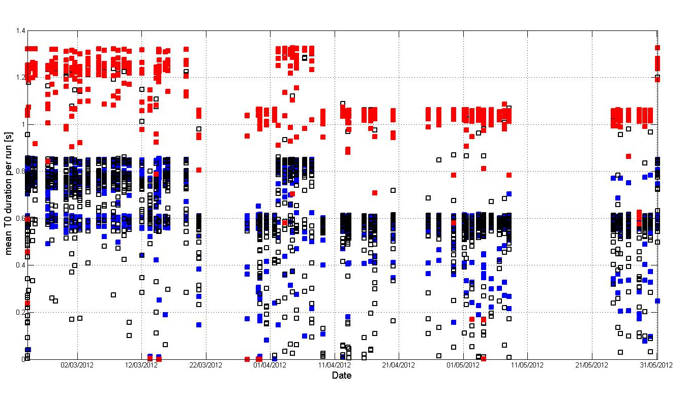
T0 treatment time
Some antennas are alwaysslower than the others, not depending on trigger conditions,
process (crosspoint or east), etc.
Theses machines could be the bottle neck of the DAQ treatment. To be checked.
Cross point antennas [121-158]
■ East arm antennas [101-120]
■ Antennas 110, 111, 117, 118, 130, 133, 138, 153, 157

Slide 7
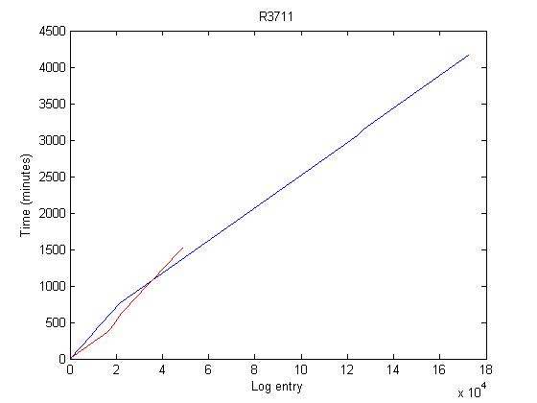
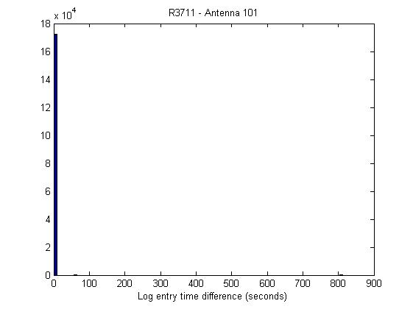
Stalling DAQ
Period of log writing can differ from the expected 1.34s
(once per loop)… DAQ seems to stale sometimes.
Together with DAQ crashes, stalling DAQ accounts on average for a loss of 30% of acq. time (up to 45% for some antennas)
Antenna 101: log entry up to 4500 mins
Antenna 101: most Δt=1.34s (as expected)
ex:R3711
Time [mn]
Antenna 101: one log entry ~80s after the previous one.
Antenna 121: no more log entry after 1500 mins
Log entry ID
Log entry Δt [seconds]
Total acquisition time
■ DAQ out (crashes + stalled DAQ)
■ Antenna monitored (PSD measurement present)
■ Antenna up (PSD OK)

Slide 8
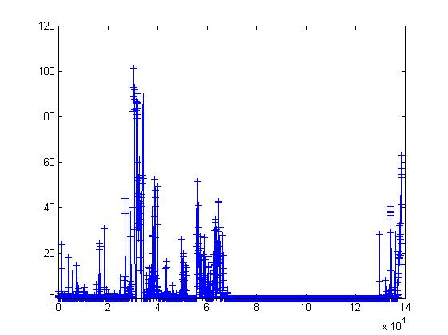
DATA PREPROCESSING:
CONSECUTIVE COINCIDENCES
Example of run 3577
49 antennas
Total duration: ~38h30
Number of events: 4.452.938
Number of coincs: 633.918
Coincidence rate (Hz)
Time (s)

Slide 9
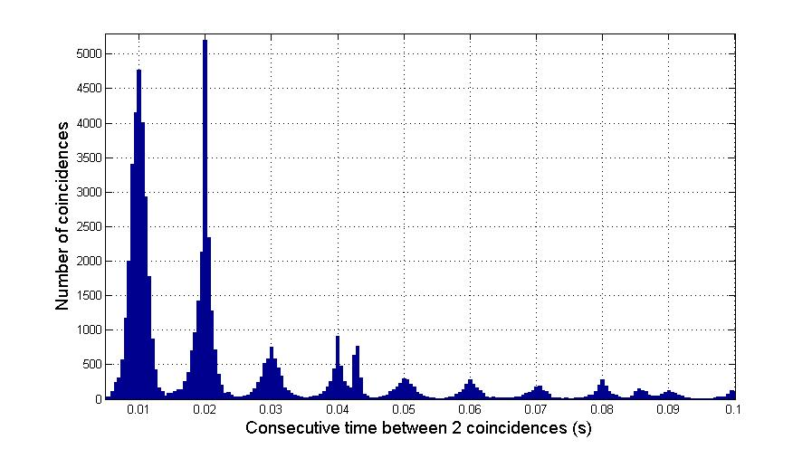
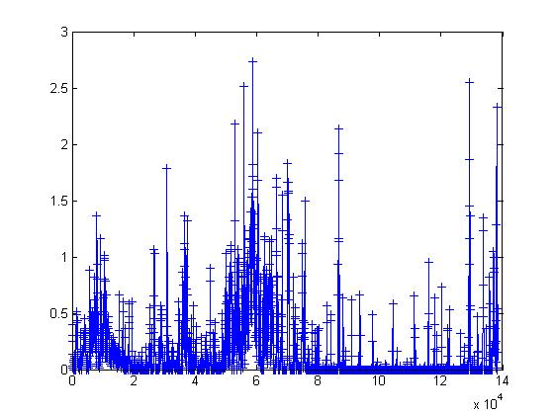
DATA PREPROCESSING:
CONSECUTIVE COINCIDENCES
Rejection of events with Δt consecutive = n.10 ms
Main source of pollution: power line (50Hz)
On run 3577: 67.406 coincidences remaining (89% rejection)
Influence on acceptance?
(mainly cross-point events, estimated dead-time ~10%)
10 ms
Coincidence rate (Hz)
Time (s)

Slide 10
(Matlab) offline code for the rejection of consecutive coincs
while Ref<size(Evt,1)
% List of hit antennas for ref event
TagRef=find(Tag(Ref,:)==1);
% List of hit antennas for following event
TagCons=find(Tag(Ref+1,:)==1);
% Minimal time on ref antenna
TimeRef=min(Time(Ref,TagRef));
% Minimal time on following antenna
TimeCons=min(Time(Ref+1,TagCons))
% Common antennas on both events
ComAnt=intersect(TagRef,TagCons);
if ~isempty(ComAnt)
TimeDiffTotal=Time(Ref+1,ComAnt)-Time(Ref,ComAnt);
TimeDiff(Ref)=min(TimeDiffTotal);
else % No antennas in common between the 2 cons coincs
TimeDiffTotal=0;
TimeDiff(Ref)=mean(Time(Ref+1,TagCons))-mean(Time(Ref,TagRef));
EvtFlag(Ref)=1;
end;
end;
% params rejection
freqpeak=10e-3; % peak every 10 ms
lowerlimit=1e-3; % reject all events under
limit=3e-3;
nsigma=2;
% Select cons coincs with Delta time < 100 ms
ind=find(TimeDiff<100e-3);
Deltat=TimeDiff;
if ConsCoincCompleteRejection==0
% Reject all coincs with Delta<3ms
indlow=find(Deltat<lowerlimit);
Reject(indlow)=1;
Reject(end)=0; %% last one TimeDiff=0 for sure, avoid direct rejection
% loop on all peaks
for i=10e-3:freqpeak:upperlimit
% Get coincs with DeltaT in range N.10ms ±3ms
inddt=find(Deltat<i+limit & Deltat>i-limit);
[a,b]=hist(Deltat(inddt),min(Deltat(inddt)):0.5e-3:max(Deltat(inddt)));
Dtmax=b(find(a==max(a)));
if ~isempty(Dtmax)
Dtmax=Dtmax(1);
indmax=find(abs(Deltat-Dtmax)==min(abs(Deltat-Dtmax)));
if length(indmax>1)
indmax=indmax(1);
end;
indzone=find(Deltat<Deltat(indmax)+limit & Deltat>Deltat(indmax)-limit);
stdzone=std(Deltat(indzone));
% rejection
indreject=find(Deltat<Deltat(indmax)+nsigma*stdzone & Deltat>Deltat(indmax)-nsigma*stdzone);
Reject(indreject)=1;
if indreject+1<=size(Evt,1)
Reject(indreject+1)=1; % reject consecutive event
end;
end;
clear inddt indzone indmax Dtmax
end;
else
Very short
Straightforward
Only requires list of triggered antennas & their trigger time

Slide 11
DAQ room
U183
300G disk
CPU
(trigger)
scans
Circular buffer
200MB
ADC
8bits
200 MS/s
Optical receiver
64dB ampli+ 50-100MHz filter
Data file
u101
Triggered events
Circular buffer
200MB
Antenna 101
Time file
u101
Optical fiber
100m<d<4km
computer
u101
1 triggered event =
4 words in time file &
1024 samples in data file
computer
u001
(ADCs init)
start
signal
50 parallel & identical chains
50 parallel & identical chains
CPU
(trigger)
scans
Optical receiver
64dB ampli+ 50-100MHz filter
Circular buffer
200MB
ADC
8bits
200 MS/s
Data file
u158
Triggered events
Circular buffer
200MB
Antenna 158
Time file
u158
computer
u158

Slide 12
Buffer structure
Buffer structure
Buffer 200MB
(268 435 456 samples)
1.34 s of data with
ADC @ 200MSamples/s
2 buffers on each machine u101 – u158.
1 buffer is 200MB (ie 2²⁸ bytes).
ADC flow synchronous on all machines thanks to start signal sent simultaneously to all ADCs by machine u001.
ADC running at 200MSamples/s (5 ns per sample)
Buffer = 1.34 s of data
If buffer full, ADC flow to second buffer.
When buffer fully analysed (see next slide), buffer cleared.
subbuffer n°1 (1024 samples)
subbuffer n° 2 (1024 samples)
subbuffer n°262 143
subbuffer n°262 144

