Slide 1
Workload Management
Status
DIRAC User Meeting
Marseille, 29-31 Oct 2012

Slide 2
Recent updates
Coming next
And then?

Slide 3
Parametric Jobs
A parametric job consists in submission of a set of jobs where only one parameter make the difference between the jobs.
The job parameters are defined as the JDL attribute “Parameter”. It can take the following values:
  A list (strings or numbers).
  Or, an integer or float specifying the number of parameters to generate, in this case the JDL attributes ParameterStart and ParameterStep/ParameterFactor must be defined in order to create the sequence of values:
    P₀ = ParameterStart
    P_{i} = P_{i-1}*ParameterFactor + ParameterStep

Slide 4
Parametric Jobs
Parameter value:
  At job submission time, the value of the parameter for each job is determined and the %s placeholder can be used in JDL attributes.
Parameter number:
  It can be represented in JDL by %n

Slide 5
Parametric Job - JDL
Executable = "testParametricJob.sh";
JobName = ”Parametric_%n";
Arguments = "%s";
Parameters = 20;
ParameterStart = 0;
ParameterStep = 0.02;
ParameterFactor = 1;
StdOutput = "StdOut_%n";
StdError = "StdErr_%n";
InputSandbox = {"testJob.sh"};
OutputSandbox = {"StdOut_%n","StdErr_%n"};
Placeholder replaced by Parameter
value for each job
Placeholder replaced by Parameter
Number value for each job

Slide 6
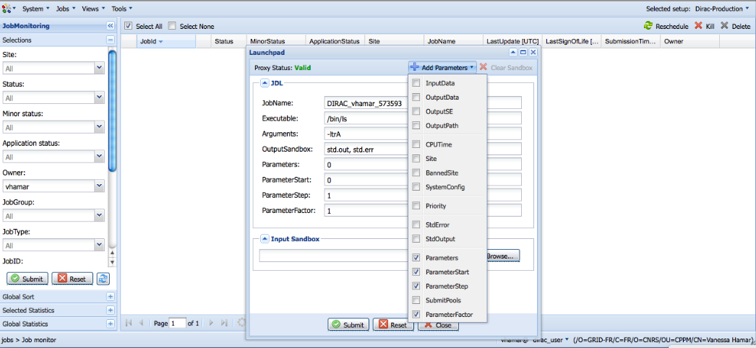
Parametric Job - JDL
Parameters
in JDL
Add parameters

Slide 7
Optimizers
From Agents to Executors
  Change the processing of new jobs in the system
  Agents:
    Poll the DB, take an action, updated the DB
    And this for 5-6 Optimizers that are needed to prepare a new jobs for execution
  Executors:
    Register a capability on a central server
    The central server distribute the actions among available executors and at the end update the DB

Slide 8
Optimizers (II)
The preparation of jobs becomes “data driven”, triggered by the submission by the user.
Advantages:
  Reduce queries to the DB backend
  Reduce the response time (no wait time involved).
  Single point of access to the DB, can optimize access to DB.
Additionally the OptimizationMind (the server) has been prepared to support parallel processing of jobs by the Optimizers (executors).

Slide 9
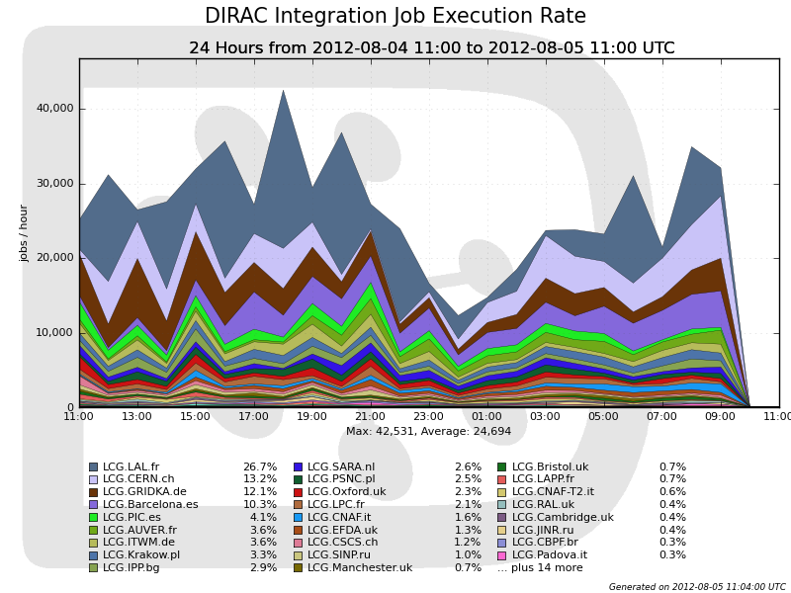
On the CERN Integration Setup

Slide 10
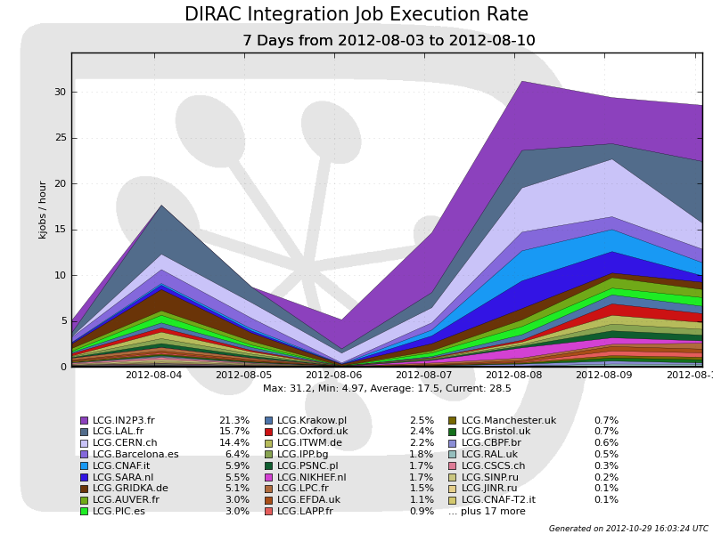

Slide 11
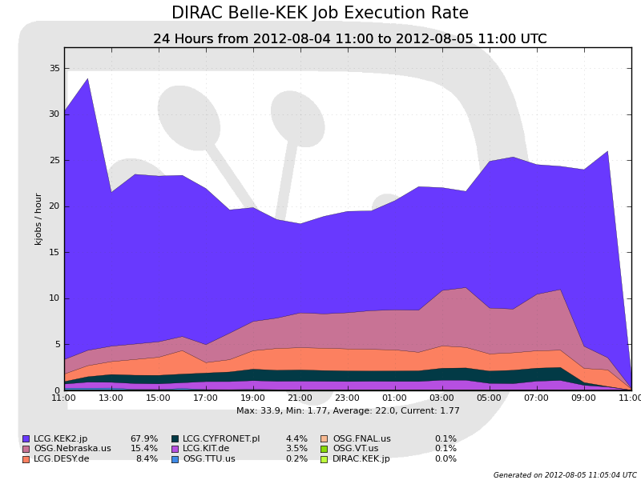
On the Belle II Setup

Slide 12
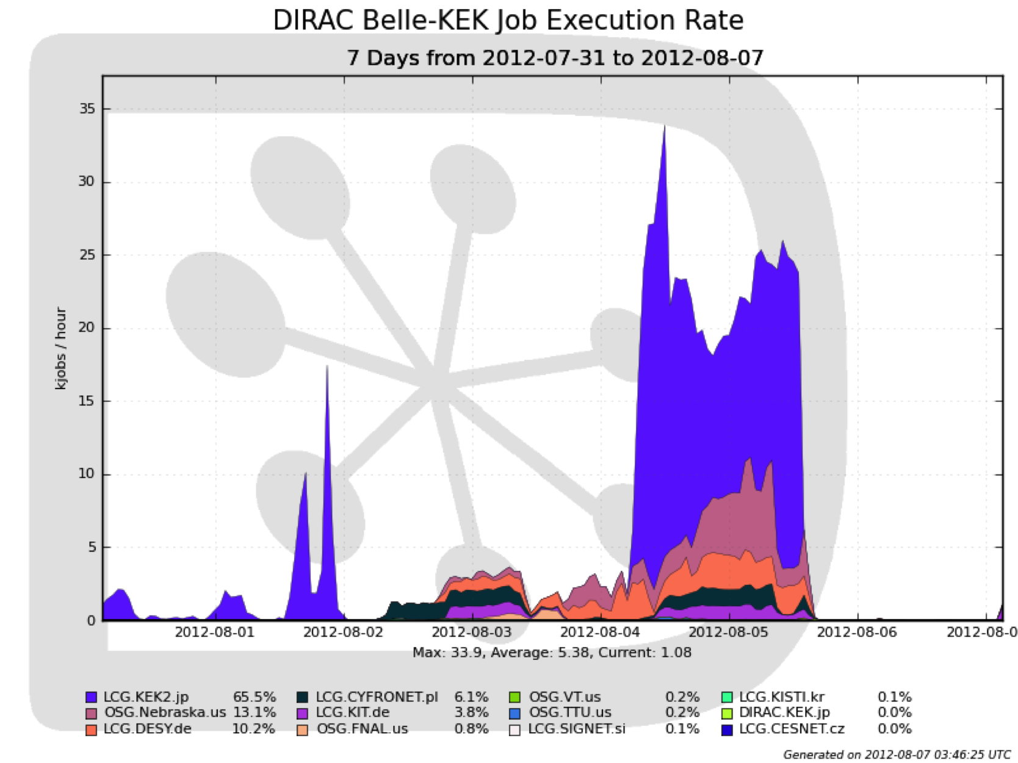

Slide 13
Observations
Using short parametric, a “single box” installation can support sustained rates over 8 Job/s:
  Submission
  Optimizing
  Matching
  Executing
The JobStateUpate service and the DB becomes the limiting factor.

Slide 14
Integration of multi-clouds
Back in 2010 the integration of Amazon EC2 with gLite Grid resources using DIRAC was proven on a a Belle MC campaign.
Clouds are becoming more common and can be a convenient solution in some cases.
There is an increasing number of solutions and flavors.
VMDIRAC defines a paradigm for a flexible integration of this type of (CPU) resources.

Slide 15
Coming next
Scheduling to Storage Elements rather than Sites.
  Pending from the Resource reorganization on the Configuration (also important for multi-VO installations).
Simplified version of Workflows
  Current DIRAC workflow objects are too complex for 99% of the use cases.
  Need to be integrated with Parametric Jobs.

Slide 16
And beyond that …
Refurbishing of WMS backend
  State Machine
  Handling collections of jobs
  Separate “active” and “halted” jobs
  JDL’s
  Job Parameters
  Improve response time

Slide 17
Summary
WMS is one of the central pieces of DIRAC functionality.
Recent improvements have addressed performance issues.
Next steps will go into improving usability.
And then back to performance.

