Slide 1
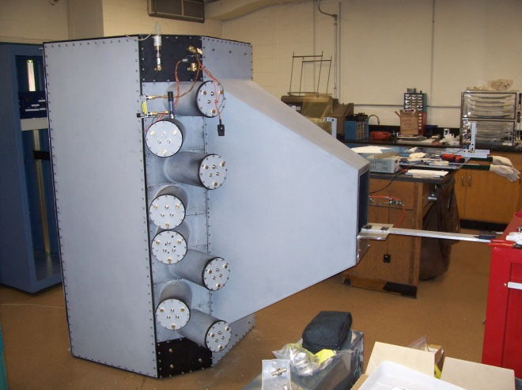
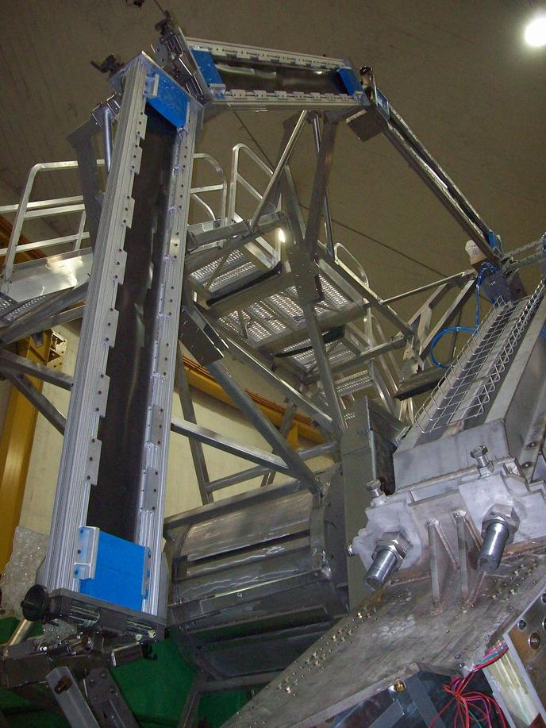

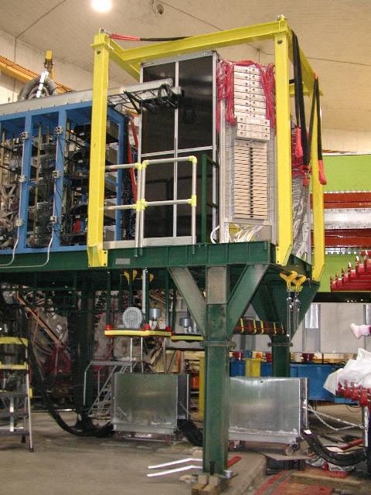
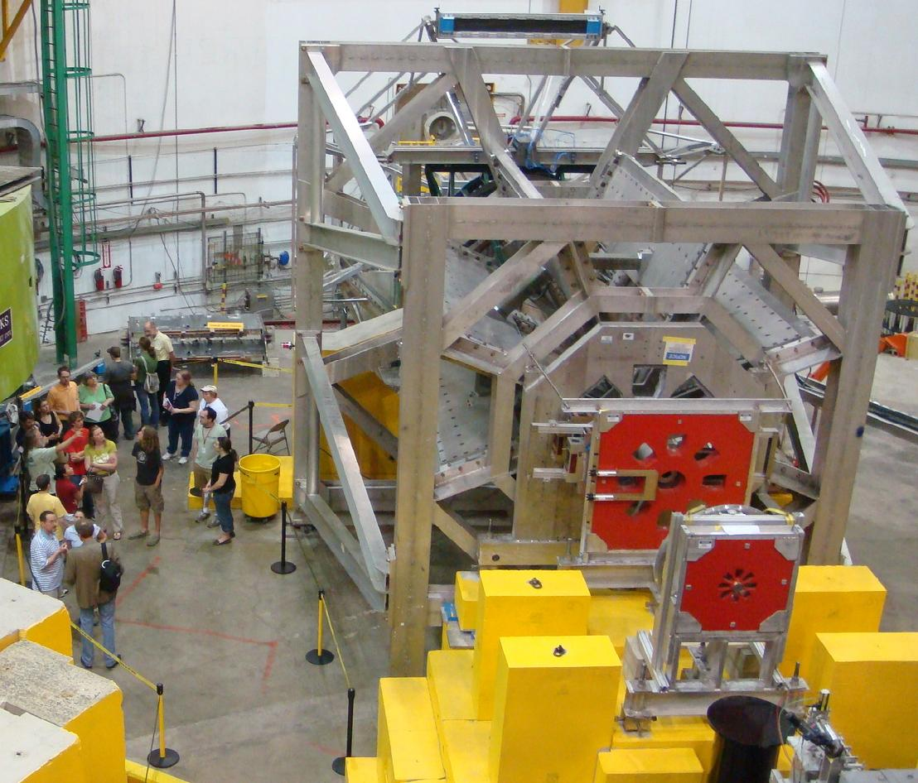
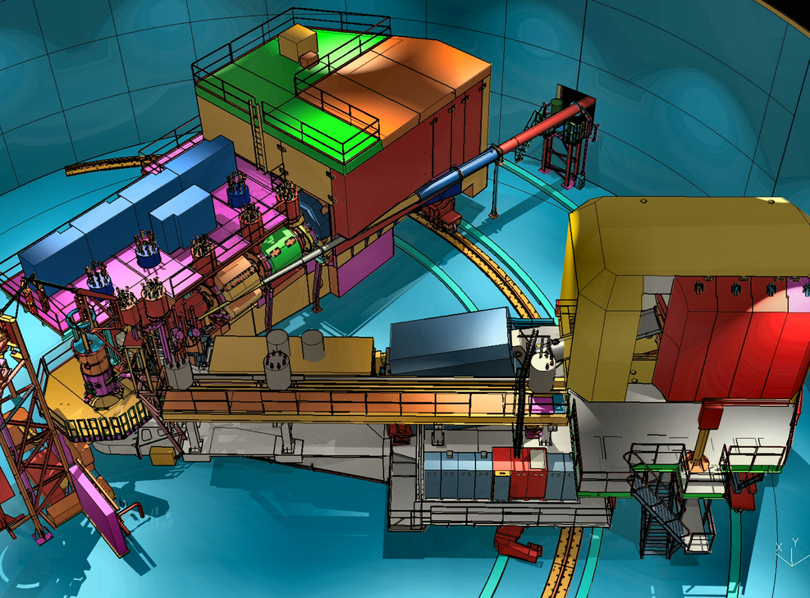
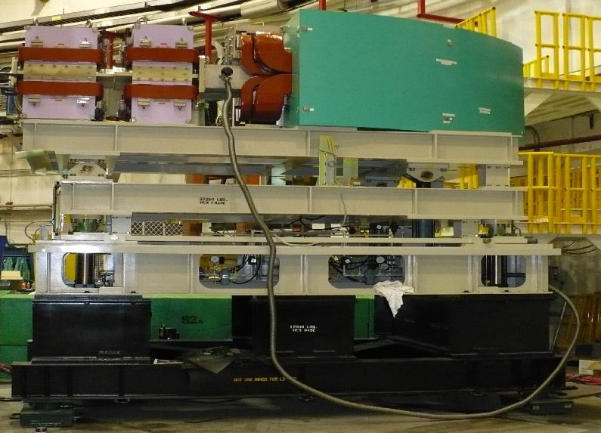
DVCS meeting
November 12, 2012
Stephen Wood

Slide 2
OUTLINE
Brief Hall C Overview
  6 GeV
  12 GeV
Examples of pi0 and photon detection in Hall C
Potential pi0 and photon detectors
L/T separations in Hall C
Approved 12 GeV experiments and early schedule
Hall C resources
Notes:
2

Slide 3
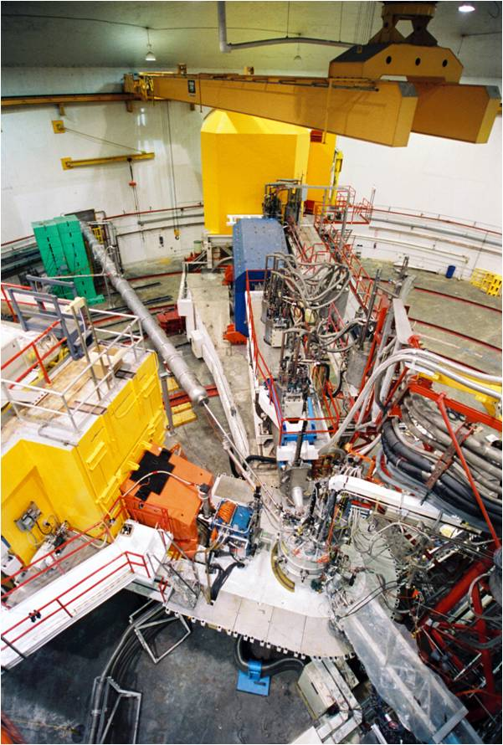
“6 GeV” Hall C Base Facility
Two Magnetic Spectrometers
  Momentum resolution < 0.1%
  Angular resolution ~ 2 mrad
  Solid angle ~6.5 msr
  e, π, K, p particle ID
High Momentum Spectrometer
  Superconducting magnets
  P → 7.5 GeV/c
  Momentum bite – 20%
Short Orbit Spectrometer
  P → 1.75 GeV/c
  Momentum bite – 40%
Moller beam polarimeter
LH₂, LD₂, ³He, ⁴He, solid targets
  Polarized H, D
HMS
SOS
Notes:
3

Slide 4
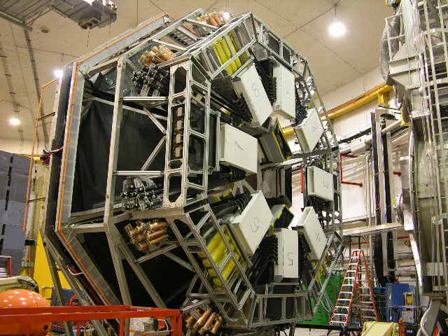
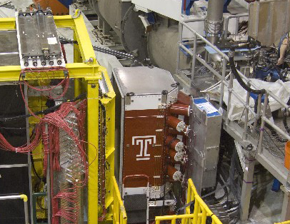
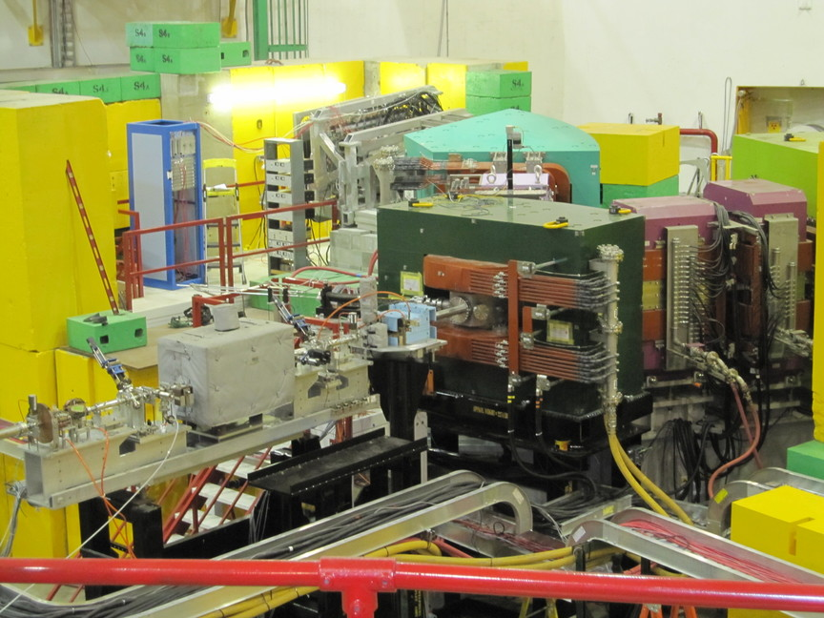
Hall C Large Installations
Hall C has installed user and Jlab supplied detectors and equipment for specific experiments:
Deuteron channel and polarimeter (T20)
NH₃, ND₃ Polarized target (GeN, spin structure functions)
Neutron polarimeter (GeN)
Superconducting toroid and detectors (G0 parity experiment)
Custom electron and kaon spectrometers (Hypernuclear program)
Big Calorimeter, proton polarimeter (GeP, spin structure functions)
High power cryotargets (Qweak)
Qweak Experiment
Notes:
4

Slide 5
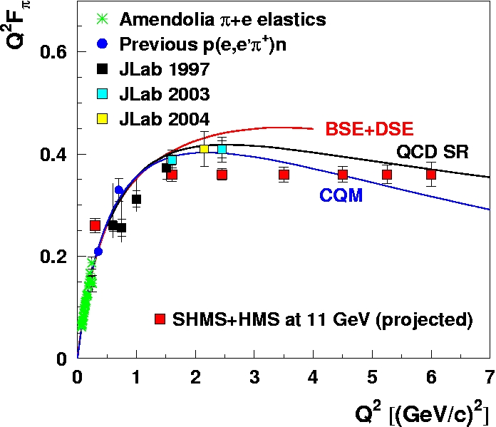
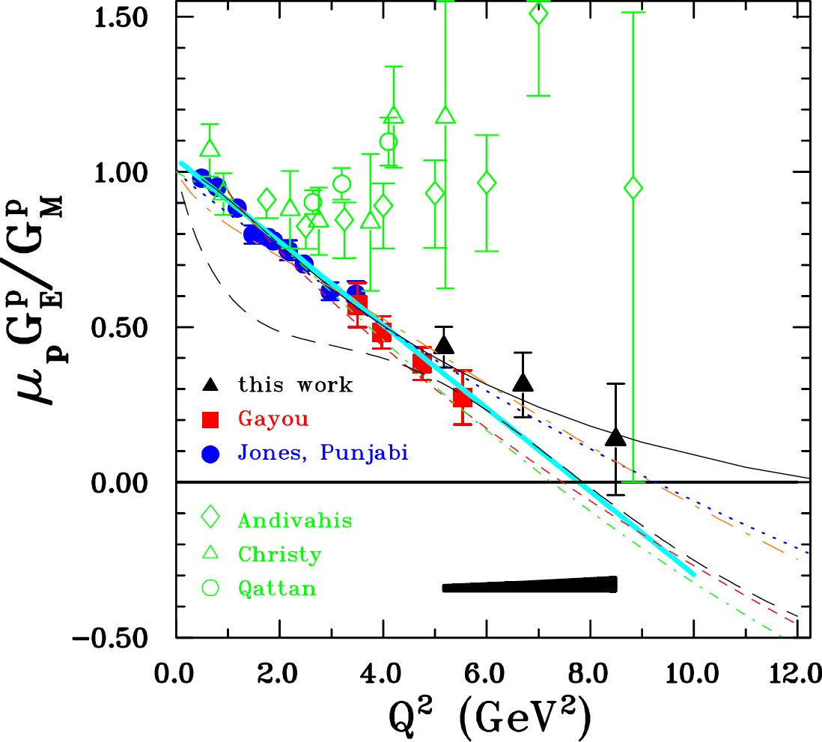
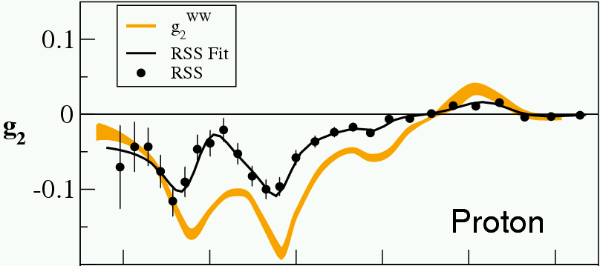
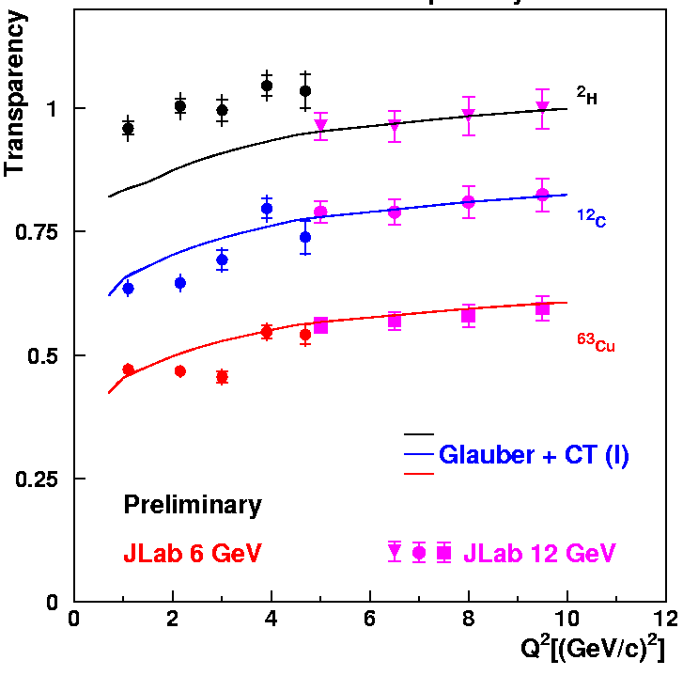
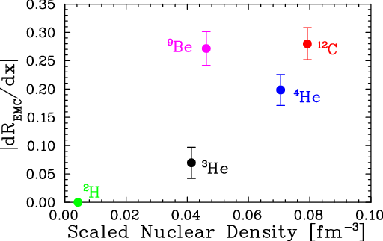

Hall C Physics
Form Factors
  Nucleon: GeN, GeP
  Strange quark contributions
  Deuteron: T20
  Pion: Fπ
  Baryon transition form factors
Nucleon Structure Functions
  Unpolarized p(e,e′), d(e,e′)
    Duality, high X
    Semi-inclusive p,d(e,e′π)
  Polarized structure functions
    g₁, g₂ on polarized p, d
Nuclear structure/effects
  Hypernuclear structure
  EMC effect
  x>1 – high momentum in nuclei
  Pion and proton transparency (attenuation) in nuclei
A(e,e’π)
Notes:
5

Slide 6
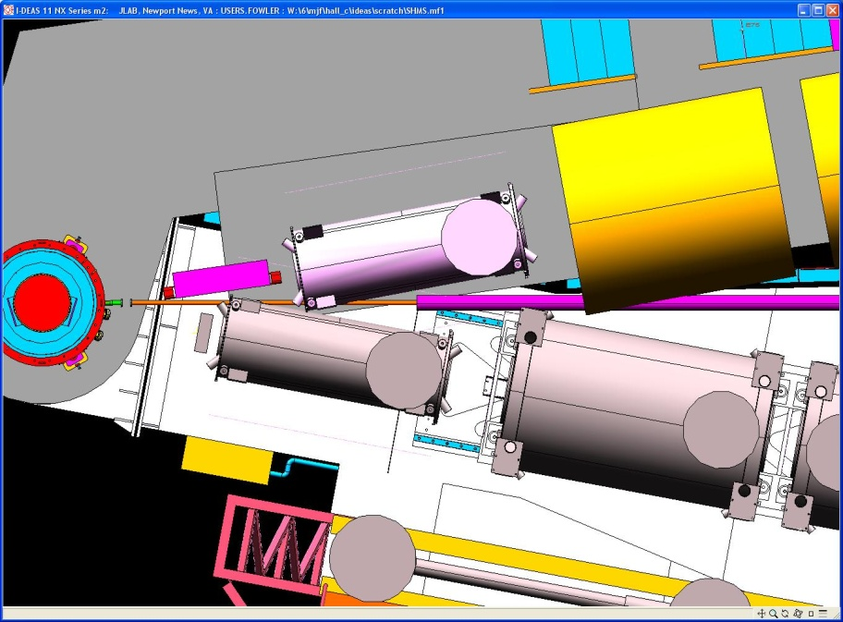
Hall C after 12 GeV Upgrade
Beam Energy: 2 – 11 GeV/c
Super High Momentum Spectrometer (SHMS)
  Horizontal Bender, 3 Quads, Dipole
  P → 11 GeV/c
  dP/P 0.5 – 1.0x10⁻³
  Acceptance: 4msr, 30%
  5.5° < θ < 40°
  Good e⁻/π⁻ e⁺/π⁺/K⁺/p PID
High Momentum Spectrometer (HMS)
  P → 7.5 GeV/c
  dP/P 0.5 – 1.0x10⁻³
  Acceptance: 6.5msr, 18%
  10.5° < θ < 90°
  Good e⁻/π⁻ e⁺/π⁺/K⁺/p PID
Minimum opening angle: 17°
Well shielded detector huts
2 beamline polarimeters
Ideal facility for:
  Rosenbluth (L/T) separations
  Exclusive reactions
  Low cross sections (neutrino level)
3º Horizontal bender
5.5⁰
SHMS
Q2
Q1
HB
Q1
Q2
12⁰
HMS
Notes:
Expand this. Later show where experiments use special capabilities. Add a focal plane picture.
Emphasize conventional technology, understand detector efficiencies to 1%, particle ID under high rates. Should I have a “physics drives design” slide?

Slide 7
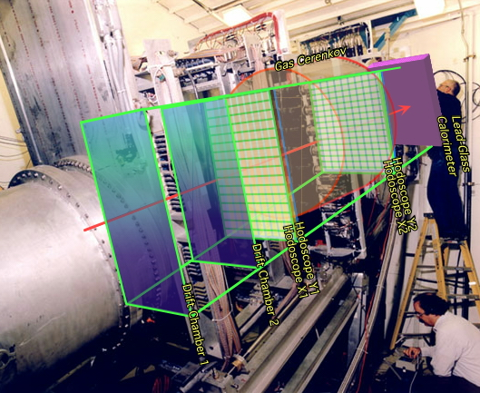
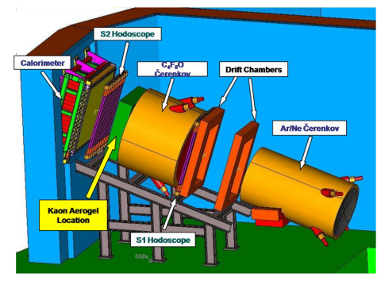
Similar HMS-SHMS detector packages
HMS
SHMS
12 horizontal-drift chamber planes
4 Planes of segmented scintillator (one plane quartz bar in SHMS)
Gas Threshold Cerenkov detectors
Aerogel Cerenkov detector
Lead Glass Shower Counter
Notes:
Logically similar detector packages. Much shared code possible between spectrometers. (In Fortran, was duplicated code)

Slide 8
12 GeV Hall C Physics
Exclusive reactions and form factors
  Neutron Electric Form Factor
  d(e,e′p)
  Pion Form Factor
  Factorization of exclusive p(e,e′π), p(e,e′K), Kaon FF?
Semi-Inclusive Deep Inelastic Scattering p,d(e, e′π±)
  Quark transverse momentum distributions
  Charge symmetry of parton distributions – u^{p}(x) = d^{n}(x) ?
Nucleon Structure Functions – Inclusive (e,e′)
  Unpolarized structure functions, high x
  Neutron spin-structure functions (polarized 3He)
Nuclear Effects
  Nuclear transparency, A(e,e′p), A(e,e′π)
  EMC effect
  x>1(Short Range Correlations, Superfast quarks)
  ⁴He(e,e’p)
Notes:
Point of this is that we do a wide variety of physics with variable precision and PID requirements

Slide 9
Examples of π⁰ and photon detection in Hall C

Slide 10
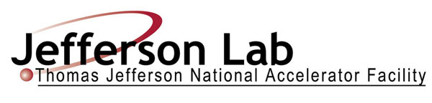

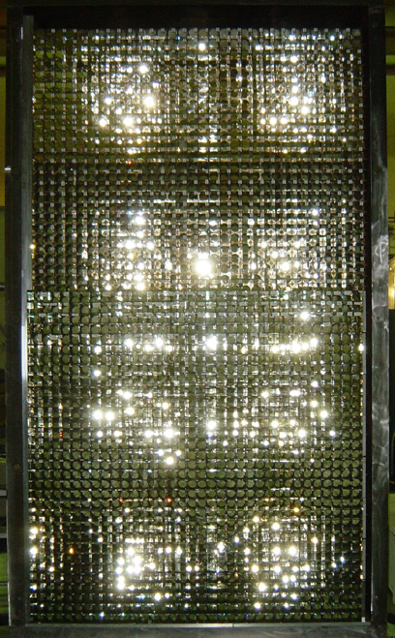
  Kinematics of π° production
121.8cm
π° will decay into 2γ(fraction 98.798%) right after its production
if one of the two γs with energy > E’/2 hits BigCal , a trigger will form and be recorded.
The minimum open angle between two γs is determined by the energy of π°, in some of kinematics we can measure both γs.
E₁
Open distance
BigCal
γ
HMS
γ
θ₁₂
217.6cm
θ_{p}
P
249.4cm
E₂
Target chamber
Beam line

Slide 11
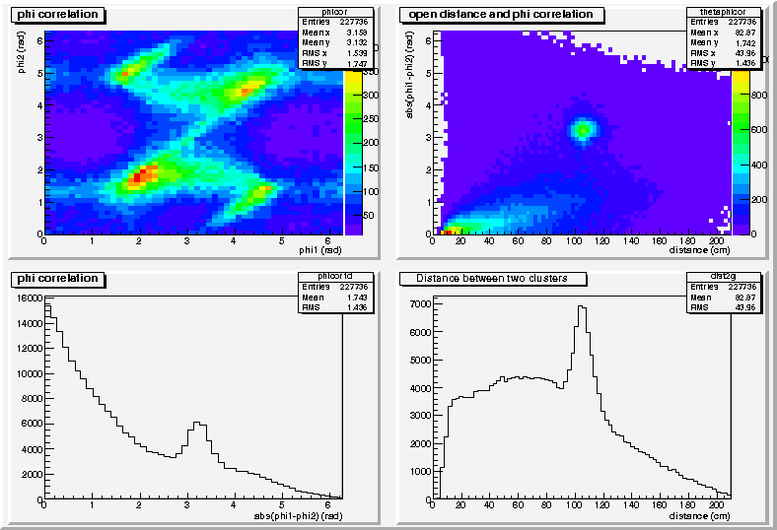
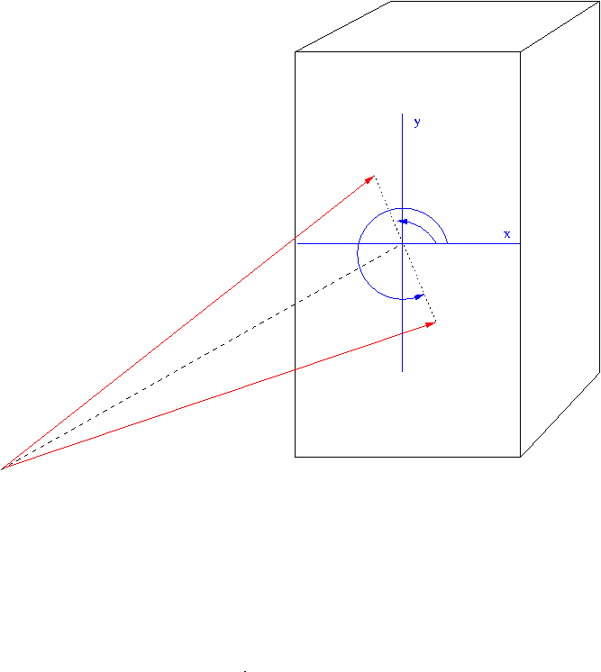
π° event identification with two clusters found in BigCal
Event distribution: Q² = 8.5 GeV²
Φ is the angle between measured cluster position and HMS predicted π° position in the following coordinate system.
BigCal
γ₂
φ₂
φ₁
γ₁
π°
Target

Slide 12
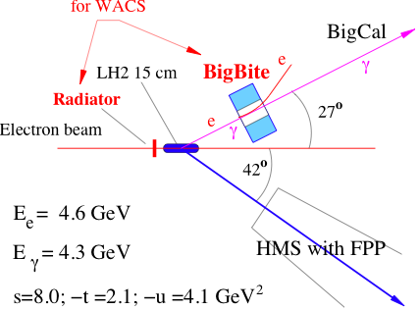
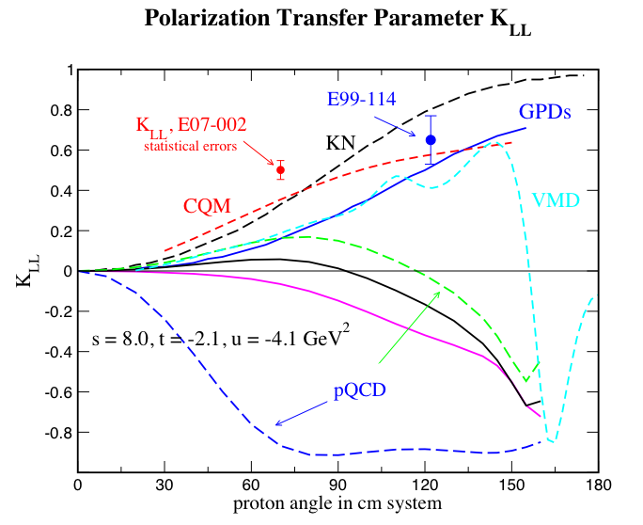
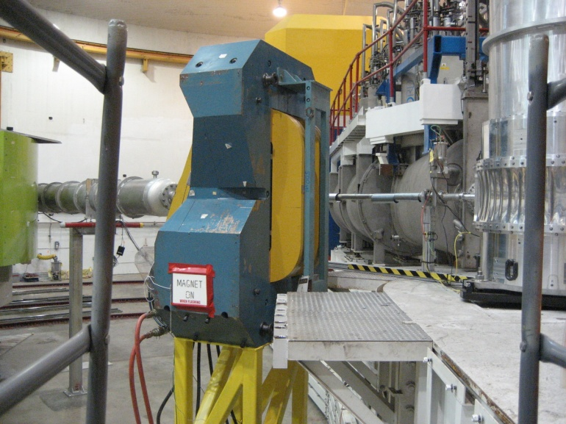
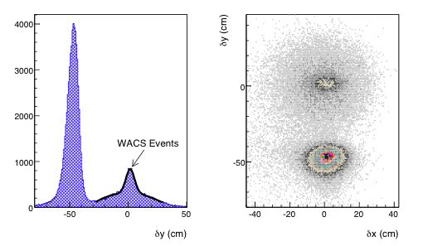
E07-002: Polarization transfer in Wide Angle Compton Scattering
Very clean data
Calibration to elastic e-p polarization data taken parallel to WACS
Expected small systematic uncertainty
Result favors CQM
γ
e⁻

Slide 13
Potential future π⁰ and photon detection in Hall C

Slide 14
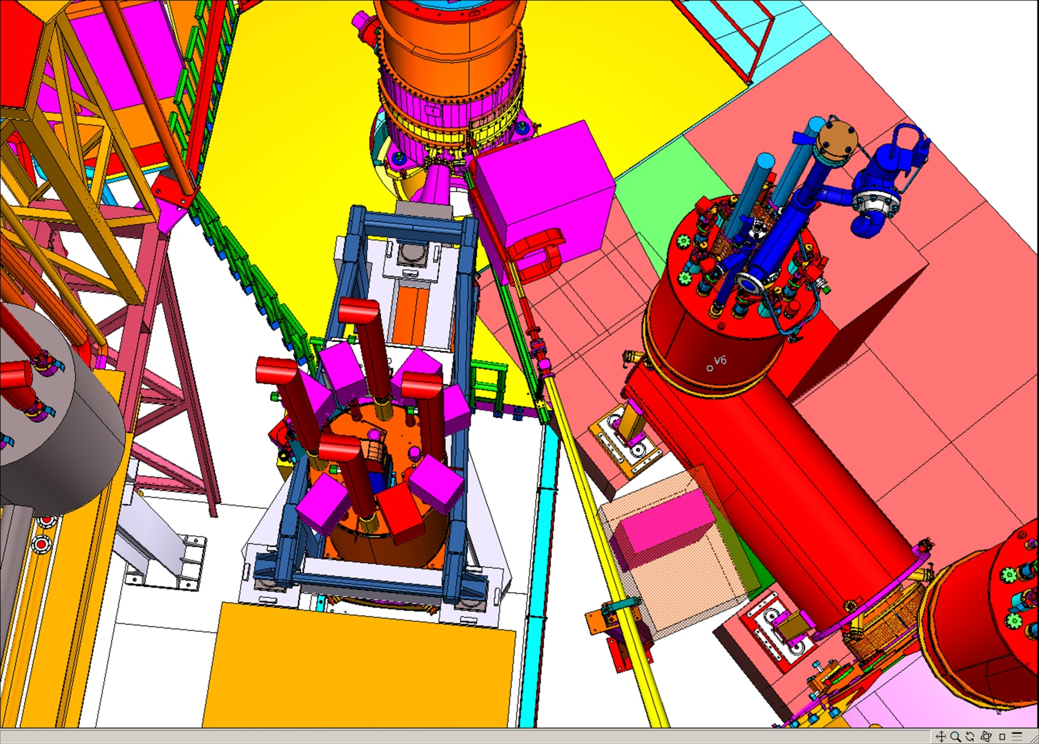
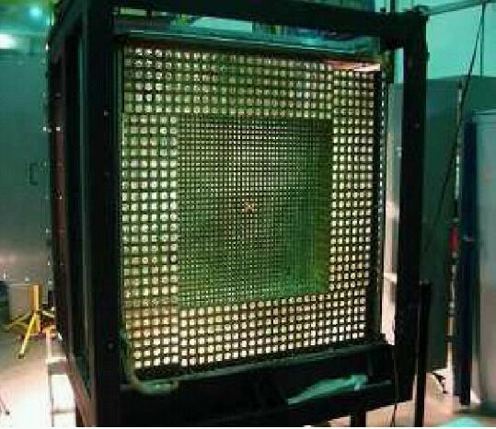
Proposed neutrals ( e.g. π⁰/γ ) detector facility in Hall C
Desire to augment spectrometers with capability for precision measurements with neutral final states. (L/T separations)
p(e,e′π⁰) exclusive and semi-inclusive L/T separated cross sections (PR12-11-111)
p(e,e′γ) DVCS (separation of twist-2 and twist-3 contributions)
Remove SHMS HB magnet, install 0.3 Tm sweeping magnet (copy features of HB to minimize stray field on beam)
Add 25 msr π⁰/γ detector using 1116 PbWO₄ blocks (with temperature-controlled frame) (PbWO₄ from Shanghai Institute of Ceramics)
Dedicated beam pipe with large critical angle + shielding
Beam direction
target
R_{SIDIS} → R_{DIS} disappears with Q²!
HMS

Slide 15
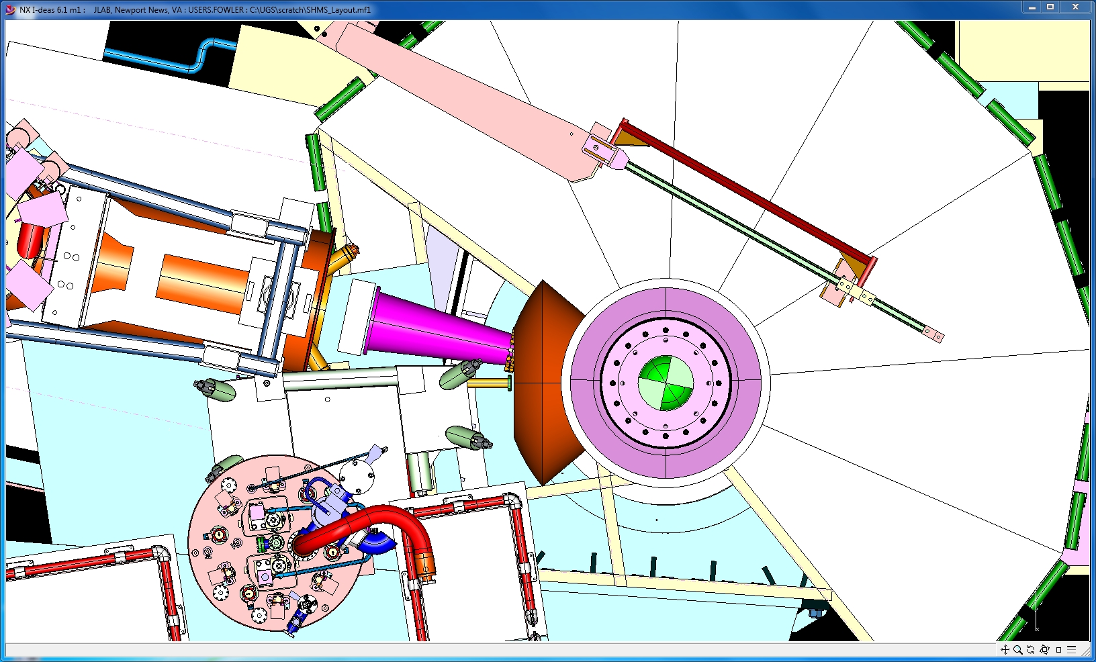
J/Ψ Calorimeter
Jpsi Top View
Calorimeter
HMS
e’
SHMS
Chamber
SHMS Utility Deck

Slide 16
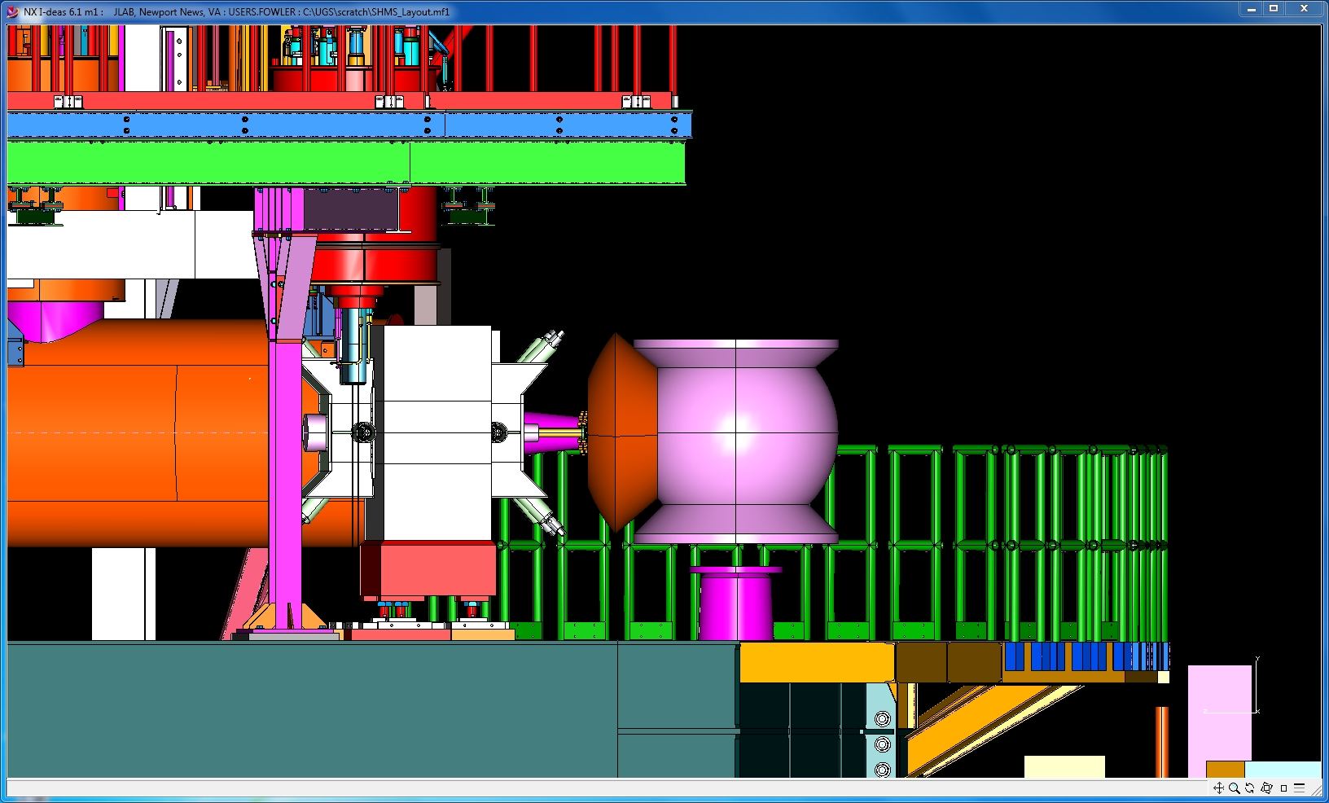
J/Ψ Calorimeter
SHMS Utility Deck
Scattering Chamber
Calorimeter
SHMS Bender
Target Post

Slide 17
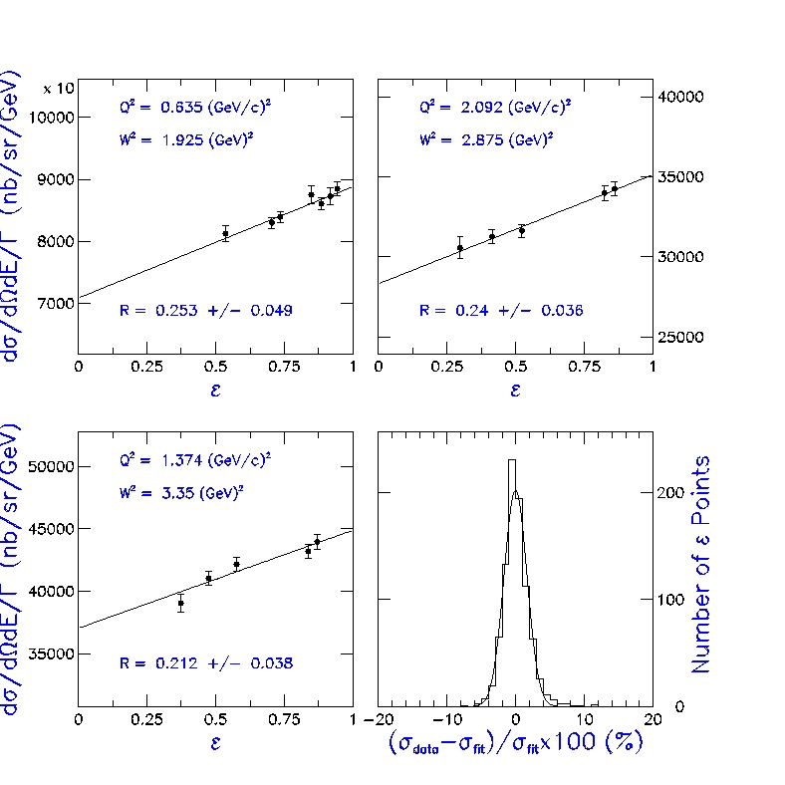
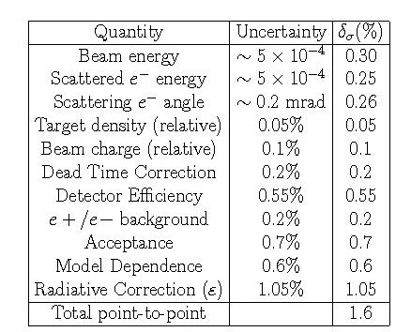
Hall C L/T Separations
Typical and unique Hall C use: σ_{L} - σ_{T} separation
  Measure σ at several ε with fixed Q²
  Control point to point errors to < 2%
  → Control tracking/PID uncertainty to < 1% over wide range of rates
σ < 1.8% - as estimated…
Notes:
In progress

Slide 18
12 GeV L/T separation
Experiments with L/T Separation
E12-06-101 – Pion Form Factor
E12-06-104 – R in semi-inclusive DIS
E12-07-105 – Scaling in exclusive (charged) Pion production
E12-09-011 – Scaling in exclusive Kaon production
E12-10-002 – Nucleon structure functions
~1/3 of approved beam time
Unique capability in the 12 GeV Era
Natural to augment L/T capability with neutron pion/gamma
detector.
E12-Pion scaling
Kaon scaling
F2 a bit
Sidis
Fpi
Bullets:
A photon/pi0 detector fits with Hall C hardware strengths and physics program. “could” be used starting 2019/20.
Low cost facility addition to assure healthy program to 2030.
Modest resources can be applied to support detector development, test runs in Hall
Notes:
F2 and C12 scans good for acceptance studies

Slide 19
Approved 12 GeV Hall C proposals 1
Title | Days | Grade
Measurement of the Charged Pion Form Factor to High Q² (E12-06-101) Spokespersons: G.M. Huber (huberg@uregina.ca ), D. Gaskell | 52 | A
Measurement of the Ratio R = σ_{L}/σ_{T} in Semi-Inclusive DIS (E12-06-104) Spokespersons: R. Ent, (ent@jlab.org) ,H. Mkrtchyan | 40 | A-
Inclusive Scattering from Nuclei at x > 1 in the quasielastic and deeply inelastic regimes. (E12-06-105) Spokespersons: J. Arrington (johna@anl.gov), D. Day | 32 | A-
The Search for Color Transparency at 12 GeV (E12-06-107) Spokespersons: D. Dutta (ddutta@jlab.org) , R. Ent | 26 | B+
Measurement of Neutron Spin Asymmetry A_{1n} in the Valence Quark Region Using an 11 GeV Beam and a Polarized ³He Target in Hall C (E12-06-110) Spokespersons: J.-P. Chen, X. Zheng (xiaochao@jlab.org), Z. E. Meziani, G. D. Cates | 36 | A
Neutron g₂ and d₂ at High Q² in Hall C (E12-06-121) Spokespersons: B. Sawatzky (brads@jlab.org) , W. Korsch , Z.-E. Meziani, T. Averett | 29 | A-
Scaling Study of the L-T Separated Pion Electroproduction Cross Section at 11 GeV (E12-07-105) Spokespersons:. T. Horn (hornt@jlab.org) , G .Huber | 36 | A-
Charge Symmetry Violating Quark Distributions via Precise Measurement of pi+/pi- Ratios in Semi inclusive Deep Inelastic Scattering (E12-09-002) Spokespersons:K. Haﬁdi (kawtar@anl.gov ),D. Gaskell, D. Dutta | 22 | A-

Slide 20
Approved 12 GeV Hall C proposals 2
Title | Days | Grade
Studies of the L-T separated kaon electroproduction cross sections from 5-11 GeV (E12-09-011) Spokespersons:T. Horn (hornt@jlab.org) , G .Huber, P. Markowitz | 40 | B+
Transverse Momentum Dependence of Semi-Inclusive Pion Production (E12-09-017) Spokespersons:R. Ent (ent@jlab.org), H. Mkrtchyan,P. Bosted | 32 | A-
Precision measurements of the F₂ structure function at large x in the resonance region and beyond (E12-10-002) Spokespersons:S.P. Malace (simona@jlab.org) , I.M. Niculescu, C. Keppel | 13 | B+
Deuteron Electro-Disintegration at Very High Missing Momenta (E12-10-003) Spokespersons: W. Boeglin (boeglin@fiu.edu), M. Jones | 21 | B⁺
Detailed studies of the nuclear dependence of F₂ in light nuclei (E12-10-008) Spokespersons: A. Daniel, J. Arrington, D. Gaskell (gaskelld@jlab.org ) | 23 | A-
Proton Recoil Polarization in the ⁴He(e,e'p)³H, ²H(e,e'p)n, and ¹H(e,e'p) Reactions (E)12-11-102) Spokespersons: E. Brash , R. Ransome, G. M. Huber, S. Strauch (strauch@jlab.org) | 37 | B+
In Medium Nucleon Structure Functions, SRC, and the EMC effect (PR-12-11-107) Spokespersons:O. Hen, L.B. Weinstein (weinstei@jlab.org), S. Gilad | 40 | B+
The Neutron Electric Form Factor at Q² up to 7 (GeV/c)² from the Reaction ²H(e, e n)¹H via Recoil Polarimetry (E12-11-009) Spokespersons:B. D. Anderson J. Arrington (johna@anl.gov) ,S. Kowalski, R. Madey, B. Plaster, A.Yu. Semenov | 50 | B+

Slide 21
Approved and CA 12 GeV Hall C Experiments

Slide 22
Timeline for Hall C Upgrade
May 2012 Q_{weak} ended and removal (Q_{weak}+SOS) started
Early 2013 SHMS installation begins
Magnet | Delivery Date
Q1 | Dec 2013
Dipole | Dec 2013
Q2,Q3 | May, Oct 2014
3º Horizontal Bender | Dec 2013
Late 2013-14 Detector installation
2015 SHMS commissioning
  Commissioning Experiments in Hall C

Slide 23
Early running plans – Year 1
2015: ~25 PAC days – Commissioning “Experiment”
  9 days of E12-06-107 search for color transparency
  A(e,e’p) only – “easy” coincidence measurement
  E12-10-002 F₂^{p,d} structure functions at large x
  Momentum scans help understand acceptance
  2 days E12-10-108 EMC Effect
  Integrate light nuclei with F₂ run,
  Point target helps acceptance studies.
  3 days of E12-10-003 d(e,e’p)
  If time available
  Push to lower cross sections
Notes:
F2 and C12 scans good for acceptance studies

Slide 24
Early running plan – Years 2
2016:
E12-09-017 P_{t} dependence of basic SIDIS cross sections
Push particle ID capabilities of SHMS
E12-09-002 Precise π⁺π⁻ ratios in SIDIS – Charge Symmetry Detector efficiencies
E12-09-011 L/T separated p(e,e′K⁺) factorization test
Easiest L/T separation
2017:
E12-06-121 g₂^{n} measurements at fixed Q²
First polarized ³He target experiment in Hall C
E12-06-110 high x A₁^{n} ???
If high luminosity ³He target is ready
Else Fπ or other base equipment???

Slide 25
Early running plan – Years 2
2016:
E12-09-017 P_{t} dependence of basic SIDIS cross sections
Push particle ID capabilities of SHMS
E12-09-002 Precise π⁺π⁻ ratios in SIDIS – Charge Symmetry Detector efficiencies
E12-09-011 L/T separated p(e,e′K⁺) factorization test
Easiest L/T separation
2017:
E12-06-121 g₂^{n} measurements at fixed Q²
First polarized ³He target experiment in Hall C
E12-06-110 high x A₁^{n} ???
If high luminosity ³He target is ready
Else Fπ or other base equipment???

Slide 26
Entirely speculative run plan idea
2017:
E12-06-121 (29) g₂^{n} measurements at fixed Q²
E12-06-101 (52) Fπ
Make up from 2015/16
2018:
E12-11-009 (50) Neutron Form Factor – Large installation
E12-11-102 (37) Proton Recoil polarization
EMC, x>1 time permitting
2019:
E12-11-107 (40) d(e,e’ backward p) EMC
E12-06-110 (36) high x A₁^{n}
More EMC, x>1
2020:
E12-06-104 (40) R = σ_{L}/σ_{T} in Semi-Inclusive DIS
Finish EMC, x>1, Color Transparency, d(e,e’p)

Slide 27
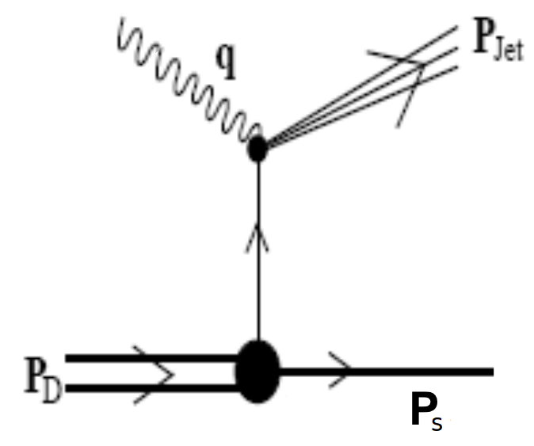
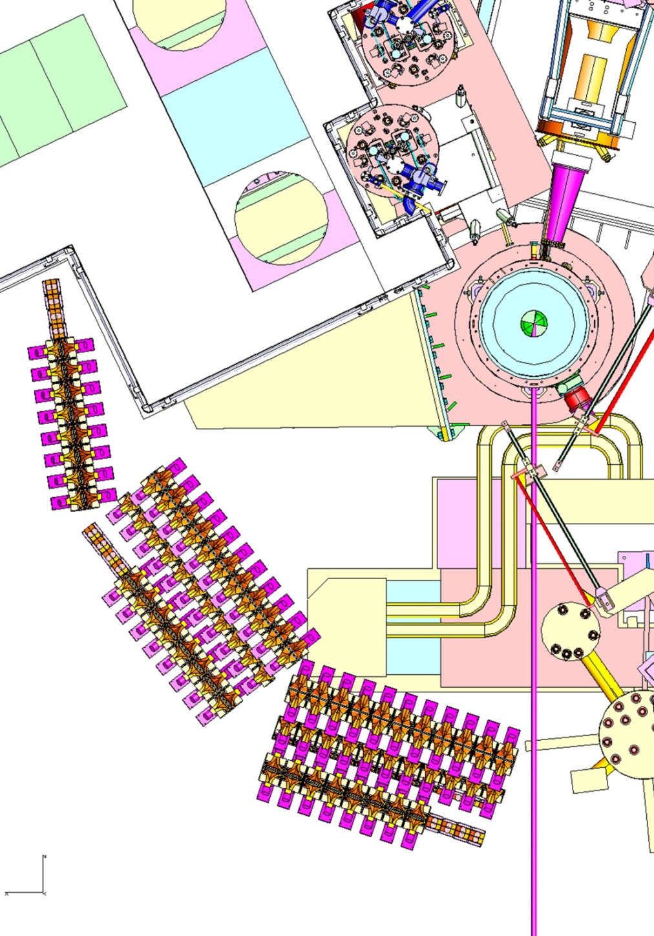
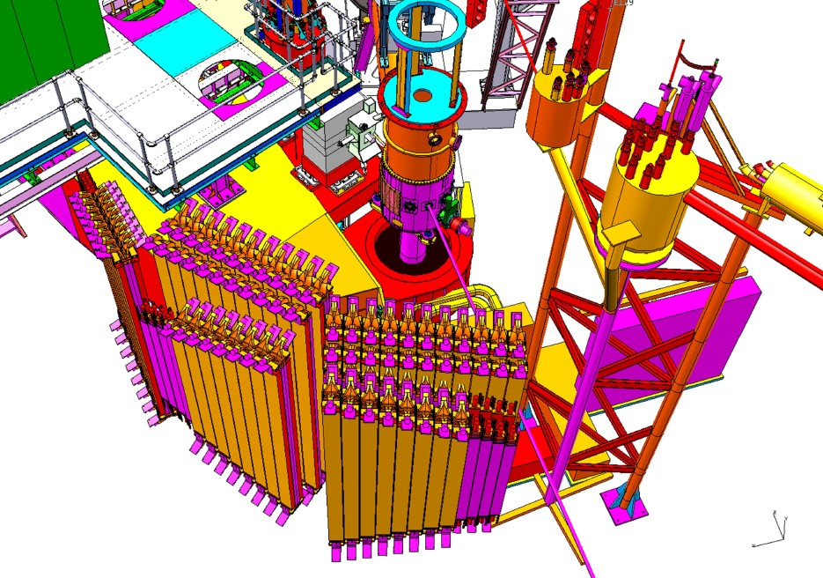
Backward nucleon detector – EMC effect
E12-11-107
d(e, e′N_{backward})
Detect spectator proton or neutron to tag in medium structure function on off-shell nucleon.
HMS
SHMS
Recycled CLAS6 (Hall B) TOF detectors
Possible GEMs for vertex reconstruction

Slide 28
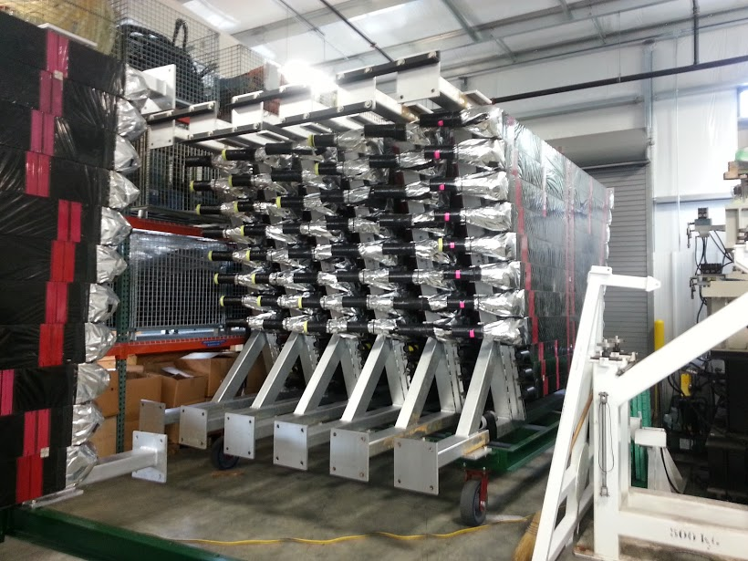
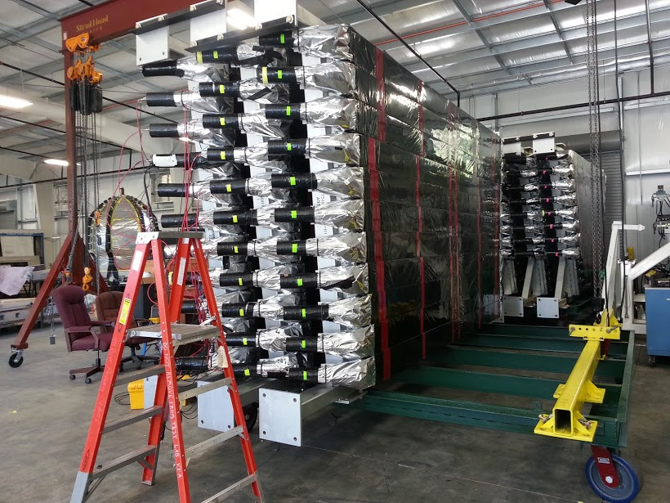
CLAS TOF scintillators on Hall C Frames
User labor and Modest JLab resources were applied to preserve
Hall B detectors.

Slide 29
Hall C 12 GeV Era Summary
Hall C will have two well shielded magnetic spectrometers able to exploit full beam energy, measure low cross sections with precision, L/T separations
Approved program of structure functions, SIDIS, exclusive reactions and nuclear effects (EMC, X>1, Transparency) → ~2020
Additions to base equipment:
  Neutron and proton polarimeters
  Backward nucleon detector
π⁰/γ detector a low cost natural addition to base equipment
  Use “could” start 2019/2020
  Would help assure healthy physics program to 2030
  Hall C can support modest development/design/fabrication efforts. Parasite beam testing possible.

