Slide 1
12 GeV Hall DVCS DAQ
Alexandre Camsonne
Hall A DVCS collaboration meeting
November 13th 2012

Slide 2
Outline
Overview
HRS
Trigger
Detector stack
VME crate
DVCS DAQ
ARS
Trigger
Timeline

Slide 3
Detectors
Left arm
Right arm
DVCS
S0 (2)
1st FPP chamber(318)
Gas Cerenkov(10)
S2m(32)
Pion rejector 1(34)
Pion rejector 2(34)
S0 (2)
1st FPP chamber(318)
Gas Cerenkov(10)
S2m(32)
Preshower(48)
Shower(75)
PbF2 calorimeter ( 208 )

Slide 4
Left HRS possible layout
FPP
FPP
elect
Detector stack
DVCS
patch
LVDS
Fastbus
DVCS
elect

Slide 5
Left HRS possible layout ?
2nd level Left HRS platform
FPP electronics
Trigger
electronics

Slide 6
Overview
Pion rejector
S2m
Cerenkov
FPP
S0
VDC
HRS
208 calorimeter channels
Calorimeter

Slide 7
HRS
VDC
Switch to MAD amplifier discriminator card going
Trigger
Main : S2m Cerenkov
Efficiency : S2m S0, S0 Cerenkov
Additionnal efficiency triggers : S0 Shower
New :
Send signals to VME high resolution TDC
Replacement CAMAC crate by VME, efficiency trigger done with V1495
Avoid remote delays : go for fixed delays for DVCS and GMp

Slide 8
Discr
Or
And
3
Σ
20
Logic module
20
25 ns
S2
S2.not busy
And
T5=S2.T3.Valid
Or
Delay 8
T3
Busy
TS
Inhibit calo
valid
L1A
ROC17
γ
stop
880 ns
Discr
And
T3
S0
8
Start trigger
Analog delay
RT
ROC18
330 ns
ROC3
ROC4
ROC5
ROC6
ROC19
Fastbus
Fastbus
Fastbus
VME
TM
Calo

Slide 9
Detector stack
Detector | channels | Readout
VDC | 384*4 | Fastbus
S0 | 2 | Fastbus + VME
Gas Cerenkov | 10 | Fastbus+VME
S2m | 16*2 | Fastbus+VME
Pion rejector | 34*2 | Fastbus
FPP |  | Fastbus

Slide 10
Counting house
Not final setup because of refurbishing will have to test with final network switch configuration
Use switch in Hall A until CH is done

Slide 11
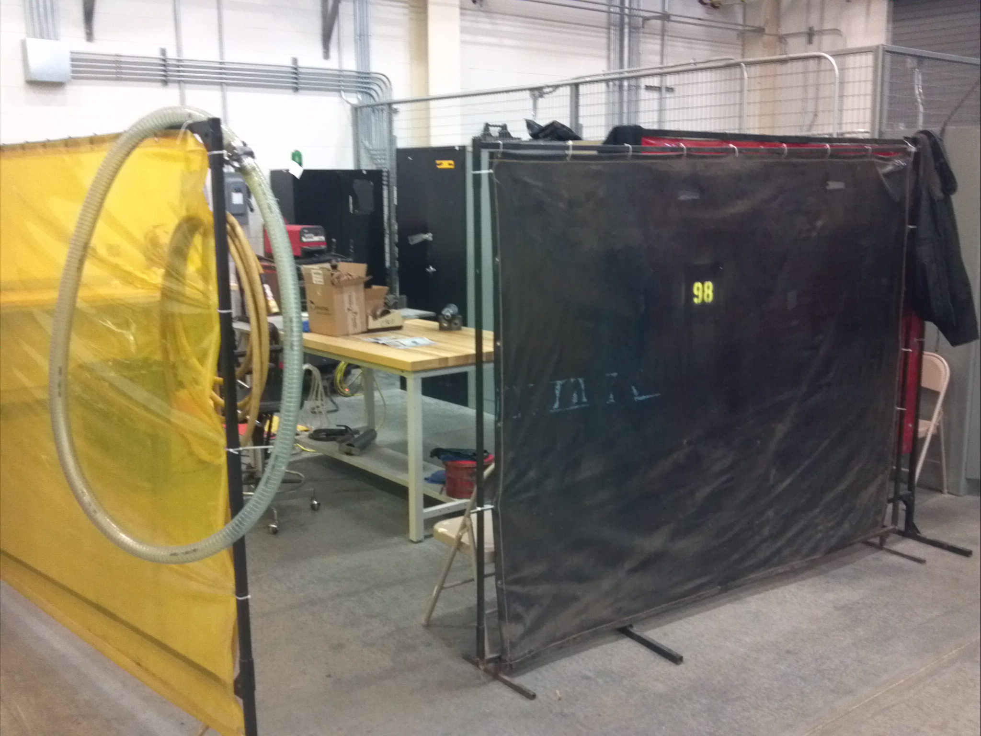
TEDF space

Slide 12
TEDF installation
Shelve
Table
Locker
HV
crate
Calorimeter
HV cables
DAQ
crate
Signal
cables

Slide 13
DVCS DAQ
3 VME64X/VXS crate + trigger = 1 rack
New Intel VME CPU ( 40 MB/s to 100 MB/s )
300 Mb/s max, need check network
208 calorimeters channels : 13 ARS boards
New trigger to be tested

Slide 14
Man power
Alexandre Camsonne : DVCS DAQ, HRS DAQ / Trigger, Compton
Robert Michaels : HRS DAQ / Trigger , Moller, Raster , BCM , BPM
1 DVCS student ?
1 MIT Postdoc / 1 Graduate student
?

Slide 15
Rough timeline
Month | Year | Task 1 | Task 2 | Task 3
11 | 2012 | Install VDC AD | Install FPP | Setup / check Lumi
12 | 2013 | Install 1877S | Cable VDC | Cable FPP
1 | 2013 | Install S0 | Run Gas / Cosmics trigger | Cable BCM / BPM / Raster
2 | 2013 | HRS cosmics checkout | Setup EDTM | Timing S2m
3 | 2013 | HRS cosmics / high rate tests | Single arm trigger both HRS | Implement sparsification
4 | 2013 | DVCS electronics install | Install RG213 | (MQT installation ? )
5 | 2013 | DVCS calorimeter install | DVCS cosmics trigger | Setup / check helicity
6 | 2013 | HRS and DVCS calo cosmics | DVCS high rate tests
7 | 2013 | DVCS trigger timing
8 | 2013 | Install Intel CPU | HRS and DVCS calo cosmics
9 | 2013 | Install CODA3 TS and TI | Debug

Slide 16
Timeline
Month | Year | Task 1 | Task 2 | Task 3
10 | 2013 | HRS and DVCS calo cosmics | HRS and DVCS calo cosmics
11 | 2013 |  | HRS / DVCS high rate tests
12 | 2013
1 | 2014
2 | 2014
3 | 2014 | Commissioning beamline | Commissioning HRS | GMp / DVCS
4 | 2014 | GMp / DVCS
5 | 2014 | GMp / DVCS
6 | 2014 | Can install DVCS here
7 | 2014
8 | 2014 | GMp/DVCS
9 | 2014 | GMp/DVCS
10 | 2014 | GMp/DVCS

Slide 17
Conclusions
Starting HRS work
Few minor changes to HRS trigger
Mostly same setup as previously
Early testing of calorimeter trigger

