Slide 1
2014 DVCS Run Preparations
DVCS and GMP Symbiosis
Charles Hyde

Slide 2
Three models:
Independence
  GMp installs and runs first ~1 PAC month
    Full operation of both HRS for GMp, no Luminosity limits from DVCS
  One month shutdown for DVCS installation
  DVCS runs ~3 PAC months
  No modification to scattering chamber needed
Cooperation
  GMp and DVCS install together (except DVCS Calo.)
  GMp runs independently
    Restrictions on HRS angles from vacuum chamber and DVCS stand
    Restrictions on HRS movement from DVCS cables and stand,
    HRS movement needs manual assistance
  One week shutdown to install DVCS Calo.
  DVCS runs ~3 PAC months
    GMp acquires parasitic data in HRS-R at large angles.
Symbiosis
  GMp and DVCS fully install together
  GMp and DVCS running is interlaced (circa weekly)
    Maximum luminosity is 25μA × 15 cm LH₂ (radiation limit for DVCS Calo.)
    Beam in Compton Chicane
    Restrictions on HRS angles and movement
    GMp acquires “unlimited” parasitic data in wide angle HRS-R
      Luminosity is correlated with beam energy: 10³⁷ @ 6.6 GeV, of 10•10³⁷ @ 11 GeV
    GMp angles < 49° only accessible with HRS-L
      DVCS Calo parked in “safe mode” at 5.5 m from target at 14°
No 11 GeV beam before Autumn 2014
Must have DVCS
DAQ operational Jan 2014
Too many restrictions on G_{M}^{p}

Slide 3
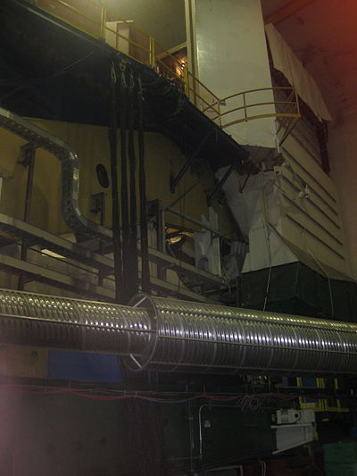
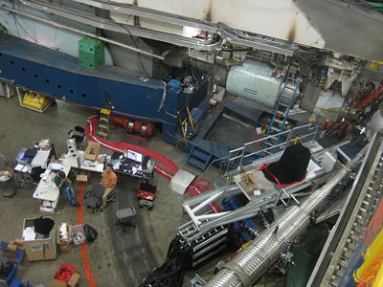
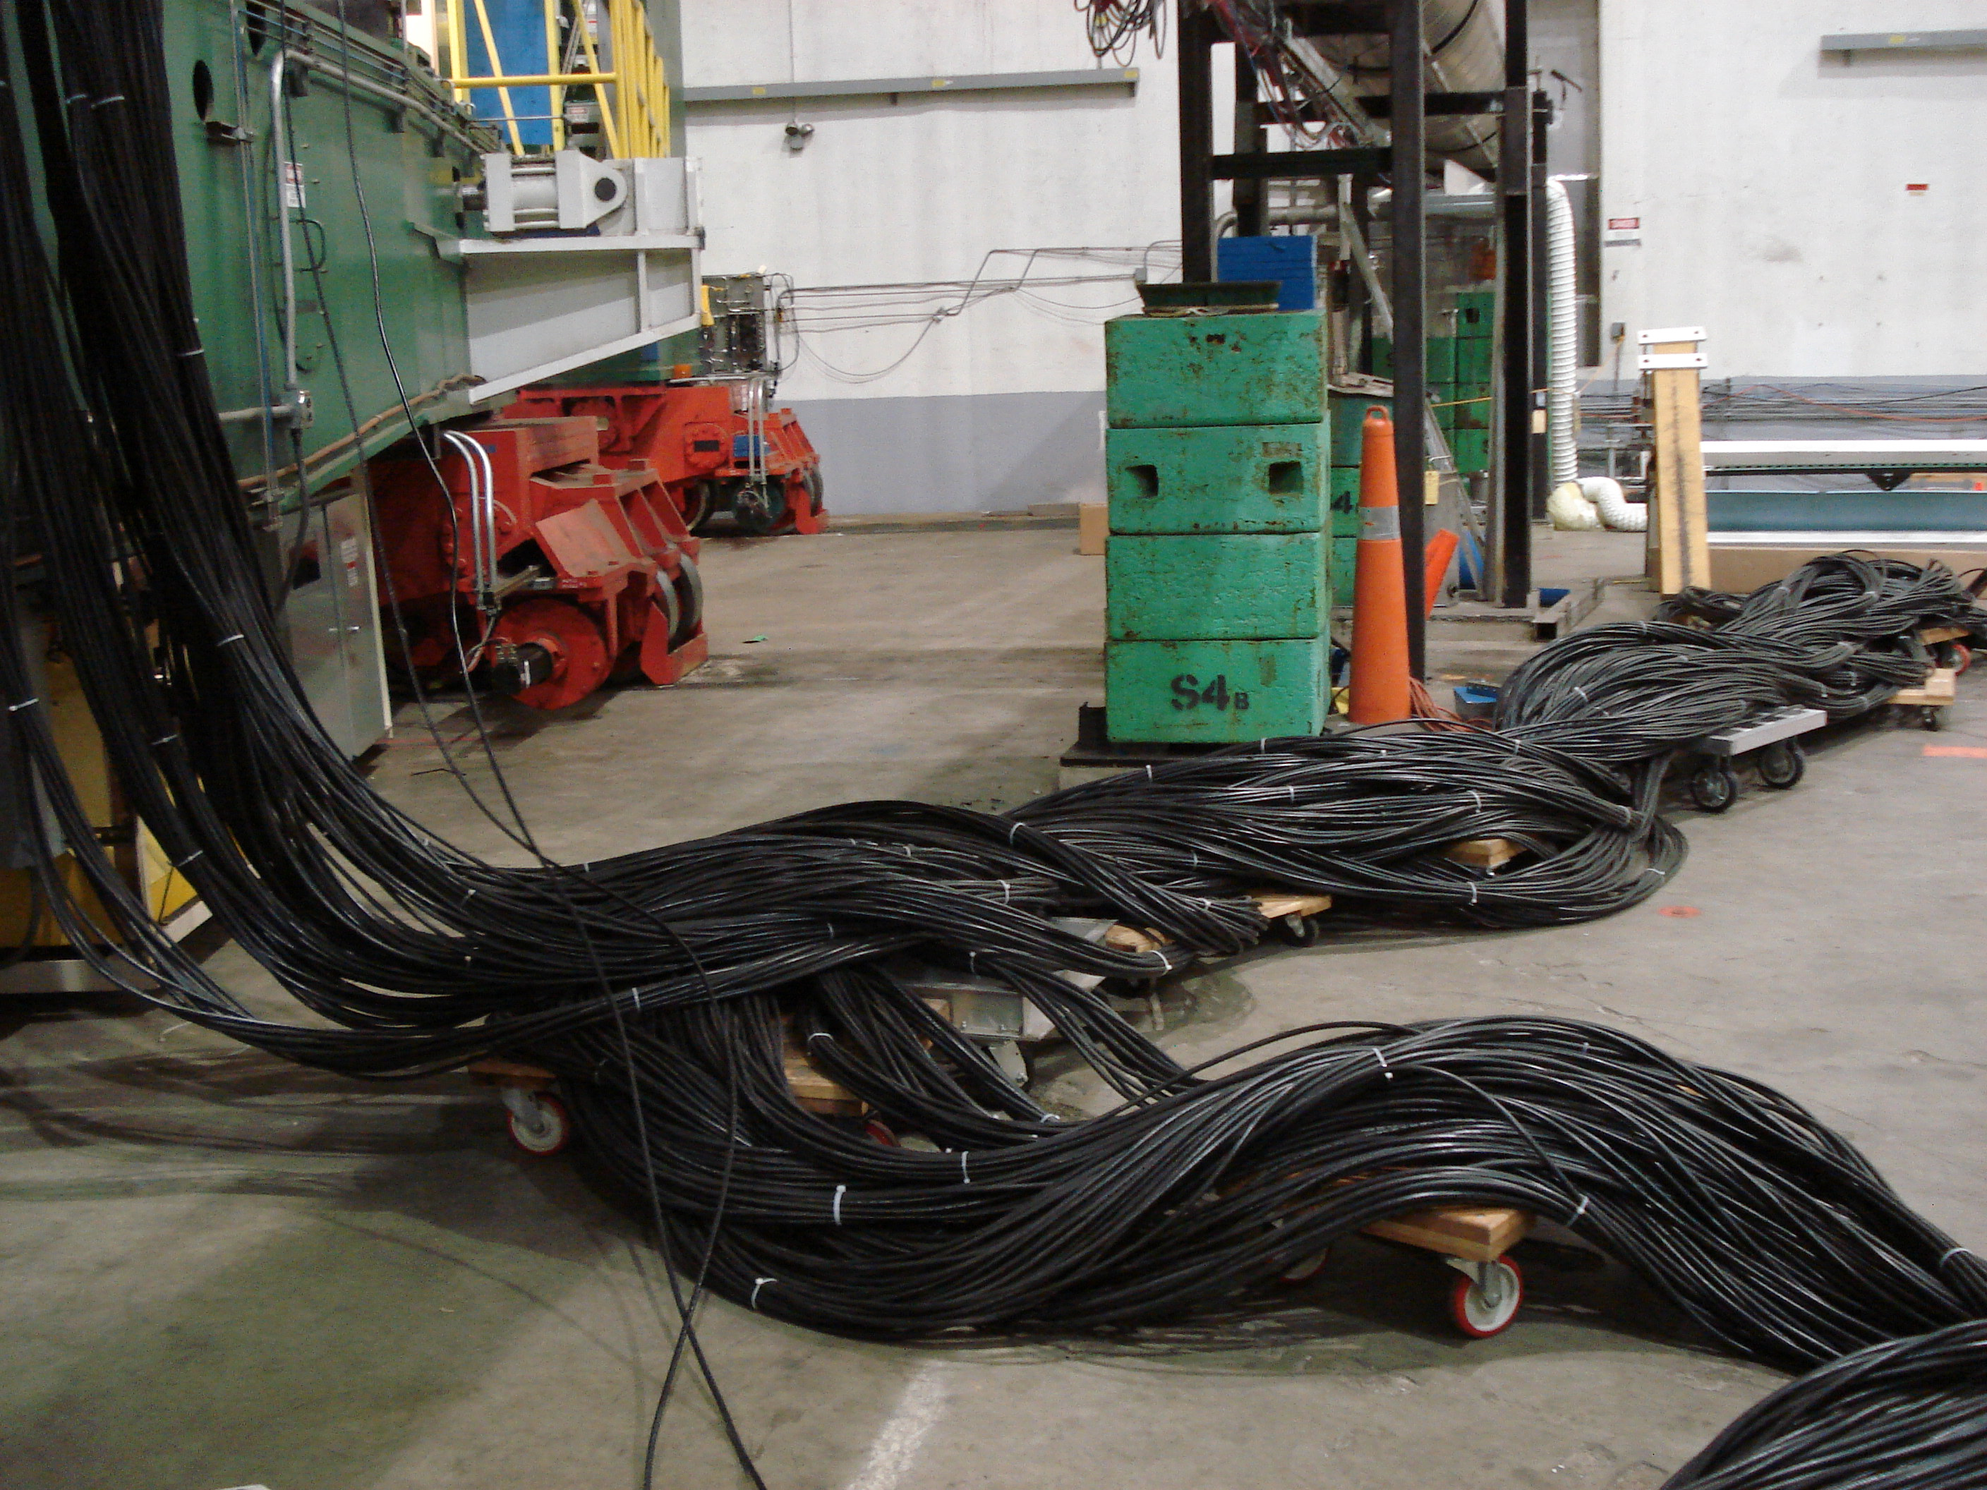
DVCS Cabling
Spectrometers movement must be monitored
in the Hall
220 RG-213 cables
DVCS cables must be moved by hand with HRS-L movement
(multi-person effort)

Slide 4
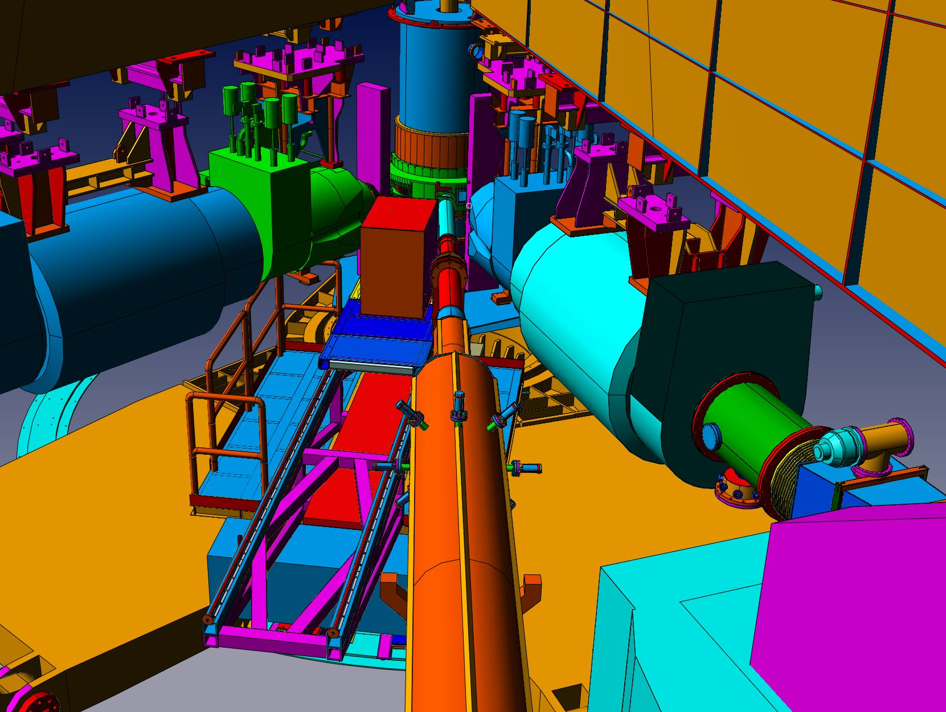
New (skinny) support for DVCS Stand
HRS-L: 20.2°; HRS-R: –43°; DVCS:–8.5°

Slide 5
New (skinny) support for DVCS Stand
HRS-L: 20.2°; HRS-R: –43°; DVCS:–8.5°
Removable support struts for walkways
Must be removed for angle changes

Slide 6
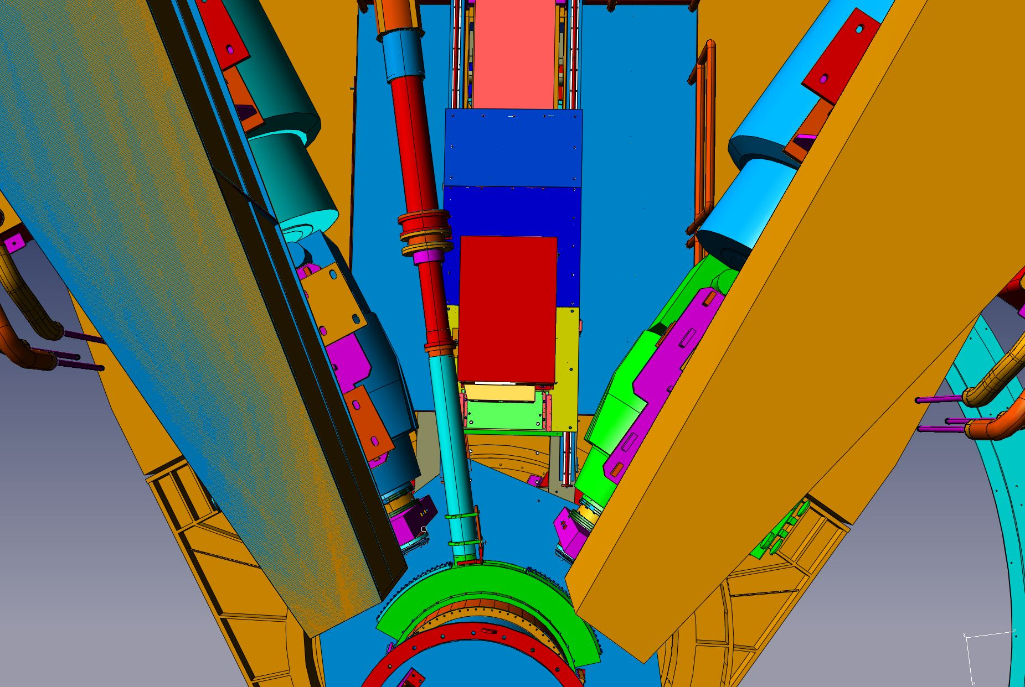
DVCS: –8.5° and 2.0 m from target center
(minimum distance 1.5 m)

Slide 7
Angle Restrictions
(Approximate, to be revised)
Minimum (central) HRS—DVCS-Calo opening angle: 25° (limited by DVCS-Calo stand)
  θ(HRS-L)–θ(DVCS-Calo) ≥ 28.7°
    HRS-L ≥ 19° with DVCS-Calo @ –9.7°
  θ(DVCS-Calo)–θ(HRS-R) ≥ 34.5°
    |HRS-R| ≥ 49° with DVCS-Calo @ –14.5°
Restrictions of the common Scattering Chamber design
  HRS-L ≤ 46°
  HRS-R: 33°—80°

Slide 8
Scattering Chamber
  HRS-R (central angles)
  49°—80° w/ DVCS Calo @ 14.5°
DVCS
Calo
HRS-L
  12.5°—46° (central angles)
    14.5° min w/ Calo @ 14.5°

Slide 9
E12-04-114 DVCS Kinematics: nucl-ex/0609015
Beam (GeV) | k’ (GeV) | θ (HRS-L) | Q² (GeV²) | x_{Bj} | Beam (μA) | θ(Calo) | d(Calo) (m) | Time (days)
6.6 | 2.15 | 26.5° | 3.0 | 0.36 | 5.0 | –11.7° | 1.5 | 3
6.6 | 3.20 | 22.5 | 3.1 | 0.50 | 5.0 | –18.5 | 1.5 | 5
Subtotal days @ 6.6 GeV |  |  |  |  |  |  |  |  | 8
8.8 | 2.88 | 22.9 | 4.0 | 0.36 | 8.5 | –10.3 | 2.0 | 2
8.8 | 3.68 | 22.2 | 4.8 | 0.50 | 8.5 | –14.5 | 2.0 | 4
8.8 | 4.27 | 21.2 | 5.1 | 0.60 | 5.0 | –17.8 | 1.5 | 13
8.8 | 3.47 | 25.6 | 6.0 | 0.60 | 5.0 | –14.1 | 1.5 | 16
Subtotal days @ 8.8 GeV |  |  |  |  |  |  |  |  | 35
11.0 | 4.26 | 17.9 | 4.5 | 0.36 | 13. | –10.8 | 2.5 | 1
11.0 | 4.29 | 21.1 | 6.3 | 0.50 | 13. | –12.4 | 2.5 | 4
11.0 | 3.32 | 25.6 | 7.2 | 0.50 | 13. | –10.2 | 2.5 | 7
11.0 | 4.16 | 23.6 | 7.7 | 0.60 | 13. | –13.1 | 2.5 | 13
11.0 | 3.00 | 30.2 | 9.0 | 0.60 | 20. | –10.2 | 3.0 | 20
Subtotal days @ 11 GeV |  |  |  |  |  |  |  |  | 45

Slide 10
G_{M}^{p} Proposal
Last two kinematic points rejected by PAC
Possible parasitic points in
blue

Slide 11
Cryotargets

Slide 12
Detector Configuration
Cerenkov mirrors need re-coating.
Short Cerenkov for FPP chamber?
Trigger options:
  S0
  Cerenkov
  Pb-Glass

Slide 13
2013
Reconstruct the Calorimeter
  Return PMT to JLab
  re-wrap blocks
Remount calorimeter
  Space in TEDF building?
  Small stand for Calo
  Space to organize cables?
  Need 200 x ~5m cables to connect to ARS
Re-commission ARS/Trigger/CODA
Ready for Jan 2014?

