Slide 1
DDVCS in Hall A

Slide 2
Double DVCS
Detect dilepton pair instead of real photon
Allow to vary xi
Charge particule in final state can use spectrometer to measure momentum ( no calorimeter radiation damage )
Muon channel can go through large amount of material, possibly clean trigger with coincidence

Slide 3
Double DVCS
Challenges
Pion muon discrimination
Vertex reconstruction
Need detector without shielding for accurate momenta and vertex resolution ( GEM )

Slide 4
SuperBigbite

Slide 5
SuperBigBite

Slide 7
SBS and HRS

Slide 8
SBS as muon detector
Trackers pads
ECAL
HCAL

Slide 9
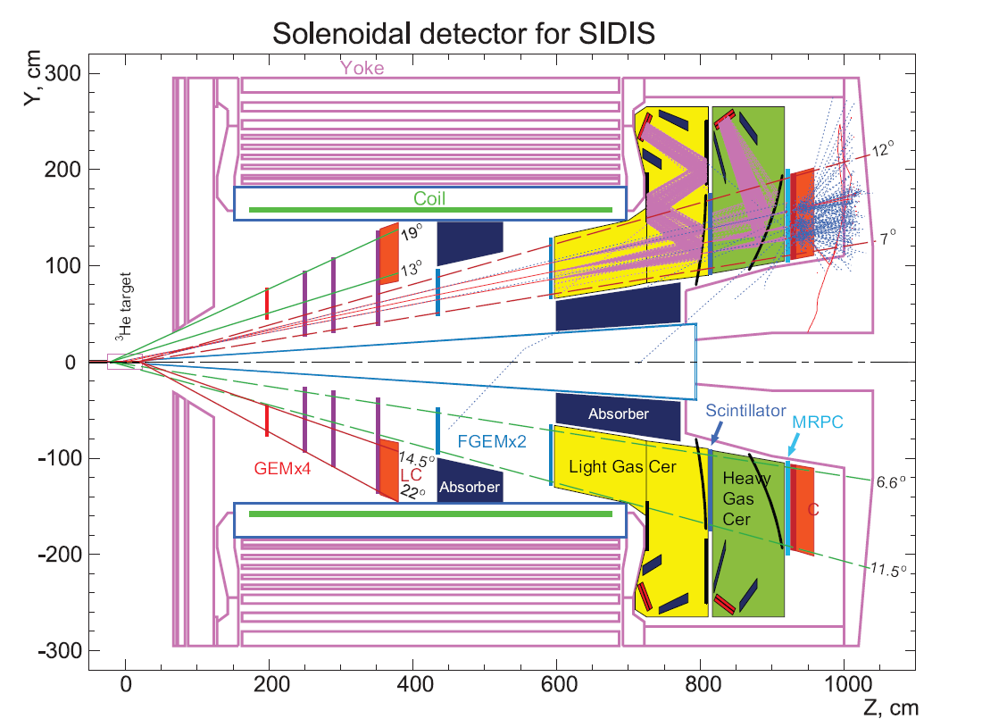
Detector layout for DDVCS
Scintillator +
trackers
CLAS DVCS
Solenoid
Muon ID and trigger

Slide 10
Simulation work
Use SoLID SBS to look at occupancy in tracker
Model muons detector to determine trigger rate

