Slide 1
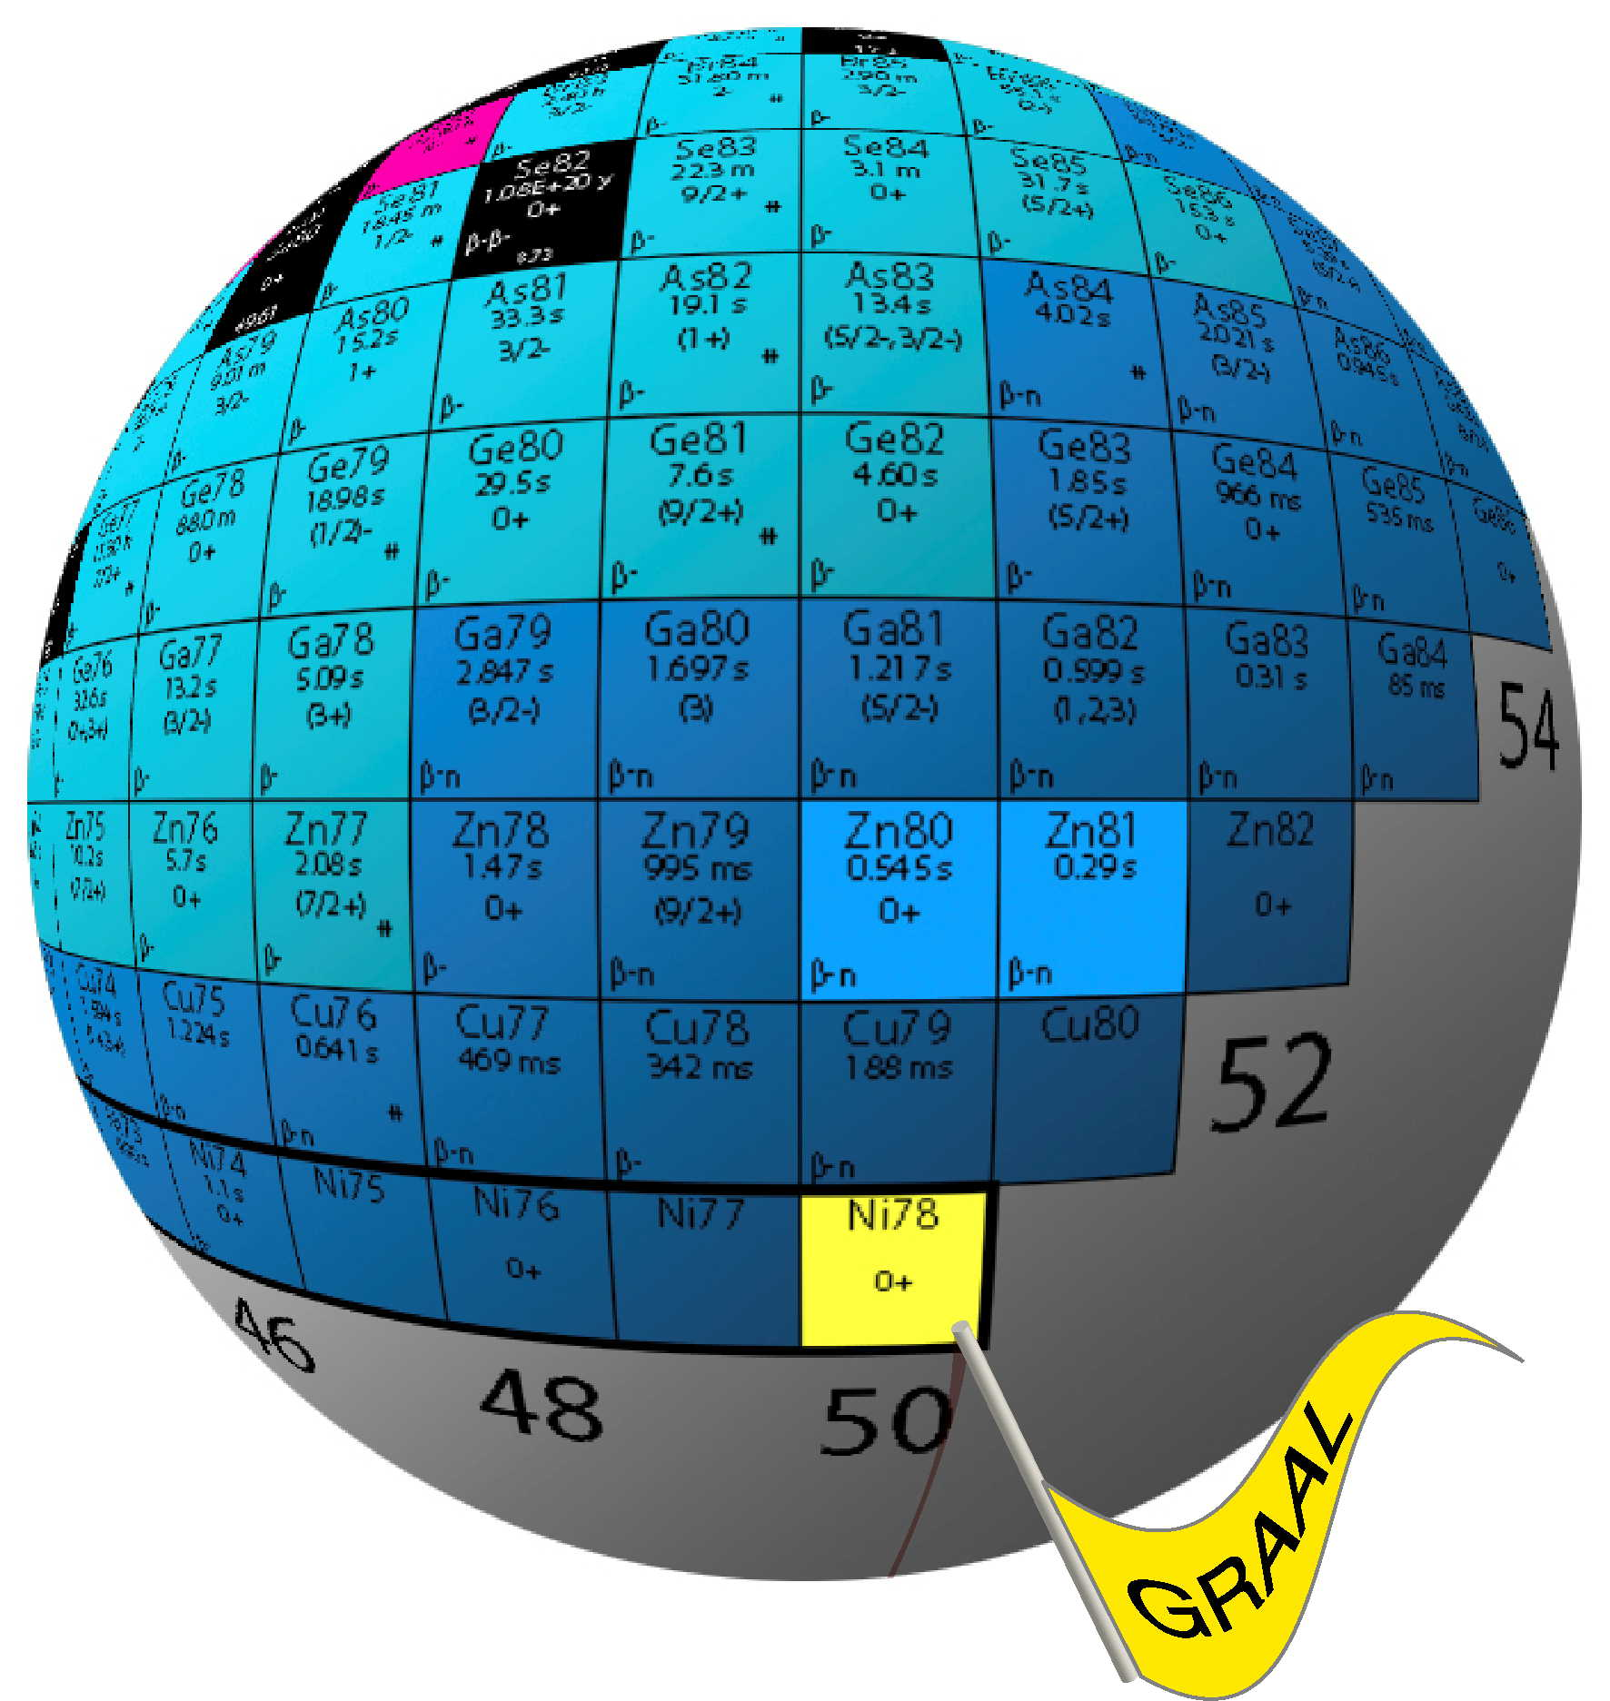
Structure evolution towards ⁷⁸Ni :
challenges in the interpretation of hard-won experimental data
solved by simple means
1
the N=50 shell effect, evolution towards ⁷⁸Ni :
present status
2
deeper into nuclear structure close to ⁷⁸Ni :
2-1
proton single particle state effective sequence
(unexpectedly revealed by the study of odd-odd nuclei)
2-2
neutron single particle state effective sequence
(from the study of the odd N=51 isotones)
Aesop's fable of The Hare and The Tortoise,
the moral of which is "Slow and steady wins the race"
Shell Model as Unified View of Nuclear Structure
Workshop in honor of founders of Strasbourg-Madrid Shell Model Collaboration: E. Caurier, A. Poves and A. P. Zuker
IPHC Strasbourg - October 8 ‐ 10, 2012

Slide 2
warm tribute to the scientific generosity of the Strasbourg-Madrid collaboration
Page 2/
Verney – IPN Orsay Shell Model as Unified View of Nuclear Structure – 8-10 Oct. 2012

Slide 3
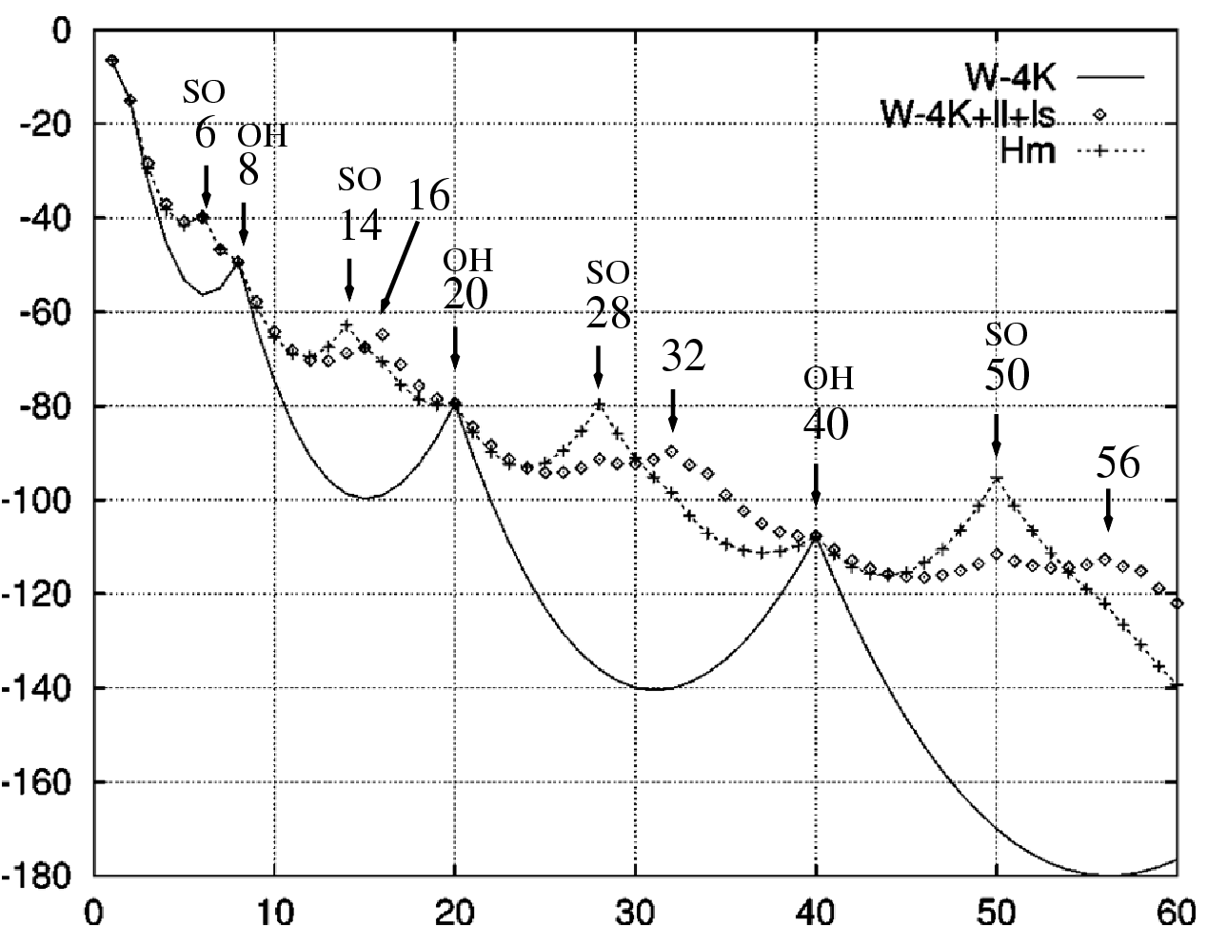
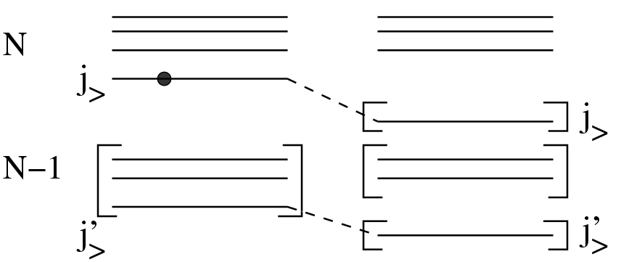
N=50 in the landscape of magic numbers
J. Duflo et A. P. Zuker, Phys. Rev. C 59, R2347 (1999)
related important questions :
the true origin of spin-orbit shell closures ?
the role of the 3-body force
3 body interactions produce “naturally” this mechanism
A. P. Zuker, Phys. Rev. Lett. 90, 042502 (2003)
Solving the problem of non-creation of SO gaps:
N=14 in oxygen and
N=28 in calcium
T. Otsuka et al., Phys. Rev. Lett. 104, 012501 (2010),
J. D. Holt et al. arXiv :1009.5984v3 [nucl-th] (2012)
conclusion of
K. Sieja et F. Nowacki, Phys. Rev. C 85, 051301(R) (2012):
should be the case also for the formation of N=50
Page 3/
Verney – IPN Orsay Shell Model as Unified View of Nuclear Structure – 8-10 Oct. 2012

Slide 4
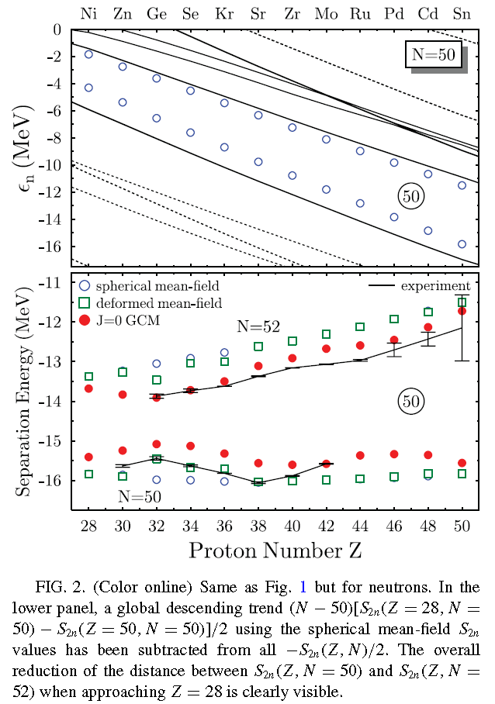
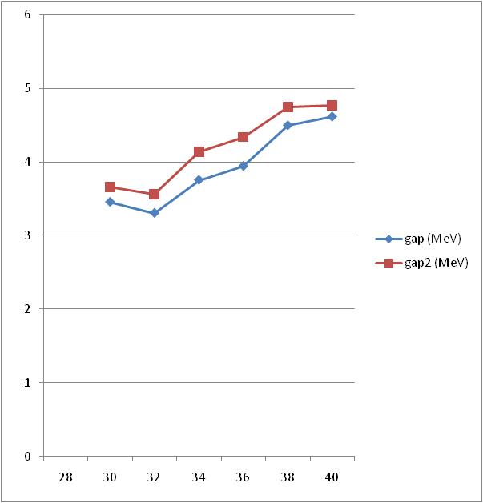
present status of N=50 shell effect evolution towards ⁷⁸Ni
collective origin
theoretically : Bender et al. Phys. Rev. C 78, 054312 (2008)
experimentally: Lebois et al. Phys. Rev. C 80, 044308 (2009)
using data taken from mass evaluation 2010 Audi et al.
[including Hakala et al. PRL101 052502 (2008)]
Duflo Zuker gap
⁷⁸Ni =5,7 MeV
Duflo Zuker gap PRC59 (1999)
⁹⁰Zr =4,7 MeV
Δ = S_{2n}(52)-S_{2n}(50)
gap « rough »
K. Heyde graphical method
NPA466 (1987) 189
« prescripted » gap
extracted from
Bender et al. Phys. Rev. C 78, 054312 (2008)
εd_{5/2} – εg_{9/2} (MeV)
local minimum at Z=32
maximum influence of beyond mean-field correlations
Ni
Zn
Ge
Se
Kr
Sr
Zr
Page 4/
Verney – IPN Orsay Shell Model as Unified View of Nuclear Structure – 8-10 Oct. 2012

Slide 5
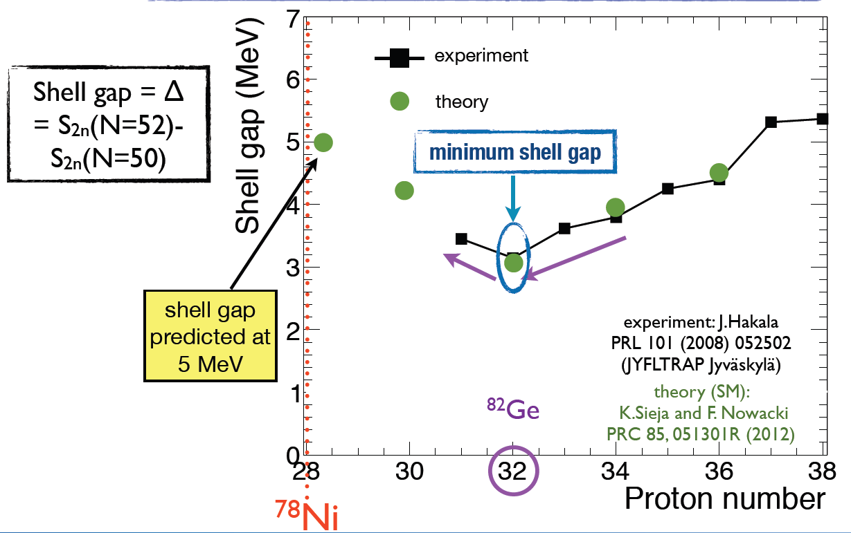
K. Sieja and F. Nowacki, Phys. Rev. C 85, 051301R (2012)
minimum in gap Δ
Page 5/
Verney – IPN Orsay Shell Model as Unified View of Nuclear Structure – 8-10 Oct. 2012

Slide 6
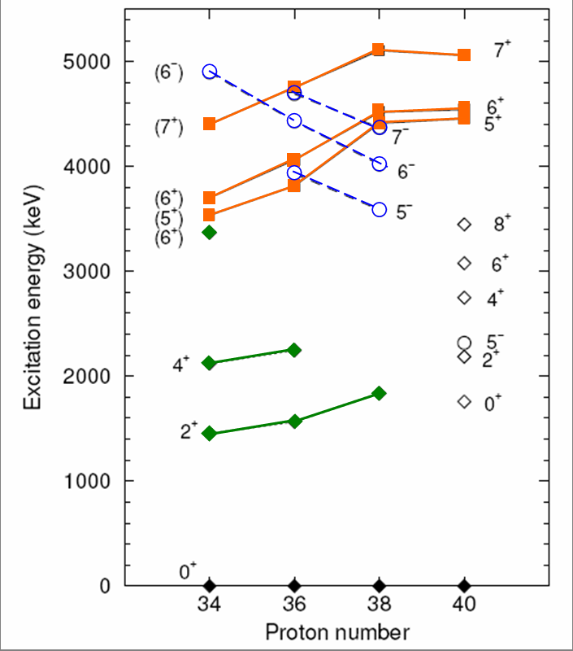
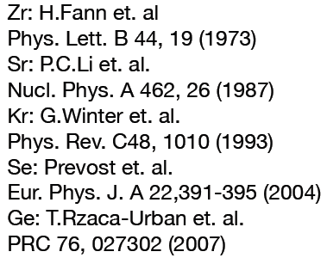
d_{5/2}
Z=32 local minimum
50
g_{9/2}
p_{1/2}
neutrons
Duflo Zuker gap
⁷⁸Ni =5,7 MeV
Duflo Zuker gap PRC59 (1999)
⁹⁰Zr =4,7 MeV
gap « rough »
« prescripted » gap
εd_{5/2} – εg_{9/2} (MeV)
local minimum at Z=32
Ni
Zn
Ge
Se
Kr
Sr
Zr
32
Page 6/
Verney – IPN Orsay Shell Model as Unified View of Nuclear Structure – 8-10 Oct. 2012

Slide 7
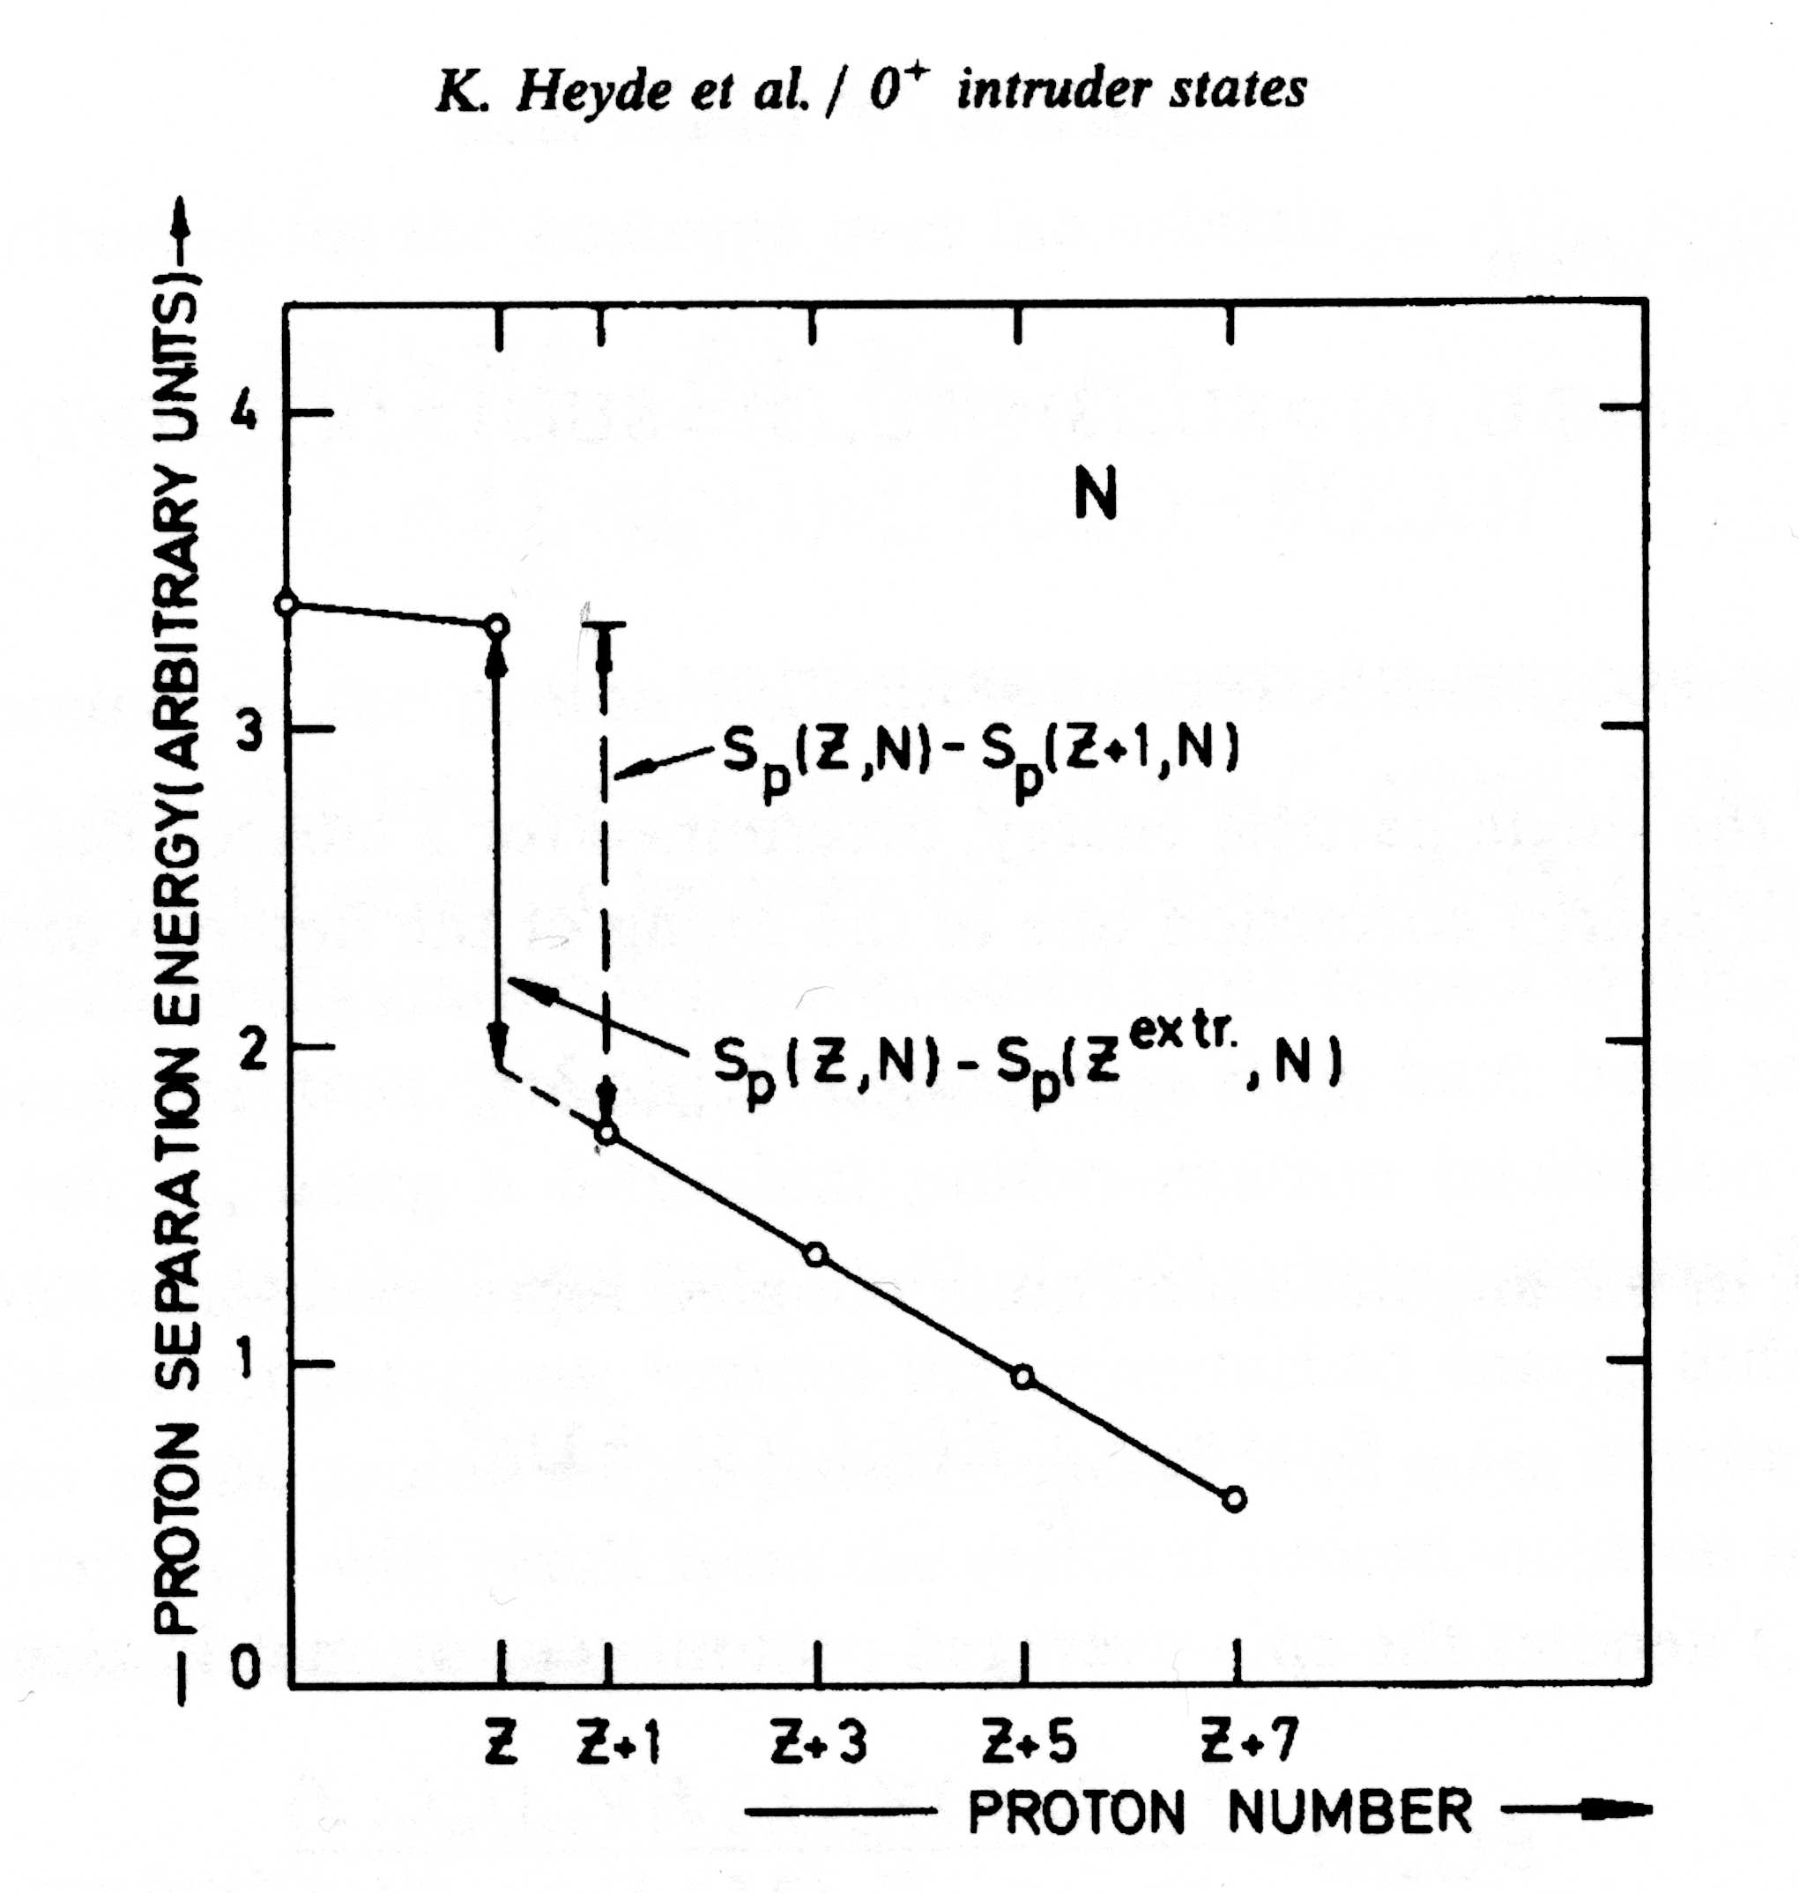
Z=32 local minimum
NPA466 (1987) 189
Z
S_{n}(Z,N)-S_{n}(Z,N+1)
gap from mass data
using K. Heyde et al. graphical method
S_{n}(Z,N)-S_{n}(Z,N^{extr})
N
N+1
N+3
N+5
N+7
neutron number
6+
ε_{jν}
5+
50
gap in the single particle levels
ε_{j’ν}
−ε_{j’ν}= S_{n}(Z,N)
ν
(Koopmans theorem)
but S_{n}(Z,N+1) is not a good prescription for for the evaluation of ε_{jν}
one has to estimate ε_{j’ν} and ε_{jν} in the same nucleus
then the good prescription becomes :
ε_{jν}—ε_{j’ν} = S_{n}(Z,N) —S_{n}(Z,N^{extr})
Page 7/
Verney – IPN Orsay Shell Model as Unified View of Nuclear Structure – 8-10 Oct. 2012

Slide 8
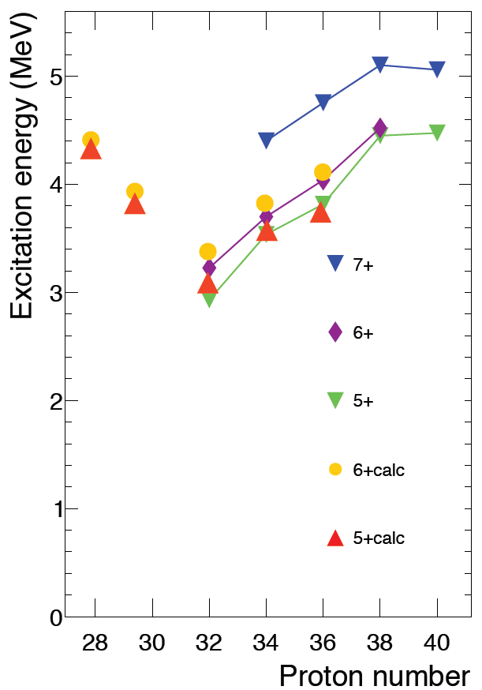
gap from mass data
using K. Heyde et al. graphical method
6+
5+
K. Sieja and F. Nowacki,
Phys. Rev. C 85,
051301R (2012)
Page 8/
Verney – IPN Orsay Shell Model as Unified View of Nuclear Structure – 8-10 Oct. 2012

Slide 9
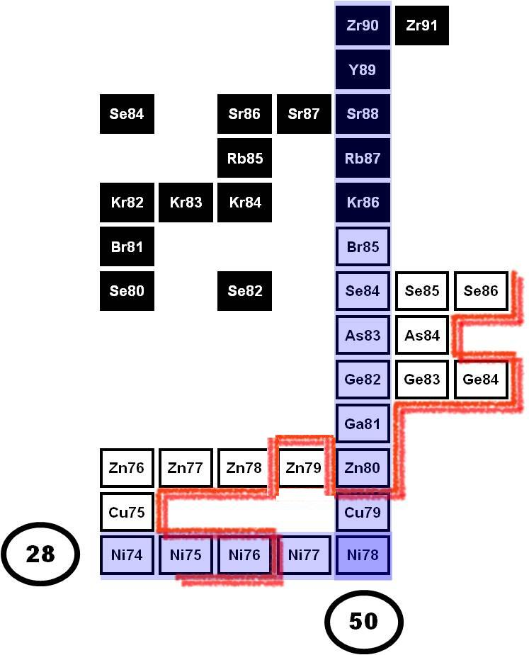
more than 10 years of experiments in the ⁷⁸Ni region
at the PARRNe mass separator (Tandem/ALTO)
Present limit of structure knowledge
(at least few excited states are known)
hot plasma ionization
(1 µA deuteron primary beam)
O. Perru PhD – def. 10th December 2004
Eur. Phys. J. A 28, 307 (2006)
surface ionization
(2-4 µA electron primary beam)
M. Lebois PhD – def. 23th September 2008
PRC 80 (2009) 044308
B. Tastet PhD – def. 13th May 2011
laser ionization
(10 µA electron primary beam)
K. Kolos PhD – def. September 2012
As82
Ge79
Ge80
Ge81
Ge85
Ge86
Ga79
Ga80
Ga82
Ga83
Ga84
Ga85
Zn81
hot plasma ionization
(1 µA deuteron primary beam)
Verney et al PRC 76 (2007) 054312
Page 9/
Verney – IPN Orsay Shell Model as Unified View of Nuclear Structure – 8-10 Oct. 2012

Slide 10
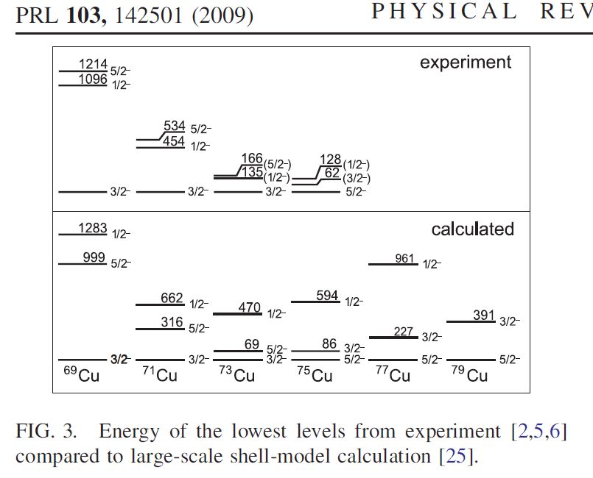
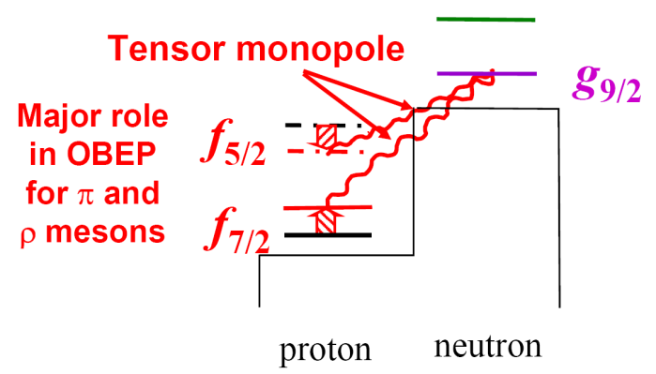
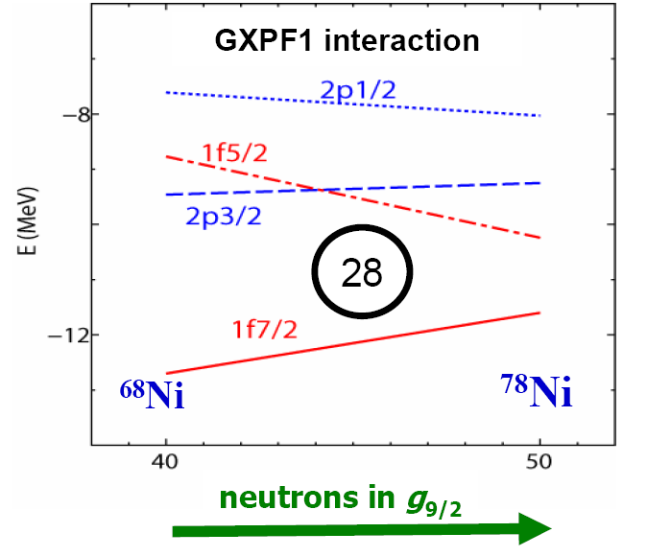
Shell structure in the vicinity of ⁷⁸Ni
single particle sequence : PROTONS
K. Flanagan et al.
Proton single particles at N=50
E (MeV)
► understood as due to the tensor term of the monopole part of the p-n interaction (cf T. Otsuka et al. PRL95, 232502 (2005)
-7,121
50
g_{9/2}
40
-11,831
p_{1/2}
N=40
N=42
N=44
N=46
N=48
N=50
-13,233
p_{3/2}
-14,386
f_{5/2}
28
►already hinted at in the 80’s !!
(from shell model, empirical interaction)
Ji and Wildenthal Phys. Rev. C 38, 2849 (1988)
Page 10/
Verney – IPN Orsay Shell Model as Unified View of Nuclear Structure – 8-10 Oct. 2012

Slide 11
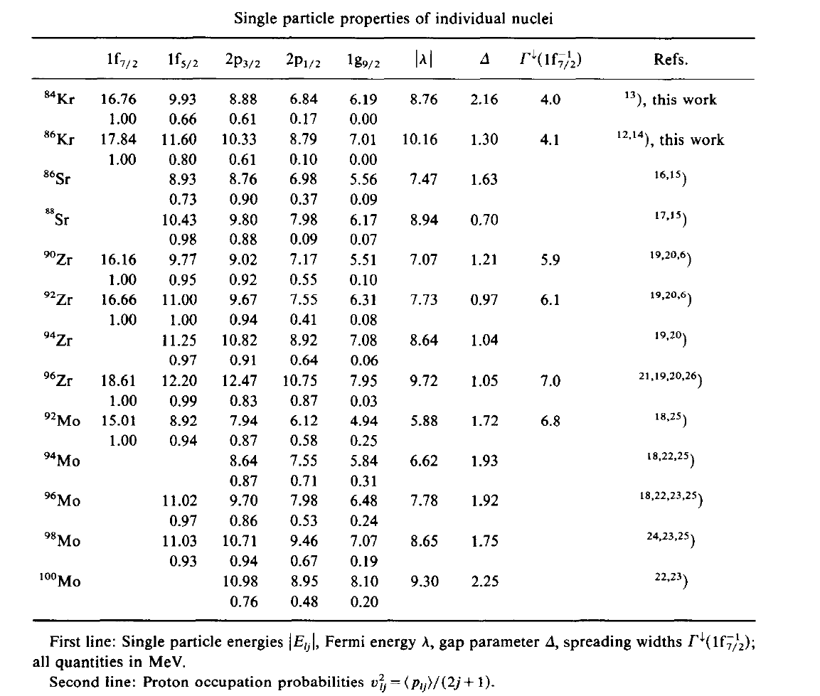
Shell structure in the vicinity of ⁷⁸Ni
single particle sequence : PROTONS
A. Pfeiffer et al. NPA 455 (1986) 381
E (MeV)
Proton single particles
-7,121
50
g_{9/2}
40
-11,831
p_{1/2}
-13,233
p_{3/2}
-14,386
f_{5/2}
28
From Ji et Wildenthal
Phys. Rev. C 38, 2849 (1988)
Page 11/
Verney – IPN Orsay Shell Model as Unified View of Nuclear Structure – 8-10 Oct. 2012

Slide 12
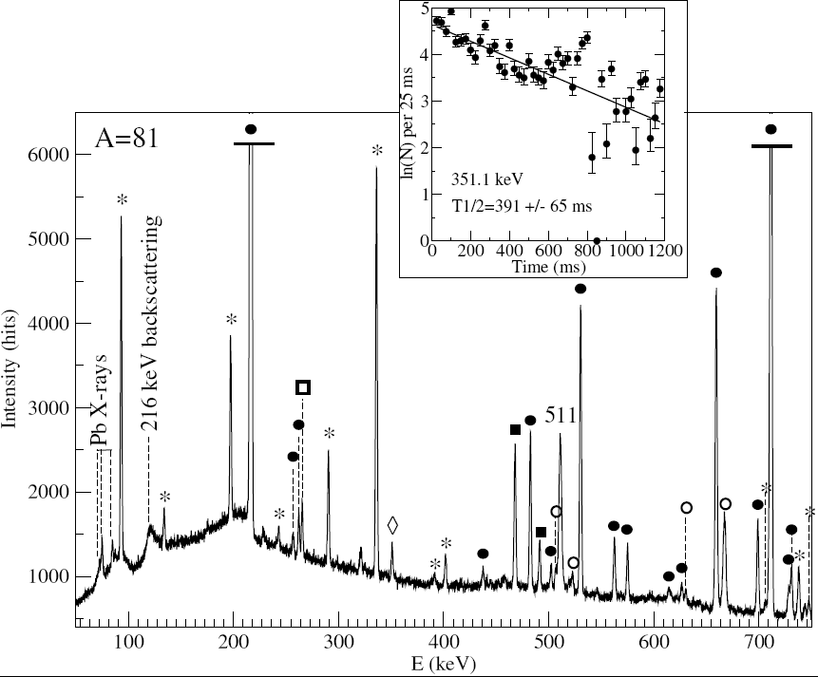
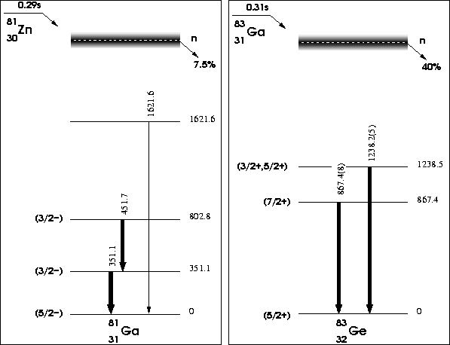
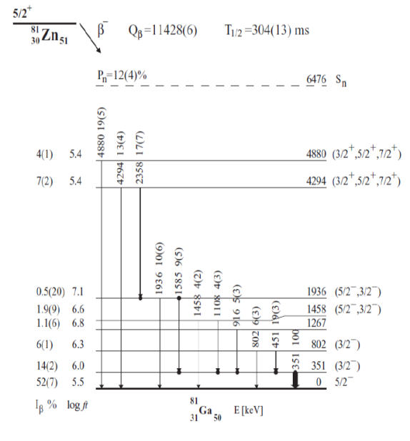
Proton structure above ⁷⁸Ni
Towards South : Milestone in the Paris(⁸⁸Sr)-Dakar(⁷⁸Ni) race : ⁸¹Ga
Zr90
Zr91
Zr92
Zr93
Zr92
Zr93
Zr94
Zr95
Zr96
PARRNe
Y89
Sr88
81
3 protons out of a ⁷⁸Ni core
Rb87
Ga
31
50
Kr86
Br85
Se84
Se85
Se86
As83
As84
Ge82
Ge83
Ge84
hot subject - β-decay experiment redone at ISOLDE and Oak Ridge
Ga81
Zn80
Zn81
augmented by S. Padgett et al :, Phys. Rev. C 82, 064314 (2010)
Cu79
Ni78
observed in DIC experiments at Legnaro
G. De Angelis et al. NPA 787 (2007) 74c
1236
(9/2-)
50
observed in β-decay at Orsay (PARRNe)
D. Verney et al PRC 76 (2007) 054312
Page 12/
Verney – IPN Orsay Shell Model as Unified View of Nuclear Structure – 8-10 Oct. 2012

Slide 13
Proton structure above ⁷⁸Ni
Towards South : Milestone in the Paris(⁸⁸Sr)-Dakar(⁷⁸Ni) race : ⁸¹Ga
⁸³As Z=33 N=50
⁸¹Ga Z=31 N=50
keV
9/2-
3/2-
1977.9 keV
7/2-
1985 keV
1897 keV
1/2-
3/2-
1879 keV
1800
1804.76 keV
1857 keV
1845 keV
1600
9/2-
1643 keV
1525.52 keV
5/2-
1400
5/2-
1434.92 keV
1/2-
1455 keV
1368 keV
1415.11 keV
1382 keV
1/2-
1279 keV
(9/2-)
1236 keV
1329.87 keV
3/2-
1253 keV
1200
1256.76 keV
5/2-
1196.53 keV
1115 keV
1000
1193.7 keV
7/2-
990 keV
800
(3/2-)
802.8 keV
3/2-
679 keV
711.66 keV
600
451.7 keV
3/2-
589 keV
400
(3/2-)
351.1 keV
(3/2-)
1/2-
353 keV
200
306.51 keV
351.1 keV
3/2-
189 keV
5/2-
64 keV
0
3/2-
0 keV
(5/2-)
0 keV
(5/2-)
0 keV
5/2-
0 keV
Theory
Experiment
Experiment
Theory
Ji & Wildenthal, PRC 40, 389 (1989)
Winger et al, PRC 38,
285 (1988)
empirical effective interaction :
fit on a series of carefully selected states
Valence space N=50 closed & Z=28 closed
(the doubly magical nature of 78Ni is assumed)
The valence space is reduced to proton orbitals
Page 13/
Verney – IPN Orsay Shell Model as Unified View of Nuclear Structure – 8-10 Oct. 2012

Slide 14
Back to school with Talmi
what to do ?
remember the textbooks and assume π1f_{5/2} is indeed the first proton orbit filled above ⁷⁸Ni
for identical particles in j≤7/2 there exists a closed formula expressing the configuration energy (by Talmi)
Talmi : <V_{J}>=
single particle
(binding) energy
number of particles in the configuration
seniority number
82Ge
81Ga
80Zn
(π1f_{5/2})⁴
(π1f_{5/2})³
(π1f_{5/2})²
n=3, =3
n=2, =2
BE(f_{5/2})= -13.576 MeV………JW give -14.386 MeV
803 keV
3/2+
1492 keV
2+
E(9/2-) in ⁸¹Ga=1250 keV ……experiment :1236 keV
5/2+
n=2, =0
n=3, =1
0+
E(4+) in ⁸⁰Zn=1809 keV ………experiment :?
but also extract :
<f_{5/2}f_{5/2}|V|f_{5/2}f_{5/2}>_{J=0}
<f_{5/2}f_{5/2}|V|f_{5/2}f_{5/2}>_{J=2}
<f_{5/2}f_{5/2}|V|f_{5/2}f_{5/2}>_{J=4}
n=4, =0
0+
Page 14/
Verney – IPN Orsay Shell Model as Unified View of Nuclear Structure – 8-10 Oct. 2012

Slide 15
Proton structure above ⁷⁸Ni
A patch on the interaction
back to the Ji Wildenthal proton-proton residual interaction :
f_{5/2}
f_{5/2}
f_{5/2}
f_{5/2}
f_{5/2}
f_{5/2}
f_{5/2}
f_{5/2}
f_{5/2}
f_{5/2}
f_{5/2}
f_{5/2}
pairing looks small !
Is it possible to find a simple cure to the interaction ?
Page 15/
Verney – IPN Orsay Shell Model as Unified View of Nuclear Structure – 8-10 Oct. 2012

Slide 16
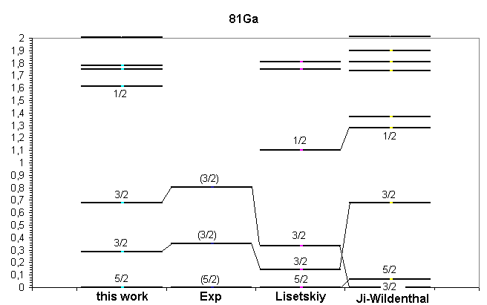
Proton structure above ⁷⁸Ni
a temporary patch on an interaction (for interpretation purpose only)
Z=31 N=50
Ji & Wildenthal,
PRC 40, 389 (1989)
A.F. Lisetskiy et al.,
PRC 70 (2004)
v=3(πf5/2)³
1qp πp3/2
1qp πf5/2
JW+rustine
Page 16/
Verney – IPN Orsay Shell Model as Unified View of Nuclear Structure – 8-10 Oct. 2012

Slide 17
Proton structure above ⁷⁸Ni
Proton quasi-particle evolution towards ⁷⁸Ni
and the observed structure of the odd-proton N=50 isotones simply (and naturally) reflects the change of the Fermi level
2p_{1/2}
2p_{1/2}
2p_{1/2}
2p_{3/2}
2p_{3/2}
2p_{3/2}
1f_{5/2}
1f_{5/2}
1f_{5/2}
⁸¹Ga Z=31 N=50
⁸³As Z=33 N=50
⁸⁵Br Z=35 N=50
g9/2
p1/2
if these are QPs :
what is the occupation probability ??
p3/2
Page 17/
Verney – IPN Orsay Shell Model as Unified View of Nuclear Structure – 8-10 Oct. 2012

Slide 18
Proton structure above ⁷⁸Ni
Proton quasi-particle evolution towards 78Ni
A. Pfeiffer et al. NPA 455 (1986) 381
Page 18/
Verney – IPN Orsay Shell Model as Unified View of Nuclear Structure – 8-10 Oct. 2012

Slide 19
ODD-ODD

Slide 20
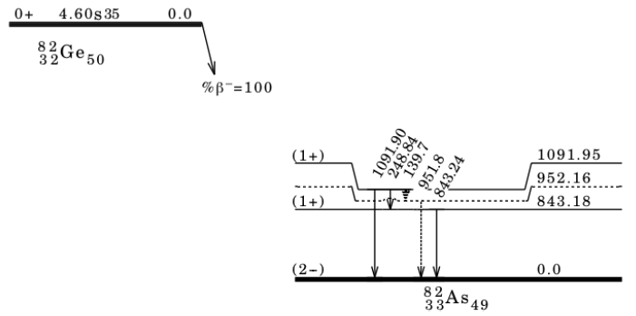
⁸²Ge→⁸²As (Z=33, N=49)
BEFORE :
Hoff & Fogelberg Nucl. Phys. A 368 (1981)
AFTER :
B. Tastet PhD thesis
Univ. Paris Sud (2011)
(unpublished)
Page 20/
Verney – IPN Orsay Shell Model as Unified View of Nuclear Structure – 8-10 Oct. 2012

Slide 21
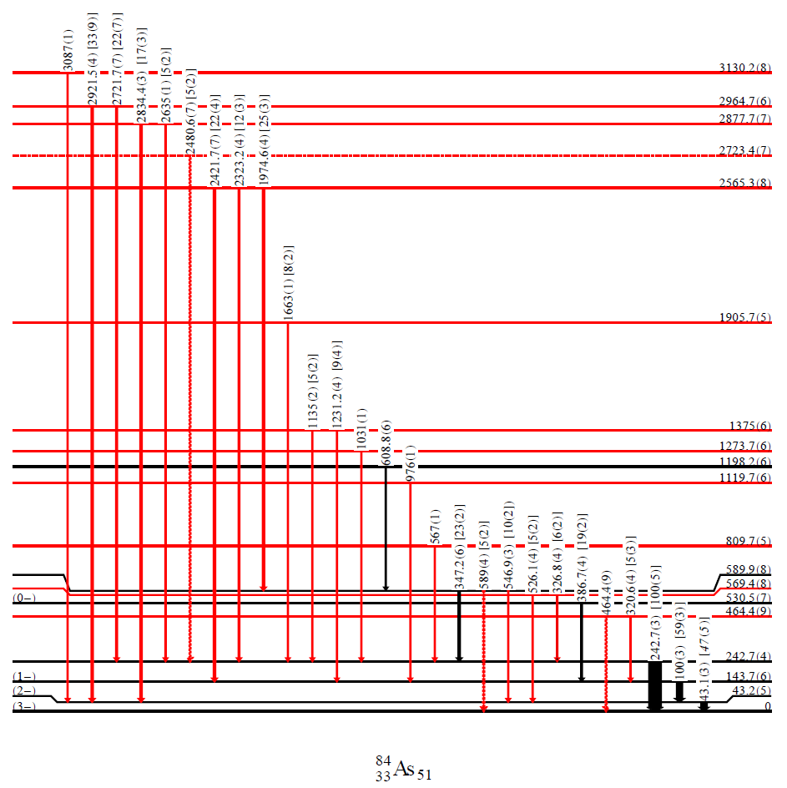
⁸⁴Ge→⁸⁴As (Z=33, N=51)
tentative Jπ assignements
B. Tastet PhD thesis (2011) unpublished
augmented by K. Kolos PhD work
(1+)
(1+)
(1+)
J . A . Winger et al. Proc . 4th . Intern. Conf. Fission and Properties of Neutron-Rich Nuclei, Sanibel Island, Florida p.663 (2008)
(2−)
(3-)
Page 21/
Verney – IPN Orsay Shell Model as Unified View of Nuclear Structure – 8-10 Oct. 2012

Slide 22
What is the structure of these odd-odd nuclei ?
does it fit with the global picture of structure evolution towards ⁷⁸Ni
what can we learn from them ?
π-ν multiplet splitting
splitting energy
J
most of the time splitting small
the multiplet members always remain close to QP energies
(when one of the two species is in open shell)
v²
Page 22/
Verney – IPN Orsay Shell Model as Unified View of Nuclear Structure – 8-10 Oct. 2012

Slide 23
+
πg_{9/2}
90Zr
―
―
+
πp_{1/2}
N=49
N=51
νp_{1/2}
νg_{9/2}
+
+
88Sr
νd_{5/2}
νs_{1/2}
Z=38
●
πf_{5/2}⁻¹⊗νg_{9/2}⁻¹
πf_{5/2}⁻¹⊗νd_{5/2}⁺¹
●
●
p3
○
Z=37
●
86Rb
88Rb
―
πp_{3/2}⁻¹⊗νg_{9/2}⁻¹
●
●
●
●
f5
●
πp_{3/2}⁻¹⊗ νd_{5/2}⁺¹
πp_{3/2}
p3/2 turns into particle character
○
○
πf_{5/2}⁻¹⊗νg_{9/2}⁻¹
p3
●
○
πf_{5/2}⁻¹⊗ νd_{5/2}⁺¹
Z=35
●
84Br
86Br
●
●
●
●
f5
●
πp_{3/2}⁺¹⊗νg_{9/2}⁻¹
πp_{3/2}⁺¹⊗ νd_{5/2}⁺¹
p3
πf_{5/2}⁻¹⊗νg_{9/2}⁻¹
πf_{5/2}⁻¹⊗ νd_{5/2}⁺¹
Z=33
●
82As
84As
●
●
●
●
f5
○
πp_{3/2}⁺¹⊗νg_{9/2}⁻¹
πp_{3/2}⁺¹⊗ νd_{5/2}⁺¹
―
f5/2 turns into particle character
πf_{5/2}
p3
πf_{5/2}⁺¹⊗νg_{9/2}⁻¹
πf_{5/2}⁺¹⊗ νd_{5/2}⁺¹
Z=31
●
80Ga
82Ga
●
●
○
○
f5
○
πp_{3/2}⁺¹⊗νg_{9/2}⁻¹
πp_{3/2}⁺¹⊗ νd_{5/2}⁺¹
p3
πf_{5/2}⁺¹⊗νg_{9/2}⁻¹
πf_{5/2}⁺¹⊗ νd_{5/2}⁺¹
Z=29
●
78Cu
80Cu
f5
πp_{3/2}⁺¹⊗νg_{9/2}⁻¹
πp_{3/2}⁺¹⊗ νd_{5/2}⁺¹
78Ni
N=49
N=50
N=51

Slide 24
90Zr
J. Van Maldeghem et al PRC 32 (1985)
Pandya transformation
88Sr
86Rb
88Rb
v²
84Br
86Br
π-ν multiplet splitting
N=49
π-ν multiplet splitting
N=51
82As
84As
80Ga
82Ga
78Cu
80Cu
78Ni
N=49
N=50
N=51

Slide 25
neutron and proton “QP” identification from experimental data
neutron QP
bellow N=50
proton QP
above Z=28
from beta-decay
Hoff & Fogelberg Nucl. Phys. A 368 (1981)
neutron QP above N=50
from beta-decay
Verney et al.
PRC 76, 054312 (2007)
from (d,p) Oak Ridge : Thomas et al. PRC 76, 044302 (2007)
Page 25/
Verney – IPN Orsay Shell Model as Unified View of Nuclear Structure – 8-10 Oct. 2012

Slide 26
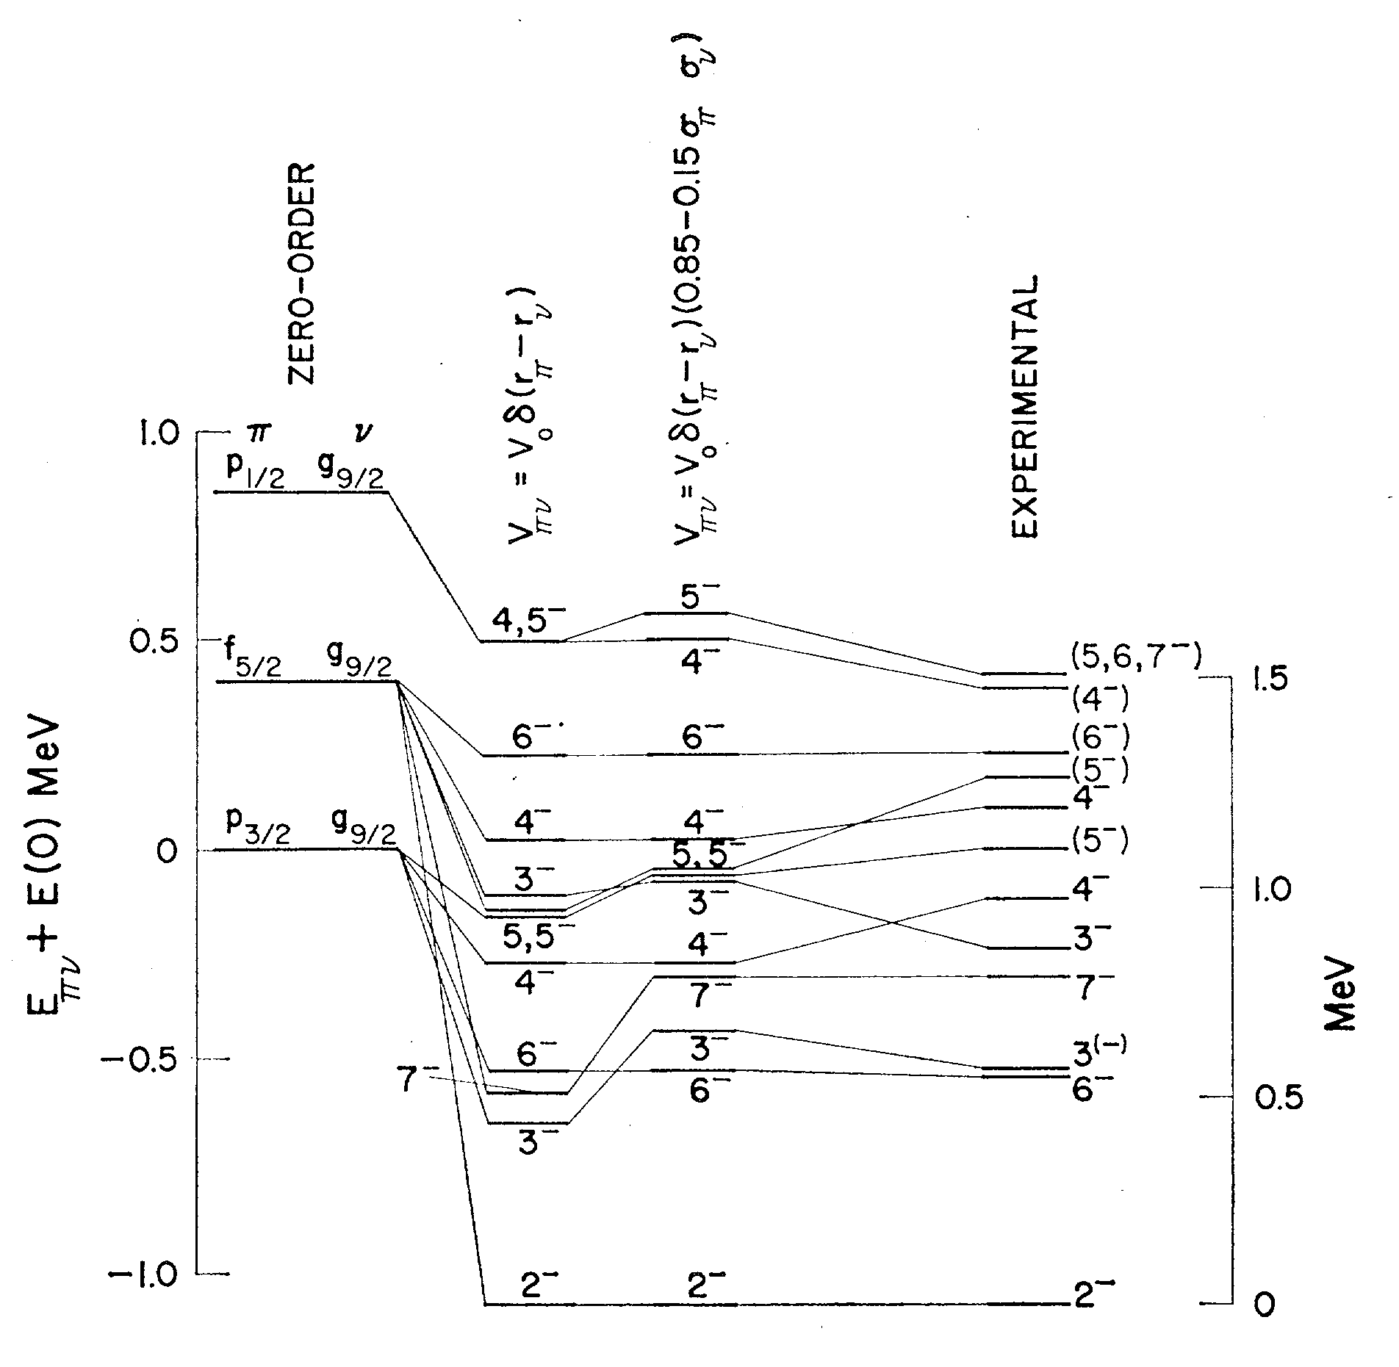
―
+
νp_{1/2}
νg_{9/2}
⁸⁶Rb
Dawson et al. Phys. Rev. 181 (1969)
―
Z=38
88Sr
●
πp_{3/2}
●
●
p3
○
Z=37
●
86Rb
●
●
●
●
f5
●
○
○
p3
●
○
Z=35
●
84Br
●
●
●
●
f5
●
2,3,4,5,6,7
Z=33
p3
82As
●
●
●
●
●
f5
○
―
3,4,5,6
πf_{5/2}
p3
80Ga
Z=31
●
●
●
○
○
f5
○
p3
78Cu
Z=29
f5
●
78Ni
α=0.15 ; V₀=624 MeV.fm3
N=49
N=50
Page 26/
Verney – IPN Orsay Shell Model as Unified View of Nuclear Structure – 8-10 Oct. 2012

Slide 27
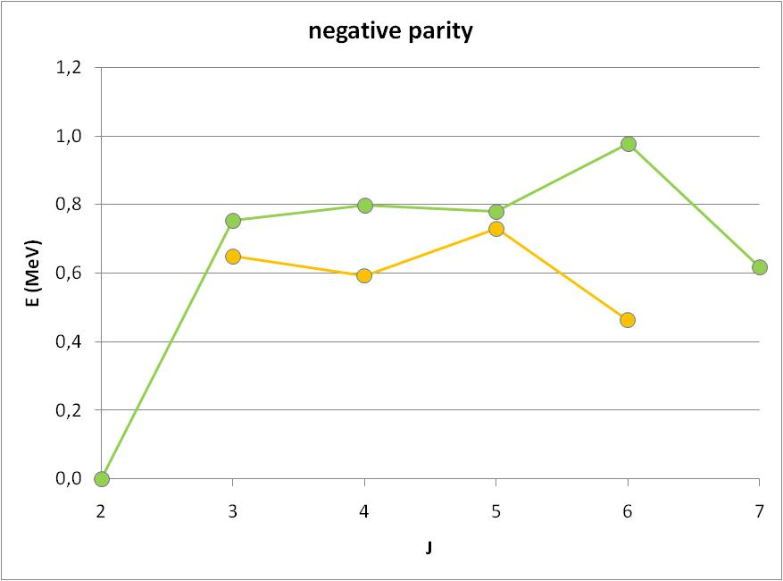
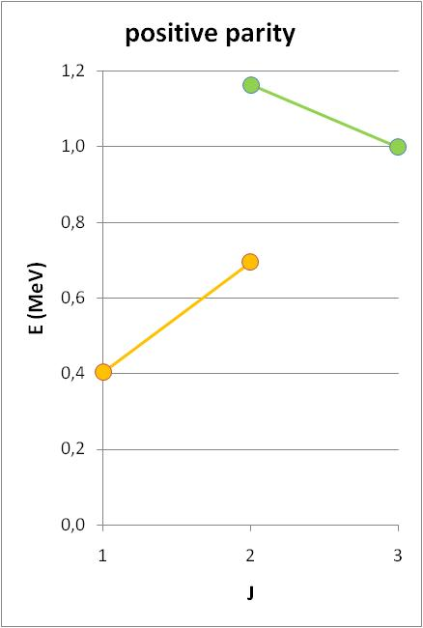
+
πg_{9/2}
―
84Br
πp_{1/2}
Z=38
―
88Sr
πp_{3/2}
Z=37
86Rb
experiment
πf_{5/2}⊗νp_{1/2}
Z=35
84Br
πf_{5/2}⊗νg_{9/2}
850±100 keV
7-
M1 530 keV
1+
πp_{3/2}⊗νg_{9/2}
320±100 keV
6-
πp_{3/2}⊗νp_{1/2}
408keV
Z=33
82As
―
πf_{5/2}
0
2-
2
3
4
5
6
7
1
2
3
Z=31
80Ga
Z=29
78Cu
78Ni
N=49
N=50
Page 27/
Verney – IPN Orsay Shell Model as Unified View of Nuclear Structure – 8-10 Oct. 2012

Slide 28
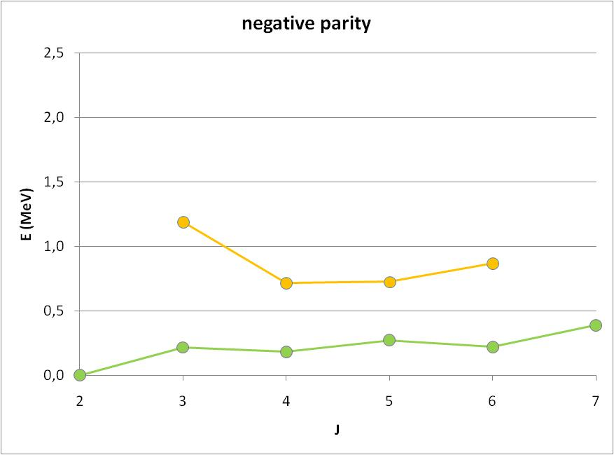
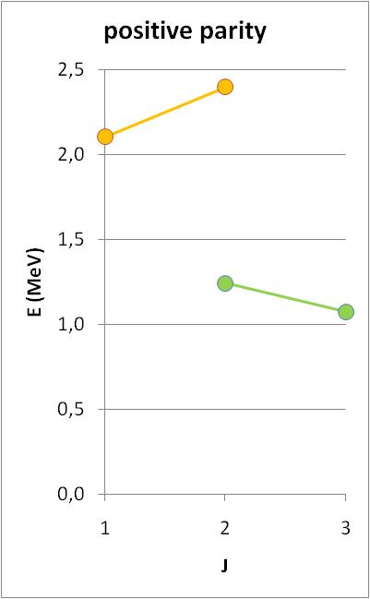
82As
+
νg_{9/2}
―
νp_{1/2}
experiment
Z=38
―
πp_{3/2}⊗νp_{1/2}
88Sr
πp_{3/2}
Z=37
86Rb
1+
πf_{5/2}⊗νp_{1/2}
πp_{3/2}⊗νg_{9/2}
1092keV
(3+)
Z=35
84Br
πf_{5/2}⊗νg_{9/2}
146±27 keV
5-
2-
2
3
4
5
6
7
0
1
2
3
Gausemel et al. PRC70 (2004)
Z=33
82As
―
πf_{5/2}
Z=31
80Ga
Z=29
78Cu
78Ni
B. Tastet PhD thesis
Univ. Paris Sud (2011)
(unpublished)
N=49
N=50
Page 28/
Verney – IPN Orsay Shell Model as Unified View of Nuclear Structure – 8-10 Oct. 2012

Slide 29
+
νg_{9/2}
Porquet et al Eur. Phys. J. A 131 (2009)
yrast structure
fusion-fission
―
νp_{1/2}
88Rb
Z=38
88Sr
―
experiment
Z=37
88Rb
πp_{3/2}
πg_{9/2}⊗νd_{5/2}
7+
1374keV
Z=35
86Br
πf_{5/2}⊗νs_{1/2}
862
2-
727
5-
Z=33
―
84As
πp_{3/2}⊗νs_{1/2}
πf_{5/2}⊗νd_{5/2}
πf_{5/2}
340
4-
362
2-
πp_{1/2}⊗νd_{5/2}
(1-)
196
Z=31
82Ga
3-
πp_{3/2}⊗νd_{5/2}
0
27
2-
Z=29
80Cu
78Ni
N=50
N=51
Page 29/
Verney – IPN Orsay Shell Model as Unified View of Nuclear Structure – 8-10 Oct. 2012

Slide 30
+
νg_{9/2}
―
νp_{1/2}
86Br
Z=38
88Sr
experiment
Z=37
―
88Rb
1624
7+
πp_{3/2}
πg_{9/2}⊗νd_{5/2}
Z=35
86Br
πf_{5/2}⊗νs_{1/2}
Z=33
84As
πp_{1/2}⊗νd_{5/2}
574
5-
―
πp_{3/2}⊗νs_{1/2}
(1-)
πf_{5/2}
435
πf_{5/2}⊗νd_{5/2}
243
4-
Z=31
82Ga
130
4-
πp_{3/2}⊗νd_{5/2}
53
3-
0
5
1-
2-
Z=29
80Cu
78Ni
N=50
Page 30/
Verney – IPN Orsay Shell Model as Unified View of Nuclear Structure – 8-10 Oct. 2012

Slide 31
(very) tentative Jπ assignements
84As
B. Tastet PhD thesis (2011) unpublished
augmented by K. Kolos PhD work
+
νg_{9/2}
―
νp_{1/2}
(1+)
Z=38
88Sr
(1+)
Z=37
―
88Rb
(1+)
πp_{3/2}
Z=35
86Br
Z=33
―
84As
πf_{5/2}
Z=31
82Ga
Z=29
80Cu
(2−)
(3-)
78Ni
ground spin (3-) ???
J.V. Kratz et al. Nucl. Phys. A 250 13 (1975)
from systematics (N<50) and weak Nordheim rule
N=50
Page 31/
Verney – IPN Orsay Shell Model as Unified View of Nuclear Structure – 8-10 Oct. 2012

Slide 32
+
νg_{9/2}
84As
―
νp_{1/2}
Z=38
88Sr
Z=37
―
88Rb
πp_{3/2}
Z=35
86Br
experiment
πf_{5/2}⊗νs_{1/2}
Z=33
84As
πp_{3/2}⊗νs_{1/2}
―
529
(0-)
πf_{5/2}
464
(2-?)
πf_{5/2}⊗νd_{5/2}
(2-)
243
(1-)
Z=31
82Ga
πp_{3/2}⊗νd_{5/2}
143
43
(2-)
0
(3-)
Z=29
80Cu
78Ni
N=50
Page 32/
Verney – IPN Orsay Shell Model as Unified View of Nuclear Structure – 8-10 Oct. 2012

Slide 33
from the odd-odd nuclei:
evolution of the occupation probability
from the odd nuclei:
evolution of the proton QP energies
86,88Rb
84,86Br
82,84As
etc
from the masses
using data taken from mass evaluation 2011
Z=28 Δp=0,990 MeV (ext.)
Z=30 Δp=0,904 MeV
Z=32 Δp=1,012 MeV
Z=34 Δp=1,031 MeV
Z=36 Δp=0,996 MeV
BCS
obtain ESPE !
Page 33/
Verney – IPN Orsay Shell Model as Unified View of Nuclear Structure – 8-10 Oct. 2012

Slide 34
first experimental hint of proton evolution towards ⁷⁸Ni
along the N=50 line
very temptative, preliminary etc
Z (N=50)
Cu
Ga
As
Br
Rb
g9/2
p1/2
Fermi level
p3/2
proton ESPS (MeV)
f5/2
f7/2
extrapolation
exactly consistent with
Pfeiffer et al. NPA 455 (1986) 381
who provided sp energies, QP energies and v².
allows to explain the Jπ of ⁸⁰Ga and ^{80m}Ga
ISOLDE experiment, laser spectroscopy :
two long lived states in ⁸⁰Ga J=3 and J=6
B. Cheal et al., PRC 82 (2010) 051302
Page 34/
Verney – IPN Orsay Shell Model as Unified View of Nuclear Structure – 8-10 Oct. 2012

Slide 35
may be useful for shell model calculations in the ⁷⁸Ni region
g9/2
p1/2
p3/2
f5/2
JW
Lis
JUN45
JJ4B
SN
this work
Ji et Wildenthal
Phys. Rev. C 38, 2849 (1988)
M. Honma et al
Phys. Rev. C 80, 064323 (2009)
A.F. Lisetskiy et al
Phys. Rev. C 70, 044314 (2004)
Sieja & Nowacki
Phys. Rev. C 81, 061303(R) (2010)
fitted SPE
A. Brown priv. com.
used in
Verney et al Phys. Rev. C 76, 054312 (2007)
result from monopole migration (realistic N-N interactions)
Page 35/
Verney – IPN Orsay Shell Model as Unified View of Nuclear Structure – 8-10 Oct. 2012

Slide 36
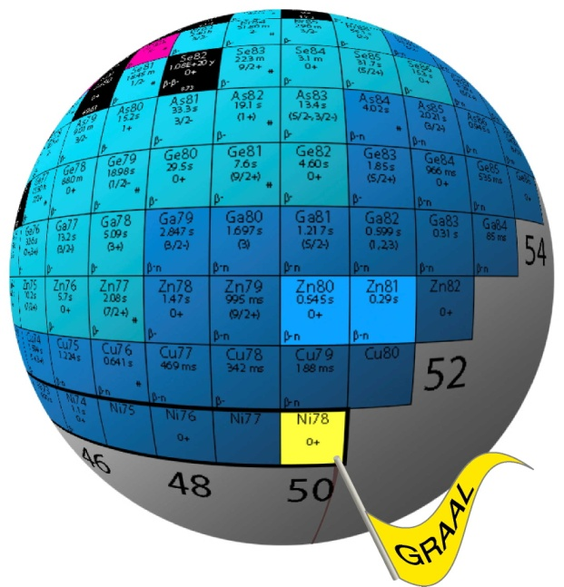
summary and conclusion
►up to now no real evidence of a N=50 collapse towards ⁷⁸Ni
some erosion of the shell effect is observed,
due to correlations,
of which we see a maximum of influence at Z=32
►detailed spectroscopy may be of some use
to help in guiding the emerging shell model calculations in the ⁷⁸Ni region
►conversely :
“Shell model as unified view” of this mass region is called for !
may have to do with:
the semi-secular problem of the 3-body interaction and the formation of spin-orbite shell closure
next generation of RIBs is close at hand
next generation of theoreticians is already at work
Page 36/
Verney – IPN Orsay Shell Model as Unified View of Nuclear Structure – 8-10 Oct. 2012

Slide 37
backup/other talk

Slide 38
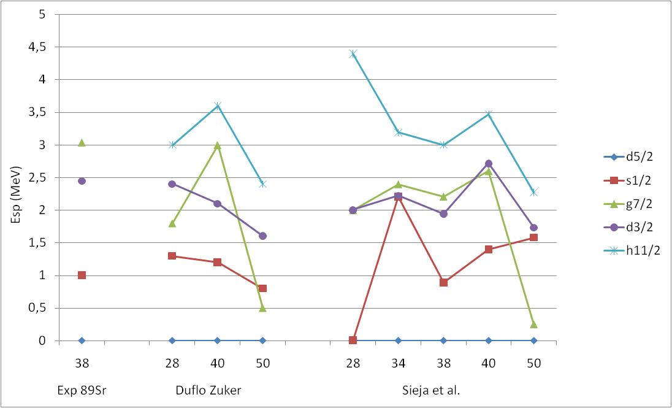
Shell structure in the vicinity of ⁷⁸Ni
single particle sequence : NEUTRONS
⁸⁹Sr
⁸⁹Sr
h11/2
h11/2 ?
g7/2
h11/2
d3/2
d3/2
g7/2
g7/2
d3/2
s1/2
s1/2
s1/2
d5/2
d5/2
d5/2
Z
Z
Z
From T.A. Hughes
Phys. Rev. 181, 1586 (1969)
but in fact the problem of the position of h11/2 remains unsolved → need for the observation of negative parity Yrast states in N=51
From Duflo Zuker
PRC 59, R2347 (1999)
SM calculations in valence space above ⁷⁸Ni
K. Sieja et al. PRC 79, 064310 (2009)
Page 38/
Verney – IPN Orsay Shell Model as Unified View of Nuclear Structure – 8-10 Oct. 2012

Slide 39
towards South : Milestone in the Paris(⁸⁸Sr)-Dakar(⁷⁸Ni) race : ⁸³Ge
Zr90
Zr91
Zr92
Zr93
Zr92
Zr93
Zr94
Zr95
Zr96
Y89
Sr88
83
4 protons + 1 neutron out of a ⁷⁸Ni core
Rb87
Ge
32
51
Kr86
Br85
Se84
Se85
Se86
As83
As84
Ge82
Ge83
Ge84
Ga81
Ga83
Ga84
Zn80
(3/2,5/2⁺)
observed in β-decay at PARRNe
O. Perru et al.
EPJ A 28 (2006) 307
Cu79
Ni78
50
7/2⁺
observed in βn-decay at ALTO
Lebois et al. PRC 80 (2009) 044308
1/2+
247.8
observed in ²H(⁸²Ge,p)⁸³Ge at Oak Ridge
Thomas et al.
PRC 71 (2005) p. 021302
ν3s_{1/2}
β-decay at Oak Ridge J. A. Winger et al. PRC 81, 044303 (2010) : questioned the existence of 867 keV
ν2d_{5/2}
Page 39/
Verney – IPN Orsay Shell Model as Unified View of Nuclear Structure – 8-10 Oct. 2012

Slide 40
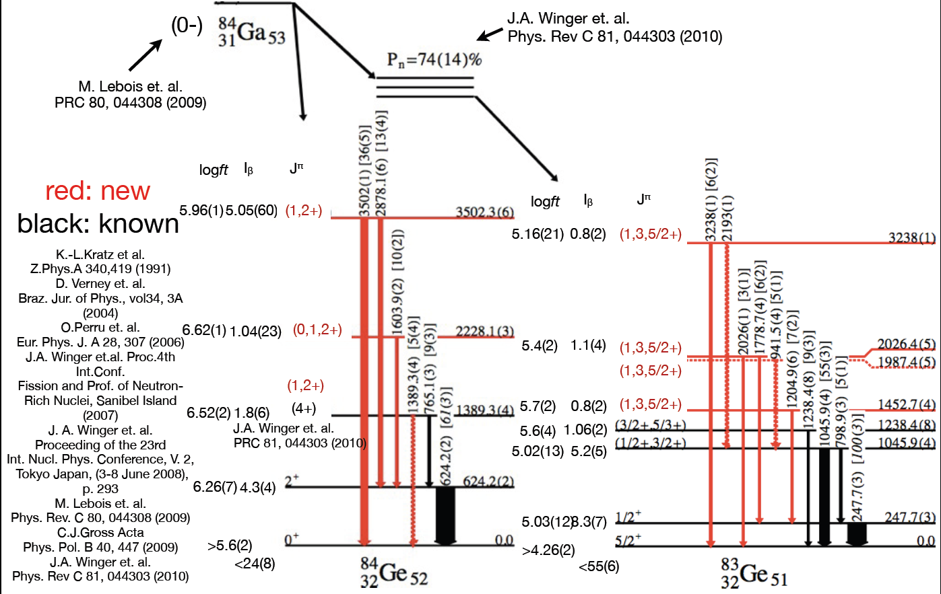
Milestone in the Paris(⁸⁸Sr)-Dakar(⁷⁸Ni) race : ⁸³Ge
in red : K. Kolos PhD work
at ALTO
Page 40/
Verney – IPN Orsay Shell Model as Unified View of Nuclear Structure – 8-10 Oct. 2012

Slide 41
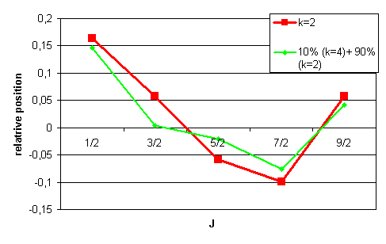
Back to school with De Shalit and Talmi
Even-even semi-magic core
single particle
Q=0
Q>0
Q<0
J=1/2
J=3/2
J=9/2
2+₁ 2d5/2
J=5/2
J=7/2
Page 41/
Verney – IPN Orsay Shell Model as Unified View of Nuclear Structure – 8-10 Oct. 2012

Slide 42
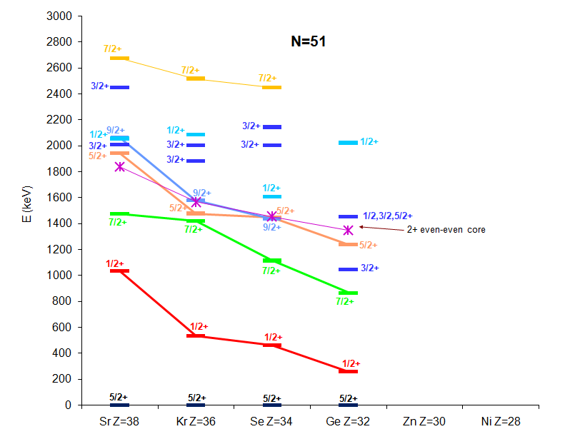
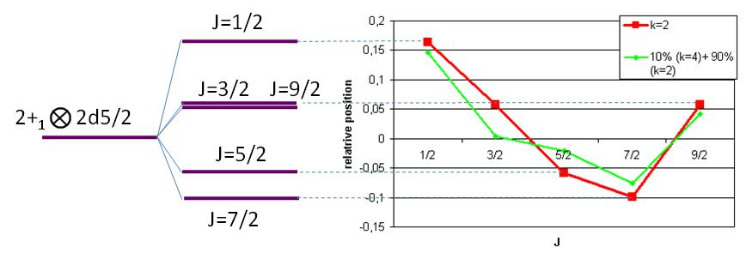
Disentangling collectivity from individuality
?
Page 42/
Verney – IPN Orsay Shell Model as Unified View of Nuclear Structure – 8-10 Oct. 2012

Slide 43
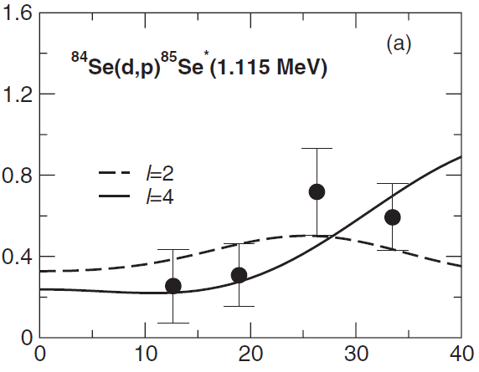
Disentangling collectivity from individuality
first 7/2 state is 2+*d_{5/2} coupled state, g_{7/2} is higher in energy
from J. S. Thomas et al. PRC 76, 044302 (2007)
S=0.84
S=0.49
d_{3/2}
S=0.06±0.02
g_{7/2}
S=0.77±0.27
(1/2+)?
S=0.016
non-stripped
not observed in (d,p)
?
Page 43/
Verney – IPN Orsay Shell Model as Unified View of Nuclear Structure – 8-10 Oct. 2012

Slide 44
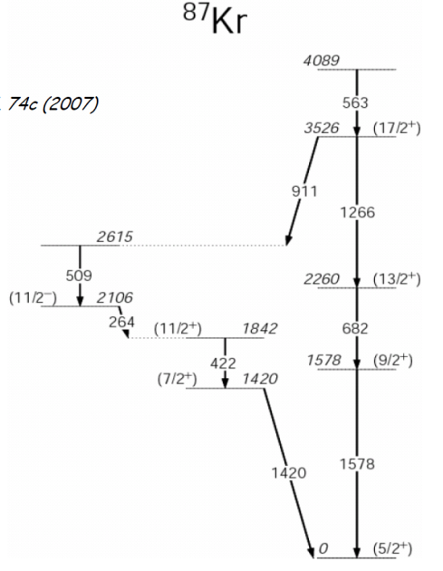
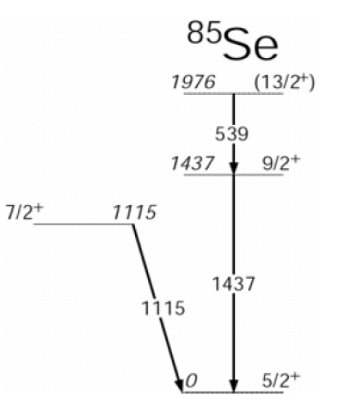
a good way to disentangle the situation :
lifetime measurements of the 7/2⁺₁ in the N=51 chain using the plunger technique
experiment performed last in nov 2011 AGATA dem. at LNL
(spokespersons : G. Duchêne and DV - analysis in progress)
from G. De Angelis et al.
Nucl. Phys. A787 (2007) 74c
7/2⁺₁ was fed in
⁸²Se(@505MeV) +²³⁸U
(1/2+)?
τ_{1/2}=0.26 ps
2⁺ d_{5/2}
τ_{1/2}=?
τ_{1/2}=?
?
τ_{1/2}=?
Page 44/
Verney – IPN Orsay Shell Model as Unified View of Nuclear Structure – 8-10 Oct. 2012

Slide 45
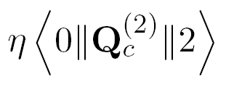
Disentangling collectivity from individuality
how to extract (at least approximately) effective single particle energies when no direct reaction data is available ?
use a simple empirical model
Vector space :
0+₁ 2d5/2
2+₁ 2d5/2
2+₁ 3s1/2
Etc…
Core – particle coupling model
Thankappan & True
Phys. Rev. B, 137, 793 (1965)
Even-even semi-magic core
Neutron single particle
L. S. Kisslinger & R. A. Sorensen Rev. Mod. Phys., 35, 853, (1963)
Core excitation energies taken from experiment : E(2+)
χ₁
χ₂
Parameters :
=
=
Quadrupole moment of the 2+ state
⇒
Phenomenological model with a clear underlying physical image. All parameters with straightforward interpretation:
Example : harmonic vibrator : Q₂₊=0 ⇒ χ₂=0
Page 45/
Verney – IPN Orsay Shell Model as Unified View of Nuclear Structure – 8-10 Oct. 2012

Slide 46
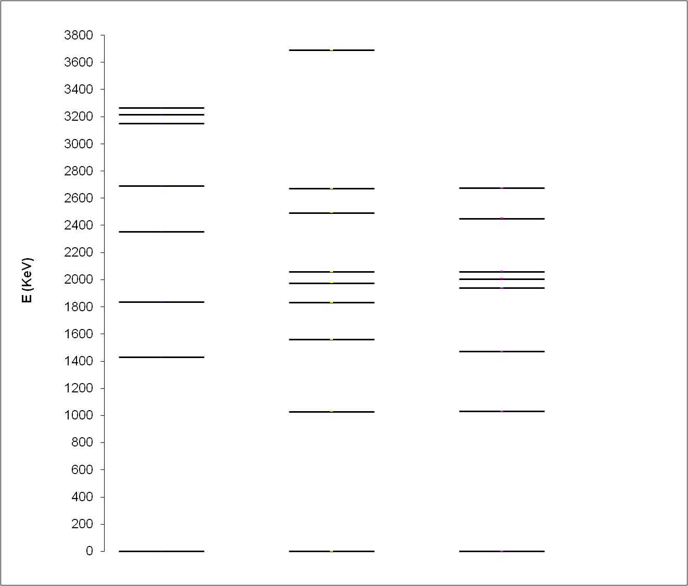
⁸⁹Sr
1
τ_{1/2} calculated assuming only M1 and E2 transitions
e(ν)=1 and g_{s}=0.6 g_{sfree}
2
2⁺ s1/2
3
5
2
2
core-particle coupling
experiment
not included in the model space
2₂⁺ d5/2
1
3
5
7
9
Q_{calc}= -0.27 eb
μ_{calc}= -1.020 n.m.
Q_{exp}= -0.28(3) eb / -0.32(2) eb μ_{exp}= -1.1481 n.m.
2
2
2
2
2
5
0₂⁺ d5/2
2
0⁺ g7/2
7
2
S=0.74
S=0.84
7
7
2
2
S=0.34
3
S=0.15
0⁺ d3/2
3
2
3
2
2
0.09ps
9
0.21ps
9
2
2
0.10ps
S=0.64
0.02ps
S=0.46
3
3
0.19ps
S=0.053
1
3
5
7
9
2
2⁺ d5/2
2
5
2
2
2
2
2
0.16ps
S=0.091
5
2
2
0.11ps
7
7
0⁺ s1/2
1
2
0.26ps
S=0.016
2
2
δ²=0.87 (M1+E2)
δ²=0.56 (M1+E2)
1
>1 ps
1
1.85ps
S=0.905
S=0.78
2
2
0⁺ d5/2
5
5
5
S=0.79
S=0.88
2
2
2
unperturbed
theory
experiment

Slide 47
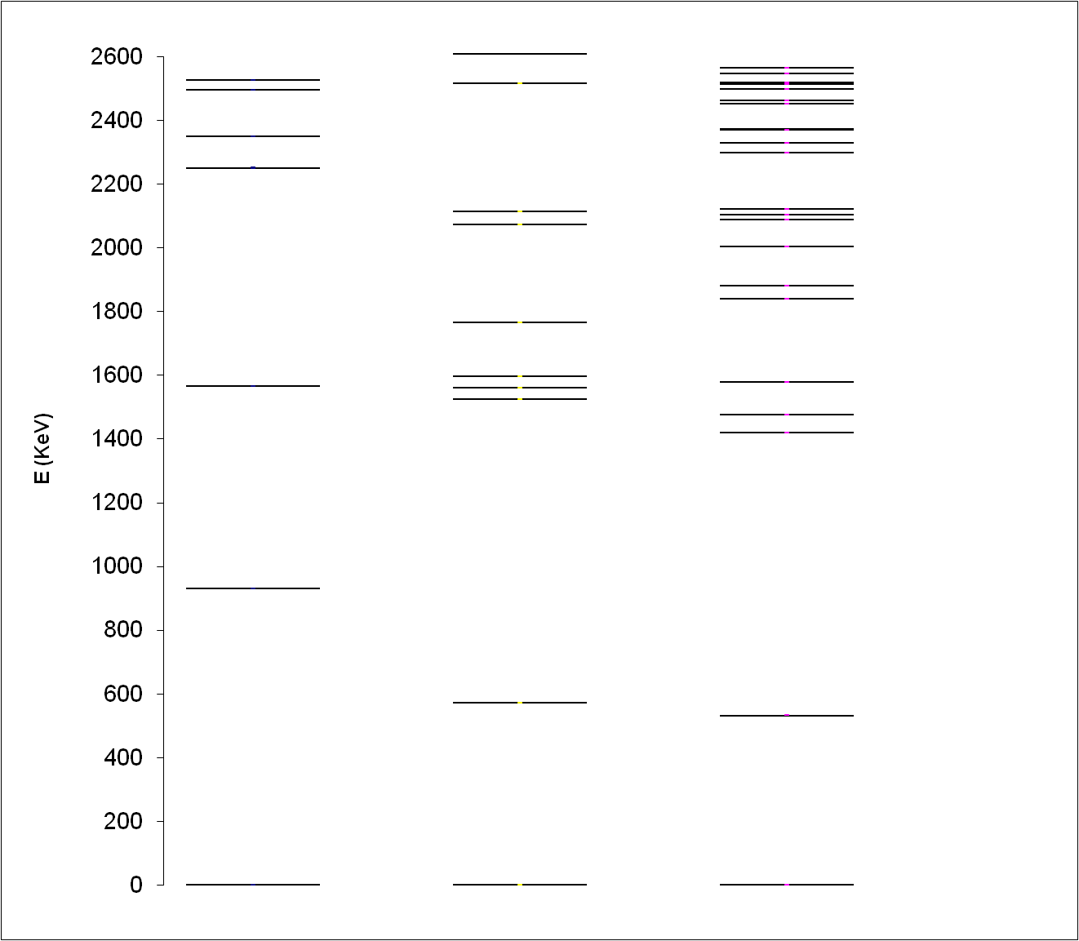
⁸⁷Kr
5
S=0.03
0⁺ g7/2
7
2
7
2
S=0.84
S=0.49
3
5
7
2
2⁺ s1/2
2
2
2
2₂⁺ d5/2
1
3
5
7
9
2
2
2
2
2
3
5
13
4⁺ d5/2
2
2
7
9
11
3
5
3
2
2
2
2
S=0.3
0⁺ d3/2
2
1
2
2
S=0.27
11
2
2
1
3
S=0.18
S=0.43
S=0.09
2
2
3
5
2
2
3
5
S=0.02
2
5
2
S=0.06
9
2
2
1
3
5
7
9
7
2⁺ d5/2
S=0.02
9
2
2
2
2
2
2
2
9
2
3
5
3
S=0.23
S=0.20
2
2
2
7
2
0⁺ s1/2
1
2
1
2
1
S=0.68
S=0.46
2
0⁺ d5/2
5
5
5
2
2
2
S=0.90
S=0.56
unperturbed
theory
experiment

Slide 48
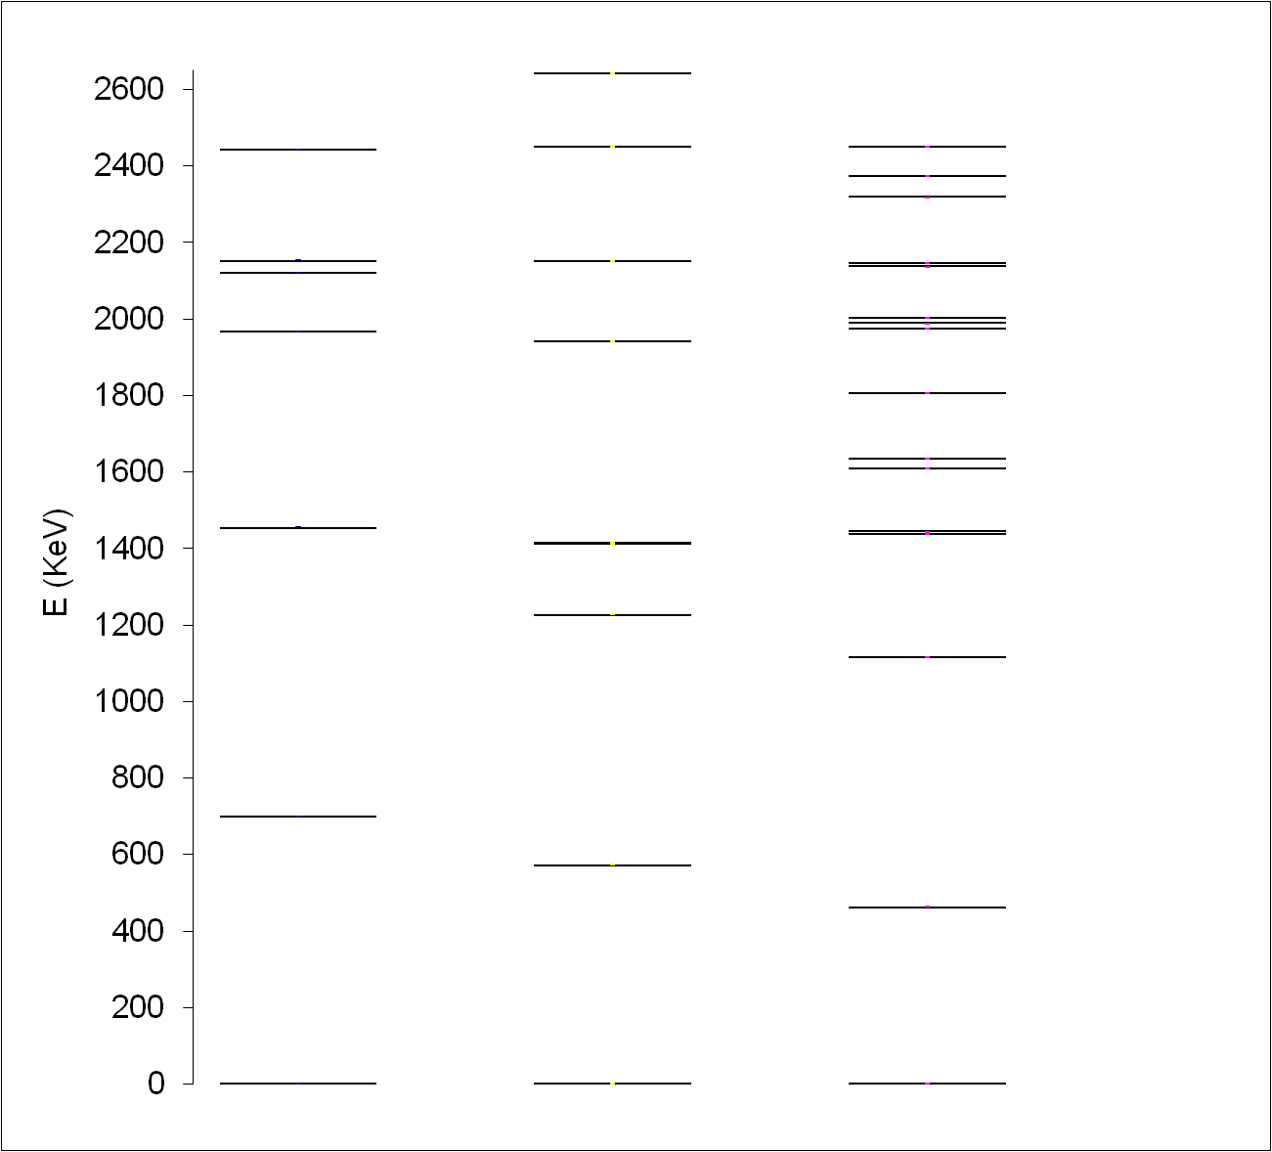
⁸⁵Se
1
2
0⁺ d3/2
3
7
3
5
7
2
2
?
2
2
2
7
0⁺ g7/2
2
13
2
11
2
5
7
2⁺ s1/2
3
5
3
3
2
2
2
2
2
?
2
3
5
13
1
9
3
4⁺ d5/2
7
9
11
2
2
2
2
2
2
2
2
2
3
?
3
5
5
2
2
2
0₂⁺ d5/2
2
11
7
-
2
2
?
1
9
2
2
1
?
1
3
5
7
9
2
2⁺ d5/2
3
5
2
2
2
2
2
5
2
2
2
9
9
2
2
S=0.09
7
2
7
S=0.77 or 0.06
2
0⁺ s1/2
1
2
1
S=0.86
2
1
S=0.31
2
0⁺ d5/2
5
5
5
2
S=0.90
S=0.38
2
2
unperturbed
theory
experiment

Slide 49
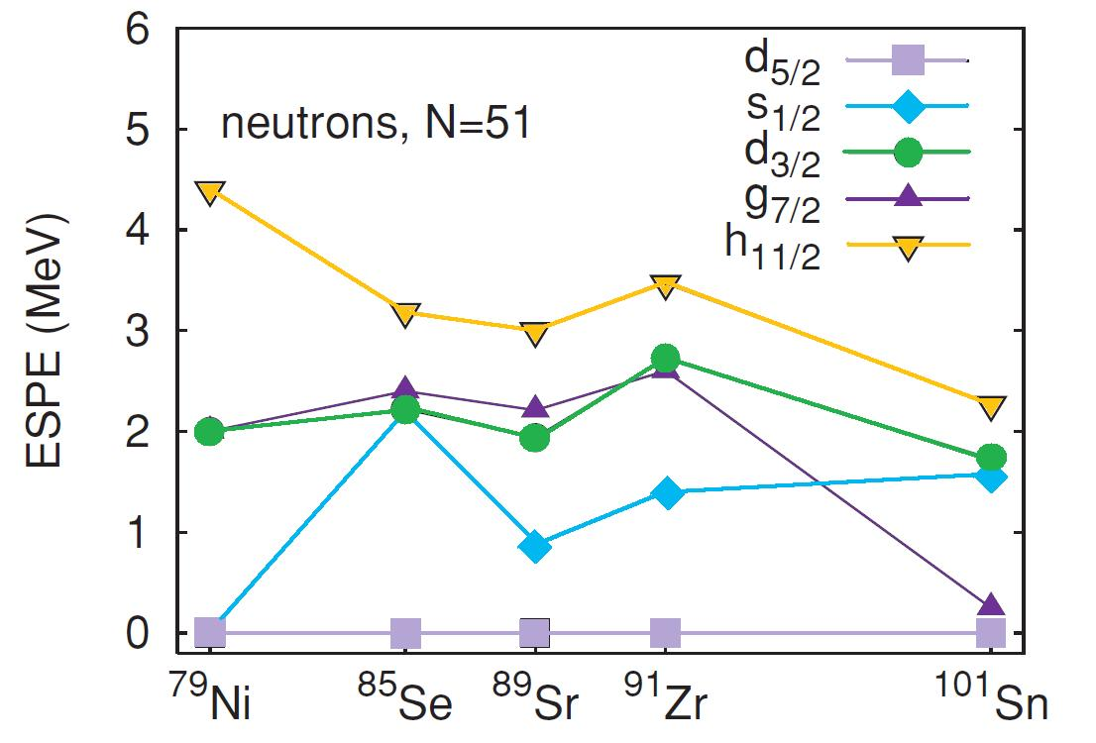
Neutron effective single particle energy evolution
as revealed from N=51 systematics, using the core-particle coupling approach
THEORY (SM)
K. Sieja et al. PRC 79, 064310 (2009)
g7/2
d3/2
s1/2
d5/2
Sr
Kr
Se
Ge
Zn
Ni
g9/2

