Slide 1
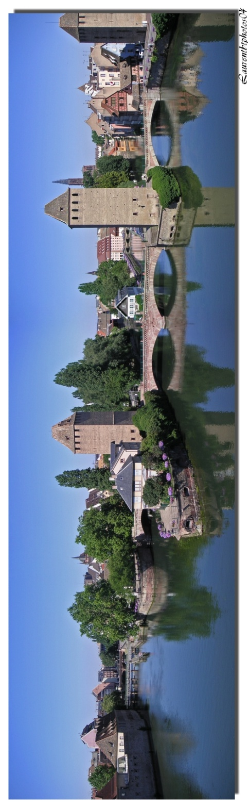
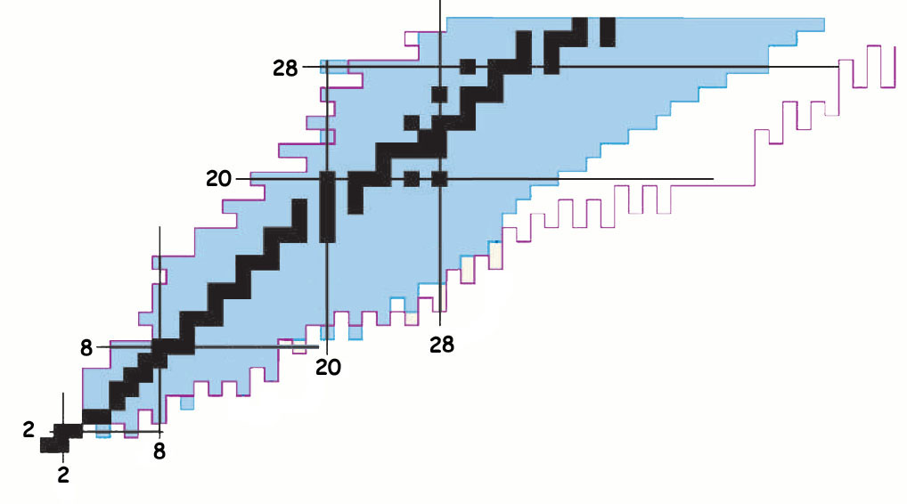
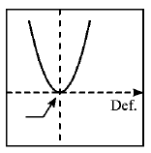
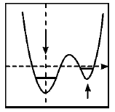
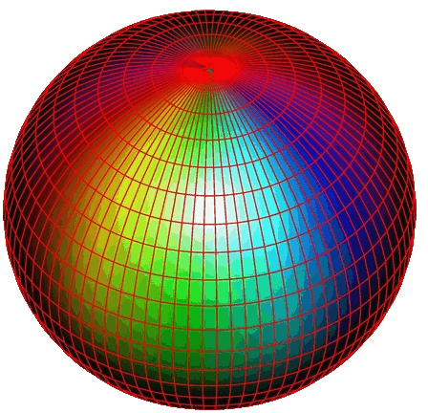
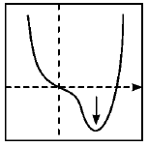
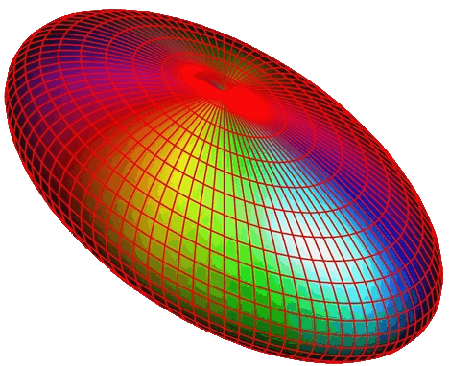


Unveiling the intruder deformed 0⁺₂ state in ³⁴Si₂₀
and few words about N=28
IFIN - Bucharest F. Rotaru (PhD) GANIL - Caen
IPN - Orsay INR - Debrecen
FLNR - Dubna NPI - Rez,
IPHC - Strasbourg University of Madrid
CEA - Bruyères-le- Châtel
Stephane Grévy : grevy@in2p3.fr
October 8, 2012

Slide 2
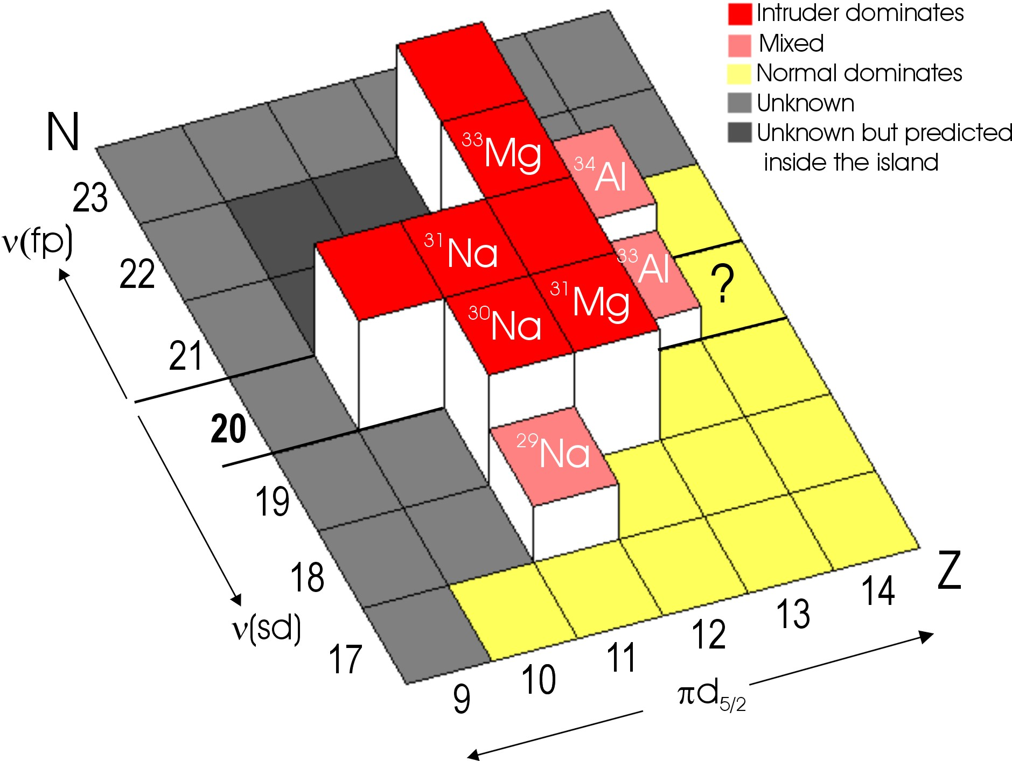
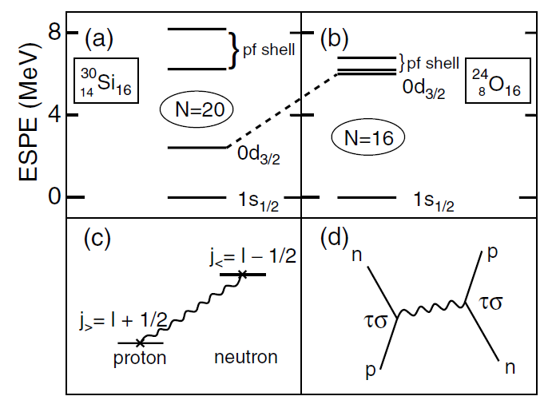
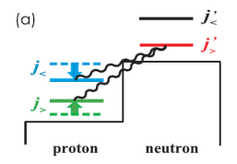
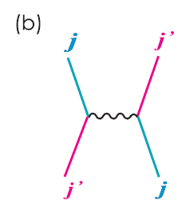
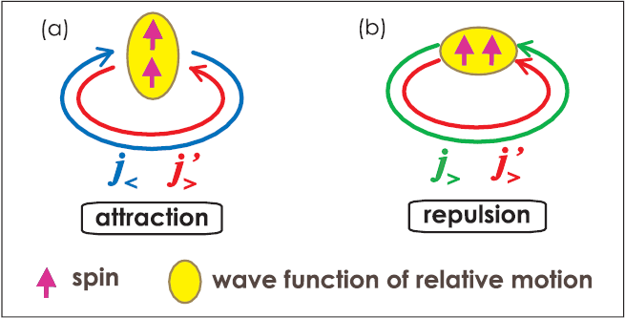
“island of inversion” around ³²Mg
³²Mg
³⁶S
³⁴Si
³⁰Mg
²⁸Mg
Follow the evolution of the "excited" configurations from the stability towards the Island of Inversion
→ Study the evolution of the excited 0⁺ states
Nħω
O⁺₂(³⁰Mg) :
W. Schwerdtfeger, PRL2009
Nħω
3346
5702
O⁺₂(³²Mg) :
K. Wimmer, PRL2010
?
2ħω
Nħω
1789
0ħω
0ħω
0ħω
1058
0ħω
0ħω
2ħω
²⁸Mg
³⁰Mg
³²Mg
³⁴Si
³⁶S
→ 0⁺₂ state in ³⁴Si : how the intruder configurations develop at N=20

Slide 3
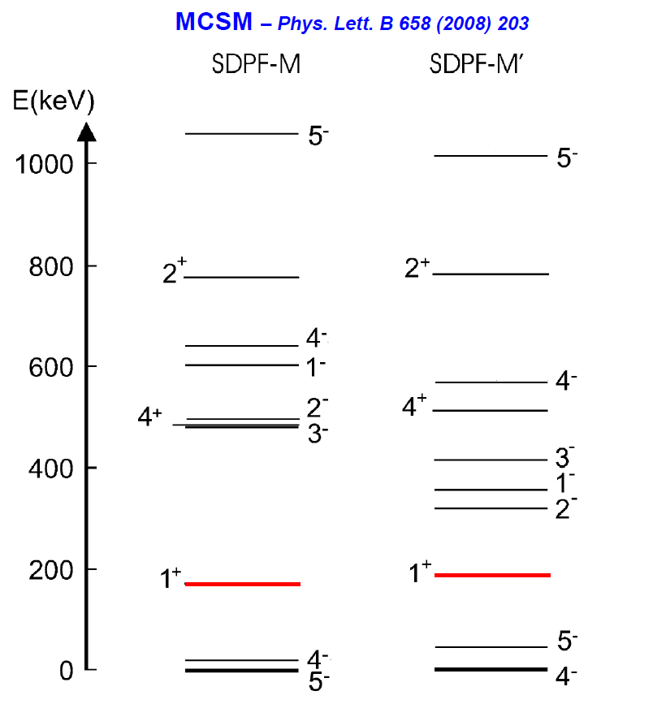
Search for the 0⁺₂ state in ³⁴Si
N=20
All experiments failed in this quest…
    → inelastic scattering, β-decay of ³⁴Al,…
⁴⁰Ca
2ħω
³⁸Ar
³⁴Si : 0⁺₂ deformed state → π(d_{5/2})⁶  ν(d_{3/2})⁻²(f7/2)⁺²
³⁴Si : 0⁺ ground state → π(d_{5/2})⁶  ν(d_{3/2})⁺⁴
³⁶S
³⁴Al : 4⁻ ground state → π(d_{5/2})⁵  ν(d_{3/2})⁺⁴(f7/2)⁺¹
³⁴Al : 1⁺ excited state (E~200 keV) → π(d_{5/2})⁵  ν(d_{3/2})⁻¹(f7/2)⁺²
³⁴Si
hypothesis :
the 0⁺₂ could be directly populated
through the β-decay of a predicted
isomeric 1⁺ state in ³⁴Al.
³⁴Al
³²Mg
Almost all the calculations predict
the 0⁺₂ state to be located below the 2⁺₁
³⁰Ne
decay by :
- internal pair creation
- internal conversion electron
[if E(0⁺₂) <1022 keV - not expected]

Slide 4
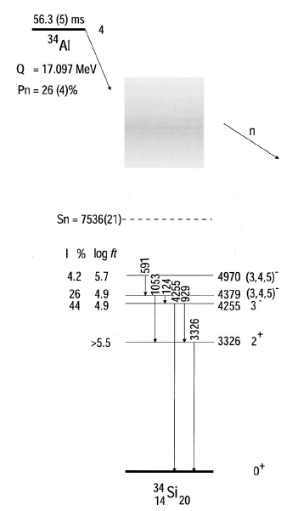
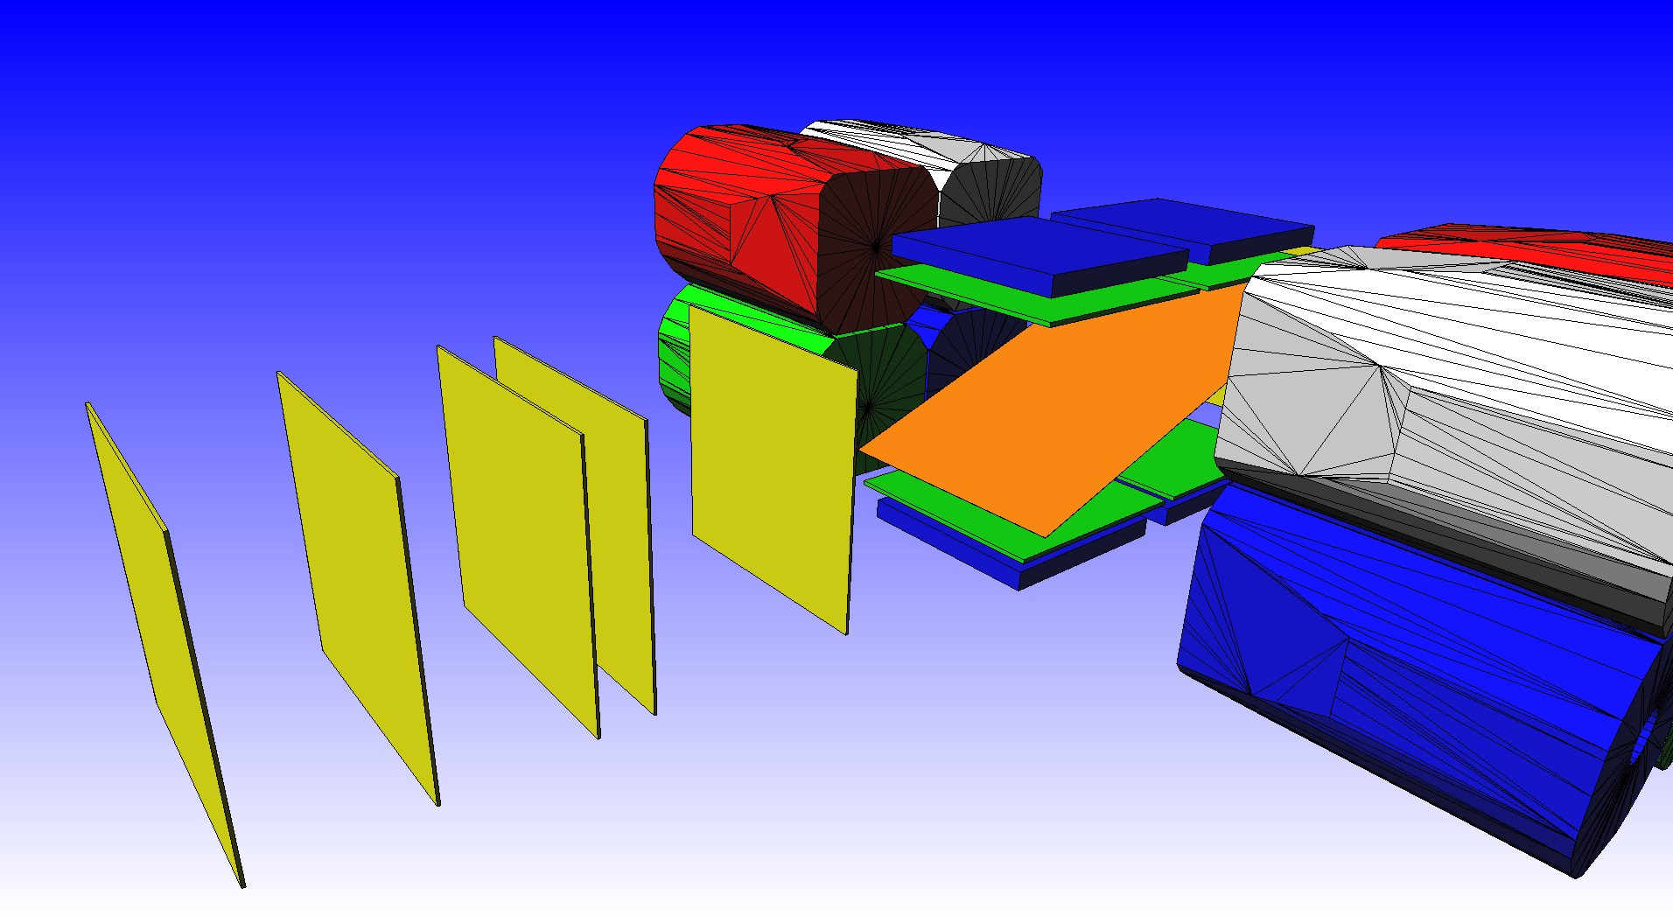
0⁺₂ in ³⁴Si : the experiment
1⁺
Experiment :
production the ³⁴Al in the "predicted" isomeric 1⁺
→ projectile fragmentation @ GANIL/LISE
- implantation in a Kp foil
4⁻
b
trigger on the β-decay from the gs and the isomer and
measurement of the energy of both e⁺ and e⁻ in coincidence
→ 4 Si-SiLi telescopes
β
measurement of the gamma-rays
  → 2 Ge clovers (EXOGAM)
F. Rotaru et al., Phys. Rev. Lett.109 (2012)092503
0⁺₂
e+ e-
Erot1
Edeg1&2
E2XY
E1D6
GANIL/LISE3 Experiment, may 2010

Slide 5
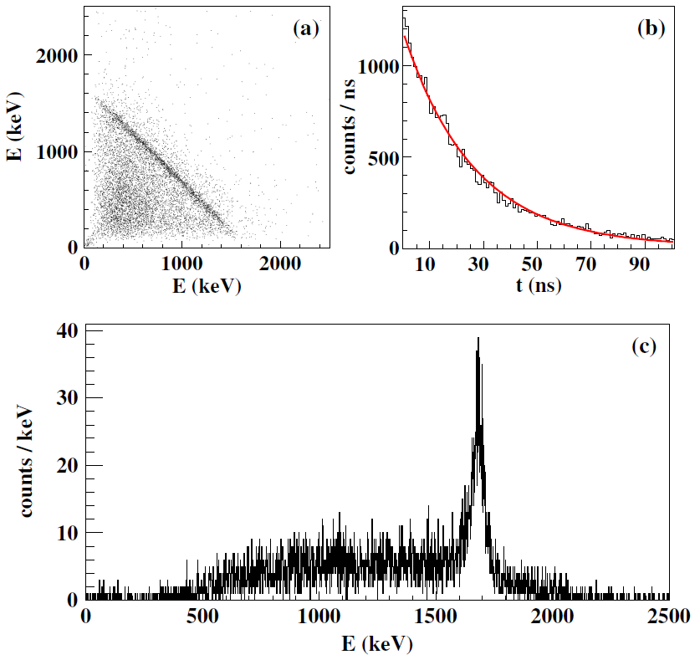
0⁺₂ in ³⁴Si : experimental results 1/3
1⁺
4⁻
4⁻
4⁻
β⁻
e⁺ e⁻
2719(3) 0₂⁺
19.4(7) ns
F. Rotaru et al., Phys. Rev. Lett.109 (2012)092503
E_{e1}+E_{e2} = cst = 1697(3) keV
E(0⁺₂) = 1697 keV
+ 1022 = 2719(3)
T_{1/2}(0⁺₂) = 19.4(7) ns
Electric monopole strength:
ρ²(E0)=(13 ± 0.9)x10⁻³

Slide 6
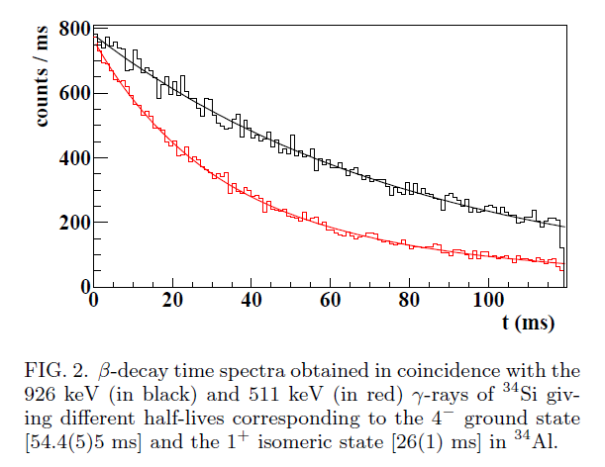
0⁺₂ in ³⁴Si : experimental results 2/3
1⁺
4⁻
26 (1) msec
4⁻
54.4 (5) msec
β⁻
Beta decay time from ³⁴Al :
e⁺ e⁻
19.4(7) ns
2719(3) 0₂⁺
F. Rotaru et al., Phys. Rev. Lett.109 (2012)092503
54.4 (5) msec
26 (1) msec

Slide 7
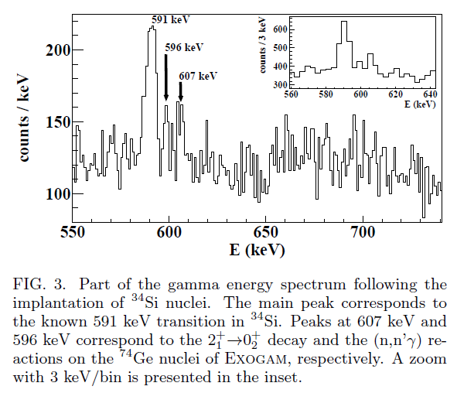
0⁺₂ in ³⁴Si : experimental results 3/3
1⁺ 26 (1) msec
4⁻
4⁻
?
17(7)
19.4(7) ns
2719(3) 0₂⁺
F. Rotaru et al., Phys. Rev. Lett.109 (2012)092503
B(E2:2⁺₁→0⁺₂) from
- B(E2:2⁺₁→0⁺₁) = 17(7) e²fm⁴
Coulex : Ibbotson, PRC80(1998)2081
- Iγ(3326 keV)/Iγ(606 keV) = 1380(717)
B(E2:2⁺₁→0⁺₂) = 61(40) e²fm⁴

Slide 8
0⁺₂ in ³⁴Si : mixing and deformation
1⁺ 26 (1) msec
4⁻
4⁻
17(7)
19.4(7) ns
61(40)
2719(3) 0₂⁺
F. Rotaru et al., Phys. Rev. Lett.109 (2012)092503
ρ²(E0: 0⁺₂→0⁺₁) = 13.0(0.9) mu
B(E2: 2⁺₁→0⁺₂) = 61(40) e²fm⁴
+
B(E2: 2⁺₁→0⁺₁) = 17(7) e²fm⁴
 mixing of the 0⁺ states : cos²θ ~ 0.22
ρ² = (3Z/4p)²cos²θ∗(1−cos²θ)∗(β₁²-β₂²)²
if spherical-deformed configuration → β₂ = 0
 β₂ ~ 0.29

Slide 9
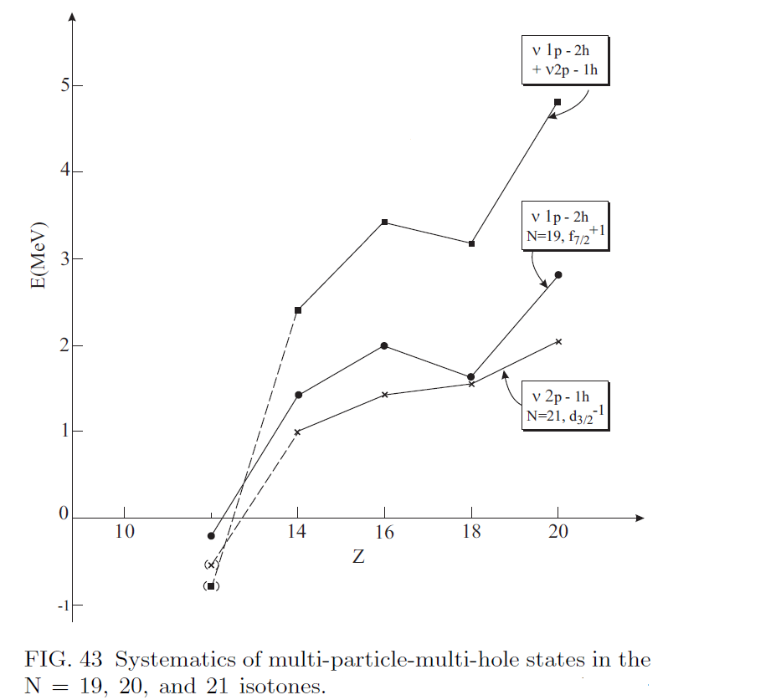
0⁺₂ in ³⁴Si : np-nh excitations
f_{7/2}
d_{3/2}
2ħω
s_{1/2}
ν
d_{5/2}
0⁺₁
f_{7/2}
From Heyde and Wood, Rev. Mod. Phys.
d_{3/2}
7/2⁻
s_{1/2}
ν
d_{5/2}
3/2+
f_{7/2}
d_{3/2}
3/2⁺
s_{1/2}
ν
d_{5/2}
7/2⁻
 The energy of the 0⁺₂ in ³⁴Si is in agreement with a 2p-2h character

Slide 10
Important to have a interaction capable of describing various situations in a unified manner.
In particular, the major pillars to understand the Island of Inversion are the 0⁺_{1,2} states in ³⁰Mg, ³²Mg and ³⁴Si
A good interaction should therefore be able to reproduce :
- addition of two neutrons to ³⁰Mg → 3 MeV shift
0⁺_{def}
1789
-3 MeV
0⁺_{sph}
gs
1058
0⁺_{sph}
gs
0⁺_{def}
³⁰Mg
³²Mg
- removal of two protons from ³⁴Si → 4 MeV shift
0⁺_{def}
2713
-4 MeV
0⁺_{sph}
gs
1058
0⁺_{sph}
gs
0⁺_{def}
³⁴Si
³²Mg

Slide 11
SDPF-U-SI interaction :
valence protons : sd shell
valence neutrons : sd or pf shell → no (sd → pf) neutron excitations
 labeled "0ħω"
not able to describe nuclei in wich neutron
excitations from sd to pf are important
such as, by definition, in the "island of inversion"
20
8
8
8
π
ν
π
ν
To account for (sd → pf) neutron excitations :
off diagonal matrix elements
Lee-Kahana-Scott G matrix
scaled as for the description of the SD states
in ⁴⁰Ca (multi p-multi h excitations)
8
8
neutron SPE's for sd-pf shells on a ¹⁶O core
- sd → standard USD
- fp → no experimental guidance
 SDPF-U-SI in case of 0ħω limit
 0⁺₂(³⁰Mg) at the correct energy
→ SDPF-U-MIX interaction

Slide 12
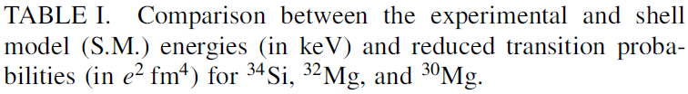
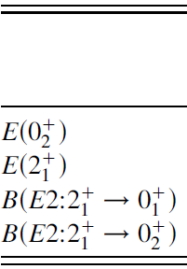



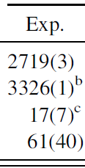

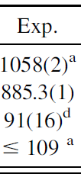

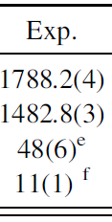

0⁺₂ in ³⁴Si : Shell Model calculations
SDPF-U-MIX
decrease of the 0⁺_{def}
Expt. SM
³⁴Si→³²Mg
3767 3852
³³Mg→³²Mg
2846 2999
26(1)ms
1⁺
4⁻
30 ms
0.550 1⁺ 92% 2p-1h
4⁻ 78% 0ħω
54.4(5)ms
59 ms
b
b
b
Excellent agreement
experiment – Shell Model
60%
5⁻
3⁻
4⁻
~5000
30%
3510 2⁺
61(40)
67
2713(3)
0⁺₂
2570
0⁺₂ 86% 2p-2h
17(7)
10%
11
0⁺₁ 89% 0ħω

Slide 13
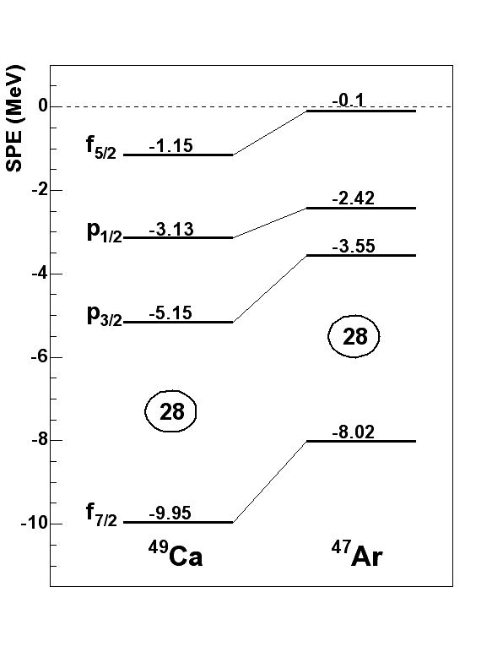
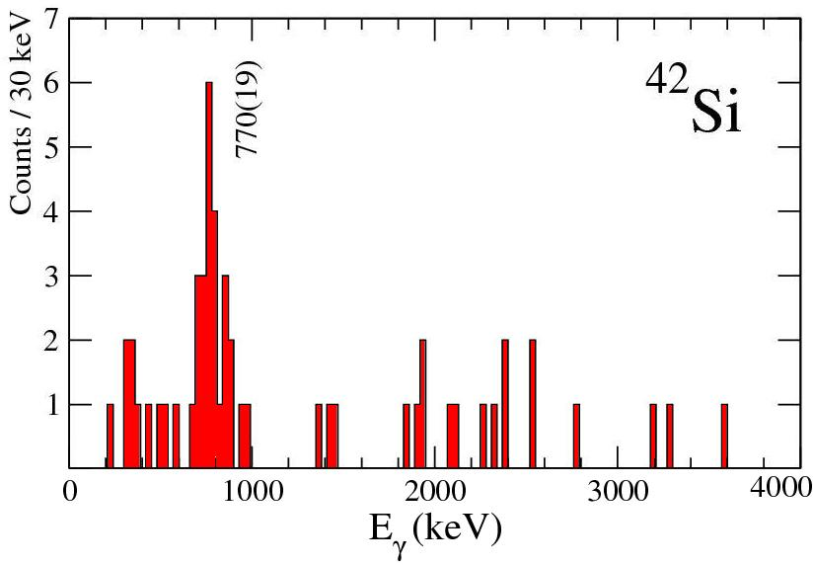
Study for the 0⁺₂ state in ⁴⁴S
neutron f7/2
N=20
N=28
K isotopes
Ca Z=20
⁴⁰Ca
⁴⁸Ca
⁴⁸Ca
Ar Z=18
Feeding of the νf_{7/2}
⁴⁶Ar
Compression of the
πs_{1/2}d_{3/2} orbitals
proton d3/2-s1/2 and d5/2
S Z=16
³⁶S
Removal of the πsd
⁴⁴S
➢ Reduction of N=28 gap
Si Z=14
³⁴Si
⁴²Si
³²Mg
GANIL 2007
L.Gaudefroy et al, PRL97(2006)
2⁺ → 0⁺ : 770 ± 19 keV
PRL99(2007)022503
SDPF-U-NR → SDPF-U-SI

Slide 14
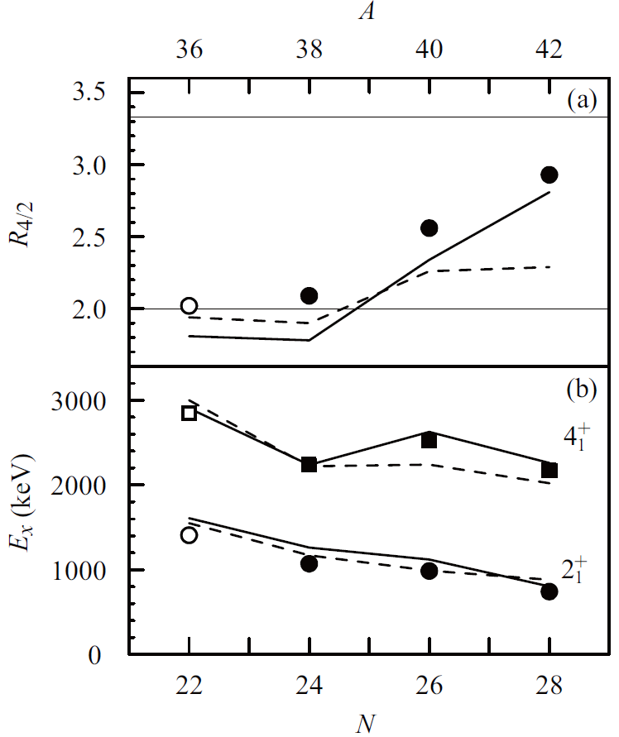
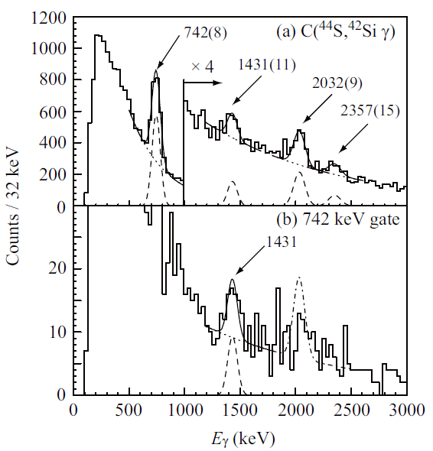
RIBF 2012
 well deformed rotor
S. Takeuchi et al., arXiv:1207.6191
accepteded to PRL (sept. 2012, 28th)
GANIL 2007
PRL99(2007)022503

Slide 15
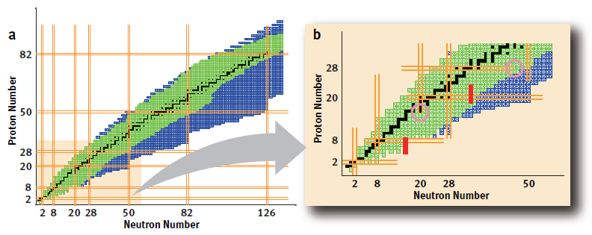
Conclusions
By the study of the 0⁺₂ states in ³⁴Si we have better characterized the shape
coexistence at N=20
We used this work to extend the SDFP-U-SI interaction to take into account the
neutron excitation above N=20
We have an interaction SDPF-U-MIX which is now able to describe very well
both the N=20 and N=28 regions.
Perspectives (from an experimental point of view)
Better characterize the 1⁺ isomer in ³⁴Al
  → g factor measurement
  mass measurement
  Make the link between N=20 and N=20 : from an island of inversion towards a peninsula

Slide 16
Special thanks to the Madrid-Strasbourg collaboration
Large collaboration : many experiments from 1993 to 2012…
GANIL
IPN Orsay
CEA Bruyères
CEA Saclay
IPHC
U. of Madrid
INR Debrecen
IFIN Bucharest
JINR Dubna
…
and the GANIL staff for providing beams and support

Slide 18
N=28

Slide 19
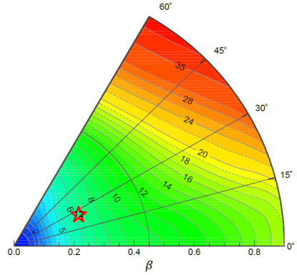
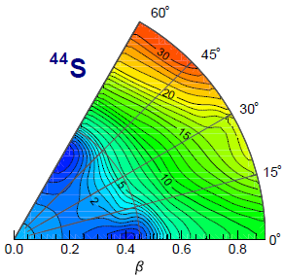
Study for the 0⁺₂ state in ⁴⁴S
neutron f7/2
N=20
N=28
⁴⁸Ca
Ca Z=20
⁴⁰Ca
⁴⁸Ca
⁴⁸Ca
Ar Z=18
Feeding of the νf_{7/2}
⁴⁶Ar
Compression of the
πs_{1/2}d_{3/2} orbitals
proton d3/2-s1/2 and d5/2
S Z=16
³⁶S
Removal of the πsd
⁴⁴S
➢ Reduction of N=28 gap
Si Z=14
³⁴Si
⁴²Si
³²Mg
HFB - D1S calculations from CEA-DAM
2002 :
Shell Model predictions : in ⁴⁴S the ground state could be a mixture
of closed shell and np-nh excitations. This mixing will produce a very
low lying first excited O⁺ that might be taken as a signature of
spherical-deformed shape coexistence . E. Caurier et al., EPJ A15 (2002)
2004 :
Observation of 0⁺₂ state at low excitation energy (1365 keV)
S. Grévy et al., EPJ A25(2005)

Slide 20
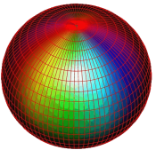
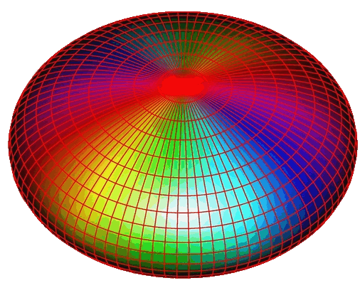
neutron f7/2
N=20
N=28
⁴⁸Ca
⁴⁰Ca
⁴⁸Ca
⁴⁶Ar
proton d3/2-s1/2 and d5/2
³⁶S
⁴³S
⁴⁴S
⁴²Si
1- β-half-lives of N=28 nuclei S. Grévy et al, Phys. Lett. B 594(2004)252
Study of n-rich Ar isotopes in β-decay J. Mrazek et al, Nuclear Phys. A 734(2003)E65
2- Observation of 0⁺₂ in ⁴⁴S S. Grévy et al, Eur. Phys. J. A 25(2005)111
3- Reduction of the N=28 gap in ⁴⁷Ar L. Gaudefroy et al, Phys. Rev. Lett. 96(2006)
4- Observation of the 2⁺ state in ⁴²Si B. Bastin et al, Phys. Rev. Lett. 99(2007)022503
  In beam spectroscopy of ^{39,41}Si D. Sohler et al, Phys. Lett. B 703(2011)417
In beam spectroscopy of ⁴⁴S L. Caceres et al, Phys. Rev. C (2012)
In beam spectroscopy of even Si D. Sohler et al, in preparation
5- Shape Coexistence in ⁴⁴S C. Force et al, Phys. Rev. Lett. 105(2010)102501
6- Shape Coexistence in ⁴³S L. Gaudefroy et al, Phys. Rev. Lett. 102(2009)092501

Slide 21
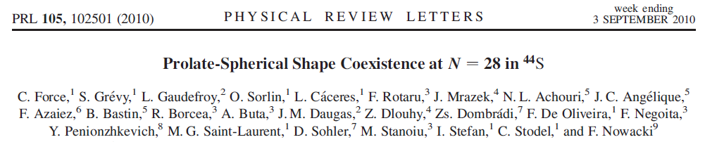
Shape Coexistence in ⁴⁴S
→ GANIL/LISE3: isomer spectroscopy of ⁴⁴S
0⁺₂
E2
2⁺₁
→ Reduced Transition Probability B(E2;0⁺₂2⁺₁)
0⁺₂
- Mixing of 0⁺ states
?
?
2⁺₁
E0
314
→ Monopole strength ρ²(E0;0⁺₂→0⁺₁)
- Deformation of 0⁺ states
0⁺₁
0⁺₁

Slide 22
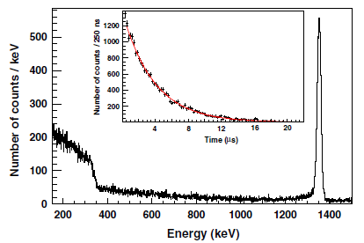
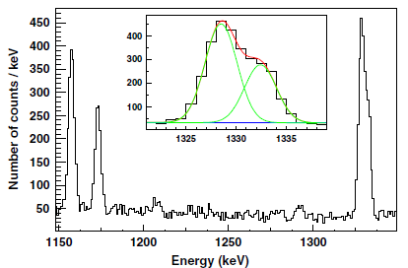
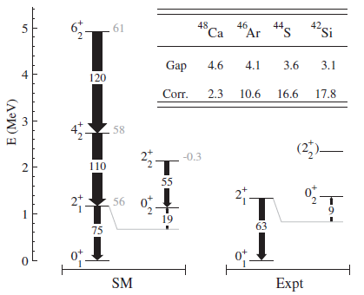
0⁺₂
2.6 μs
E2
2⁺₁
E0
1329 keV
1365 keV
0⁺₁
Measurement of :
- T_{1/2} (0⁺₂)
- λ(E0) / λ(E2)
E(MeV)
ρ²(E0: 0⁺₂→0⁺₁) = 8.7(7) mu
0⁺₂
42
8.7
2⁺₁
B(E2: 0⁺₂→2⁺₁) = 42(13) e²fm⁴
314
O+
2+
+
O+
B(E2: 0⁺₁→2⁺₁) = 314(88) e²fm⁴
0⁺₁
 mixing of the 0+ states : cos²θ=0.88 (5)
ρ² = (3Z/4p)²cos²θ∗(1−cos²θ)∗(β₁²-β₂²)²
in agreement with spherical-prolate shape
coexistence predicted by Shell Model
 β₂ = 0.25

Slide 23
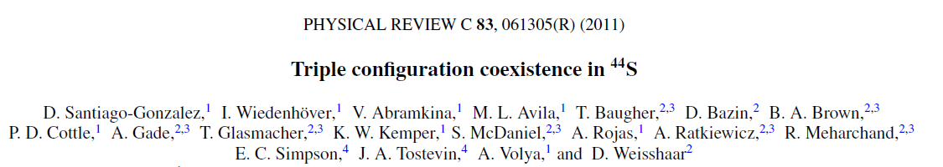
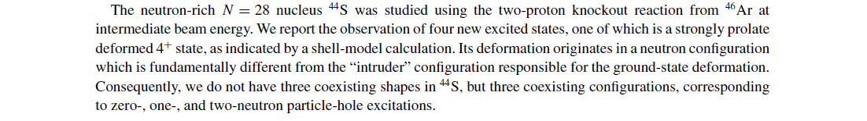
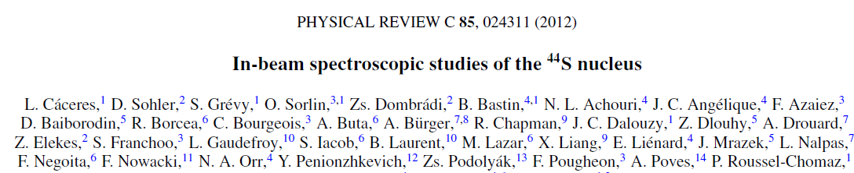
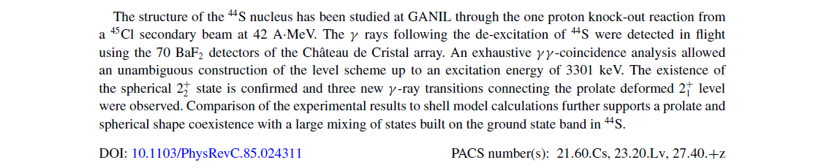

Slide 24
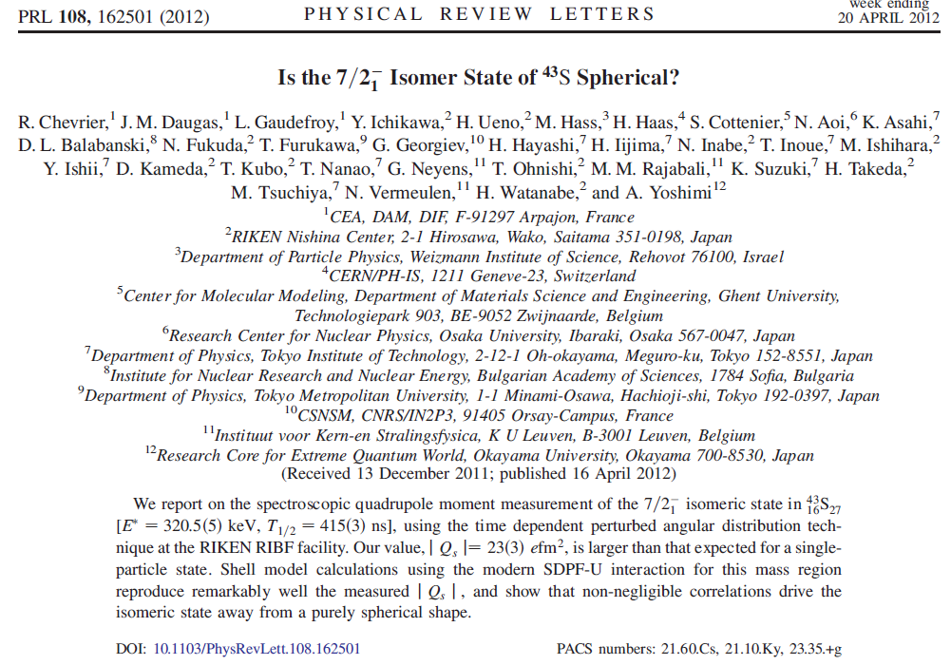

Slide 25
Conclusions
by the study of the 0⁺₂ states in ³⁴Si and ⁴⁴S we characterized the shape
coexistence at N=20 and N=28
Perspectives (from an experimental point of view)
N=20
better characterize the 1⁺ isomer in ³⁴Al
  → g factor measurement
  → mass measurement
N=28
- B(E2) of ^{40,42}Si by Coulomb excitation
E(2⁺) of ⁴⁰Mg, ⁴⁴Si by in-beam γ-spectroscopy

Slide 26
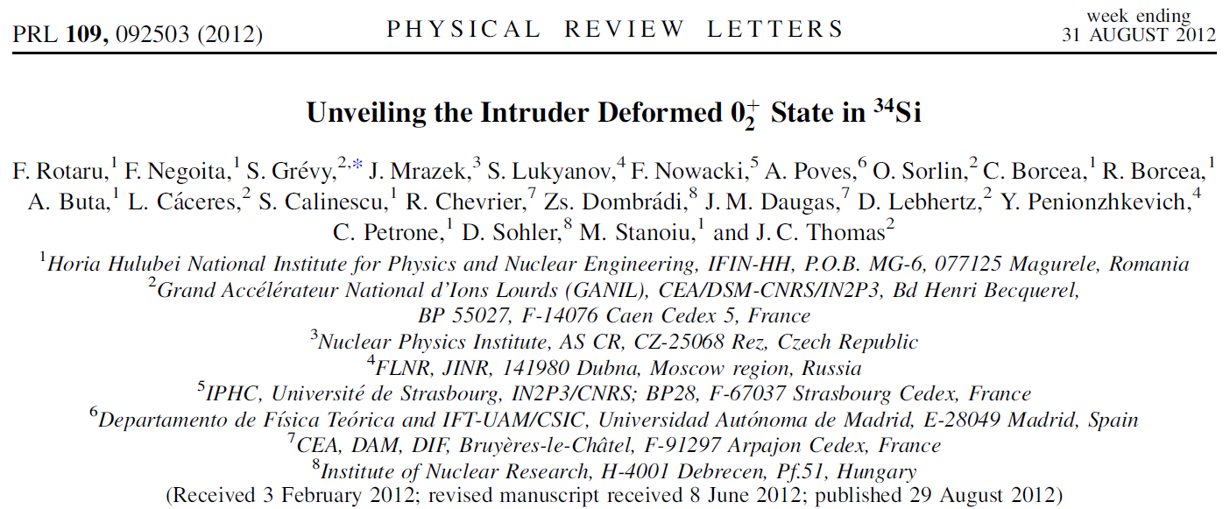
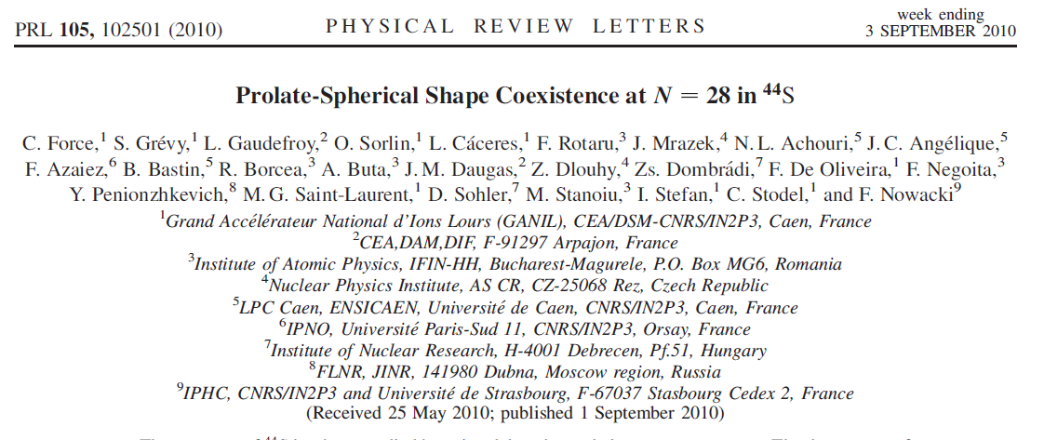
collaboration
and the GANIL staff for providing beams and support

Slide 27


Slide 28
"full (sd)fp" - "(sd)f_{7/2} "
These structures (shape coexistence, deformation…)
are not only due to a breakdown of the shell model
but also to the enormous correlation energies involved
when pair excitations across closed shells are involved
To what degree do the N=20 and N=28 shell closures survives ?

