Slide 1
Appliance Management
StratusLab Tutorial (Bordeaux, France)
25-26 October 2012

Slide 2
Appliances
What is an appliance?
Generic machine image with an OS
Optionally contains pre-installed and pre-configured services
Why is appliance management a challenge?
Usually large (1-10 GB) files
Opaque, difficult to “see” state of machine in file
Provenance is important for trusting an image
Removing private information for public images is hard

Slide 3
StratusLab Marketplace
Machine image creation is a barrier to cloud adoption
Creating virtual machine images is time-consuming
Ensuring that machines are secure and correct is difficult
Sharing existing machines lowers this barrier
Marketplace facilitates sharing of images
Registry of metadata for machine & disk images
Image contents are kept in cloud, grid, or web storage
Benefits
End-users: browse and use existing images for their analyses
Creators: publicize their work and attract larger user base
Cloud Admins.: Use metadata to evaluate trustworthiness of images

Slide 4
Interfaces
REST interface
Exposes a simple HTTP-based REST interface
Easy to program against in all languages
Web interface
REST interface also allows browsing via a web browser
Signed entries can also be uploaded via the browser
Global Service
Global URL: https://marketplace.stratuslab.eu/
Private or local Marketplace instances are possible

Slide 5
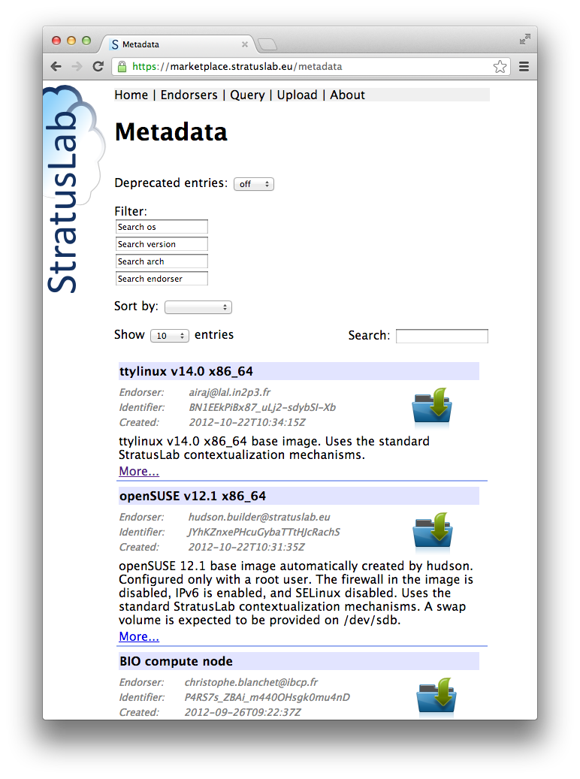
Appliance Summary
Identifier is the fingerprint of the image.
SHA-1 checksum in base64 encoding.
Search Criteria
Appliance Summary

Slide 6
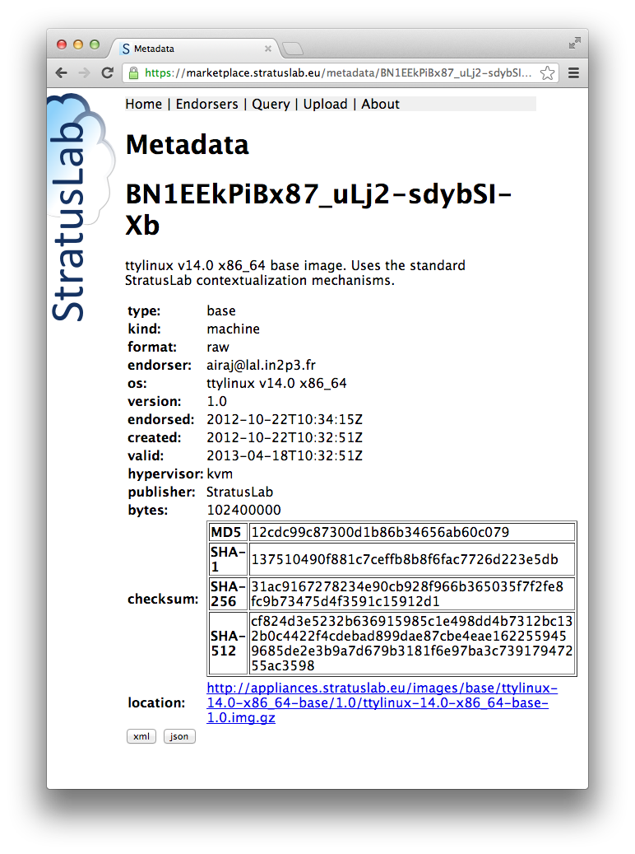
Appliance Details
Identifier
Description
Detailed Info.
Location(s)
Other formats

Slide 7
Appliances
Image metadata
Must conform to a defined schema
Uses the RDF-XML format
Must be cryptographically signed with a (grid) certificate
Must contain image ID and checksums to make connection to image
May contain location elements with image content URL(s)
Image Content
Separated from metadata
Can be stored in web, cloud, or other storage
Multiple locations of the image can be provided
Cached by the cloud to provide low-latency starts

Slide 8
Workflow
Typical Marketplace workflow:
Create image from scratch or based on existing image
Upload the image to cloud, grid, or web storage area
Create the metadata for the image
Sign the metadata with your (grid) certificate
Upload the signed metadata to the Marketplace

Slide 9
Creating an Image
Creating an image is difficult, long, tedious…
Don’t do it; reuse an existing image instead!
Images for popular operating systems are provided by StratusLab
Adapt an existing image:
StratusLab provides tools to create new images from existing ones
Provides standard contextualization and good security practices
Create an image from scratch:
Only do this if you really must and contact us for help!
Must provide contextualization for image to work on cloud
Ensure no private information is embedded in image
Lock down services to avoid security holes

Slide 10
Creating and Uploading Image
Cheat (!)
Normally, use one of the previous methods to create image
Copy the ttylinux image locally to try out metadata utilities
Uploading of image
Normally, image would be transferred to cloud, grid, or web storage
Public images must be accessible via http(s) at the moment
Private images can be accessible via a pdisk URL
Location URL(s) must be part of metadata for image to be used
Just note the URL of the image that you have downloaded

Slide 11
Create Metadata Description
Use stratus-build-metadata for creating metadata:
Wait for the unknown state, then kill (remove) the instance:
Look at the contents of the file:
Identifier is a base64 encoded SHA-1 checksum
Checksums ensure that downloaded images match the metadata; these must be the checksums of the uncompressed image!
Empty endorser element and no signature element
$ stratus-build-metadata \
--author='your name' \
--os=ttylinux \
--os-version=9.7 \
--os-arch=i486 \
--image-version=1.3 \
--location=http://example.org/ttylinux.gz \
--compression=gz \
ttylinux-9.7-i486-base-1.3.img
$

Slide 12
Create Metadata Description
Try to validate the unsigned metadata file:
There is no signature so the file should not be valid
Sign the contents of the file with a grid certificate:
Signed file contains endorser and signature elements
Certificate location and password can be specified in config. file
A signed file can be re-signed by same or different person
$ stratus-validate-metadata ttylinux-9.7-i486-base-1.3.xml
Invalid: ttylinux-9.7-i486-base-1.3.xml
no signature
$ stratus-sign-metadata \
--p12-cert grid.p12 \
--p12-password xxxxxx \
ttylinux-9.7-i486-base-1.3.xml
Manifest file successfully signed: ttylinux-9.7-i486-base-1.3.xml
$ stratus-validate-metadata ttylinux-9.7-i486-base-1.3.xml
Valid: ttylinux-9.7-i486-base-1.3.xml

Slide 13
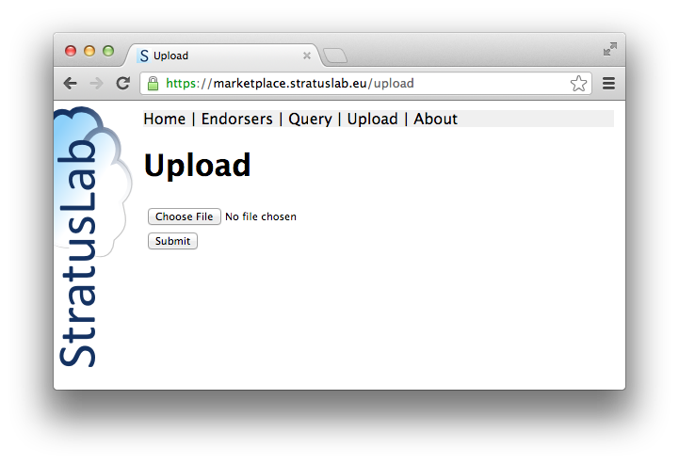
Upload Metadata Description
File can be uploaded via the command line:
Use: stratus-upload-metadata
Or via a browser ➔
$ stratus-upload-metadata ttylinux-9.7-i486-base-1.3.xml
http://cloud.lal.stratuslab.eu:8081/metadata/LwcRbwCalYSysY1wftQdAj6Bwoi/email address/2011-09-13T09:58:54Z
Note: The server may validate the email address in the metadata.

Slide 14
Using an Image in the Marketplace
Pass the identifier for metadata entry to start instance
stratus-run-instance LwcRbwCalYSysY1wftQdAj6Bwoi
Use normal machine lifecycle to control machine
StratusLab will validate image before running it:
stratus-policy-image enforces policy defined by administrator
Policies can include endorser white lists, checksum black lists, etc.

Slide 15
Image deprecation
Invalidating (remove endorsement of) an image:
Use: stratus-deprecate-metadata
The command deprecates an image and gives a reason
If there are no other endorsers, the image won’t be run
$ stratus-deprecate-metadata \
--reason=“JUST FOR FUN” \
--p12-cert=/Users/loomis/.globus/cert.p12 \
--p12-password=XXXXXX \
$TTYLINUX_ID
http://cloud.lal.stratuslab.eu:8081/metadata/LwcRbwCalYSysY1wftQdAj6Bwoi/loomis@lal.in2p3.fr/2011-09-21T14:52:43Z

Slide 16
Questions and Discussion

Slide 17
Exercises: Marketplace Metadata
Marketplace
Search Marketplace to see what types of machines are available
What metadata is available for existing virtual machines?
What metadata would you like to have?
Image Metadata Lifecycle
Run through entire lifecycle (except uploading) for image metadata
What information is required in the metadata?
What additional information can be provided?
Can there be multiple metadata entries for an image?
How would you use the Marketplace as end-user, administrator, developer?

