Slide 1
Advanced Topics
StratusLab Tutorial (Bordeaux, France)
25-26 October 2012

Slide 2
Virtualization Benefits
Control of Resource Consumption
Share/limit CPU and network bandwidth
Hard limit on memory (RAM) utilization
Control IO bandwidth to local/remote disks
Better monitoring/accounting of these resources
Isolation of Virtual Machines
Control address connectivity (what machines can see the VM?)
Control what ports are accessible on a VM
Dynamic control of both connectivity and ports

Slide 3
Contextualization
Horrible word but…
Machines must be able to run in variable network/machine contexts
Information on how to integrate with local context must be given to VM
No universal standard for doing this (StratusLab, HEPiX, AWS, …)
StratusLab Contextualization
Information packaged into CD-ROM image and made available to VM
VMs mount CD-ROM image and run a script using context information
Networking information is passed exclusively via DHCP
Additional information can be passed to VMs to configure services

Slide 4
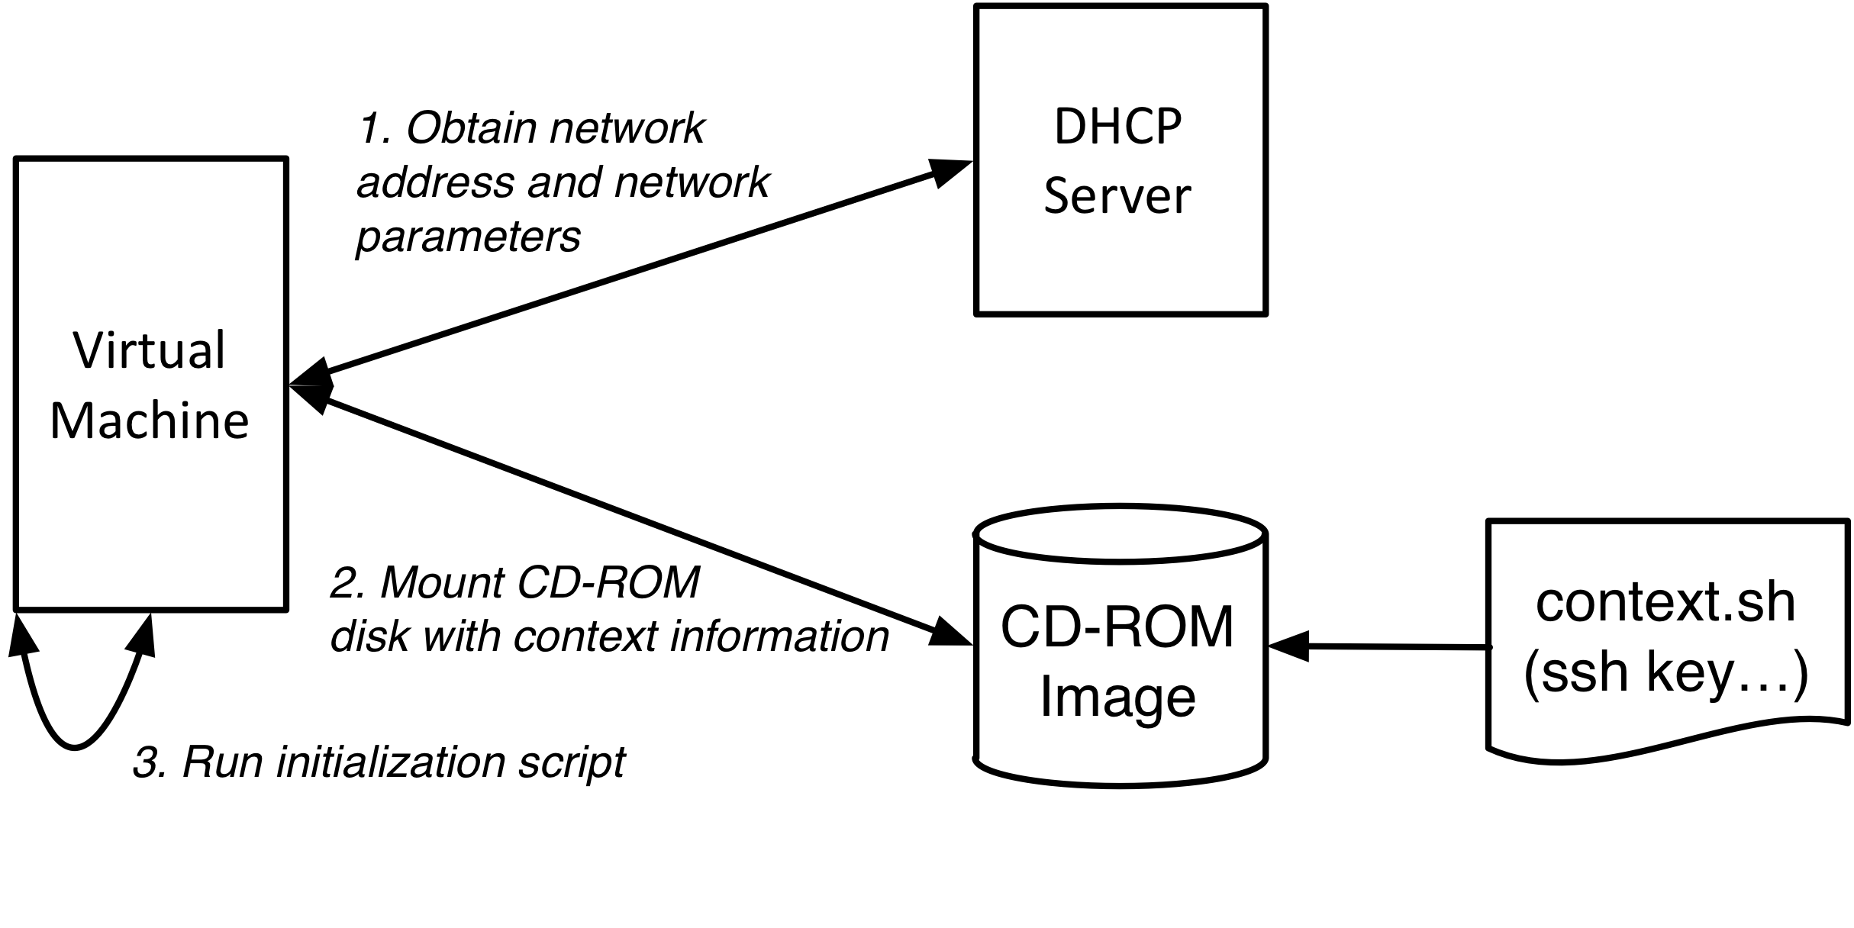
Contextualization
Discovery of VM Context
Network connections (DHCP)
Authentication/Authorization (SSH Keys)
Service Configuration (e.g. Grid Certificates)

Slide 5
Network Security
Limit Access
Limit ssh access to known users with ssh keys
Do not add accounts with password access
Best practices
Only run services on your VM that are necessary
Setup and use a firewall within the VM

Slide 6
StratusLab Network Configuration
Static Configuration
Three classes of IP addresses (public, local, and private)
No dynamic VLAN or firewall configuration
All machines receive network information via DHCP
TO MACHINE
 | External | Public | Local | Private
External | ? | ✔ | ✗ | ✗
Public | ✔ | ✔ | ✔ | ✗
Local | NAT | ✔ | ✔ | ✗
Private | NAT | ✔ | ✔ | ✗
FROM MACHINE

Slide 7
Questions and Discussion

Slide 8
Exercises: Contextualization
Discover Contextualization Procedure
Log into a VM and find CD-ROM image.
What files are present?
What information is passed to machine?
How is that information used within the machine?
Modify the Context
Look for command line option to send user-defined context
Send some customized information via the context
Verify that the information can be found on the running machine
How could you use this to configure your services?

