Slide 1
France Grilles
La grandeur des actions humaines se mesure à l’inspiration qui les fait naître. Louis Pasteur
V. Breton
F2F Conseil de Groupement
13/6/2012

Slide 2
Vision
Build and operate a Distributed Computing Infrastructure
Open to all disciplines
Open to developing countries
Make it a place of exchange and collaboration
Within disciplines and organizations
Across disciplines and organizations

Slide 3
France Grilles organization
France Grilles council
Scientific advisory committee
International Advisory Committee
Executive board:
F. Desprez (INRIA)
JP Meyer (CEA)
J. Montagnat (CNRS)
Director
V. Breton
Expert on cloud computing:
F. Suter
Users’ liaiason
G. Romier
N. Haitas
Y. Legré
Technical coordination
H. Cordier
G. Mathieu
Communication - training
V. Dutruel
Administrator
G. Fettahi
Departures: M. Pellen (replaced by G. Fettahi),
D. Fouossong (temporarily replaced by G. Mathieu)
Technical committee

Slide 4
France Grilles production related key figures
11-12% of EGI capacity
18 production sites
31,860 logical CPUs
15.7 PB disk and 22.5 PB tape storage
A focus on excellence
98.4% availability
99.0% reliability
100.0% availability/reliability of our central core services (Top-BDII) since September 2011

Slide 5
Highlights on operations since last IAC
National Virtual Organization
Second step for new user communities
Candidate for an international pool of resources
Boost on cloud activities
Dedicated workshops
First investments in CC-IN2P3 and Toulouse
New services (DIRAC)
Notes:
Mentionner StratusLab

Slide 6
Cloud initiatives (1) – Academic Cloud at CC-IN2P3
Who/what
Initiated in Nov. 2011 by M. Puel
France-Grilles directly sponsored : 384 cores (16*24 cores)+ 1,5 TB (16*96 GB) +32 TB
State of the art
Currently evaluating Openstack/Open Nebula/VM-Ware
Evaluation criteria:
General considerations (wide adoption, compliance with standards, scalability, overall cost)
functionalities (cloud management, monitoring, accounting, local storage)
Credit: G. Mathieu

Slide 7
Cloud initiatives (2) – Academic Cloud at CC-IN2P3
Steps
Offer IAAS resources through generic interfaces (EC2/OCCI)
Integrate national/international academic federations
Use-case to be opened to :
EGI Cloud Federation Task Force testbed
DIRAC usage of cloud resources
Individual early users (biomed)
Webimatics (neurobiology)
Later: eTRIKS project (drug discovery)
Participation to EGI Cloud Federation TF
WP4 (development of the Openstack driver for federated accounting)
WP5 (VM monitoring)
Credit: G. Mathieu

Slide 8
Cloud initiatives (3) – Hybrid Cloud at cloudmip.univ-tlse3.fr
Who/what
Managed by F. Thiebolt & J.M. Pierson
France-Grilles directly sponsored : 32 blades (8 cores, 32Go RAM, 2 x SAS 15ktpm) – March 2012
State of the art :
Openstack
Interests /issues
Green IT in datacenter
Distributed storage
Use-case to be opened to :
Local academics
Users of grid5K
Some private companies
Credit: G. Mathieu

Slide 9
France Grilles key facts on user communities
About 750 users from many disciplines
> 100 scientific papers in 2011!
LHC papers not included
Notes:
Mettre le camembert des utilisateurs par discipline de l’exposé de Genevieve

Slide 10
Highlights on user related activities
Evaluation of scientific production on the grid
Collection of scientific papers using HAL database
First French Grid Day
Growing contribution to international efforts
Involvement in Virtual Teams
New active user communities (biodiversity, solid state physics)

Slide 11
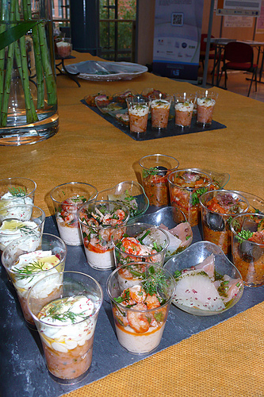
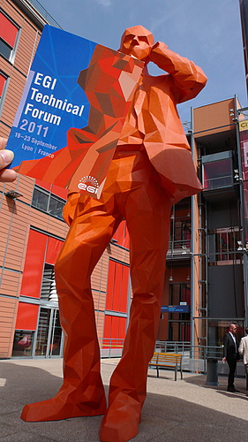
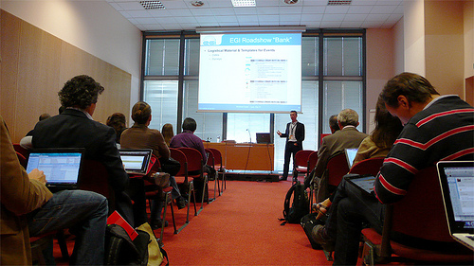
Highlights: EGI Technical Forum in Lyon
Event co-organized by CC-IN2P3, EGI.eu and France Grilles
A success:
> 650 participants to all co-located events
Balanced budget
First French Grid Day
Copyright: EGI.eu
Copyright: EGI.eu
Copyright: EGI.eu
Notes:
Ajouter des photos d’EGI.eu

Slide 12
France Grilles International activities
France Grilles within EGI
European projects
Other international collaborations

Slide 13
France Grilles within EGI
Management
E. Augé replaced M. Spiro as France Grilles representative on EGI council
Contribution to EGI council task forces
Security task force
User task force
Important contributions to EGI-Inspire
Operation portal
Leadership role in JRA1 (C. L’orphelin) and SA3 (J. Montagnat) activities
Growing contribution to NA2 around G. Romier

Slide 14
Projects – EC – FP7
Grid/cloud EC-funded projects involving France Grilles partners in 2011
Acronym | Theme | number of participants | duration (mounth) | France Grilles partners | Total eligible costs / project | Total EU contribution | CNRS elligible costs | CNRS EU contribution
EPIKH | exchange program | 23 | 48 | CNRS (IdGC) | 1 188 000,00 € | 1 188 000,00 € | 43 200,00 € | 43 200,00 €
EUMEDGRID-Support | infrastructure | 14 | 24 | CNRS (IdGC, IPHC, LPSC) | 867 495,00 € | 740 000,00 € | 56 160,00 € | 50 076,00 €
EGI-InSPIRE | infrastructure | 53 | 48 | CEA, CNRS (IdGC, LAL, LPC, LPNHE, I3S, CPPM, LAPP, DSI, CC-IN2P3, IPSL, IPGP) | 71 916 867,00 € | 25 000 000,00 € | 4 752 000,00 € | 1 635 638,00 €
StratusLab | infrastructure | 6 | 24 | CNRS (LAL, IBCP) | 3 137 221,00 € | 2 300 000,00 € | 623 463,00 € | 470 043,00 €
EDGI | infrastructure | 10 | 24 | CNRS (LAL) | 2 436 371,00 € | 2 150 000,00 € | 234 000,00 € | 205 300,00 €
DEGISCO | infrastructure | 12 | 24 | CNRS (LAL) | 871 702,00 € | 799 925,00 € | 101 400,00 € | 90 415,00 €
GISELA | infrastructure | 19 | 24 | CNRS (CPPM, IPGP) | 2 820 043,00 € | 850 000,00 € | 381 930,00 € | 47 810,00 €
N4U | users | 11 | 42 | CNRS (IdGC, CREATIS, I3S) | 4 438 912,00 € | 3 600 000,00 € | 515 297,00 € | 337 404,00 €
CReATIVE-B | users | 7 | 36 | CNRS (IdGC) | 761 938,00 € | 700 000,00 € | 92 400,00 € | 82 390,00 €
ENVRI | users | 16 | 36 | CNRS (IdGC) | 5 081 514,00 € | 3 700 000,00 € | 243 320,00 € | 167 689,00 €

Slide 15
Other International Collaborations: highlights
Bilateral collaboration on cloud computing with Spain
France-Asia Virtual Organization
Goal: strengthen scientific collaboration with Asia
Significant resources committed by China, Japan, Korea and Vietnam
Contribution to training schools
Algeria, Marocco, Korea and Vietnam

Slide 16
Budget: who pays for the production infrastructure?
Origin of funding | Use of funding | Organization responsible for using the funds
French Ministry of Research grant to France-Grilles (TGIR): 615 Keuros | Running costs for operation of central services – networking activities – new equipment | France Grilles
EC-funding : about 1MEuros for 10 projects | Salaries of engineers hired on short-mid term contracts - travel money | CEA and other CNRS units receiving EC funds through CNRS IdGC
CEA - CNRS - Universities | Running infrastructure costs(electricity, air conditionning) | CNRS and University laboratories
Regional authorities | New equipment | CNRS and university laboratories

Slide 17
Details on expenditures on TGIR grant
Spending |  | Income
 |  | TGIR grant | 617000
Communication (booths, web site, documents) | 22154,69
EGI.eu 2011 fee | 79880
EGI.eu 2012 fee (Advanced payment) | 56332
Small equipment | 1130
Reimbursement of 2010 operation costs (LPC) | 10000
IT equipment for 2 academic clouds | 154000
Training | 40000
Organization of events (IAC, French Grid Day) | 16733,35
FG management travel costs (EGI council, EGI and FG meetings) | 11980,67
Operation related costs (participation to EGI Inspire and small equipment for sites) | 97850,35
Support to European Projects (StratusLab) | 12000
Support to Regional Grids and User Communities (local events, international VOs) | 114938,25
TOTAL | 617000 | TOTAL | 617000

Slide 18
Evaluation of costs for operating the infrastructure
 |  | Exécuté |  | BP | Demande
DEPENSES liées à la TGIR |  | 2010 | 2011 | 2012 | 2013 | 2014 | 2015
Fonctionnement |  | 2,600 | 2,600 | 2,600 | 2,600 | 2,600 | 2,600
Investissement |  | 0,712 | 0,154 | 0,300 | 1,000 | 1,000 | 1,000
Personnel | TGIR Agrégat 1 : Personnel non permanent | 0,265 | 0,050 | 0,050 | 0,050 | 0,050 | 0,050
 | TGIR Agrégat 1 : Personnel permanent | 0,575 | 0,762 | 0,780 | 0,860 | 0,940 | 0,940
 | TGIR Agrégat 2 : Personnel
TOTAL DEPENSES |  | 4,152 | 3,566 | 3,730 | 4,510 | 4,590 | 4,590
Figure used for 2011:
0.01 € per normalized CPU hour (KSI2K) for electricity, fluids and cluster operation
Notes:
Préciser que les coûts de personnel supplémentaires correspondent au personnel mobilisé en plus pour la grille elle-même (services centraux, maintenance du middleware)

