Slide 1


Recent activity on two-photon exchange
Egle Tomasi-Gustafsson
IRFU, SPhN-Saclay,
and
IN2P3- IPN Orsay France
Experimental and theoretical aspects of the proton form factors
St.Petersburg, Gatchina,
Petersburg Nuclear Physics Institute (PNPI), July 9 - 11, 2012

Slide 2
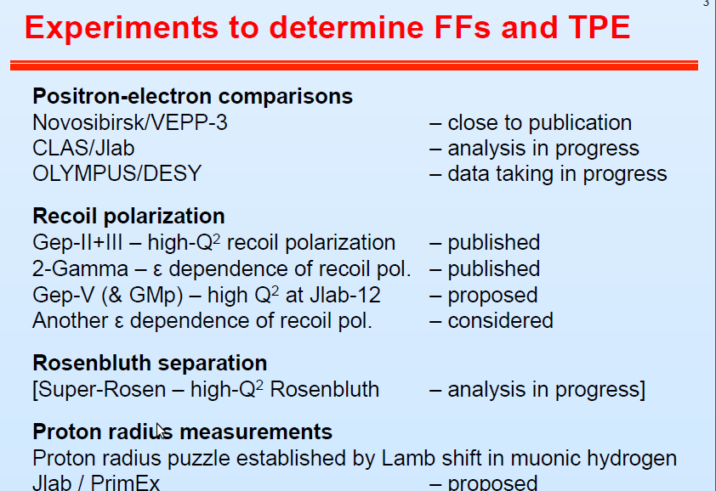
M. Kohl,A. Puckett

Slide 3
Plan
Introduction
  History-basics
Experimental programs
  Novosibirsk
  Olympus
  Clas
What do data say?
Model independent considerations
  Space-like
  Time-like
Which future for GEp ?
Conclusions

Slide 4
Two-Photon exchange
1γ-2γ interference is of the order of a=e²/4p=1/137 (in usual calculations of radiative corrections, one photon is ‘hard’ and one is ‘soft’)
“Invent a mechanism” to enhance this contribution
In the 70’s it was shown [J. Gunion and L. Stodolsky, V. Franco, F.M. Lev, V.N. Boitsov, L. Kondratyuk and V.B. Kopeliovich, R. Blankenbecker and J. Gunion] that, at large momentum transfer, due to the sharp decrease of the FFs, if the momentum is shared between the two photons, the 2γ- contribution can become very large.
The 2γ amplitude is expected to be mostly imaginary.
In this case, the 1γ-2γ interference is more important in time-like region, as the Born amplitude is complex.

Slide 5
Qualitative estimation of 2γ exchange
For ed elastic scattering:
q/2
q/2
From quark counting rules: F_{d} ~ t⁻⁵ and F_{N}~t⁻² . At t = 4 GeV²
For d, ³He, ⁴He, 2γ effect should appear at ~1 GeV²,
for protons ~ 10 GeV²

Slide 6
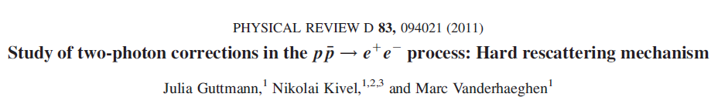
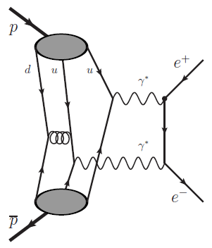
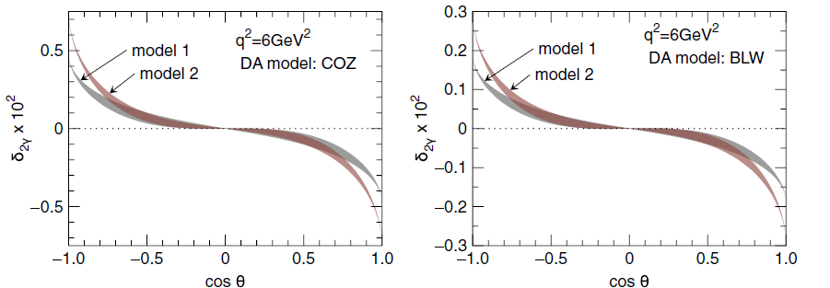
Works for large q²
Predicts large contribution in SL
small in TL
Depends on quark w.f.

Slide 7
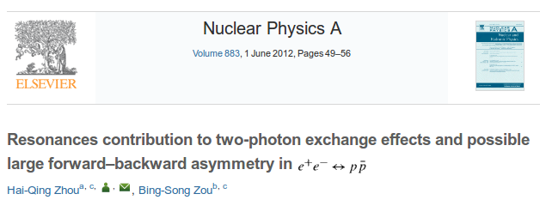
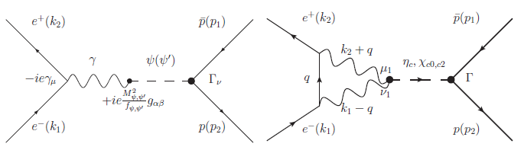
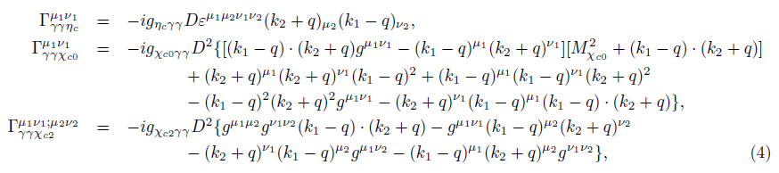
Contributions for charmonium 0⁻⁺ , 0⁺⁺ , 2⁺⁺

Slide 8
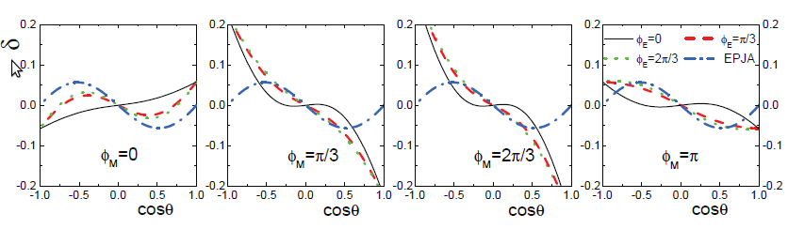
Large contribution for χ_{c2}
Depends on relative phase
Observable in PANDA?

Slide 9

Electron/Positron scattering
Born approximation
2γ exchange:
Asymmetry
The effect is enhanced in the ratio

Slide 10
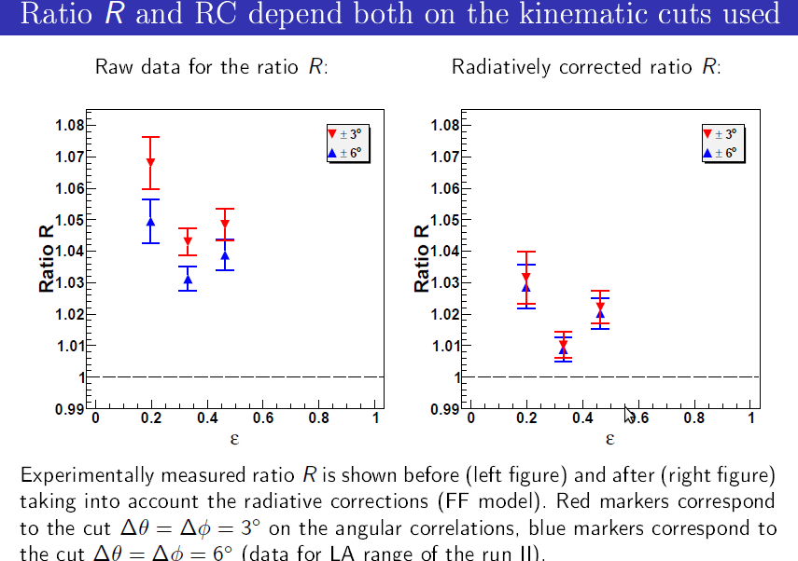
A. Gramolin

Slide 11
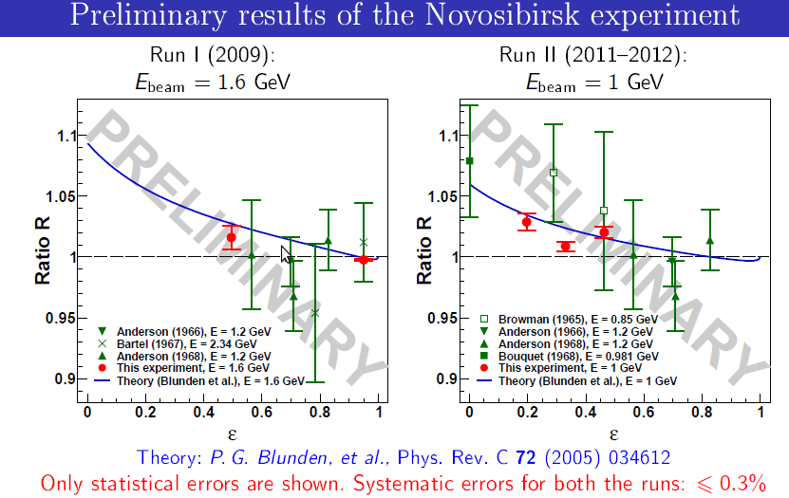
Agreement with calculation?
A. Gramolin

Slide 12
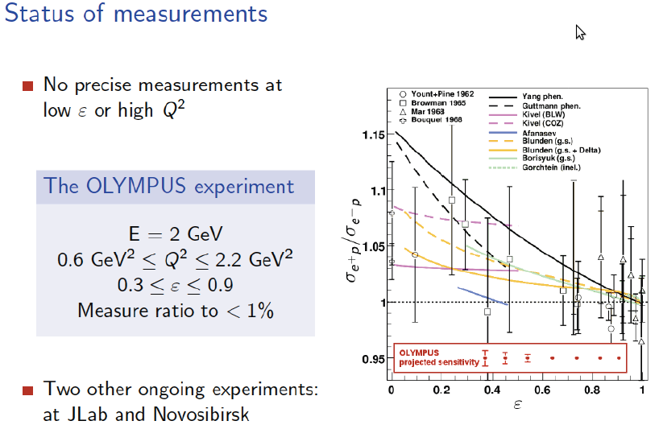
Olympus
M. Kohl

Slide 13
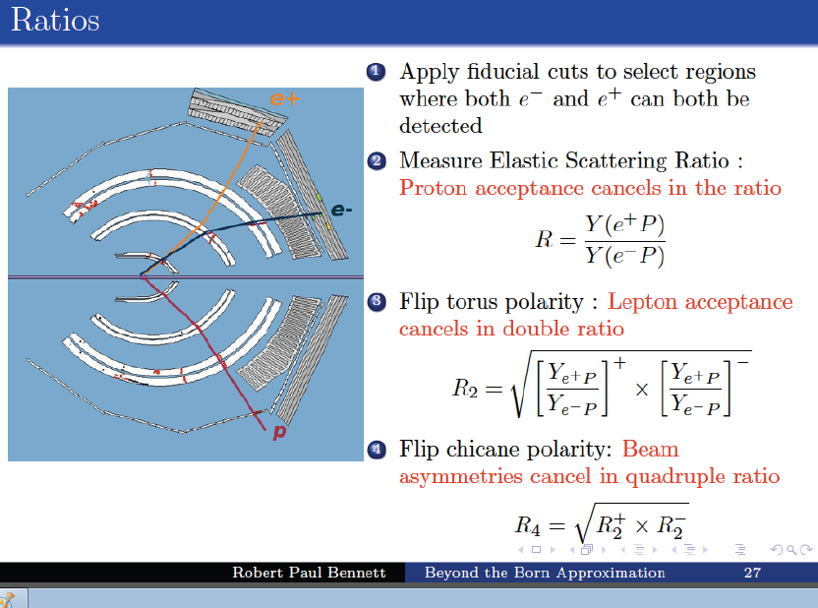

Slide 14
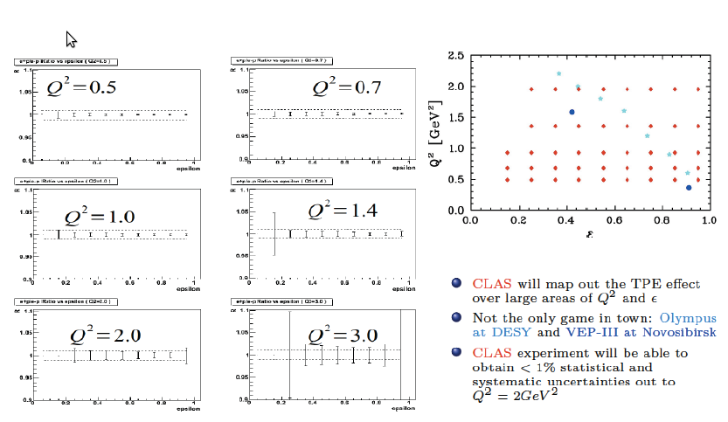
CLAS-Projections
R. Bennett

Slide 15
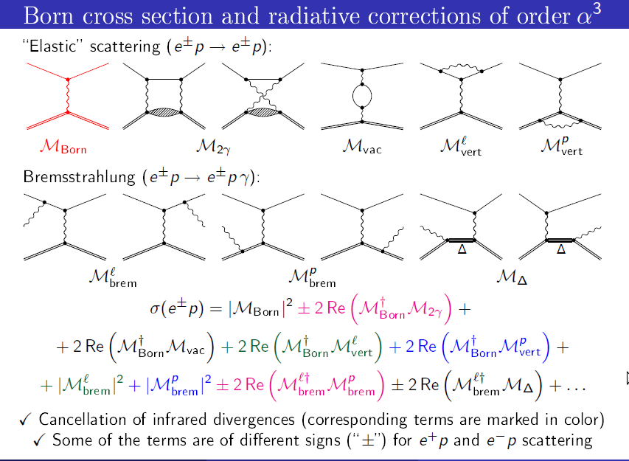
A. Gramolin

Slide 16
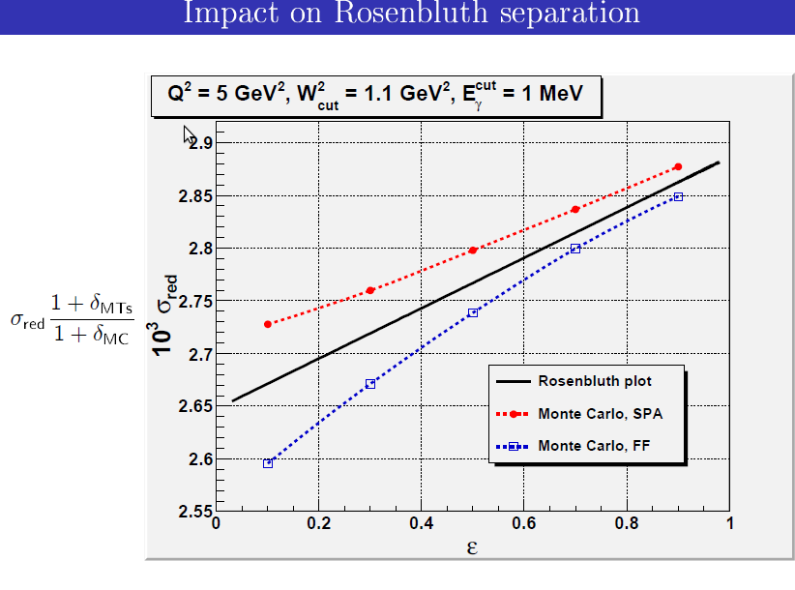
A. Gramolin

Slide 17
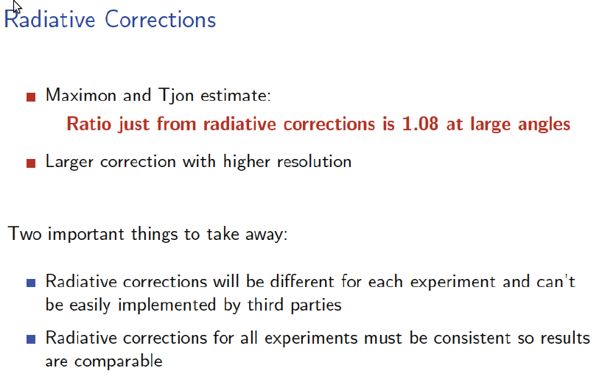
R. Russell
?

Slide 18
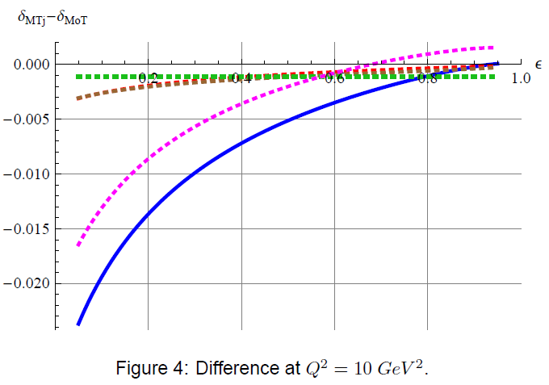
V. Fadin
…comparison among different experiments will be very difficult from different calculations inserted in dedicated MonteCarlo
(ansatz for cutting divergencies, numerical artefacts…)

Slide 19
2 γ exchange
What do data say?

Slide 20
World data e+e- scattering
Fitting
with a constant
R=0.997
DR=0.003
χ² =1.03

Slide 21

Elastic scattering
q² =1, 3, 5 GeV²
ε=0.2, 0.5, 0.8
R=(-0.071 ± 0.016 )ε +(1.058 ±0.014)

Slide 22
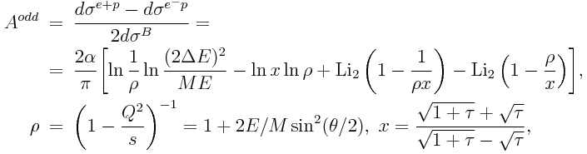
Electron/Positron scattering
E.A. Kuraev, V.V.Bytev, S.Bakmaev and E.T-G, PRC 78, 015295 (2008).
C=0.97,0.99
ε=0.4
q²=3 GeV²
Soft photon emission
2γ exchange

Slide 23
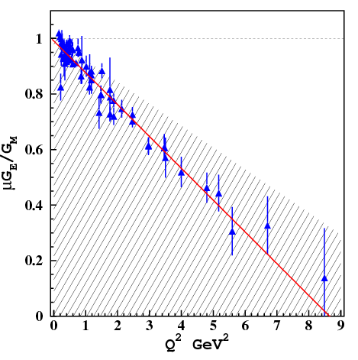
Exclusion plot
1) Revise RC
2) Odd part from e+/e- data
3) If all the odd contribution
come from two
photon exchange, would
it be sufficient to bring
consistency between
Rosenbluth and Gep data?
95% exclusion plot
E.T.-G, M. Osipenko, E. Kuraev, Y. Bystrisky, arXiv 0909.4736,

Slide 24
Two-Photon exchange in ed-scatterng
Discrepancy between the results from
  Hall A [L.C. Alexa et al., P.R.L. 82, 1374 (1999)]
  Hall C [D. Abbott et al., P.R.L. . 82, 1379 (1999)].
Model-independent parametrization of the
2γ− contribution.
Applied to ed-elastic scattering data.
  M. P. Rekalo, E. T-G and D. Prout, Phys. Rev. C60, 042202 (1999)

Slide 25
1γ-2γ interference
  M. P. Rekalo, E. T-G and D. Prout, Phys. Rev. C60, 042202 (1999)
1γ
2γ
{
{
1{g
  M. P. Rekalo, E. T-G and D. Prout, Phys. Rev. C60, 042202 (1999)

Slide 26
Interaction of 4 spin ½ fermions
16 amplitudes in the general case.
P- and T-invariance of EM interaction,
helicity conservation,
One-photon exchange:
- Two form factors (real in SL, complex in TL)
- Functions of one variable (t)
Two-photon exchange:
- Three (complex) amplitudes
- Functions of two variables (s,t)

Slide 27
The 1γ-2γ interference destroys the linearity of the Rosenbluth plot!
What about data?

Slide 28


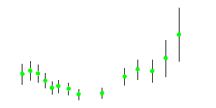
1γ-2γ interference
C/A
D/A
  M. P. Rekalo, E. T-G and D. Prout, Phys. Rev. C60, 042202 (1999)

Slide 29

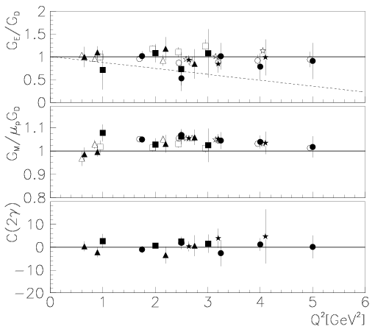
Parametrization of 2γ-contribution for e+p
From the data:
deviation from linearity
<< 1%!
E. T.-G., G. Gakh, Phys. Rev. C 72, 015209 (2005)

Slide 30


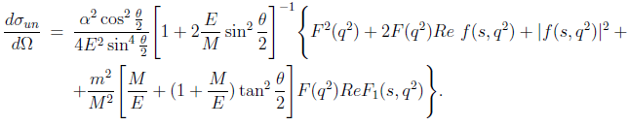
e+⁴He scattering
G.I Gakh, and E. T.-G., Nucl.Phys. A838 (2010) 50-60
Spin 0 particle: F(q²) in Born approximation
2γ exchange : F₁(s,q²),F₂(s,q²)=F(q²) +f(s,q²)
F(q²)~α⁰, F₁(s,q²)~α

Slide 31

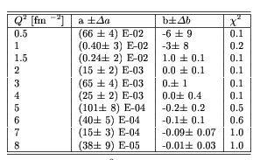
Linear fit to e+⁴He elastic scattering
G.I Gakh, and E. T.-G., Nucl.Phys. A838 (2010) 50-60

Slide 32
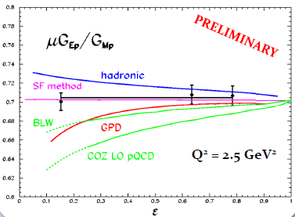
Polarization ratio (ε-dependence)
DATA: No evidence
of ε-dependence at 1% level
MODELS: large correction (opposite sign) at small ε
SF method: ε-(almost)independent corrections
•Theory: corrections to the Born approximation at Q2= 2.5 GeV2
Y. Bystritskiy, E.A. Kuraev and E.T.-G, Phys.Rev.C75: 015207 (2007)
P. Blunden et al., Phys. Rev. C72:034612 (2005) (mainly GM)
A. Afanasev et al., Phys. Rev. D72:013008 (2005) (mainly GE)
N.Kivel and M.Vanderhaeghen, Phys. Rev. Lett.103:092004 (2009). (high Q₂)

Slide 33
Is it still possible to extract
the « real » FFs in presence
of 2γ exchange?
Space-like region
Possible but difficult!

Slide 34
Model independent considerations for
e± N scattering
Determination of EM form factors,
in presence of 2γ exchange:
  electron and positron beams
  - longitudinally polarized ,
  - in identical kinematical conditions,
M. P. Rekalo, E. T.-G. , EPJA (2004), Nucl. Phys. A (2004)

Slide 35
Model independent considerations for e± N scattering
Determination of EM form factors, in presence of 2γ exchange
  - electron and positron beams,
  - longitudinally polarized ,
  - in identical kinematical conditions,
Generalization of the polarization method
(A. Akhiezer and M.P. Rekalo)
  M. P. Rekalo and E. T-G Nucl. Phys. A740 (2004) 271,
  M. P. Rekalo and E. T-G Nucl. Phys. A742 (2004) 322

Slide 36
If no positron beam…
Either three T-odd polarization observables….
Ay: unpolarized leptons, transversally polarized
target or
Py: outgoing nucleon polarization with
unpolarized leptons, unpolarized target
Depolarization tensor (Dab): dependence of the
b-component of the final nucleon
polarization on the a-component of the nucleon
target with longitudinally polarized leptons
  M. P. Rekalo and E. T-G Nucl. Phys. A740 (2004) 271
  M. P. Rekalo and E. T-G Nucl. Phys. A742 (2004) 322

Slide 37
If no positron beam…
This ratio contains the ‘TRUE ‘form factors!
Very difficult experiments
Three T-odd polarization observables….
Expected small, of the order of α, triple spin correlations
but… Model independent way

Slide 38
If no positron beam…
Either three T-odd polarization observables….
..or five T-even polarization observables….
among dσ/dΩ, Px(λe), Pz(λe), Dxx, Dyy, Dzz, Dxz
Again very difficult experiments
Only Model independent ways (without positron beams)
  M. P. Rekalo and E. T-G Nucl. Phys. A740 (2004) 271,
  M. P. Rekalo and E. T-G Nucl. Phys. A742 (2004) 322

Slide 39
Is it still possible to extract
the « real » FFs in presence
of 2γ exchange?
Time-like region
much easier…in principle!

Slide 40
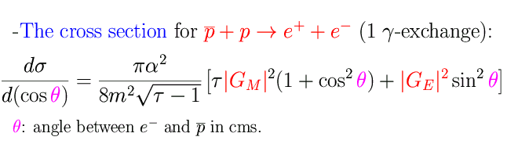
Time-like observables: | G_{E}| ² and | G_{M}| ²
A. Zichichi, S. M. Berman, N. Cabibbo, R. Gatto, Il Nuovo Cimento XXIV, 170 (1962)
B. Bilenkii, C. Giunti, V. Wataghin, Z. Phys. C 59, 475 (1993).
G. Gakh, E.T-G., Nucl. Phys. A761,120 (2005).
As in SL region:
- Dependence on q² contained in FFs
- Even dependence on cos²θ (1γ exchange)
- No dependence on sign of FFs
- Enhancement of magnetic term
but TL form factors are complex!

Slide 41


Unpolarized cross section
Two Photon Exchange:
Induces four new terms
Odd function of θ:
Does not contribute at θ =90°
M.P. Rekalo and E. T.-G., EPJA 22, 331 (2004)
G.I. Gakh and E. T.-G., NPA761, 120 (2005)

Slide 42

Symmetry relations
Properties of the TPE amplitudes with respect to the transformation: cos θ = - cos θ i.e., θ → π - θ
(equivalent to non-linearity in Rosenbluth fit)
Based on these properties one can remove or single out TPE contribution
E. T.-G., G. Gakh, NPA (2007)

Slide 43

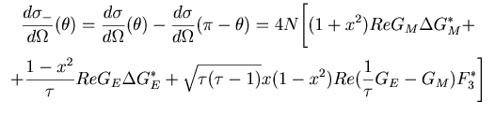

Symmetry relations (annihilation)
Differential cross section at complementary angles:
The SUM cancels the 2γ contribution:
The DIFFERENCE enhances the 2γ contribution:
E. T.-G., G. Gakh, NPA (2007)

Slide 44

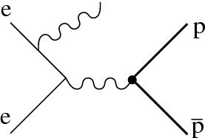
Radiative Return (ISR)
e⁺ +e⁻ → p + p + γ
B. Aubert ( BABAR Collaboration) Phys Rev. D73, 012005 (2006)

Slide 45

Angular distribution
1.877÷1.950
1.950÷2.025
2.025÷2.100
2.100÷2.200
2.200÷2.400
Events/0.2 vs. cos θ
2.400÷3.000
    2γ−exchange?

Slide 46
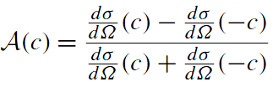
Angular Asymmetry
Mpp=1.877-1.9
A=0.01±0.02
Mpp=2.4-3
E. T.-G., E.A. Kuraev, S. Bakmaev, S. Pacetti, Phys. Lett. B (2008)

Slide 47



Structure Function method
e⁺ +e⁻ → p + p + γ
E.A. Kuraev, V. Meledin, Nucl; Phys. B
ΔE=0.05
E. T.-G., E.A. Kuraev, S. Bakmaev, S. Pacetti, Phys. Lett. B (2008)

Slide 48


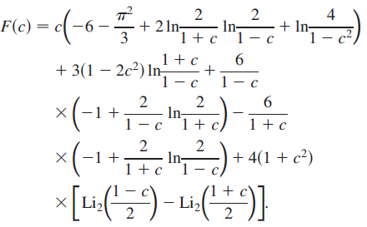
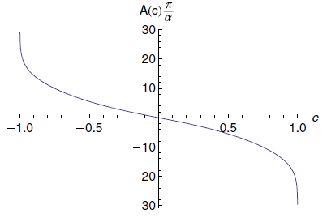
Charge Asymmetry
Radiative proton-antiproton annihilation to a lepton pair.
A.I. Ahmadov, V.V. Bytev, E.A. Kuraev, E. T.-G., Phys.Rev. D82 (2010) 094016

Slide 49
Which alternative for GEp?

Slide 50
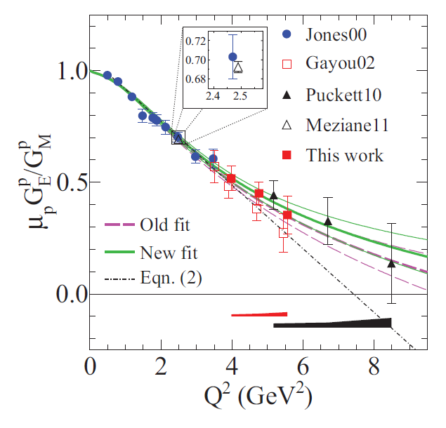
Polarization experiments - Jlab
A.I. Akhiezer and M.P. Rekalo, 1967
  GEp collaboration
  "standard" dipole function for the nucleon magnetic FFs GMp and GMn
  2) linear deviation from the dipole function for the electric proton FF Gep
  3) QCD scaling not reached
  3) Zero crossing of Gep?
  4) contradiction between polarized and unpolarized measurements
  A.J.R. Puckett et al, PRL (2010)
  PRC85 (2012) 045203

Slide 51
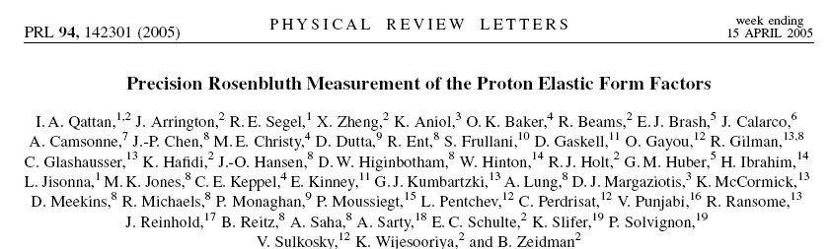
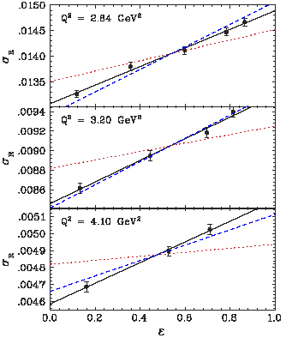
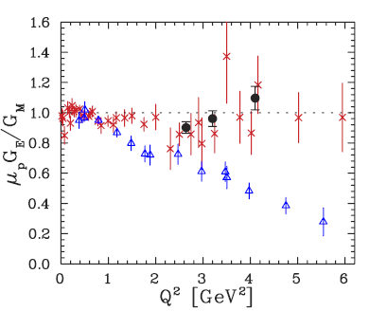
WHY these points are aligned?

Slide 52


Rosenbluth separation
Contribution of the electric term
ε=0.8
…to be compared to the absolute value of the error on σ and to the size and ε dependence of RC
ε=0.2
ε=0.5
  E.T-G, Phys. Part. Nucl. Lett. 4, 281 (2007)

Slide 53
Experimental correlation
σ_{el}=σ_{meas} · RC
RC(ε)
only published values!!
Correlation (<RC•ε>)
Q² > 2 GeV²
Q² < 2 GeV²
  E.T-G, Phys. Part. Nucl. Lett. 4, 281 (2007)

Slide 54
Radiative Corrections (ep)
Andivahis et al., PRD50, 5491 (1994)
Q²=1.75 GeV²
Q²=3.75 GeV²
May change
the slope of σ_{R}
(and even the sign !!!)
Q²=5 GeV²
RC to the cross section:
− large (may reach 40%)
ε and Q² dependent
− calculated at first order
E. T.-G., G. Gakh, Phys. Rev. C 72 (2005) 015209
C.F. Perdrisat,, Progr. Part. Nucl. Phys. 59,694 (2007)

Slide 55

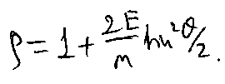
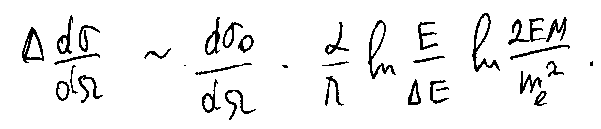
Scattered electron energy
final state emission
Initial state emission
Quasi-elastic scattering
3%
Not so small!
Shift to LOWER Q²
Y₀
All orders of PT needed →
beyond Mo & Tsai approximation!

Slide 56
Which future for GEp?

Slide 57
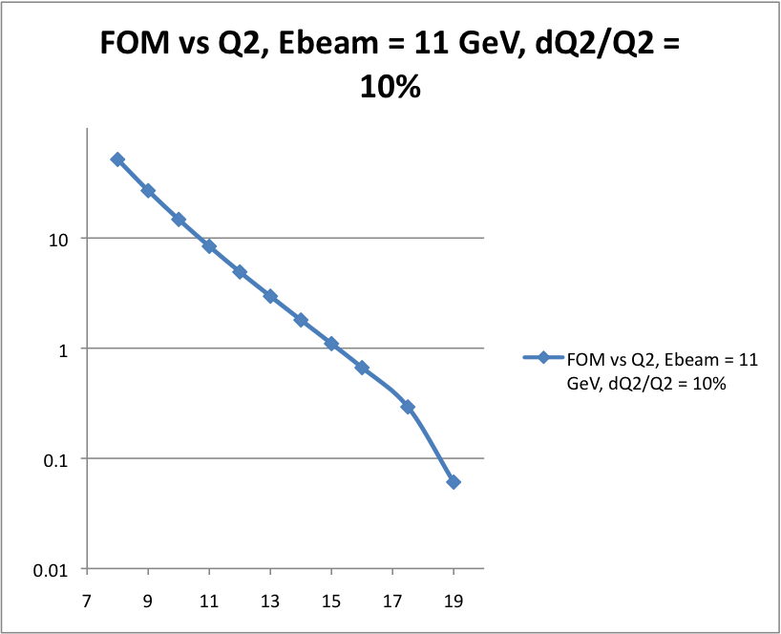
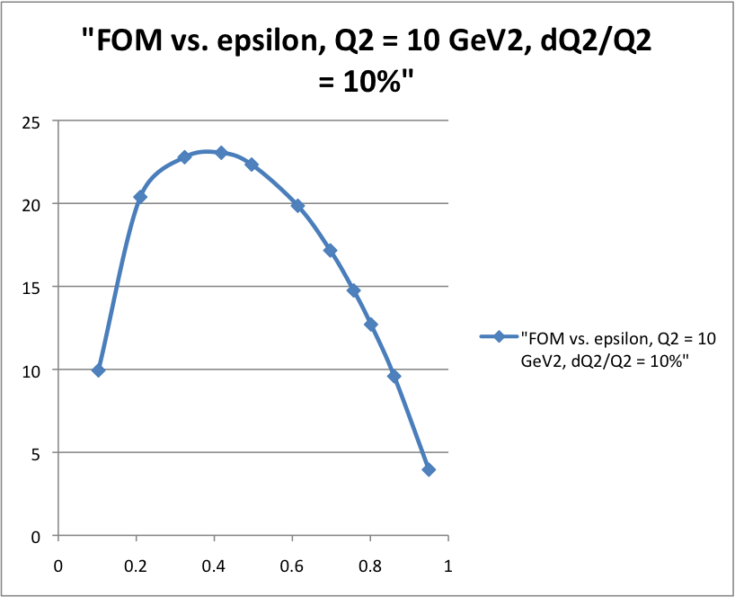
How to go to higher Q²?
A. Puckett
FOM vs. Q² at E = 11 GeV (a. u.)
FOM vs. ε at Q² = 10 GeV² (a. u.)
Must increase luminosity and acceptance to compensate for E²/Q¹⁶ dependence of (cross section * A_{y}² contributions to ) figure of merit

Slide 58
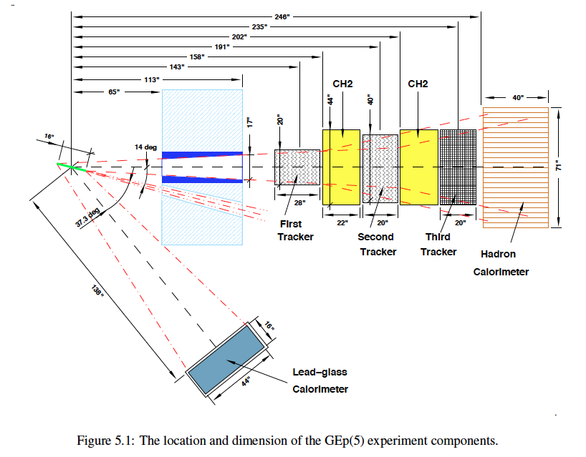
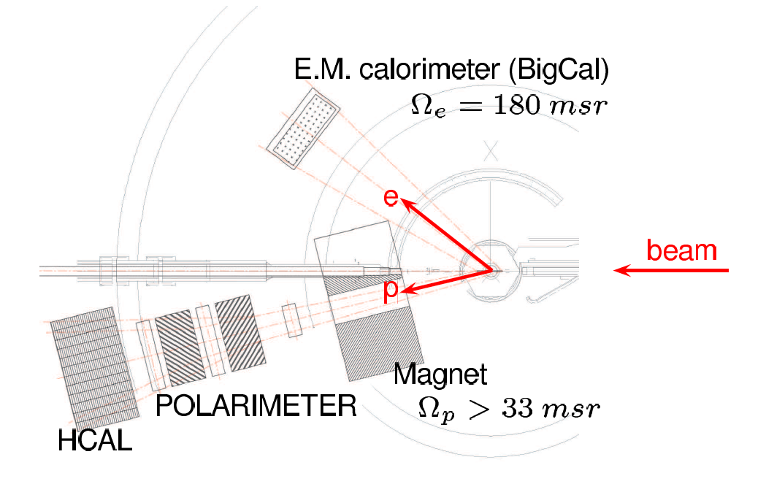
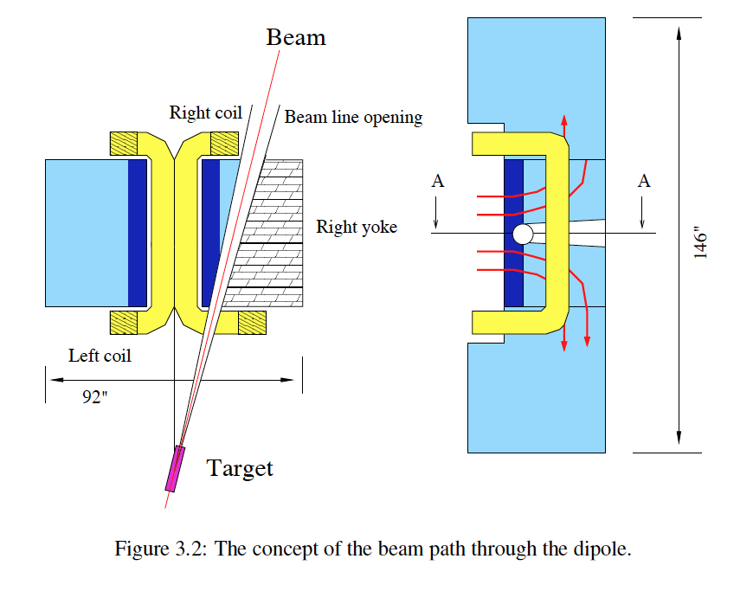
GEp-V: The Final Frontier
A. Puckett
At large Q², the proton in ep elastic scattering goes to forward angles at high momentum.
New “Super BigBite” spectrometer: Open-geometry, vertical-bend dipole spectrometer
High-rate tracking based on GEM technology.
New FPP with full geometric acceptance for angles up to 10°
Spokespersons: B. Wojtsekhowski (contact), L. Pentchev, C. F. Perdrisat, V. Punjabi, M. K. Jones, E. Cisbani, E. Brash, ...

Slide 59
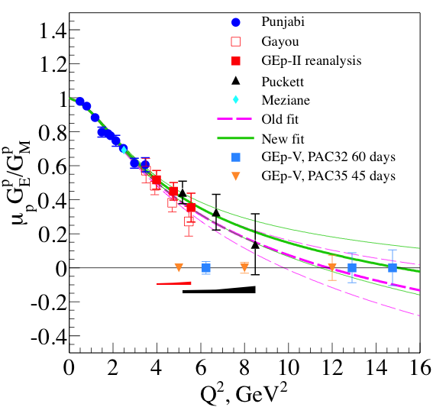
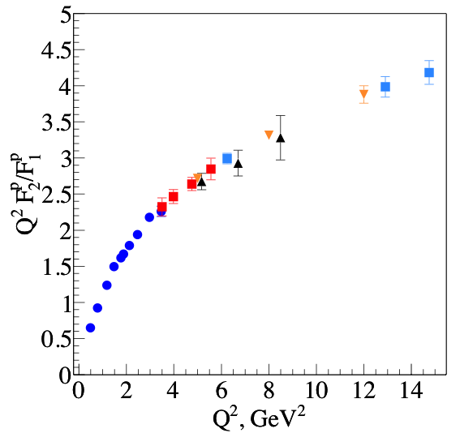
Projected Results Approved by JLab PAC
Projected results as μG_{E}/G_{M}
Projected results as Q² F₂/F₁
A. Puckett

Slide 60
Conclusion of our work (today..)
Our Suggestion for search of 2γ effects:
Search for model independent statements (M.P. Rekalo, G. Gakh..)
Exact calculation in frame of QED (p~μ)
Prove that QED box is upper limit of QCD box diagram
Study analytical properties of the Compton amplitude
Compare to experimental data
Our Conclusions for elastic ep scattering
Two photon contribution is negligible (real part) (E.A. Kuraev)
Radiative corrections are huge: take into account higher order effects (Structure Functions method) ) (Yu. Bystricky)
Look for Multiple Photon Exchange in e-A scattering
Small angle e, or p or pbar - Heavy ion scattering
E.A. Kuraev, M. Shatnev, E.T-G., PRC80 (2009) 018201
2γ effects are expected to be larger in TL region (complex nature)

Slide 61
Interference of 1γ ⊗2γ exchange
Explicit calculation for structureless proton
  The contribution is small, for unpolarized and polarized ep scattering
  Does not contain the enhancement factor L
  The relevant contribution to K is ~ 1
eμ (elastic) scattering is upper limit for ep
  E.A.Kuraev, V. Bytev, Yu. Bystricky, E.T-G , Phys. Rev. D74 013003 (1076)

Slide 62



QED versus QCD
electron
proton
Imaginary part of the 2γ amplitude

Slide 63


QED versus QCD
Q²=0.05 GeV²
Q²=1.2 GeV²
Q²=2 GeV²

Slide 64
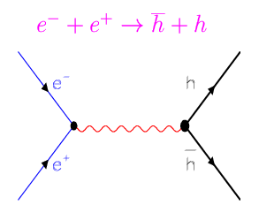
Crossing Symmetry
Scattering and annihilation channels:
- Described by the same amplitude :
- function of two kinematical variables
- which scan different kinematical regions
k₂ → – k₂
p₂ → – p₁

Slide 65
