Slide 1
EM physics at PANDA
Electromagnetic channels with PANDA
pp → e⁺e⁻ at PANDA: proton time-like electromagnetic form factors
pp → π°e⁺e⁻ reaction: time-like electromagnetic form factors in the unphysical region

Slide 2
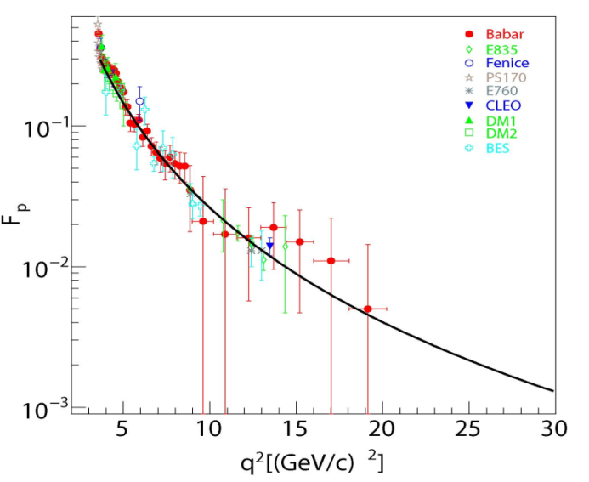
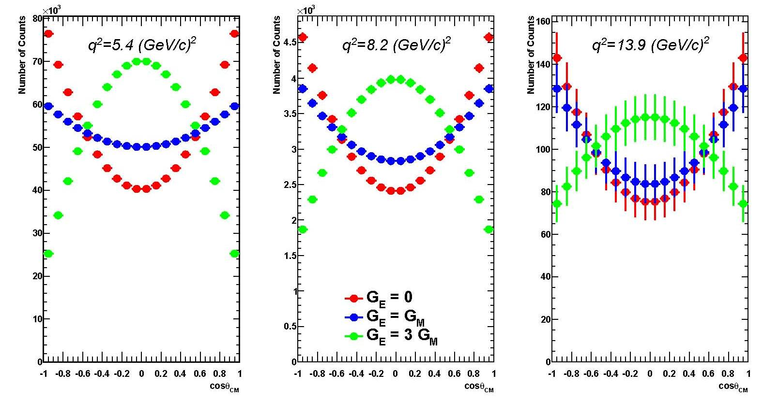
Counting rate and sensitivity to |G_{E}|
~120 days, L = 2. 10³² cm⁻²s⁻¹
L _{int}= 2 fb⁻¹
Statistical errors only
G_{E}=0
G_{E}=G_{M}
G_{E}=3G_{M}
N_{tot}=1.1 10⁶ N_{tot}=64000 N_{tot}=2000
M. Sudol et al. EPJA 44 (2010) 373

Slide 3
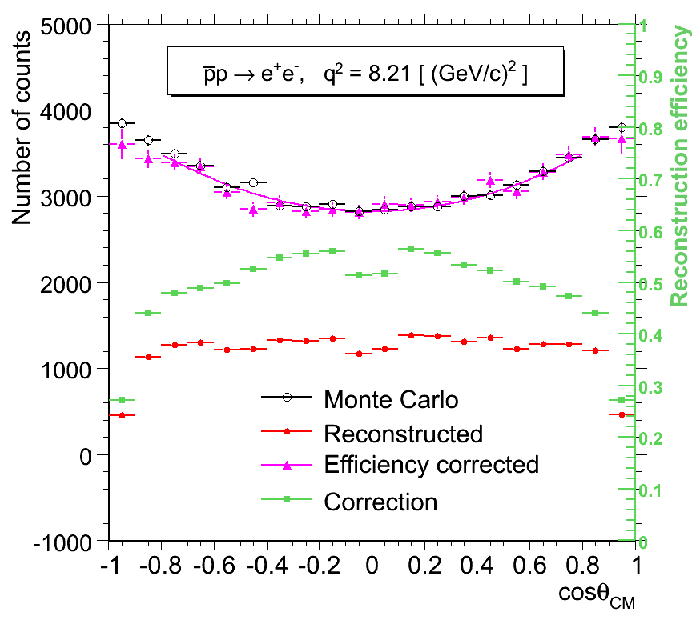
pp →e⁺e⁻ signal reconstruction
-
Sudol et al. EPJA 44 (2010) 373
q² π⁺π⁻
[GeV/c]² contamination
8.2 0.004 %
12.9 0.017 %
16.7 0.061 %
→ contamination < 0.1 %
Background suppression factor is at
least of the order of 10⁹
Taking into account PID & kinematic fit
contamination <<1%

Slide 4
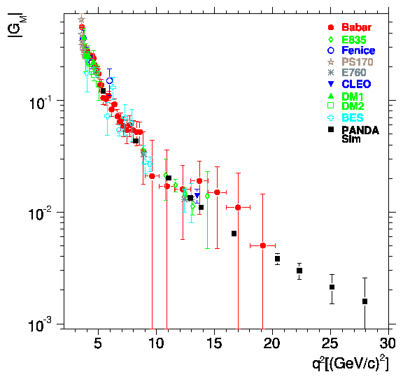
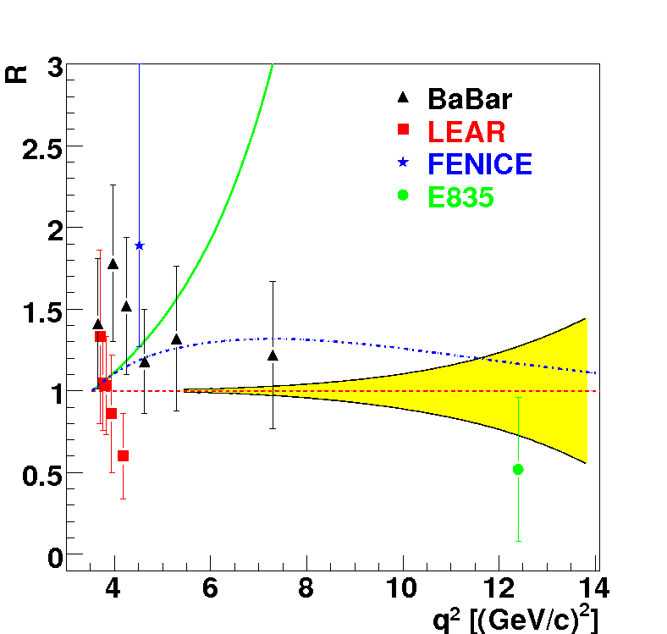
Time-Like Form Factor measurement with PANDA : precision estimates
L=2 fb⁻¹
Sudol et al. EPJA 44 (2010) 373
-VDM: F. Iachello et al., PLB43, 171 (1973)
…extended VDM, PRC66, 045501 (2002)
Egle Tomasi-Gustafsson et al., EPJA24 (2005) 419
G_{eff}
PANDA
PANDA
BES
BES
< 1% ~10% ~23% ~50%
pQCD ?
PANDA will bring
Precise determination of |G_{E}| and | G_{M} | up to 14 (GeV/c)²
G_{eff} up to 30 (GeV/c)² : transition towards perturbative QCD
Notes:
In this publication, we also evaluate the precision on the form factor measurement that will be achieved with PANDA and compare it to the existing data. The ratio of electric to magn FF can be measured up to 14 GeV/c2 from an analysis of the angular distributions with a good precision. This will improve very much the present experimental situation. In addition, it will allow to discriminate among models which are all able to reproduce the Geff and also the space like data, but give different predictions for the ratio GE/GM. Here we see for example the Iachello model in green, which predicts a very strong electric form factor.
Cross-sections and therefore the effective form factor can be measured with good precision up to 30 GeV/c2, which is the maximum available q2 at PANDA.

Slide 5
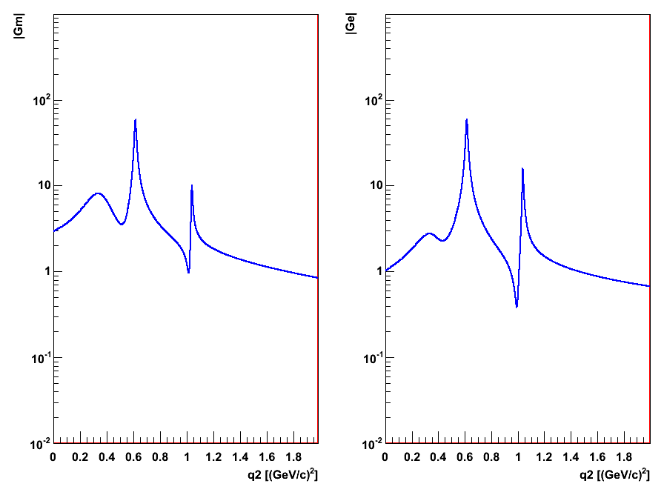
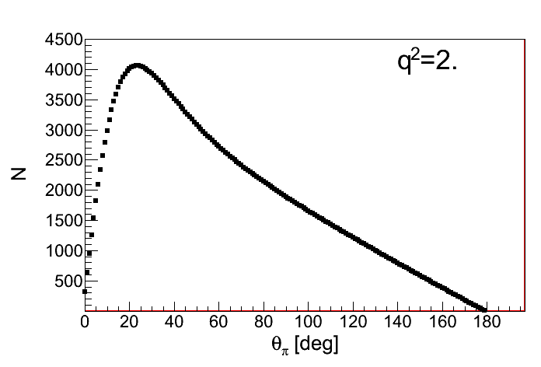
Count rate predictions for pp →π⁰e⁺e⁻
Iachello VMD form factor model
Phys. Rev. C69, 055204, 2004
Incident energy dependence
ρ, ω and φ resonances
|G_{M}|
|G_{E}|
q² (GeV/c2)
q² (GeV/c2)
Luminosity =2 fb-1
-
p
q2
e+
T=1GeV
q²=2.±0.25 (GeV/c)²
e-
p
π°
at T=1 GeV , q²=2 (GeV/c)²
172000 events for Δq²=0.5 (GeV/c)²,
4000 events for Δθ_{π}=1° (θ_{π}=20°)
J. Boucher PhD Orsay dec.2011

Slide 6
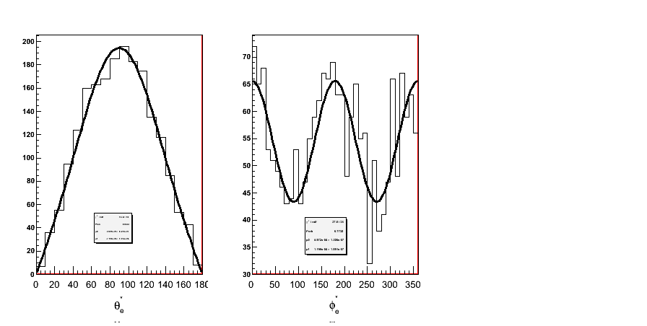
-
From hadronic tensors to form factors
How to extract G_{E} and G_{M} in p p → e+ e- π0 ?
-
p
q2
e+
e+
γ*
θ_{e}
e-
p
+ exch.
π°
e-
dσ/dφ_{e}
J. Boucher PhD Orsay dec. 2011
In the one nucleon exchange model :
dσ/dθ_{e}
dσ/dφ_{e}
For fixed θ_{π0} and q²,
Fit of lepton angular distributions in γ* frame
→ R=|G_{E}/G_{M}| and cos(ϕ_{E}-ϕ_{M})
θ_{e+} (deg)
φ_{e+} (deg)
General result: the angular distribution in θ_{e}* and φ_{e}* in γ* frame
gives access to 4 H_{μν} at fixed θ_{π0} and q²

Slide 7
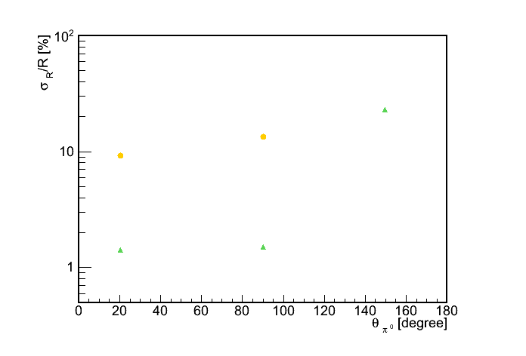
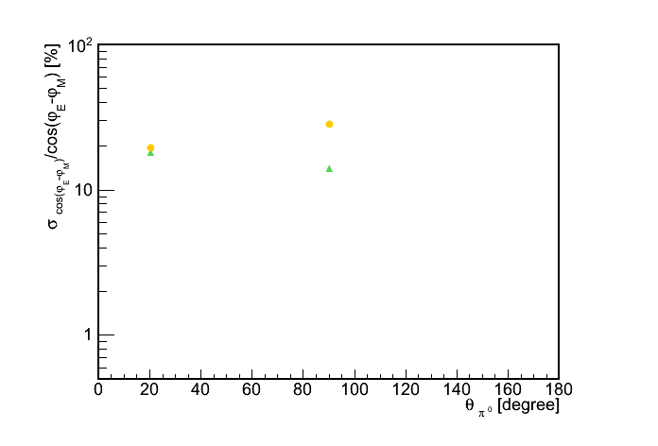
Expected precision on |G_{E}|/|G_{M}| and the phase difference
p p → e⁺ e⁻ π⁰
|
q²=0.605 ± 0.005 (GeV/c²)²
σ_{R}/R [%]
|G_{E}|/|G_{M}|
q²=2.0 ± 0.125 (GeV/c²)²
Signal contamination <1 % at q²=0.6
< 10% at q²=2.0
q²=2
~ 1% precision close to the ω resonance
~ 10% precision at q² =2 (GeV/c²)²
~ 20% precision at q²= 4M_{p}² =3.52 (GeV/c²)²
Signal contamination <1 % at q²=0.6
< 10% at q²=2.0
q²=0.6
~ 1% precision close to the ω resonance
~ 10% precision at q² =2 (GeV/c²)²
~ 20% precision at q²= 4M_{p}² =3.52 (GeV/c²)²
q²=2
q²=0.6
For the first time cos(φ_{E}-φ_{M}) can be extracted with 10-30% precision
σ_{cos(δφ)} /cos(δφ) [%]
cos(ϕ_{E}-ϕ_{M})
T. Hennino, J. Boucher, IPN Orsay

Slide 8
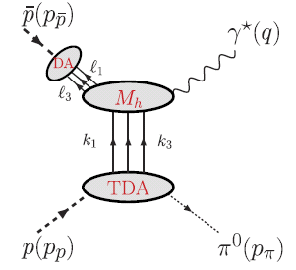
Another approach for the pp→e⁺e⁻π⁰ reaction : Transition Distribution Amplitudes
-
Hard sub-process :
Signature: Angular distribution of the e⁺/e⁻ in the γ* frame
~ (1+ cos²θ)
Distribution Amplitude = 3-quark operator matrix element
<0|uud|p>
q²>>1
Transition Distribution Amplitude = 3-quark operator matrix element
<π|uud|p>
θ_{π}=0⁰ or θ_{π} = 180⁰
‘π’ at rest in p or pbar rest frame
Δ_{t}=(p_{p/p}-p_{π})_{t}=0 → 3 TDA
-
J.P. Lansberg et al, PRC76,111502(2007)
New window on the sea quarks in proton wave function
complementary to corresponding quantities from CLAS/JLAB

Slide 9
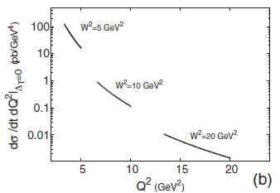
Transition Distribution Amplitudes in pp→e⁺e⁻π⁰ reaction : estimates for PANDA
-
J.P. Lansberg et al, PRC76,111502(2007)
-
T_{p}=0.788 GeV
Estimates for PANDA: ( Mainz/Orsay collaboration
M.C. Mora Espi, B. Ma) including acceptance and efficiency
L= 2 fb⁻¹ , ΔQ² < 1 GeV²
→ Feasible at s=W²=5 (GeV/c)^{2,} but probably not at W²=10 (GeV/c)²
-
T_{p}=3.5 GeV
also to be studied
pp→J/Ψ π⁰ (same TDA’s)
Possible generalization to η and ρ (more TDAs)
-

Slide 10
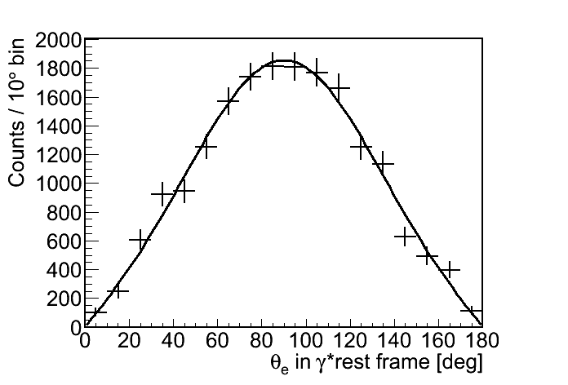
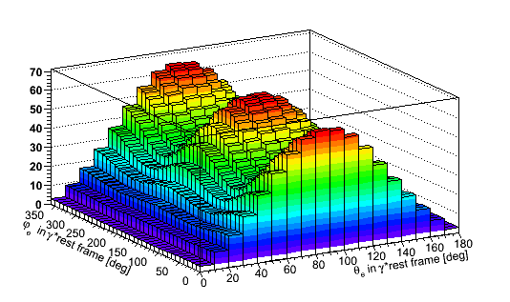
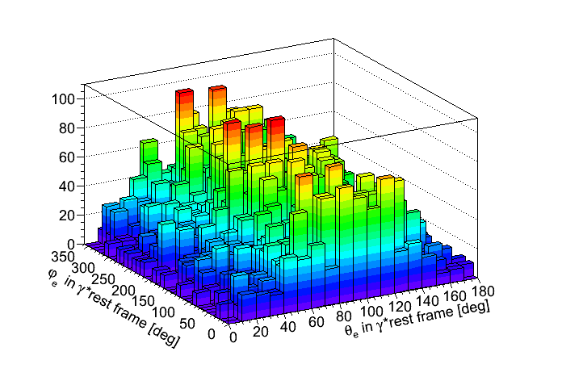
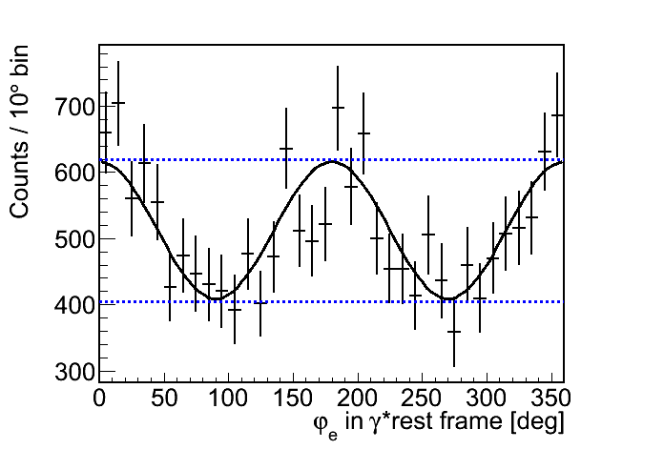
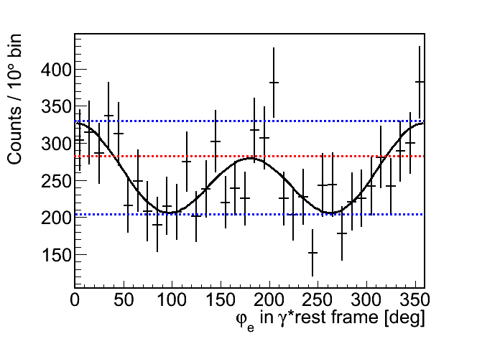
From experimental to physical information
T_{p}=1 GeV ; q²=2.0 ± 0.125 (GeV/c²)² ;
10°<θ_{π°}<30°;
N^{th}=18 486
→H₁₁+H₂₂-2H₃₃
Predicted e⁺ distribution in γ*
Corrected experimental distribution
Full simulation chain
Projection
and fit
→H₁₁-H₂₂
Determination of
R=|G_{E}|/|G_{M}| and cos(φ_{E}-φ_{M})
from the shapes only
→H₁₁-H₂₂ and H₁₃
Notes:
Le detail sur les projections peut etre enleve.

Slide 11
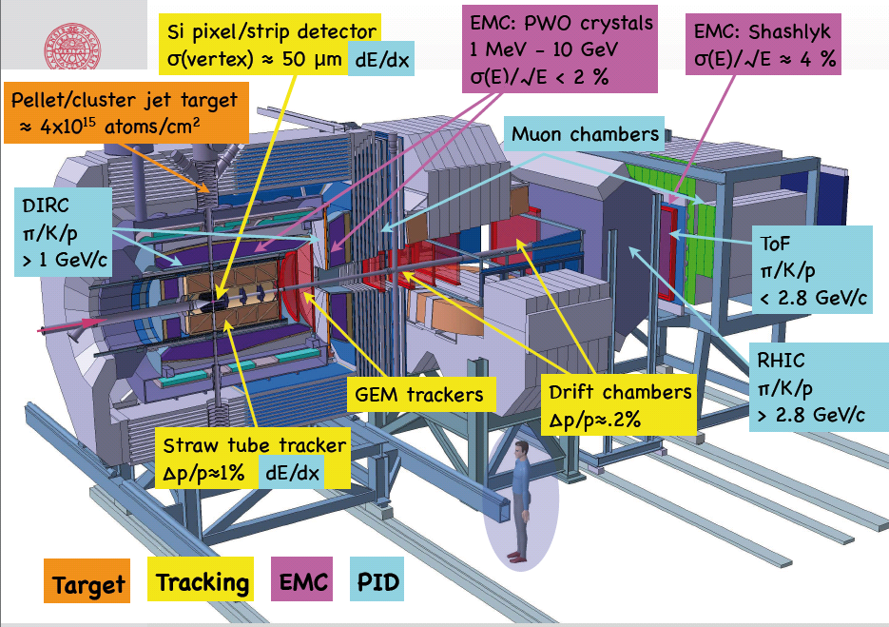
The PANDA experimental set-up
RICH

