Slide 1
The StratusLab Distribution and Its Evolution
4ème Journée Cloud (Bordeaux, France)
30 November 2012

Slide 2
StratusLab History
Informal collaboration to investigate running grid services on Amazon EC2 (2007)
Project (June 2010 to May 2012) co-funded by EC with 6 partners from 5 countries
Open collaboration to continue the development and support of the StratusLab software
Website: http://stratuslab.eu
Twitter: @StratusLab
Support: support@stratuslab.eu
Source: http://github.com/StratusLab

Slide 3
Reference Cloud Infrastructures
LAL
Running v2.1 → v2.1.1 very shortly
8 computing nodes (24 cores, 36 GB RAM) → 20 in January 2013
20 TB of storage available with more in reserve
GRNET
Currently being reinstalled with v2.1.1
Has 16 nodes (8x2 cores, 48 GB RAM)
3 TB of storage
Around 230 registered users for these infrastructures.

Slide 4
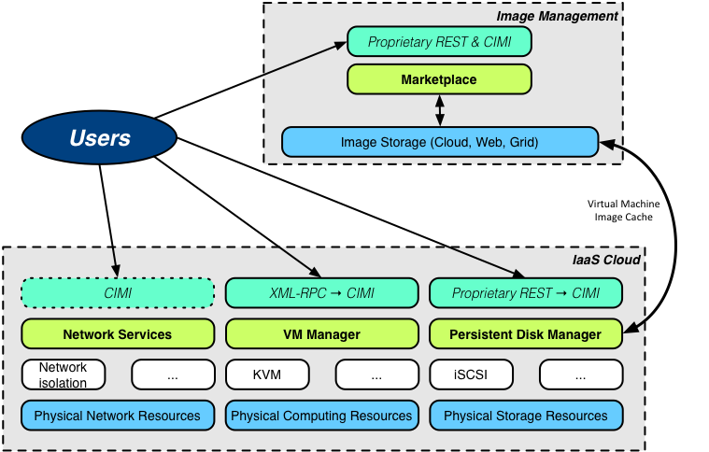
StratusLab Architecture

Slide 5
Releases
Recent Releases
V2.1 (16/10): Streamlined release with obsolete components removed Better support for virtio drivers to improve IO performance
V2.1.1 (29/11): Bug fix release (storage upload feature) and better Windows support
Release Policy
Next major release planned for February 2013 (13.02)
Moving to quarterly timed releases (13.02, 13.05, …) to allow users to plan upgrades
Bug fix releases between quarterly releases as needed
Development of 6 month roadmap to communicate better the evolution of the software

Slide 6
Software: High-Level Roadmap
New/Improved Features
Watches/notification for state changes and service events
Better resource utilization overview and management
Fine-grained accounting of resources
Improved stability and robustness of services
Ability to support different virtual machine managers
Interfaces
Adopt CIMI as the standard interface to services
Provide complete browser interface for all services
Provide EC2 adaptor to REST interface
Documentation
Better organization (‘general’ on web site; ‘specific’ in code repos.)
Provide support for several standard deployment scenarios

Slide 7
Changes Related to Standards
CIMI (DMTF DSP0263 http://dmtf.org/standards/cloud)
Resource-Oriented API with reasonable mappings to JSON and XML
IaaS-focused specification that will likely become ISO std. (like CDMI)
Defined mapping to OVF schema
Full coverage of StratusLab services
OCCI
Working StratusLab plugin for rOCCI available
Contextualization
Both HEPiX and OpenNebula contextualization supported
Will likely move to (or add) support for CloudInit
Remain compatible with contextualization specified in CIMI

Slide 8
Individual Components
Authentication/REST Interface
Integrated view of all site services via REST interface
Client
Better Windows support
Adaptations for changes in other services
Storage
Better coordination and visibility of various services (pdisk, iSCSI, …)
Improved support for advanced storage services (NetApp, …)
Marketplace
To facilitate federation and to simplify impl. move to Cassandra
Likely replacement of SPARQL search with full text search

Slide 9
Individual Components
Metadata
Split from Marketplace repository
Improved documentation on extending info. in image manifests
Standard Base Images
Fully automate build process for all standard base images
Better publicize the collaboration’s recommended images
Documentation/High-level Tests
Bring together tutorial, use-cases, and benchmarks
Automate testing of standard workflows

Slide 10
Individual Components
Virtual Machine Management
Integrate with newer versions of OpenNebula
Clarify interfaces between StratusLab and OpenNebula
Support for OpenNebula through UCM
Investigate use of other virtual machine managers

Slide 11
Conclusions
StratusLab Collaboration
Effort committed to continue development and support
Collaboration to be formalized through MoUs
Join the collaboration as an institute or individual
Provide Feedback
On overall roadmap or for individual components
How you want to get information and support from the collaboration
Contacts
Website: http://stratuslab.eu/
Twitter: @StratusLab
Support: support@stratuslab.eu
Source: http://github.com/StratusLab

Slide 12
Questions and Discussion

