Slide 1
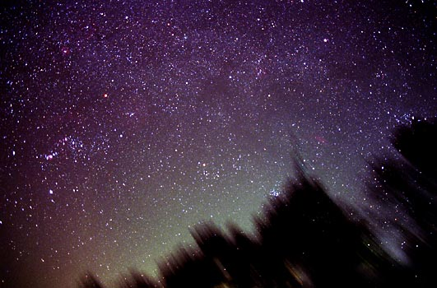
THE DARK SIDE OF THE UNIVERSE
Amna Ali
Saha Institute of Nuclear Physics
Kolkata, India

Slide 2
One of the most challenging problems in Physics
Several cosmological observations demonstrated that the expansion of the universe is accelerating
What is causing this acceleration?
How can we learn more about this acceleration, the Dark Energy it implies, and the questions it raises?

Slide 3
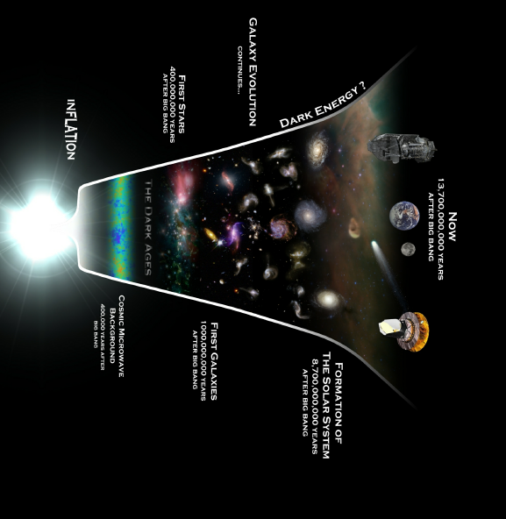
BIG BANG
INFLATION
Horizon Problem,
Flatness Problem
Late Time Cosmic Acceleration
OBSERVATIONS

Slide 4
Observational evidences of Cosmic Acceleration
Supernovae type Ia
Universe is Accelerating
standard candles
Their intrinsic luminosity is know
  Large Scale Structure
Clustering of matter gives information on
cosmological parameters, especially matter content
Dark Energy
76%
Cosmic Microwave Background
CMB is an almost isotropic relic radiation of T=2.725±0.002 K
CMB is a strong pillar of the Big Bang cosmology
It is a powerful tool to use in order to constrain several cosmological parameters

Slide 5


Universe as we know it today
What is dark energy?
“Normal Matter”
4%
Dark Energy
73%
Dark Matter
23%
96% of the universe is unknown!

Slide 6
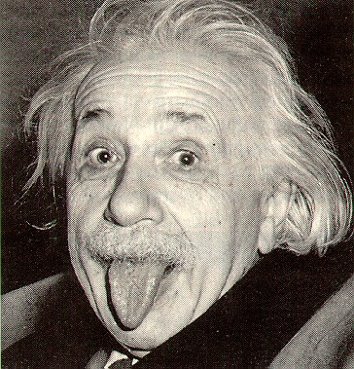
Einstein’s Cosmological Constant ~ what’s needed!
Introduced originally to counteract gravity.
Λ
Dark energy = Cosmological Constant?

Slide 7
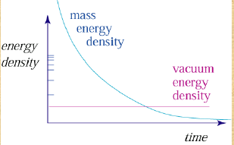
Cosmological Constant contd…
Has constant energy density
It naturally arises as an energy density of vacuum.
Λ is consistent with observations but is plagued with difficult theoretical issues.
Fine Tuning Problem !
Cosmic coincidence Problem !
Why do we see matter and Λ almost equal in amount?

Slide 8


Dynamical dark energy models
There are two approaches.
(Einstein equation)
(i) Modified gravity
(ii) Modified matter
f(R) gravity,
Scalar-tensor theory,
Braneworlds,
Gauss-Bonnet gravity,
…..
Quintessence,
K-essence,
Tachyon,
Chaplygin gas,
…..

Slide 9


Modifying
SCALAR FIELD AS DARK ENERGY
They can mimic Λ at the present epoch and give rise to other observed values of the equation of state parameter ω. (ω lies in a narrow strip around ω=-1
Quintessence :
Introduced mostly to address the “why now?” problem
Potential determines dark energy properties
Energy-momentum tensor
T_{μν}=(2/√-g) [ δ(√-g L )/δg_{μν} ]
Energy density: ρ_{φ} = (1/2) φ ² + V(φ)
Pressure : p_{φ} = (1/2) φ ² - V(φ)
Einstein gravity says gravitating mass ρ+3p< 0
so acceleration if equation of state ratio w = p/ρ < -1/3
w = (K-V) / (K+V)
Potential energy dominates (slow roll): V >> K ⇒ w = -1
Kinetic energy dominates (fast roll): K >> V ⇒ w = +1

Slide 10

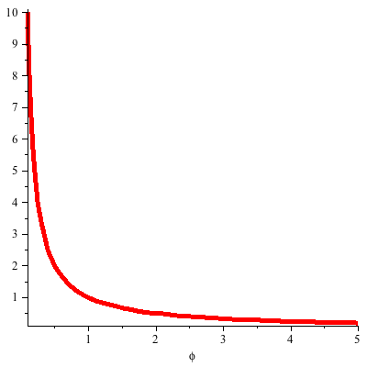

Dynamics of Quintessence
Equation of motion of scalar field :
driven by steepness of potential
slowed by Hubble friction
Broad categorization -- which term dominates:
Classification of quintessence potentials
(Caldwell and Linder, 2003)
(A) Freezing models:
Models in which scalar field mimics the background (radiation/matter) being subdominant for most of the evolution history. Only at late times it becomes dominant and accounts for the late time acceleration. Such a solution is referred to as tracker.
The evolution of the field gradually
slows down.
w decreases to -1.

Slide 11
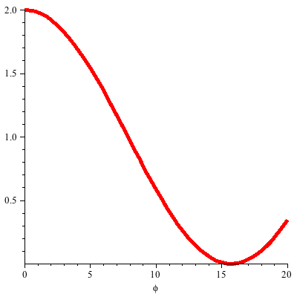

(B) Thawing models:
At early times, the field gets locked (w(φ) = −1) due to large Hubble damping and waits for the matter energy density to become comparable to field energy density which is made to happen at late times. The field then begins to evolve towards larger values of w(φ) starting from w(φ) = −1.
The field begins to move only recently.
w increases from -1.
Scalar Field Dynamics in presence of background matter : Tracker or Freezing Models

Slide 12
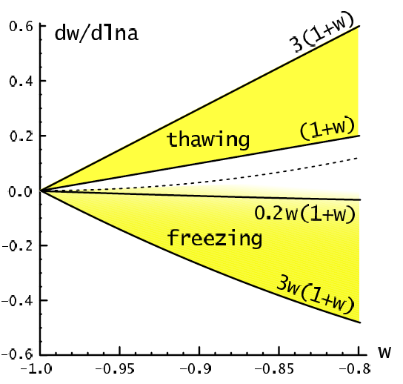
Quintessence in the (w,w’) plane
Present observations
do not see the evidence
for the variation of w.
.
Hopefully we can find
some deviation from
the LCDM model
in future observations.
LCDM

Slide 13






DYNAMICS OF TACHYON FIELD
Action is given by:
Energy Density:
Pressure Density:
Equation of State:
Equation of motion for φ(t):
One can define variables:
prime ->d/d log(a)
With this one can now write:

Slide 14

Autonomous System
Let us consider the inverse power law type potential
Γ >3/2 if n<-2
Allowing λ to increase monotonously for large values of field, in this case w 0
Γ <3/2 if n>-2
Approaches the de-Sitter limit
arXiv:hep-th/0411192v2
Γ =3/2 if n=-2
Provides the analog of scaling potential

Slide 15


One can now construct an autonomous system:
The first two equations can be combined into one by a change of variable

Slide 16



Late time evolution
we are interested in the investigations of cosmological dynamics around the present epoch where
Secondly, in our case w(φ) improves slightly beginning from the locking regime, thereby, telling us that the slope of the potential does not change appreciably. This implies that the potential is very flat around the present epoch such that
Assuming that the slope of the potential is constant
Identical to standard scalar field case

Slide 17


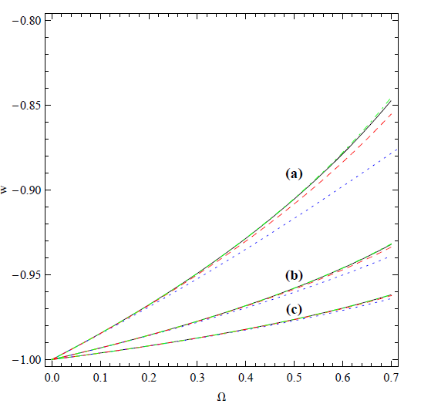
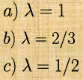
Boundary condition :
The solution:
Solid is for approximate result dot-dashed, dashed, dotted for V(φ) = φ−3 , φ−2 , φ−1

Slide 18

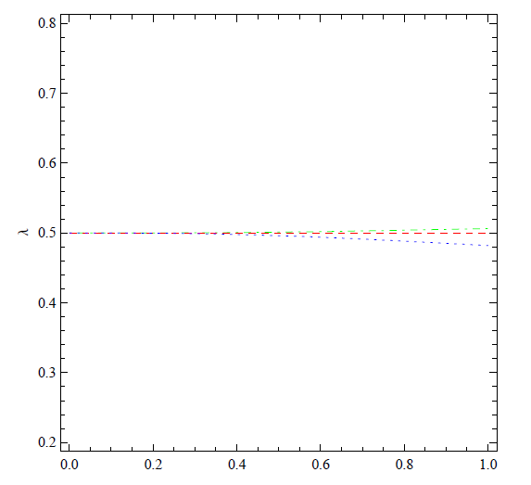


We can quantify our second assumption that the slope of the potential does not change appreciably during the evolution as λ′/λ<< 1. Noting that γ ∼ λ^2 and also γ << 1, One can write using the equation of λ′ together with first slow roll condition:
this ensures the second slow-roll condition to be satisfied.

Slide 19

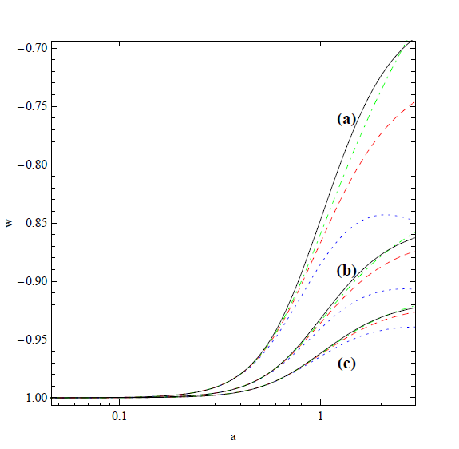
Solid is for approximate result dot-dashed, dashed, dotted for V(φ) = φ−3 , φ−2 , φ−1

Slide 20

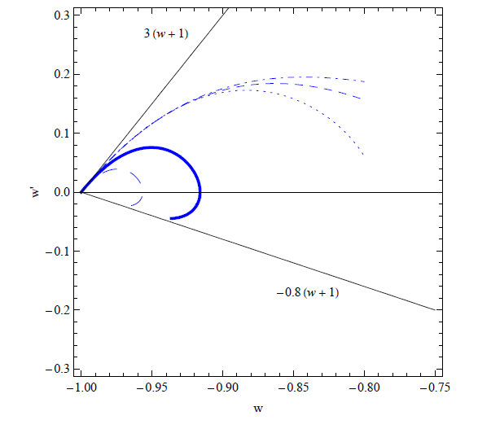
Limits of thawing Tachyon
Similar to the case of thawing quintessence, tachyon models are restricted to a part of the w′ − w plane. To specify the limits, let us define a
parameter X
Since the Hubble parameter is determined by matter dominated regime in the beginning of evolution, we find that X = −3/2w
upper limit, w′ < 3(1 + w).
The lower bound on w′ is estimated numerically (demanding that at present
<= 0.8) as, w′ > −.8(1 + w) giving rise to the permissible region of w′-w plane
− 0.8(1 + w) < w′ < 3(1 + w).

Slide 21
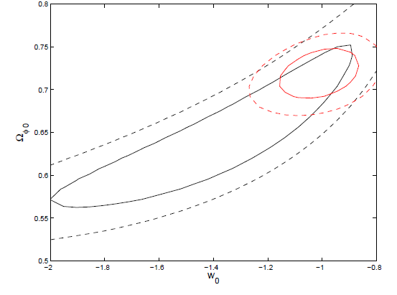
Observational constrains
one can not distinguish cosmological constant with a thawing dark energy models with present data although the phantom dark energy models
are preferred.
A.Ali, MS, A. A.Sen ,Phys.Rev.D79:123501,2009

Slide 22
Problems of Scalar Fields:
For a priori given cosmic history, it is always possible to construct a
field potential such that it gives rise to the desired result. Thus the
scalar field models should be judged by their generic features.
does not solve cosmological constant problem
Scalar field has no predictable power
Interesting:
Motivated by some fundamental theory
Have some generic features like trackers
Explain “ w” around -1
Needed to explain the dynamics of dark energy

Slide 23

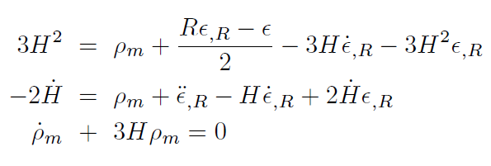


f(R) theories of gravity
The large scale modification of gravity can account for the current acceleration of the universe
One could seek a modification of Einstein gravity by
R f(R)
f(R)= R+ є(R)
In FRW background :

Slide 24





Viable f(R) Model
The Stability of f(R) theory is ensured provided that:
Geff >0
Avoid tachyonic instability
A .
Model 1
B.
C.
Model 2
D.

Slide 25
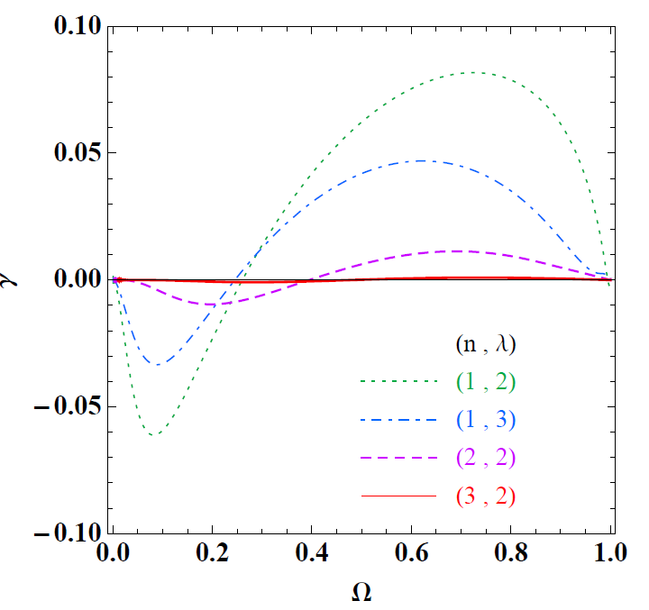
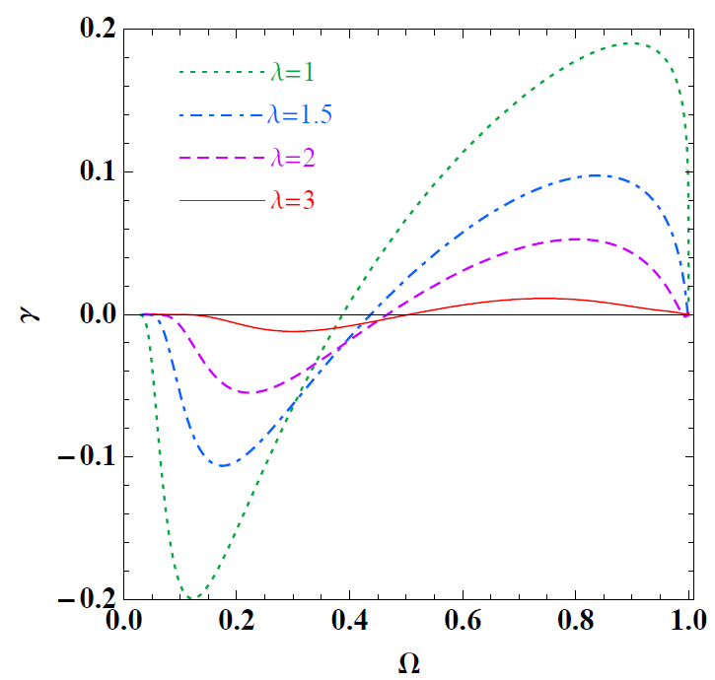
Late Time Evolution:
Assume initially:
Models are close to ΛCDM
Ω is negligibly small
Model 1
Model 2

Slide 26


Statefinder Analysis
Given the rapidly improving quality of observational
data and also the abundance of different theoretical models
of dark energy, the need of the hour clearly is a robust
and sensitive statistic which can succeed in differentiating
cosmological models with various kinds of dark energy both from each other and, even more importantly, from an exact cosmological constant
Sahni et al. (2003).
astro-ph/0201498]
geometric quantities
The statefinder probes the expansion dynamics of the universe through higher derivatives of the expansion factor a
Important Property :
{r, s} = {1, 0} is a fixed point for
the flat LCDM FRW cosmological model

Slide 27
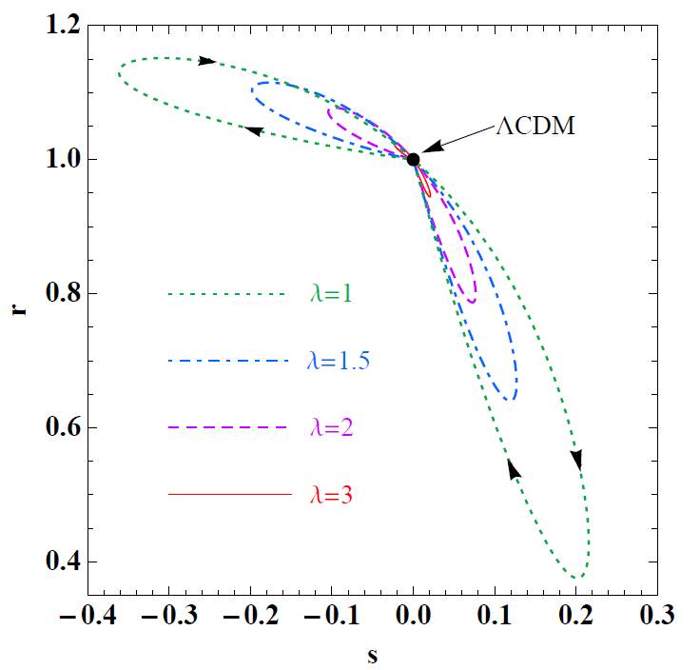
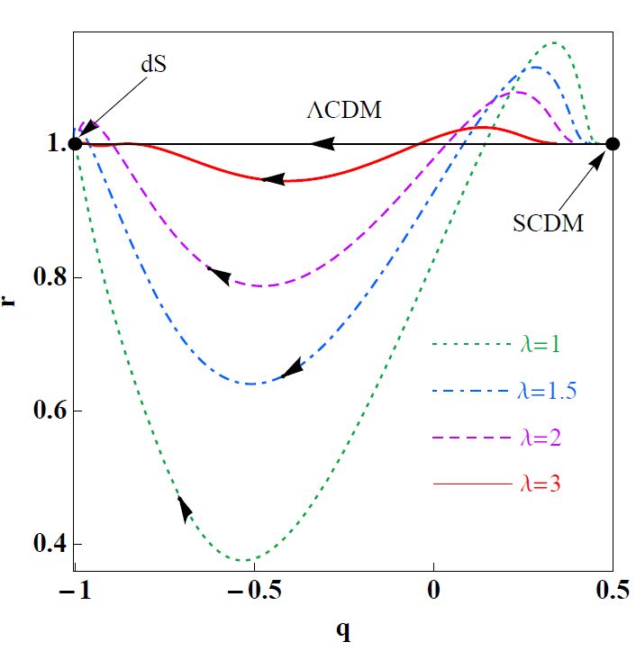
Statefinder Analysis contd…
The models under consideration are close to the CDM model in the past. The system crosses the phantom line and enters the quintessence phase in late times

Slide 28
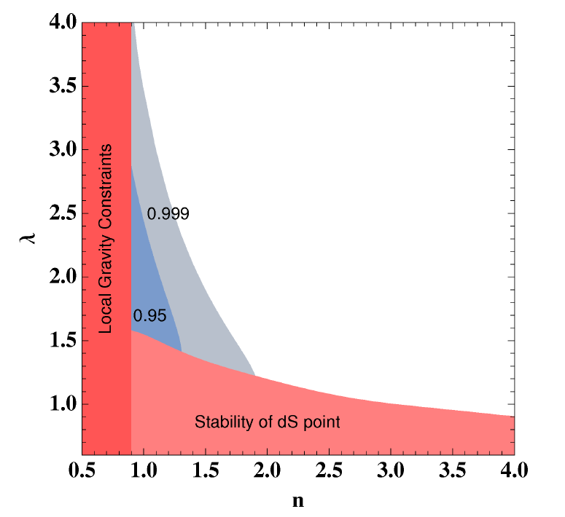
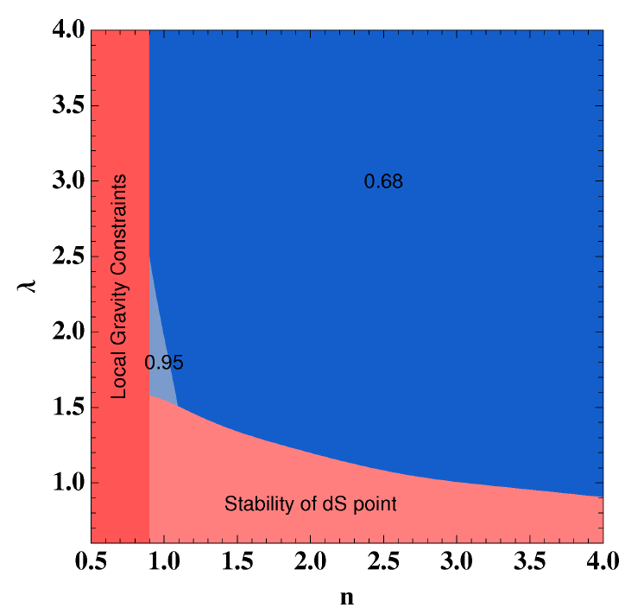


Observational Constrains
Model 1

Slide 29
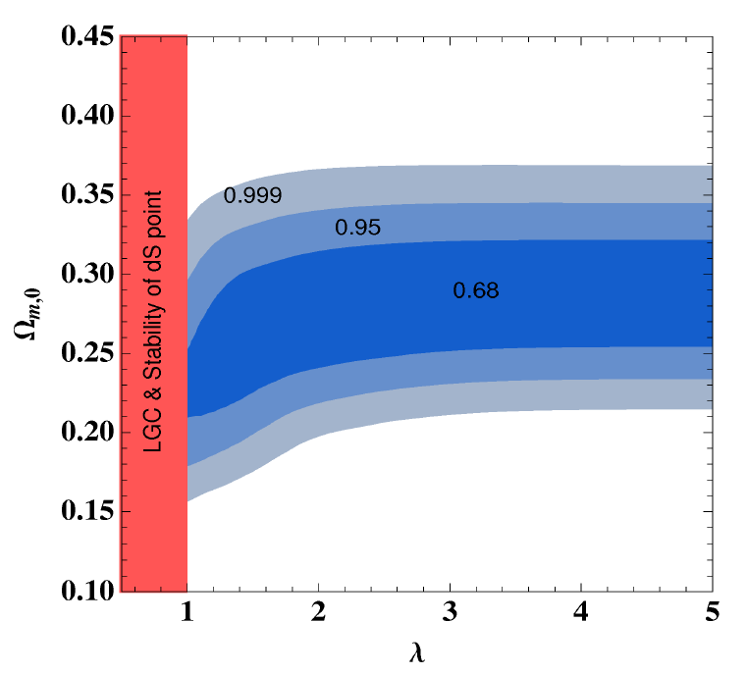
Model 2
A. Ali, R. Gannouji, M. Sami, A. A. Sen
Phys.Rev.D81:104029,2010

Slide 30

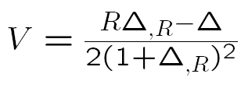
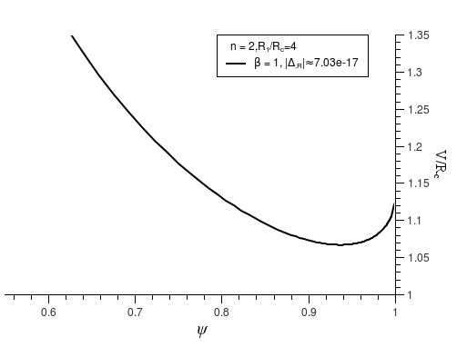
Problems of f(R)
Scalaron Mass:
For n>1
Curvature Singularity:
A.V. Frolov,
Phys.Rev.Lett.101:061103,2008

Slide 31
MODIFIED GRAVITY– a la Galileon
the large scale modification of gravity arises due to the nonlinear derivative self interaction of a scalar field
The effect of extra dimension is suppressed using the Vainshtein mechanism
Which allows us to recover general relativity small scales due to non linear
interaction .

Slide 32
De-Sitter Solutions
A. Nicolis,R. Rattazi, E. Trincherini, hep-th/0811.2197
The Galileon gravity can give rise to late time acceleration and are interesting
for the following reason:
It is free from negative energy instabilities
Unlike f(R) theories , galileon modified gravity does not suffer from curvature
singularity
The chameleon mechanism of f(R) gravity might come in to conflict with
equivalence principle whereas Vainshtein mechanism is free from such
problem

Slide 33
COSMOLOGICAL DYNAMICS- Background evolution
Self accelerating solution
Radouane Gannouji, M. Sami
Phys. Rev.D 82,024011,2010
Therefore there are two de Sitter solutions for this model, namely the positive
branch and the negative branch

Slide 34
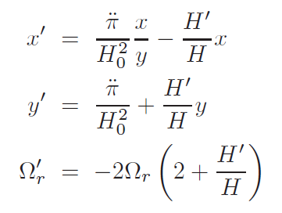


Stability:
It is straightforward to show that
Considering the stability of the theory, negative branch is ruled out
Leaving us only with one self accelerating solution in the positive branch
Autonomous System

Slide 35
COSMOLOGICAL DYNAMICS-Attractor solution

Slide 36
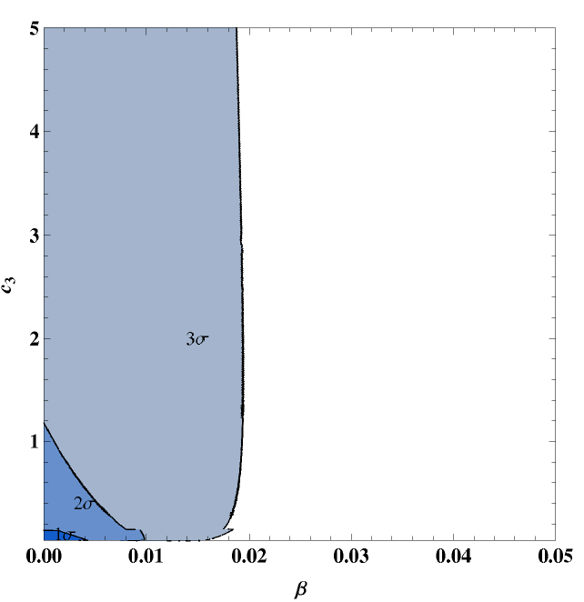
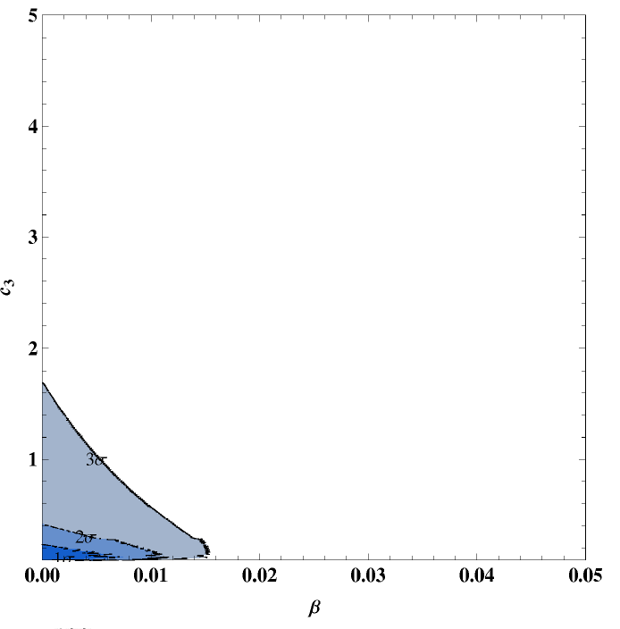
Observational Contraints:

Slide 37
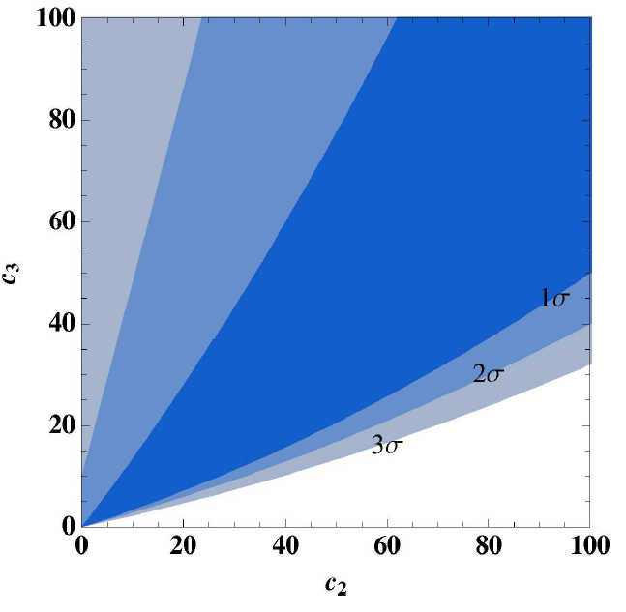
A. Ali, R. Gannouji, M. Sami
Phys.Rev.D82:103015,2010

Slide 38
Conclusion
The late time acceleration of the universe can be explained by:
Scalar fields :
Interesting alternative to cosmological constant
Mimic cosmological constant like behaviour at late times and can provide a viable cosmological dynamics at early epochs.
Scalar field models with generic features can alleviate the fine tuning and coincidence problem
It is consistent with observations but large number of scalar field is allowed by the data.
Large scale modification of gravity:
Phenomenological
Motivated by higher dimensions
The large scale modification must reconcile with local physics constraints and should have potential of being distinguished from cosmological constant.

Slide 39
Thank You

