Slide 1
Wet Mateable Optical Connector Advancements Steven Thumbeck SEACON Advanced Products April, 23 2008 VLVnT08 Workshop - Toulon
VLVnT08 - Toulon, Var, France, 22-24 April 2008

Slide 2
Wet Mate Fiber Optics - Developments
1998 | Development of 1st Generation Optical Wet-Mate Connector “HydraStar”
2002 | Development of 2nd Generation Optical Wet-Mate Connector “HydraLight”
2007 | Development of 3rd Generation Optical Wet-Mate Connector “G3”
A Total of Over 1500 Connectors Produced 1999-2008
VLVnT08 - Toulon, Var, France, 22-24 April 2008

Slide 3
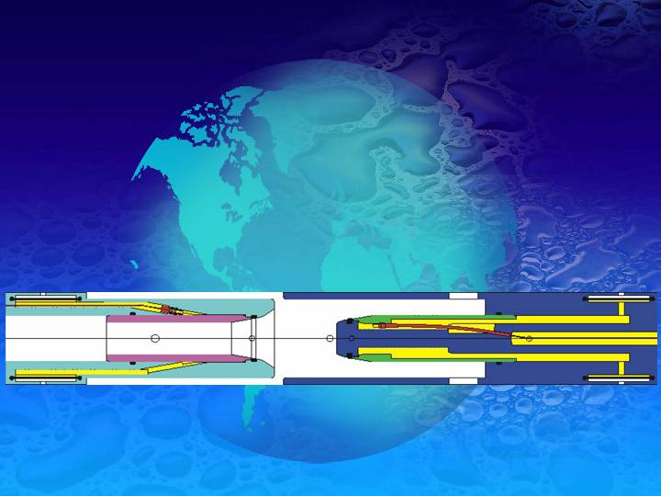
Joined Chamber WMC
“WMC Technology How They Work “
The optical fibre ferrules are housed within oil filled enclosures.
During coupling, each connector half joins together, sealing against the other before allowing the optical couplings to take place within the benign oil-filled environment.
The next series of slides demonstrate the coupling sequence of the WMC:
Receptacle
Plug
VLVnT08 - Toulon, Var, France, 22-24 April 2008

Slide 4
Basic Features
The coupling of the connectors is done in 3 stages
Physical Alignment
Joined Chambers
Optical Coupling
Plug
Flex-Tubes (red)
End Seal
Receptacle
Optical Ferrule and Split Sleeve
Sliding Sleeve (green)
End Seal
Sliding Sleeve (pink)
VLVnT08 - Toulon, Var, France, 22-24 April 2008

Slide 5
VLVnT08 - Toulon, Var, France, 22-24 April 2008

Slide 6
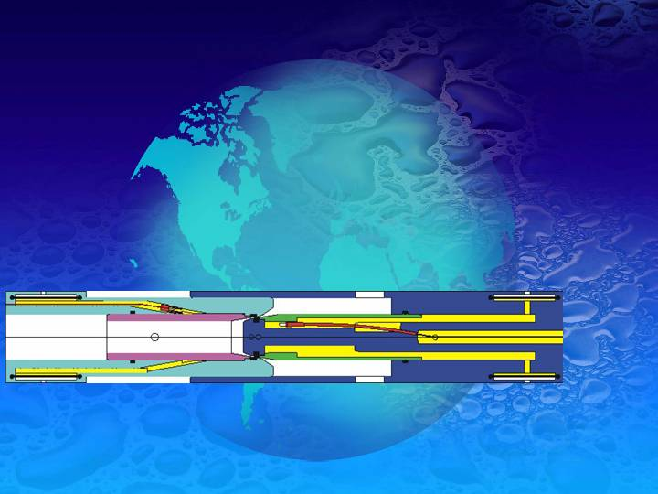
VLVnT08 - Toulon, Var, France, 22-24 April 2008

Slide 7
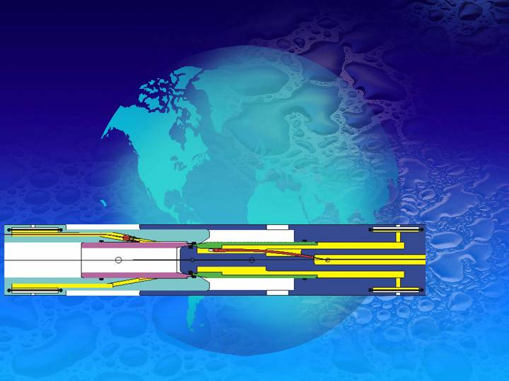
VLVnT08 - Toulon, Var, France, 22-24 April 2008

Slide 8
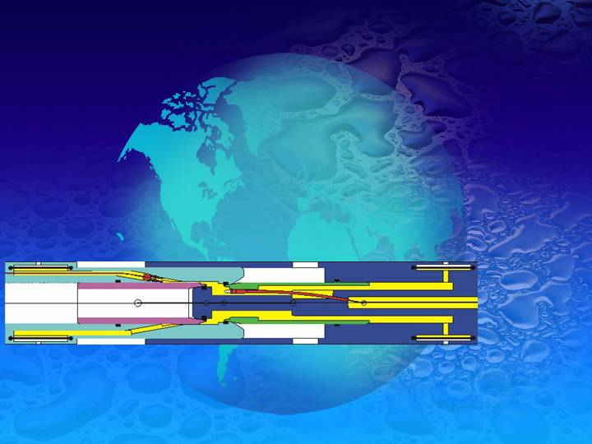
VLVnT08 - Toulon, Var, France, 22-24 April 2008

Slide 9
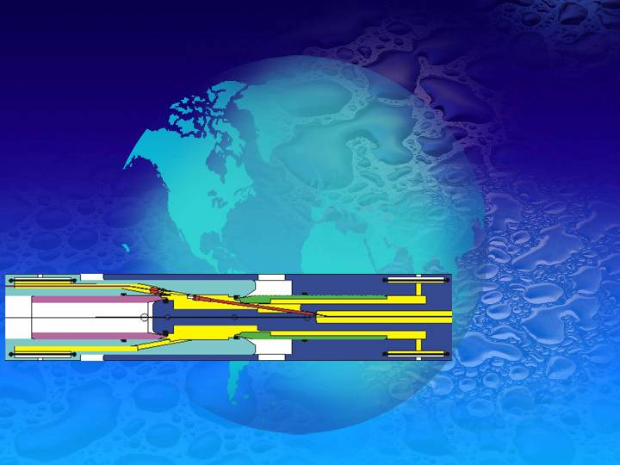
VLVnT08 - Toulon, Var, France, 22-24 April 2008

Slide 10
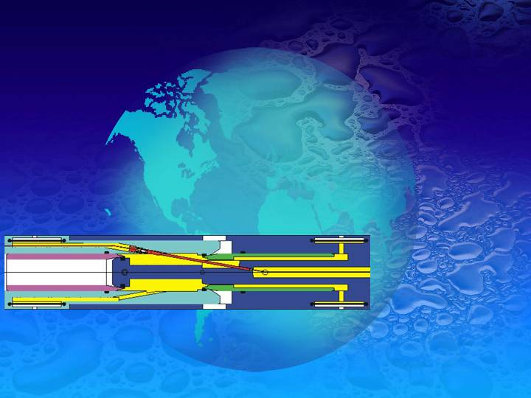
VLVnT08 - Toulon, Var, France, 22-24 April 2008

Slide 11
VLVnT08 - Toulon, Var, France, 22-24 April 2008

Slide 12
VLVnT08 - Toulon, Var, France, 22-24 April 2008

Slide 13
VLVnT08 - Toulon, Var, France, 22-24 April 2008

Slide 14
VLVnT08 - Toulon, Var, France, 22-24 April 2008

Slide 15
VLVnT08 - Toulon, Var, France, 22-24 April 2008

Slide 16
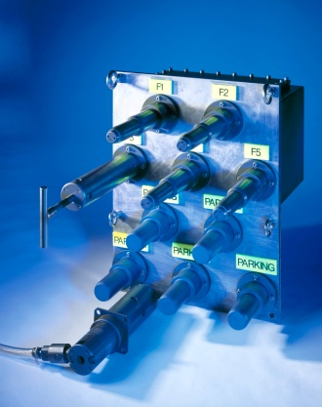
1999 | 1st Generation Optical WMC “HydraStar”
HydraStar 1998-2001
SEACON’s First Wet Mate Fibre Optic Connector On the Market
Patented By Lockheed Martin in San Diego, CA
Manufacturing and Design Controlled by SEACON
Joined Chamber Concept
Simple Operation

Slide 17
Optical Wet-Mate Connectors
HydraStar 1998-2001
1st-Generation, 8-channel, Hybrid, high-integrity, deepwater connector
Subsea Deployment Experienced Gained
Experienced IR problems w/combined Electrical and FO Circuits
Manufacturing Issues with Machined Component Tolerances Resulted in a Jammed Sliding Sleeve during Antares Component Qual. Testing
Refinement of Manufacturing Design Needed and Completed
No other Problems Since Jammed Sliding Sleeve was Corrected
Still being produced for Optic Only Applications (Navy Applications)
Over 120 HydraStar Optic Wet Mate Connectors Sent Subsea
VLVnT08 - Toulon, Var, France, 22-24 April 2008

Slide 18
Optical Wet-Mate Connectors
HydraStar 1998-2001
Major Deployments:
1998 – 12 WMC for Production Control – KOS Unknown swd
2000 – 15 WMC for Classified – US Navy Unknown swd
2001 – 23 WMC for 3C4D Seismic – Oyo Geospace 600m swd
2001 – 11 WMC for O&G Communications ABB 350m swd
2001 – 6 WMC for Burullus West Delta Egypt, KOP 850m swd
All connectors deployed and In operation.
VLVnT08 - Toulon, Var, France, 22-24 April 2008

Slide 19
2002 | 2nd Generation Optical WMC Connector “HydraLight”
Development Considerations
Fundamental Decision Made by Oil Majors to Separate Fibre and Electric Lines
Only Optical Circuits in Connector
Significant evaluation of Mechanical Components for Robustness of Operation
Consultation with Major Users for Refinements and Integration Considerations

Slide 20
2002 | 2nd Generation Optical WMC Connector “HydraLight”
Robust Shell Design and ROV Handle for ROV Operations
Positive Latching System
Protected, Replaceable, Fluorosilicone Main Seals

Slide 21
Optical Wet-Mate Connectors
HydraLight
2nd-Generation, 8-channel, high-integrity, deepwater connector
Extensively qualified, field-proven, very reliable
Over 1350 connectors supplied to customers
Accumulated operating time of over 16 million hours
Optical performance:
Insertion Loss: Average of -0.2dB
Back-Reflection: Average of –50dB

Slide 22
Optical Wet-Mate Connectors
HydraLight – 2nd Generation Enhancement Program
Mechanically robust.
“Scoop proof” Protected End Seals.
Matched Pairs not required to Maintain performance within Specification.
Main seal ‘wipes over and past’ to remove Debris.
Matched Oil Volume - no flow of oil from one connector to the other.
Full pressure-rated isolation penetrator, Connector to Hose.
Internal and External, 100% corrosion resistant materials, fully seawater compatible for operation and anti-corrosion.
Elastomers are selected and qualified to be highly resilient to many harsh chemicals.
VLVnT08 - Toulon, Var, France, 22-24 April 2008

Slide 23
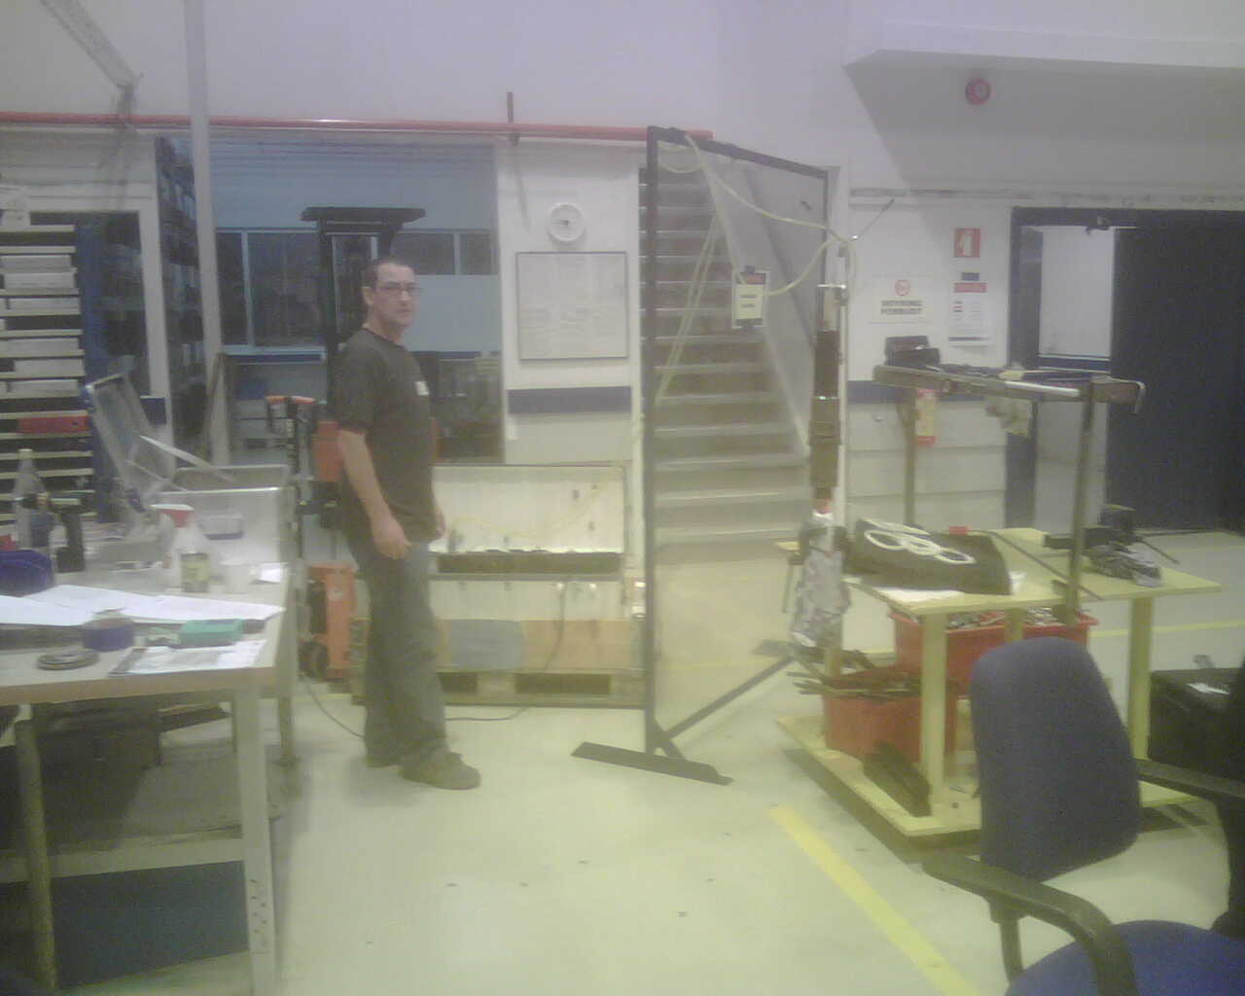
Oil Fill & Vent System
WMC Field Maintenance
VLVnT08 - Toulon, Var, France, 22-24 April 2008

Slide 24
Optical Wet-Mate Connectors
HydraLight 2002-2008
Major Deployments:
2002(04) – 64 WMC for Fram Vest – FMC 2,000m swd
2004(05) – 146 WMC for Ormen Lange – FMC 2,000m swd
2006 – 27 WMC for Tordis IOR – FMC 3,000m swd
2006(7) – 189 WMC for Tyrihans FMC 285m swd
2006(7) -151 WMC for OilExco / Framo
Over 1,350 Connectors Delivered
900 Units In-Service – Zero Subsea Failures
VLVnT08 - Toulon, Var, France, 22-24 April 2008

Slide 25
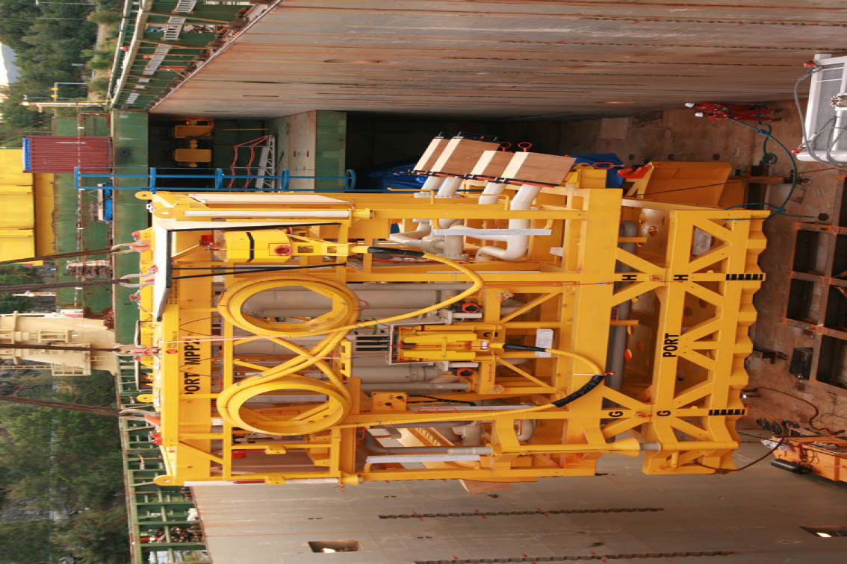
TORDIS IOR Optical WMC(S)
Vincent Optical WMC(S) for Main
Cable Termination
FRAMO PUMPING SYSTEMS

Slide 26
With Over 40 Years of Connector Development We have Learned that: Having a Design is the First Step of many to Having a successful working Subsea Connector A Typical Connector Development Project from Concept Phase to Deployment will consist of: 1. Funding 2. Industry Partnership(s) 3. Development of Operation Specification 4. Design Modeling 5. Prototype Manufacturing 6. Qualification Testing 7. Manufacturing Tooling 8. Manufacturing Procedures, Laboratory Configuration for Mass Production 9. Process Repeatability – Build it many times over in a production environment 10. A successful Field History Average Wet Mate Connector Development Program Costs 1M€
VLVnT08 - Toulon, Var, France, 22-24 April 2008

Slide 27
Typical Wet Mate Optical Performance Specification
Description | Parameter
Design Life | 25 years if correctly maintained and used within the rated number of mate/de-mate cycles.
Optical Performance – Single Mode
Insertion Loss (IL) 1310nm & 1550nm | Better than -0.50 dB (Average –0.12dB)
Back Reflection (BR) 1310nm & 1550nm | Better than –40.0dB (Average –50.0dB)
Pressure Rating
Operational Depth | 7,000m (23,000 feet)
Header Differential Pressure Rating / Test | 230 Bar (3,333psi) / 345 Bar (5,000psi)
Temperature Rating
Operating | -5ºC to +45ºC (23ºF to +113ºF)
Storage | -40ºC to +60ºC (-40ºF to +140ºF)
Mate / De-Mate
Minimum Number Mate/De-Mate Cycles |  | 100
Maximum Mate / De-Mate Speed |  | 0.3 meters per second (12 inches/second) [Qualified for 0.6m/s (24 inches per second)]
Latch |  | Linear Mate/De-Mate, positive visual indication
Maximum mate/de-mate force |  | M 622N (140 lbs). D 222N (50lbs). Mating/De-mating forces are also dependent on misalignment and excessive build of sand and silt sediments.
Mate / De-Mate
Typical mate stroke length |  | 121mm (4.8 inches)
Maximum Rotational / Angular / Radial misalignment |  | Rotational 10º / Angular 5º / Radial 6.4mm (0.25inches)
Maximum applied mating force |  | 5000 N (1124 lbs.)
Chemical Compatibility
Materials and components within the HydraLight are compatible with the following fluids: |  | Dow Corning DC200 Silicon Oil, Mineral Oil, Diesel, Castrol Brayco Micronic 864HT200 synthetic base hydraulic fluid, Marsten Bentley HW443 water based hydraulic fluid, Glycol, 50% Citric acid, 50% Acetic acid, Xylene, Methanol, Mono Ethylene Glycol (MEG), Water, Seawater

Slide 28
Typical Qualification Testing Program
Description
Optical Attenuation
Optical Cross talk
Optical Back Reflection
Helium Leak Test (24 hour)
Maximum misalignment
Locking Device
Mating Forces
Turbid Tank Tests
Turbid Tank Partial Mating Test
Post Turbid Tank Connector Inspection
Hose Header Pressure Tests
Long-Term Hose Header Tests
Thermal Shock
Mechanical Shock
Vibration
Optical Performance Longevity
ROV Force Test
Sliding sleeve integrity
Sliding sleeve tolerance to misalignment
Flex-Tube Bending Capabilities
Mate/De-Mate Speed Tests
Turbid Sand, Silt Tests Extended
Helium Integrity Testing
Vacuum Integrity Testing
Compensation-Oil Loss / Water-Ingress Testing
Cold Mate/De-Mate
Cold Mate/De-Mate at 10,000psi (690bar)
Oil Selection & Qualification
Oil Cleanliness
Elastomer Compatibility
Epoxy Bonding

Slide 29
Typical Testing
18 month Qualification Test Programs
Optical Performance
Optical Attenuation
Optical Cross-Talk
Optical Back Reflection
Optical Performance Longevity
Environmental Testing
Thermal Shock Test
Mechanical Shock Test
Vibration
Mechanical Tests
Locking Device
ROV Force Test
Mating Forces
Mate/De-Mate Speeds
Maximum Misalignment
Sliding Sleeve Tolerance to Misalignment
Sliding Sleeve Integrity
Flex-Tube Bending Capabilities
VLVnT08 - Toulon, Var, France, 22-24 April 2008

Slide 30
TyPICAL Testing
18 month Qualification Test Programs
Turbid Sand & Silt Testing
Cold 0°C and 4.5°C
Horizontal connectors
Vertical connectors
40 degree connectors
690 bar
Optical performance longevity
Partial mate-de-mate
Pressure Testing
690 bar testing
Cold mate/de-mate
Turbid sand & silt
Header Testing
Flooded connector back-end
Long-term flooded connector
back-end
VLVnT08 - Toulon, Var, France, 22-24 April 2008

Slide 31
Mate and Demate Rig for Performing operating test 690bar
Mate and Demate In Turbid Environment
Environmental Stress Screening:
Shake and Vibration

Slide 32
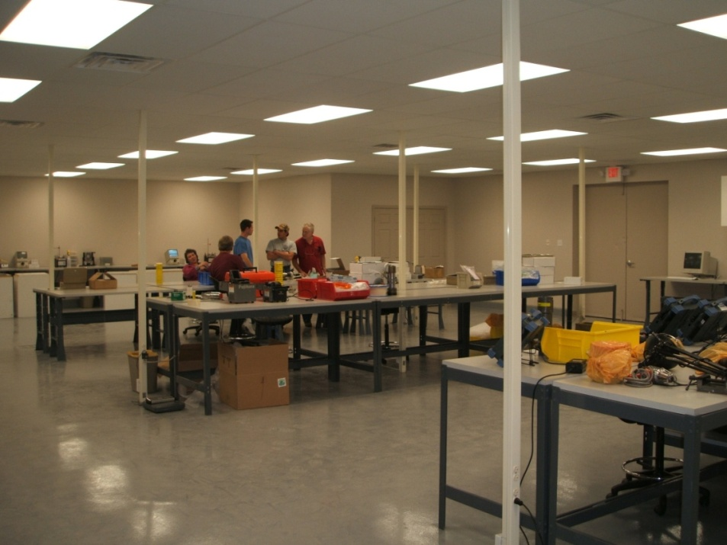
Specialized Manufacturing facilities
For Connector Production
Fiber-Optic Laboratory
Helium Leak Testing
Component Cleaning

Slide 33
Typical Wet Mate Development schedule:
Year | 2006 |  |  | 2007 |  |  |  |  |  |  |  |  |  |  |  | 2008
Task | O | N | D | J | F | M | A | M | J | J | A | S | O | N | D | J | F | M
Program Definition
Component Validation Testing
Material Compatibility
Detailed Design & Validation Testing
Prototype Manufacture
Prototype Testing
Qualification Testing
VLVnT08 - Toulon, Var, France, 22-24 April 2008

Slide 34
2007 | New 3rd Generation Optical WMC “G3”
Looking to the Future
Lower Cost, Much Smaller
Many Channels in a Dense Package
Plug - Diameter 1.5” X 0.875” 8”
Recep. -Diameter 1.5” X 0.875” 12”
6 Channels
Combination of single- and/or multi-mode optical fibers
Optical
Better than 0.5dB insertion loss
-45 dB SM back reflection
-35 dB MM back reflection

Slide 35
Product selection should be based on:
Vendor quality
Manufacturing Workmanship
Product Cost
Availability
Application and System Engineering Support
and
6. Value of Maintaining Legacy Interfaces
VLVnT08 - Toulon, Var, France, 22-24 April 2008

Slide 36
Thank You!
Steven Thumbeck
SEACON Advanced Products
steven.thumbeck@seacon-ap.com
VLVnT08 - Toulon, Var, France, 22-24 April 2008

