Slide 1
Virgo commercial seismic sensors and examples of their use
Irene Fiori for the Virgo collaboration and EGO

Slide 2
Virgo aerial view
North
Terminal
building
West
Terminal
building
Mode Cleaner
building
Central
building

Slide 3
Environmental sensors map, Central Bd.
By INFN Napoli – Barone, R. De-Rosa, F.Garufi, L.Milano
Network of probes,
Permanent and continuously running
Syncronized with Virgo clock
GPS time stamped
also in MC, West, North Bd.
Temperature,
Humidity
Pressure
Weather station
Lightnings
Mains power
Seismometers
Magnetometers
Microphones
Radio frequency

Slide 4
List of sensors
SLOW sensors (sampling frequency = 1Hz)
Weather station, Vantage Pro2 by Davis (wind speed and direction, external temperature and humidity, rain)
Lightning detector, LD-250 from Boltek (strikes distance and angle up to 400km distance)
Temperature probes, AD 590 MF, 1 µA/K thermocouples, monitor buildings and in-vacuum temperature
Humidity probes, based on polymer capacitance,
Pressure probes, piezoresistive transducers, 45.9 mV/kPa
More INFO: http://wwwcascina.virgo.infn.it/EnvMon/sensors.htm

Slide 5
List of sensors
FAST sensors (sampling frequency 1kHz, 10kHz or 20kHz depending on probe)
Monitor | probe | type | Flat response range (Hz) | Conditioning | No. Of output | No. of probes
Seismic | velocimeter | Guralp CMG-40T (30s) | 0.033 to 50 Hz | custom | 3 | 1
Seismic | accelerometer | Kinemetrics Episensor FBA-ES-T | 0.1 to 100Hz | custom | 3 | 9
Vibration | accelerometer | Piezotronics 393B12 | 10Hz to 1000Hz | nexus | 1 | 11
Vibration | accelerometer | B&K – 4378 and Endevco – 7702A | 10Hz to 1000Hz | nexus | 1 | 7
Magnetic | Magnetometer | Metronix - MFS-06 | 4-10000 Hz | custom | 1 | 10
Acoustic | microphone | B&K 4190+2669 | 0.1-20000 | nexus | 1 | 9
Radio Frequency | antenna | ARA-60 | 4 to 60 MHz | mixer | 1 | 1
Mains | transformer | custom | DC-1000 Hz | custom | 1 | 20

Slide 6
Vibration sensors
HIGH FREQUENCY:
PCB-Piezotronics 393B12 , B&K – 4378, Endevco – 7702A accelerometer,
single axis, useful bandwidth 10Hz -2000Hz (sampled 10kHz)
- 18 sensors, anchored to “critical” interferometer components,
such as Vacuum tanks, pipes, external benches.

Slide 7
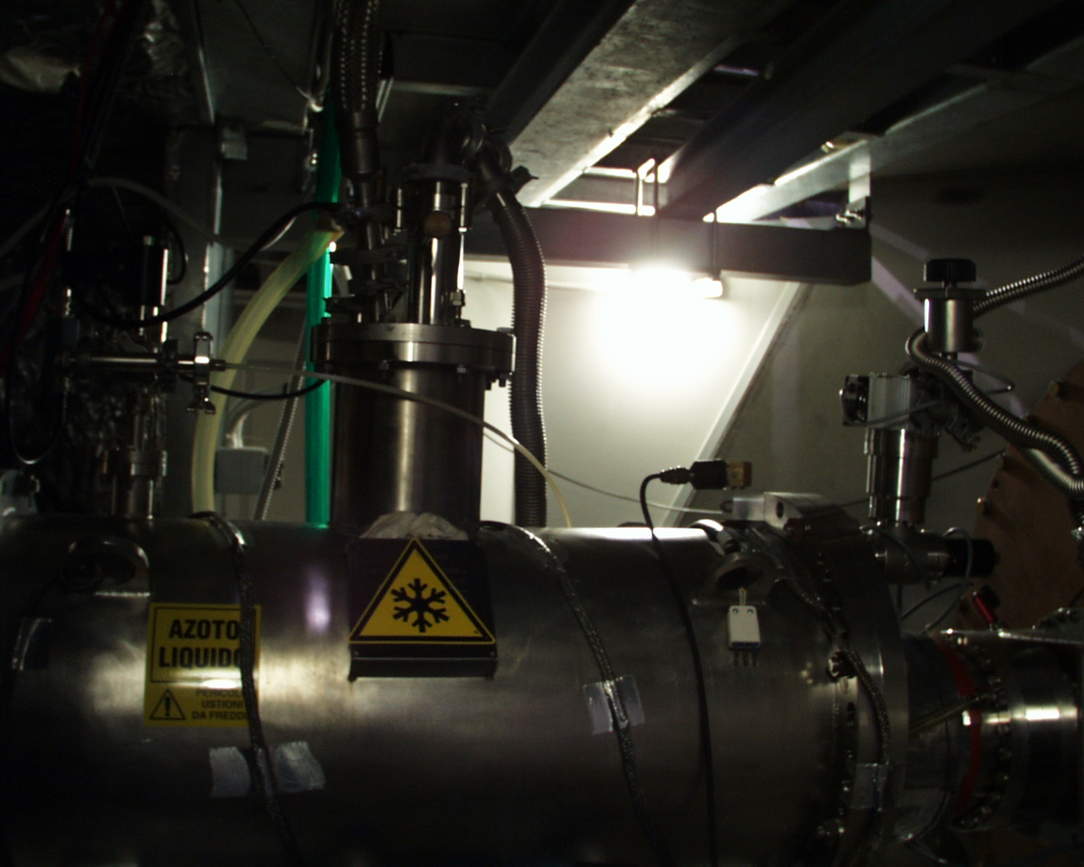
Cryogenic vacuum pump

Slide 9
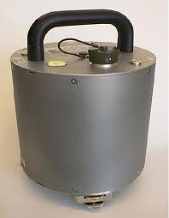
Seismic sensors
LOW FREQUENCY:
Guralp CMG-40-T, velocimeter, tri-axial, nominal
bandwidth (-3dB corner frequency) 0.033Hz to 100Hz,
1kHz sampling
1 sensor
deployed on central building concrete ground floor
>>>> Advanced Virgo plans to have 4, one per building

Slide 10
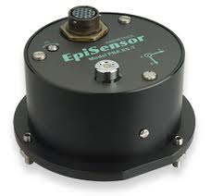
Seismic sensors
LOW FREQUENCY:
Episensor FBA-ES-T, accelerometer, tri-axial,
nominal bandwidth 0.1Hz to 100Hz , 1kHz sampling
9 sensors:
1 sensor anchored to MC building concrete ground floor
8 sensors anchored on top of external optical benches: 6 in Central Building, 1 in West terminal Building, 1 in North terminal Building
Sensors on optical benches move as Bd floor ground from DC to up to about 5Hz, above 5Hz sense bench mechanical modes

Slide 11
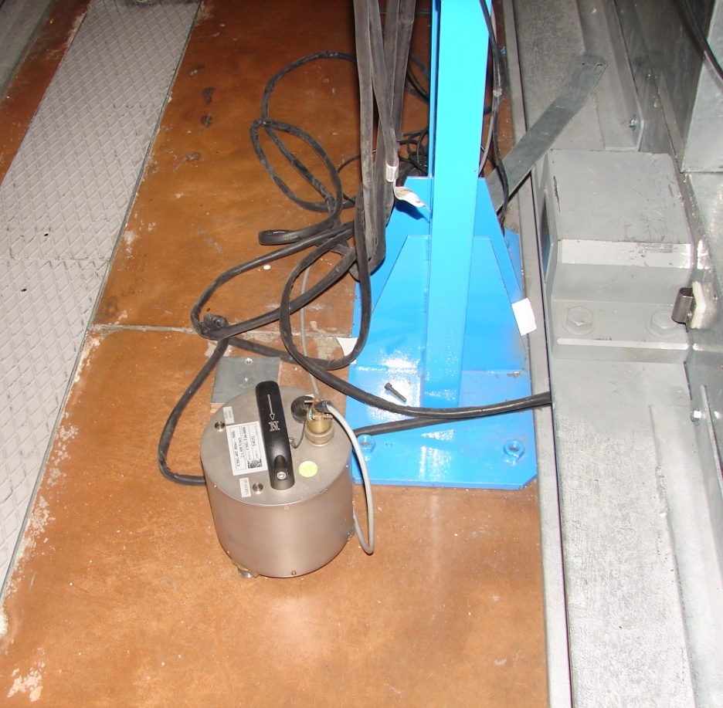
Guralp 40T-30s

Slide 12
MC

Slide 13
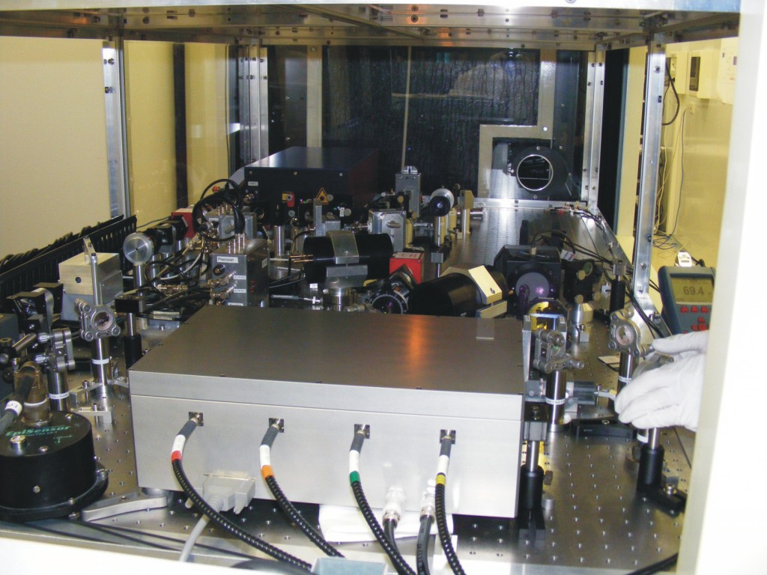
Laser bench

Slide 14
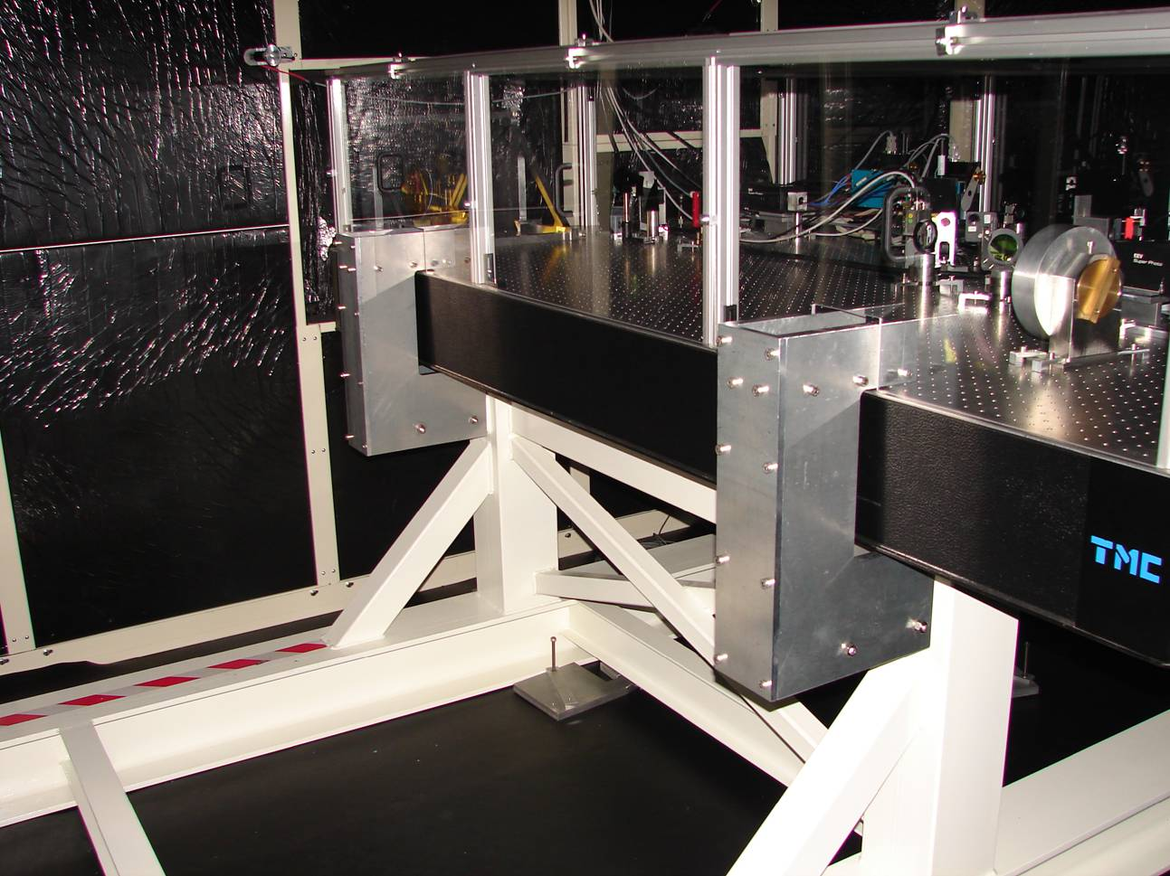
North end bench

Slide 15
Seismometers Location
ORIENTATION: same for all tri-axial sensors
Horizontal axis are oriented along Virgo interferometer arms:
“X” is along “Virgo West arm”
“Z” is along “Virgo North arm”
“Y” is VERTICAL
N
North Bd.
1 sensor (on bench)
West Bd.
1 sensor
(on bench)
≈20°
MC Bd.
(≈140m
from CB)
1 sensor (on ground)
Central Building
7 sensors (1 ground, 5 benches, 1 tower base)

Slide 16
Data acquistion and Online processing
How sensors data are acquired, processed for online GW data quality monitors, and stored:
DATA streams
PROCESSING fast information :
Coherence with GW signal
“Lines” identification
Spectrograms
Transient events detection
Sensor
ADC
“RAW”
Conditioning
Sensor powering,
signal amplification
Offset adjust
Filtering (only for
seismometers)
Custom
ADC7674,
800 kHz, 18-bit,
differential input
Filtering and
Decimation
Decimation
to 50Hz
Online monitors
PROCESSING slow information:
MAX,MIN,RMS
Band limited RMS
FLAGS of “noisy” periods
“50Hz”
DATA sterams are
stored to disk
Formatted as “frames” (*.gwf)
Matlab compatible
Online “TREND” monitors:
Environmental noise climate
Alarms on critical
environmental conditions
“dead” channels monitor
“trend”

Slide 17
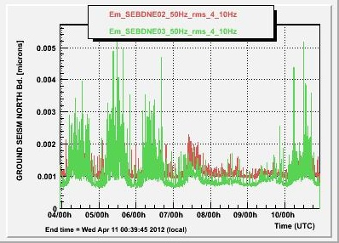
Trend Monitor, examples:
Traffic activity: band limited RMS 4Hz to 10Hz
Easter Easter
Sat. Sun. Mon.

Slide 18
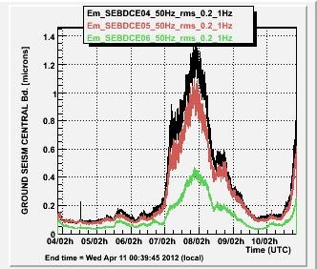
Trend Monitor, examples:
Sea activity: band limited RMS 0.2Hz to 1Hz

Slide 19
Short tour of seismic noise “hunting” at Virgo

Slide 20
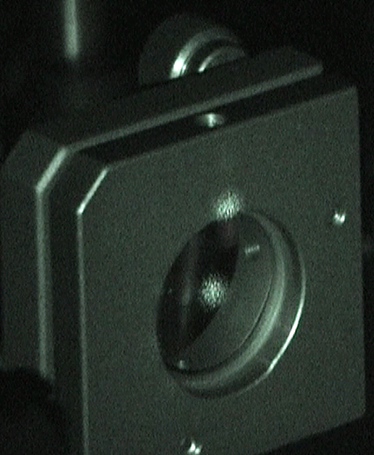
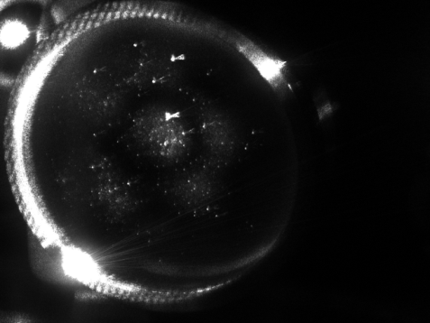
How seismic noise couples to GW signal ?
Scattered light
tiny fractions of light happen (unlucky!) to be scattered off the main beam path and inpinge on seismically excited surfaces (i.e. vacuum pipes, optics mount on external bences) and then scattered back into the main beam path. The back-scattered beam is phase modulated by the scatterer vibration and couples this noise to the GW signal.
Example, scattered light from vacuum pipe wall:
Il TUBO VIBRA, per contatto con il suolo,
oppure pressione esercitata dal suono
Similarly, we can have light scattered by the optics sitting on external
benches, which receive pick-off beams for ITF control purposes:

Slide 21
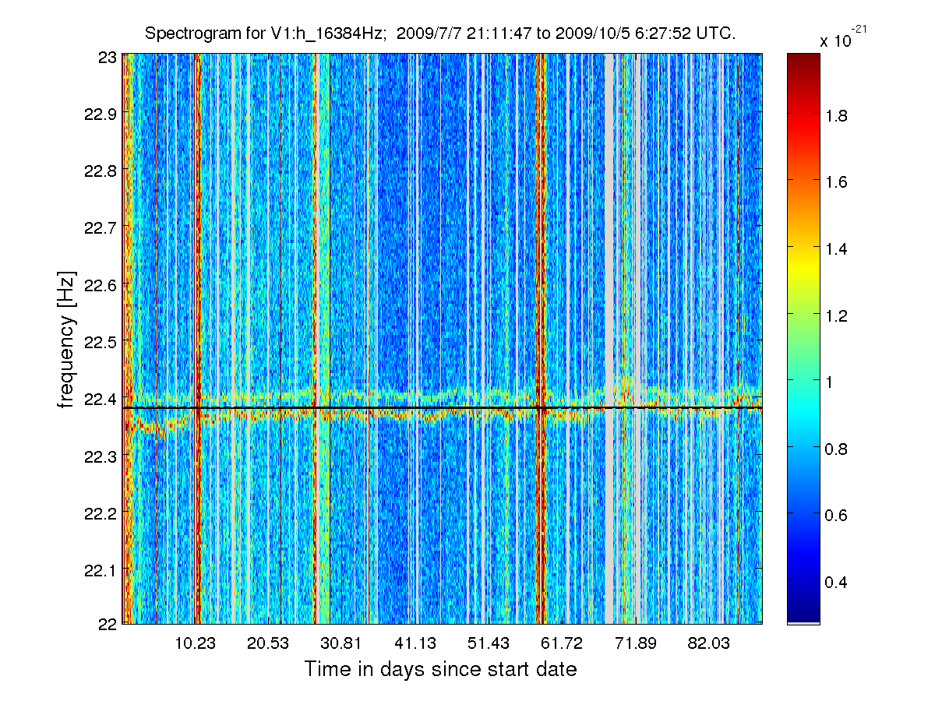
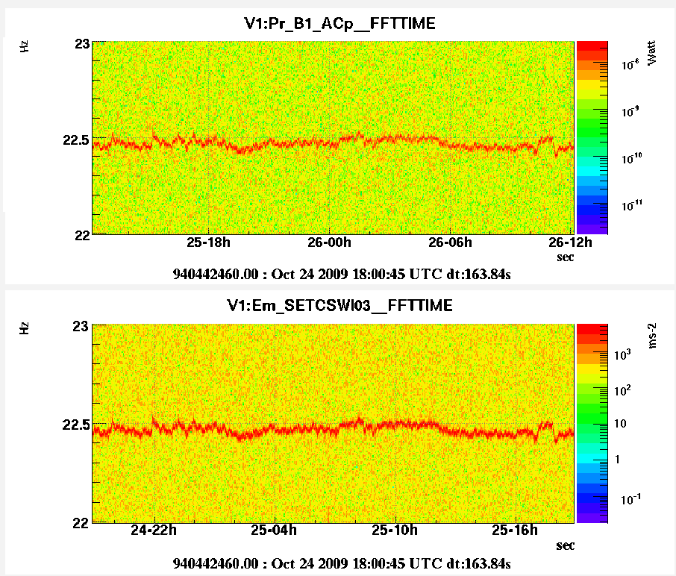
Example of periodic noise: “VELA killer”
Periodic vibrations reducing sensitivity at the GW signal from the VELA pulsar (expected at 22.38Hz)
Sources were engines of TCS laser CHILLERS, then cured.

Slide 22
Example of airco. fan vibration
Plots from the “Line monitor”
GW signal

Slide 23
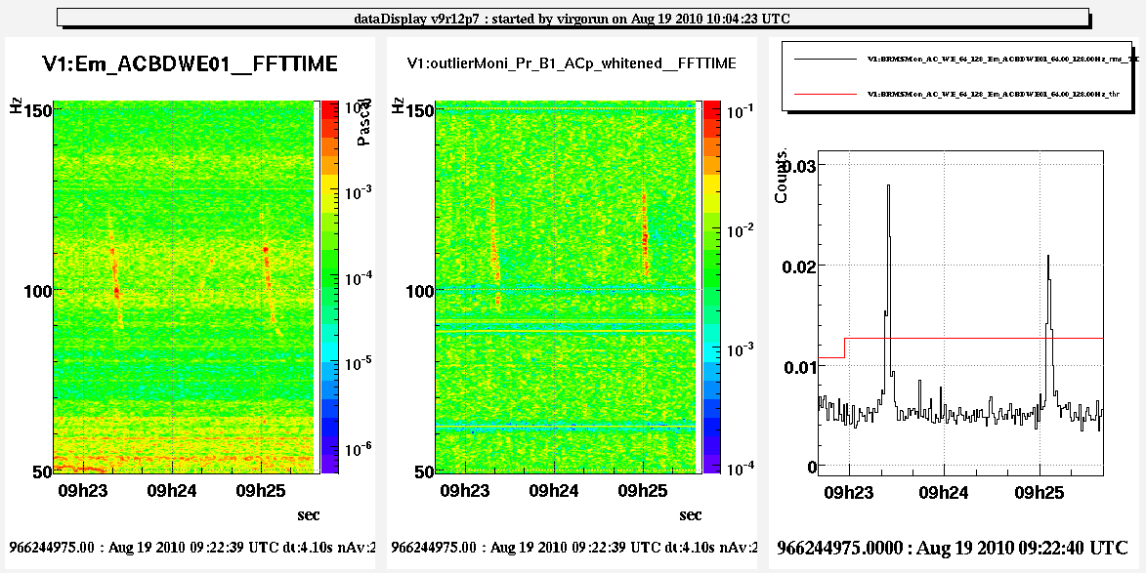
Transient noise: aircrafts
Vibration noise induced by sound pressure waves, couples as diffused light (particularly critical during VSR3 science run)

Slide 24
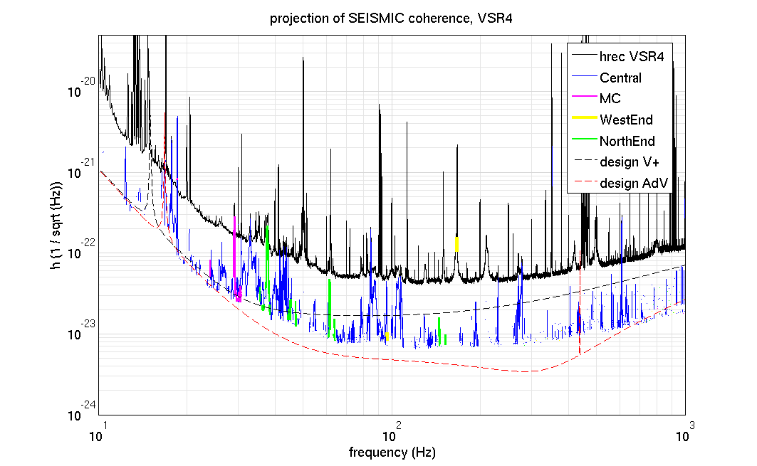
Seismic noise polluting the Virgo detection bandwidth
10-1000 Hz coherent seismic noise projected to Virgo sensitivity
Sources are close to ITF, mainly pumps, cooling fans, HVAC...
(Have plans to drastically reduce this noise in Advanced Virgo, reducing back scattered light, using in vacuum and suspended optical benches, mitigating sources)

Slide 25
And what about
low frequency (<1Hz) seismic noise?

Slide 26
Low frequency seismic noise? It is also important to us!
Back-scattered ligh coupling is non-linear, and can up-convert low frequency seismic vibrations into the Virgo detection bandwidth
Example, up-conversion of Sea microseism:
V_{sc} (t) = scatterer velocity
f _{fringe} (t) = frequency of GW noise
T. Accadia et al. Class. Quant. Grav. 27, 194011 (2010)

Slide 27
Microseismic noise “arches”
These events are identified and “FLAGGED” as “NOISY DATA” by
looking at ground seism velocity measured by seismometers (or SA Lvdt sensors)
These are excluded from GW search analyses
J. Aasi et al. Virgo data characterization
and impact on gravitational wave searches,
arXiv:1203.5613v1 2012
Hz

Slide 28
Short tour of studies on seismic sources near to EGO-Virgo site >>>>

Slide 29
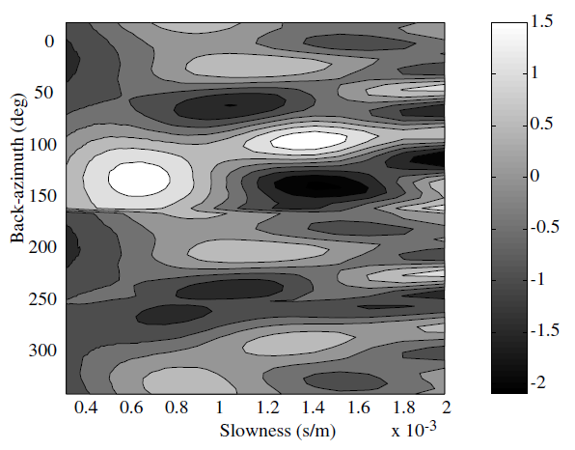
Sources: 0.1-1Hz, Sea microseism
Most intense and persistent peak at 0.3-0.4Hz, seasonally (after large swells)
it moves to 0.1-0.2 or 0.8Hz.
Peak ampitude varies from 0.5µm to 20µm
Seismic array study, measured wave velocity and propagation direction:
plane wave field from West, 700 m/s or 1600 m/s (E.Marchetti, M.Mazzoni,
Acernese F et al. Class. Quantum Grav. 21 S433 (2004))

Slide 30
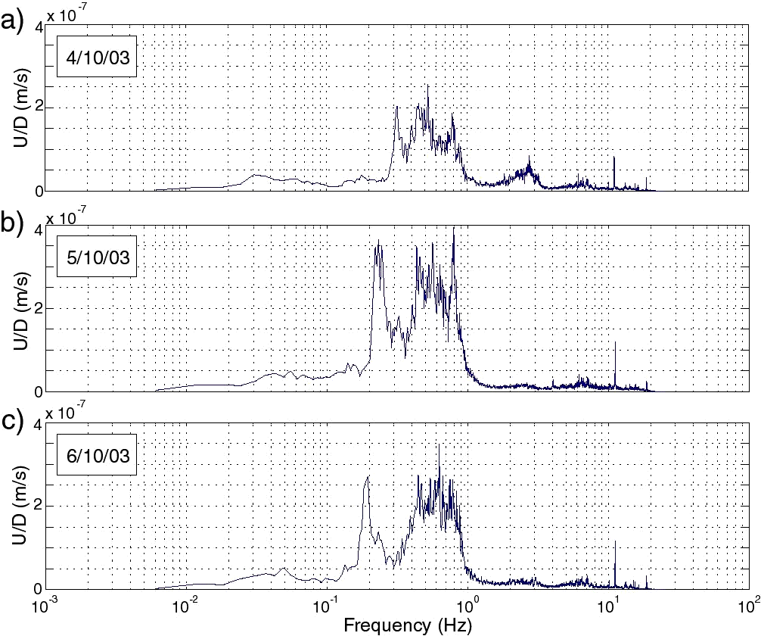
Low frequency seism evolution during a sea swell

Slide 31
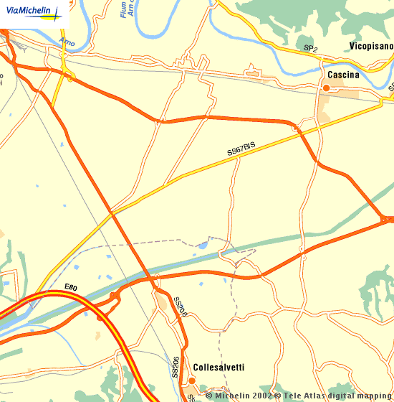
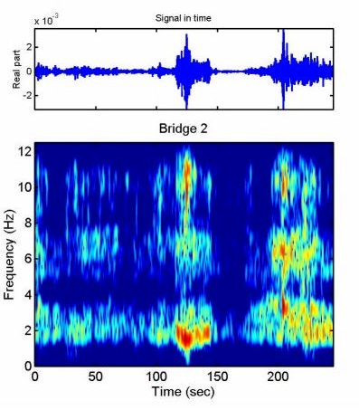
Sources: 1-10Hz bridges oscillations
Seismometer underneath bridge:
Elevated Bridges :
L.Holloway, Fiori, VIR-NOT-FIR-1390-251

Slide 32
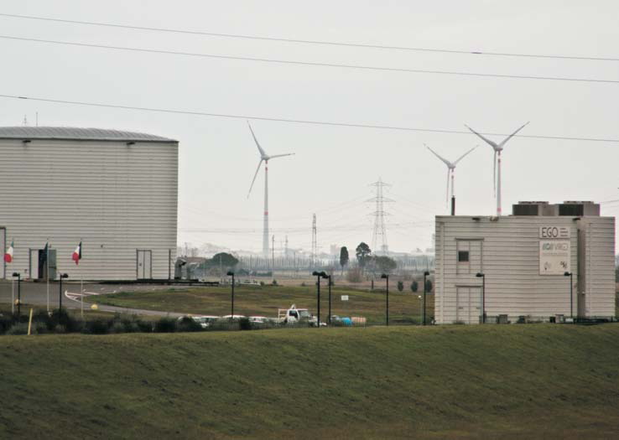
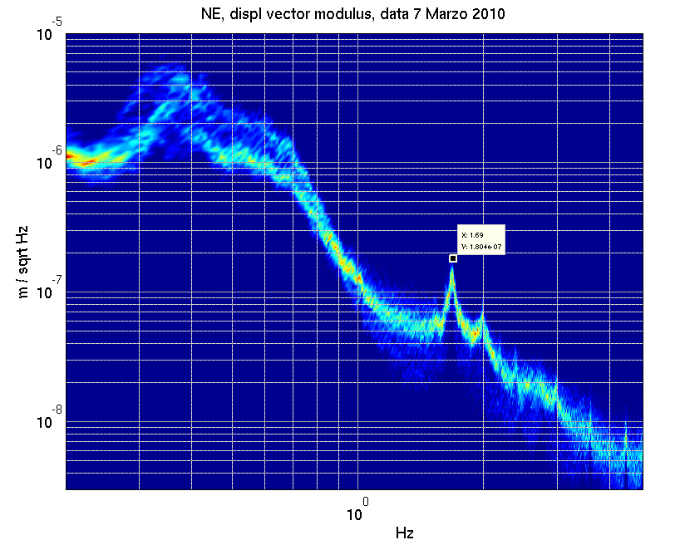
Wind turbines
1.7Hz seismic vibration from a wind farm 6km distant

Slide 33
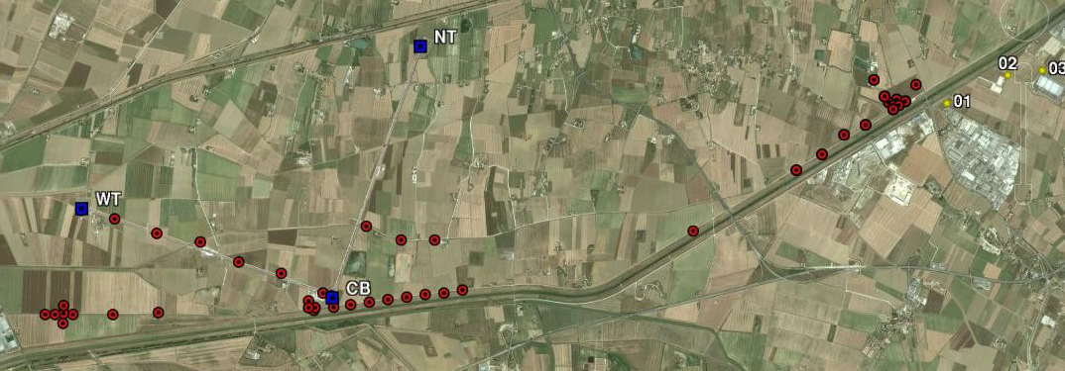
Study of wind turbines signal
By “Istituto Nazionale di Geofisica e Vulcanologia” and EGO,
( G.Saccorotti et al. BSSA, April 2011; v. 101; no. 2; p. 568-578)
14 stations, with Lennartz LE3D-5s (0.2-40Hz) or CMG-40 (0.03-50Hz) seismometers, or EpiSensor FBA ES-T (0.1-100Hz)
Some kept fixed, other arranged in temporary array configurations
Wind speed recording: atop Virgo control building,10m height

Slide 34
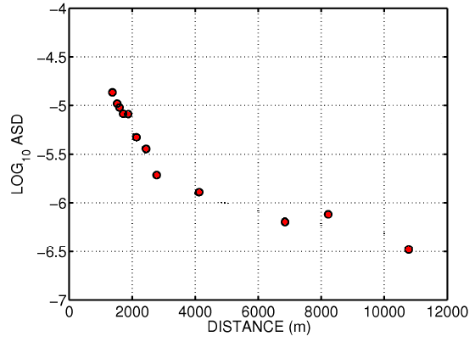
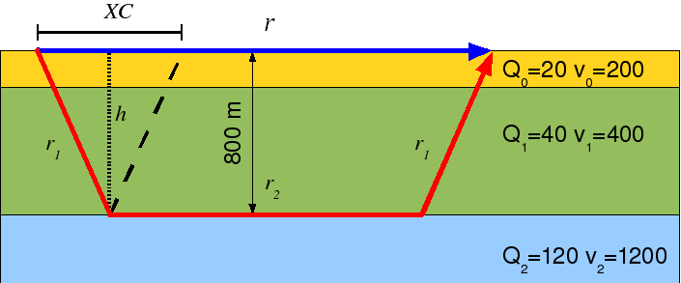
Seism propagation model
Amplitude decay of
soil velocity
at 1.7Hz
Miocene carbonate basement
Borehole studies (Cantini.P et al.
Tectonophysics, 330, 25-43)
SUM of two components:
(1) DIRECT SURFACE WAVE in the shallowest layer characterized by slow velocity and large absorption (velocity v=200m/s, and quality factor Q=20: MEASURED in this study).
(2) REFRACTED BODY WAVE, travelling through the intermediate layer and continuously refracted by the 800m deep carbonate layer interface (velocity and Q factors from litterature and data fit).
Simplifying assumptions: energy is equally parted in direct and refracted waves, velocity structure of soil is laterally homogeneous, negligible local amplification effects.

Slide 35
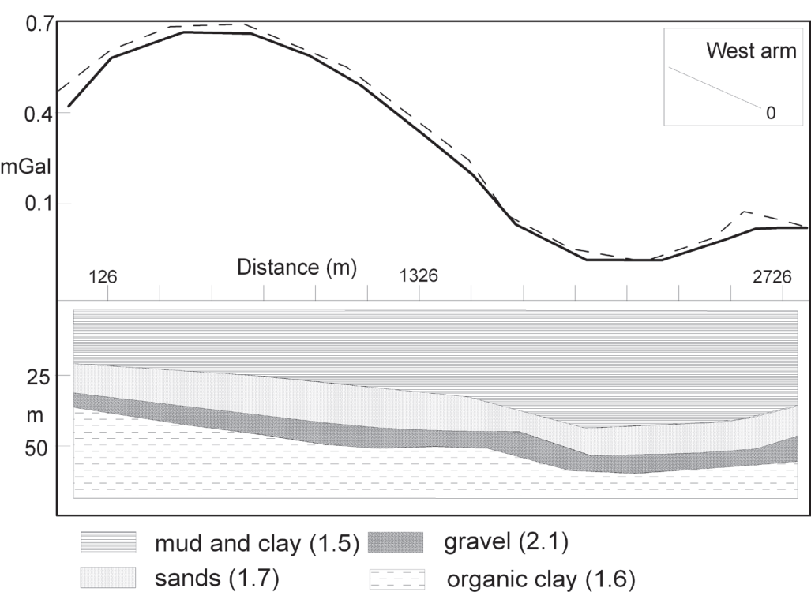
Studies on the composition of the near subsurface of VIRGO
From the gravimetric study:
Drilling soil samples along two arms (A.Paoli)

Slide 36
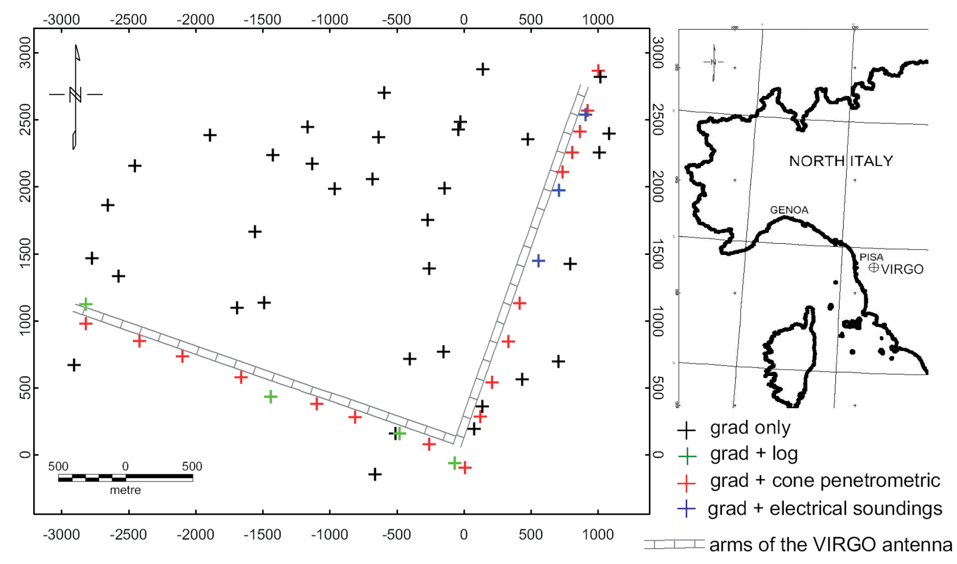
Studies on the composition of the near subsurface of VIRGO
Microgravity vertical gradient measurement in the site of VIRGO interferometric antenna (Pisa plain, Italy. P.Stefanelli (1), C.Carmisciano (1), F.Tontini (1), L.Cocchi (1), N.Beverini (2), F.Fidecaro (2) and D.Embriaco (1). ANNALS OF GEOPHYSICS, VOL. 51, N. 5/6, October/December 2008

Slide 37
Virgo site seism
Central Building floor, Guralp 40T
SHADOW = spectral noise variation density based on 1-year data
SOLID BLACK = median
PURPLE = 99% of time seism is below this curve, RED = Peterson’s Low High Noise models
Wind &
teleseisms
Sea
Bridges,
site roads
Virgo
Infrastructures

Slide 38
our Commercial sensors “versus” Super-Attenuator sensors

Slide 39
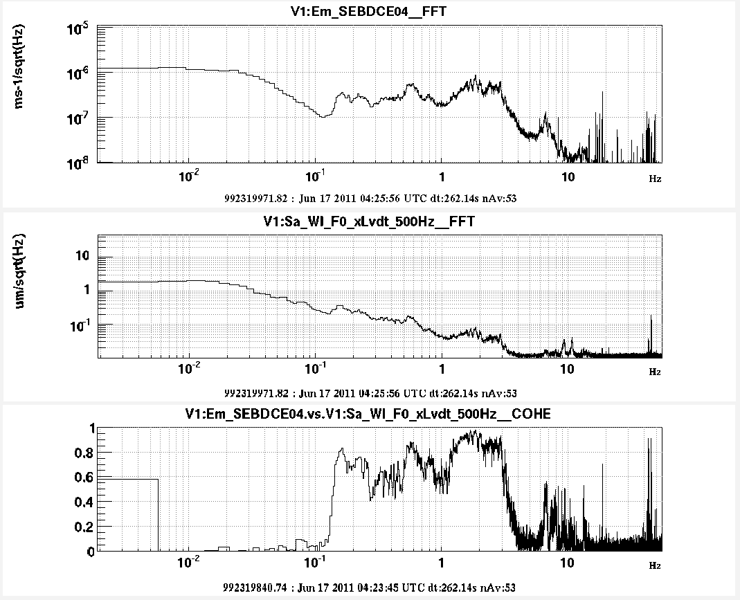
Quiet night

Slide 40
Some wind (few km/h)

Slide 41
Stronger wind (>15km/h)

Slide 42
and one Earthquake (6.2 Japan)

Slide 43
Same Earthquake, time
RED = WI super-attenuator top stage “x” and “z” sensors
BLUE= Guralp 40T sensor.

Slide 44
Same Earthquake, time zoom-in
RED = WI super-attenuator top stage “x” and “z” sensors
BLUE= Guralp 40T sensor (integrated to go from vel → displacement)
No compensation for sensors frequency response applied.

Slide 45
Same Earthquake, spectrum
RED = Super-Attenuator top stage “x” and “z” sensors (WI)
BLACK= Guralp 40T sensor.
Just simple time integration
applied to Guralp (vel -> displ).
Similar response
between 0.1 and 2 Hz
Around 0.1 Hz difference is
presumably due to
SA control loop which here is
NOT compensated.
Below ≈0.03Hz, Guralp is noisy
Above 3Hz, SA sensor is noisy

Slide 46
Episensor vs Guralp40T

Slide 47
Conclusions
Commercial sensors monitor Virgo Buildings floor.
Their major scope and use has been to correlate to GW signal for noise hunting (above ≈1 Hz).
These sensors can be trusted to measure real seism down to ≈0.1Hz, also in the quietest noise conditions .
Below 0.1Hz, teleseisms of magnitude ≥6 are sensed as well.
In this range of frequency and intensity, Virgo commencial sensors can be used together withSA sensor.

