Slide 1
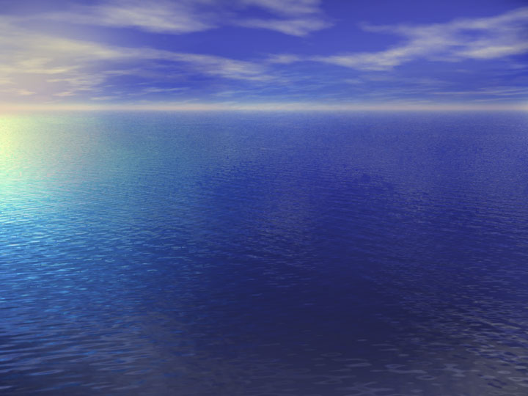
Precise measurements of global geodynamical effects by conventional instruments
(gravity meters, strainmeters) : results and unsolved problems
by Alexander Kopaev
Sternberg Astronomical Institute of Moscow State University,
119992, Moscow, Universitetski prosp., 13,
<gravity3@yandex.ru>

Slide 2
Global Geodynamical Phenomena
Earth Tides
Nutations
Polar motion
Earth rotation
Global Tectonics
Sea Level Changes

Slide 3
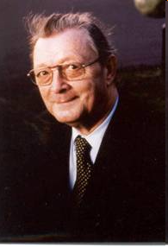
Baron Prof.
Paul Melchior
(1926-2004):
Founder of modern global geodynamics
and tidal science
“Earth Tides
represent a bridge
between Astronomy
and Geophysics”

Slide 4
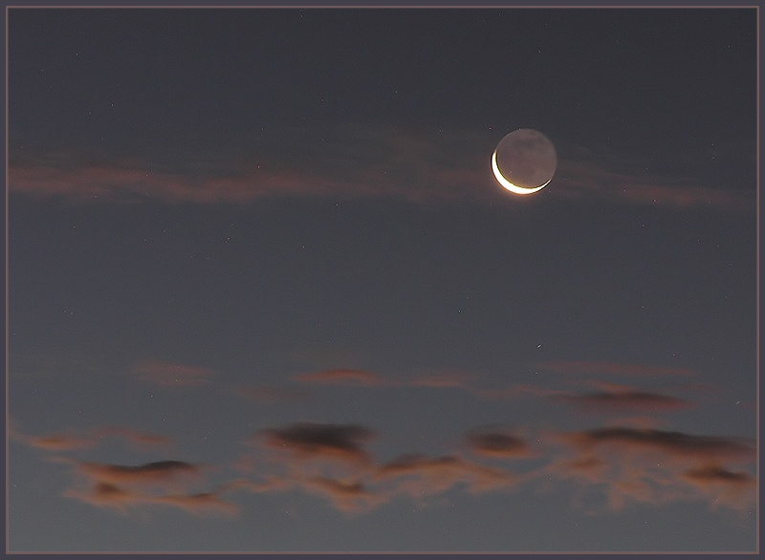
        Earth Tides

Slide 5
Earth Tides as a bridge between Astronomy and Geophysics are
forced vibrations of the Earth powered by space-time variable Luni-Solar gravitational potential
the only geodynamical phenomena where frequencies, amplitudes and phases of force are known precisely thanks to astronomy

Slide 6
For a fictitious Moon in the equator only one tidal period 12h 25m : M2
The inclination of the celestial body orbit creates a diurnal waves
Each orbital perturbation (inclination, eccentricity, …. ) produces additional waves

Slide 7
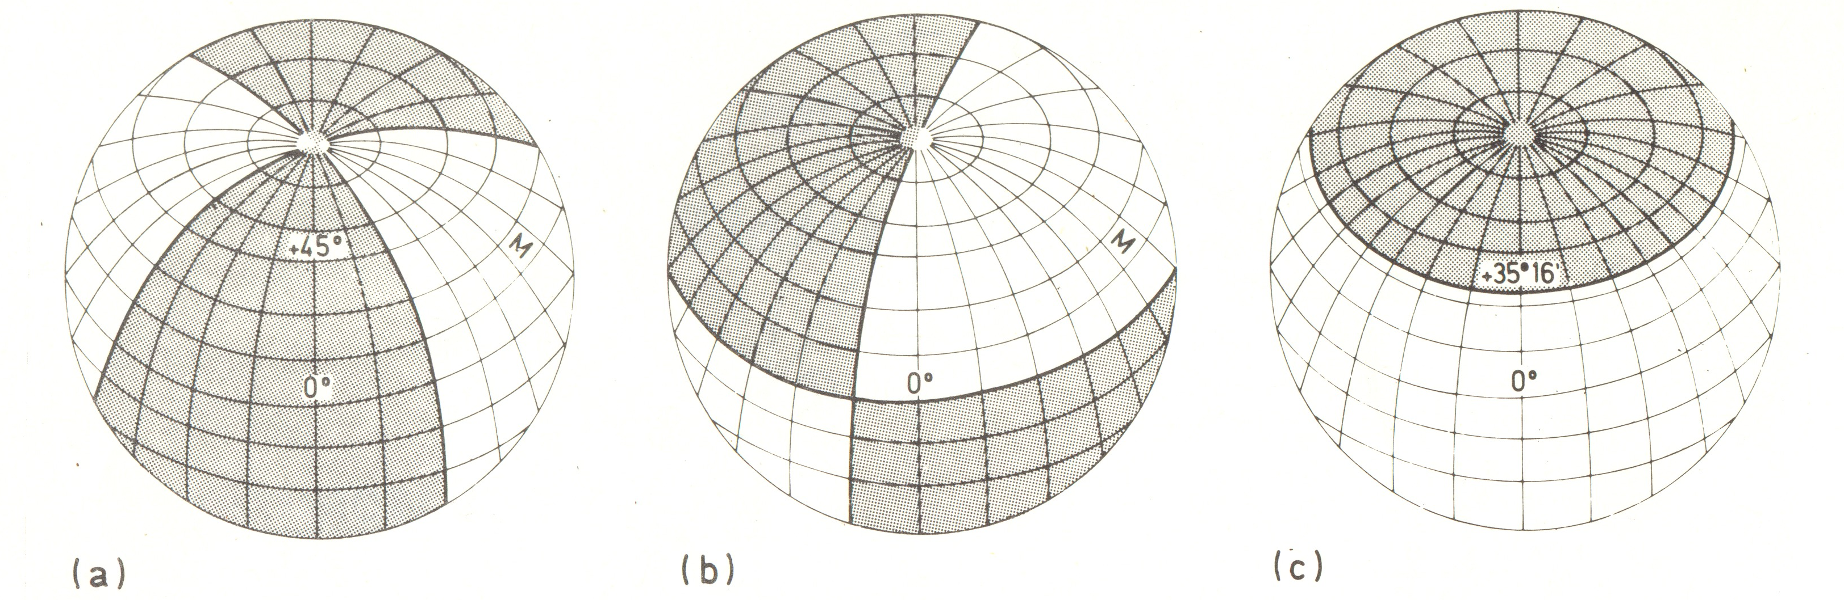
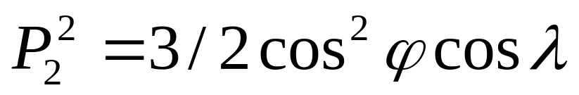
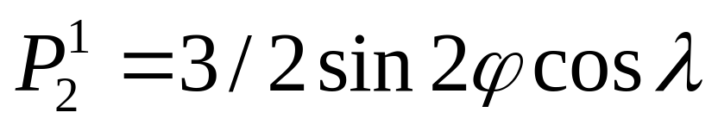
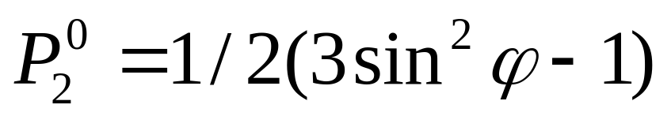
The Tidal Families (Laplace)
SD
Braking the Earth rotation
(lag of equatorial bulge)
D
Precession and nutations
(equatorial torque)
LP
Change of speed of the Earth rotation
(Moment of inertia)

Slide 8
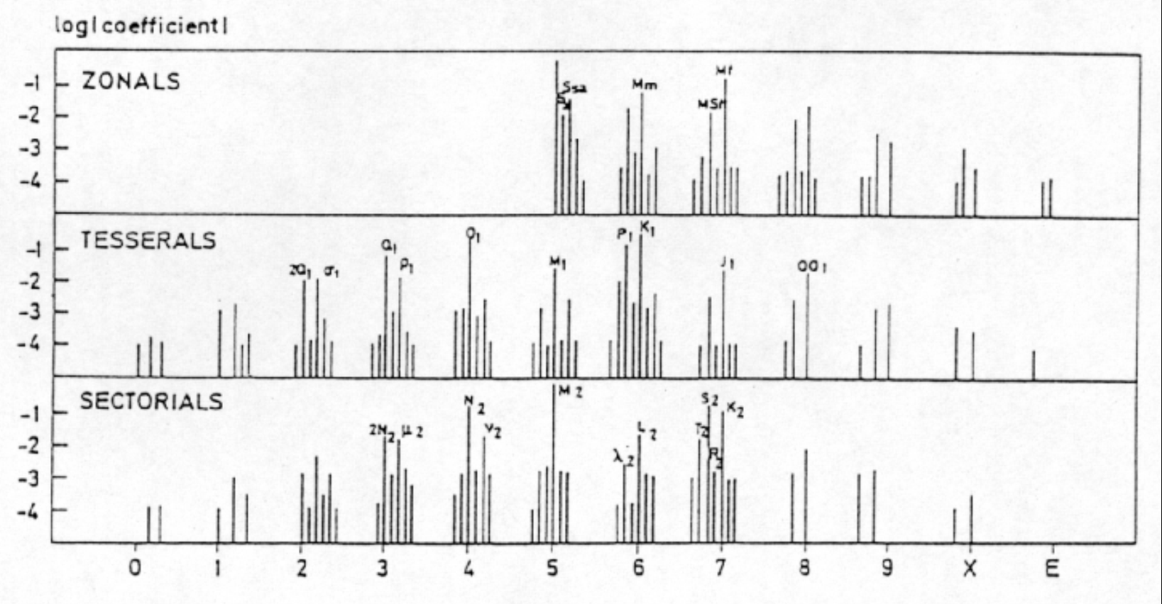
Tidal development
Effects of declination and ellipticity
Zonal: Luni-solar: M₀S₀ principal
Moon: M_{f} fortnightly (declinational), M_{m} monthly (elliptic)
Sun: S_{sa} 6 month (declinational), S_{a} yearly (elliptic)
Diurnal: Moon:K₁, O1 main declinational
Sun: K₁, P₁ main declinational
Semi-diurnal: Moon: M₂ principal, N₂ and L₂ - elliptic
Sun: S₂ principal, T₂ and R₂ - elliptic

Slide 9
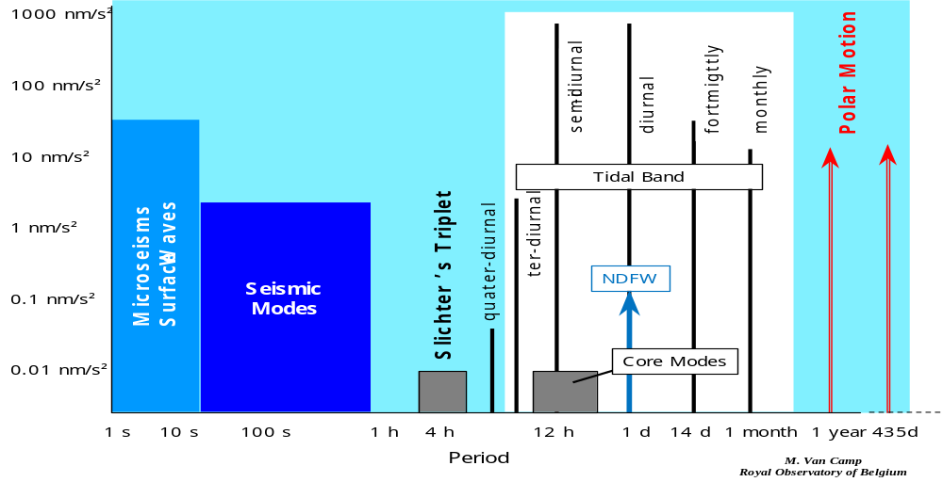
Spectrum of geodynamical phenomena
Tidal observations bridge a frequency gap between seismic frequencies (periods larger than 1 hour) and polar motion signal.

Slide 10
Earth Tides and Astronomy
Diurnal tides and nutations are directly coupled
Considering the solar argument h defining the tropic year we get symmetrically around K₁
P₁ 6 month nutation
-h
S₁ yearly nutation
-h
K₁ sidereal day Precession
+h
ψ₁ yearly nutation
+h
ϕ₁ 6 month nutation
The Nearly Diurnal Free Wobble (NDFW) located between K₁ and ψ₁ will modifies the Earth’ output to different waves and the associated nutations.

Slide 11
Earth Tides and Astronomy
The NDFW can be determined from ground based tidal observations.
We want to determine the transfer function of the Earth using as input a known tidal signal.
As we know beforehand the spectrum of the tidal potential we work in the frequency domain.
For each tidal wave we can determine a specific transfer function

Slide 12
Earth Tides Signal
In fact as the astronomical or rigid Earth signal is well known we are only interested in the solid Earth response itself. It amounts:
15% for gravity
25% for tilt
100% for strain
However the elastic deformation of the crust due to strain/tilt coupling (topography and cavity effects) badly affects the tilt and strain observations, so that the most reliable results are still obtained in tidal gravity

Slide 13
Observations of tidal phenomena
Tidal gravity variations
Tidal tilts
Tidal strains
Oceanic tides and …

Slide 14
Gravity Tides
The most precise observations are performed using superconducting gravimeters.
The accuracy of the observations is limited by the calibration of the instruments
• in amplitude: 0.15%
• in phase: time lag within a few seconds (better than 0.°02 on M₂)

Slide 15
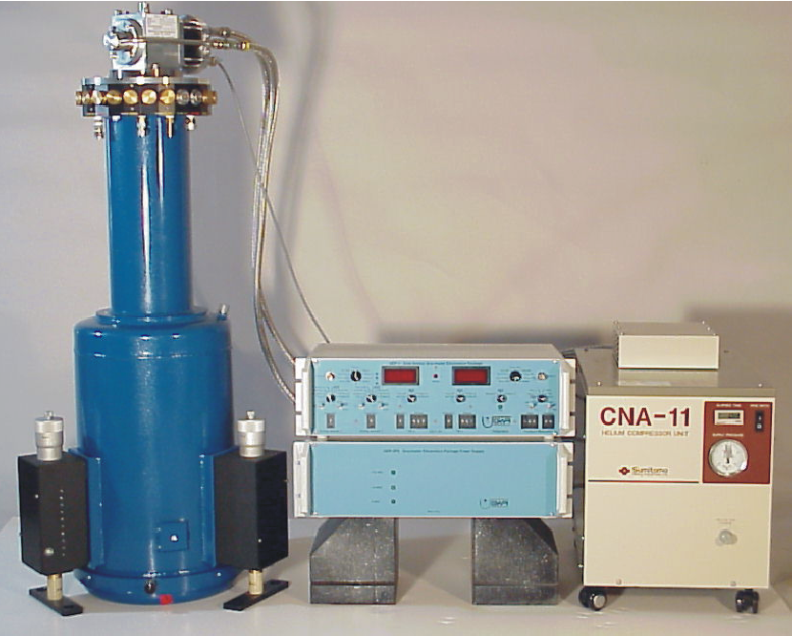
Superconducting Gravimeter (SG)
Most preciise instrument for gravity variations
Coldhead
(Sumitomo SRDK-101D)
Performance
Data acquisition and control electronics
Gravity resolution: 10⁻¹¹ m/s²
Measurement range:
from seconds to years
with a linear transfer function
Drift: ~ 3 µgal/year linear
Liquid He filled Dewar
with Gravity Sensor
Compressor (Sumitomo CAN-11C)
Notes:
The Superconducting Gravimeter is the capable instrument for the comparison, because it has the required resolution and long term stability.

Slide 16
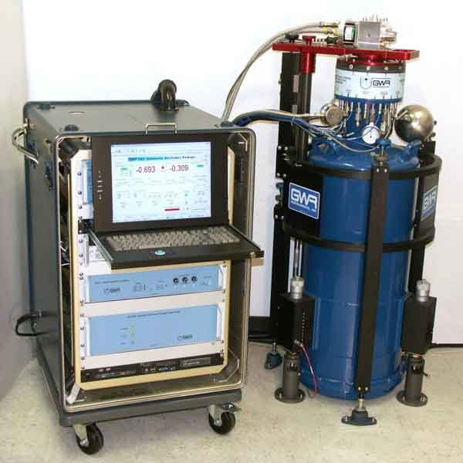
GWR observatory superconducting gravity meter

Slide 17
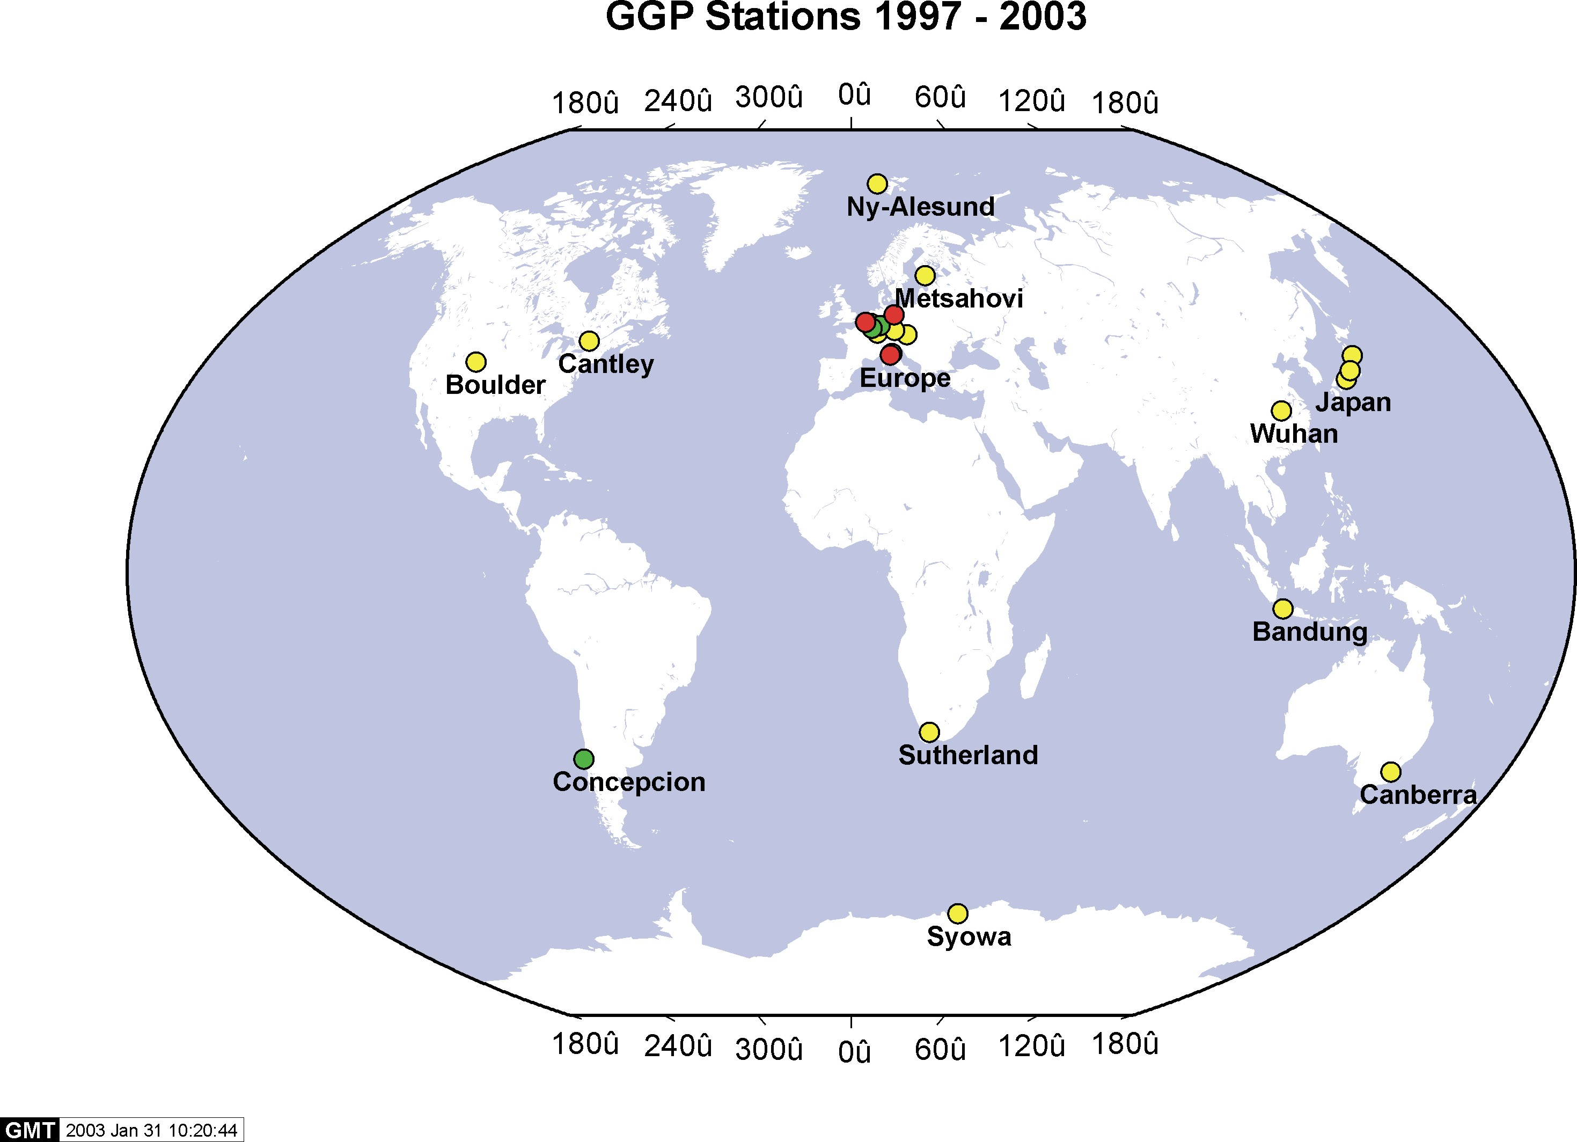
Global Geodynamics Project

Slide 18
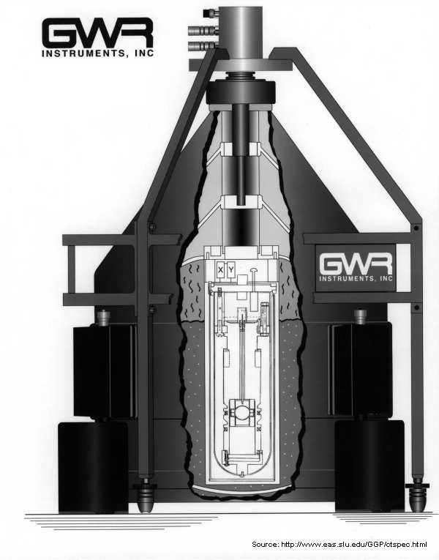
mvc

Slide 19
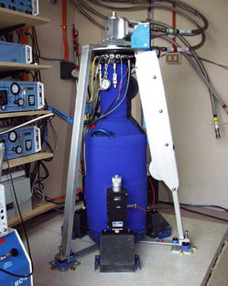
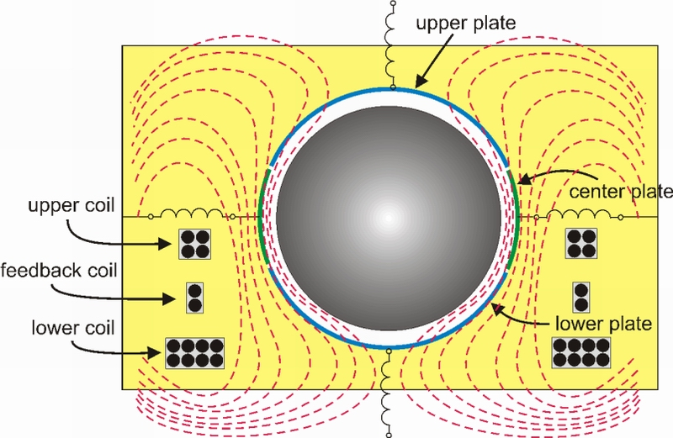
Accuracy of some nGal or ~ 10⁻¹² g

Slide 20
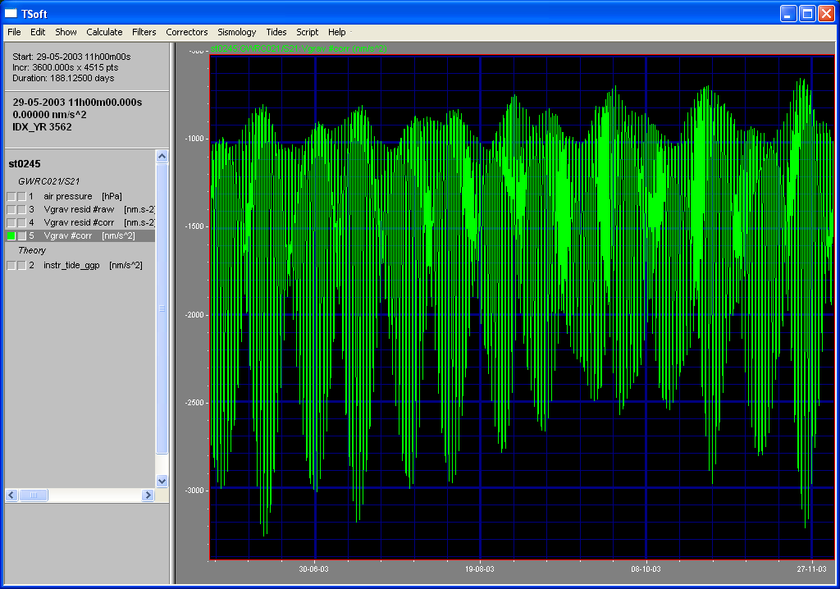
Example of tidal record with SG #C021

Slide 21
Tidal Gravity Observations
• The results have to be corrected for
• the ocean loading
• the atmospheric loading
• the underground water effects
• the instrumental coupling with meteorology (S1 and its harmonics, annual term and its harmonics)

Slide 22
Principal Tidal waves and its amplitudes in gravity
Long-periodic
M₀
S₀
S_{a}
S_{sa}
M_{SM}
M_{m}
M_{SF}
M_{f} 6 µGal
M_{STM}
M_{TM}
M_{SQM}
Diurnal
Q₁
O₁ 35 µGal
LK₁
NO₁
p₁
P₁ 16 µGal
S₁
K^{m}₁ 33 µGal
K^{S}₁ 15 µGal
y₁
f₁
J₁
OO₁
Semi-Diurnal
2N₂
μ₂
N₂
ν₂
M₂ 36 µGal
λ₂
T₂
S₂ 17 µGal
R₂
K^{m}₂
K^{s}₂
Waves with largest amplitudes
in red
Typical observational periods:
1 month, 6 months, 1 year

Slide 23
Model values of tidal parameters
Forced vibrations of the Earth powered by time-space varying Luni-Solar potential
Spherically symmetrical PREM model is used

Slide 24
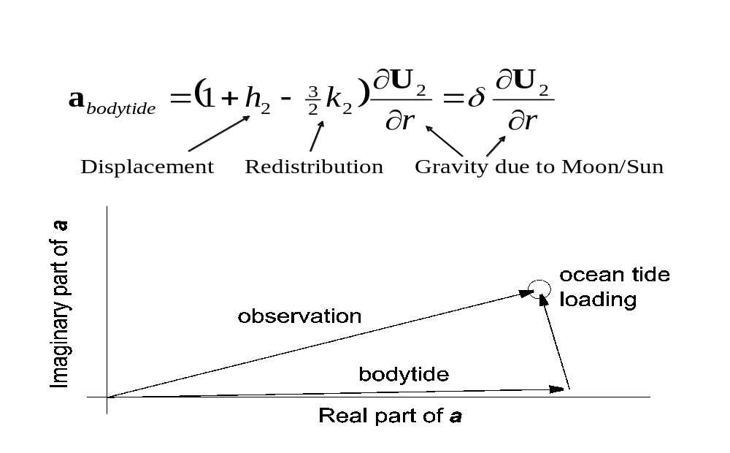
Vectorial representation of Earth tides

Slide 25
Important Achievements
Results from GGP network show general agreement with VLBI results on the determination of the NDFW frequency.
The Pole tide is now determined with a precision of 1% on individual stations and 0.5% on the global adjustment of 9 GGP stations.

Slide 26
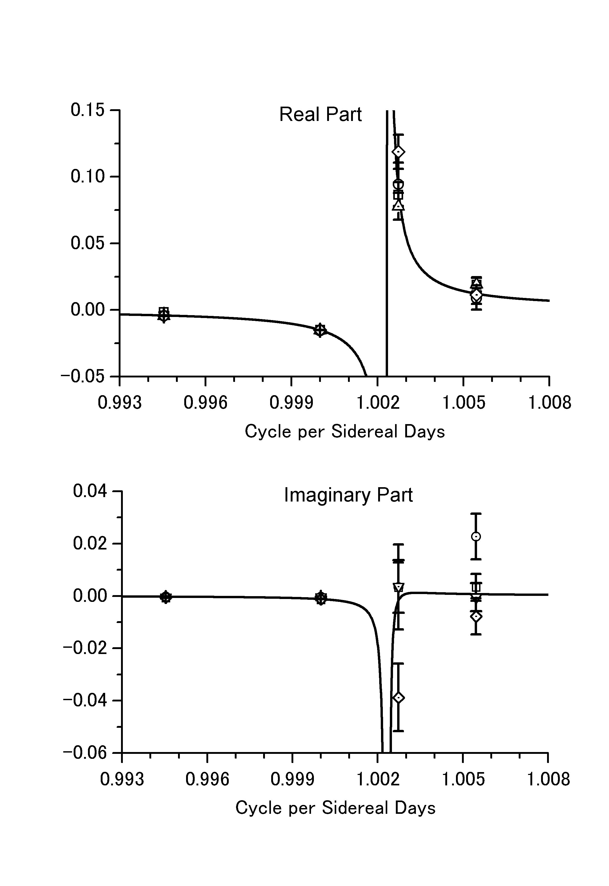

Fluid Core Resonance
(Sato & al., 2002)
Experimental determination of the fluid core resonance (stations Canberra, Esashi, Matsushiro and Membach)
Ocean model NAO99b
T=429.66±1.43 s.d.
Q=9,350~10,385
Theory (DDW99)
T=456.98 s.d. hydrostatic
T=431.37 s.d. non hydro.
• VLBI
T=429.5 s.d.
O₁ K₁ ψ₁ ϕ₁

Slide 27
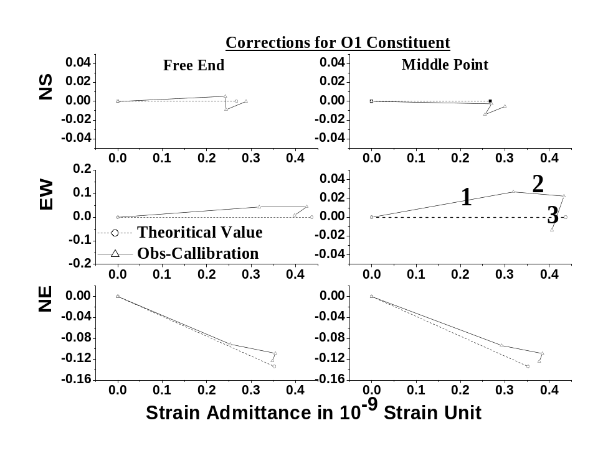
Fluid Core Resonance by Strain Observation at Esashi station (J.Ping & al., 2004)
Strain observations have to be corrected for ocean loading (3), atmospheric loading, meteorological and hydrological effects.
1 observed
2 local effect
3 ocean loading
2
3
These components are very sensitive to local heterogeneities (cavity effects) and boundary conditions (topography) (2). These effects have to be modelled using finite element techniques, which is always a very difficult task

Slide 28
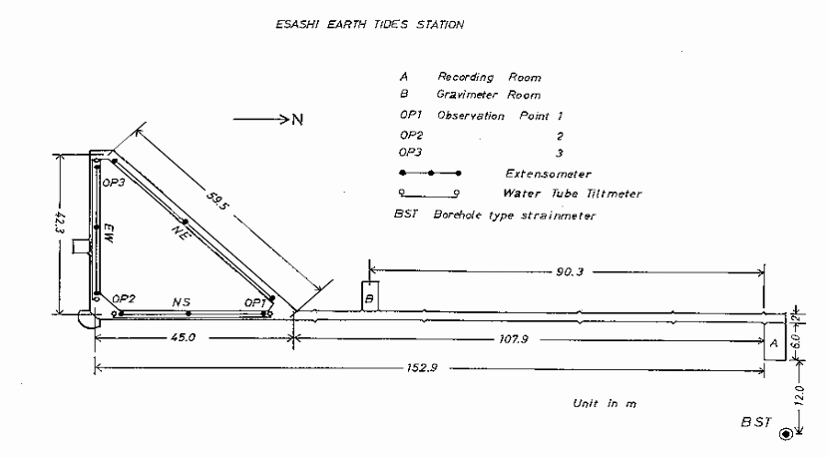
Fluid Core Resonance by Strain Observation at Esashi station (J.Ping & al., 2004)
 | T_{FCN} (s. d.) | Q
1.Free end | 421.7 ±1.6 | 10 500 ±2 350
2.Mid point | 410.6 ±1.1 | 6 870 ±830
1+2 | 419.9 ±1.3 | 6 670 ±770
VLBI
T=429.5 s.d

Slide 29
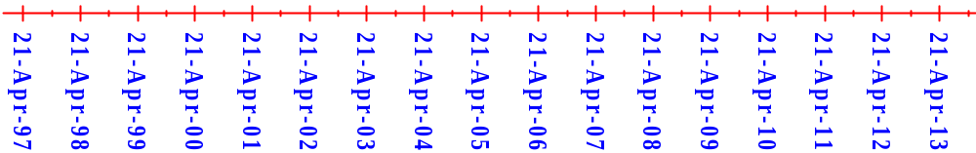
Polar tide and Chandler pole motion effect from different SG locations
Boulder 1.1829 ±0.0086
Brussels 1.1866 ±0.0127
Canberra 1.1784 ±0.0056
Cantley 1.1851 ±0.0176
Membach 1.1921 ±0.0138
Moxa 1.1661 ±0.0138
Potsdam 1.1859 ±0.0093
Strasbourg 1.1857 ±0.0148
Vienna 1.1526 ±0.0086

Slide 30
New Perspectives
• Superconducting gravimeters have a better signal to noise ratio than modern seismometers below .001Hz. They can thus improve the determination of the low overtones of the fundamental mode of the Earth free oscillations. A lot of efforts is now devoted to identify the inner core oscillation known as Slichter’s mode.

Slide 31
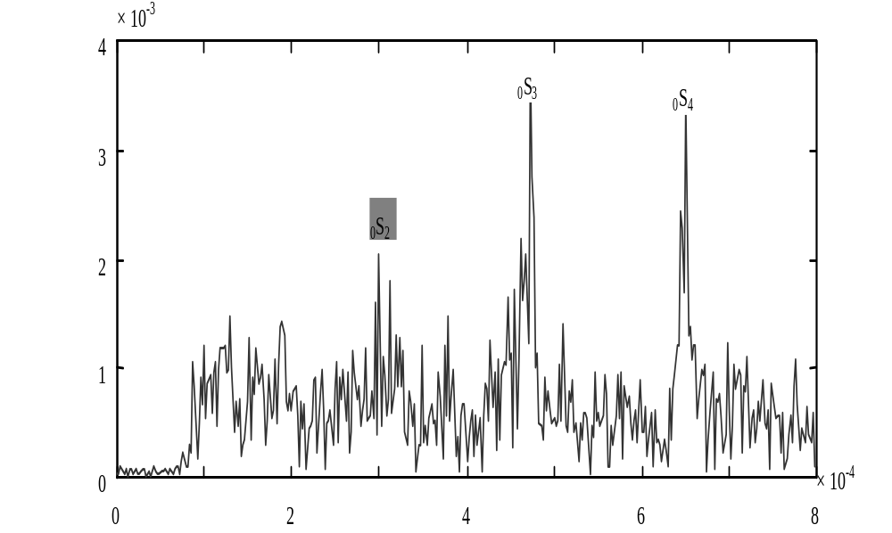
Free oscillation spectrum (0-0.8 mHz
(Xiang & al., 2002)
_{O}S₃
_{O}S₄
_{O}S₂

Slide 32
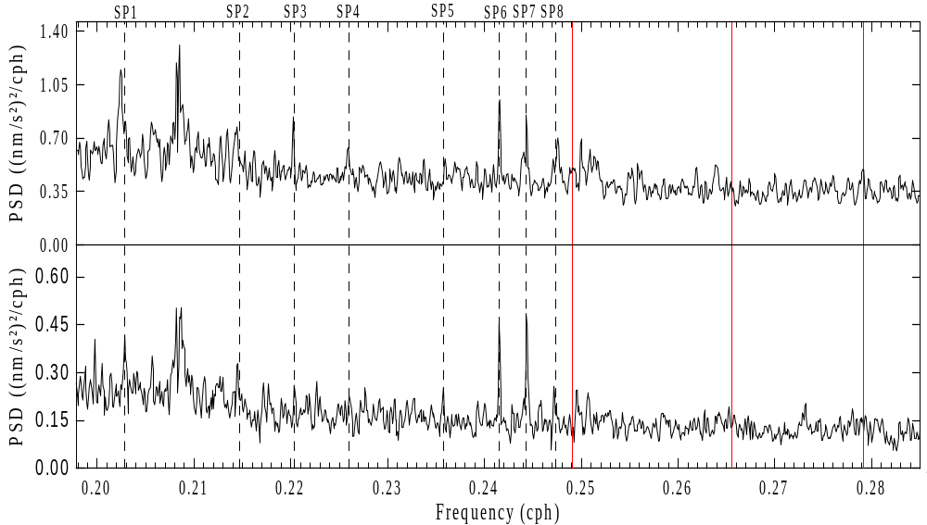
Search for Slichter’s Triplet (Sun &al., 2003)
Identification of peaks with non-linear tides
SP1 ≡ 2MK5, SP6 ≡ M6, SP7 ≡ 2MS6, SP8 ≡ 2SM6
Possible triplets Smylie(1991),
Smith(1976)
SP1
SP6 SP7 SP8

Slide 33
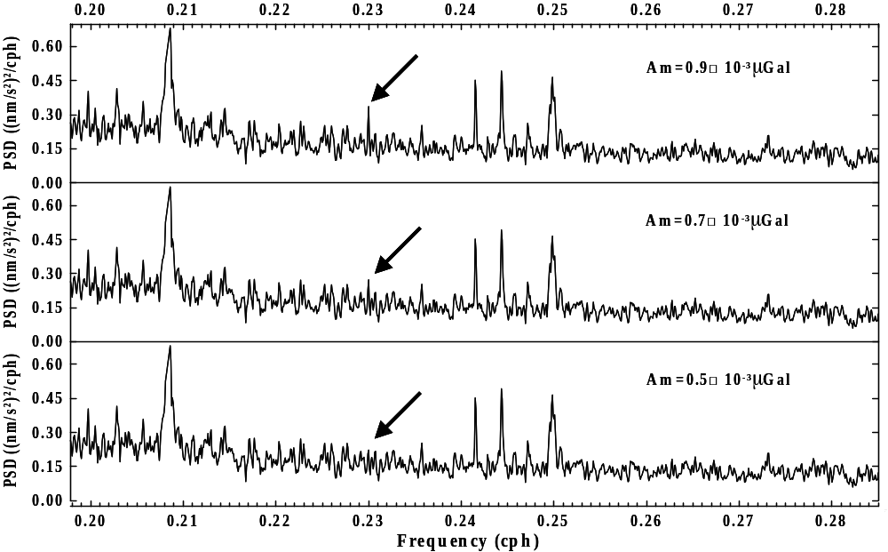
Search for Slichter’s Triplet (Sun &al., 2003)
A steady signal with an amplitude of 1 nanogal should be detected

Slide 34
Tidal gravity observations at SAI MSU

Slide 35
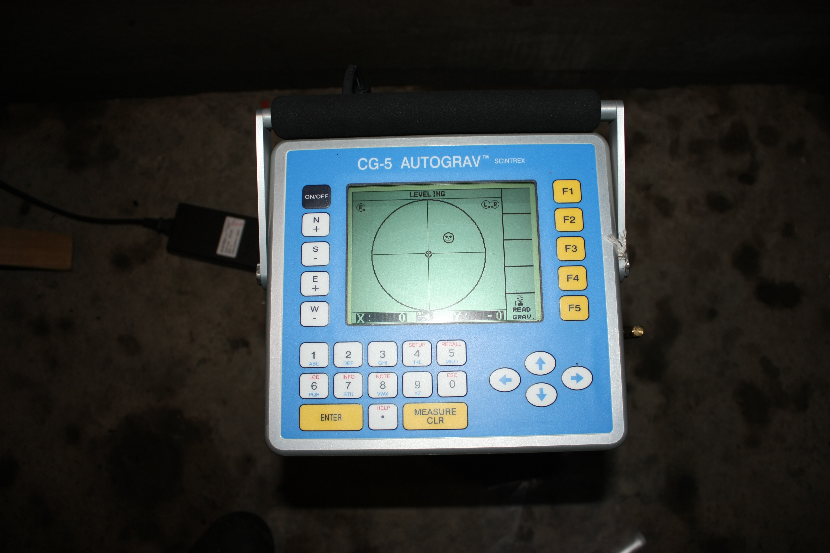
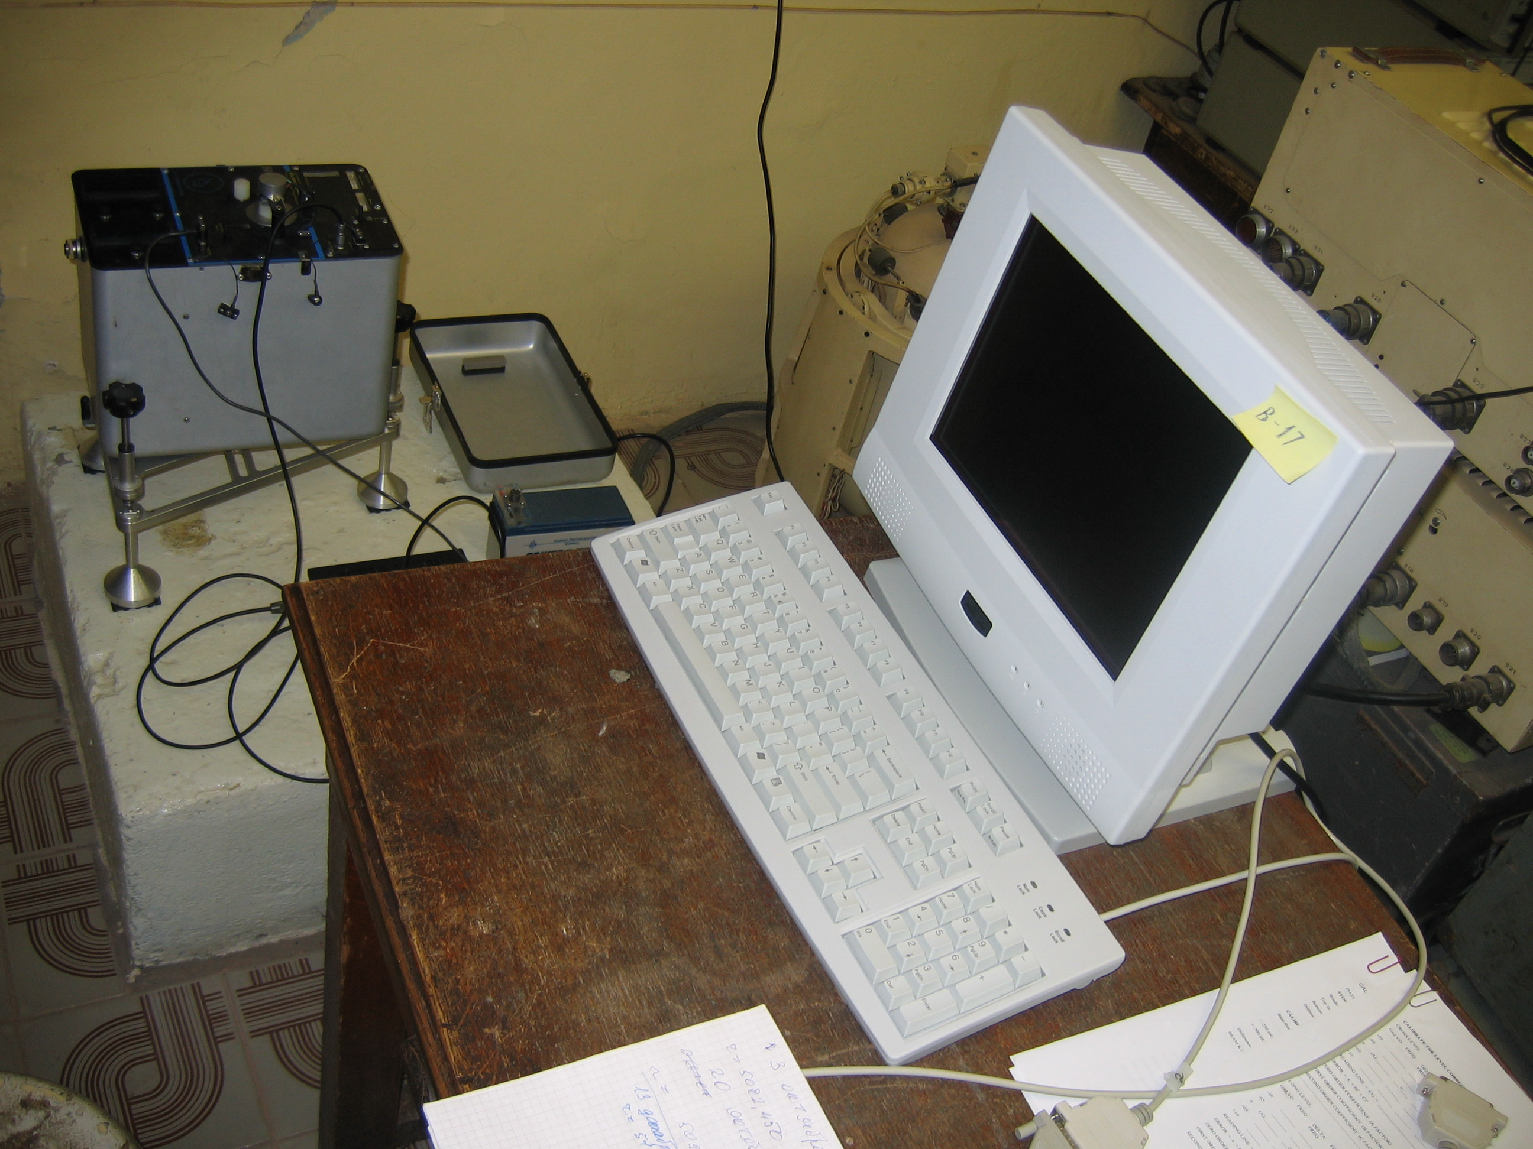
Modern relative field gravity meters
Scintrex CG-5 and ZLS-Burris

Slide 36
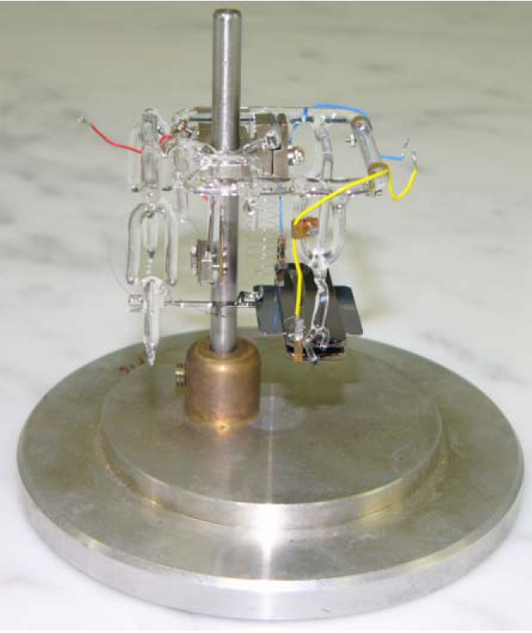
Sensitive system of Scintrex CG-5
gravity meter
g
mvc

Slide 37
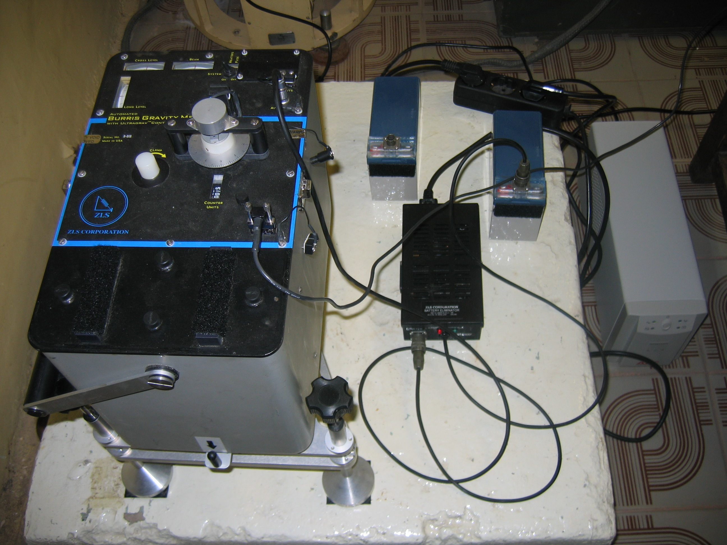
ZLS B018 gravity meter

Slide 38
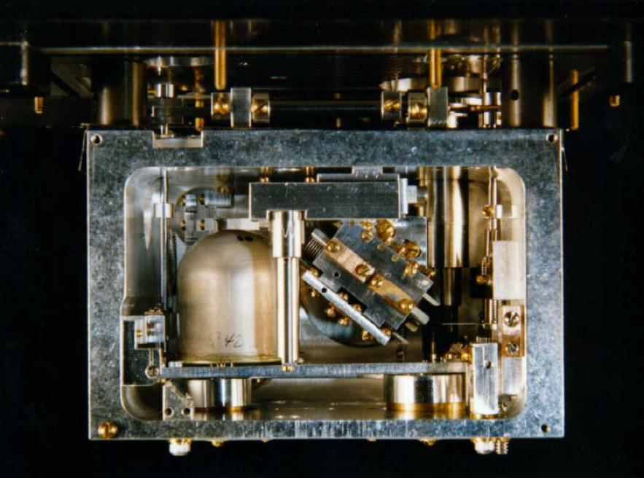
Sensitive system of ZLS-Burris gravity meter (astatized, same as LCR)

Slide 39
Problems of tidal observations
Systematic errors due to coherent meteorological noise (temperature variations, atmospheric pressure changes, …)
The observational room should be thermostatized (ideal case)
Many months of observations are needed to:
1) increase the spectral resolution
2) improve the accuracy of parameters estimation using the accumulation of coherent signal
3) averaging the systematic influence of seasonal variations of coherent noises
Calibration problem …
Is solved perfectly using laser strain meters only

Slide 40
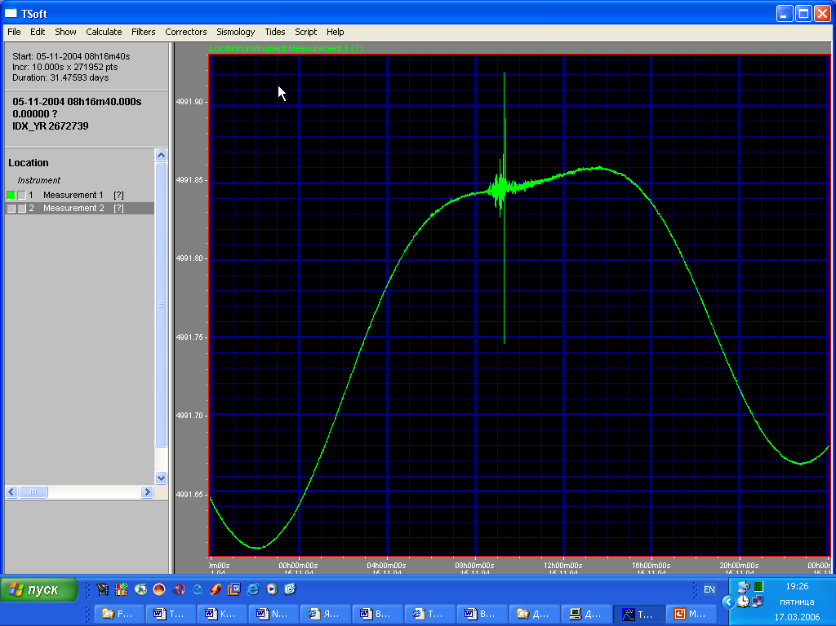
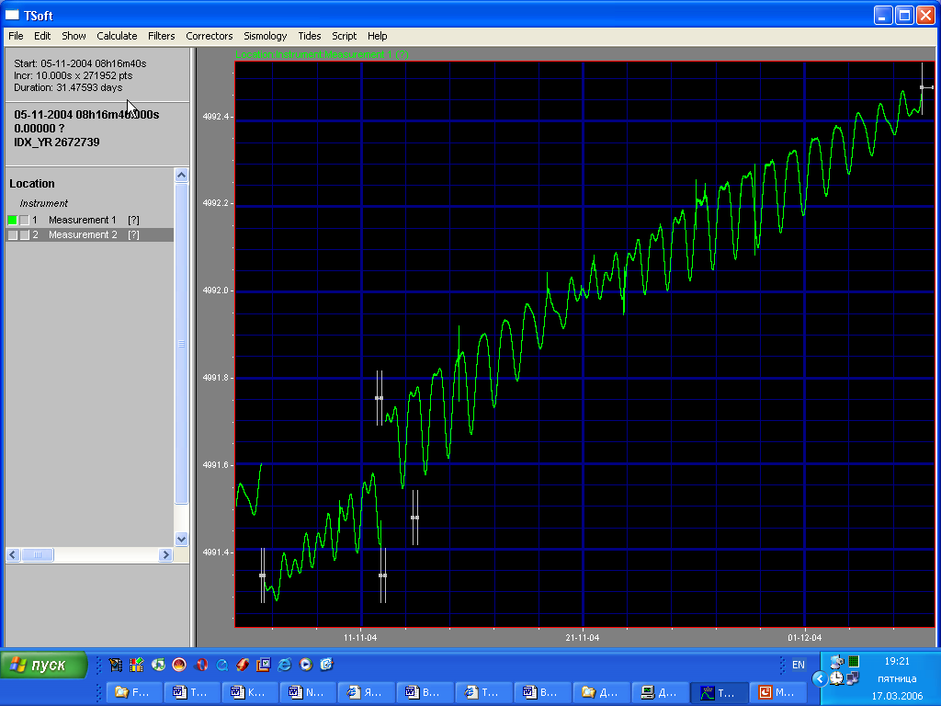
Examples of dayly and monthly tidal records with ZLS gravity meters

Slide 41
Gravity Units in SI and SGS
1 nm/s² = 0.1 μGal ~ 10⁻¹⁰ g
1 μGal = 10 nm/s² ~ 10⁻⁹ g

Slide 42
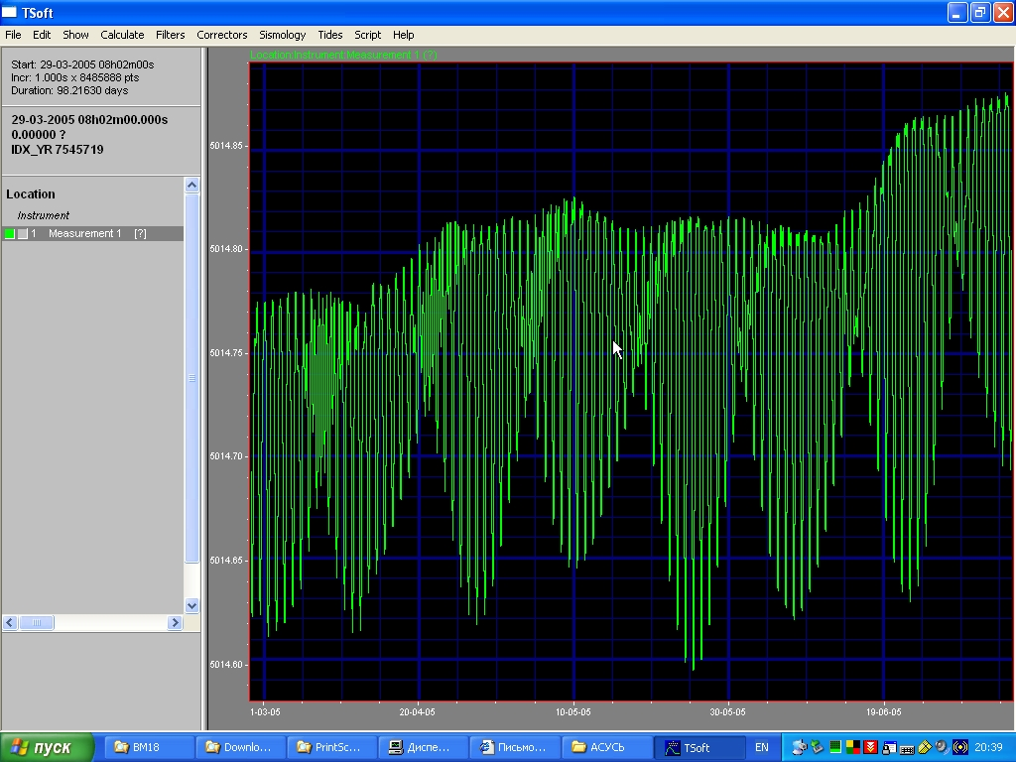
100 days of tidal gravity record with ZLS B-018 gravity meter

Slide 43
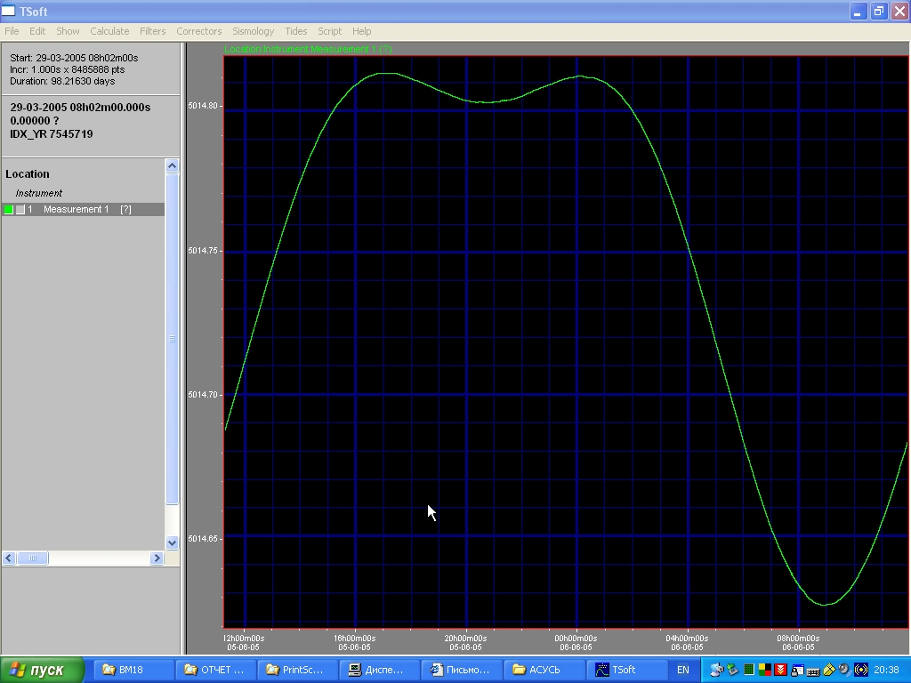
1-day record, noise of the order of 0.1 μGal

Slide 44
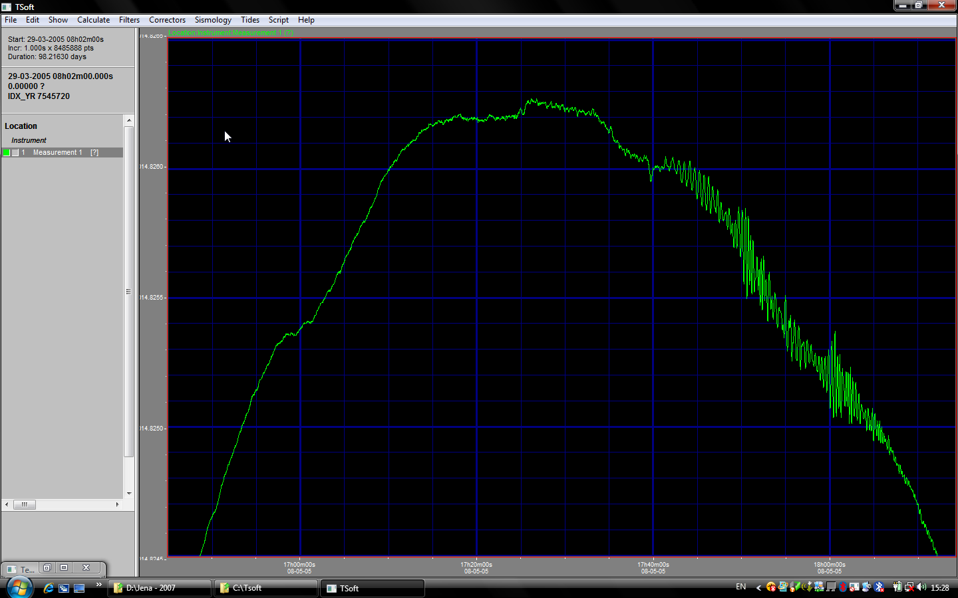

Slide 45
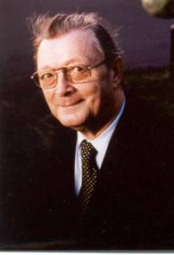
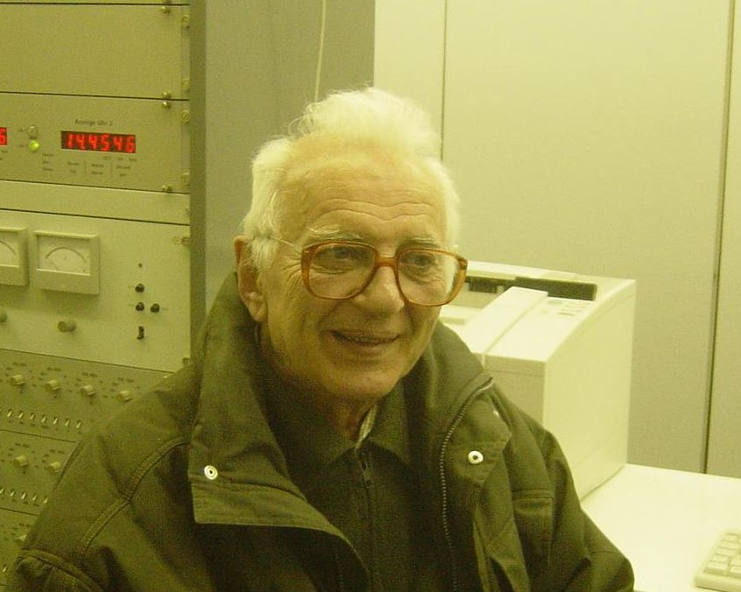
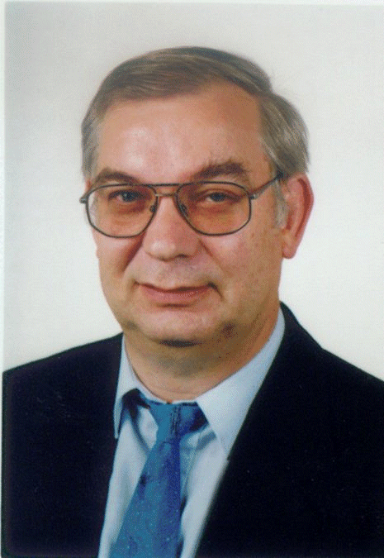
Prof. P. Melchior
Prof. A. Venedikov
Pioneers of tidal data processing
Prof. H.-G. Wenzel

Slide 46
Data processing of tidal observations with ETERNA, or VAV or BAYTAP-G programs uses the harmonic analysis on the base of LSM
Decomposition of observational series into a sum of harmonic constituents (tidal waves), non-linear drift, atmospheric pressure response, observational noise, …
Gaps of any duration are no more problematic
➔ Better resolution than of spectral analysis
Sophisticated semi-automatic preprocessing with Tsoft and PRETERNA programs helps to remove steps, spikes and interpolate small gaps in data that are usually unavoidable …

Slide 47
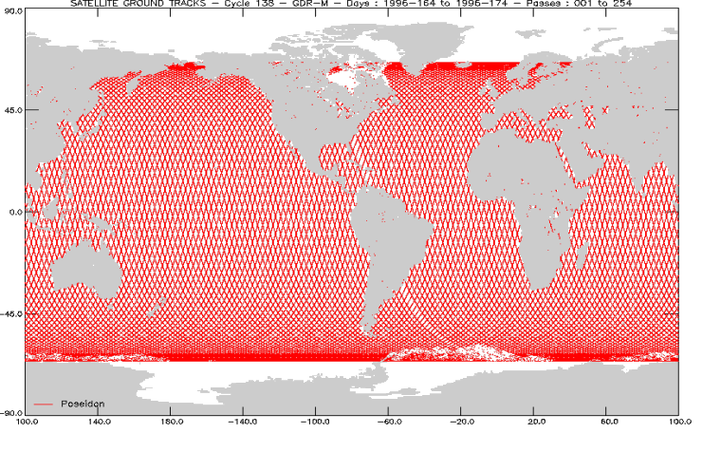
FES’04, NAO’99, TPXO’7, CSR’4, GOT’00, AG’06 – newest oceanic tidal models on the base of satellite altimetry
Accurate correction for oceanic and loading tides
is necessary

Slide 48
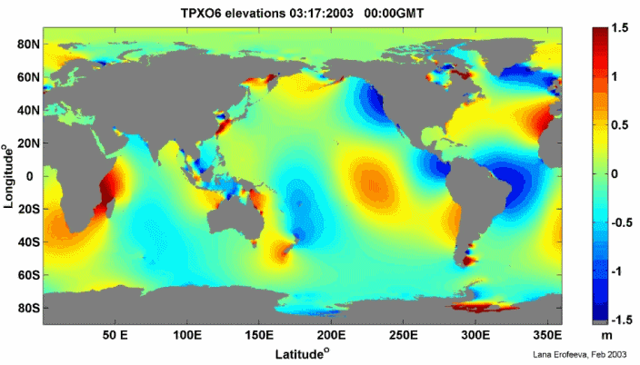
Oceanic tides

Slide 49
Typical results of tidal observations analysis using ETERNA program
####################################################################
# Gravimetric earth tide station Moscow, Russia #
# Sternberg Astronomical Institute of Moscow State University #
# Lat= 56.00 N, Lon= 38.0 E, H= 150 m, Vertical component #
# Gravimeter ZLS B-018 #
# 2008.07.23 - 2008.08.21 98 days #
####################################################################
Number of recorded days in total : 96.88
TAMURA 1987 tidal potential used.
HANN window used for least squares adjustment.
Numerical filter is PERTZEV 1959 with 51 coefficients.
Estimation of noise by FOURIER-spectrum of residuals
0.1 cpd band 9999.9999 nm/s**2 1.0 cpd band 0.5421 nm/s**2
2.0 cpd band 0.2940 nm/s**2 3.0 cpd band 0.2030 nm/s**2
adjusted tidal parameters :
from to wave ampl. signal/ ampl.fac. stdv. phase lead stdv.
nm/s**2 noise [deg] [deg]
286 428 Q1 63.304 116.8 1.14727 0.00982 1.7057 0.4906
429 488 O1 330.763 610.2 1.14773 0.00188 1.6489 0.0939
489 537 M1 25.487 47.0 1.12450 0.02392 1.9682 1.2186
538 592 P1S1 459.234 847.2 1.13306 0.00134 1.8208 0.0676
593 634 J1 25.907 47.8 1.14306 0.02392 2.2203 1.1988
635 736 OO1 13.924 25.7 1.12280 0.04371 0.7173 2.2305
737 839 2N2 7.879 26.8 1.09619 0.04091 1.4245 2.1383
840 890 N2 53.881 183.2 1.19719 0.00653 1.6000 0.3127
891 947 M2 277.689 944.4 1.18132 0.00125 2.0230 0.0607
948 987 L2 7.588 25.8 1.14200 0.04425 3.3879 2.2203
988 1121 S2K2 128.416 436.7 1.17420 0.00269 1.1863 0.1312
Standard deviation : 5.159 nm/s**2

Slide 50
The same without filters. Tchebyshev polinomials are used for drift approximation
Number of recorded days in total : 96.88
TAMURA 1987 tidal potential used.
HANN window used for least squares adjustment.
Numerical filter is NO FILTER with 1 coefficients.
adjusted tidal parameters :
from to wave ampl. signal/ ampl.fac. stdv. phase lead stdv.
nm/s**2 noise [deg] [deg]
91 153 Mf 81.018 8.2 1.18969 0.14430 -3.8539 6.9495
286 428 Q1 63.345 110.3 1.14802 0.01041 1.6895 0.5197
429 488 O1 330.750 575.7 1.14768 0.00199 1.6427 0.0995
489 537 M1 25.469 44.3 1.12374 0.02535 1.9920 1.2925
538 592 P1S1 459.237 799.3 1.13306 0.00142 1.8198 0.0717
593 634 J1 25.896 45.1 1.14258 0.02535 2.1625 1.2712
635 736 OO1 13.931 24.2 1.12338 0.04633 0.7213 2.3630
737 839 2N2 7.879 26.1 1.09624 0.04207 1.4431 2.1986
840 890 N2 53.894 178.3 1.19750 0.00672 1.6041 0.3214
891 947 M2 277.684 918.5 1.18130 0.00129 2.0209 0.0624
948 987 L2 7.592 25.1 1.14264 0.04550 3.3674 2.2817
988 1121 S2K2 128.437 424.8 1.17439 0.00276 1.1871 0.1349
1122 1194 M3 2.994 15.9 1.15690 0.07260 1.3146 3.5954
Standard deviation : 40.796 nm/s**2
Adjusted TSCHEBYSCHEFF polynomial bias parameters :
block degree bias stdv.
1 0 7160.746951 nm/s**2 3.088640 nm/s**2
1 1 149.037851 nm/s**2 3.307733 nm/s**2
1 2 29.059356 nm/s**2 3.856850 nm/s**2
2 0 7863.797844 nm/s**2 3.086766 nm/s**2
2 1 317.611723 nm/s**2 3.306347 nm/s**2
2 2 155.205499 nm/s**2 3.854495 nm/s**2

Slide 51
Tidal observations at LNE, Trappes
gravimeter Scintrex CG-5 No 105 belonging to Paris Observatory
2006-2007

Slide 52
####################################################################
# Gravimetric earth tide station Trappes, LNE #
# Lat= 48.761 N, Lon= 1.983 E, H= 160 m, Vertical component #
# Gravimeter Scintrex CG-5 #
# 13.12.2006-11.05.2007 150 days #
# Installation: S.Merlet, LNE-SYRTE #
# Data processing: A.Kopaev, M.Yarkov #
# Original Manufacturer Calibration #
####################################################################
Summary of observation data :
20061213190000...20070126 20000 20070126190000...20070403230000
20070404170000...20070510230000
Number of recorded days in total : 146.83
adjusted tidal parameters :
from to wave ampl. signal/ ampl.fac. stdv. phase lead stdv.
nm/s**2 noise [deg] [deg]
286 428 Q1 66.855 112.9 1.13363 0.01004 -0.8808 0.5076
429 488 O1 352.580 595.3 1.14466 0.00192 0.0029 0.0962
489 537 M1 28.293 47.8 1.16795 0.02445 -0.3015 1.1994
538 592 P1S1 493.424 833.1 1.13903 0.00137 0.3391 0.0688
593 634 J1 28.239 47.7 1.16575 0.02445 0.4235 1.2017
635 736 OO1 15.336 25.9 1.15708 0.04469 0.0265 2.2127
737 839 2N2 11.238 31.7 1.12560 0.03547 3.2582 1.8056
840 890 N2 73.322 207.0 1.17281 0.00566 3.6573 0.2767
891 947 M2 389.664 1100.3 1.19334 0.00108 3.3941 0.0521
948 987 L2 11.057 31.2 1.19796 0.03837 -0.7334 1.8352
988 1121 S2K2 182.547 515.5 1.20160 0.00233 1.3352 0.1112
1122 1194 M3 4.306 11.8 1.01643 0.08582 -3.2515 4.8376
Standard deviation : 7.042 nm/s**2

Slide 53
Tidal observations close to the sea/ocean are of special interest
Oceanic tides cause direct attraction as well as deform the earth crust considerably on the distances up to hundreds of km
Tidal gravity observations in “natural volcano-tectonic laboratory” of Kamchatka Peninsula have started recently by joint efforts of Institute of Volcanology and Seismology of RAS and SAI MSU

Slide 54
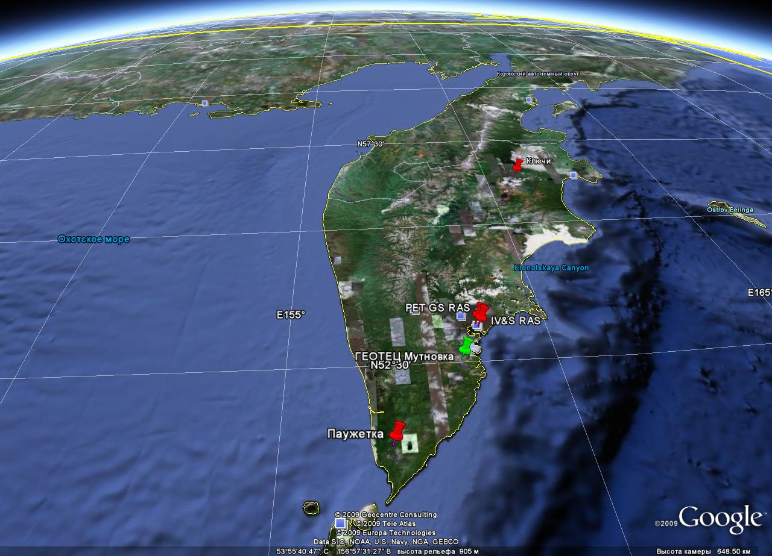
Tidal gravity stations on the territory of Kamchatka

Slide 55
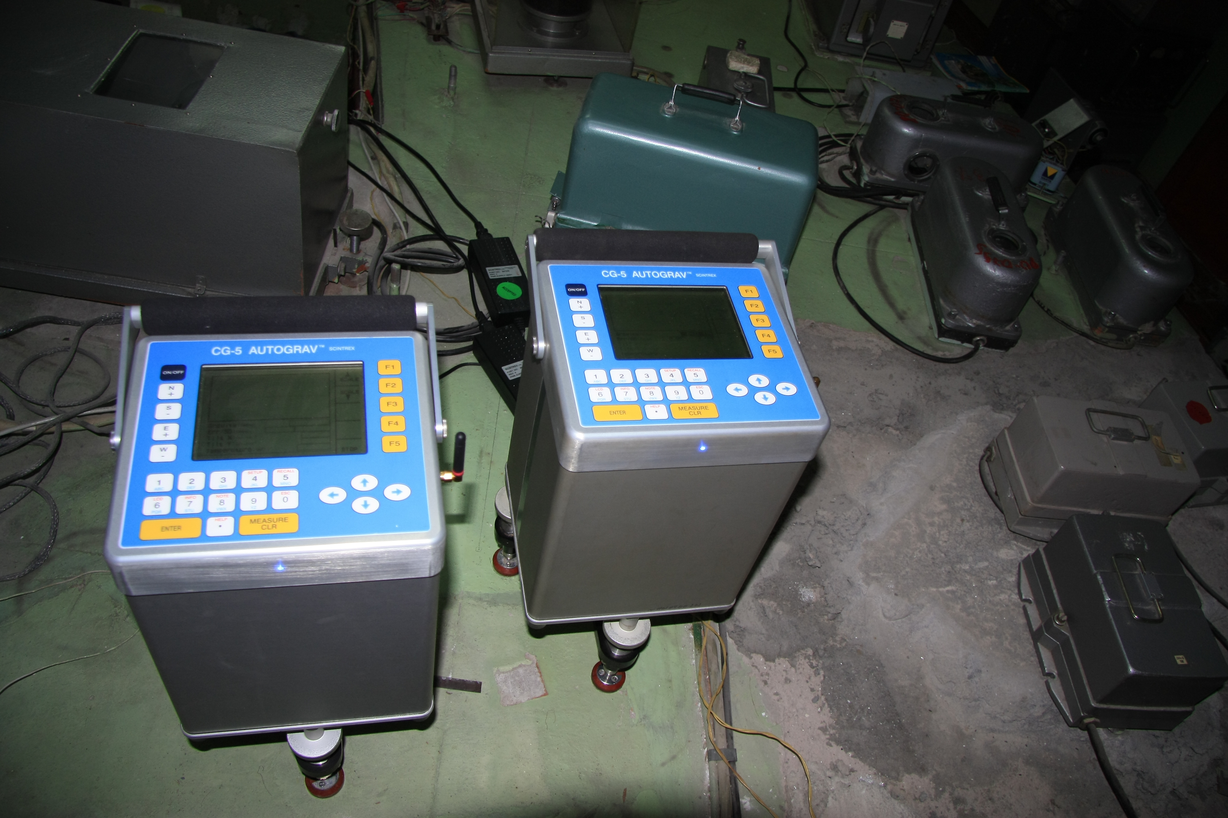
Scintrex gravity meters №№ 448 и 450 at PET seismological station

Slide 56
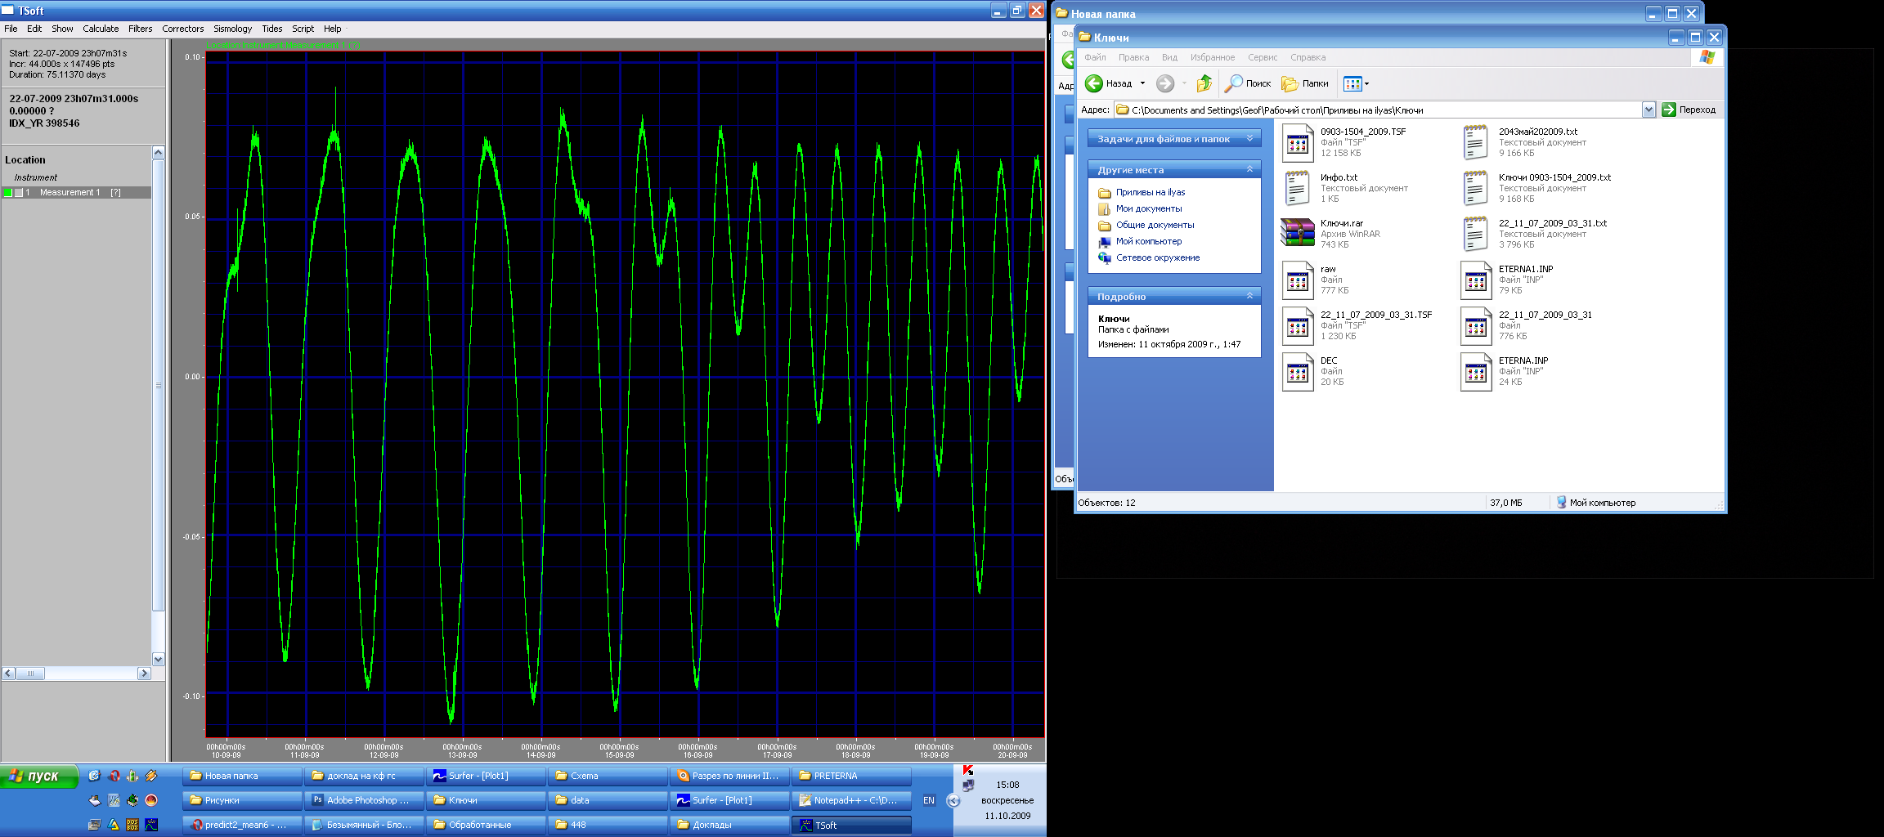
Example of 10-days record at PET station

Slide 57
Results of data analysis
Summary of observation data :
20090206 80000...20090412150000 20090413 80000...20090512140000
20090513 80000...20090626210000 20090723 80000...20091005170000
Number of recorded days in total : 213.63
TAMURA 1987 tidal potential used.
UNITY window used for least squares adjustment.
Numerical filter is PERTZEV 1959 with 51 coefficients.
Estimation of noise by FOURIER-spectrum of residuals
0.1 cpd band 9999.9999 nm/s**2 1.0 cpd band 1.0312 nm/s**2
2.0 cpd band 0.6191 nm/s**2 3.0 cpd band 0.4675 nm/s**2
4.0 cpd band 0.4072 nm/s**2
adjusted tidal parameters :
from to wave ampl. signal/ ampl.fac. stdv. phase lead stdv.
nm/s**2 noise [deg] [deg]
286 428 Q1 69.904 67.8 1.22219 0.01803 5.5661 0.8452
429 488 O1 369.781 358.6 1.23784 0.00345 4.2251 0.1598
489 537 M1 29.994 29.1 1.27668 0.04389 -2.3567 1.9698
538 592 P1S1 510.853 495.4 1.21593 0.00245 2.3348 0.1157
593 634 J1 28.782 27.9 1.22511 0.04389 2.1967 2.0528
635 736 OO1 13.732 13.3 1.06828 0.08022 2.5686 4.3024
737 839 2N2 9.532 15.4 1.14524 0.07439 0.5280 3.7215
840 890 N2 59.106 95.5 1.13405 0.01188 2.3106 0.6002
891 947 M2 321.220 518.8 1.18000 0.00227 2.9618 0.1104
948 987 L2 10.696 17.3 1.39009 0.08046 -0.4495 3.3165
988 1121 S2K2 153.492 247.9 1.21192 0.00489 0.6920 0.2311
1122 1194 M3 4.042 8.6 1.25334 0.14493 6.0441 6.6254
Standard deviation : 11.893 nm/s**2

Slide 58
Tidal strain observations at SAI MSU

Slide 59
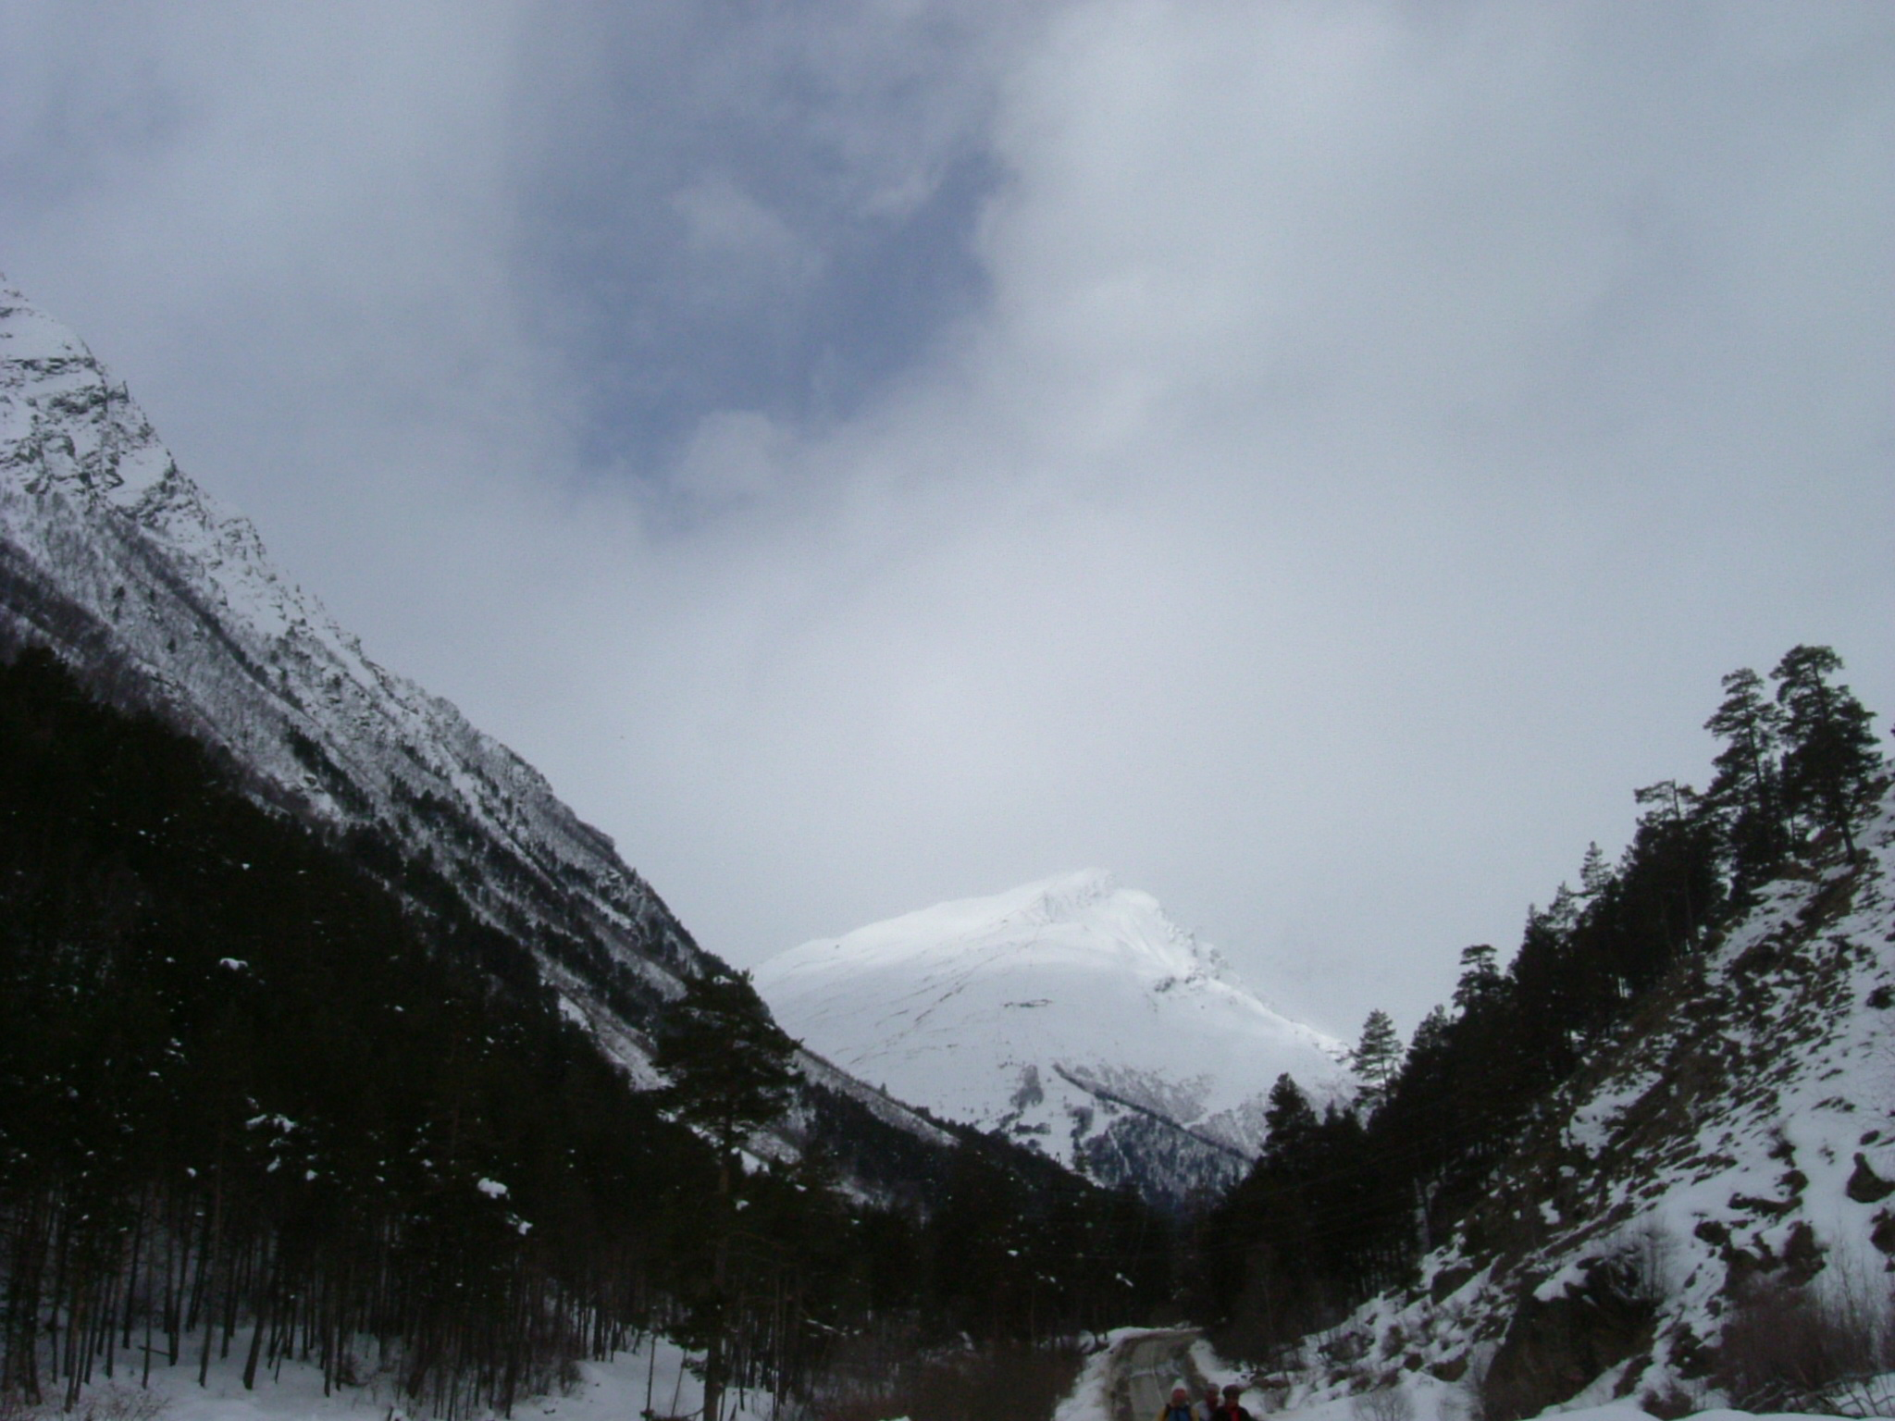
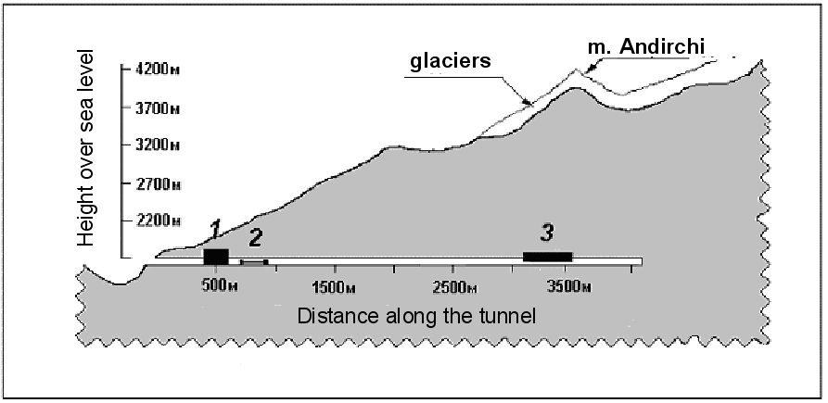
Baksan Geodynamical Observatory of Moscow University
Location: Baksan canyon, 20 km apart from Elbrus sleeping volcano
Latutude 43˚12', Longitude – 42˚43',

Slide 60
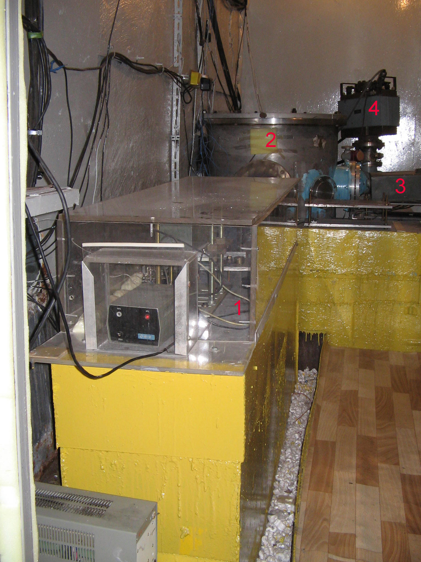
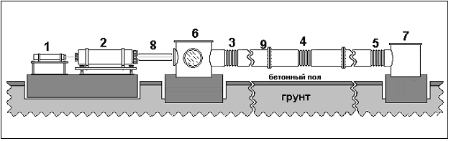
Baksan laser strainmeter of SAI MSU with length of 75 m is located along the tunnel of Baksan Neutrino observatory of RAS on the depth of 650 m

Slide 61
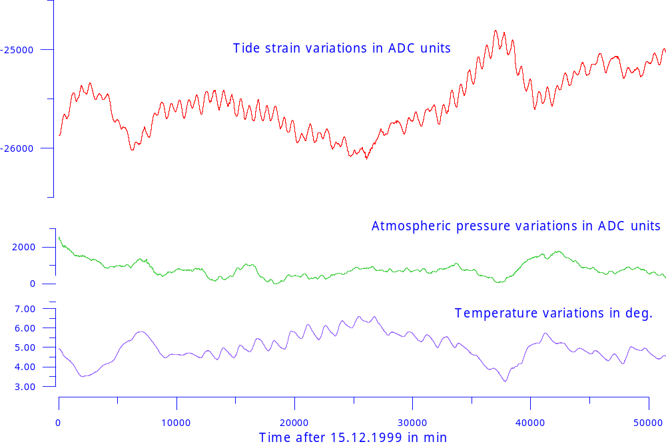
Example of tidal strain record together with atmospheric pressure and temperature variations

Slide 62
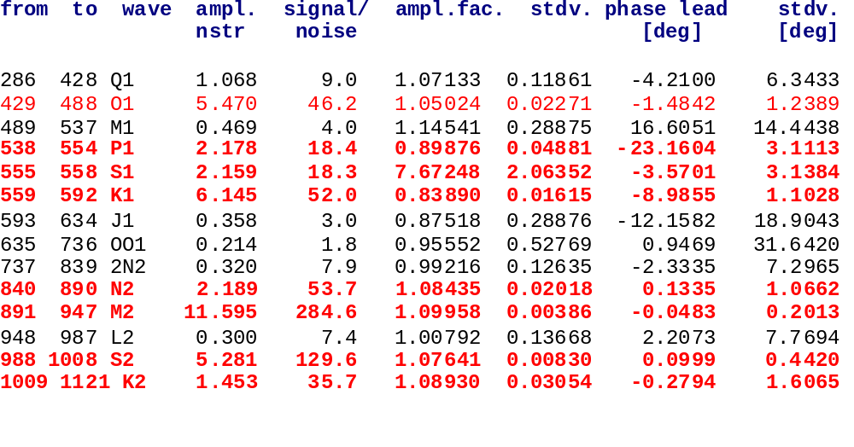
Results of harmonic analysis with ETERNA of strain record during XI / 2003 – XI / 2006
M2: S/N ≈ 285
O1: S/N ≈ 46
K1 /O1 = 0.80 ± 0.02

Slide 63
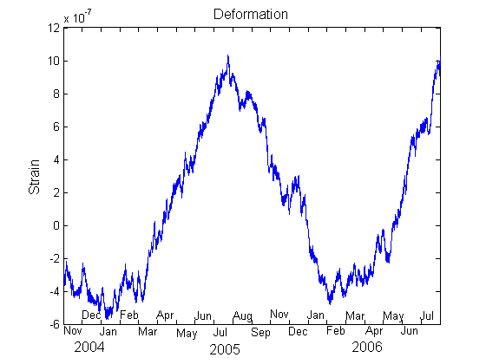
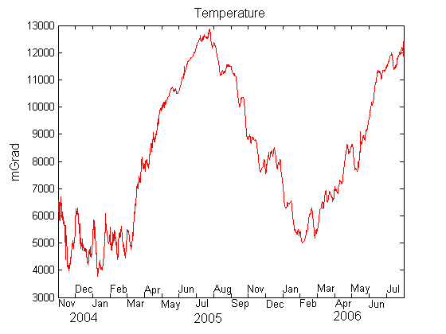

Strain variation during 20 months (Nov 2004 – July 2006)
Temperature variation of the rock
Pressure variation

Slide 64


Time stability of M2 and O1 amplitudes
М2
S/N ~ 100-200
mean anomaly:
12%
О1
S/N ~ 20-50
mean anomaly:
20%

Slide 65
We have developed recently the original (and probably optimal in presence of enormously large correlated noise of meteorological origin) techniques based on iterative application of TSoft, PRETERNA and ETERNA programs that helps to reduce its influence by 30-50 %

Slide 66



Topography correction in tidal deformations
2D approximation of canyon topography with a 8th degree polynomial
Tidal deformations
of relief increase
observed values
by ~ 20% ± ??

Slide 67

Continental volcanoes composition

Slide 68


Influence of magmagenerating fault on tidal strains (Molodenskii, 1977)
δV_{p} / V_{p}≈ -0.25;
δV_{s} / V_{s} ≈ -0.25;
λ ≈ μ
Anomaly of 12%
on the distance of 18 km

Slide 69
Conclusions
Both superconducting GWR as well as field ZLS-Burris and Scintrex CG-5 gravity meters are able to record tidal gravity variations giving S/N ratio up to 1000 for main tidal waves
Tidal strains could be effectively recorded with the help of laser strain meters. Due to the coherent meteorological noise influence the S/N ratio is hardly to achieve better that 100 resp. 300 for main tidal waves O1 and M2.

Slide 70
Perspectives of tidal studies on VIRGO

Slide 71

Example of low frequency VIRGO output, semi-automatic cleaning using TSoft

Slide 72

Beginning of record, tides are clearly visible

Slide 73


Slide 74

Tides and temperature variations

Slide 75


Slide 76
Future Plans
Exhaustive data preprocessing with TSoft and PRETERNA
Harmonic analysis with ETERNA
Determination of pressure and temperature frequency dependant admittances
Estimation of tidal parameters for main waves
Improvement of low-frequency modeling of VIRGO suspension system
Improvement the tidal modeling using ETGTAB

Slide 77

Thank you for attention and/or patience!

