Slide 1
Network Monitoring and High Throughput Data Sharing Testbed
Hiroyuki Matsunaga
(Some materials were provided by Go Iwai)
Computing Research Center, KEK
FJPPL @ Lyon, March 2012

Slide 2
Outline
Introduction
Network and Grid
Belle II experiment
Collaboration among Asian computing centers
Network monitoring
perfSONAR deployment
Data sharing testbed
Data storage system as a PoP (Point of Presence)
Data transfer/sharing between PoPs
Implementation
Summary

Slide 3
Background
The network becomes more and more important in High Energy and Nuclear Physics
Smaller number of larger experiments in the world
More collaborators worldwide
Distributed data analysis using remote data centers
Remote operations of a detector and an accelerator
New communication tools: e-mail, web, phone and video conference etc.
Increasing data volume
Higher energies and/or higher luminosities
More sensors in a detector for higher granularity/precision

Slide 4
Data Grid
The Grid is used in large HEP experiments
In particular, the WLCG (Worldwide LHC Computing Grid) for the LHC experiments at CERN is the largest one
The Belle II experiment, hosted by KEK, is going to use the Grid
Many Asian institutes have been involved in the LHC or Belle II experiments
Stable network operation is vital for the Grid
This Grid is a “Data Grid” that needs to handle a large amount of data
High throughputs over WAN for data transfers between sites
Do not forget about local data analysis which needs more bandwidth in LAN than data transfer over WAN

Slide 5
Network Monitoring
Network monitoring system is necessary for stable operations of the Grid and other high network activities
Also useful for common network use
For administrators as well as users
Makes it easier and faster to troubleshoot network problems
Many parties (sites, network providers) are involved
Difficult to spot problems under the above circumstance, and occasionally takes long time to fix them
The system can be established with little effort and low cost
Only a few servers are needed
Once set up, operational cost is very low

Slide 6
Deploying perfSONAR
perfSONAR is a network performance monitoring infrastructure
http://www.perfsonar.net/
Developed by major academic network providers: ESnet, GEANT, internet2, …
Deployed at many WLCG sites
Tier 0 & Tier 1 sites, large Tier 2 sites (involved in LHCOPN or LHCONE)
LHCOPN: http://twiki.cern.ch/twiki/bin/view/LHCOPN/PerfsonarPS
LHCONE: http://twiki.cern.ch/twiki/bin/view/LHCONE/SiteList

Slide 7
perfSONAR
perfSONAR includes a collection of tools to perform various network tests bi-directionally
Bandwidth
BWCTL (BandWidth ConTroL): using iperf etc.
Latency
OWAMP (One Way Active Measurement Protocol), …
Traceroute
Packet loss
perfSONAR also provides Graphical tools (Cacti)
Each site should have dedicated machines
Better to have 2 small servers instead of 1 powerful machine
One server for bandwidth, the other for latency
With a network connectivity of 1 Gbps or more
Preferably 10 Gbps, if a site is connected to the internet with >10 G link

Slide 8
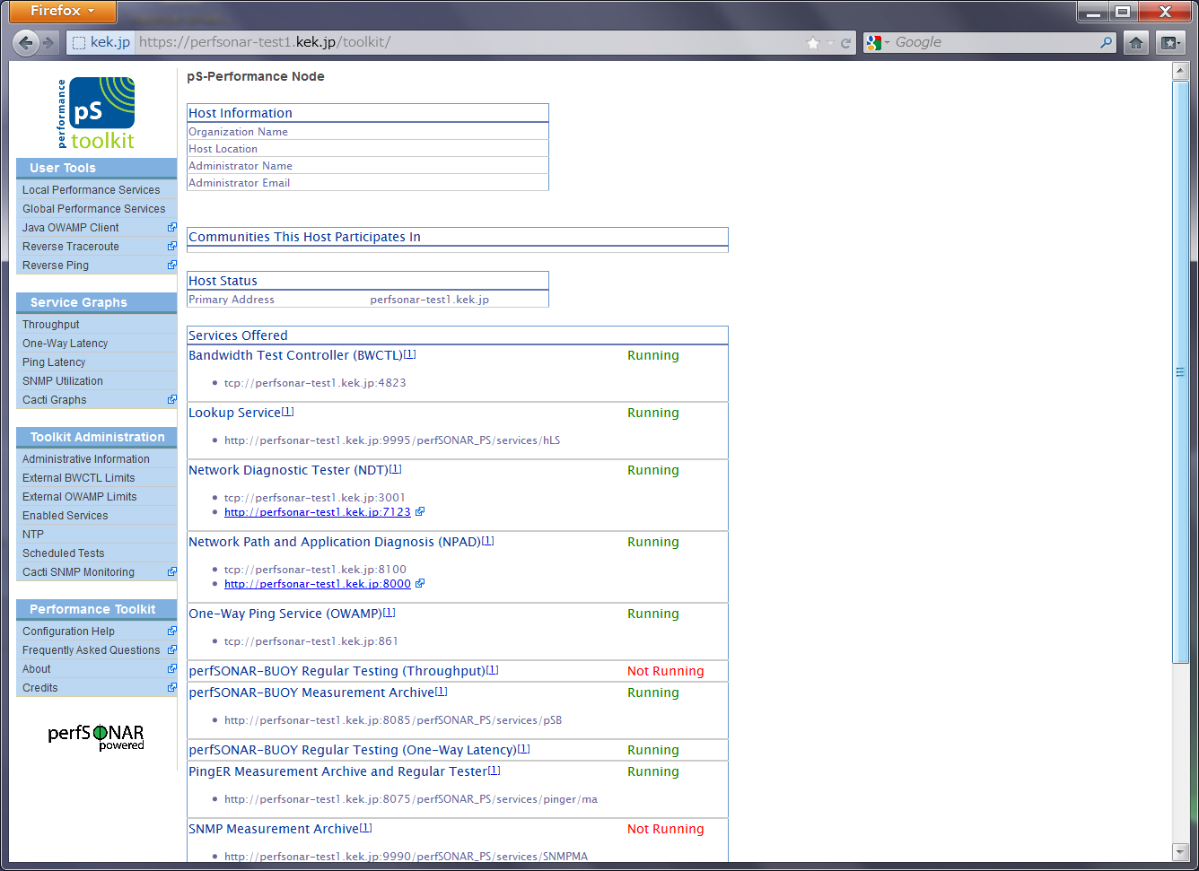

Slide 9
perfSONAR at KEK
KEK has been running perfSONAR on a test machine for the last few years
Set up by Prof. Soh Suzuki in network group of KEK
pS-Performance Toolkit 3.2 was installed
http://psps.perfsonar.net/
perfsonar-test1.kek.jp (Pentium4, 3.0 GHz)
Scientific Linux 5.4, 32 bit
1 Gbps NIC
Most of the services are running
Some tools in perfSONAR have been helpful to solve network problems
Network throughputs were checked by BWCTL for a network path from KEK to Pacific Northwest National Laboratory (PNNL) in U.S. last year

Slide 10
New Servers at KEK
Setting up 2 new machines
Primarily for the Belle II Grid operations
Based on the PS hardware recommendations
http://psps.perfsonar.net/toolkit/hardware.html
Also with reference to LHC documents
2 Dell R310 servers
CPU: single Xeon X3470
Memory: 4 GB (32 bit OS is only available by net install)
HDD: 500 GB
10 G NICs
The new servers will be located in the same subnet as the Belle II computer system
The same firewall is used

Slide 11
Deployment Issues
Firewall is a matter of concern
Many ports (not only TCP but also UDP) have to be open to all other collaboration sites
Negotiation/coordination is needed for the deployment and configuration
The main obstacle will be a site policy rather than a technical issue?
Most of the LHCOPN/LHCONE servers are inaccessible from outsiders
Better to have a homogeneous environment (hardware and configuration) among the sites
In order to obtain “absolute” results…
In line with LHC sites?

Slide 12
Belle II Experiment
The Belle II Grid plans to deploy perfSONAR at all participating sites and monitor network conditions continuously in the full-mesh topology (i.e. between any combination of 2 sites)
We will officially propose this deployment plan at the Belle II Grid site meeting at Munich (co-located with EGI community forum) later this month
Participating sites include so far:
Asia Pacific: KEK (Japan), TIFR (India), KISTI (Korea), Melbourne (Australia), IHEP (China), ASGC (Taiwan)
Europe: GridKa (Germany), SiGNet (Sloveina), Cyfronet (Poland), Prague (Czech)
America: PNNL (USA), Virginia Tech (USA)

Slide 13
Deployment in Asian Region
We recently proposed the establishment of network monitoring infrastructure in the Asian region
At the AFAD (Asian Forum for Accelerators and Detectors) 2012 meeting in Kolkata, India in February 2012
This could be (partly) shared with the Belle II perfSONAR infrastructure
Understanding network conditions in Asia would be interesting
(Academic) network connectivity within Asia is not as good as that between Asia and U.S./Europe
The launching of perfSONAR could be a first step for a future collaboration among Asian computer centers

Slide 14
Asia-Pacific Network(from http://apan.net)

Slide 15
Central Dashboard
For WLCG, BNL has set up a central monitor server for the perfSONAR results in LHCOPN, LHCONE,…
Helpful for administrators and experiments to check a network and site problems
KEK will set up a similar system for the Belle II
Also for the Asian institutes

Slide 16
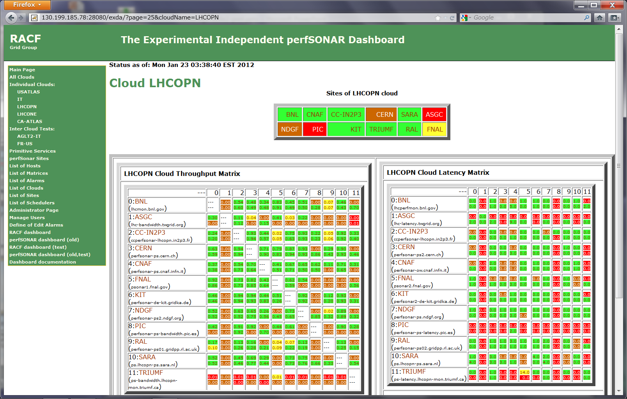
perfSONAR Dashboard at BNL

Slide 17
Data Sharing Testbed
Data sharing testbed was also proposed (by Iwai san) at the AFAD 2012 meeting last month
The aim is to provide storage service for a distributed environment
The service should be easy to use and manage, and good at the performance for data transfer and access
We will build it as a testbed, and do not intend to operate in production (for the time being)
The testbed could be used for replication (for emergency) or as temporary space (in case of migration etc.)
This testbed can be also used for actual network performance test
More realistic network test compared to perfSONAR
Should be employed subsequent to the perfSONAR deployment

Slide 18
RENKEI-PoP (Point of Presence)
RENKEI-PoP is a good model for the data sharing testbed
It is an appliance for e-Science data federation
Originally proposed in the RENKEI project
RENKEI means “federation” in Japanese
The RENKEI project aims to develop middleware for federation or sharing of distributed computing resources
RENKEI-PoP targets the development and evaluation of middleware and provisions of a means of collaboration between users
Installed in each computer center as a gateway server (PoP)

Slide 19
Courtesy K. Aida
RENKEI-POP is proposed in a sub-theme of the RENKEI project

Slide 20
RENKEI-POP (cont.)
A RENKEI-PoP is just a storage server which has
a large amount of data storage
high speed network interface
support for running VMs
Built with open source software, such as linux kernel, kvm, libvirt and Grid middleware.
Connected to a high speed (10 Gbps) R&E network (SINET)
Realizes a distributed filesystem, or fast data sharing/transfer

Slide 21
RENKEI-PoP Deployment
10 Gbps Network

Slide 22
Services by RENKEI-PoP
File transfer/sharing between PoP’s and data access services
Distributed filesystem (Gfarm)
pNFS is expected to be employed in a testbed
Gridftp, openssh, gsissh, gfarm-client, …
Virtual machine hosting
A cloud-like hosting service based on OpenNebula

Slide 23
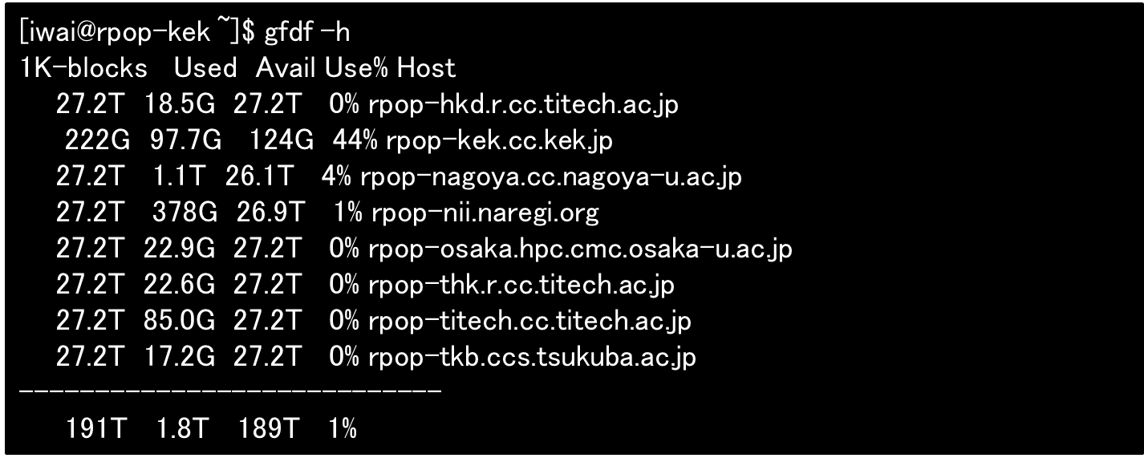
Gfarm - Network Shared Filesystem -

Slide 24
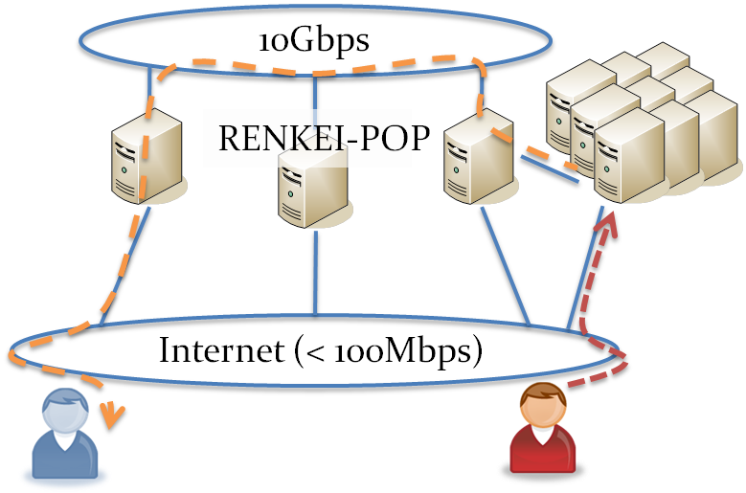
Typical Use Case
File sharing/transfer between PoPs
Reads data from
the nearest PoP
(for user B)
Writes data to the
nearest PoP
(for user A)

Slide 25
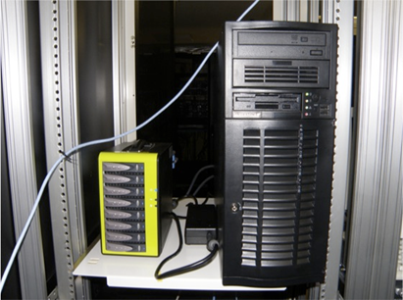
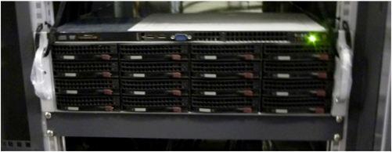
Hardware Design
The peak performance of inter-PoP disk-to-disk data transfer is designed to be 1 GB(bytes)ps
Each PoP server is equipped with a high throughput storage device that uses 8 to 16 SSDs (or HDDs) via a HBA and a 10 GbE NIC for remote connections

Slide 26
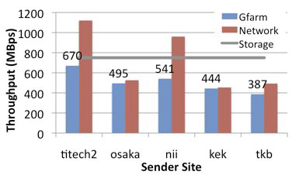
Data Transfer Performance
14 GB astronomy data was sent from various PoP’s to 1 in Tokyo Tech (titech)
Applied network tuning techniques include:
kernel TCP and flow control parameter tunings
Configuration of some device specific properties (such as TSO and interrupt interval)

Slide 27
Belle II and Asia-PoP
We intend to have such infrastructure for Belle II and for Asian computer centers after our experience of RENKEI-PoP
This will be prospoed in addition to the perfSONAR, at the Belle II meeting at Munich
RENKEI-PoP connects to high speed network in Japan. The question on whether new testbed works well in worse network conditions should be explored.

Slide 28
Summary
Network is vital in accelerator science nowadays
For the Grid operations in particular
We propose deploying perfSONAR at Belle II and at Asian computer centers to monitor network conditions in a full-mesh topology
We also propose the employment of data sharing testbed
Good experience from RENKEI-PoP
Software for installation can be chosen on demand
Gfarm (in NAREGI/RENKEI) is not widely used outside Japan
These could be potential topics under FJPPL?

