Slide 1
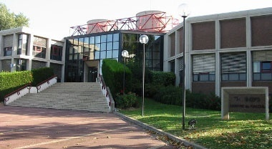
CC-IN2P3 Status and News
FJPPL Meeting at CC-IN2P3

Slide 2
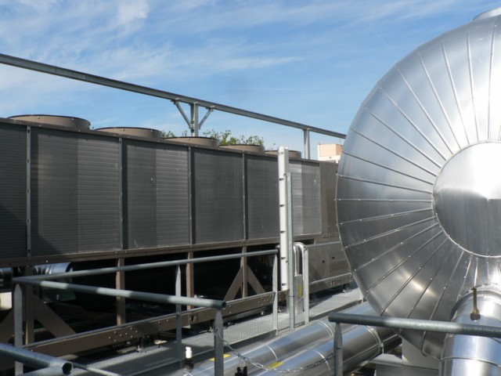
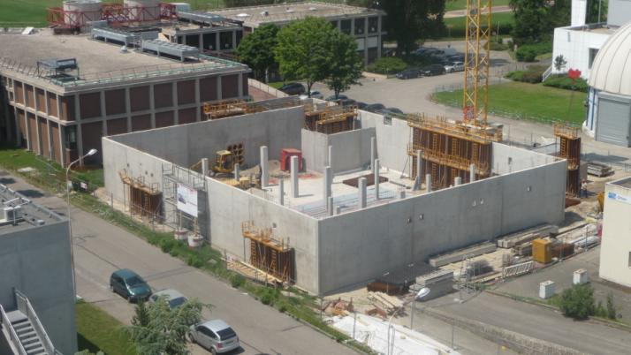
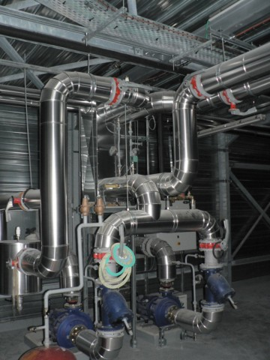
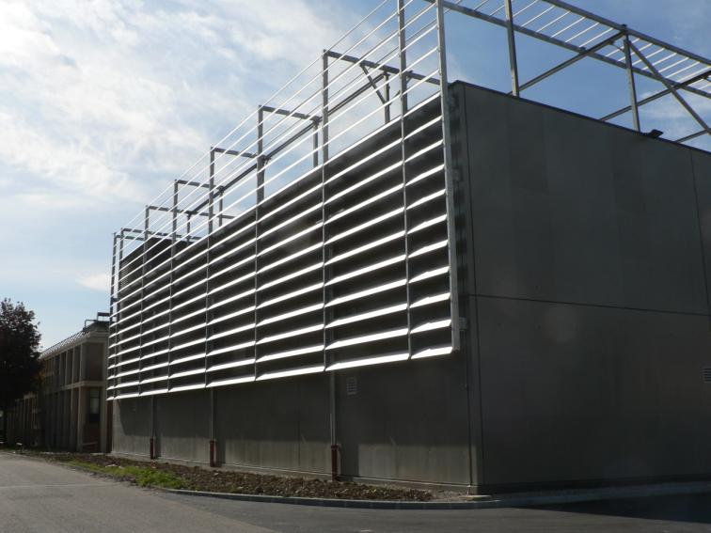
New Building
June 2010
April 2011

Slide 3
New building
The design and build procedure has been very successful
The key is the quality of the design document and the fact that the building is very technological and focused on one single objective
Do not mix the computer room and the office space !
The budget has been perfectly kept under control
7.5 M€
1 M€ was foreseen for contingencies but …
No contingencies at all
The 1 M€ has been reinvested to upgrade the computer room
Extra 1 MW UPS system (2 x 500 kW redundant)
Extra 2 MVA transformer
Extra 600 kW chiller
Provisional equipment for a second 40 rack line

Slide 4
New computer room
Original design
indicated power is for computing only
power for cooling has to be added
End up with:
2011
40 racks
600 kW
2012
80 racks
1 MW
2015
125 racks
1.5 MW
2019
240 racks
3.2 MW
On top of the existing computer room (1 MW)
Redundant : HV Transformer – UPS – Chiller
Will connect a second independent 20 kV power supply line in June
➔ No diesel generator

Slide 5
Remarks and problems
We spent a significant amount of time to install the first line of racks
➔ several issues had to be fixed – Some had a significant impact on the budget
Power Distribution Units (PDU) / Power boxes
Special design / production from the manufacturer
Cable routing
Accessibility
All the issues have been taken into account to design the second rack line
Very few but annoying problems :
Bad heater connection on the cooling system water pipes (➔ leak during the cold weather)
Some problems with the UPS chains
Perhaps some neutral / ground mis-cabling… to be investigated…
One guy drilled a hole in a cable tray while the power was on !!!

Slide 6
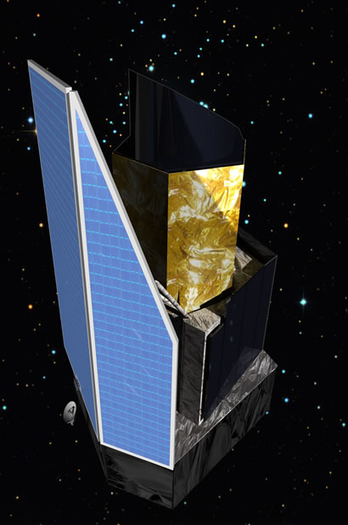
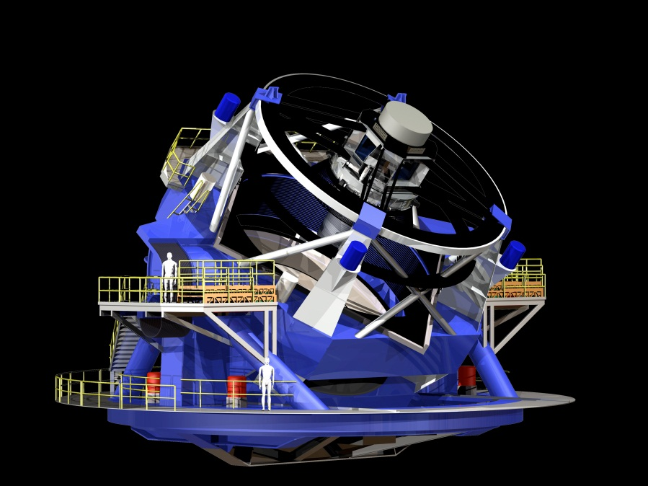
Future astroparticle projects
CC-IN2P3 is getting involved in 2 next generation large scale astroparticle projects
EUCLID
LSST
Two complementary projects for IN2P3
➔ To understand the dark energy puzzle
3.2 Gpixels CCD camera
1 picture every 15 s
15 – 30 TB / night
50% of the LSST data will be processed at CC-IN2P3. Second half at NCSA ➔ full dataset in France

Slide 7
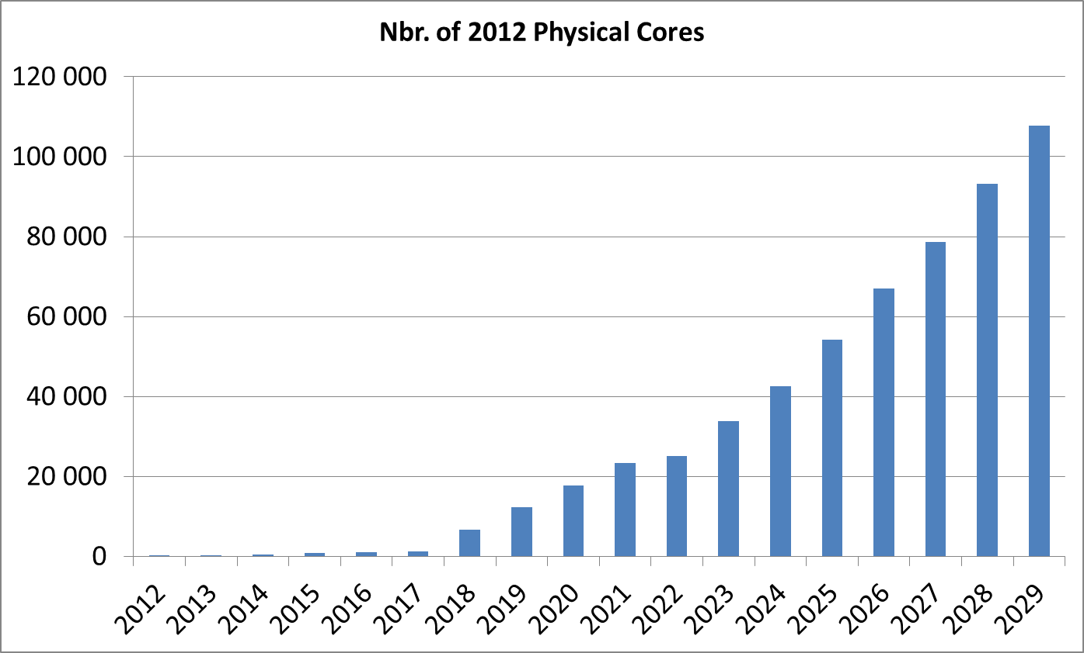
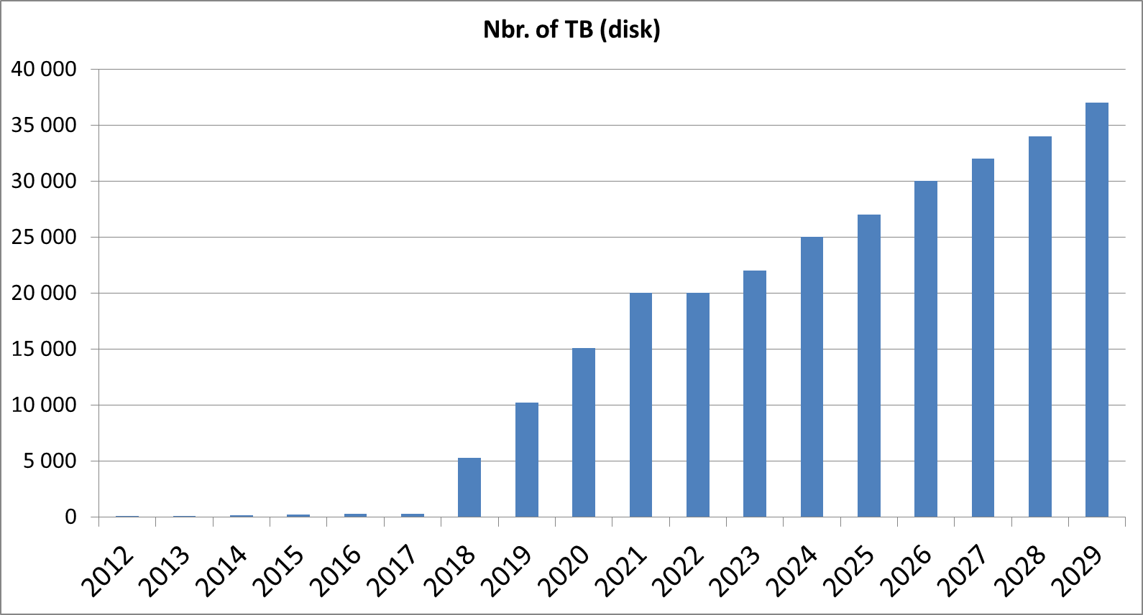
LSST
The computing infrastructure should be available in 2018
2018 – 2019 : 2 commissioning years
Then 2020 – 2029 : “survey” years
➔ Mechanism to compensate computing investment by a reduction of the contribution to the common fund

Slide 8
Toward new projects
We need to find new ways to get :
Money
Manpower
… and to maintain and develop CC-IN2P3 expertize
CC-IN2P3 as well as other HEP centers has a strong expertize in data processing
➔ Bring this expertize to new communities
We already have very good contacts with several scientific teams in the framework of the CC-IN2P3 multidisciplinary opening (< 5% of the resources)
We receive requests to host and deploy computing resources on a monthly (sometimes weekly) basis. Most of them are coming from the Life Science community

Slide 9
“Investissements d’avenir”
Big program launched by the French government to fund innovative projects
35 Billion € in total
Part is directly available for investment
Part is invested and only the interest are available
Several programs and calls for proposals
Will certainly fully modify the research landscape in France

Slide 10
From Grids to Clouds
Virtualization technologies and Cloud model are now changing the landscape of intensive and distributed computing
The boundary between Grid and Clouds is fuzzy, both can be seen as complementary approaches which will coexist for some time
Complex middleware – Difficulty to port applications to the Grid – Rigid hardware and software …
The grid model is extremely powerful for well structured collaborations (LHC Computing is a very big success)
Out of reach of other communities
The Cloud / virtualization model is a chance to overcome (at least partly) some of these difficulties
Grid → Virtualization → Elasticity → Cloud specific software services → …
Natural hierarchy : IaaS → PaaS → SaaS

Slide 11
Academic cloud CAPRI
➔ Create a cloud infrastructure for all the future multidisciplinary projects, coherent with HEP virtualization initiatives
User-centric approach in close collaboration with specialists of data intensive applications
Work with specific communities / project ➔ build use cases
Open the platform to other communities as soon as we have working solutions
Close relationship with France-Grilles (French NGI) – CAPRI will become the main France-Grilles cloud infrastructure
Coherent with the EGI and LCG strategies → virtualization task forces

Slide 12
CAPRI
1st step is to create an IaaS testbed using standard cloud solutions
CPU oriented in a first step
We are currently testing several cloud software stacks ➔ choice to be made
We received funds from the France Grilles in 2011 (75 k€) → +250 k€ in 2012
The goal is to open the prototype ~June and to demonstrate how it behaves with pilot applications
We will have to understand how it articulates with other project like HELIX Nebula

Slide 13
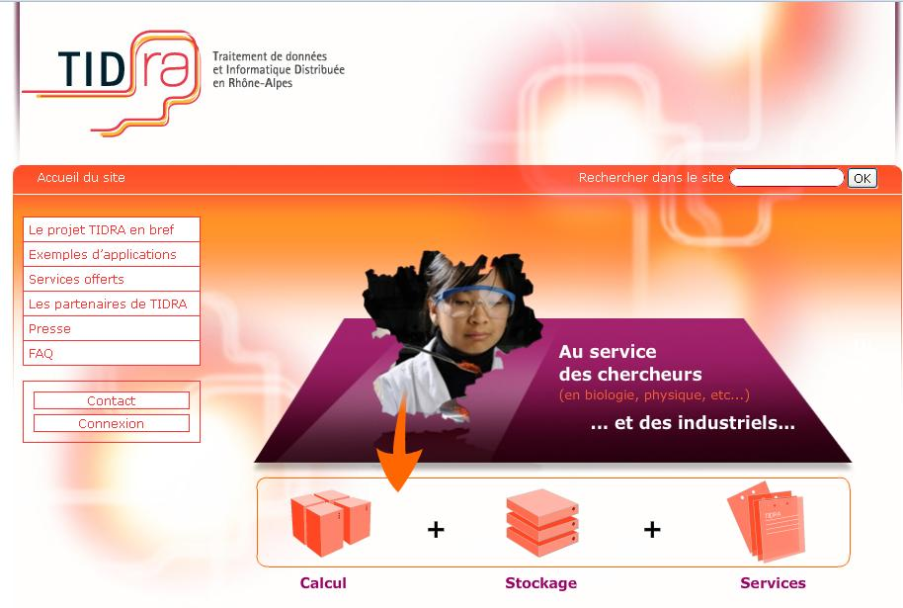
CAPRI
We are investigating how to open CAPRI to industrial users at full cost
It will extend the Regional Grid TIDRA
Biomedical
Image processing
“Pôles de compétitivité”
LyonBiopôle
Imaginove
This a complete change for CC-IN2P3 and we will have to handle it very carefully
Develop innovative approach for multidisciplinary applications
While keeping computing for HEP as a top priority
The new computer room can easily host such an academic Cloud

Slide 14
Institute for Research and Technology
CC-IN2P3 is a partner of the IRT LyonBioTech / BioAster
Will provide a research and development infrastructure on infectious diseases
Strongly oriented toward industrial applications
Budget > 800 M€ in total
Should become economically self-sufficient within 10 years
Aim at creating 10 000 jobs (direct and indirect)
CC-IN2P3 and a regional startup (SysFera) will be in charge to provide the IT infrastructure
2.2 M€
Several positions
Very complex structure to be created from scratch with many partners
Several kind of applications but strong orientation toward database systems
Very important as it can promote CC-IN2P3 as the leading data processing center for biomedicine in France

Slide 15
Applications
Bioinformatics
Portals
Support
SysFera
Middleware
Support
Catalog of services
Storage
Computing
Data processing
CC-IN2P3
Security / Confidentiality
Network

Slide 16
eTRIKS
European Translation Information & Knowledge Management Service Infrastructure based on the tranSMART platform
Biomedical knowledge management system within the Innovative Medicine Initiative (IMI)
Establish correlation between multiple biomedical data
Genome – proteome – imagery – medical data – etc…
~20 M€ project : 10 M€ from Europe – 10 M€ from the "pharmas"
➔ 1.7 M€ for CC-IN2P3 (530 k€ in hardware – the rest in manpower)
November 24th, 2011
16
First phase has been accepted by IMI – eTRIKS is alone for the second phase
CC-IN2P3 will be in charge of the cloud platform, of the database infrastructure and of part of the user support.
➔ Deadline is Today !

Slide 17
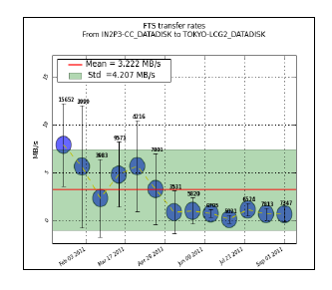
Other news / issues
Grid Engine is now deployed and in production
Oracle version
We experienced some problems (crash of the master server)
Loss of all the jobs (running and queued)
Good interaction with Oracle support
CVMFS turned to be a good solution for heavy LHC experiments' access to configuration and software files
Serious problem with our Oracle system ➔ crash with unrecoverable loss of data ! ➔ apparently related to a bad Oracle DB behavior after a seroius hardware failure
➔ PILLAR storage system being exchanged
On going issue with data transfer between far remote T2 sites and some T1

Slide 18
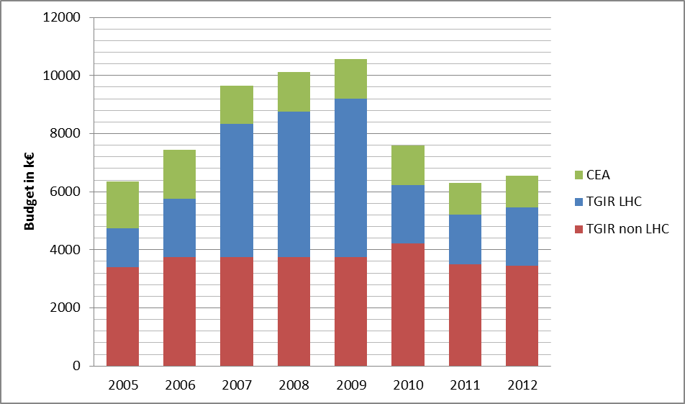
Budget
Hardware acquired during this period has to be replaced
Strong impact on CC-IN2P3 : No increase of the computing resources offered to the users this year
➔ Somewhat difficult situation

