Slide 1
Geant4 system testing

Slide 2
Geant4 collaboration
Developers are independent researchers and most of them are not paid for Geant4
We do not want to depend on the particular institute for resources
We need more resources for system testing still
We encourage Marc and Sebastien to contact CC-IN2P3 to have more resources

Slide 3
Geant4 system test
Needs system testing before every releases
Major release
Once a year in December
Minor release
One a year before summer vacation
Here is the example of Grid usage

Slide 4
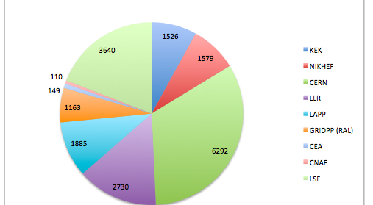
Grid resource usage

