Slide 1
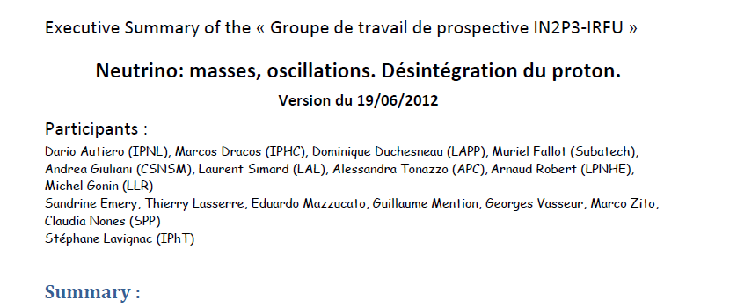
Summary Prospective IN2P3-IRFU
Brief status and fundamental questions
Proposed research topics
Paris, 20 juin 2012

Slide 2
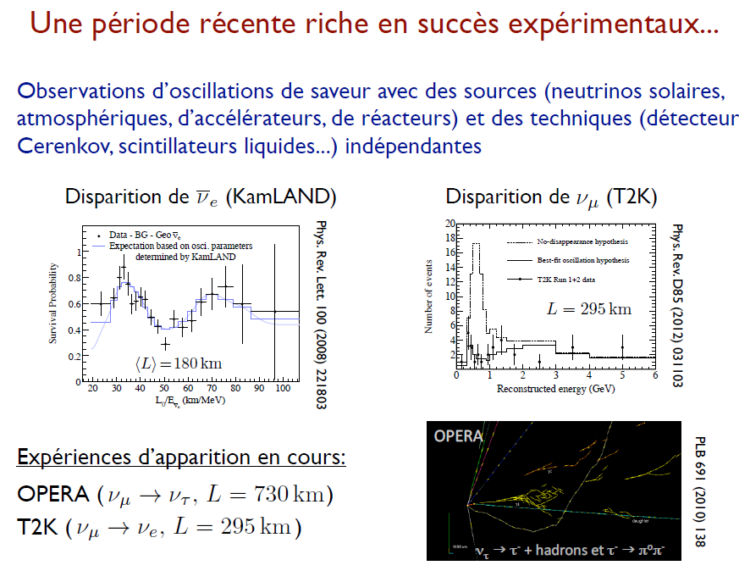

Slide 3
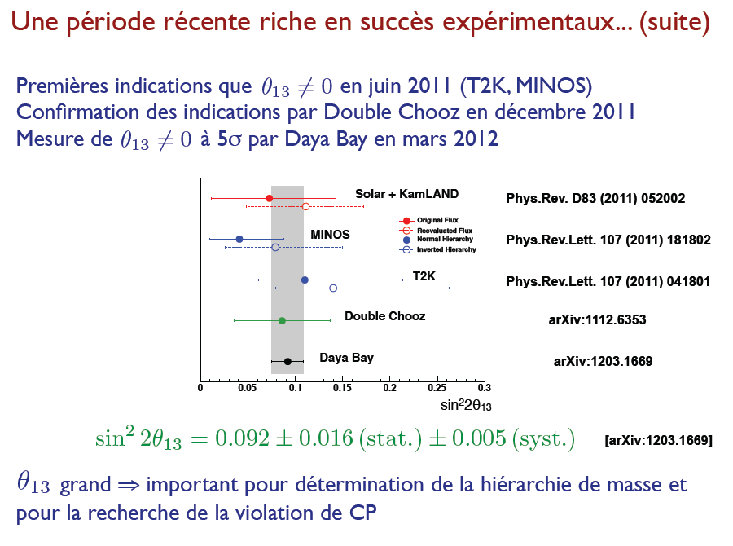
+ RENO

Slide 4
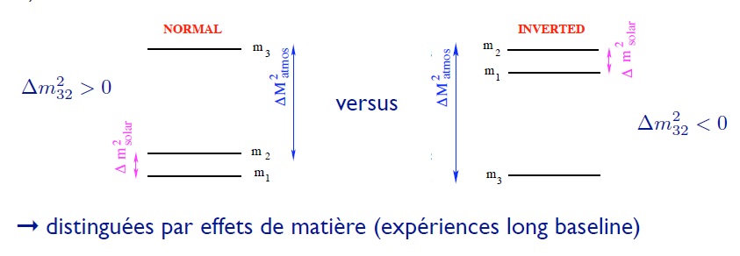
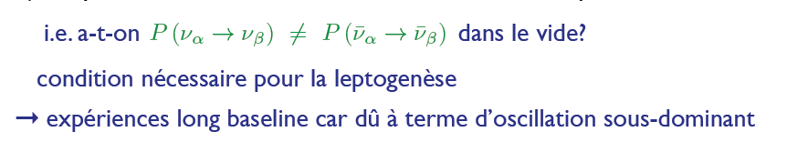
Le mélange leptonique reflète-t-il une symétrie sous-jacente?
  e.g. l’angle est-il maximal? (sin² θ₂₃ = 1 )
  ➞ mesures de précision (expériences long baseline)
Quelle est la hiérarchie de masse?
La symétrie CP est-elle violée dans le secteur des leptons?

Slide 5
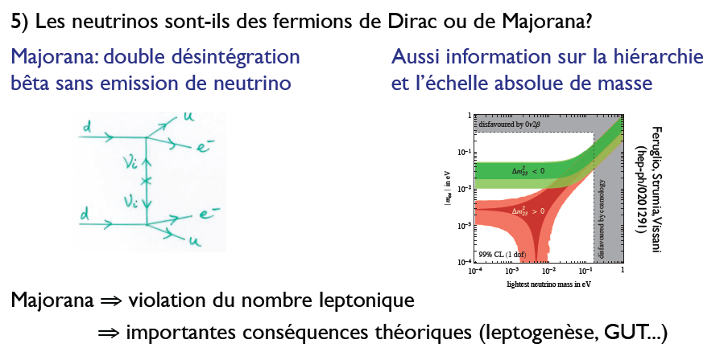
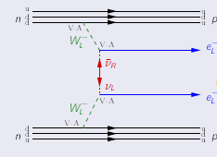
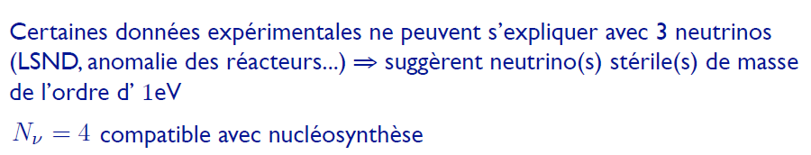
Les neutrinos sont-ils des fermions de Dirac ou de Majorana?
Existe-t-il plus de 3 neutrinos?

Slide 6
The research program in neutrino physics proposed by the French community for the next ten years concerns:
Oscillation studies and PMNS precision measurements
Anomaly investigation and search for sterile neutrino
Future long baseline neutrino experiment for mass hierarchy determination and search for CP violation in the leptonic sector, proton decay.
Study of the nature of the neutrino with the search for neutrinoless double beta decay process.
Those research projects are covering most of the fundamental questions of the field and short, medium and long term plans

Slide 7
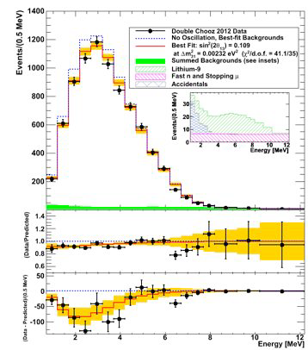
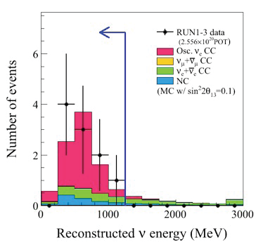
Oscillation studies and PMNS precision measurements
Double Chooz
T2K
The two experiments will continue their data taking in order to provide improved measurements with careful systematics studies.
Double Chooz is continuing with the construction and commissioning of the near detector for 2013.
The physics program of T2K could be complemented by data taken in anti-neutrino mode, followed by an upgrade phase of the accelerator complex to increase the JPARC beam intensity.

Slide 8
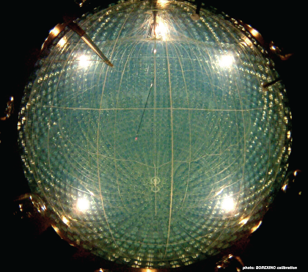
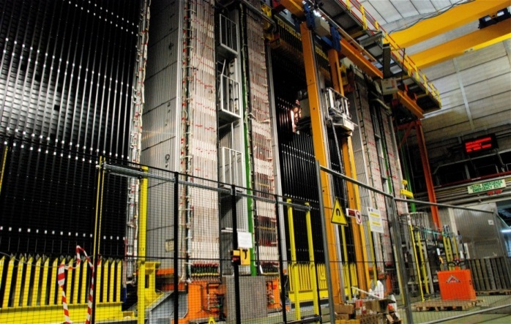
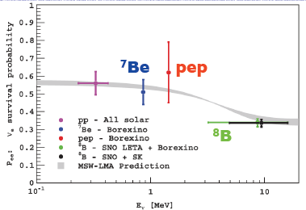
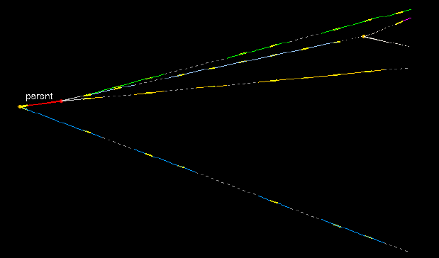
Oscillation studies and PMNS precision measurements
OPERA
OPERA studies the νμ -> ντ oscillations and is expected to conclude its data taking by providing a clear proof of the ντ appearance in a νμ beam by 2015
Borexino
Borexino probes the low energy solar neutrino flux for the determination of oscillation parameters Δm²₂₁ and θ₁₂, and provides significant information on nuclear mechanisms at work in the heart of the Sun

Slide 9
Anomaly investigation and search for sterile neutrino
SBL beam projects exist but there is no French activity for the moment on these experimental program

Slide 10
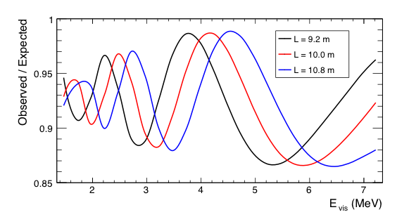
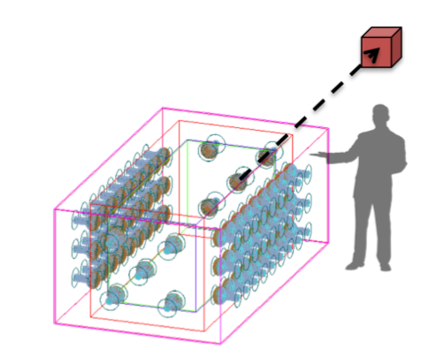
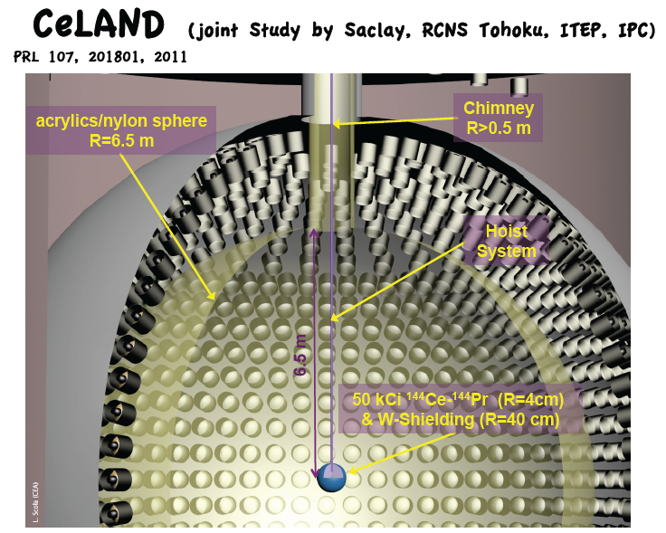
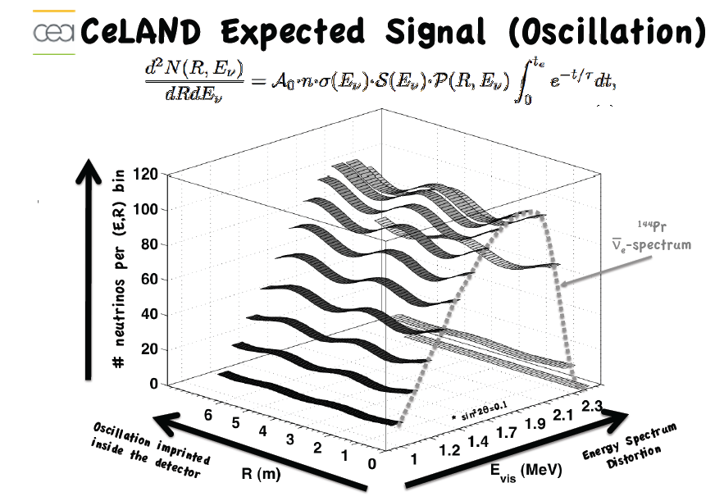
Anomaly investigation and search for sterile neutrino
STEREO Experiment Concept: under study (CEA:Irfu)
Proposal under study
Reactor experiment @ ILL (Grenoble, France)
Compact reactor core (~ 40 cm)
Detector Liq. Scint.
1m x 1m x 2m
64 PMTs
Goal: focus on shape
distorsion

Slide 11
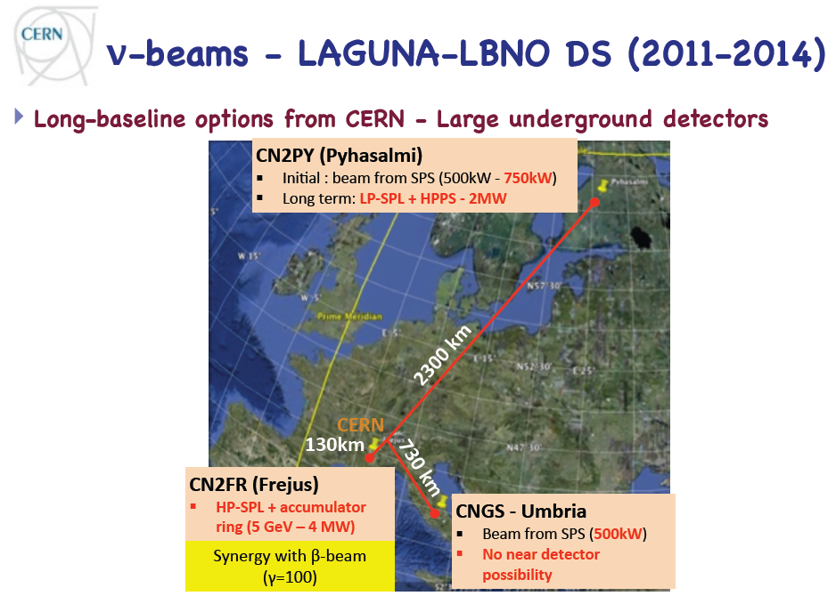

Etudes de projet pour futur faisceau en Europe (LAGUNA-LBNO)
Effort européen (études similaires se font aux US et Japon)

Slide 12
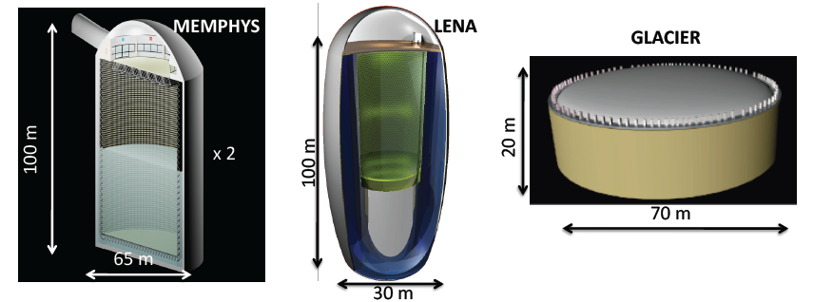
Riche programme de physique
Propriétés des ν (oscillation, violation CP leptonique: faisceaux, ν atm..)
Etudes de phénomènes astrophysiques liés aux ν:
  Effondrement gravitationnel d’étoiles (ν des Supernovae)
  Formation des étoiles au début de l’univers (fond diffus de ν de SN)
  Etude des processus de fusion avec ν solaire)
Test des modèles géophysique de la terre (Geo - ν , U, Th - ν)
Désintégration du proton
Water Čerenkov 2x 300kT
Liq. Argon →100kT
Liq. Scintillator
→50kT

Slide 13
Future long baseline neutrino experiment for mass hierarchy determination and search for CP violation in the leptonic sector, proton decay.
Europe has considerable assets, especially with the possibility of a short baseline, CERN to Frejus 130 km, and that of a very long baseline, CERN Pyhäsalmi of 2300 km, close to the "magic" distance. It is on these two options that the LAGUNA-LBNO
After a preliminary phase of studies (LAGUNA, EURONU, LAGUNA-LBNO) and comparison of the various options the French community is today in the position to make more explicit recommendations
We strongly support the CERN to Pyhasalmi option for the first phase of the exploration of the Mass Hierarchy and CP phase with a powerful beam based on SPS and a 20 to 100 kton Liquid Argon TPC plus a magnetized iron scintillator calorimeter.

Slide 14
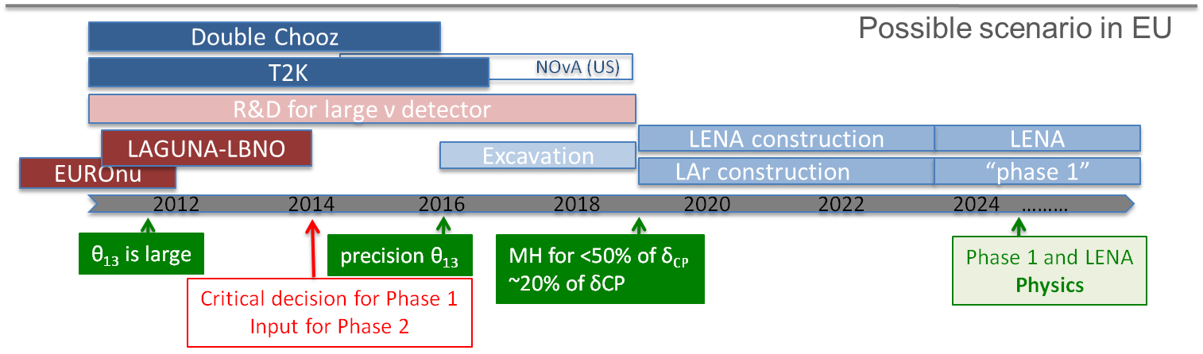
An Expression of Interest has been submitted to CERN in June 2012. This effort, which includes a strong participation of the French community, must be followed and supported, given the fundamental importance of this research.
We stress the high potential of this underground observatory for a range of astrophysical measurements, including atmospheric, solar and SN neutrinos, and for GUT-related studies of nucleon decay.
We notice that this baseline is suitable for a Neutrino Factory, the option retained by the EURONu project for the ultimate neutrino oscillation facility.
If CERN will decide for the construction of a high power SPL, or if the MEMPHYS detector will be built, the option of a short baseline SuperBeam should be considered.
We recognize that this challenging program over more than a decade needs a matching program of R&D, both in the areas of high power proton accelerators and neutrinos beams and for the ambitious large mass neutrino detectors of the new generation

Slide 15
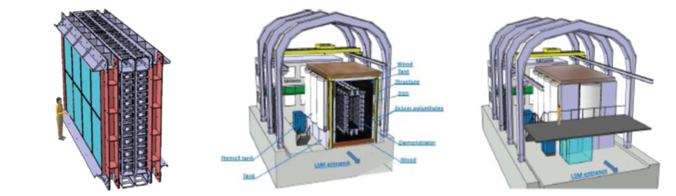
Study of the nature of the neutrino with the search for neutrinoless double beta decay process
several projects capable in principle to approach the exploration of the inverted hierarchy region of the neutrino mass pattern, in intriguing synergy with the future long baseline neutrino oscillation projects.
SuperNemo
Period: 2012-2016 with installation at LSM in 2014
Goal: demonstrate the feasibility to build such low radioactivity level detector and constrain the existence of neutrinoless double beta decay
sensitivity on the Majorana neutrino of about 0.05 eV in 2016-2018 with a scenario based on sequential SuperNEMO module start.

Slide 16
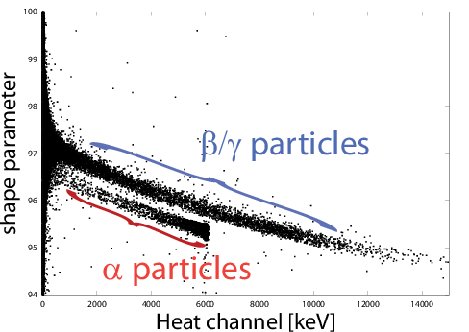
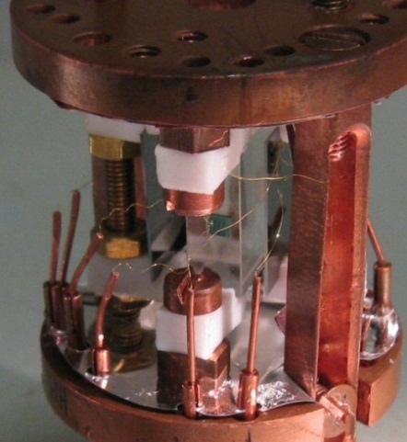
Study of the nature of the neutrino with the search for neutrinoless double beta decay process
an extremely promising development, based on the technique of scintillating bolometers, began very recently, partly in connection with the project LUCIFER and partly by following an original approach that would use crystals ZnMoO4 for research with promising isotope ¹⁰⁰Mo.
Discrimination Alpha/beta avec la forme du pulse de chaleur et la mesure de la lumière
commissioning
Cristal ZnMoO₄
Construction
⁸²Se 7kg
prise de données
démonstrateur
SuperNEMO
construction autres modules ⁸²Se 100kg
ZnMoO₄
tests détecteurs
Mo naturel
petite taille
Mo enrichi
0,2 kg
Mo enrichi 0,5 kg
Expérience pilote souterraine
Mo naturel 0,5 kg
2012
2013
2014
2015
2016
2017

Slide 17
The End

Slide 18
Programme neutrino expérimental à court et moyen terme 2012-2016:
Etude des paramètres d’oscillations atmosphériques et confirmation du mécanisme:
OPERA/ Minos/ T2K
Mesure de θ₁₃:
accélérateurs: T2K / Nova
réacteurs : Double Chooz / Daya Bay /RENO
Nature du neutrino (désintégration double béta):
projets bolomètres, HPGe, TPC xénon
Démonstrateur SuperNemo (7 kg de source) au LSM
Anomalies des oscillations
projet de réacteur avec détecteur très proches du cœur
projet de mettre une source radioactive dans Borexino
Programme expérimental à long terme > 2018:
Au delà de 2015 il y a des projets pour déterminer l’existence ou pas de violation CP; déterminer la hiérarchie de masse etc…. Cela va requérir des faisceaux longues distances, très puissants et des détecteurs géants
Puis des projets de double beta avec des centaines de kg de source dans des environnements de très faible radio activité.

Slide 19
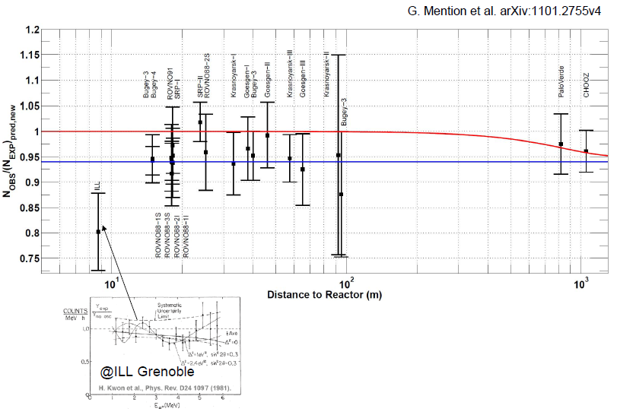
Anomalies réacteur: flux des réacteurs utilisés jusqu’à présent sur expériences oscillations semblent être sous estimés de 6%
=> Problème de cohérence dans le schéma classique d’oscillation?
Faut-il considérer des neutrinos stériles?
Faut-il croire les nouvelles estimations?

